Slide 1
Completeness Theorems for Adaptively Secure Broadcast
Ran Cohen
Juan Garay
Vassilis Zikas

Slide 2
Secure Multiparty Computation (MPC)
Jointly compute on secret data, without revealing the data
$$≈$$
A protocol is secure if $∀$ real-world adversary $∃$ ideal-world adversary such that no environment can distinguish real from ideal

Slide 3
Secure Multiparty Computation (MPC)
Adaptive corruptions?
$$≈$$
adaptive
adaptive
A protocol is secure if $∀$ real-world adversary $∃$ ideal-world adversary such that no environment can distinguish real from ideal

Slide 4
Secure Multiparty Computation (MPC)
Holistic definition
Composition
Clear meaning of security
Hard to prove
Is it an overkill?
$$≈$$
adaptive
adaptive
A protocol is secure if $∀$ real-world adversary $∃$ ideal-world adversary such that no environment can distinguish real from ideal

Slide 5
MPC: Property based
A protocol is secure if the following properties are satisfied against any XYX adversary:
Correctness
Privacy
Independence of inputs
Fairness
Guaranteed output delivery

Slide 6
MPC: Property based
Adaptive corruptions?
A protocol is secure if the following properties are satisfied against any XYX adversary:
Correctness
Privacy
Independence of inputs
Fairness
Guaranteed output delivery
adaptive
Should a protocol satisfying those properties in the presence of an adaptive adversary be considered adaptively secure?

Slide 7
Case study: Adaptively Secure Broadcast
Goal: emulate a broadcast channel
A broadcast protocol with sender $S$ is considered secure if it satisfies the following properties:
Agreement: every honest party outputs the same value $y$
Validity: if the sender is honest and has input $x$, then $y=x$
Should a broadcast protocol satisfying those properties in the presence of an adaptive adversary be considered adaptively secure?
NOOOO!!!

Slide 8
Case study: Adaptively Secure Broadcast
Goal: emulate a broadcast channel
A broadcast protocol with sender $S$ is considered secure if it satisfies the following properties:
Agreement: every honest party outputs the same value $y$
Validity: if the sender is honest and has input $x$, then $y=x$
at the end of the protocol
until the end of the protocol
Should a broadcast protocol satisfying those properties in the presence of an adaptive adversary be considered adaptively secure?
MMAYBE??

Slide 9
Case study: Adaptively Secure Broadcast
Problem: everybody broadcasts a bit; the adversary wants the output to be (as close as possible to) 0000…000
1
0
0
1
0
1
0
1
0
0
1
0
1
0

Slide 10
Case study: Adaptively Secure Broadcast
Problem: everybody broadcasts a bit; the adversary wants the output to be (as close as possible to) 0000…000
0
0
0
1
0
0
0
1
0
0
1
0
1
0
Static adversary, 3 corruptions

Slide 11
Case study: Adaptively Secure Broadcast
Problem: everybody broadcasts a bit; the adversary wants the output to be (as close as possible to) 0000…000
0
0
0
1
0
0
0
1
0
0
1
0
1
0
Adaptive adversary, 3 corruptions, broadcast channel

Slide 12
What if we use a broadcast protocol?
(Almost) all known broadcast protocols follow this paradigm:
Step 1: Sender sends its input $x$ to every party
Step 2: Parties try to establish agreement
$$x$$
$$x$$
$$x$$
$$x$$

Slide 13
What if we use a broadcast protocol?
(Almost) all known broadcast protocols follow this paradigm:
Step 1: Sender sends its input $x$ to every party
Step 2: Parties try to establish agreement

Slide 14
What if we use a broadcast protocol?
(Almost) all known broadcast protocols follow this paradigm:
Step 1: Sender sends its input $x$ to every party
Step 2: Parties try to establish agreement
All these protocols satisfy agreement and validity, even facing an adaptive adversary Should they be considered adaptively secure?
$$x$$
$$\tilde{x}$$
$$\tilde{x}$$
$$\tilde{x}$$
The input $x$ might be delivered first to a corrupt party (rushing adversary)
If the adversary doesn’t like $x$ he can corrupt the sender and send $\tilde{x}≠x$ instead (or crash)

Slide 15
What if we use a broadcast protocol?
The adversary gets to:
Be the first to learn the sender input $x$
Decide whether to resume with $x$ (without corrupting the sender) or corrupt the sender and change the input to $\tilde{x}$
Should I be worried? This attack seems to require strong adversarial power
$$x$$
$$\tilde{x}$$
$$\tilde{x}$$
$$\tilde{x}$$
Think of message diffusion mechanisms (à la Bitcoin, Cardano, Algorand,…)

Slide 16
Case study: Adaptively Secure Broadcast
Problem: everybody broadcasts a bit; the adversary wants the output to be (as close as possible to) 0000…000
0
0
0
0
0
0
0
1
0
0
1
0
1
0
Adaptive adversary, 3 corruptions, standard broadcast protocol

Slide 17
Simulation-based broadcast
Hirt and Zikas [EC’10]: simulation-based security of adaptively secure broadcast
Broadcast : Megaphone
Weak Broadcast : “Unfair” Megaphone
$$x$$
$$x$$
$$x$$
$$x$$
$$x$$
$$x$$
$$x$$
$$x$$
$$x$$
$$x$$
$$x$$
$$x$$
Possible for $t<n/3$ without setup
Possible for $t≤n/2$ with PKI
Impossible for $t>n/2$ even with PKI
Typical BC implement this with adaptive security:
For $t<n/3$ without setup
For $t<n$ with PKI

Slide 18
This is a very annoying impossibility…
Question: “This is an artifact of strong requirements of simulation-based (composable) security” [TCC’19,TCC’20a,TCC’20b]
Maybe using a weaker definition makes the impossibility go away?
Question: programmable random oracle can overcome many impossibilities regrading adaptive corruptions (e.g., Non-Committing Encryption)
Can we use RO to overcome also this impossibility?
Question: Time-Lock Puzzles (TLPs) hide information from rushing adversaries
Can we use TLPs to overcome also this impossibility?

Slide 19
Main Results
This is not an artifact of simulation-based security!
A new property for adaptively secure broadcast (corruption-fairness)
Characterization of feasibility (for $t>n/2$)
 | Property-based | Simulation-based
PKI
PKI + RO
PKI + TLP
PKI + TLP + RO
$$\left(∗\right)$$
[HZ’10]
$$\left(∗\right)$$
$\left(∗\right)$ for a large class of broadcast protocols
First (limited) composition theorem for resource-restricted adversaries

Slide 20
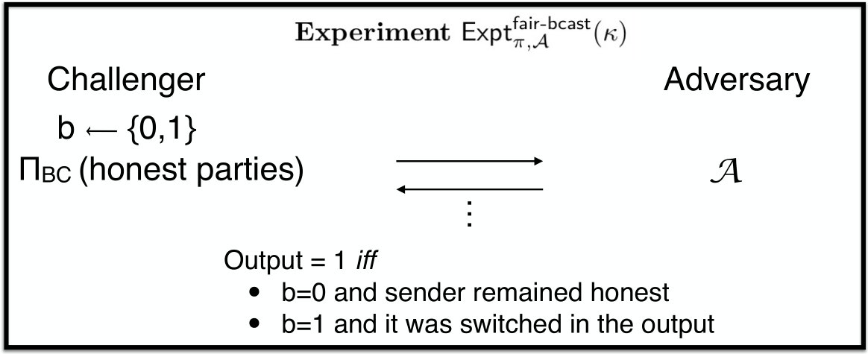
Corruption-Fairness
Informally: the adversary should not be able to:
First learn the sender’s input
Based on the input value, corrupt the sender and affect honest parties’ output
$$x←\left\{0,1\right\}$$
$π$
$x=0$ and the sender remained honest
$x=1$ and it was switched in the output
$$π$$

Slide 21
Adaptively Secure Broadcast: Property-based
A broadcast protocol with sender $S$ is considered adaptively secure if it satisfies the following properties:
Agreement
Validity
Corruption-Fairness
Lemma (sanity check): this definition is implied by the simulation-based (“megaphone”) definition

Slide 22
Impossibility of Property-based Broadcast
Protocol class $Π^{∗}$: $∃$ a round $r^{∗}$ and a set $C^{∗}$ of size $n/2−1$ such that
Until round $r^{∗}$ no set of size $n/2−1$(excluding the sender) knows the input $x$ with certainty (i.e., if everyone else crash they will make a noticeable error)
At round $r^{∗}$ parties in $C^{∗}$ know $x$ (i.e., output $x$ with overwhelming probability)
Uncertainty for any $n/2−1$ parties
$$r^{∗}$$
$C^{∗}$ knows $x$
rounds
All broadcast protocols are in $Π^{∗}$ (with $r^{∗}=1$)

Slide 23
Impossibility of Property-based Broadcast
$𝒜$corrupts the sender with negligible probability
Theorem 1: No protocol in $Π^{∗}$ is adaptively secure (property-based) against $>n/2$ corruptions
$𝒜$ switches from 1 to 0 with noticeable probability
The rushing adversary corrupts $C^{∗}$
At round $r^{∗}$ the adversary can learn the value $x$
If $x=0$, the adversary lets the protocol complete
If $x=1$, the adversary crashes parties in $C^{∗}$ and the sender, before sending their round $r^{∗}$ messages

Slide 24
Overcoming the impossibility?
What if $C^{∗}$ has all the information to learn $x$ in round $r^{∗}$, but cannot access it until round $r^{∗}+1$ begins?
In this case $𝒜$doesn’t know whether to corrupt the sender or not
Intuitively, TLPs do exactly that
The sender can put the message in a TLP
Everyone who work enough will get the message
Anyone who doesn’t work enough sees gibberish
Need to restrict the sequential speed of the adversary
A PPT adversary $𝒜$ is $\left(R,T\right)$-bounded if within $R$ communication rounds, $𝒜$ can evaluate circuits of maximal depth $T$

Slide 25
Overcoming the impossibility?
Theorem 2: if corruption-unfair broadcast can be computed in $R$ rounds, and the adversary is $\left(R,T\right)$-bounded, and TLPs exist, then there exists adaptively secure broadcast (property-based) for $t<n$ corruptions
Protocol:
Sender locks $x$ in a TLP and sends using corruption-unfair broadcast
Once received, everyone works to open the TLP

Slide 26
Is the protocol simulation-based secure?
When the sender is honest, Sim must simulate the puzzle
But Sim doesn’t know $x$ at this point
If Sim asks the megaphone for $x$, then Sim gets stuck if $𝒜$asks to corrupt the sender and change its input
If Sim doesn’t ask the megaphone and commits to an arbitrary bit, then Sim gets stuck w.p. 1/2 if $𝒜$lets the protocol complete without corrupting the sender
Theorem 3: No broadcast protocol is adaptively secure (simulation-based) against $>n/2$ corruptions, even assuming TLPs

Slide 27
Overcoming the impossibility?
The simulator got stuck because TLPs are committing
Is it possible to make a TLP non-committing?
Yes! In the programmable random oracle model
Protocol:
Sender locks $r$ in a TLP and sends with $H\left(r\right)⊕x$ using corruption-unfair broadcast
Once received, everyone works to open the TLP and recover $x$
Theorem 4: if corruption-unfair broadcast can be computed in $R$ rounds, and the adversary is $\left(R,T\right)$-bounded, and TLPs exist, then there exists adaptively secure broadcast (simulation-based) for $t<n$ corruptions in the programmable ROM

Slide 28
TLP and Composition
Dolev-Strong

Slide 29
TLP and Composition
Dolev-Strong

Slide 30
TLP and Composition
Adjusted Dolev Strong:
Round 0:
$P_{i}$ generates a TLP and sends to $P_{j}$
$P_{j}$ solves the returns answer to $P_{i}$
Next, parties run Dolev-Strong
This is still a corruption-unfair broadcast!
But completely breaks our constructions

Slide 31
TLP and Composition
Adjusted Dolev Strong:
Round 0:
$P_{i}$ generates a TLP and sends to $P_{j}$
$P_{j}$ solves the returns answer to $P_{i}$
Parties run Dolev-Strong
This is still a corruption-unfair broadcast!
But completely breaks our constructions
$$x$$

Slide 32
TLP and Composition
Normally we restrict the sequential time of the adversary
For composition we need to restrict honest parties as well
Very tricky for composition
We prove the first (limited) composition theorem
$$x$$

Slide 33
Summary
 | Property-based | Simulation-based
PKI
PKI + RO
PKI + TLP
PKI + TLP + RO
$$\left(∗\right)$$
[HZ’10]
$$\left(∗\right)$$

