Slide 1
Non-interactive Universal Arguments
Nir Bitansky, Omer Paneth, Dana Shamir and Tomer Solomon
Tel-Aviv University

Slide 2
Succinct Arguments [Kilian92, Micali94]
$$L∈NP$$
$$poly(x)$$
Prover
Verifier
$$\tilde{O}(x)$$
$$x,w$$
$$x$$
Completeness
Computational soundness
Doubly efficient
accept / reject

Slide 3
Universal Arguments [Barak-Goldreich08]
The universal language
$L_{u}=\left\{\left(M,x,T\right) \right| M$ non-det accepts $x$ within $T$ steps$\}$
$L_{u}∉NP$

Slide 4
Universal Arguments [Barak-Goldreich08]
$$poly(T)$$
Prover
Verifier
$$polylog\left(T\right)$$
$$(M,x,T)$$
$$(M,x,T)$$
$$w$$
accept / reject
Computational soundness: against poly-time malicious prover
Doubly efficient: with $poly\left(T\right)$-time honest prover

Slide 5
Universal Arguments Motivation
Succinct argument Fixed poly upper bound on $T$
Universal argument One protocol $∀T$
ZK non-black box simulation [Barak 01]
Incrementally Verifiable Computation [Valiant 08]
$$state_{0}$$
$$state_{1}$$
$$state_{2}$$
$$⋯$$
$$state_{T}$$
$${proof}_{0}$$
$$proof_{1}$$
$$proof_{2}$$
$$proof_{T}$$

Slide 6
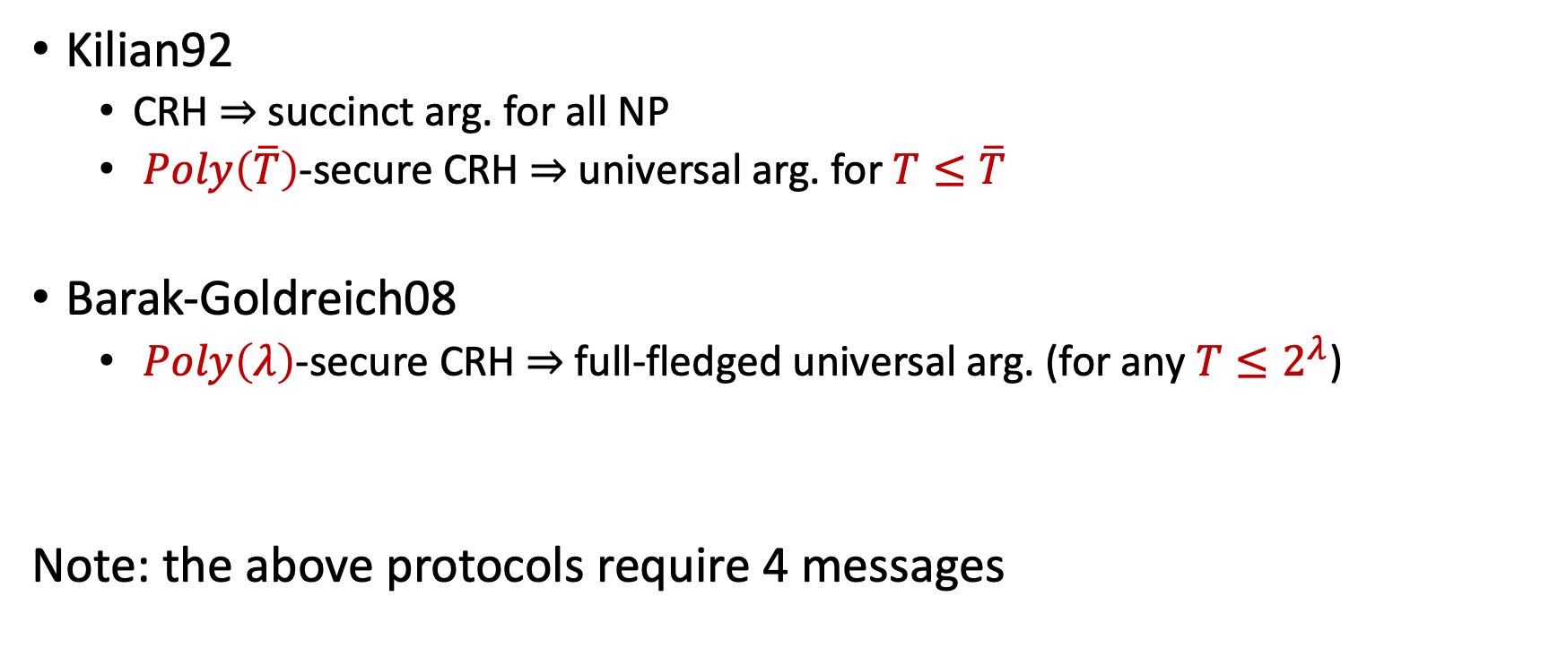
Known Results
Kilian92
CRH $⇒$ succinct arg. for all NP
$Poly\left(\overline{T}\right)$-secure CRH $⇒$ universal arg. for $T≤\overline{T}$
Barak-Goldreich08
$Poly\left(λ\right)$-secure CRH $⇒$ full-fledged universal arg. (for any $T≤2^{λ}$)
Note: the above protocols require 4 messages
(semi-universal argument)

Slide 7
Non-interactive Universal Arguments?

Slide 8
Non-interactive Arguments (SNARGS)
$$L∈NP$$
CRS
$$poly(x)$$
Prover
Verifier
$$\tilde{O}(x)$$
$$x,w$$
$$x$$
Completeness
Computational soundness
Doubly efficient
accept / reject

Slide 9
SNARGs for P
Choudhuri-Jain-Jin21, Waters-Wu22, Kalai-Lombardi-Vaikuntanathan-Wichs22, Kalai-Paneth-Yang19, Paneth-Pass22, Devadas-Goyal-Kalai-Vaikuntanathan22, Choudhuri-Jain-Zhengzhong21, Jawale-Kalai-Khurana-Zhang21, Kalai-Lombardi-Vaikuntanathan-Wichs22, Choudhuri-Garg-Jain-Jin-Zhang22
Under polynomial assumptions
for $A∈\left\{LWE, DLIN\right\}$, $A⇒$ SNARGs for P
$Poly\left(\overline{T}\right)$-secure A $⇒$ universal SNARGs for detereministic computation with $T≤\overline{T}$
Goal:
$Poly\left(λ\right)$-secure A
$⇒$ universal SNARGs for deterministic computation with $T≤2^{λ}$

Slide 10
Main Result
Non-interactive universal arguments assuming:
LWE/DLIN
FHE
mild worst case complexity assumption

Slide 11
Results (cont.)
Notion
Complexity Assumption
Uniform soundness
None
General soundness
Circuits of fixed poly size can’t decide all P: $$∀c∈ℕ, P⊄ioSIZE\left(n^{c}\right)$$
Incrementally Verifiable
Computation
$$∃d,∀c, P∩DSPACE\left(n^{d}\right)⊄ioSIZE\left(n^{c}\right)$$
Non-uniform ETH

Slide 12
Lifting Theorem
universal arguments
+ puzzles
SNARGS for P

Slide 13
Lifting Theorem
universal arguments
Soundness guaranteed $∀ T≤2^{λ}$
+ puzzles
Existing constructions of SNARGS for P
semi-universal arguments
Soundness guaranteed when $T≤poly\left(λ\right)$

Slide 14
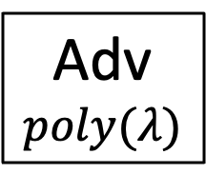
Existing Constructions Aren’t Universal
Adv
$$poly(λ)$$
R
$$\left(M,x,T\right)$$
$$Size(Adv, T)$$
Break LWE/DLIN

Slide 15
Main Idea
Adv
$$poly(λ)$$
R
$$\left(M,x,T\right)$$
+ Proof that it executed time-$T$ computation
$$Size(Adv, T)$$
(Solution to $T$-hard puzzle)
Break LWE/DLIN

Slide 16
Cryptographic Puzzles
$$T$$
Solver
$$Z$$
Challenger
$$≈T$$
$$S$$
$$poly\left(λ,\log{T}\right)$$
Verify
construct semi-universal puzzles from:
Worst case complexity assumption
FHE
Semi-universal argument
Completeness
Fast sampling and verification
Soundness: can’t solve in time $T^{ε}$
Semi-universal soundness (i.e., for $T≤poly$)

Slide 17
Universal Argument Construction
CRS
Prover
Verifier
$$π$$
$$\left(M,x,T\right)$$
$$\left(M,x,T\right)$$
Verify

Slide 18
Universal Argument Construction
$Z_{0},…,Z_{λ}$ with $Z_{i}$ of difficulty $2^{i}$
CRS
Prover
Verifier
$$S_{\log{T}}, π$$
$$\left(M,x,T\right)$$
$$\left(M,x,T\right)$$
Verify $S_{\log{T}}$ and $π$

Slide 19
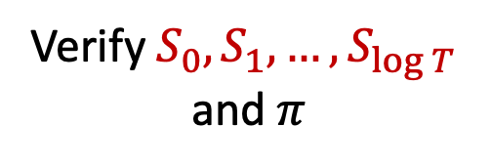
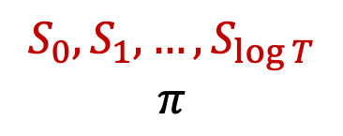
Universal Argument Construction
$Z_{0},…,Z_{λ}$ with $Z_{i}$ of difficulty $2^{i}$
CRS
Prover
$$S_{0},S_{1},…,S_{\log{T}}$$
$$π$$
Verifier
$$\left(M,x,T\right)$$
$$\left(M,x,T\right)$$
Verify $S_{0},S_{1},…,S_{\log{T}}$ and $π$

Slide 20
Proof Idea
$$\left|Adv\right|=poly\left(λ\right)$$
Adv $⟶\left(M,x,T\right)$
$$\left|Adv\right|<T^{ε}$$
$$\left|Adv\right|>T^{ε}$$
Break soundness of puzzle $Z_{\log{T}}$
Break soundness of semi-universal argument

Slide 21
Future Directions
Is there a direct analysis showing universal soundness of existing SNARGs (KRR14, CJJ21) without relying on puzzles? (a la Barak-Goldreich)
Use puzzles to reduce super-poly assumptions to poly assumptions?
Example: Bitnasky-Solomon23
Thank you!

