Slide 1
Brakedown: Linear-time and field-agnostic SNARKs for R1CS
Alexander Golovnev,† Jonathan Lee,‡
Srinath Setty,⋆ Justin Thaler,†⋄ and Riad S. Wahby^{λ}
⋆Microsoft Research †Georgetown ‡Nanotronics ⋄A16Z ^{λ}CMU

Slide 2
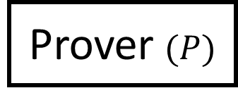
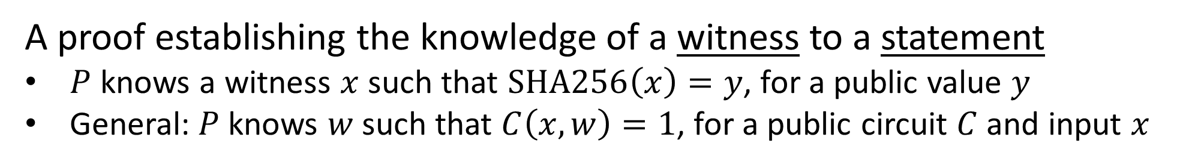
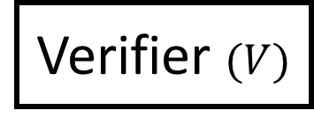
What is a SNARK?
π
Prover $(P)$
Verifier $(V)$
A proof establishing the knowledge of a witness to a statement
$P$ knows a witness $x$ such that $SHA256\left(x\right)=y$, for a public value $y$
General: $P$knows $w$such that $C\left(x, w\right)=1$, for a public circuit $C$ and input $x$
A trivial proof system: $P$ sends its $w$, and $V$checks if $C\left(x, w\right)=1$
A SNARK achieves better properties:
The size of the proof π is sub-linear in the size of the statement proven
The cost to verify π is sub-linear in the cost to check the witness

Slide 3
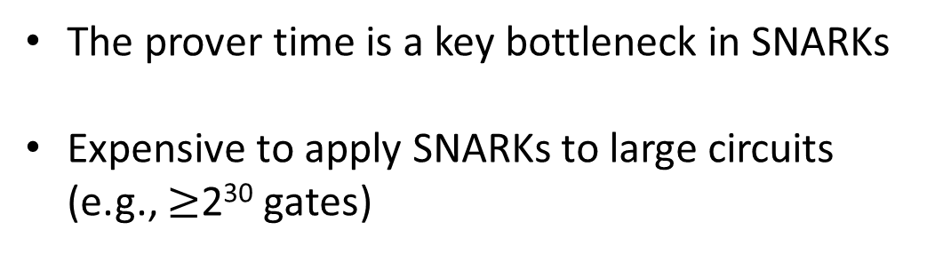
SNARKs have many applications
Rollups/zkVMs
zkBridge
VDFs
zkML
PhotoProof
Public key transparency
The prover time is a key bottleneck in SNARKs
Expensive to apply SNARKs to large circuits (e.g., $≥$2³⁰ gates)

Slide 4

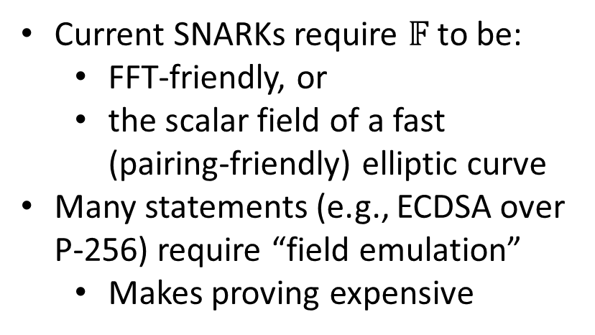
Our focus in this work
(1) SNARKs with the fastest possible prover
(2) SNARKs that can prove a circuit $C$ defined over an arbitrary finite field $𝔽$
Current SNARKs require $𝔽$ to be:
  FFT-friendly, or
  the scalar field of a fast (pairing-friendly) elliptic curve
Many statements (e.g., ECDSA over P-256) require “field emulation”
  Makes proving expensive

Slide 5
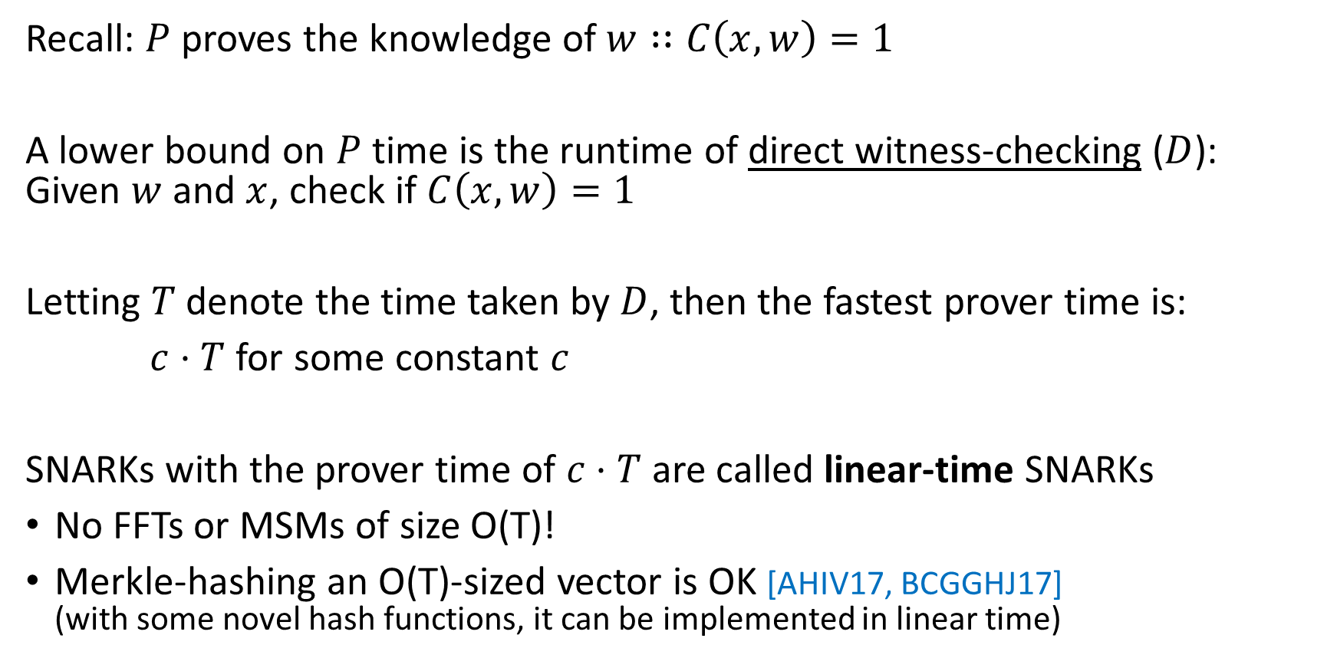
How fast can we hope the SNARK prover to be?
Recall: $P$ proves the knowledge of $w∷C\left(x, w\right)=1$
A lower bound on $P$ time is the runtime of direct witness-checking ($D$): Given $w$ and $x$, check if $C\left(x,w\right)=1$
Letting $T$ denote the time taken by $D$, then the fastest prover time is:
$c⋅T$ for some constant $c$
SNARKs with the prover time of $c⋅T$ are called linear-time SNARKs
No FFTs or MSMs of size O(T)!
Merkle-hashing an O(T)-sized vector is OK [AHIV17, BCGGHJ17] (with some novel hash functions, it can be implemented in linear time)
Notes:
$P$ must convince itself of the statement that is proven, let alone the verifier

Slide 6
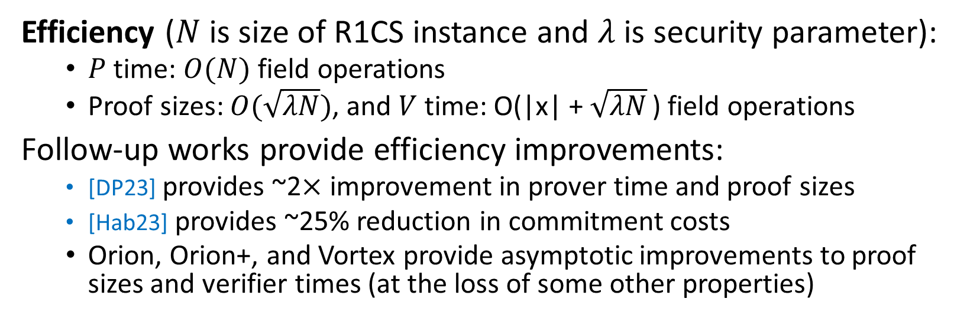
Brakedown in a nutshell
Plausibly post-quantum secure
Linear-time SNARK
The first implemented SNARK with either property
No trusted setup
Supports any large (e.g., 128-bit) field
Supports R1CS, extends to CCS [STW23]
Efficiency ($N$ is size of R1CS instance and $λ$ is security parameter):
  $P$ time: $O(N)$ field operations
  Proof sizes: $O(\sqrt{λN})$, and $V$ time: O(|x| + $\sqrt{λN}$ ) field operations
Follow-up works provide efficiency improvements:
  [DP23] provides ~2$×$ improvement in prover time and proof sizes
  [Hab23] provides ~25% reduction in commitment costs
  Orion, Orion+, and Vortex provide asymptotic improvements to proof sizes and verifier times (at the loss of some other properties)

Slide 7
Rest of this talk
Background on the modern SNARK design
Design of Brakedown
Experimental results

Slide 8
Recipe in modern SNARK constructions
(1) Construct a succinct interactive argument of knowledge:
Polynomial IOP
Polynomial commitment scheme
(2) Render it non-interactive using the Fiat-Shamir transformation
Exceptions:
Linear-PCP-based SNARKs (e.g., Groth16)
Folding-scheme-based SNARKs (e.g., Nova)

Slide 9



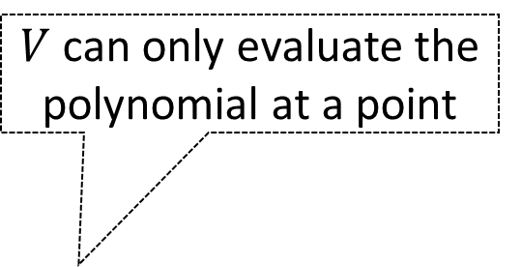


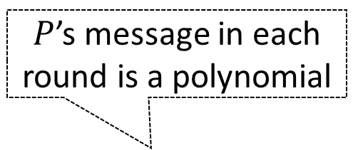

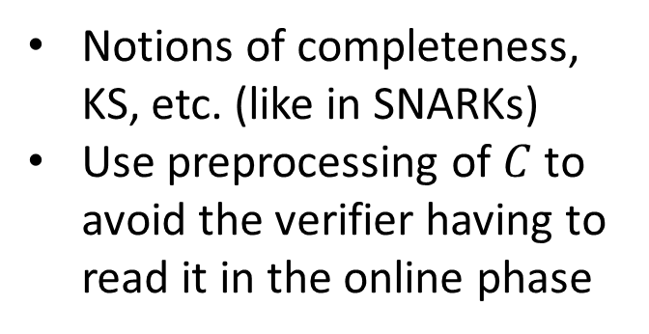



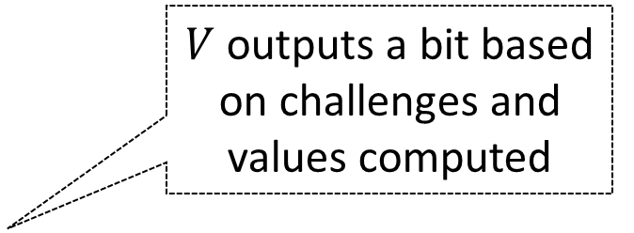
What is a polynomial IOP for CSAT?
Interactive protocol for $P$ to convince $V$ that it knows a $w∷C\left(x, w\right)=1$
Notions of completeness, KS, etc. (like in SNARKs)
Use preprocessing of $C$ to avoid the verifier having to read it in the online phase
$P$’s message in each round is a polynomial
$V$ can only evaluate the polynomial at a point
$$P$$
$$g_{1}$$
$$V$$
$$r_{1}$$
$${v_{1}←g}_{1}\left(r_{1}\right)$$
$$g_{ℓ}$$
$${v_{ℓ}←g}_{ℓ}\left(r_{ℓ}\right)$$
$V$ outputs a bit based on challenges and values computed
$$r_{ℓ}$$
$$ψ\left(C, x, r_{1},…, r_{ℓ}, v_{1},…,v_{ℓ}\right)→\{0, 1\}$$

Slide 10
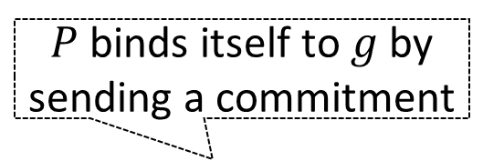



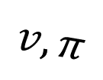

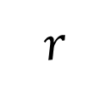
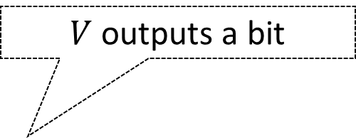
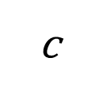
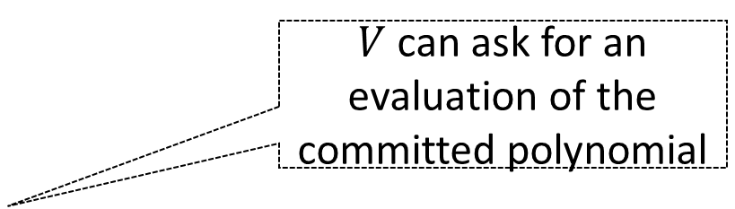
Polynomial commitment scheme (PCS)
Suppose $P$ has a polynomial $g$
$P$ binds itself to $g$ by sending a commitment
$V$ can ask for an evaluation of the committed polynomial
Commitments are short and proofs are quick to verify
Notions of completeness, binding, extractability, etc.
$$c$$
$$P$$
$$V$$
$$r$$
$$v, π$$
$V$ outputs a bit
$$ψ\left(c, r, v,π \right)→\{0, 1\}$$

Slide 11
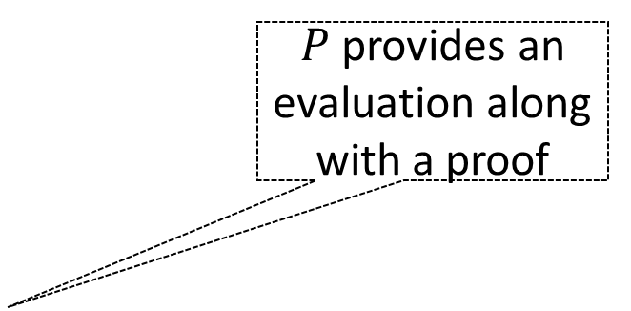
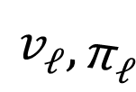

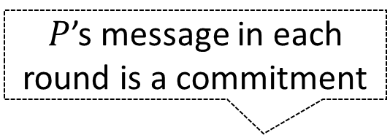
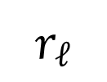

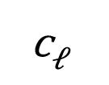
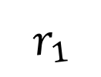
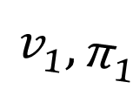
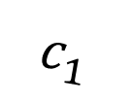
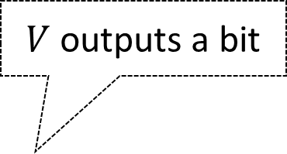
Polynomial IOP + PCS for CSAT
Interactive argument for $P$ to convince $V$ that it knows a $w∷C\left(x, w\right)=1$
$P$’s message in each round is a commitment
$P$ provides an evaluation along with a proof
$$c_{1}$$
$$P$$
$$V$$
Make it non-interactive with Fiat-Shamir transformation, obtaining a SNARK
$$r_{1}$$
$$v_{1}, π_{1}$$
$$c_{ℓ}$$
$$r_{ℓ}$$
$$v_{ℓ}, π_{ℓ}$$
$V$ outputs a bit
$$ψ\left(C, x, r_{1},…, r_{ℓ}, v_{1},…,v_{ℓ}, π_{1},…,π_{ℓ}\right)→\{0, 1\}$$

Slide 12
Recipe in modern SNARK constructions
Polynomial IOP
PCS
Spartan [S19]
Plonk [GWC19]
Marlin [CHM+19]
…
KZG [KZG10], [PST13]
IPA [BCCGP16]
Hyrax [WTs+18]
Dory [Lee21]
…
Ligero-PC [AHIV17]
FRI-based [BBHR18]
Virgo-PC [ZXZS20]
…
MSMs
Require FFTs of size proportional to the circuit size
FFTs

Slide 13
Rest of this talk
Background on the modern SNARK design
Design of Brakedown
Experimental results

Slide 14
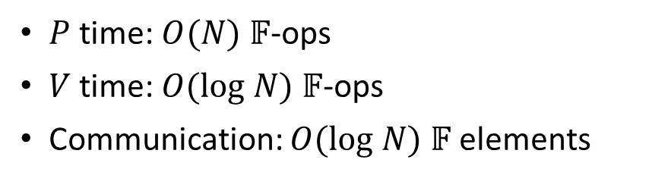
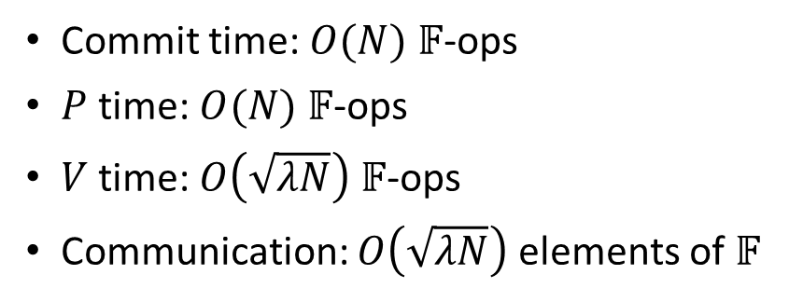
Brakedown: A linear-time SNARK based on a new PCS
Spartan’s
Polynomial IOP [S19]
Brakedown PCS
$P$ time: $O(N)$ $𝔽$-ops
$V$ time: $O(log N)$ $𝔽$-ops
Communication: $O(log N)$ $𝔽$elements
Commit time: $O(N)$ $𝔽$-ops
$P$ time: $O(N)$ $𝔽$-ops
$V$ time: $O\left(\sqrt{λN}\right)$ $𝔽$-ops
Communication: $O\left(\sqrt{λN}\right)$ elements of $𝔽$

Slide 15
Brakedown PCS
Builds on prior theoretical work [AHIV17, BCGGHJ17, BCG20]
An implicit result in these works: A PCS with a linear-time committer and prover, given an error correcting code with a linear-time encoder
Unfortunately: prior linear-time encodable codes [Spi96, DI14] are impractical
Brakedown’s key contributions:
Distill a linear-time polynomial commitment scheme from prior works
Provide a suitable error-correcting code that is practical

Slide 16


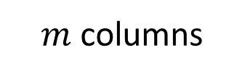
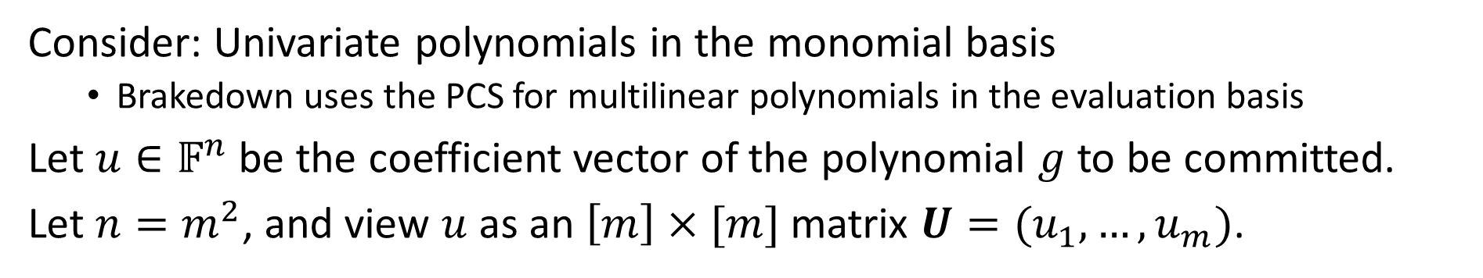
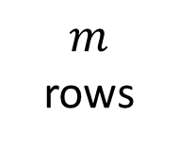
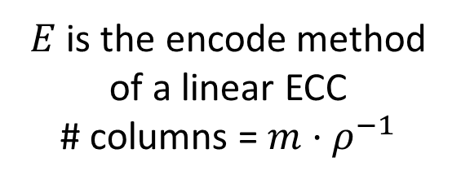




An overview of the PCS: Commitment
Consider: Univariate polynomials in the monomial basis
  Brakedown uses the PCS for multilinear polynomials in the evaluation basis
Let $u∈𝔽^{n}$ be the coefficient vector of the polynomial $g$ to be committed.
Let $n=m^{2}$, and view $u$ as an $\left[m\right]×[m]$ matrix $U=(u_{1},…,u_{m})$.
$$u_{1}$$
Encode each row
$${E(u}_{1})$$
Merkle hash columns
$$u_{2}$$
$$E(u_{2})$$
$m$
rows
…
…
$$u_{m}$$
$$E(u_{m})$$
$E$ is the encode method of a linear ECC
# columns = $m⋅ρ^{−1}$
Columns of the encoded matrix
$m$ columns

Slide 17

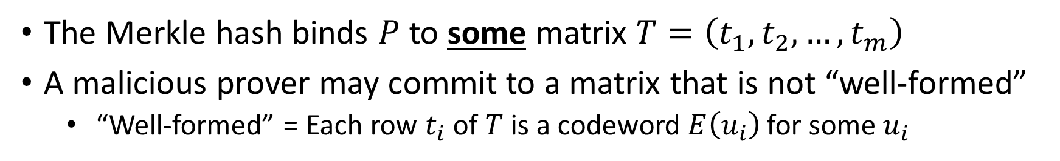



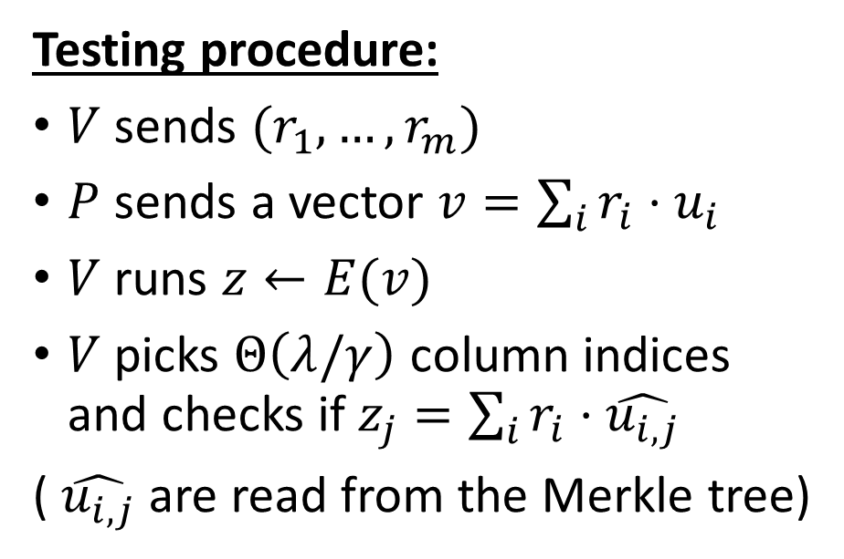
Testing if the commitment is “valid”
The Merkle hash binds $P$ to some matrix $T=\left(t_{1},t_{2},…, t_{m}\right)$
A malicious prover may commit to a matrix that is not “well-formed”
  “Well-formed” = Each row $t_{i}$ of $T$ is a codeword $E\left(u_{i}\right)$ for some $u_{i}$
Testing procedure:
$V$ sends ${(r}_{1}, …, r_{m})$
$P$ sends a vector $v=\sum_{i}{r_{i}⋅u_{i}}$
$V$ runs $z←E(v)$
$V$ picks $Θ\left(λ/γ\right)$ column indices and checks if $z_{j}=\sum_{i}{r_{i}⋅\hat{u_{i, j}}}$
( $\hat{u_{i,j}}$ are read from the Merkle tree)
$$r_{1}$$
. . . . .
$$r_{2}$$
. . . . .
…
$$r_{m}$$
. . . . .
. . . . .
$$z$$

Slide 18



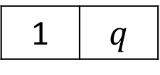


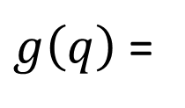

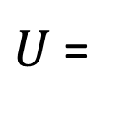
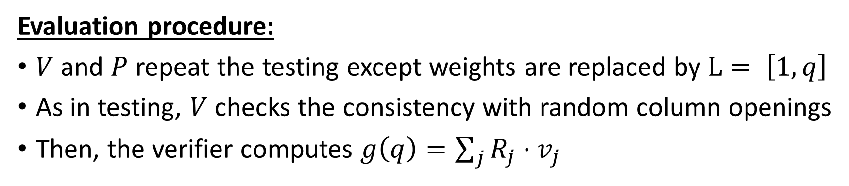

Proving the evaluation of a committed polynomial
Example $g\left(x\right)=x+2 x^{2}+3 x^{3}$
0 | 2
1 | 3
$U$ =
$g$ can be evaluated at a point $q∈𝔽$ by exploiting the following identity.
0 | 2
1 | 3
1
$$q^{2}$$
$g\left(q\right)$ =
1 | $$q$$
$$⋅$$
$$⋅$$
$$L$$
$$U$$
$$R$$
Evaluation procedure:
$V$ and $P$ repeat the testing except weights are replaced by $L= \left[1, q\right]$
As in testing, $V$ checks the consistency with random column openings
Then, the verifier computes $g\left(q\right)=\sum_{j}{R_{j}⋅v_{j}}$

Slide 19




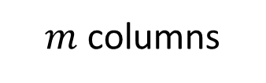
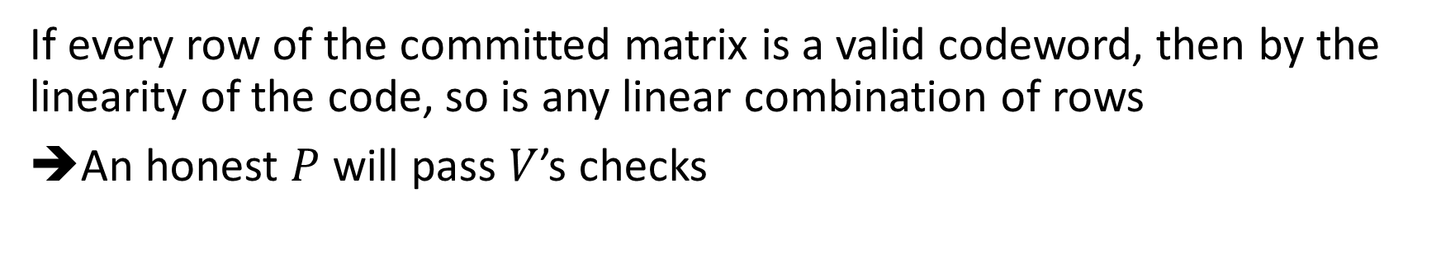
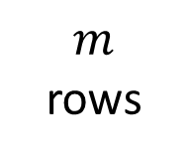
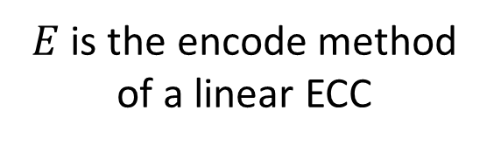


Completeness of the PCS
$$u_{1}$$
Encode each row
$${E(u}_{1})$$
$$u_{2}$$
$$E(u_{2})$$
$m$
rows
…
…
$$u_{m}$$
$$E(u_{m})$$
$E$ is the encode method of a linear ECC
$m$ columns
If every row of the committed matrix is a valid codeword, then by the linearity of the code, so is any linear combination of rows
An honest $P$ will pass $V$’s checks

Slide 20
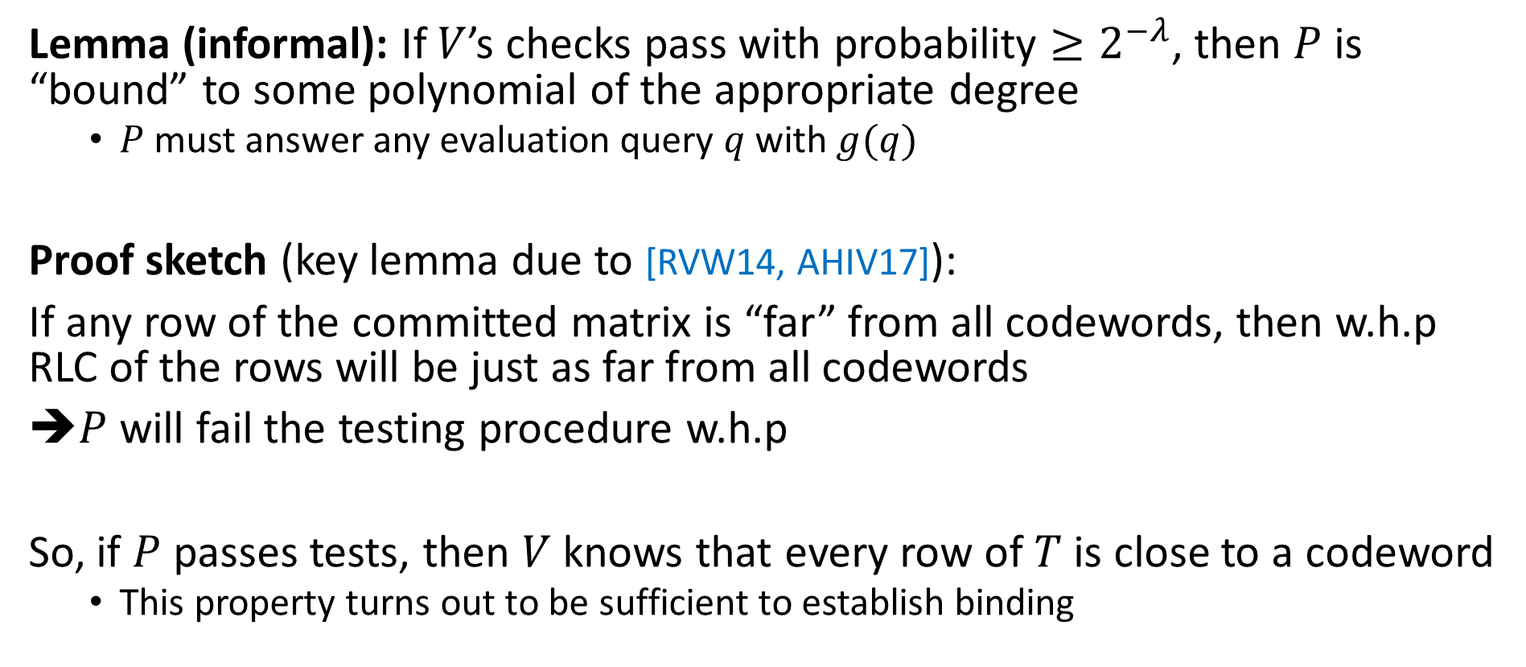
Binding property of the PCS
Lemma (informal): If $V$’s checks pass with probability $≥2^{−λ}$, then $P$ is “bound” to some polynomial of the appropriate degree
  $P$ must answer any evaluation query $q$ with $g(q)$
Proof sketch (key lemma due to [RVW14, AHIV17]):
If any row of the committed matrix is “far” from all codewords, then w.h.p RLC of the rows will be just as far from all codewords
$P$ will fail the testing procedure w.h.p
So, if $P$ passes tests, then $V$ knows that every row of $T$ is close to a codeword
  This property turns out to be sufficient to establish binding

Slide 21
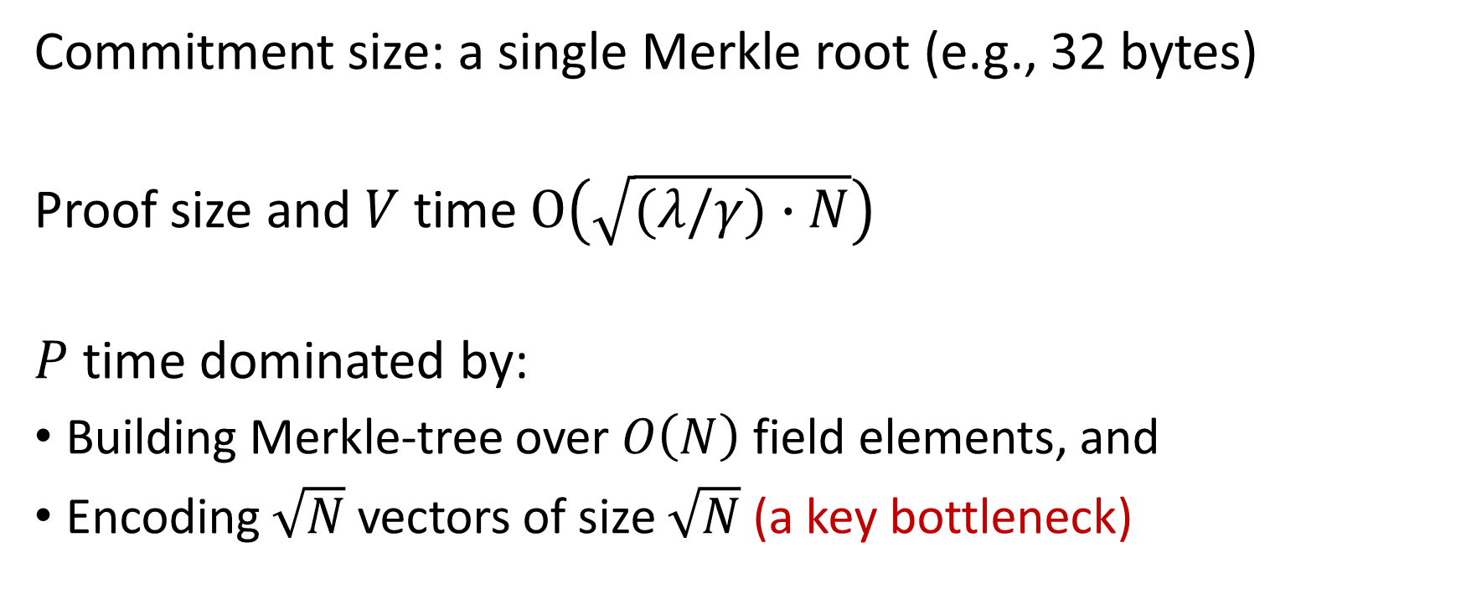

PCS costs for a polynomial with for $N$ coefficients
Commitment size: a single Merkle root (e.g., 32 bytes)
Proof size and $V$ time $O\left(\sqrt{(λ/γ)∙N}\right)$
$P$ time dominated by:
Building Merkle-tree over $O\left(N\right)$ field elements, and
Encoding $\sqrt{N}$ vectors of size $\sqrt{N}$ (a key bottleneck)

Slide 22
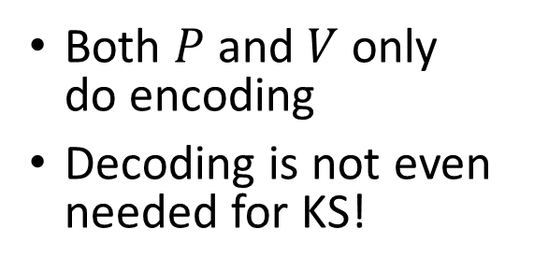
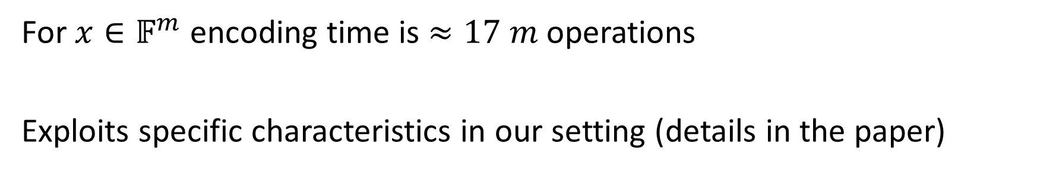
Brakedown provides a practical code
For $x∈𝔽^{m}$ encoding time is $≈17 m$ operations
Exploits specific characteristics in our setting (details in the paper)
No need for efficient decoding
Work over large (e.g., 128-bit) fields
Randomized codes are acceptable
Both $P$ and $V$ only do encoding
Decoding is not even needed for KS!
Large fields are required for the IOP’s soundness
w.h.p a random code satisfies a distance bound

Slide 23
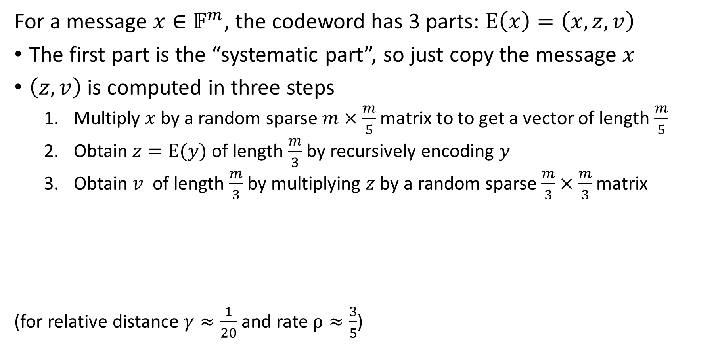
A high-level overview of the code construction
For a message $x∈𝔽^{m}$, the codeword has 3 parts: $E\left(x\right)=\left(x, z, v\right)$
The first part is the “systematic part”, so just copy the message $x$
$\left(z, v\right)$ is computed in three steps
  Multiply $x$ by a random sparse $m×\frac{m}{5}$matrix to to get a vector of length $\frac{m}{5}$
  Obtain $z=E(y)$ of length $\frac{m}{3}$by recursively encoding $y$
  Obtain $v$ of length $\frac{m}{3}$by multiplying $z$ by a random sparse $\frac{m}{3}×\frac{m}{3}$ matrix
(for relative distance $γ≈\frac{1}{20}$ and rate $ρ≈\frac{3}{5}$)

Slide 24
Systematic part
Recursively encode a compressed version of the message
Multiply the second component with a random sparse matrix
Distance analysis of the code construction (please see the paper)

Slide 25
Rest of this talk
Background on the modern SNARK design
Design of Brakedown
Experimental results

Slide 26
Implementation
Implemented in Rust, with many optimizations (details in the paper)
We also implement a variant of Brakedown that uses Reed-Solomon codes
  Gives up linear-time prover, but provides smaller proofs than Brakedown
Both schemes are available from fork of Spartan (https://github.com/conroi/Spartan)

Slide 27
Performance for R1CS statements with 2²⁰ constraints
 | Prover time (s) | Proof size (KB) | Verifier time (ms)
Ligero [CCS17] | 69 | 20,000.0 | 31,000
Hyrax [S&P18] | 486 | 58.0 | 7,700
Aurora [EUROCRYPT19] | 485 | 1,600.0 | 108,000
Spartan w/ Hyrax-PC [CRYPTO20] | 6 | 48.0 | 366
Brakedown | 3 | 10,230 | 660
SNARKs for
uniform circuits
Groth16 [EUROCRYPT16] | 76 | 0.2 | 3
Fractal [EUROCRYPT20] | 880 | 2,500.0 | 220
Spartan w/ Hyrax-PC [CRYPTO20] | 45 | 142.0 | 100
Brakedown | 33 | 53,846 | 2,219
SNARKs for non-uniform circuits
Brakedown offers the fastest prover
Proof sizes are large, but they can be reduced (e.g., see Orion and Orion+)

Slide 28
Summary
Brakedown is a linear-time and field-agnostic SNARK
Key contributions:
A linear-time polynomial commitment scheme (distilled from prior work)
A practical linear-time encodable code to instantiate the PCS
Combine the new PCS with Spartan’s polynomial IOP to get a linear-time SNARK

