Slide 1


When Messages Are Keys:
Is HMAC a Dual-PRF?
Matilda Backendal
Applied Cryptography Group
ETH Zurich
together with Mihir Bellare, Felix Günther and Matteo Scarlata
CRYPTO, August 24, 2023
Notes:
Exploring the security of HMAC if you happen to swap the key and message inputs

Slide 2



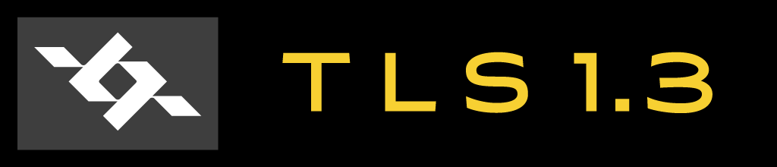

HMAC: the Swiss Army Knife of Crypto
HMAC [CRYPTO’96:BCK] is
a hash-based MAC,
standardized,
provably secure,
versatile,
and widely used.
Key derivation
MAC
in HKDF
PRF
KEMTLS
Key combiner
Post-quantum *
>_ SSH
IPSec
Image credit: openclipart
Notes:
HMAC is a hash-based MAC, designed by Bellare, Canetti and Krawczyk and presented at CRYPTO’96.
It has been standardized by the IETF and NIST, and analyzed and proven secure as a PRF, which means that it can be used as a MAC and also for key derivation. Indeed, it forms the basis of HKDF.Expand and Extract.
Most importantly, it is widely used in cryptographic applications and protocols, including in IPSec, SSH, TLS and Wireguard.
It is also being used in Post-Quantum protocols, such as KEMTLS, PQ Noise, Wireguard, etc. In this setting, HMAC is being used as a key combiner, for example to combine classical and PQ keys.
It is in this setting in particular, where HMAC is being used to combine multiple cryptographic keys or secrets, that the question of its dual-PRF security shows up.

Slide 3



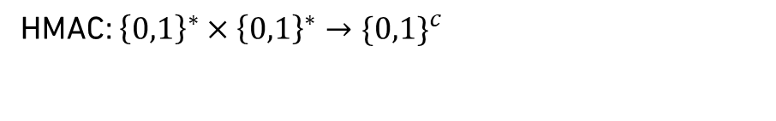

HMAC in Action
Legend:
Input secrets
Message
TLS 1.3 Key Schedule
Derived secrets
HMAC: ${\left\{0,1\right\}}^{∗}×{\left\{0,1\right\}}^{∗}→{\{0,1\}}^{c}$
Key
HMAC
Session keys
Key space
Message space
PSK
KEM secret
DHE
label₁
Swap-PRF
Swap-PRF
Extractor
PRF
0
HMAC
HMAC
HMAC
₁
PRF
label₂
PRF
HMAC
₂
$$⋮$$
Notes:
Let’s take a look at HMAC in action. As an example, we will use a high-level overview of the TLS 1.3 key schedule (in PSK mode).
But first, what is HMAC? Mathematically, it is a function which takes as input two strings of arbitrary length, usually referred to as key and message, to produce a fixed-length string as output. Btw, notice that the key length is variable. Many of you may assume that HMAC has fixed length keys, but actually, the standard allows keys of any length.
In this example, I will use this figure to illustrate HMAC, with the first input (the key in the standard usage) coming in from the left and the second input (usually the message) from the top. I will use these colors for the various keys and secrets in the key schedule.
In a late stage of the TLS key schedule, HMAC is being used in HKDF.Expand to derive multiple session keys, in blue, from some previously derived master secret, in red.
Here, HMAC is assumed to be a PRF. (Meaning keyed as usually with the first input.)
Before this, HMAC is used on input secrets. As you can see, the secret is now coming in from the top! It might look strange with the inputs in the “wrong places”, but this comes from the fact that the input can be DHE, in which case HMAC is used as an extractor.
But in some settings, this is actually a uniform key. For example, in PSK mode the first input secret is a PSK, and in KEM-TLS the second one is a key produced by a KEM encapsulation.
In these settings, HMAC is being used with swapped inputs, i.e. it is assumed to be a “swap-PRF”.
If that assumption holds, the output is uniformly random (enter red key), so HMAC can again be used as a PRF in the second case.

Slide 4

HMAC in Action
Legend:
Input secrets
Message
TLS 1.3 Key Schedule
Derived secrets
HMAC: ${\left\{0,1\right\}}^{∗}×{\left\{0,1\right\}}^{∗}→{\{0,1\}}^{c}$
Key
HMAC
Session keys
PSK
KEM secret
DHE
label₁
Swap-PRF
Swap-PRF
Extractor
PRF
0
HMAC
HMAC
HMAC
₁
PRF
label₂
Dual-PRF
PRF
HMAC
₂
$$⋮$$
Notes:
This combination of PRF and swap-PRF security is what we refer to as “dual-PRF” security. That is, dual PRF security means that HMAC is assumed to be secure when keyed both regularly with the first input, as well as in the swapped setting when keyed through the message input.

Slide 5
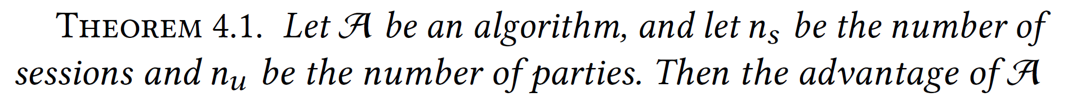
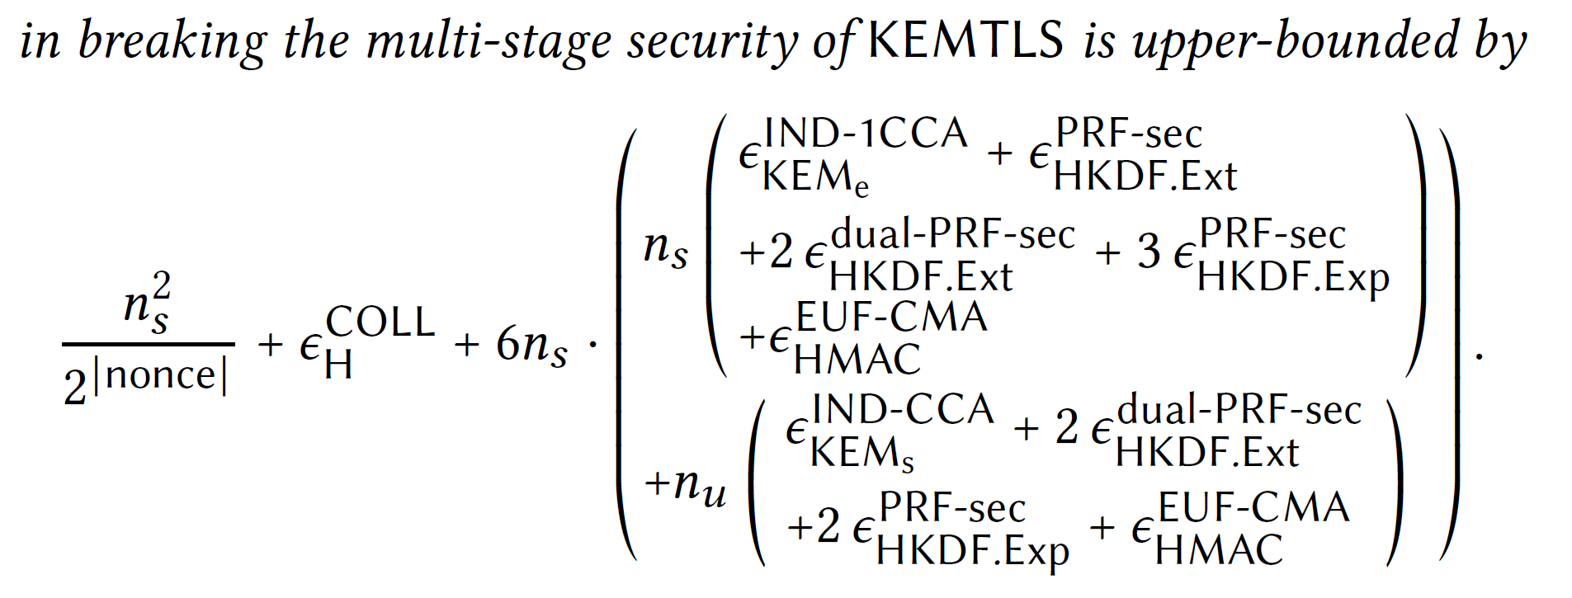
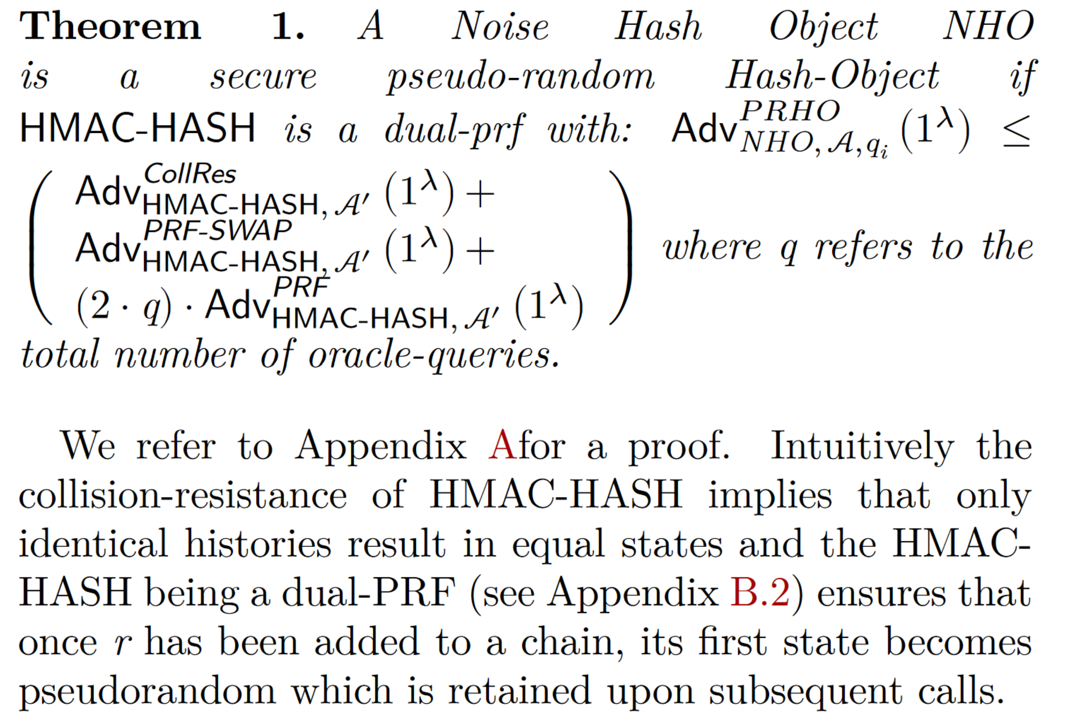
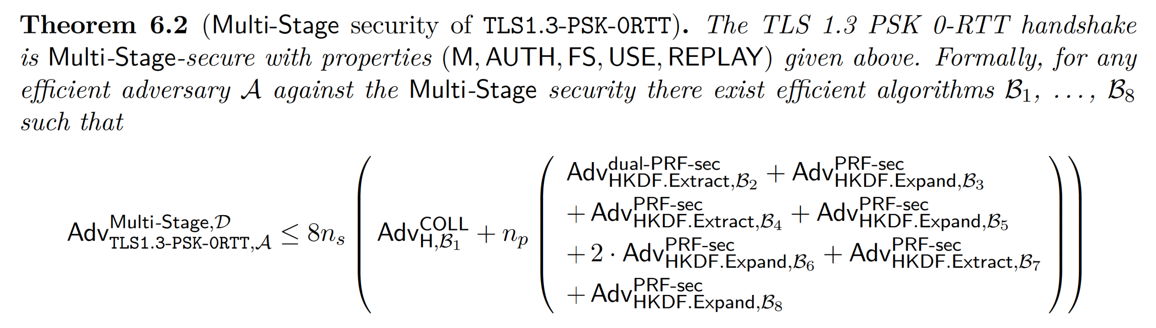
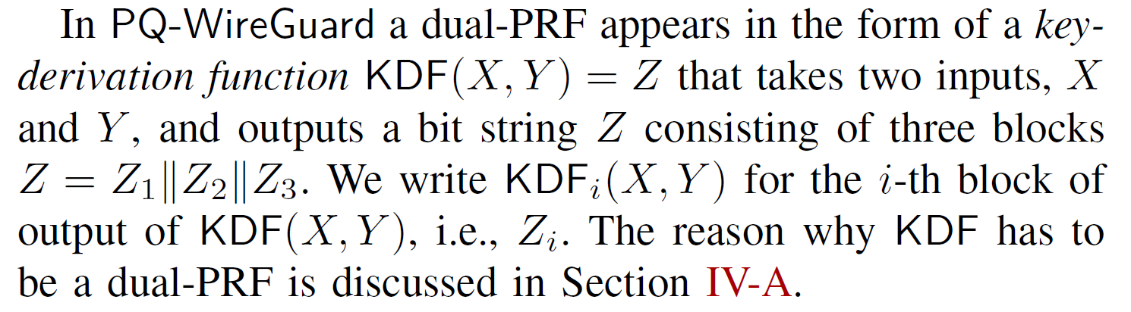
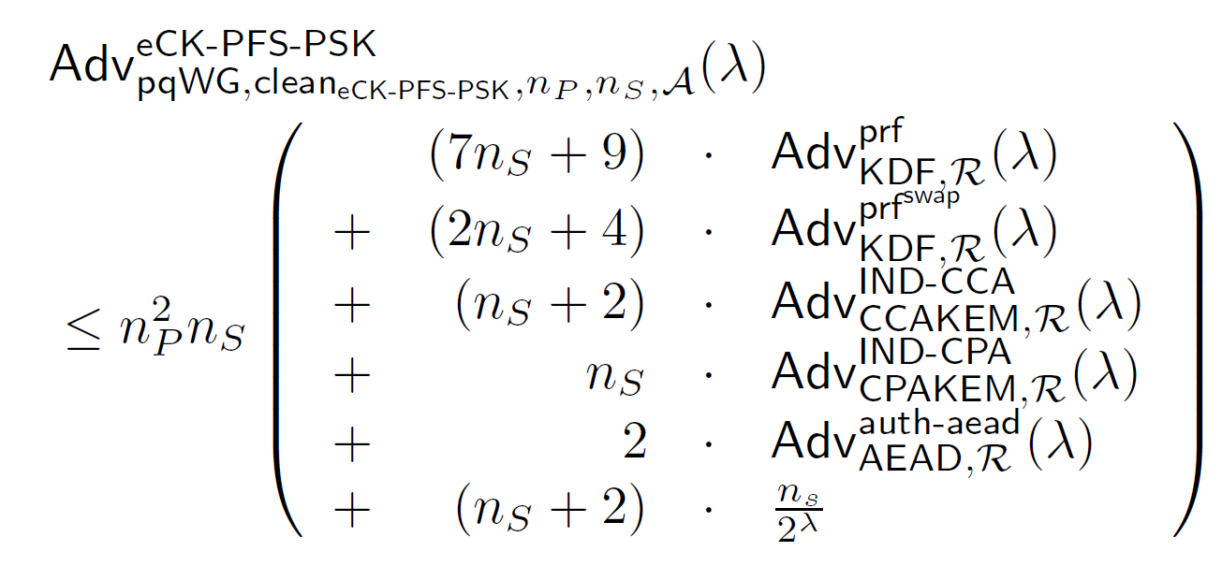
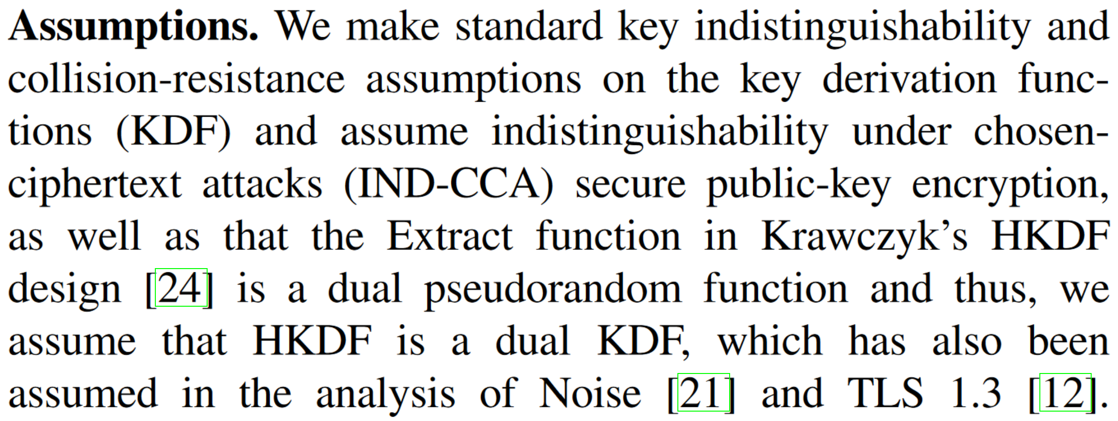
HMAC Is Assumed to Be a Dual-PRF
In the analysis of:
TLS 1.3 PSK [JoC’22:DFGS]
KEMTLS [CCS’20:SSW]
PQ Wireguard [S&P’21:HNSWZ]
PQ Noise [CCS’22:ADHSW]
Messaging Layer Security (MLS) [S&P’22:BCK]
[…]
Notes:
This assumption, that HMAC is dual- or swap-PRF, shows up in the analysis of a myriad of protocols, including…
TLS 1.3 in PSK mode, where it’s used to show key exchange security of the handshake protocol.
Further examples are …
Note: HKDF.Extract is just HMAC with swapped inputs

Slide 6
Is HMAC a Dual-PRF?
Notes:
So it’s clearly interesting to know if HMAC is a dual-PRF.
The starting point for this work was the observation that surprisingly, this has not been shown.
To answer this question, we need to have a look inside HMAC.

Slide 7
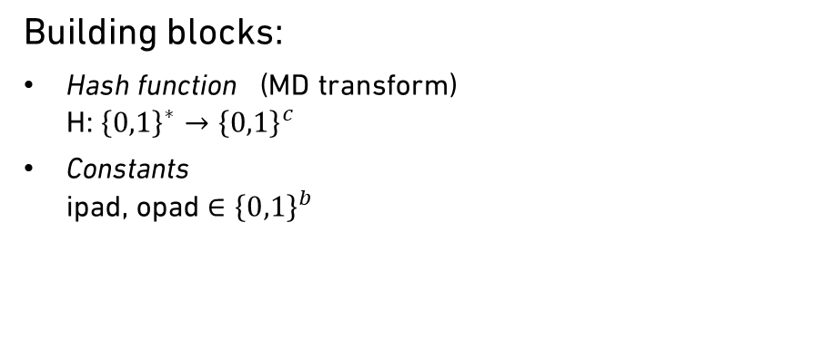

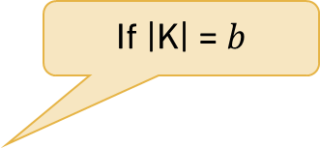

HMAC
Building blocks:
Hash function (MD transform)
H: ${\left\{0,1\right\}}^{∗}→{\left\{0,1\right\}}^{c}$
Constants
ipad, opad ${∈\left\{0,1\right\}}^{b}$
M
If |K| = $b$
K
H((K $⊕$ opad) || H((K $⊕$ipad) || M))
$${∈\left\{0,1\right\}}^{c}$$
HMAC(K, M)
Notes:
You might recognize HMAC written as this.
Here H is a hash function. Usually a MD construction such as SHA-2.
Ipad and opad are fixed b-bit constants, where b is the block length of the compression function underlying the hash function.
Holds when K is exactly one block, that is, b bits long. But recall that HMAC allows keys of any length!

Slide 8

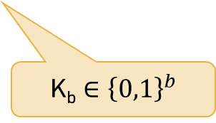
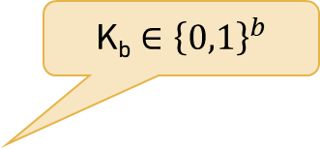
HMAC
HMAC_{b}(K_{b}, M) =
Building blocks:
Hash function (MD transform)
H: ${\left\{0,1\right\}}^{∗}→{\left\{0,1\right\}}^{c}$
Constants
ipad, opad ${∈\left\{0,1\right\}}^{b}$
M
K_{b} ${∈\left\{0,1\right\}}^{b}$
K_{b} ${∈\left\{0,1\right\}}^{b}$
K_{b}
H((K_{b} $⊕$ opad) || H((K_{b} $⊕$ipad) || M))
$${∈\left\{0,1\right\}}^{c}$$
HMAC_{b}(K_{b}, M)
Notes:
So for now, let’s assume that the key is block length. We call this HMAC_{b}.
Let’s have a look inside HMAC_{b}, starting with the inner application of H.

Slide 9




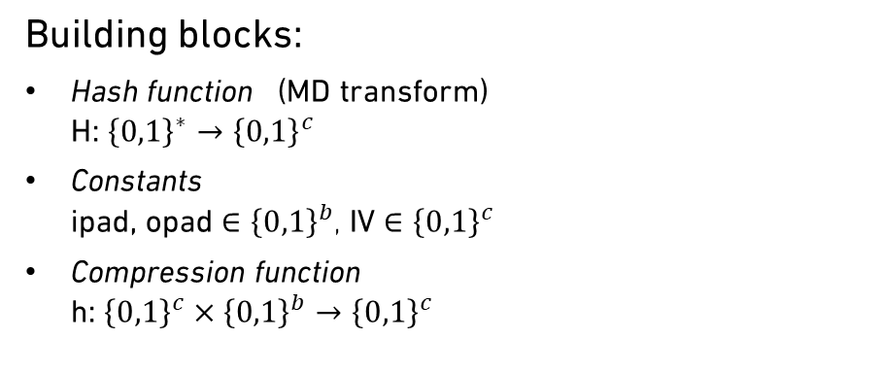
HMAC
HMAC_{b}(K_{b}, M) =
H((K_{b} $⊕$ opad) || H((K_{b} $⊕$ipad) || M))
Building blocks:
Hash function (MD transform)
H: ${\left\{0,1\right\}}^{∗}→{\left\{0,1\right\}}^{c}$
Constants
ipad, opad ${∈\left\{0,1\right\}}^{b}$, IV ${∈\left\{0,1\right\}}^{c}$
Compression function
h: ${\left\{0,1\right\}}^{c}×{\left\{0,1\right\}}^{b}→{\left\{0,1\right\}}^{c}$
M
K_{b} ${∈\left\{0,1\right\}}^{b}$
M || pad($b$ + |M|)
K_{b}$⊕$ipad
M[0]
M[1]
…
M[n]
K_{b}
IV
h
h
h
…
h
$${∈\left\{0,1\right\}}^{c}$$
Z_{i}
HMAC_{b}(K_{b}, M)
Notes:
First, K_{b} is XORed with ipad and fed into the compression function h, which in SHA-2 is built with the Davies-Meyer construction, together with the IV, which is c-bit initial vector.
Then, following the MD transform, the message with some added padding and length encoding is split into blocks and fed into a cascade of h calls.

Slide 10

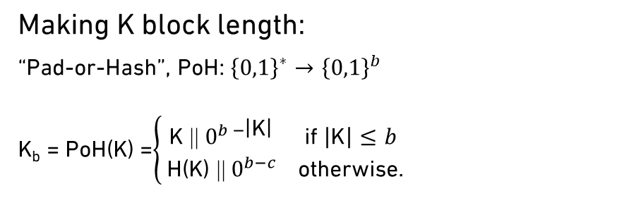
HMAC
HMAC_{b}(K_{b}, M) =
H((K_{b} $⊕$ opad) || H((K_{b} $⊕$ipad) || M))
Building blocks:
Hash function (MD transform)
H: ${\left\{0,1\right\}}^{∗}→{\left\{0,1\right\}}^{c}$
Constants
ipad, opad ${∈\left\{0,1\right\}}^{b}$, IV ${∈\left\{0,1\right\}}^{c}$
Compression function
h: ${\left\{0,1\right\}}^{c}×{\left\{0,1\right\}}^{b}→{\left\{0,1\right\}}^{c}$
M
K_{b} ${∈\left\{0,1\right\}}^{b}$
M || pad($b$ + |M|)
K_{b}$⊕$ipad
M[0]
M[1]
…
M[n]
K_{b}
IV
h
h
h
…
h
K_{b}$⊕$ opad
Z_{i} || pad
Making K block length:
“Pad-or-Hash”, PoH: ${\left\{0,1\right\}}^{∗}→{\left\{0,1\right\}}^{b}$
K_{b} = PoH(K) =$\left\{\begin{aligned}\text{K}\text{ ||}{ 0}^{b −\text{|}\text{K}\text{|}} \text{if} \left|\text{K}\right|≤b \\ \text{H}\text{(}\text{K}\text{) ||}{ 0}^{b−c} \text{otherwise}\text{.}\end{aligned}\right.$
IV
h
h
HMAC_{b}(K_{b}, M)
K “short”: zero-pad
K “long”: hash, then zero-pad
Notes:
In the outer hash function call, …
What remains to get to the full HMAC is to turn a key of arbitrary length into block length.
PoH: if K is short: pad with zeros. If K is long, hash and then zero-pad.

Slide 11


HMAC
HMAC_{b}(K_{b}, M) =
H((K_{b} $⊕$ opad) || H((K_{b} $⊕$ipad) || M))
Building blocks:
Hash function (MD transform)
H: ${\left\{0,1\right\}}^{∗}→{\left\{0,1\right\}}^{c}$
Constants
ipad, opad ${∈\left\{0,1\right\}}^{b}$, IV ${∈\left\{0,1\right\}}^{c}$
Compression function
h: ${\left\{0,1\right\}}^{c}×{\left\{0,1\right\}}^{b}→{\left\{0,1\right\}}^{c}$
M
K_{b} ${∈\left\{0,1\right\}}^{b}$
M || pad($b$ + |M|)
PoH(K)$⊕$ipad
M[0]
M[1]
…
M[n]
K
IV
h
h
h
…
h
PoH(K)$⊕$ opad
Z_{i} || pad
Making K block length:
“Pad-or-Hash”, PoH: ${\left\{0,1\right\}}^{∗}→{\left\{0,1\right\}}^{b}$
K_{b} = PoH(K) =$\left\{\begin{aligned}\text{K}\text{ ||}{ 0}^{b −\text{|}\text{K}\text{|}} \text{if} \left|\text{K}\right|≤b \\ \text{H}\text{(}\text{K}\text{) ||}{ 0}^{b−c} \text{otherwise}\text{.}\end{aligned}\right.$
IV
h
h
HMAC_{b}(K_{b}, M)
HMAC(K, M)
K “short”: zero-pad
K “long”: hash, then zero-pad
Notes:
Now we can replace K_{b} with PoH(K), allowing the key to be of arbitrary length, and we have arrived at the full HMAC.

Slide 12
Is HMAC a Dual-PRF?
Notes:
So coming back to our original question. Is HMAC a dual-PRF?

Slide 13
Is HMAC a PRF & Swap-PRF?
Notes:
Recall that this means PRF + swap-PRF security.

Slide 14

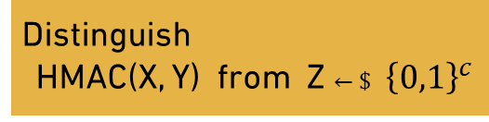


PRF and Swap-PRF Security
HMAC: ${\left\{0,1\right\}}^{∗}×{\left\{0,1\right\}}^{∗}→{\left\{0,1\right\}}^{c}$
Y
Y ∈ ${\left\{0,1\right\}}^{∗}$
PRF:
X
Y
Swap-PRF:
X
X $←\$$ ${\left\{0,1\right\}}^{∗}$
Z
HMAC(X, Y)
Adversary:
Distinguish
HMAC(X, Y) from Z $←\$$ ${\left\{0,1\right\}}^{c}$
Notes:
So what does that mean in this setting? Let’s forget about the details of HMAC for a moment and view it as a black box function of two inputs.
Since we are looking at a setting where messages are keys, let’s replace K and M by X and Y.
PRF security means…

Slide 15



PRF and Swap-PRF Security
HMAC: ${\left\{0,1\right\}}^{∗}×{\left\{0,1\right\}}^{∗}→{\left\{0,1\right\}}^{c}$
Y
Y $←\$$ ${\left\{0,1\right\}}^{∗}$
PRF:
[C’06:Bel, C’14:GPR]
X
Y
Swap-PRF:
X
Y
X
X ∈ ${\left\{0,1\right\}}^{∗}$
Z
HMAC(X, Y)
Adversary:
Distinguish
HMAC(X, Y) from Z $←\$$ ${\left\{0,1\right\}}^{c}$
Notes:
Swap-PRF security means…
We have good results on the PRF security of HMAC.
So let’s focus on swap-PRF security, which prior to this work had not been studied.

Slide 16
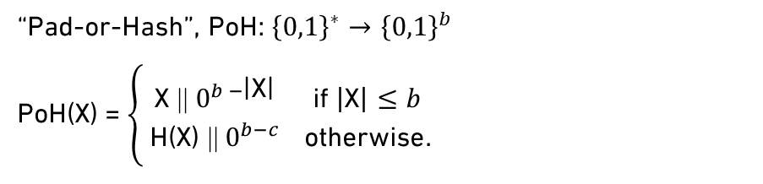



Is HMAC a Swap-PRF?
HMAC: ${\left\{0,1\right\}}^{∗}×{\left\{0,1\right\}}^{∗}→{\left\{0,1\right\}}^{c}$
Y
PRF:
[C’06:Bel, C’14:GPR]
X
Y
Y || pad($b$ + |Y|)
PoH(X)
$$⊕$$
ipad
Swap-PRF:
X
Y
Y[0]
Y[1]
…
Y[n]
ipad
X₁ or X₂
…
Attack:
X
IV
h
h
h
h
X₁ = 0
X₂ = 00
⇒ PoH(X₁) = 0^{b}
⇒ PoH(X₂) = 0^{b}
PoH(X)$⊕$ opad
Z_{i} || pad
opad
IV
h
h
Z
HMAC(X, Y)
“Pad-or-Hash”, PoH: ${\left\{0,1\right\}}^{∗}→{\left\{0,1\right\}}^{b}$
PoH(X) = $\left\{\begin{aligned}\text{X}\text{ ||}{ 0}^{b −\text{|}\text{X}\text{|}} \text{if} \left|\text{X}\right|≤b \\ \text{H}\text{(}\text{X}\text{) ||}{ 0}^{b−c} \text{otherwise}\text{.}\end{aligned}\right.$
Adversary:
X “short”: zero-pad
Distinguish
HMAC(X, Y) from Z $←\$$ ${\left\{0,1\right\}}^{c}$
X “long”: hash, then zero-pad
Notes:
To analyze this, we need to bring back the details of HMAC.
Because of PoH, there is actually a simple attack which breaks swap-PRF security. Namely, making one query with X input 0 and a second one with X input 00.
Applying PoH, both X₁ and X₂ become a full block of zeros. Same input to HMAC in both cases => same output in real world, easy to distinguish from random.

Slide 17
Is HMAC a PRF & Swap-PRF?
No!
Notes:
HMAC is not a swap-PRF. This is a problem, because it immediately invalidates the general assumption that HMAC is a dual-PRF, (which was) used in the security analysis of all of the aforementioned protocols. We’ll get to what this means in practice in a bit.
But what about the other half? At least HMAC is a secure PRF, right?

Slide 18
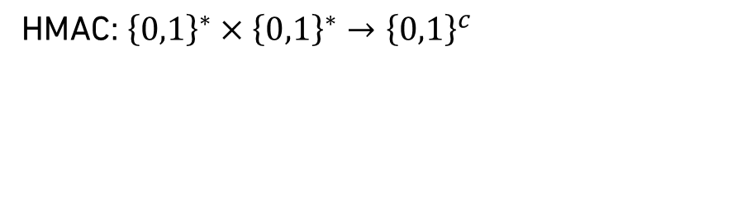
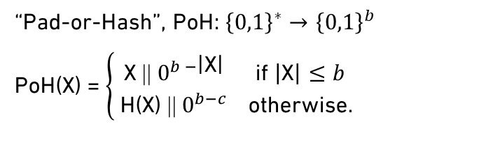



Is HMAC a PRF?
Shows PRF security of HMAC_{b}
HMAC: ${\left\{0,1\right\}}^{∗}×{\left\{0,1\right\}}^{∗}→{\left\{0,1\right\}}^{c}$
Y
PRF:
[C’06:Bel, C’14:GPR]
X
Y
Y || pad($b$ + |Y|)
No!
Swap-PRF:
X
Y
…
PoH(X)$⊕$ipad
Y[0]
Y[1]
Y[n]
X
IV
h
h
h
…
h
PoH(X)$⊕$ opad
Z_{i} || pad
Not considered in prior proofs!
IV
h
h
Z
HMAC(X, Y)
“Pad-or-Hash”, PoH: ${\left\{0,1\right\}}^{∗}→{\left\{0,1\right\}}^{b}$
PoH(X) = $\left\{\begin{aligned}\text{X}\text{ ||}{ 0}^{b −\text{|}\text{X}\text{|}} \text{if} \left|\text{X}\right|≤b \\ \text{H}\text{(}\text{X}\text{) ||}{ 0}^{b−c} \text{otherwise}\text{.}\end{aligned}\right.$
X “short”: zero-pad
X “long”: hash, then zero-pad
Notes:
We said before that we have good results on the PRF security of HMAC. But actually, the existing proofs are for the PRF security of HMAC_{b}, not HMAC. That is, the keys are assumed to be block-length (which means that PoH is not applied). But in practice the key is actually rarely of block length!

Slide 19
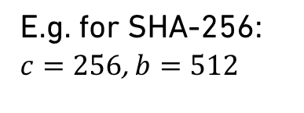

HMAC in Practice Uses Short Keys
HMAC: ${\left\{0,1\right\}}^{∗}×{\left\{0,1\right\}}^{∗}→{\{0,1\}}^{c}$
E.g. for SHA-256:
$c=256$, $b=512$
Pad-or-Hash applied here
TLS 1.3 Key Schedule
PSK
KEM secret
DHE
label₁
0
HMAC
HMAC
HMAC
₁
256
256
Needs 512 bit keys!
label₂
HMAC
₂
$$⋮$$
Notes:
Recall that HMAC (as standardized) allows both key and message inputs of any length.
In practice, if you take HMAC instantiated with SHA-256, then we have c = 256 and b = 512 (the output length c is shorter than b).
Looking back at the TLS example, the derived secrets are 256 bits long, but are used directly as keys to HMAC.
As we know, HMAC internally needs block length keys. 512 bits in this case. This means that PoH will be applied.
In practice, it is not sufficient to have PRF security of HMAC_{b}, as the keys being used are often shorter than block length.
Indeed, HMAC might even be used with different length keys within the same application.

Slide 20
Is HMAC a PRF & Swap-PRF?
??
No!
Notes:
So HMAC is not a swap-PRF, and now its PRF security is also in doubt.
What does this mean in practice? Does this invalidate all prior analyses of protocols that rely on the dual-PRF security of HMAC?

Slide 21






HMAC Is a Variable Key-Length PRF
Y
New definition: vkl-PRF
Adversary controls key length $ℓ$
Adaptive multi-user security
Y || pad($b$ + |Y|)
PoH(X)$⊕$ipad
Y[0]
Y[1]
…
Y[n]
X
IV
h
h
h
…
h
X $←\$$ ${\left\{0,1\right\}}^{∗}$
X $←\$$ ${\left\{0,1\right\}}^{ℓ}$
PoH(X)$⊕$ opad
Z_{i} || pad
IV
h
h
Z
HMAC(X, Y)
Notes:
We provide a new definition of variable key-length (vkl) PRF which takes care of the variable-length keys used in practice.
Example: PRF setting. We had X sampled at random. Mathematicians might have wondered “what does it even mean to sample u.a.r from an infinite set?”. If so, very good question.
In vkl-PRF security, we let the adversary control the key length.
The definition is multi-user. When adversary asks for a new key, it can adaptively specify the length.

Slide 22

HMAC Is a Variable Key-Length PRF
Y
Contributions
PRF setting:
HMAC_{b} PRF $→$ HMAC vkl-PRF
Good multi-user bounds
Standard model assumptions
Y || pad($b$ + |Y|)
PoH(X)$⊕$ipad
Y[0]
Y[1]
…
Y[n]
X
IV
h
h
h
…
h
Assumption | HMAC_{b} PRF [CRYPTO’06:Bel] | HMAC vkl-PRF [Our work]
h is a PRF | ✔️ | ✔️
h is a swap-PRF | ✔️ | ✔️
h is swap-PRF under related-key attacks (rka) | ✔️ | ✔️*
PoH(X)$⊕$ opad
Z_{i} || pad
IV
h
h
Z
HMAC(X, Y)
*broader class of RKD functions (validated assuming ideal block cipher)
Notes:
In the PRF setting, we bridge the gap between HMAC_{b} [space] and HMAC and give a proof that HMAC is a vkl-PRF.
Good multi-user bounds, that is, the bound does not degrade with the number of users. The proof uses only standard model assumptions all the way down to the compression function.
The assumptions are similar to those use in prior proofs for HMAC_{b.}

Slide 23



HMAC Is a Variable Key-Length PRF
Proof steps:
Modularize: HMAC = Comp[NMAC, HSKD]
Prove: Comp[NMAC, HSKD] is a vkl-PRF if
  NMAC is a PRF
  HSKD is variable seed-length (vsl) PRG
Prove a): NMAC is a PRF [C’96:BCK, C’06:Bel, C’14:GPR]
(With good multi-user bounds)
Prove b): HSKD is a vsl-PRG
Y
HMAC Subkey Derivation Function
Y || pad($b$ + |Y|)
PoH(X)$⊕$ipad
Y[0]
Y[1]
…
Y[n]
IV
h
h
h
…
h
X
HSKD
NMAC
Z_{i} || pad
PoH(X)$⊕$ opad
IV
h
h
Z
HSKD
HMAC(X, Y)
Notes:
Let’s take a look at the proof.
As in prior proofs, we start by modularizing HMAC into components. In our case, we split it into NMAC and a function we call HSKD, for “HMAC subkey derivation function”.
We then prove that the composition of NMAC and HSKD is a vkl-PRF given that a) NMAC is a PRF – this follows prior proofs for HMAC -- and b) HSKD is a vsl-PRG, which is a new definition that we introduce. It works just like normal PRG security, except that the adversary is allowed to specify the length of the seed of the generator.
Next, we go on to prove these two conditions.
Prior work has already shown that NMAC is a PRF. Our contribution here is to give a new proof which achieves good multi-user bounds.
Next, we prove that the subkey derivation function is a variable-seed length PRG. Since this is new, let’s look at it in more detail.

Slide 24









HSKD Is a Variable Seed-Length PRG
Proof steps:
Modularize: HMAC = Comp[NMAC, HSKD]
Prove: Comp[NMAC, HSKD] is a vkl-PRF if
  NMAC is a PRF
  HSKD is variable seed-length (vsl) PRG
Prove a): NMAC is a PRF [C’96:BCK, C’06:Bel, C’14:GPR]
(With good multi-user bounds)
Prove b): HSKD is a vsl-PRG
HMAC Subkey Derivation Function
Apply related-key deriving function
PoH(X)$⊕$ipad
ipad
$$c$$
$
IV
h
X_{i}
X
HSKD
X $←\$$ ${\left\{0,1\right\}}^{ℓ}$
X_{i} $\text{}$ X_{o}
Goal:
$$2c$$
PoH(X)$⊕$ opad
$
Assumption | HMAC vkl-PRF
h is a PRF | ✔️
h is a swap-PRF | ✔️
h is swap-PRF under related-key attacks (rka) | ✔️*
opad
opad
$$c$$
$
3. NMAC
IV
h
X_{o}
E
HSKD
4. HSKD
$$⊕$$
$$c$$
If E is rka-PRP secure
IV
h
$
Validated assuming E is an ideal cipher
Notes:
The output of HSKD is defined as the concatenation of the inner layer output X_{i} and the outer layer X_{o}.
Recall that we are in the PRF setting, so X is u.r. The goal for vsl-PRG security is to show that the output is indistinguishable from a u.r. string of the same length.
To do this, we will reduce to the swap-PRF security of h under rka. Swap, because the secret key material is coming in from the top, which is the message input of h. Rka because the key is pad-or-hashed and then XORed with ipad or opad. Simplified, you can think of the proof as first applying a RKD function to replace the functions on X with two related keys, K_{ipad} and K_{opad.} Then, assuming that h is a swap-PRF in this setting, the outputs will be indistinguishable from random, and so we have arrived at the goal.
Is this a reasonable assumption on h? Inside, h is a DM construction, so there is a block cipher turned around on its side. Surprisingly, being in the swap setting actually helps us here, because the key is now coming in to the usual key input of the BC. So we can directly reduce the rka-swap-PRF security of h to the PRP security of E under rka. We validate this assumption in the ICM.

Slide 25

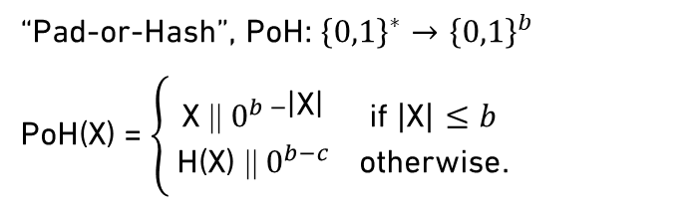



HMAC Is a Variable Key-Length Swap-PRF
Y
Contributions
Swap-PRF setting:
In general ❌
“Feasible” input sets ✅
  Security iff inputs are in $S_{s}$ or $S_{l}$
collisions
Y || pad($b$ + |Y|)
PoH(X)$⊕$ipad
Y[0]
Y[1]
…
Y[n]
Assumption | HMAC vkl-PRF | HMAC vkl- swap-PRF
h is a PRF | ✔️ | ✔️
h is a swap-PRF | ✔️
h is swap-PRF under related-key attacks | ✔️* | ✔️*
h is collision resistant |  | ✔️
Messages inputs are in feasible sets |  | ✔️
X
IV
h
h
h
…
h
PoH(X)$⊕$ opad
Z_{i} || pad
IV
h
h
Z
HMAC(X, Y)
Holds for protocols
“Pad-or-Hash”, PoH: ${\left\{0,1\right\}}^{∗}→{\left\{0,1\right\}}^{b}$
PoH(X) = $\left\{\begin{aligned}\text{X}\text{ ||}{ 0}^{b −\text{|}\text{X}\text{|}} \text{if} \left|\text{X}\right|≤b \\ \text{H}\text{(}\text{X}\text{) ||}{ 0}^{b−c} \text{otherwise}\text{.}\end{aligned}\right.$
Only fixed length “short” inputs: $S_{s}$
X “short”: zero-pad
or
Cover practical use!
X “long”: hash, then zero-pad
Only “long” inputs: $S_{l}$
Notes:
In the swap-PRF setting, we already know from the attack we saw earlier that we cannot get security for all input sets because of collisions due to PoH.
In our paper, we characterize the input spaces for which we can get swap-PRF security. We call these input sets “feasible”.
There are two classes. The first is the class of fixed length strings shorter than block length. The second is the class of all strings longer than block length.
We give proofs and attacks to show that HMAC is a vkl swap-PRF if and only if the inputs are restricted to one of the two classes.
Luckily for the proofs that assume the dual-PRF security of HMAC, protocols in practice have inputs which are in the first of these classes. So the feasible sets cover the practical usage of HMAC, meaning that when we need it, we do have swap-PRF security.
The assumptions that we need to prove this are again that h is a PRF, as well as a swap-PRF under rka. Additionally, we need that h is CR and that message inputs are in the feasible sets, to avoid attacks from collisions.

Slide 26

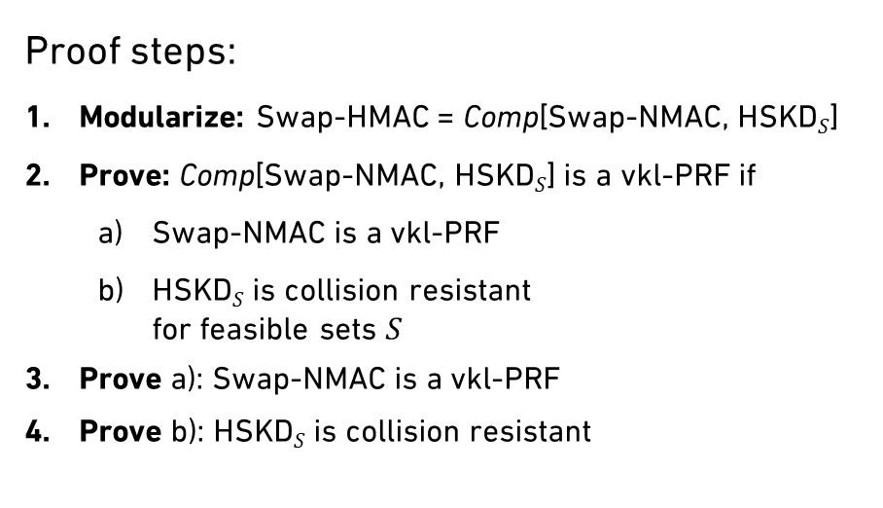




HMAC Is a Variable Key-Length Swap-PRF
Proof steps:
Modularize: Swap-HMAC = Comp[Swap-NMAC, HSKD$S$]
Prove: Comp[Swap-NMAC, HSKD$S$] is a vkl-PRF if
  Swap-NMAC is a vkl-PRF
  HSKD$S$ is collision resistant
  for feasible sets $S$
Prove a): Swap-NMAC is a vkl-PRF
Prove b): HSKD$S$ is collision resistant
Y
Y || pad($b$ + |Y|)
PoH(X)$⊕$ipad
Y[0]
Y[1]
…
Y[n]
IV
h
h
h
…
h
X
HSKD$S$
Swap-NMAC
PoH(X)$⊕$ opad
Z_{i} || pad
IV
h
h
Z
HSKD$S$
HMAC(X, Y)
Notes:
Let’s take a look at the proof.
Again, we start by modularizing HMAC into components. In this case, into swap-NMAC and HSKD_{S}, restricted to inputs in set S.
We then prove that the composition of swap-NMAC and HSKD is a vkl-PRF given that a) swap-NMAC is a b) HSKD_{S} is CR. As previous, we then prove these two conditions.
This time, since we already talked about why HSKD needs to be collision resistant, I’ll focus on the vkl-PRF security of NMAC.

Slide 27



Swap-NMAC is a vkl-PRF
Proof steps:
Modularize: Swap-HMAC = Comp[Swap-NMAC, HSKD$S$]
Prove: Comp[Swap-NMAC, HSKD$S$] is a vkl-PRF if
  Swap-NMAC is a vkl-PRF
  HSKD$S$ is collision resistant
  for feasible sets $S$
Prove a): Swap-NMAC is a vkl-PRF
Prove b): HSKD$S$ is collision resistant
Y
Y $←\$$ ${\left\{0,1\right\}}^{ℓ}$
Related-key assumption for padding
Y || pad($b$ + |Y|)
Y[0]
Y[1]
…
Y[n]
Y[0]
rka-
swap-PRF
PRF
PRF
$$c$$
…
$$c$$
X_{i}
h
$
h
h
$
Swap-NMAC
$$c$$
$
Z_{i} || pad
Y[0]
rka-
swap-PRF
X_{o}
h
Z
Goal:
$$c$$
$
Notes:
Here, since we are in the swap setting, Y is the secret key. In order to show that swap-NMAC is a vkl-PRF, we need to show that the output is indistinguishable from random when X_{i} and X_{o} are controlled by the adversary. To do this, we apply rka-swap-PRF security of h at its first invocation. Again, swap because the key material comes in from the top, and this time RKA takes care of the padding that is potentially applied to Y. With this assumption, we can replace the output by random, which means that we now have a uniformly random input into the key input of the second invocation. So we can apply PRF security throughout the cascade. Then, assuming again that h is a swap-PRF under RKA, where RKA takes care of the padding, we arrive at our goal.

Slide 28
Is
HMAC
a Dual-PRF
?
Notes:
Now we can finally give an answer to our original question “Is HMAC a dual-PRF?”
The long answer is: it’s complicated.
But for practical matters, HMAC is a dual PRF.

Slide 29

Thank you!
Get in touch: mbackendal@inf.ethz.ch
HMAC
Is
a Dual-PRF
*
*variable key-length PRF for feasible inputs
**details in the paper
eprint: 2023/861
Notes:
As long as you accept the terms and conditions, which are that “PRF” now means vkl-PRF and that the inputs must be restricted to the feasible sets.

