Slide 1
Expand-Convolute Codes
for Pseudorandom Correlation Generators from LPN
Titouan Tanguy
Peter Rindal
Srinivasan Raghuraman

Slide 2

Oblivious Transfer
[Rab81, EGL82]
Sender
Receiver
$$m_{0},m_{1}∈𝔽$$
$OT$
$$c$$
$$∈\{0,1\}$$
$$m_{c}$$

Slide 3

Oblivious Transfer
[Rab81, EGL82]
Sender
Receiver
$m_{0},m_{1}∈𝔽$
$rOT$
$$c$$
$$∈\{0,1\}$$
$$m_{c}$$
$$,$$

Slide 4
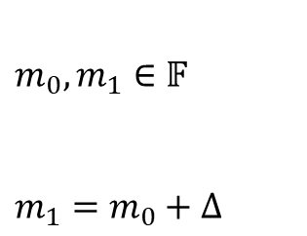
Oblivious Transfer
[Rab81, EGL82]
Sender
Receiver
$$rOT$$
$m_{0},m_{1}∈𝔽$
$m_{1}=m_{0}+Δ$
$$c$$
$$m_{c}=m_{0}+c Δ$$
$$,$$

Slide 5

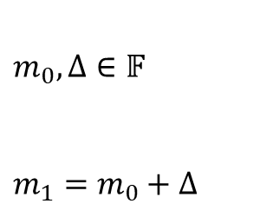
Oblivious Transfer Linear Evaluation (OLE)
Sender
Receiver
$$OLE$$
$m_{0},Δ∈𝔽$
$m_{1}=m_{0}+Δ$
$$c$$
$$m_{c}=m_{0}+c Δ$$
$$,$$

Slide 6
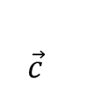
Vector Oblivious Linear Evaluation (VOLE)
Sender
Receiver
$$VOLE$$
$$\vec{m_{0}},Δ$$
$$\vec{c}$$
$$\vec{m_{c}}=\vec{m_{0}}+\vec{c}Δ$$
$$,$$

Slide 7
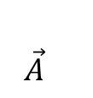
VOLE & OT
Sender
Receiver
$$VOLE$$
$$,$$
$$\vec{A}$$
$$B$$
$$Δ$$
$$,$$
$$A$$
$$C$$
$$C$$
$$−$$
$$B$$
$$=$$
$$Δ$$
$$A$$
Batched Oblivious Transfer:
Binary $\vec{A}$ vector
Hash output
Vector OLE:
Field $\vec{A}$ vector

Slide 8
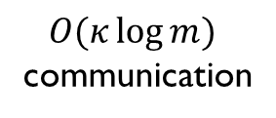
Silent VOLE & OT
Sender
Receiver
$$sVOLE$$
$O(κ\log{m})$ communication
$$k_{0}$$
$$k_{1}$$
$$sVOLE$$
Non-interactive
Expand
Expand
$$\vec{B},Δ$$
$$\vec{A}$$
$$\vec{C}=\vec{B}+\vec{A}Δ$$
$$,$$
$$C$$
$$−$$
$$B$$
$$=$$
$$Δ$$
$$A$$

Slide 9
Silent Vole & OT
Sender
$$PPRF \\ Gen$$
Receiver
$$k_{0}$$
$$k_{1}$$
PPRF
PPRF
$$Δ$$
,
,
$$B^{′}$$
$$A′$$
$$C^{′}$$
$$C^{′}$$
$$−$$
$$B^{′}$$
$$=$$
$$Δ$$
$$A′$$

Slide 10
Silent Vole & OT
Sender
$$PPRF \\ Gen$$
Receiver
$$k_{0}$$
$$k_{1}$$
PPRF
$$\vec{C′}−\vec{B^{′}}=Δ \vec{A′}$$
PPRF
$$Δ$$
,
,
$$B^{′}$$
$$A′$$
$$C^{′}$$
LPN
LPN
$$G$$
$$=$$
$$B$$
$$G$$
$$=$$
$$G$$
$$=$$
$$A$$
$$C$$
$$B^{′}$$
$$A′$$
$$C^{′}$$

Slide 11
Silent Vole & OT
Sender
$$PPRF \\ Gen$$
Receiver
$$k_{0}$$
$$k_{1}$$
PPRF
$$\vec{C′}−\vec{B^{′}}=Δ \vec{A′}$$
PPRF
$$Δ$$
,
,
$$B^{′}$$
$$A′$$
$$C^{′}$$
LPN
LPN
$Δ$ ,
$$B$$
$$A$$
$$C$$
$$C$$
$$−$$
$$B$$
$$=$$
$$Δ$$
$$A$$

Slide 12
Silent Vole & OT
Want to generate millions of OT/VOLEs
Very large LPN instances.
Classic LPN $→$ uniform $G$
$O\left(n^{2}\right)=2^{45}$ time!
Structured LPN,
Allow $G$ to have special structure
Sender
$$PPRF \\ Gen$$
Receiver
$$2^{23}$$
$$k_{0}$$
$$k_{1}$$
$$G$$
$$=$$
$$2^{22}$$
$$B$$
PPRF
$$\vec{C′}−\vec{B^{′}}=Δ \vec{A′}$$
PPRF
$$B^{′}$$
$$Δ$$
,
,
$$B^{′}$$
$$A′$$
$$C^{′}$$
LPN
LPN
$$Δ$$
,
,
$$B$$
$$A$$
$$C$$

Slide 13
Duel-LPN (AKA Syndrome Decoding)
$$n$$
$$m$$
$$G$$
$$=$$
$$r$$
$$e$$
Weight-$t$ sparse $e∈𝔽_{2}^{m}$
Security:
$$\left(G, r\right)≈(G, \$)$$

Slide 14
Linear Test Framework
Linear Test
$$n$$
$$m$$
$$G$$
$$=$$
$$r$$
$$e$$
, output $b=$
$$𝒜\left(G\right)→$$
$$v$$
$$r$$
$$v$$
$$⋅$$
Numerous attacks:
Gaussian Eliminations [BKW00, Lyu05, LF06, EKM17]
Cover Sets [ZJW16, BV16, BTV16, GJL20]
Information set decoding attacks [Pra62, Ste88, FS09, BLP11, MMT11, BJMM12,MO15, EKM17, BM18]
Statistical decoding attacks [AJ01, FKI06, Ove06, DAT17]
Generalized birthday attacks [Wag02, Kir11],
Linearization attacks [BM97, Saa07],
Low weight code [Zic17],
…

Slide 15
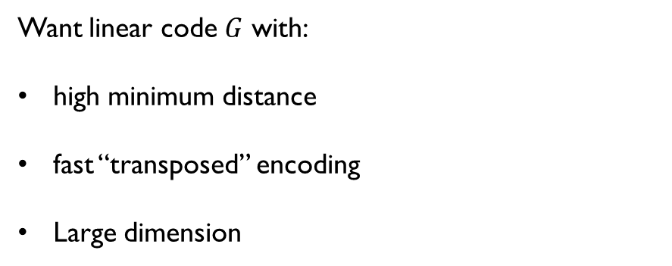
Linear Test Framework
Linear Test
$$n$$
$$m$$
$$G$$
$$=$$
$$r$$
$$e$$
, output $b=$
$$𝒜\left(G\right)→$$
$$v$$
$$r$$
$$v$$
$$⋅$$
High minimum distance $⇒$Provably prevents linear attacks
Want linear code $G$ with:
high minimum distance
fast “transposed” encoding
Large dimension
$$G$$
$$B$$
$$=$$
$$B^{′}$$

Slide 16
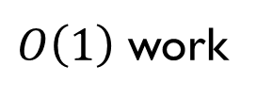

Efficient Linear Code Receipt
High minimum distance $→$ $G$ is dense
Lower bounded $HW(G_{i})$
$HW\left(G\right)=O\left(n^{2}\right)$
“Linear time” encoding
Decompose $G$ $G=M_{1}⋅M_{2}⋅ … ⋅M_{O\left(n\right)}$
$$x$$
$$=$$
$$y$$
$$G$$
$O\left(1\right)$ work

Slide 17
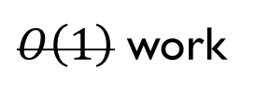
Efficient Linear Code Receipt
High minimum distance $→$ $G$ is dense
Lower bounded $HW(G_{i})$
$HW\left(G\right)=O\left(n^{2}\right)$
“Linear time” encoding
Decompose $G$ $G=M_{1}⋅M_{2}⋅ … ⋅M_{O\left(n\right)}$
$$x$$
$$=$$
$$y$$
$$G$$
$O\left(1\right)$ work
$$O\left(log n\right)$$

Slide 18
Convolutions
$$x$$
$${∈𝔽}^{n}$$
Input:
Output:
$y_{i}$ is a linear function of the region around $x_{i}$
Convolutions have a “memory”
$x$ was the output of $M_{i−1}$
$$M_{i}$$
$$y_{i}$$
$$y$$
$${∈𝔽}^{n}$$

Slide 19
Convolutions
$$x$$
$${∈𝔽}^{n}$$
Input:
Output:
$y_{i}$ is a linear function of the region around $x_{i}$
Convolutions have a “memory”
$x$ was the output of $M_{i−1}$
$$M_{i+1}$$
$$y_{i}$$
$$y_{i+1}$$
$$y$$
$${∈𝔽}^{n}$$

Slide 20
Convolutions
$$y_{i}$$
$$x$$
$${∈𝔽}^{n}$$
Input:
Output:
$y_{i}$ is a linear function of the region around $x_{i}$
Convolutions have a “memory”
$x$ was the output of $M_{i−1}$
$$M_{i+2}$$
$$y_{i+1}$$
$$y_{i+2}$$
$$y$$
$${∈𝔽}^{n}$$

Slide 21
Convolutions
$$x_{i}$$
$$x$$
$${∈𝔽}^{n}$$
In/Out:
$M_{i}$ update:
$x_{i}+=$ $L_{i}\left(x_{i−s},…, x_{i−1}\right)$
$$M_{i}$$

Slide 22

Convolutions
$$x_{i}$$
$$x$$
$${∈𝔽}^{n}$$
In/Out:
$M_{i}$ update:
$x_{i}+=$ $L_{i}\left(x_{i−s},…, x_{i−1}\right)$
Example: In: 00010100000000000 Out: 00010011010111010
Once non-zero, a convolution tends to stay non-zero
$G$ is upper triangular
$$G=M_{1}⋅M_{2}⋅ … ⋅M_{n}$$
$$1$$
$$1$$
$$1$$
$$1$$
$$1$$
$$1$$
$$1$$
$$1$$
$$1$$
$$1$$
$$1$$
$$1$$
$$1$$
$$1$$
$$1$$
$$1$$
$$1$$
$$1$$
$$1$$
$$1$$
$$1$$
$$1$$
$$1$$
$$1$$
$$1$$
$$1$$
$$1$$
$$1$$
$$1$$
$$1$$
$$1$$
$$1$$
$$1$$
$$1$$
$$1$$
$$1$$
$$1$$
$$1$$
$$1$$
$$1$$
$$1$$
$$1$$
$$1$$
$$1$$
$$1$$
$$1$$
$$1$$
$$1$$
$$1$$
$$0$$
$$1$$
$$1$$
$$1$$
$$1$$
$$1$$
$$1$$
$$1$$
$$1$$
$$1$$
$$1$$
$$1$$
$$1$$
$$1$$

Slide 23
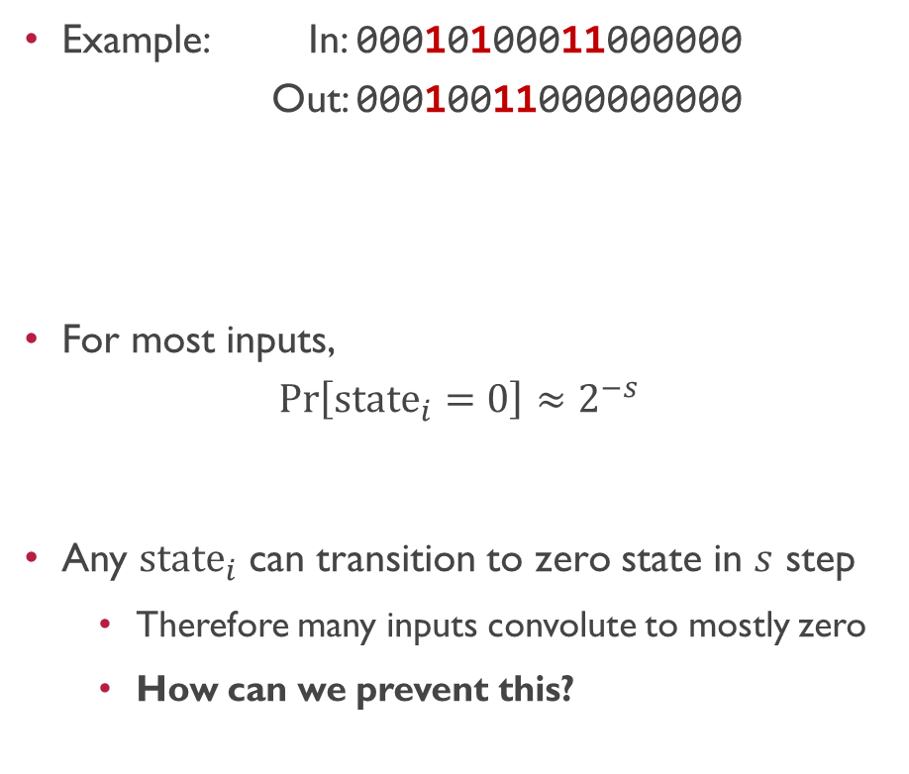
Convolution Properties
$$G=M_{1}⋅M_{2}⋅ … ⋅M_{n}$$
Example: In: 00010100011000000 Out: 00010011000000000
For most inputs, $\operatorname{Pr}\left[state_{i}=0\right]≈2^{−s}$
Any $state_{i}$ can transition to zero state in $s$ step
Therefore many inputs convolute to mostly zero
How can we prevent this?
$$1$$
$$1$$
$$1$$
$$1$$
$$1$$
$$1$$
$$1$$
$$1$$
$$1$$
$$1$$
$$1$$
$$1$$
$$1$$
$$1$$
$$1$$
$$1$$
$$1$$
$$1$$
$$1$$
$$1$$
$$1$$
$$1$$
$$1$$
$$1$$
$$1$$
$$1$$
$$1$$
$$1$$
$$1$$
$$state_{i}$$
$$1$$
$$1$$
$$1$$
$$1$$
$$1$$
$$1$$
$$1$$
$$1$$
$$1$$
$$1$$
$$1$$
$$1$$
$$1$$
$$1$$
$$1$$
$$1$$
$$1$$
$$1$$
$$1$$
$$1$$
$$0$$
$$1$$
$$1$$
$$1$$
$$1$$
$$1$$
$$1$$
$$1$$
$$1$$
$$1$$
$$1$$
$$1$$
$$1$$
$$1$$

Slide 24
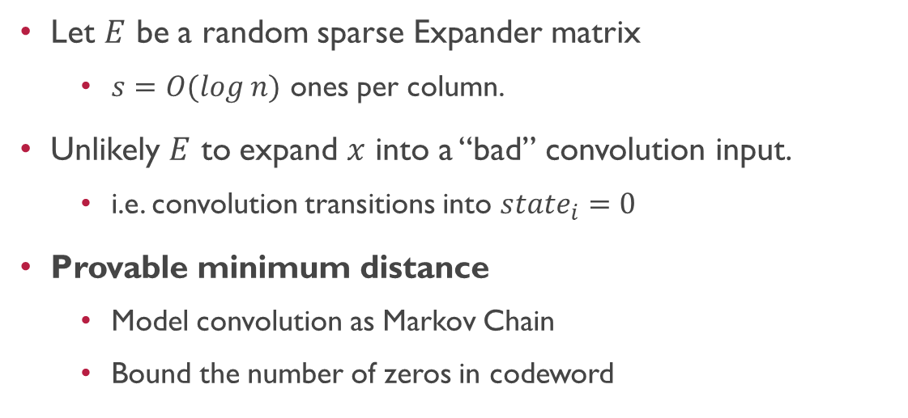
Expand Convolution Codes
$$G=E⋅M_{1}⋅M_{2}⋅ … ⋅M_{n}$$
$$xG=$$
$$x$$
$$1$$
$$1$$
$$1$$
$$1$$
$$1$$
$$1$$
$$1$$
$$1$$
$$1$$
$$1$$
$$1$$
$$1$$
$$1$$
$$1$$
$$1$$
$$1$$
$$1$$
$$1$$
$$1$$
$$1$$
$$1$$
$$1$$
$$1$$
$$1$$
$$1$$
$$1$$
$$1$$
$$1$$
$$1$$
$$1$$
$$1$$
$$1$$
$$1$$
$$1$$
$$1$$
$$1$$
$$1$$
$$1$$
$$1$$
$$1$$
$$1$$
$$1$$
$$1$$
$$1$$
$$1$$
$$1$$
$$1$$
$$1$$
$$1$$
$$1$$
$$1$$
$$1$$
$$1$$
$$1$$
$$1$$
$$1$$
$$1$$
$$1$$
$$1$$
$$1$$
$$1$$
$$1$$
$$1$$
$$1$$
$$1$$
$$1$$
$$1$$
$$0$$
$$1$$
$$1$$
$$1$$
$$1$$
$$1$$
Let $E$ be a random sparse Expander matrix
$s=O(log n)$ ones per column.
Unlikely $E$ to expand $x$ into a “bad” convolution input.
i.e. convolution transitions into $state_{i}=0$
Provable minimum distance
Model convolution as Markov Chain
Bound the number of zeros in codeword
$$1$$
$$1$$
$$1$$
$$1$$
$$1$$
$$1$$
$$1$$
$$1$$

Slide 25
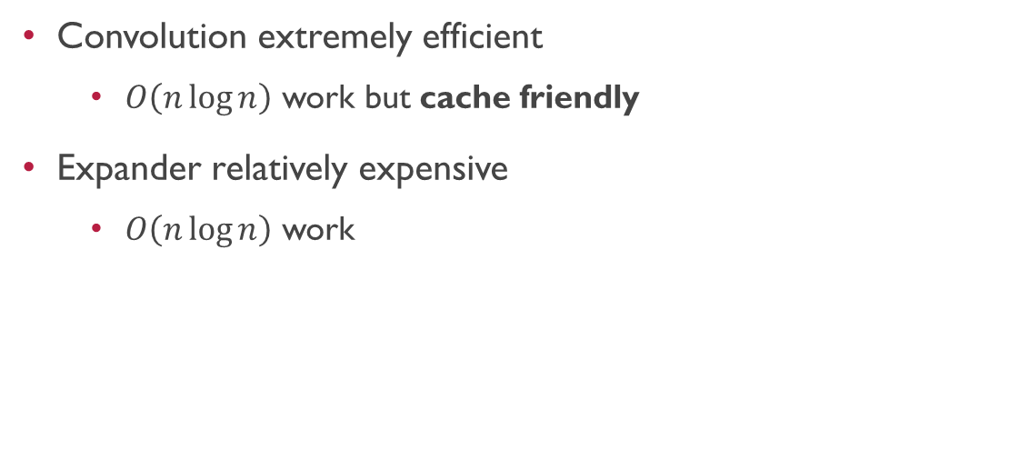
Expand Convolution Codes
$$G=E⋅M_{1}⋅M_{2}⋅ … ⋅M_{n}$$
$$xG=$$
$$x$$
$$1$$
$$1$$
$$1$$
$$1$$
$$1$$
$$1$$
$$1$$
$$1$$
$$1$$
$$1$$
$$1$$
$$1$$
$$1$$
$$1$$
$$1$$
$$1$$
$$1$$
$$1$$
$$1$$
$$1$$
$$1$$
$$1$$
$$1$$
$$1$$
$$1$$
$$1$$
$$1$$
$$1$$
$$1$$
$$1$$
$$1$$
$$1$$
$$1$$
$$1$$
$$1$$
$$1$$
$$1$$
$$1$$
$$1$$
$$1$$
$$1$$
$$1$$
$$1$$
$$1$$
$$1$$
$$1$$
$$1$$
$$1$$
$$1$$
$$1$$
$$1$$
$$1$$
$$1$$
$$1$$
$$1$$
$$1$$
$$1$$
$$1$$
$$1$$
$$1$$
$$1$$
$$1$$
$$1$$
$$1$$
$$1$$
$$1$$
$$1$$
$$0$$
$$1$$
$$1$$
$$1$$
$$1$$
$$1$$
Convolution extremely efficient
$O\left(n\log{n}\right)$ work but cache friendly
Expander relatively expensive
$O\left(n\log{n}\right)$ work
$$1$$
$$1$$
$$1$$
$$1$$
$$1$$
$$1$$
$$1$$
$$1$$

Slide 26
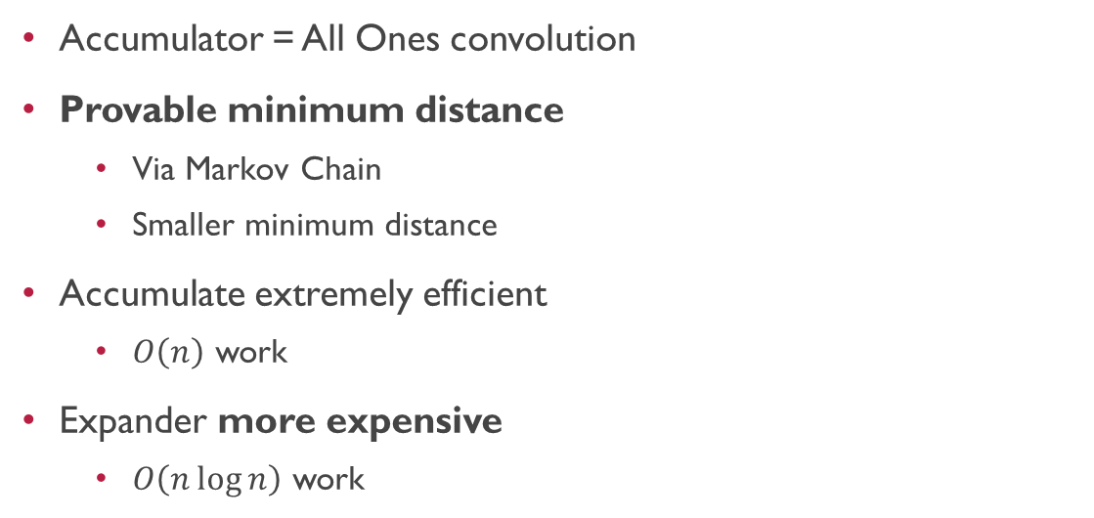
Prior work: Expand Accumulate Codes
$$G=E⋅M_{1}⋅M_{2}⋅ … ⋅M_{n}$$
$$xG=$$
$$x$$
$$1$$
$$1$$
$$1$$
$$1$$
$$1$$
$$1$$
$$1$$
$$1$$
$$1$$
$$1$$
$$1$$
$$1$$
$$1$$
$$1$$
$$1$$
$$1$$
$$1$$
$$1$$
$$1$$
$$1$$
$$1$$
$$1$$
$$1$$
$$1$$
$$1$$
$$1$$
$$1$$
$$1$$
$$1$$
$$1$$
$$1$$
$$1$$
$$1$$
$$1$$
$$1$$
$$1$$
$$1$$
$$1$$
$$1$$
$$1$$
$$1$$
$$1$$
$$1$$
$$1$$
$$1$$
$$1$$
$$1$$
$$1$$
$$1$$
$$1$$
$$1$$
$$1$$
$$1$$
$$1$$
$$1$$
$$1$$
$$1$$
$$1$$
$$1$$
$$1$$
$$1$$
$$1$$
$$1$$
$$1$$
$$1$$
$$1$$
$$1$$
$$1$$
$$1$$
$$1$$
$$1$$
$$1$$
$$1$$
$$1$$
$$1$$
$$1$$
$$1$$
$$1$$
$$1$$
$$1$$
$$1$$
$$1$$
$$1$$
$$1$$
$$1$$
$$1$$
$$1$$
$$1$$
$$1$$
$$1$$
$$1$$
$$1$$
$$1$$
$$1$$
$$1$$
$$1$$
$$1$$
$$1$$
$$1$$
$$1$$
$$1$$
$$1$$
$$1$$
$$1$$
$$1$$
$$1$$
$$0$$
$$1$$
$$1$$
$$1$$
$$1$$
$$1$$
$$1$$
$$1$$
$$1$$
$$1$$
Accumulator = All Ones convolution
Provable minimum distance
Via Markov Chain
Smaller minimum distance
Accumulate extremely efficient
$O\left(n\right)$ work
Expander more expensive
$O\left(n\log{n}\right)$ work
$$1$$
$$1$$
$$1$$
$$1$$
$$1$$
$$1$$
$$1$$
$$1$$
Conjectured “aggressive” parameters:
We show they are “too aggressive”
New upper bounds on minimum distance

Slide 27
Prior work: Silver Codes
$$G=E⋅M_{1}⋅M_{2}⋅ … ⋅M_{n}$$
$$xG=$$
$$x$$
$$1$$
$$1$$
$$1$$
$$1$$
$$1$$
$$1$$
$$1$$
$$1$$
$$1$$
$$1$$
$$1$$
$$1$$
$$1$$
$$1$$
$$1$$
$$1$$
$$1$$
$$1$$
$$1$$
$$1$$
$$1$$
$$1$$
$$1$$
$$1$$
$$1$$
$$1$$
$$1$$
$$1$$
$$1$$
$$1$$
$$1$$
$$1$$
$$1$$
$$1$$
$$1$$
$$1$$
$$1$$
$$1$$
$$1$$
$$1$$
$$1$$
$$1$$
$$1$$
$$1$$
$$1$$
$$1$$
$$1$$
$$1$$
$$1$$
$$1$$
$$1$$
$$1$$
$$1$$
$$1$$
$$1$$
$$1$$
$$1$$
$$1$$
$$1$$
$$1$$
$$1$$
$$1$$
$$1$$
$$1$$
$$1$$
$$1$$
$$1$$
$$1$$
$$1$$
$$1$$
$$0$$
$$1$$
$$1$$
$$1$$
$$1$$
$$1$$
Conjectured minimum distance
Experimentally evaluated
Disproven by us
Too cache friendly
Linear minimum distance $⇒$ non-cache friendly
$$1$$
$$1$$
$$1$$
$$1$$
$$1$$
$$1$$
$$1$$
$$1$$

Slide 28
Minimum Distance
Orders of magnitude better minimum distance
EA = Expand Accumulate
EC = Expand Convolute
Improved code rate
EC with rate 0.5
EA with rate 0.2
$n=2^{20}$
$$n=2^{20}$$

Slide 29
Running Time
Several time faster
EA = Expand Accumulate
EC = Expand Convolute
For comparable distance
EA: 740ms
EC: 190ms
4x faster
$$n=2^{20}$$

Slide 30
Expand-Convolute Codes
for Pseudorandom Correlation Generators from LPN
Eprint: 2023/882
Questions?
Titouan Tanguy
Peter Rindal
Srinivasan Raghuraman

