Slide 1
A Note on Non-Interactive Zero-Knowledge from CDH
Geoffroy Couteau
Abhishek Jain
Zhengzhong Jin
Willy Quach
Université Paris-Cité
John Hopkins University
MIT
Northeastern University
CNRS, IRIF
Weizmann
CRYPTO 2023

Slide 2
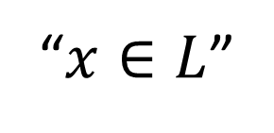
Non-Interactive Zero-Knowledge (NIZK)
NP language $L$
Witness
Statement
$$x,w$$
$$x$$
Prover
Verifier
“$x∈L$”

Slide 3
Non-Interactive Zero-Knowledge (NIZK)
NP language $L$
Witness
Statement
$$x,w$$
$$x$$
Prover
Verifier
$$π$$
accept/reject

Slide 4
Non-Interactive Zero-Knowledge (NIZK)
NP language $L$
Witness
Statement
Completeness: verifier accepts if $x∈L$
$$x,w$$
$$x$$
Prover
Verifier
$$π$$
accept

Slide 5
Non-Interactive Zero-Knowledge (NIZK)
NP language $L$
Statement
Completeness: verifier accepts if $x∈L$
$$x$$
$$x$$
Computational Soundness: if $x∉L$,
No efficient prover can make verifier accept
Prover
Verifier
$$π$$
reject

Slide 6
Non-Interactive Zero-Knowledge (NIZK)
NP language $L$
Witness
Statement
Completeness: verifier accepts if $x∈L$
$$crs$$
$$x$$
$$x,w$$
Computational Soundness: if $x∉L$,
No efficient prover can make verifier accept
Prover
Verifier
$$π$$
Computational Zero-Knowledge: if $x∈L$,
Efficient verifiers don’t learn anything else

Slide 7
Non-Interactive Zero-Knowledge (NIZK)
NP language $L$
Witness
Statement
Completeness: verifier accepts if $x∈L$
$$crs$$
$$x$$
$$x,w$$
Computational Soundness: if $x∉L$,
No efficient prover can make verifier accept
Prover
Verifier
$$π$$
Computational Zero-Knowledge: if $x∈L$,
Efficient verifiers don’t learn anything else
accept/reject
Main question:
How to build NIZKs, and under what assumptions?

Slide 8
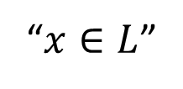
Prior Work on Building NIZKs
Witness
NP language $L$
Statement
Main question:
How to build NIZKs,
and under what assumptions?
$$x,w$$
$$crs$$
$$x$$
Prover
Verifier
“$x∈L$”
Public-Key Assumptions
Random Oracles
(heuristic)
Factoring and friends [Blum-Feldman-Micali88…]
Pairings [Canetti-Halevi-Katz03,Groth-Ostrovsky-Sahai06…]
Learning with Errors (LWE) […Peikert-Shiehian19]
Decisional Diffie-Hellman (DDH) [Jain-Jin21]
Indistinguishability
Obfuscation
(+ one-way funct.)
[Fiat-Shamir86]
Open questions:
[Sahai-Waters13]
Generic Public-Key Encryption?
Computational Diffie-Hellman (CDH)
Learning Parity with Noise (LPN)

Slide 9
Our Main Result
Theorem (informal): Assuming the sub-exp. hardness of CDH*,
NIZKs for all $NP$
there exist
with weak soundness
ZAP arguments
ZAP: two-message, public-coin-verifier,
witness-indistinguishable argument
*With restrictions on $G$ (e.g. $⊆ℤ_{q}^{∗}$)

Slide 10
Our Main Result
Theorem (informal): Assuming the sub-exp. hardness of CDH*,
NIZKs for all $NP$
there exist
with weak soundness
ZAP arguments
infinitely-often (“sub-exp. often”)
Caveats: soundness only holds
against uniform cheating provers
More details:
Common random string (a.k.a. uniform random string URS)
Soundness: computational, adaptive
Zero-knowledge: computational, adaptive, multi-theorem
ZAP: two-message, public-coin-verifier,
witness-indistinguishable argument
*With restrictions on $G$ (e.g. $⊆ℤ_{q}^{∗}$)

Slide 11
Diffie-Hellman Assumptions
$G$ cyclic group of prime order $p$ generated by $g∈G$
Computational Diffie-Hellman (CDH)
Decisional Diffie-Hellman (DDH)
Lossy trapdoor functions
Additively homomorphic encryption
2-round single server PIR
Somewhere-stat. binding hash functions
…
Given $g^{a}, g^{b}$ for random $a,b$
Hard to compute $g^{ab}$
Given $g^{a}, g^{b}$ for random $a,b$
$g^{ab}≈_{c}$ uniform
“Less structured hardness”
“More structured hardness”
?

Slide 12
Prior Work on NIZKs + DH assumptions
$G$ cyclic group of prime order $p$ generated by $g∈G$
Computational Diffie-Hellman (CDH)
Decisional Diffie-Hellman (DDH)
Given $g^{a}, g^{b}$ for random $a,b$
Hard to compute $g^{ab}$
Given $g^{a}, g^{b}$ for random $a,b$
$g^{ab}≈_{c}$ uniform
NIZKs from sub-exp. hardness of DDH*
[Jain-Jin21]
*With restrictions on $G$ (e.g. $⊆ℤ_{q}^{∗}$)

Slide 13
Prior Work on NIZKs + DH assumptions
$G$ cyclic group of prime order $p$ generated by $g∈G$
Computational Diffie-Hellman (CDH)
Decisional Diffie-Hellman (DDH)
Designated-Verifier NIZKs from CDH [Couteau-Hofheinz19, Q-Rothblum-Wichs19,
Katsumata-Nisimaki-Yamada-Yamakawa19]
Given $g^{a}, g^{b}$ for random $a,b$
Hard to compute $g^{ab}$
Given $g^{a}, g^{b}$ for random $a,b$
$g^{ab}≈_{c}$ uniform
Blueprint:
Reduces to CDH + prove/decide DH tuples $(g^{a},g^{b},g^{ab})$
// keyword: hidden-bits model
Hash-proof systems [Cramer-Shoup02] $⇒$ DV-NIZK for DH tuples
Prover proves to verifier validity of DH tuple using DV-NIZK $⇒$ DV-NIZK from CDH
(Symmetric) Pairings: decide DH tuples over source group
Verifier verifies himself DH tuple using pairing $⇒$ NIZK from CDH over source group with pairing [Canetti-Halevi-Katz03]
DV-NIZK: Verifier is given a reusable but secret verification key from a trusted setup

Slide 14
Prior Work on NIZKs + DH assumptions
$G$ cyclic group of prime order $p$ generated by $g∈G$
Computational Diffie-Hellman (CDH)
Designated-Verifier NIZKs from CDH [Couteau-Hofheinz19, Q-Rothblum-Wichs19,
Katsumata-Nisimaki-Yamada-Yamakawa19]
Given $g^{a}, g^{b}$ for random $a,b$
Hard to compute $g^{ab}$
Blueprint:
Reduces to CDH + prove/decide DH tuples $(g^{a},g^{b},g^{ab})$
// keyword: hidden-bits model
Hash-proof systems [Cramer-Shoup02] $⇒$ DV-NIZK for DH tuples
Prover proves to verifier validity of DH tuple using DV-NIZK $⇒$ DV-NIZK from CDH
Pairings: decide DH tuples over source group
Verifier verifies himself DH tuple using pairing $⇒$ NIZK from CDH over source group with pairing [Canetti-Halevi-Katz03]
DDH broken $⇒$ NIZK from CDH!
DV-NIZK: Verifier is given a reusable but secret verification key from a trusted setup

Slide 15
A Disjunction Argument
$G$ cyclic group* of prime order $p$ generated by $g∈G$
such that CDH holds over $G$
DDH broken $⇒$ NIZK from CDH!
OR
DDH secure* $⇒$ NIZK (from DDH!)
Conclusion: NIZK from CDH*?
NO: “broken” $≠$ “not secure”
*With restrictions on $G$ (e.g. $⊆ℤ_{q}^{∗}$)

Slide 16
Mismatches Broken $↔$ Not Secure
DDH broken $⇒$ NIZK from CDH!
DDH not secure (no NIZK from DDH)
Need break with very high success rate
Break with sub-exp. small advantage

Slide 17
Mismatches Broken $↔$ Not Secure
DDH broken $⇒$ NIZK from CDH!
DDH not secure (no NIZK from DDH)
Need break with very high success rate
Break with sub-exp. small advantage
Need break on arbitrary inputs $(g^{a},g^{b}, g^{c})$
Break on random inputs $(g^{a},g^{b}, g^{c})$

Slide 18
Mismatches Broken $↔$ Not Secure
DDH broken $⇒$ NIZK from CDH!
DDH not secure (no NIZK from DDH)
Need break with very high success rate
Break with sub-exp. small advantage
Need break on arbitrary inputs $(g^{a},g^{b}, g^{c})$
Break on random inputs $(g^{a},g^{b}, g^{c})$
Honest verifier runs the break
Break is non-uniform, non-explicit

Slide 19
Mismatches Broken $↔$ Not Secure
DDH broken $⇒$ NIZK from CDH!
DDH not secure (no NIZK from DDH)
Fix:
Amplification
(sub-exp.)
via
Random
Self-reducibility
Need break with very high success rate
Break with sub-exp. small advantage
Need break on arbitrary inputs $(g^{a},g^{b}, g^{c})$
Break on random inputs $(g^{a},g^{b}, g^{c})$
Honest verifier runs the break
Break is non-uniform, non-explicit
Need break to work for
(almost) all security parameters
Break only works for
infinitely-many security parameters

Slide 20
Mismatches Broken $↔$ Not Secure
DDH broken $⇒$ NIZK from CDH!
DDH not secure (no NIZK from DDH)
Fix:
Amplification
(sub-exp.)
via
Random
Self-reducibility
Need break with very high success rate
Break with sub-exp. small advantage
Need break on arbitrary inputs $(g^{a},g^{b}, g^{c})$
Break on random inputs $(g^{a},g^{b}, g^{c})$
Honest verifier runs the break
Break is non-uniform, non-explicit
Sources of
Caveats
Need break to work for
(almost) all security parameters
Break only works for
infinitely-many security parameters
Notes:
Non uniform attacks can be made explicit?

Slide 21
A Disjunction Argument
$G$ cyclic group* of prime order $p$ generated by $g∈G$
such that CDH holds over $G$
DDH broken $⇒$ NIZK from CDH!
OR
DDH secure* $⇒$ NIZK (from DDH!)
Side Result 1: NIZK from sub-exp. CDH*
with non-uniform, non-explicit verifier
and infinitely-often sound
// soundness against
non-uniform provers
*With restrictions on $G$ (e.g. $⊆ℤ_{q}^{∗}$)

Slide 22
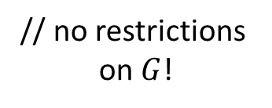
Variants of the Disjunction Argument (1)
$G$ cyclic group of prime order $p$ generated by $g∈G$
such that CDH holds over $G$
DDH broken $⇒$ NIZK from CDH!
OR
DDH
and
LPN
secure $⇒$ NIZK
[Brakerski
-Koppula
-Mour20]
Side Result 2: NIZK from polynomial CDH + LPN
with non-uniform, non-explicit verifier
and infinitely-often sound
// no restrictions
on $G$!
Curiosity: can show that either CDH implies NIZKs or LPN implies NIZK with caveats

Slide 23
Variants of the Disjunction Argument (2)
$G$ cyclic group* of prime order $p$ generated by $g∈G$
such that CDH holds over $G$
DDH broken $⇒$ ZAP from CDH!
OR
DDH secure* $⇒$ ZAP arguments
Stat. sound, URS + [Dwork-Naor00]
[Jain-Jin21]
Side Result 3: ZAP arguments from sub-exp. CDH*
with non-uniform, non-explicit verifier
and infinitely-often sound
ZAP args: 2-message,
public-coin-verifier,
witness-ind. args.
*With restrictions on $G$ (e.g. $⊆ℤ_{q}^{∗}$)

Slide 24
A Better Disjunction Argument
DDH secure* $⇒$ NIZK
Verifier is non-uniform
Verifier is non-explicit
Soundness only holds inf. often
Current caveats:
OR
DDH broken $⇒$ NIZK from CDH!
Standard drawbacks of disjunction arguments
Refined approach:
Identify “secure security parameters”
Find explicit breaks on “insecure sec. params.”
Use DDH-secure NIZK
Use DDH-broken NIZK
New goal: build an explicit “universal DDH breaker”
Specifications (informal): on input a security parameter:
Find an efficient break if one exists
Ensure that no break exist if it doesn’t find any

Slide 25
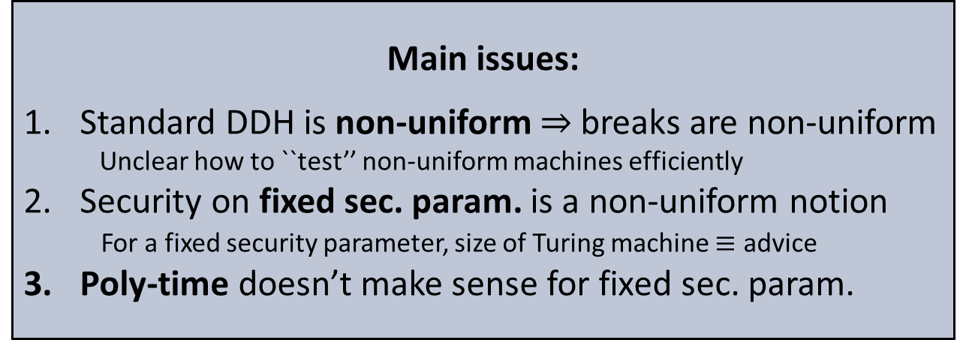
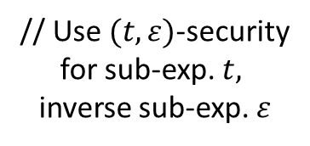
A Universal Breaker for DDH (1)
New goal: build an explicit “universal DDH breaker”
DDH secure* $⇒$ NIZK
OR
Specifications (informal): on input a security parameter:
Find an efficient break if one exists
Ensure that no break exist if it doesn’t find any
DDH broken $⇒$ NIZK from CDH!
Main issues:
Standard DDH is non-uniform $⇒$ breaks are non-uniform
Unclear how to ``test’’ non-uniform machines efficiently
Security on fixed sec. param. is a non-uniform notion
For a fixed security parameter, size of Turing machine $≡$ advice
Poly-time doesn’t make sense for fixed sec. param.
Fixes:
// Replace by uniform DDH
Cost: uniform soundness
// Bound size of Turing machine
// Use $(t, ε)$-security
for sub-exp. $t,$
inverse sub-exp. $ε$

Slide 26
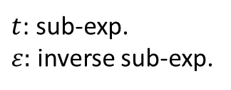
A Universal Breaker for DDH (2)
New goal: build an explicit “universal DDH breaker”
DDH secure* $⇒$ NIZK
OR
Specifications (informal): on input a security parameter:
Finds an efficient break if one exists
Ensures that no break exist if it doesn’t find any
DDH broken $⇒$ NIZK from CDH!
Our notion of security (for DDH): given sec. par. $λ$, no attacks with:
Attack is a (uniform) Turing machine of size $≤⌊log λ⌋$
Running time $t(λ)$, advantage $ε(λ)$
$t$: sub-exp.
$ε:$ inverse sub-exp.

Slide 27
A Universal Breaker for DDH (2)
New goal: build an explicit “universal DDH breaker”
DDH secure* $⇒$ NIZK
(uniform soundness)
OR
Specifications (informal): on input a security parameter:
Finds an efficient break if one exists
Ensures that no break exist if it doesn’t find any
DDH broken $⇒$ NIZK from CDH!
Our notion of security (for DDH): given sec. par. $λ$, no attacks with:
Attack is a (uniform) Turing machine of size $≤⌊log λ⌋$
Running time $t(λ)$, advantage $ε(λ)$
$t$: sub-exp.
$ε:$ inverse sub-exp.
Our construction: test all TMs of size $≤\left\lfloor log λ\right\rfloor$
sufficiently many times (given $t,ε$)
// run-time $≈t/ε²$ = sub-exponential
// correctness by Chernoff bounds

Slide 28
NIZKs from Universal Breakers
DDH secure* $⇒$ NIZK
(uniform soundness)
$UnivBreak(1^{λ})$: on input a security parameter $λ$:
Finds an efficient break if one exists
Ensures that no break exist if it doesn’t find any
stat. ZK
OR
Witness
NP language $L$
Statement
DDH broken $⇒$ NIZK from CDH!
$$x,w$$
$$crs$$
$$x$$
Prover
Verifier
$$π$$
DDH-secure NIZK
Run $UnivBreak$
If $λ$ is “secure” then verify the DDH-secure proof
Otherwise verify the DDH-broken proof using $UnivBreak$
$$π$$
DDH-broken NIZK
Verifier is uniform and explicit
☺
Now always sound, but not arbitrarily sparse:
$UnivBreak$ runs in sub-exp. time ($≈t/ε^{2})$
$⇒$Need complexity leveraging
NIZK is “sub-exp. often sound”:
$∀λ,$ $∃$ sound parameter in $[λ,2^{λ^{K}}]$
☺

Slide 29
Our Main Result
Theorem (informal): Assuming the sub-exp. hardness of CDH*,
NIZKs for all $NP$
there exist
with weak soundness
ZAP arguments
*With restrictions on $G$
(e.g. $⊆ℤ_{q}^{∗}$)
“sub-exponentially often”
$∀λ,$ $∃$ sound parameter in $[λ,2^{λ^{K}}]$
Caveats: soundness only holds
against uniform cheating provers
Main Techniques:
Open Questions:
DDH secure* $⇒$ NIZK (from DDH!)
Standard NIZKs from CDH?
NIZKs from public-key encryption? (Hard)
Other disjunction arguments?
More crypto from CDH over pairings?
Disjunction argument:
DDH broken $⇒$ NIZK from CDH!
Universal breaker: uniform, explicit algs, dense params.
General tool for disjunction arguments!
Thanks!
Thanks Eysa
for the drawings!

