Slide 1
SNARGs for Monotone
Policy Batch NP
Zvika Brakerski
Weizmann Institute
Maya Farber Brodsky
Tel Aviv University
Yael Tauman Kalai
Microsoft Research and MIT
Alex Lombardi
Simons Institute and UC Berkeley
Omer Paneth
Tel Aviv University

Slide 2






Succinct Non-Interactive Arguments (SNARGs)
$$crs←Setup(\$)$$
$$≪\left|w\right|$$
Proof $π$
$$P$$
$$V$$
$$x∈ℒ ?$$
Completeness
Computational Soundness

Slide 3


Previous Work from Standard Assumptions
SNARGs for subclasses $𝒞⊆NP$:
NS-PCP
[KVZ21]
P
NTISP
Batch NP
[KRR14, BHK17]
[BKK⁺18]
[CJJ21, WW22, CGJ⁺23]
Barrier: unlikely that NP $⊆$ NS-PCP
* Restricted form of SNARGs for NP from $i𝒪$ [SW14]

Slide 4
Our Result
Assuming LWE, we construct a SNARG
for a new class of languages:
Monotone Policy Batch NP
Not known to have a non-signaling PCP!

Slide 5





SNARGs for Batch NP (BARGs) [BHK17, CJJ21]
$$crs←Setup(\$)$$
Proof $π$
$$P$$
$$V$$
$$x_{1},…,x_{k}$$
$$x_{1},…,x_{k}$$
$$w_{1},…,w_{k}$$
$$x_{1}∈ℒ∧⋯∧x_{k}∈ℒ ?$$
Efficiency: $\left|crs\right|,\left|π\right|=\left|w_{i}\right|⋅poly\left(λ\right)$

Slide 6


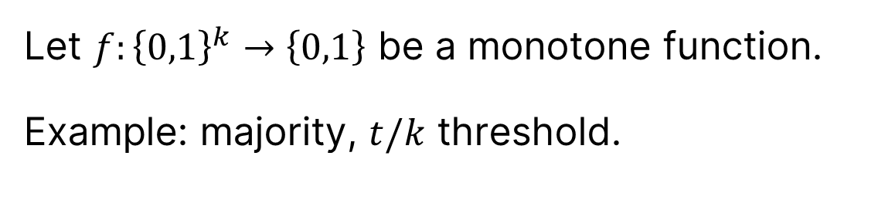








Monotone Policy Batch NP
Let $f:{\left\{0,1\right\}}^{k}→\left\{0,1\right\}$ be a monotone function.
Example: majority, $t/k$ threshold.
$$∧$$
$$∨$$
$$∨$$
$$∧$$
$$∨$$
$$∧$$
$$x_{1}∈ℒ$$
$$x_{2}∈ℒ$$
$$x_{3}∈ℒ$$
$$x_{4}∈ℒ$$

Slide 7










Monotone Policy Batch NP
Let $f:{\left\{0,1\right\}}^{k}→\left\{0,1\right\}$ be a monotone function.
Example: majority, $t/k$ threshold.
$$∧$$
$$∨$$
$$∨$$
$$∧$$
$$∨$$
$$∧$$
$$x_{1}∈ℒ$$
$$x_{2}∈ℒ$$
$$x_{3}∈ℒ$$
$$x_{4}∈ℒ$$

Slide 8
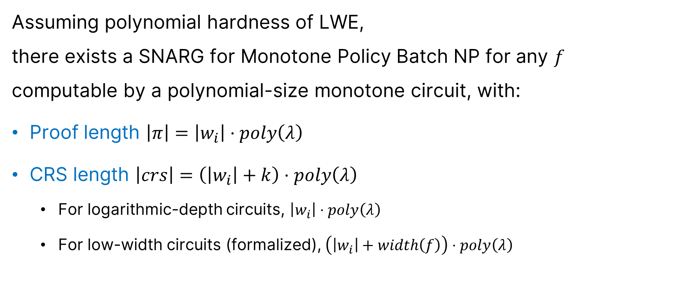
Main Theorem
Assuming polynomial hardness of LWE,
there exists a SNARG for Monotone Policy Batch NP for any $f$ computable by a polynomial-size monotone circuit, with:
Proof length $\left|π\right|=\left|w_{i}\right|⋅poly\left(λ\right)$
CRS length $\left|crs\right|=\left(\left|w_{i}\right|+k\right)⋅poly\left(λ\right)$
  For logarithmic-depth circuits, $\left|w_{i}\right|⋅poly\left(λ\right)$
  For low-width circuits (formalized), $\left(\left|w_{i}\right|+width\left(f\right)\right)⋅poly\left(λ\right)$

Slide 9
Main Theorem: Soundness
Non-adaptive:
  Our SNARG is an argument of knowledge.
Adaptive:
  Barriers to full adaptive soundness [GW11, BHK17].
  Our SNARG achieves a new relaxed notion of soundness:
  Subset Extractability.

Slide 10










Somewhere Extractability [CJJ21]
$$crs←Setup(\$)$$
$$\left(x_{1},…,x_{k}\right),π$$
$$P^{∗}$$
$$V$$
$$x_{1}∈ℒ∧⋯∧x_{k}∈ℒ ?$$
$$E$$
$$π$$
$$w_{1}$$
$$w_{2}$$
$$⋯$$
$$w_{k}$$
Problem: $\left|π\right|≈\left|w_{i}\right|$

Slide 11














Somewhere Extractability [CJJ21]
For any index $i∈\left[k\right]$,
Programmed Setup
$$crs_{i}$$
$$td_{i}$$
$$crs_{i}$$
$$P^{∗}$$
$$\left(x_{1},…,x_{k}\right),π$$
$$V$$
$$E$$
$$td_{i}$$
$$,π$$
$$w_{i}$$
$$x_{1}∈ℒ∧⋯∧x_{k}∈ℒ ?$$
What about Monotone Policy Batch NP?
$$crs≈_{c}crs_{i}$$
$$V\left(crs_{i},x,π\right)=1⟹ ℛ\left(x_{i},w_{i}\right)=1$$

Slide 12
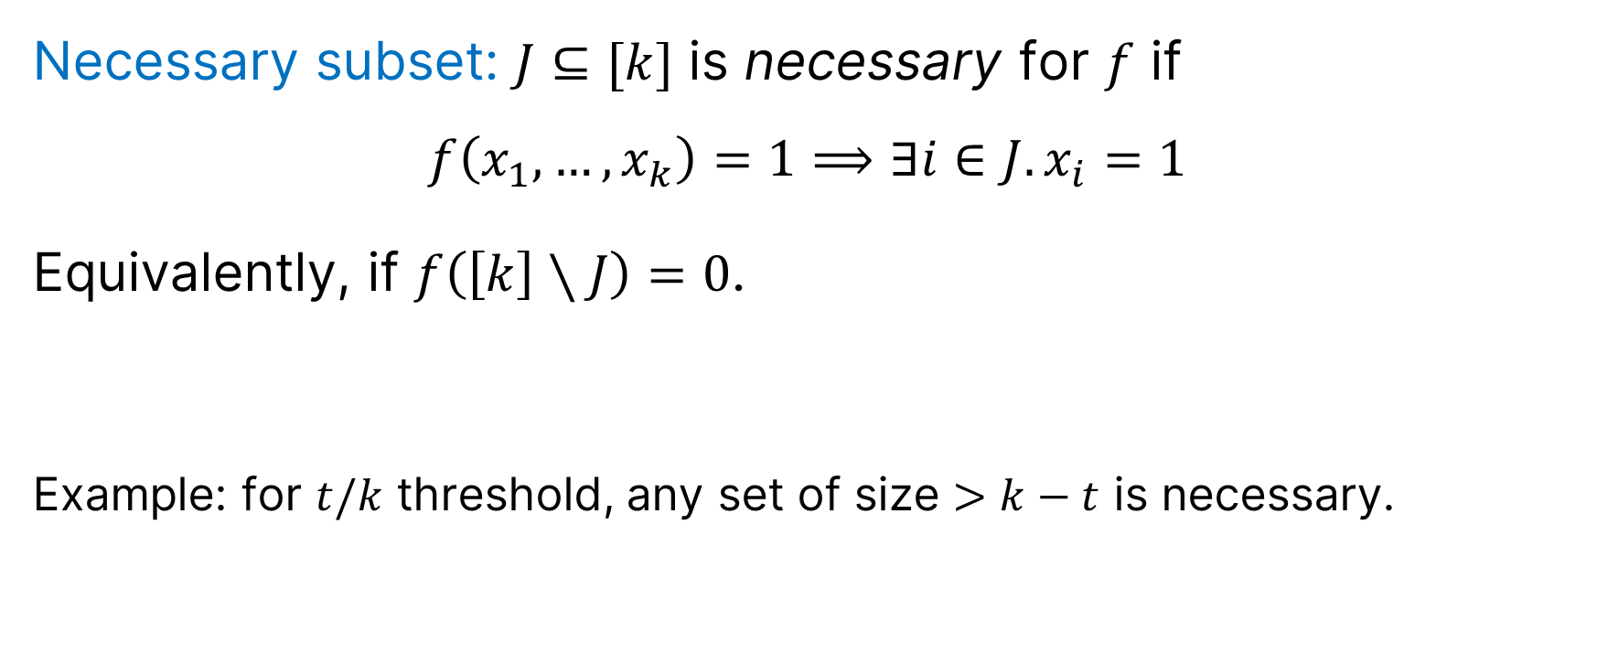
Subset Extractability
Necessary subset: $J⊆[k]$ is necessary for $f$ if
$$f\left(x_{1},…,x_{k}\right)=1⟹∃i∈J.x_{i}=1$$
Equivalently, if $f\left(\left[k\right]∖J\right)=0$.
Example: for $t/k$ threshold, any set of size $>k−t$ is necessary.

Slide 13








Subset Extractability
For any necessary $J⊆\left[k\right]$,
Programmed Setup
$$crs_{J}$$
$$td_{J}$$
$$crs_{J}$$
$$P^{∗}$$
$$\left(x_{1},…,x_{k}\right),π$$
$$V$$
$$E$$
$$td_{J}$$
$$,π$$
$${i,w}_{i}$$
$$crs≈_{c}crs_{J}$$
$$V\left(crs_{J},x,π\right)=1⟹i∈J∧ ℛ\left(x_{i},w_{i}\right)=1$$

Slide 14
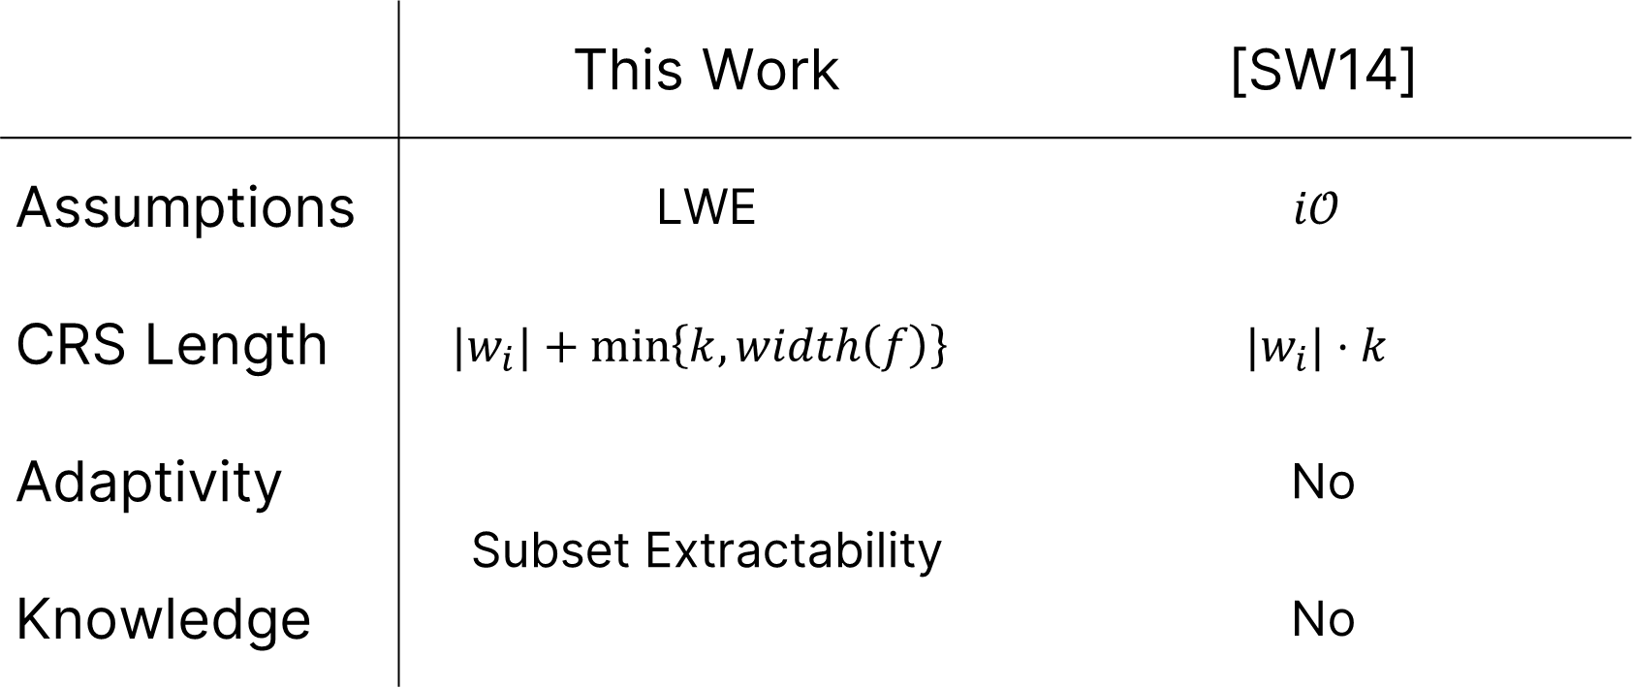
Comparison with [SW14]
 | This Work | [SW14]
Assumptions | LWE | $$i𝒪$$
CRS Length | $$|w_{i}|+\min\left\{k,width\left(f\right)\right\}$$ | $$|w_{i}|⋅k$$
Adaptivity | Subset Extractability | No
Knowledge | Yes | No

Slide 15
Our Techniques
Beyond Non-Signaling PCPs

Slide 16




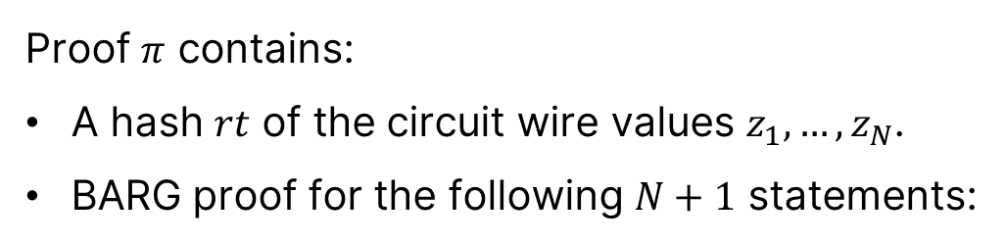



















Canonical Protocol: Hash & BARG
Proof $π$ contains:
A hash $rt$ of the circuit wire values $z_{1},…,z_{N}$.
BARG proof for the following $N+1$ statements:
$$z_{10}$$
$$∧$$
$$z_{8}$$
$$z_{9}$$
$$∨$$
$$∨$$
$$z_{5}$$
$$z_{5}$$
$$z_{6}$$
$$z_{7}$$
$$∧$$
$$∨$$
$$∧$$
$$z_{1}$$
$$z_{1}$$
$$z_{2}$$
$$z_{3}$$
$$z_{3}$$
$$z_{4}$$
$$x_{1}∈ℒ$$
$$x_{2}∈ℒ$$
$$x_{3}∈ℒ$$
$$x_{4}∈ℒ$$

Slide 17
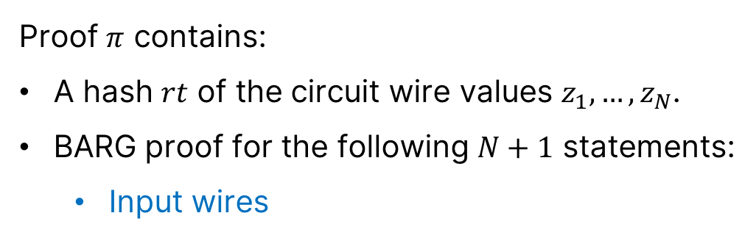


Canonical Protocol: Hash & BARG
Proof $π$ contains:
A hash $rt$ of the circuit wire values $z_{1},…,z_{N}$.
BARG proof for the following $N+1$ statements:
  Input wires
$$z_{10}$$
$$∧$$
$$z_{8}$$
$$z_{9}$$
$$∨$$
$$∨$$
$$z_{5}$$
$$z_{5}$$
$$z_{6}$$
$$z_{7}$$
$$∧$$
$$∨$$
$$∧$$
$$z_{1}$$
$$z_{1}$$
$$z_{2}$$
$$z_{3}$$
$$z_{3}$$
$$z_{4}$$
$$x_{1}∈ℒ$$
$$x_{2}∈ℒ$$
$$x_{3}∈ℒ$$
$$x_{4}∈ℒ$$

Slide 18
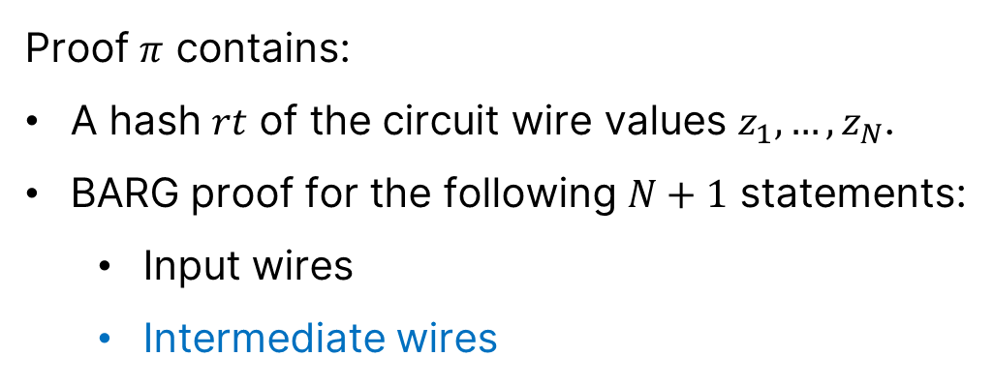




Canonical Protocol: Hash & BARG
Proof $π$ contains:
A hash $rt$ of the circuit wire values $z_{1},…,z_{N}$.
BARG proof for the following $N+1$ statements:
  Input wires
  Intermediate wires
$$z_{10}$$
$$∧$$
$$z_{8}$$
$$z_{9}$$
$$∨$$
$$∨$$
$$z_{5}$$
$$z_{5}$$
$$z_{6}$$
$$z_{7}$$
$$∧$$
$$∨$$
$$∧$$
$$z_{1}$$
$$z_{1}$$
$$z_{2}$$
$$z_{3}$$
$$z_{3}$$
$$z_{4}$$
$$x_{1}∈ℒ$$
$$x_{2}∈ℒ$$
$$x_{3}∈ℒ$$
$$x_{4}∈ℒ$$

Slide 19
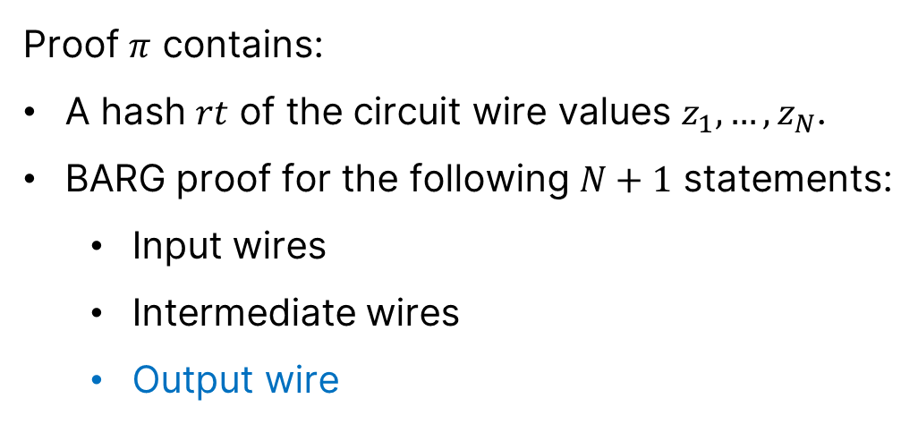


Canonical Protocol: Hash & BARG
Proof $π$ contains:
A hash $rt$ of the circuit wire values $z_{1},…,z_{N}$.
BARG proof for the following $N+1$ statements:
  Input wires
  Intermediate wires
  Output wire
$$z_{10}$$
$$∧$$
$$z_{8}$$
$$z_{9}$$
$$∨$$
$$∨$$
$$z_{5}$$
$$z_{5}$$
$$z_{6}$$
$$z_{7}$$
$$∧$$
$$∨$$
$$∧$$
$$z_{1}$$
$$z_{1}$$
$$z_{2}$$
$$z_{3}$$
$$z_{3}$$
$$z_{4}$$
$$x_{1}∈ℒ$$
$$x_{2}∈ℒ$$
$$x_{3}∈ℒ$$
$$x_{4}∈ℒ$$

Slide 20
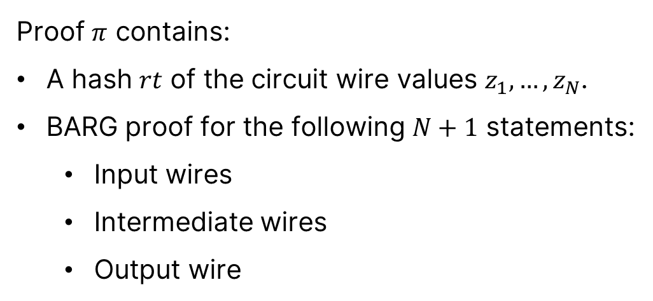
Canonical Protocol: Hash & BARG
Proof $π$ contains:
A hash $rt$ of the circuit wire values $z_{1},…,z_{N}$.
BARG proof for the following $N+1$ statements:
  Input wires
  Intermediate wires
  Output wire
$$z_{10}$$
$$∧$$
$$z_{8}$$
$$z_{9}$$
$$∨$$
$$∨$$
$$z_{5}$$
$$z_{5}$$
$$z_{6}$$
$$z_{7}$$
$$∧$$
$$∨$$
$$∧$$
Challenge: we only have somewhere extractability.
$$z_{1}$$
$$z_{1}$$
$$z_{3}$$
$$z_{3}$$
$$z_{4}$$
$$z_{2}$$
$$x_{1}∈ℒ$$
$$x_{2}∈ℒ$$
$$x_{3}∈ℒ$$
$$x_{4}∈ℒ$$

Slide 21



Fixing the Canonical Protocol
Construct a compiler to
“Hash & BARG”-friendly computations
Previous work: based on e.g., error-correcting codes [KRR14]
Non-Signaling Barrier!
$ℒ$ has an information theoretic compiler
$ℒ$ has a
non-signaling PCP
$$⟺$$

Slide 22
Fixing the Canonical Protocol
Construct a cryptographic compiler to
“Hash & BARG”-friendly computations
Based on Predicate-Extractable Hash

Slide 23









Predicate-Extractable Hash (PEHash)
Hash family $H\left(hk,x\right)→rt$ with:
Predicate extraction.
For any predicate $f∈ℱ$,
Programmed Setup
$$hk_{f}$$
$$td_{f}$$
$$hk_{f}≈_{c}hk$$
$$rt$$
,
$$td_{f}$$
$$E$$
$$f\left(x\right)$$

Slide 24

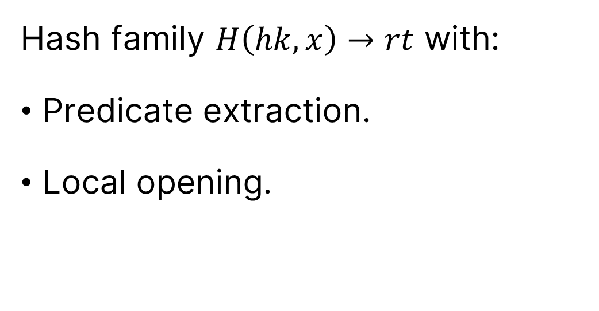








Predicate-Extractable Hash (PEHash)
Hash family $H\left(hk,x\right)→rt$ with:
Predicate extraction.
Local opening.
$$rt$$
$$x_{1}$$
$$x_{2}$$
$$x_{3}$$
$$x_{4}$$
$$x_{5}$$
$$x_{6}$$
$$x_{7}$$
$$x_{8}$$

Slide 25
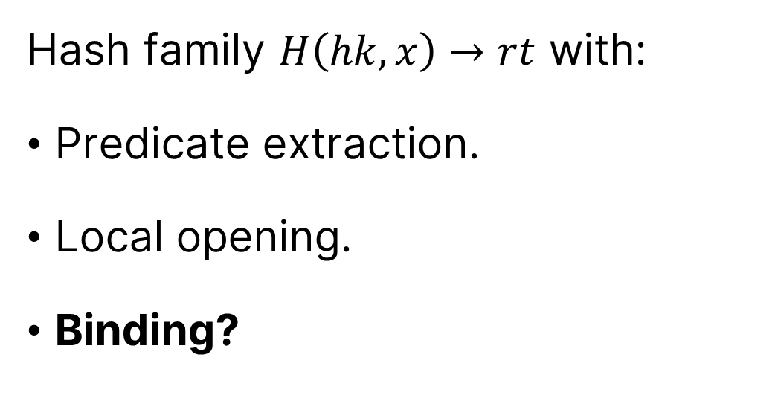
Predicate-Extractable Hash (PEHash)
Hash family $H\left(hk,x\right)→rt$ with:
Predicate extraction.
Local opening.
Binding?

Slide 26
















PEHash for Bit-Fixing Predicates
$$f=$$
$$0$$
$$∗$$
$$1$$
$$0$$
$$0$$
$$1$$
$$∗$$
$$∗$$
$$x=$$
$$x_{1}$$
$$x_{2}$$
$$x_{3}$$
$$x_{4}$$
$$x_{5}$$
$$x_{6}$$
$$x_{7}$$
$$x_{8}$$
Binding.
Construction based on leveled homomorphic encryption.

Slide 27
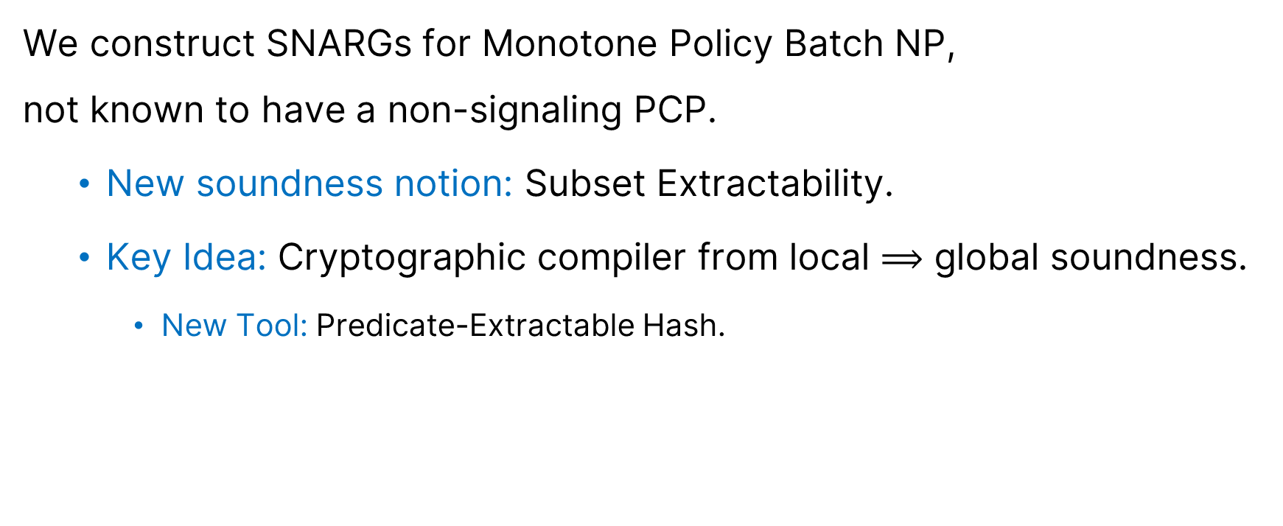
Summary
We construct SNARGs for Monotone Policy Batch NP,
not known to have a non-signaling PCP.
  New soundness notion: Subset Extractability.
  Key Idea: Cryptographic compiler from local $⟹$ global soundness.
    New Tool: Predicate-Extractable Hash.

Slide 28
Thank you!
https://eprint.iacr.org/2023/1050

