Slide 1
Accelerating HE Operations Using Key Decomposition
Yongsoo Song (Seoul National University)
Crypto 2023
Joint work with Miran Kim (Hanyang Univ), Dongwon Lee, Jinyeong Seo (SNU)

Slide 2
Motivation
DM’15: FHEW
CGGI’16: TFHE
B/FV’12
CKKS’17
BGV’12
GHS’12
GSW’13
BEHZ’16: RNS-FV
CHKKS’18: RNS-CKKS
Significant advances in the last decade
Various scheme designs & their implementations
Recent studies
Bootstrapping
Threshold / multi-key HE
Advanced functionality
Real-world applications
Hardware accelerator (e.g. DPRIVE)

Slide 3
Our Results
There’s still room for algorithmic improvements!
Goal: External Product
A common building block of HEs to reduce the noise growth
Key-switching, multiplication, automorphism and bootstrapping
Contributions
A new algorithm with better asymptotic and concrete complexity
Compatible with the prior method and its implementation

Slide 4
01
Background Gadget Decomposition & External Product
02
Previous Method RNS-friendly decomposition
Table of Contents
03
Our Solution
Performance & Implementation Results

Slide 5
Gadget Vector
Notation
$R={ℤ[X]}/{\left(X^{N}+1\right)}$: ring of integers (for a power-of-two $N$)
$Q$: ciphertext modulus
$R_{Q}={ℤ_{Q}[X]}/{\left(X^{N}+1\right)}$: residue ring
Gadget vector: $g=\left(g_{0},…, g_{d−1}\right)∈R_{Q}^{d}$.
$g_{i}$’s are called the gadget basis
We will consider linear combinations $x_{0}g_{0}+…+x_{d−1}g_{d−1} (mod Q)$ for some $x_{i}∈R$
This is well-defined since $R_{Q}$ is an $R$-module

Slide 6
Gadget Decomposition
Gadget decomposition $h :R_{Q}→R^{d}$
Represent an element of $R_{Q}$ as a linear combination of $g_{i}$ with small coefficients
For $a∈R_{Q}$, its decomposition $h\left(a\right)=\left(b_{0},…, b_{d−1}\right)$ is a short vector such that
$b_{0}g_{0}+…+b_{d−1}g_{d−1}=a \left(mod Q\right)$.
A classic example: base-$B$ representation
Let $B∈ℤ$ be a base and $d=\left\lceil \log_{B}{Q}\right\rceil$.
$\left(g_{0}, g_{1},…, g_{d−1}\right)=\left(1, B, …, B^{d−1}\right)$
$h(⋅)$ is defined by the base-$B$ representation
$h\left(a\right)=\left(b_{0},…,b_{d−1}\right)$ such that $a=\sum_{i}{b_{i}B^{i}}$ and ${\left\|b_{i}\right\|}_{∞}<B$.

Slide 7
External Product
A multiplicative operation between RLWE and RGSW encryptions [CGGI16]
We use the same terminology to refer to a more general operation
Def. A binary operation $⊡ :R_{Q}×R_{Q}^{d}→R_{Q}$
Input: $a∈R_{Q}$ and $u=(u_{0}, …, u_{d−1})∈R_{Q}^{d}$
Output: $c∈R_{Q}$
Step 1 (decomposition): $h\left(a\right)=\left(b_{0},…, b_{d−1}\right)∈R^{d}$
Step 2 (linear combination): $c=b_{0}u_{0}+…+b_{d−1}u_{d−1}∈R_{Q}$
We write $a⊡U=\left(a⊡u_{0},a⊡u_{1}\right)$ for $U=\left[u_{0} \right| u_{1}]∈R_{Q}^{d×2}$

Slide 8
Applications
The external product can realize the secure scalar multiplication
Let $a∈R_{Q}$ & $U={RLWE}_{s}(t⋅g) ∈R_{Q}^{d×2}$
Then, $c=(c_{0}, c_{1})←a⊡U∈R_{Q}^{2}$ is an RLWE ciphertext such that
$$c_{0}+c_{1}s≈at \left(mod Q\right)$$
The key-switching procedure
A common building block of nonlinear HE operations
Relinearization: $t=s^{2}$
Automorphism: $t=φ\left(s\right)$
The complexity bottleneck of homomorphic operations (85 - 95%)

Slide 9
01
Background Gadget Decomposition & External Product
02
Previous Method RNS-friendly decomposition
Table of Contents
03
Our Solution
Performance & Implementation Results

Slide 10
RNS & NTT
Residue Number System (RNS)
$Q=q_{0}q_{1}…q_{d−1}$ a product of distinct (word-size) primes
$R_{Q}→R_{q_{0}}×R_{q_{1}}×…×R_{q_{d−1}}$, $a↦\left({\left[a\right]}_{q_{0}}, {\left[a\right]}_{q_{1}},…, {\left[a\right]}_{q_{d−1}}\right)$ is an isomorphism (by CRT)
Number Theoretic Transform (NTT)
Let $ρ_{i}$ be a $(2N)$-th primitive root of unity ($q_{i}=1 \left(mod 2N\right)$).
$R_{q_{i}}→ℤ_{q_{i}}^{N}$, $a\left(X\right)↦\left(a\left(ρ_{i}\right), a\left(ρ_{i}^{3}\right), …, a\left(ρ_{i}^{2N−1}\right)\right)$
Conversion between (Coefficient representation) & (NTT form)
Complexity: $O(N\log{N})$

Slide 11
RNS-based Gadget Decomposition
The most widely used decomposition method in practice
Modulus: $Q=q_{0}q_{1}…q_{d−1}$ where $q_{0}, …, q_{d−1}$ are distinct primes
Gadget vector: $g=\left(g_{0},…, g_{d−1}\right)∈R_{Q}^{d}$
The vector of “CRT constants” s.t. $g_{i}≡1 \left(mod q_{i}\right)$ and $g_{i}≡0 \left(modQ/{q_{i}}\right)$.
RNS-based decomposition: $h\left(a\right)=\left({\left[a\right]}_{q_{0}},{\left[a\right]}_{q_{1}}, …, {\left[a\right]}_{q_{d−1}}\right)∈R^{d}$
Correctness: CRT
$${\left[a\right]}_{q_{0}}⋅g_{0}+…+{\left[a\right]}_{q_{d−1}}⋅g_{d−1}=a (mod Q)$$
Bound: $\max\left\{q_{i}\right\}$
Remark: $h\left(⋅\right)$ is RNS-friendly, but can be computed in the coefficient form

Slide 12
Previous External Product
External product of $a∈R_{Q}$ and $u=(u_{0}, …, u_{d−1})∈R_{Q}^{d}$
Step 1 (decomposition): $h\left(a\right)=\left(b_{0},…, b_{d−1}\right)∈R^{d}$
Step 2 (linear combination): $c=b_{0}u_{0}+…+b_{d−1}u_{d−1}∈R_{Q}$
Key Question: How to implement the product of $b_{i}={\left[a\right]}_{q_{i}}∈R$ and $u_{i}∈R_{Q}$?
Compute the RNS representation of $b_{0}, …, b_{d−1}$ modulo $Q$
Then, perform the inner product over $R_{Q}$
$d^{2}$ NTT conversions to obtain the NTT form of $b_{i}$ modulo $q_{j}$
$d^{2}$ multiplications between ${\left[b_{i}\right]}_{q_{j}}$ and ${\left[u_{i}\right]}_{q_{j}}$

Slide 13
01
Background Gadget Decomposition & External Product
02
Previous Method RNS-friendly decomposition
Table of Contents
03
Our Solution
Performance & Implementation Results

Slide 14
Our Approach
Goal: Compute the linear combination $c=b_{0}u_{0}+…+b_{d−1}u_{d−1}∈R_{Q}$ efficiently
Main Idea: perform as much computation as possible over $R$ (instead of $R_{Q}$)
Suppose that the gadget decompositions of $u_{i}$ are given
$h\left(u_{i}\right)=\left(v_{i,0}, …, v_{i,d−1}\right)∈R^{d}$ such that $u_{i}=v_{i,0}⋅g_{0}+…+v_{i,d−1}⋅g_{d−1} \left(mod Q\right)$.
$$c=\sum_{i}{b_{i}u_{i}}=\sum_{i}{b_{i}⋅\left(\sum_{j}{v_{i,j}⋅g_{j}}\right)}=\sum_{j}{\left(\sum_{i}{b_{i}v_{i,j}}\right)⋅g_{j}} \left(mod Q\right)$$
The output is the linear combination of gadget basis with coefficients $c_{j}=\sum_{i}{b_{i}v_{i,j}}$

Slide 15
Some Properties
$c=c_{0}g_{0}+…+c_{d−1}g_{d−1} \left(mod Q\right)$ where $c_{j}=\sum_{0≤i<d}{b_{i}v_{i,j}}$
$v_{i,j}$ can be precomputed (from $u_{i}$)
$c_{j}=\sum_{0≤i<d}{b_{i}v_{i,j}}$
This inner product is a small element of $R$
Its upper bound (the precision of DFT over $R$) is determined by $h$
$\left(c_{0},…, c_{d−1}\right)$ is the RNS representation of $c$ modulo $Q$
$c=c_{j} \left(mod q_{j}\right)$

Slide 16
New External Product
Input: $a∈R_{Q}$ and $h\left(u_{i}\right)=(v_{i,0}, …, v_{i,d−1})∈R^{d−1}$ for $0≤i<d$.
$v_{i,j}$ are precomputed and given in the DFT form over $R$
Compute $b_{1}={\left[a\right]}_{q_{0}}, …, b_{ℓ}={\left[a\right]}_{q_{d−1}}$ over $R$ $d$ DFTs
Compute $c_{j}=\sum_{i}{b_{i}v_{i,j}}$ for each $j$ $d^{2}$ multiplications
Convert $c_{j}$ back into the coefficient form $d$ inverse DFTs
Output: $\left(c_{0}, c_{1},…, c_{d−1}\right)$, the RNS representation of $c$ modulo $Q$
This is a pure algorithmic optimization, computing the same ciphertext!

Slide 17
Optimizations & Generalizations (Full paper)
General RNS-based gadget decomposition
$h\left(a\right)=\left({\left[a\right]}_{D_{0}}, …, {\left[a\right]}_{D_{d−1}}\right)$ for some $D_{0}, …, D_{d−1}$ such that $D_{0}⋯D_{d−1}=Q$
Each digit $D_{i}$ is a product of $r (=1 \sim 4)$ prime numbers
The special-modulus technique
The key-switching key has a larger modulus $Q^{′}=PQ$
Need to introduce another decomposition over $R_{Q^{′}}$ (of a different digit size $r^{′}$)
Multi-precision DFT over $R$ for arithmetic of integral polynomials
Its precision depends on $r$ and $r^{′}$

Slide 18
Implementation
Written in the Go language (the Lattigo lib)
Parameter setup
The usual HE parameters $N=2^{15}, 2^{16}$
Choose the best $r^{′}$ for each $r$
Ring of Integers
Instantiate $R$ by $R_{B}$ for sufficiently large $B>0$.
$B$ is a product of a few primes
A single DFT over $R$ is instantiated by a small number of NTTs

Slide 19
Benchmarks (key-switching, CPU)
$$N$$ | $$ℓ$$ | $$r$$ | Prev (sec) | $r^{′}$ | Ours (sec) | Speedup
2¹⁵ | 24 | 1 | 0.317 | 3 | 0.140 | 2.3
 |  | 2 | 0.204 | 4 | 0.110 | 1.9
 |  | 3 | 0.151 | 6 | 0.101 | 1.5
2¹⁶ | 48 | 1 | 2.688 | 5 | 0.818 | 3.3
 |  | 2 | 1.980 | 4 | 0.655 | 3.0
 |  | 3 | 1.438 | 6 | 0.585 | 2.5
 |  | 4 | 1.191 | 7 | 0.550 | 2.2
$N$: RLWE dimension, $ℓ$: ciphertext level
$r$, $r^{′}$: decomp size (no. of primes in each digit)

Slide 20
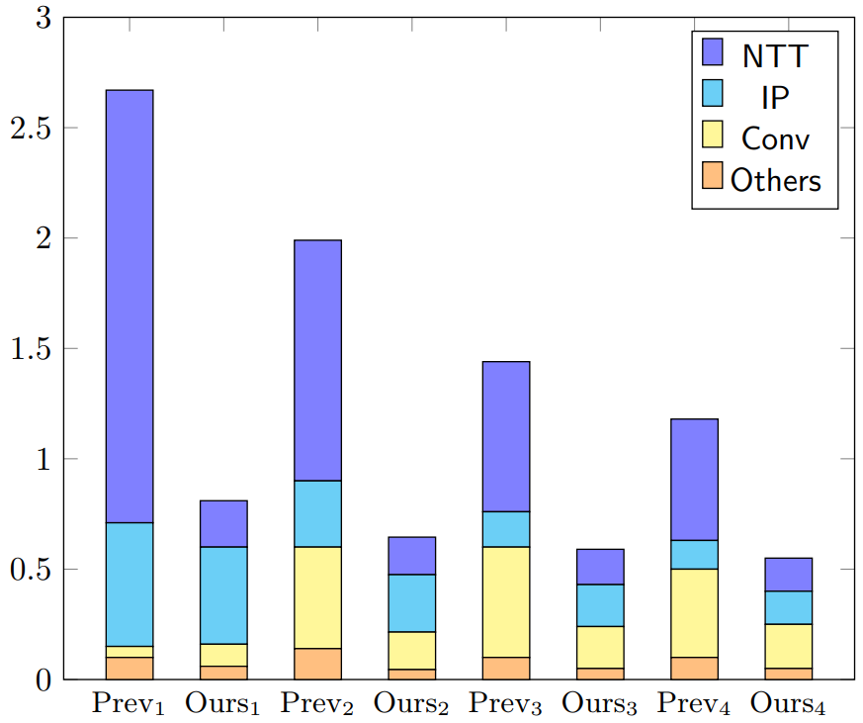
Profiling
$$r=1$$
$$r=2$$
$$r=3$$
$$r=4$$

Slide 21
Conclusion & Implications
We developed a novel external product algorithm
Time complexity
Asymptotic: from ($d^{2}$ NTTs + $d^{2}$ mults) down to ($d$ DFTs + $d^{2}$ mults)
Concrete: 2~3x speed up
NTT is no longer a major performance bottleneck
Implementation
Compatibility with the existing method
Hardware friendliness

Slide 22
https://ia.cr/2023/413
https://github.com/SNUCP/fast-ksw

