Slide 1
One-way Functions and Hardness of (Probabilistic) Time-Bounded Kolmogorov Complexity w.r.t. Samplable Distributions
Yanyi Liu Cornell Tech
Rafael Pass Tel Aviv University &
Cornell Tech

Slide 2
What is the “Best” Assumption?
Hardness of Factoring? Discrete log?
LWE? Lattice problems?
$∃$ OWF? NP is hard?
Today: “Science is hard!”
Our Focus: OWFs

Slide 3
One-way Functions (OWF) [Diffie-Hellman’76]
A function f that is
Easy to compute: can be computed in poly time
Hard to invert: no PPT can invert it
easy
x
y=f(x)
hard
Ex [Factoring]: use x to pick 2 random “large” primes p,q, and output y = p* q

Slide 4
One-way Functions (OWF) [Diffie-Hellman’76]
A function f that is
Easy to compute: can be computed in poly time
Hard to invert: no PPT can invert it
OWF both necessary [IL’89] and sufficient for:
Private-key encryption [GM84,HILL99]
Pseudorandom generators [HILL99]
Digital signatures [Rompel90]
Authentication schemes [FS90]
Pseudorandom functions [GGM84]
Commitment schemes [Naor90]
…
Not included:
public-key encryption, OT, obfuscation
Whether OWF exists is the most important problem in Cryptography

Slide 5
Characterization of OWFs
OWFs exist iff the time-bounded Kolmogorov-complexity problem is hard-on-average. [LP’20]
A win-win perspective: Either OWFs, or efficient algorithms for optimal file compression, inductive reasoning, optimal machine learning
But only over random instances!
[Today] Over “practical” instances. E.g., Science is easy (over “real-world” data)

Slide 6
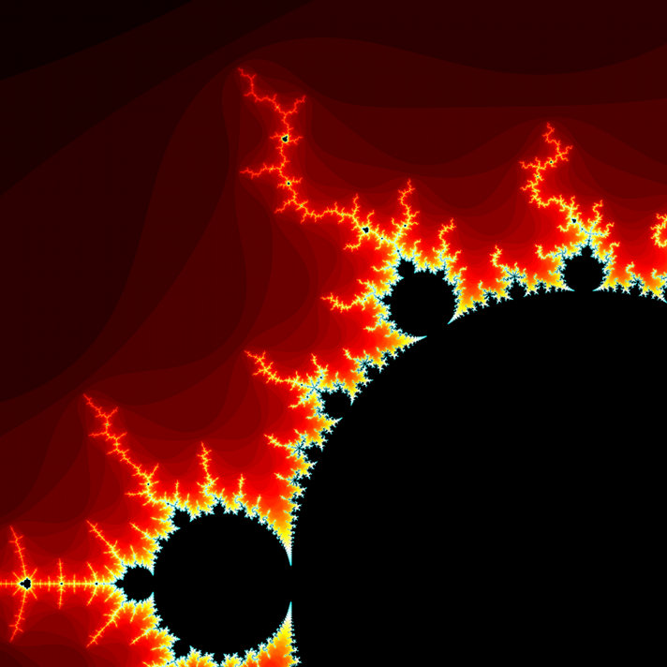
Kolmogorov Complexity [Sol’64,Kol’68,Cha’69]
Which of the following strings is more “random”:
1231231231231231231
1730544459347394037
K(x) = length of the shortest program that outputs x
Formally, we fix a universal TM U, and are looking for the length of the shortest program 𝚷 = (M,w) s.t. U(M,w) = x
Lots of amazing applications (e.g., Godel’s incompleteness theorem)
But uncomputable.

Slide 7
Time-Bounded Kolmogorov Complexity
Which of the following strings is more “random”:
1231231231231231231
1730544459347394037
K(x) = length of the shortest program that outputs x
K^{t}(x) = length of the shortest program that outputs x within time t(|x|)
Can K^{t} be efficiently computed when t is a polynomial?
Studied in the Soviet Union since 60s [Kol’68,T’84]
Independently by Hartmanis [83], Sipser [83], Ko [86]
Closely related to MCSP (Minimum Circuit Size Problem) [T’84,KC’00]
“Meta-complexity” : complexity of complexity of x

Slide 8
Average-case Hardness of K^{t}
Frequential version [60’s, T’84]
Does ∃ algorithm that computes K^{t}(x) for a “large” fraction of x’s?
Observation [60’s, T’84]: K^{t} can be approximated within log n w.p 1-1/n
Proof: simply output n.

Slide 9
Average-case Hardness of K^{t}
Frequential version [60’s, T’84]
Does ∃ algorithm that computes K^{t}(x) for a “large” fraction of x’s?
More general version: Given some (efficiently) samplable distribution D,
Does ∃ algorithm that computes K^{t}(x) over x ← D w.h.p.?
(Efficiently) samplable distributions: Distributions that can be sampled by a poly-time probabilistic TM.
KeyGen(1^n) for most schemes
Def: K^{t} is mildly-HoA w.r.t. D if there exists a polynomial p, such that no PPT heuristic H can compute K^{t} w.p 1-1/p(n) over x ← D for inf many n.

Slide 10
OWFs from Hardness of pK^{t}
[LP’23] Consider a probabilistic version of K^{t}, pK^{t}, the following are equivalent:
OWFs exist
∃ samplable D on which $∀$ poly t, pK^{t} is mildly-HoA.
On uniform distribution, $∀$ poly t, pK^{t} is mildly-HoA.
pK^{t} is a (recently introduced) notion of Kolmogorov complexity [GKLO’22]
pK^{t} captures what happens to K^{t} in the Common Random String model - The task: given a CRS, find the shortest program that outputs the string with CRS - It is the “same” (within $±$O(log n)) as K^{t} under standard derandomization assumption. [GKLO’22]

Slide 11
OWFs from Hardness of pK^{t}
[LP’23] Consider a probabilistic version of K^{t}, pK^{t}, the following are equivalent:
OWFs exist
∃ samplable D on which $∀$ poly t, pK^{t} is mildly-HoA.
On uniform distribution, $∀$ poly t, pK^{t} is mildly-HoA.
(2) => (1) yields a strong and natural win-win situation:
Either OWFs exist, or for any efficiently sampled x
we can (w.h.p.) find short programs that print x
-- an efficient approach implementing Occam’s Razor

Slide 12
Either OWFs, Or …
Science is easy*!
Occam’s razor (1287-1347, John Punch 1639):
Entities are not to be multiplied without necessity"
Non sunt multiplicanda entia sine necessitate)
“Simplest explanation is mostly likely the truest”
*Assuming nature is efficient, collecting data is easy, ...

Slide 13
OWFs from Hardness of pK^{t}
[LP’23] Consider a probabilistic version of K^{t}, pK^{t}, the following are equivalent:
OWFs exist
∃ samplable D on which $∀$ poly t, pK^{t} is mildly-HoA.
On uniform distribution, $∀$ poly t, pK^{t} is mildly-HoA.
Corr: (2) => (3) Uniform is the hardest distribution for pK^{t}.
Additional Remark: Our theorem also holds w.r.t. K^{t}, assuming E ⊈ ioNSIZE[2^{0.01n}] (which implies AM = NP).

Slide 14
Related Work
Ilango, Santhanam, and Ren [IRS’22] showed that
Under a derandomization assumption, ioOWFs ⬄ K^{t} is hard to $ω$(log n) approximate w.r.t. some samplable distribution
We only require hardness of solving exact version of K^{t}.
This is significant: Any distribution under which K^{t} is hard to $ω$(log n) approximate is itself a OWF.

Slide 15
Proof Overview
[THM1] The following are equivalent:
OWFs exist
∃ samplable D on which $∀$ poly t, pK^{t} is mildly-HoA.
On uniform distribution, $∀$ poly t, pK^{t} is mildly-HoA.
(1) => (3): mostly following [LP’20]
(3) => (2): trivial
Focus: (2) => (1)

Slide 16
Proof Overview
(2) => (1) Assume that ∃ samplable D on which pK^{t} is mildly-HoA for all poly t, then OWFs exist.
Def: We say that a distribution D is Poly-bounded by K^{t} if D samples any string x w.p. <= poly(n) / 2^{K^t(x)}
- It does not assign too much weight to “K^{t}-random” strings.
Examples:
The uniform distribution. (2^{-n} <= O(1) 2^{-K^t(x)} )
Any efficient deterministic “distribution”.
For simplicity: we consider just K^{t} (without CRS) in this overview.

Slide 17
Proof Overview
(2) => (1) Assume that ∃ samplable D on which pK^{t} is mildly-HoA for all poly t, then OWFs exist.
Outline:
Step 1. The LP20 OWF will be still (weak) one-way if we switch uniform to any distribution that is poly-bounded by K^{t}.
Step 2. Any efficiently samplable distribution must be poly-bounded by K^{t}. (Not quite, either need assumptions or appealing to a CRS.)

Slide 18
Proof Overview
(2) => (1) Assume that ∃ samplable D on which pK^{t} is mildly-HoA for all poly t, then OWFs exist.
Outline:
Step 1. The LP20 OWF will be still (weak) one-way if we switch uniform to any distribution that is poly-bounded by K^{t}.
Step 2. Any efficiently samplable distribution must be poly-bounded by K^{t}. (Not quite, either need assumptions or appealing to a CRS.)
Will follow from the “Coding Theorem” of [LOZ’22]

Slide 19
Step 1
Assume ∃ poly t, distribution D s.t. (1) D is poly-bounded by K^{t} ; and (2) K^{t} is mildly-HOA. Then OWFs exist.
Note: [LP’20] constructs only a weak OWF.
Weak OWF: “mild-HOA version” of a OWF:
efficient function f s.t. no PPT can invert f w.p. 1-1/p(n) for inf many n, for some poly p(n)>0.
Lemma [Yao’82]. If a Weak OWF exists, then a OWF exists.

Slide 20
LP20 construction: Let c be a constant so that K^{t}(x) < |x|+c for all x
Define f(𝚷’,i) where |𝚷’| = n+c, |i| = log (n+c) as follows:
Let 𝚷 = first i bits of 𝚷’ (i.e., truncate 𝚷’ to i bits).
Let y = output of 𝚷 after t(n) steps.
Output i||y.
Assume for contradiction that f is not a Weak OWF.
Then, for every inverse polynomial 𝛿, there exists a PPT attacker A that inverts f w.p 1- 𝛿.
We construct a heuristic H (using A) that computes K^{t} w.p. 1- 𝛿 poly(n) over D, which concludes that K^{t} is not mildly HOA over D, a contradiction.

Slide 21
Heuristic H(y) proceeds as follows given y ← D :
For i = 1 to n+c
- Run A(i||y) -> 𝚷 and check if 𝚷 outputs y within t(n) steps
Output the smallest i for which the check passed (or the program).
Intuitively, if A succeeds with VERY high probability, then it should also succeed with high probability conditioned on length i, for EVERY i ∈ [n+c]
But: the problem is that H is feeding A the wrong distribution over y’s.
Solution: using a relative distance argument in LP’20, we can show that they are not too far (in the paper).

Slide 22
A Brief Summary
The following are equivalent:
OWFs exist
∃ samplable D on which $∀$ poly t, pK^{t} is mildly-HoA.
On uniform distribution, $∀$ poly t, pK^{t} is mildly-HoA.
A very strong and natural (poetic) win-win situation:
Either crypto exists, or scientific discovery is easy.
The first language (without RSR) admits the property that
uniform is a “complete” distribution

Slide 23
Towards excluding Pessiland
“HoA” refers to be HoA w.r.t. some samplable distribution
NP
is
HoA
SAT
is
HoA
pK^{t}
is
HoA
$∃$OWF
To prove , it suffices to prove NP-hardness of pK^{t}
(And this may even be necessary, assuming iO—see [HIR’23])
Technicality: The reduction needs to be “oblivious” to t.
But Hirahara [Hir’22] showed such a reduction for NP-hardness of MK^{t}P*, so we are getting close!

Slide 24
Thank You

