Slide 1
Efficient Lattice-Based Two-Round Multi-Signature with Trapdoor-Free Simulation
Yanbo Chen
University of Ottawa

Slide 2






Signature
$$sk$$
$$msg$$
$$σ$$
1
Sign
$$pk$$
$$msg$$
$$σ$$
Vf

Slide 3














Multi-Signature
$$msg$$
$$sk_{1}$$
$$\tilde{σ}$$
1
$$sk_{3}$$
$$sk_{2}$$
$$pk_{1}$$
$$pk_{2}$$
$$pk_{3}$$
$$pk_{1}$$
$$pk_{2}$$
$$pk_{3}$$
$$msg$$
TX
TX
$$\tilde{σ}$$
$$σ_{1}$$
$$σ_{2}$$
$$σ_{3}$$
$$\tilde{σ}$$
Vf

Slide 4





Multi-Signature with Key-Aggregation
$$pk_{1}$$
$$pk_{2}$$
$$pk_{3}$$
$$msg$$
$$sk_{1}$$
$$\tilde{σ}$$
Non-interactive aggregation
1
$$sk_{3}$$
$$sk_{2}$$
$$\tilde{pk}$$
$$pk_{1}$$
$$pk_{2}$$
$$pk_{3}$$
$$msg$$
$$\tilde{pk}$$
TX
$$\tilde{σ}$$
$$\tilde{σ}$$
Vf

Slide 5
Prior Works in Lattice-Based MS
DOTT [Damgård-Orlandi-Takahashi-Tibouchi’21]
The first scheme with 2 rounds

Slide 6
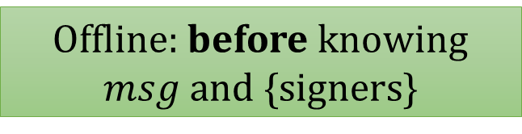
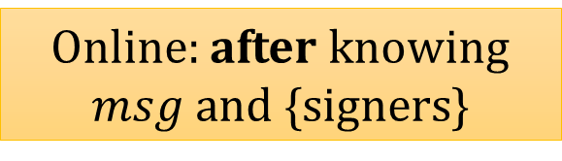
Prior Works in Lattice-Based MS
DOTT
MuSig-L [Boschini-Takahashi-Tibouchi’22]
The first scheme with 2 online rounds
The first scheme with 1 offline round + 1 online round
At the cost of higher communication
Online: after knowing $msg$ and {signers}
Offline: before knowing $msg$ and {signers}

Slide 7
Prior Works in Lattice-Based MS
DOTT
MuSig-L
The first scheme with 2 rounds
The first scheme with 1 offline round + 1 online round
Based on the same individual signature scheme: Dilithium-G
More expensive than naïve “aggregated Dilithium-G”
Simpler variant of the standardized Dilithium
E.g. adding up signatures

Slide 8
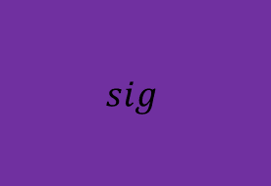
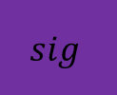
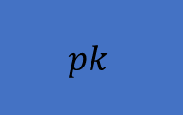

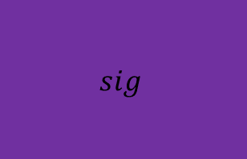


Prior Works in Lattice-Based MS
DOTT
MuSig-L
The first scheme with 2 rounds
The first scheme with 1 offline round + 1 online round
Baseline
Based on the same individual signature scheme: Dilithium-G
More expensive than naïve “aggregated Dilithium-G”
$$sig$$
$$pk$$
Signature is significantly larger
The whole system blows up (pk & sig)
$$sig$$
$$sig$$
$$pk$$
$$sig$$
$$pk$$

Slide 9
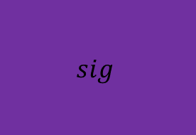



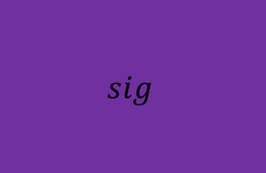





This Work: DualMS
Baseline
$$sig$$
$$pk$$
DOTT
MuSig-L
$$sig$$
$$sig$$
$$pk$$
$$sig$$
$$pk$$
DualMS
$$sig$$
$$sig$$
$$pk$$

Slide 10






This Work: DualMS
DOTT
DualMS
MuSig-L
The first scheme with 2 online rounds
2 online rounds
$$sig$$
$$sig$$
$$sig$$
$$sig$$
$$pk$$
$$pk$$

Slide 11





This Work: DualMS
DOTT
DualMS
MuSig-L
2 online rounds
The first scheme with 1 offline round + 1 online round
At the cost of higher communication
Concrete parameters:
DualMS has 2~4x times smaller pk & sig
$$sig$$
$$sig$$
$$sig$$
$$pk$$
$$pk$$

Slide 12

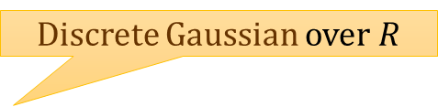

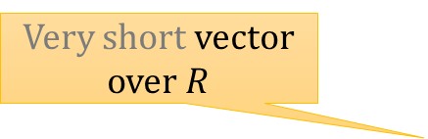
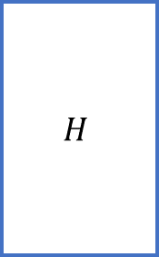

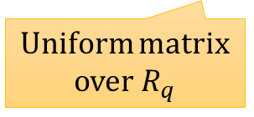
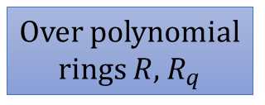
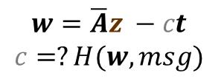
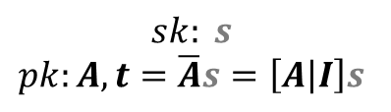

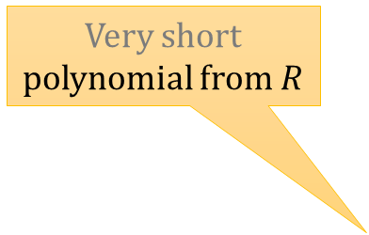
Dilithium-G
Over polynomial rings $R$, $R_{q}$
Very short polynomial from $R$
Discrete Gaussian over $R$
$w=\overline{A}y$, $msg$
$$H$$
$c=H(w, msg)$
Very short vector over $R$
$$z=y+cs$$
$$σ=(c, z)$$
$$sk: s$$
$$pk:A, t=\overline{A}s=\left[A | I\right]s$$
Rejection sampling
Uniform matrix over $R_{q}$
$$w=\overline{A}z −ct$$
$$c=?H(w, msg)$$

Slide 13
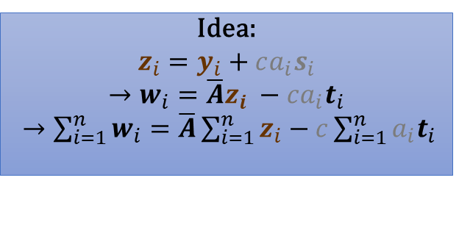


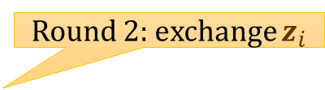
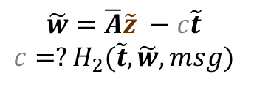


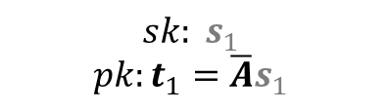
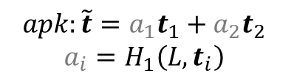
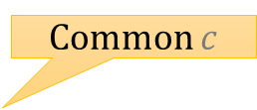




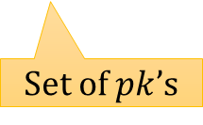

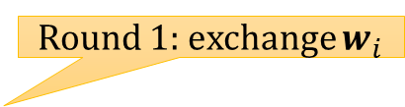


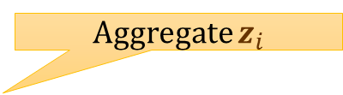
Naïve MS
Idea:
$$z_{i}=y_{i}+ca_{i}s_{i}$$
$$→w_{i}=\overline{A}z_{i} −ca_{i}t_{i}$$
$→\sum_{i=1}^{n}{w_{i}}=\overline{A}\sum_{i=1}^{n}{z_{i}}−c\sum_{i=1}^{n}{a_{i}t_{i}}$
Insecure!
$$pp:A$$
$$w_{1}=\overline{A}y_{1}$$
Round 1: exchange $w_{i}$
$w_{2}$
$$\tilde{w}=w_{1}+w_{2}$$
Common $c$
$$H_{2}$$
$$c=H_{2}( \tilde{t},\tilde{w},msg)$$
$$z_{1}=y_{1}+ca_{1}s_{1}$$
Round 2: exchange $z_{i}$
$$sk: s_{1}$$
$$pk:t_{1}=\overline{A}s_{1}$$
$z_{2}$
$$pk:t_{2}$$
Aggregate $z_{i}$
$$\tilde{z}=z_{1}+z_{2}$$
$$σ=(c, \tilde{z})$$
$$apk:\tilde{t}=a_{1}t_{1}+a_{2}t_{2}$$
$$a_{i}=H_{1}\left(L, t_{i}\right)$$
$$\tilde{w}=\overline{A}\tilde{z} −c\tilde{t}$$
$$c=?H_{2}(\tilde{t}, \tilde{w}, msg)$$
Set of $pk$’s

Slide 14


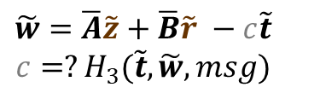



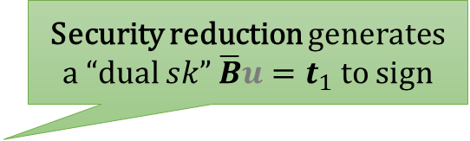

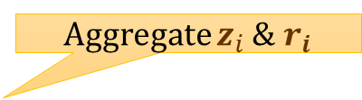



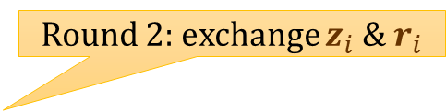
DualMS
Security reduction generates a “dual $sk$” $\overline{B}u=t_{1}$ to sign
$$B=H_{2}(\tilde{t},msg)$$
$$pp:A$$
$$w_{1}=\overline{A}y_{1}+\overline{B}r_{1}$$
Round 1: exchange $w_{i}$
$w_{2}$
$$\tilde{w}=w_{1}+w_{2}$$
Common $c$
$$H_{3}$$
$$c=H_{3}( \tilde{t},\tilde{w},msg)$$
$$z_{1}=y_{1}+ca_{1}s_{1}, r_{1}$$
Round 2: exchange $z_{i}$ & $r_{i}$
$$sk: s_{1}$$
$$pk:t_{1}=\overline{A}s_{1}$$
$z_{2}, r_{2}$
$$pk:t_{2}$$
Aggregate $z_{i}$ & $r_{i}$
$$\tilde{z}=z_{1}+z_{2}, \tilde{r}=r_{1}+r_{2}$$
$$σ=(c, \tilde{z}, \tilde{r})$$
$$apk:\tilde{t}=a_{1}t_{1}+a_{2}t_{2}$$
$$a_{i}=H_{1}\left(L, t_{i}\right)$$
$$\tilde{w}=\overline{A}\tilde{z}+\overline{B}\tilde{r} −c\tilde{t}$$
$$c=?H_{3}(\tilde{t}, \tilde{w}, msg)$$

Slide 15
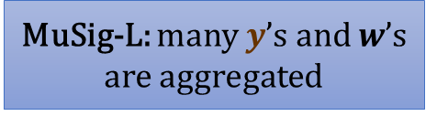

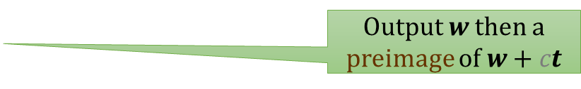

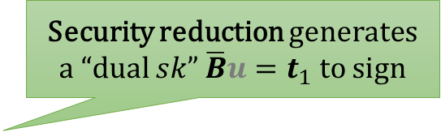
Comparison
Security reduction generates a “dual $sk$” $\overline{B}u=t_{1}$ to sign
Output $w$ then a preimage of $w+ct$
$$B=H_{2}(\tilde{t},msg)$$
DOTT: lattice trapdoor
Sample preimages of any $v$
MuSig-L: many $y$’s and $w$’s are aggregated

Slide 16
Thanks!

