Slide 1
Efficient Hybrid Exact/Relaxed Lattice Proofs and Applications to Rounding and VRFs
Muhammed F. Esgin, Ron Steinfeld, Dongxi Liu, and Sushmita Ruj
Monash University muhammed.esgin@monash.edu
CRYPTO – August 2023
mfesgin.github.io
@mfesgin

Slide 2
The Fundamental Lattice Relation
A
s
t
mod $q$
& $||s||_{∞}≤1$
Two ways to prove the above:
Exact proofs ([Ste93, …, ENS20, LNP22, …]):
Prove knowledge of $s′$ satisfying exactly the above relation
Relaxed (approximate) proofs ([Lyu09, …, ESLL19,…]):
Prove knowledge of $(\overline{c},s^{′})$ s.t. $\overline{c}⋅t=A⋅s′$ & $||s^{′}||_{∞}≤B$ with $B≫1$ (“soundness slack”)
$\sim 40$ KB $→$
$\sim 14$ KB
relaxation factor
$\sim 3$ KB
Notes:
Note that we are in the regime of linear-sized proofs where dim(s) is not “too big”. If that’s not the case, better to go with succinct proofs like Labrador (next talk at Crypto’23).
Note2: When we started this work, the cost of exact proofs was larger

Slide 3
Exact & Relaxed Proofs
Some apps (e.g. ordinary, ring, group signatures) realizable efficiently with relaxed proofs
Some settings cannot afford relaxed proofs
e.g. proving ${\left\lfloor Bs\right\rfloor }_{p}=v$
can’t do a relaxed range proof for rounding error
needs to be exactly bound
Q: What to do for protocols where exactness is partially required?
Hybrid Exact/Relaxed Proofs
Deployed in ad hoc fashion previously

Slide 4
Our Contributions
LANES⁺: framework for compact hybrid exact/relaxed proofs
Support many exact proofs: LANES ([ALS20, ENS20, LNS20]), LNP22,…
Support different system moduli
App1: Compact lattice-based rounding proofs
central tool for verifiable deterministic lattice-based cryptography
useful for Learning with Rounding (LWR) and variants
LaV: Compact (long-term) lattice-based VRF (verifiable random function)
first practical lattice-based VRF supporting (practically) unrestricted VRF evaluations
Output size: $∼$10 KB
Generalized challenge difference invertibility results (needed for soundness)
applies to challenges with $||c||_{∞}≤γ$ for $γ≥1$

Slide 5
Generalized challenge difference invertibility results
Challenge set:
Elements of $R_{q,d}=ℤ_{q}\left[X\right]/(X^{d}+1)$ - splits into $l$ subrings
$ℓ_{∞}$-norm: $γ$
total Hamming weight: $\frac{d}{l}⋅\tilde{w}$
$p_{inv}$:= non-invertibility prob. of $\overline{c}≔c−c′$ (w.r.t. “Partition-and-Sample” distribution)
Notes:
The first row results are used in LaV
As d is small in the table, challenges are full-weight for these examples

Slide 6
LANES⁺ Framework

Slide 7
Hybrid Exact/Relaxed Relation
Public matrices/vectors $A,B,t$ over $R_{q,d}$
“randomness”
“message”
A
r
B
m
t
mod $q$
- small dimension
- small coefficients (no slack allowed)
$⇒$ exact proof
- large dimension - possibly relatively small coeffs
$⇒$ relaxed proof
Imagine want to prove knowledge of a single LWE sample: $\left\langle a,s\right\rangle +e$

Slide 8
LANES⁺: Framework for Hybrid Exact/Relaxed Proofs
e.g. $P_{i}=v_{i}(v_{i}−1)$
Need two ingredients:
Relaxed Proof of Knowledge: RPoK
Exact proof: LANES (or LNP22)
Notes:
Explain the arrow notation

Slide 9
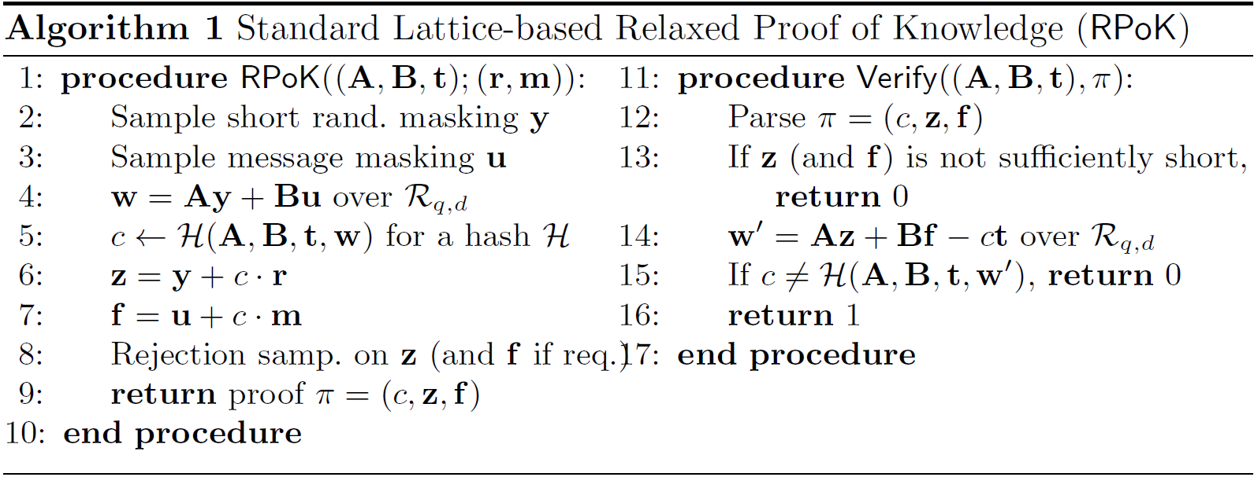
Standard RPoK Proof (“Fiat-Shamir with Aborts”)
Proves: $\overline{c}⋅t=Ar^{′}+Bm′$ where $m^{′},r^{′},\overline{c}$ are (relatively) short
Notes:
Need to prove m’ = cbar * m

Slide 10
LANES Proof
Exact (lattice) proof system due to a series of works
[ALS20]: ia.cr/2020/517
[ENS20]: ia.cr/2020/518
[LNS20]: ia.cr/2020/1183
Has commit-and-prove structure
Can prove linear and multiplicative relations (over $ℤ_{q}$):

Slide 11
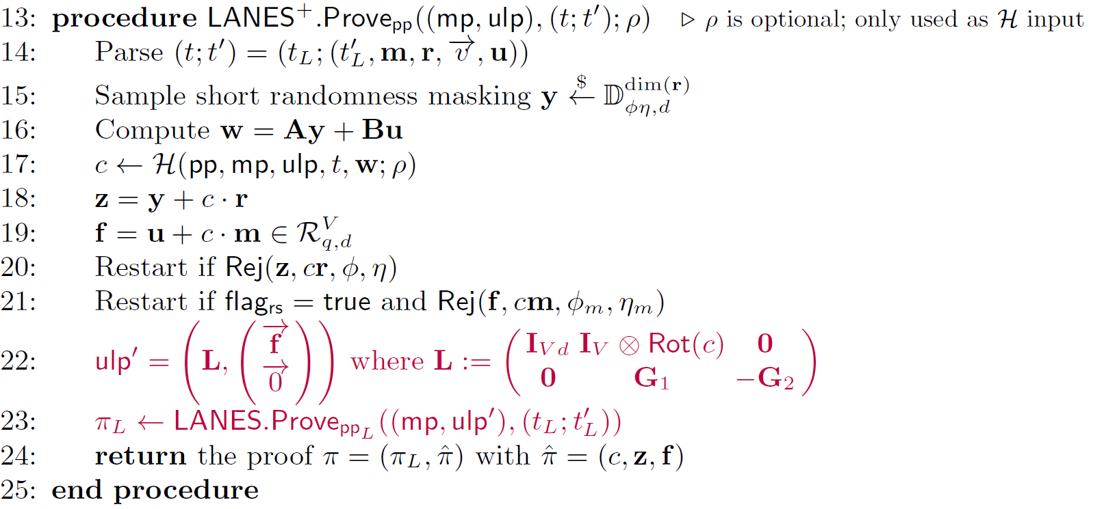
LANES⁺: RPoK + LANES
Multiplied by
$$\left(\begin{matrix}\vec{u} \\ \vec{m} \\ \vec{v }\end{matrix}\right)$$

Slide 12
LANES⁺ (cont’d)
Can support many other exact proofs
For example, LNP22 proof system
For small-dim $m$, use LANES
For medium-dim $m$, use LNP22
Can support different moduli for RPoK and LANES
Important for VRF application (to use the rounding fact)
No assumption on the shape of $B$
Can be expanding (e.g. a “gadget” matrix/vector)
[LNP22] V. Lyubashevsky, N. K. Nguyen, and M. Plançon. Lattice-based zero-knowledge proofs and applications: Shorter, simpler, and more general. In CRYPTO, 2022

Slide 13
LaV: compact long-term Lattice-based Vrf

Slide 14
Verifiable Random Function (VRF)
Introduced by Micali, Rabin and Vadhan in 1999
Goal: generate a secret-dependent random value in a verifiable fashion
Most prominent proposals:
ECVRF based on elliptic curves - used by Algorand, Cardano
BLS-VRF based on pairings/BLS signature - used by Dfinity
Advantages of EC/BLS-VRF
Does not require heavy machinery
Efficiency close to signature schemes
Applications
Proof-of-Stake (PoS) based blockchain protocols
DNSSEC protocol
Key transparency: Google, Yahoo, and WhatsApp
NOT post-quantum secure!

Slide 15
A folklore VRF approach (using random oracles)
Take a Pseudorandom Function (PRF) (with certain properties)
Glue it with a Non-Interactive Zero-Knowledge (NIZK) proof
to prove honest PRF evaluation in zero-knowledge
That gives verifiable PRF => VRF
In the paper: we describe how to handle relaxations in general

Slide 16
LaV (Module-SIS and Module-LWR)
MLWR-based PRF ${PRF}_{k}\left(m\right)={\left\lfloor A⋅s\right\rfloor }_{p}$ where $A←G(m)$ for random oracle $G$, and $k=s$ is secret vector generated at KeyGen (and $p$ divides $q$)
has deterministic error $⇒$ VRF uniqueness can work
Error can be generated at each Eval
Can evaluate for $2^{128}$ times ($→$ ever-lasting LOVE/LaV)
Ok, but why not do this years ago?
Difficult to prove rounding relation (in terms of efficiency)!
Notes:
Explain what rounding mod p does
Say in the end: So, how do we prove rounding?

Slide 17
How to prove rounding?
Fact $v={\left\lfloor u\right\rfloor }_{p}$ for $p | q$ $⇔$ $∃e∈{\left[q/p\right]}^{n}$ with $e=u−\frac{q}{p}⋅v mod q$
1) Must really prove this exactly!
2) Try to exploit relaxed proofs

Slide 18
Back to LaV
Instantiate LANES⁺ to prove
$\frac{q}{p}⋅v=Bs−e mod q$, and
$e∈{\left[q/p\right]}^{n}$ (using multiplicative proof in LANES)
Shrink the dimension of $e$ as much as possible
Concrete instantiation: $e$ is a single polynomial of degree <32 with coefficients in $[0,…,61)$
i.e., only about $6⋅32=192$ bits of entropy
However, entropy$\left(s,e\right)>7,000$ bits typically
Costs
Exact proof (LANES): 7.1 KB
Relaxed proof: 3.2 KB
(can we do exact range proof more efficiently?)

Slide 19
Performance Results

Slide 20
Comparison with “post-quantum” VRFs
VRF Scheme | Communication Size (bytes) | Key Homomorphism | Security Basis
SL-VRF ia.cr/2021/302 | 40,000* | ✗ | Block cipher
TSUBAKI ia.cr/2023/182 | 34,000 | ? | Isogeny
LaV ia.cr/2022/141 | 10,400 | ✓ | Lattice
*40KB size of SL-VRF is for LowMC block cipher. Using a more standard block cipher would likely further increase its size.

Slide 21
Open Questions & Future Work
Security analysis in Quantum Random Oracle Model (QROM)
LaV’s security is currently proven in ROM
Promising direction by Peikert and Xu for ECVRF (ia.cr/2023/223)
More applications of LANES⁺ (work in progress)
Implementation of LANES⁺ and LaV (coming soon!)

Slide 22
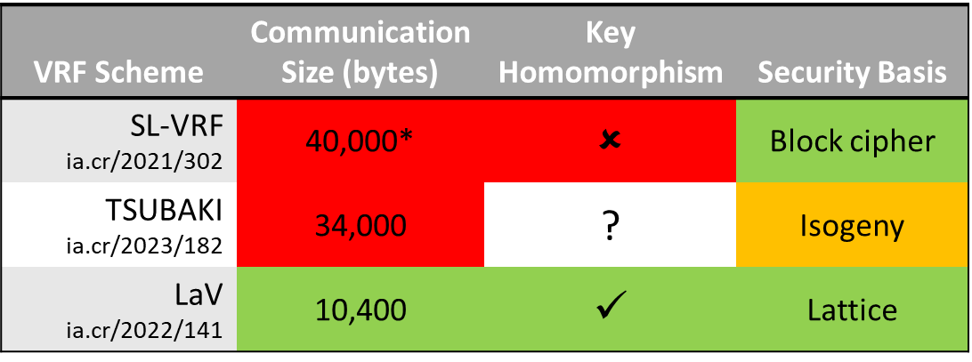
THANK YOU!
Full version of this work: ia.cr/2022/141
Please feel free to contact me: muhammed.esgin@monash.edu
mfesgin.github.io
@mfesgin

