Slide 1
Round-Optimal Black-Box MPC in the Plain Model
Yuval Ishai (Technion)
Dakshita Khurana (UIUC)
Amit Sahai (UCLA)
Akshayaram Srinivasan (University of Toronto)

Slide 2
Round-Optimal Black-Box MPC in the Plain Model
Yuval Ishai (Technion)
Dakshita Khurana (UIUC)
Amit Sahai (UCLA)
Akshayaram Srinivasan (University of Toronto)
* Presentation based on slides by Akshayaram Srinivasan

Slide 3



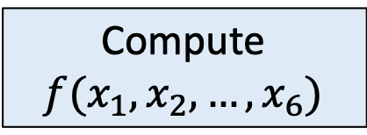

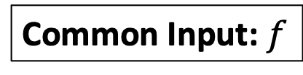


Secure Multiparty Computation
[Yao’86, Goldreich-Micali-Wigderson’87]
Only learn the output
$$x_{1}$$
$$x_{6}$$
$$x_{2}$$
Compute $f(x_{1},x_{2},…,x_{6})$
Common Input: $f$
$$x_{5}$$
$$x_{3}$$
Formally:
Simulation
$$x_{4}$$
Notes:
Let me briefly recall the setting of secure multiparty computation. We have several parties with each party having its own private input. The parties have the description of a function f as common input. The parties wish to compute the output of the function f on their joint inputs. Secure multiparty computation is a distributed computation protocol that allows the parties to compute this output by ensuring that even if an arbitrary subset of the parties are corrupted by a centralized adversary, the adversary does not learn anything else about the inputs of the honest parties except the output of the function.

Slide 4
What is the round complexity of black-box malicious-secure MPC in the plain model?
Amount of interaction
Notes:
We are interested in characterizing the round-complexity of black-box malicious-secure MPC protocol in the plain model.
By round complexity, we mean the number of sequential messages that needs to exchanged between the parties during the protocol execution.

Slide 5
What is the round complexity of black-box malicious-secure MPC in the plain model?
Make only oracle calls to the building blocks
Notes:
By black-box protocols, we mean that the protocol only makes input/output calls to the underlying building blocks and is independent of how these building blocks are implemented.

Slide 6
What is the round complexity of black-box malicious-secure MPC in the plain model?
Simulation and
security reduction make a
black-box use of adversary
Notes:
By black-box protocols, we mean that the protocol only makes input/output calls to the underlying building blocks and is independent of how these building blocks are implemented.

Slide 7
What is the round complexity of black-box malicious-secure MPC in the plain model?
Without any trusted setup
Notes:
By plain model, we mean that without any form of trusted setup. That is, we do not assume any form of common random/reference string nor assume any correlated randomness shared between the parties. This is the most basic setting for designing MPC protocols and it is important to construct MPC protocols that do not assume any form of trusted setup.

Slide 8
Why does it matter?
Non-black-box protocols are typically impractical
Are black-box protocols practical?
  Not in this talk...
  But ultimately yes!
Why insist on plain model?
  Clean and challenging question
  Motivates new techniques

Slide 9
Prior Work
Four rounds are necessary (with black-box simulation)
[GK’90, KO’04, GMPP’16]
Four rounds are sufficient [ACJ’17, BHP’17, HHPV’18, BGJKKS’18, CCGJO’20]
  Non-black-box use of cryptographic primitives
[IKSS’21]: five-round black-box protocol for general functions
  Also (optimal) four-round protocol for a special class of functions
Can we close the gap?
Notes:
Let me discuss the prior work in this area.
The work of Garg et al. from EC’2016 showed that four rounds are necessary to construct malicious secure MPC protocols in the plain model. This lower bounds holds for both black-box and non-black-box protocols, but with black-box simulation
A sequence of recent exciting works have shown that four rounds are sufficient to construct MPC protocols in the plain model. However, all these works make non-black-box use of the underlying cryptographic primitives.
A very recent work of Ishai et al. gave a construction of a five-round black-box protocol for computing general functions. In the same work, they also gave a four-round protocol for computing a special class of functions.
A fundamental question that was left open from their work is to match the round-complexity achieved by non-black-box protocols while making black-box use of cryptography.

Slide 10
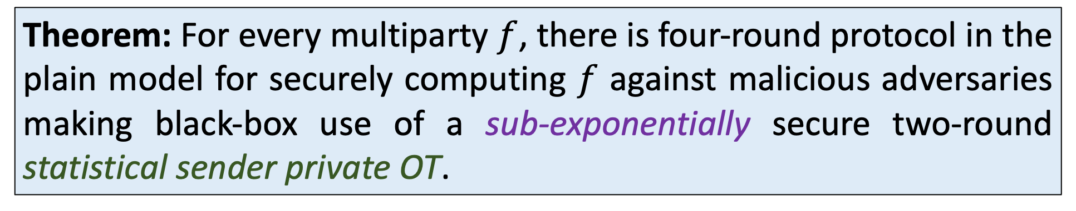
Main Result
Theorem: For every multiparty $f$, there is four-round protocol in the plain model for securely computing $f$ against malicious adversaries making black-box use of a sub-exponentially secure two-round statistical sender private OT.
Can be instantiated with sub-exponential DDH/QR/DCR/LWE
Notes:
We answer this question affirmatively.
Specifically, we show that for every multiparty function f, there exists a four round protocol for securely computing f against malicious adversaries in the plain model making black-box use of sub-exponentially secure two-round statistical sender private OT protocol.
This can be instantiated with sub-exponential versions of almost all the standard assumptions in cryptography.
In the rest of the talk, let me give a brief overview of the construction and the proof techniques.

Slide 11





Overview of IPS Compiler
[Ishai-Prabhakaran-Sahai’08]
Imagine we additionally have access to $m$ servers
$$x_{1}$$
$$x_{2}$$
Encoding of the inputs
Outer Protocol
.
.
.
$$x_{4}$$
$$x_{3}$$
Notes:
Our construction makes use of the IPS compiler and let me first give a brief overview of this compiler.
Let’s say that there are four parties each with its own private input and they want to compute some function f on their joint inputs. The first ingredient in the IPS compiler is an outer protocol.
To understand this outer protocol, let us first consider an idealized model where the parties have additionally access to m servers.
In this outer protocol, the parties generate an encoding of their inputs and send the encoded values to the servers.

Slide 12
Overview of IPS Compiler
[Ishai-Prabhakaran-Sahai’08]
Perform local computation
Decode to learn the output
$$x_{1}$$
$$x_{2}$$
Malicious security against constant fraction of server corruptions [IKP’10,Pas’10]
Encoding of the outputs
Outer Protocol
.
.
.
$$x_{4}$$
$$x_{3}$$
Notes:
The servers then perform some local computation on these encoded values and generate an encoding of the outputs that is sent back to the parties. The parties can now decode this to learn the output of the function.
The works of IKP and Paskin showed that as long as a constant fraction of the servers are corrupted by a malicious adversary, one can construct statistical secure protocols for computing log depth circuits and computationally secure protocols making black-box use of a PRG for computing general circuits.

Slide 13
Overview of IPS Compiler
[Ishai-Prabhakaran-Sahai’08]
$$x_{1}$$
$$x_{2}$$
.
.
.
$$x_{4}$$
$$x_{3}$$
Notes:
Unfortunately, in the plain model, we cannot make use of these additional servers that can perform the computation in the outer protocol.

Slide 14
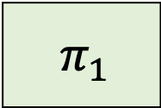
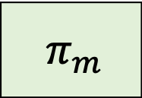
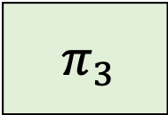
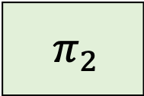
Overview of IPS Compiler
[Ishai-Prabhakaran-Sahai’08]
Functionality corresponds to the local computation of the servers
$${ π}_{1}$$
$$x_{1}$$
$$x_{2}$$
$${ π}_{2}$$
Inner Protocol
$${ π}_{3}$$
Inputs correspond to the encoded values sent to the servers in the outer protocol
.
.
.
Secure against semi-honest adversaries
$$x_{4}$$
$$x_{3}$$
$${ π}_{m}$$
Notes:
Therefore, the second ingredient of the IPS compiler is to replace the servers with an inner protocol that needs to be only secure against semi-honest adversaries. The functionality computed by this inner protocol corresponds to the local computation performed by the servers.
The inputs given to this inner protocol correspond to the encoded values sent to the servers in the outer protocol.

Slide 15
Overview of IPS Compiler
[Ishai-Prabhakaran-Sahai’08]
Functionality corresponds to the local computation of the servers
Can be run in parallel!
$${ π}_{1}$$
$$x_{1}$$
$$x_{2}$$
$${ π}_{2}$$
Outputs correspond to the encoding of the outputs generated in the outer protocol
Inner Protocol
$${ π}_{3}$$
.
.
.
Secure against semi-honest adversaries
$$x_{4}$$
$$x_{3}$$
$${ π}_{m}$$
Notes:
And, the outputs delivered by these inner protocol executions correspond to the encoding of the outputs generated in the outer protocol.
A nice feature to note here is that each of the inner protocol executions can be run in parallel and hence, the round complexity doesn’t have to grow with m.

Slide 16
Overview of IPS Compiler
[Ishai-Prabhakaran-Sahai’08]
Adversary could cheat in all inner protocol executions!
$${ π}_{1}$$
$$x_{1}$$
$$x_{2}$$
$${ π}_{2}$$
Outer protocol is only secure against constant fraction of server corruptions
Watchlist Protocol
$${ π}_{3}$$
.
.
.
$$x_{4}$$
$$x_{3}$$
$${ π}_{m}$$
Notes:
However, there is one major issue. The inner protocol is only guaranteed to be secure against semi-honest adversaries. Hence, a malicious adversary could cheat in each one of the inner protocol executions thereby break its security. Any deviation in an inner protocol execution corresponds to corrupting the corresponding server in the outer protocol. However, note that the outer protocol is only guaranteed to be secure against a constant fraction of the server corruptions. Hence, we need a mechanism to force the corrupt parties to cheat only in a small fraction of the inner protocol executions.
This is where the final ingredient in the IPS compiler comes into picture, and this is the watchlist protocol.

Slide 17
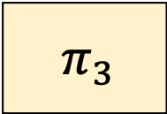
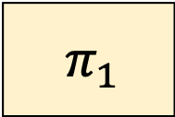
Overview of IPS Compiler
[Ishai-Prabhakaran-Sahai’08]
Ensures adversary cheats only in a small fraction of the inner protocol executions
$${ π}_{1}$$
$$x_{1}$$
$$x_{2}$$
$${ π}_{2}$$
Delivers the input and randomness used by every other party for the executions in the watchlist
Watchlist Protocol
$${ π}_{3}$$
.
.
.
$$x_{4}$$
$$x_{3}$$
$${ π}_{m}$$
Checks consistency
Notes:
In the watchlist protocol, each party chooses a small subset of the inner protocol executions as part of its watchlist. The watchlist protocol delivers the input and the randomness used by every other party in a party’s watched executions. The party can then check if the messages generated in the inner protocol are consistent with the delivered input and randomness by the watchlist protocol. If there is any deviation, then the party aborts the execution.
This ensures that if an adversary cheats in a large fraction of the executions, then with overwhelming probability, the watched executions of each honest party intersects with these cheating executions and hence, each honest party aborts. Hence, we can ensure that the adversary only cheats in a small fraction of the inner protocol executions. Therefore, we can rely on the security of the outer protocol to argue the security of the compiled protocol.
In order to instantiate the IPS compiler in the plain model, we need instantiations of the inner protocol and the watchlist protocol in the plain model.

Slide 18
How to instantiate the inner protocol?
Three-round Black-box inner protocol
[GIS’18, PS’21]
Robust to cheating in first two rounds
Watchlist execution must complete before the final round
Need to perform the consistency check before sending last round message
Need a three-round watchlist protocol!
Impossible with black-box simulation [KO’04]
Notes:
Let’s start with the inner protocol. We need the inner protocol to make black-box use of cryptography so that the overall protocol makes black-box use. And, as our goal is to construct a round-optimal protocol, we need to make use of an inner protocol that runs in an small number of rounds.
Hence, we make use of the three-round protocol secure against semi-honest adversaries from the work of Patra and Srinivasan that builds on a protocol of Garg et al.
We show that this protocol satisfies an additional important property of robustness. This robustness property states that even if an adversary deviates arbitrarily in the first two rounds of the protocol, this adversary cannot learn anything about the inputs of the honest parties.
As a result, we only need to perform the consistency check before sending the final round message and not before sending each message in the inner protocol.
To ensure that the honest parties can perform this consistency check, we need the watchlist execution to complete before the final round message is sent.
As our goal is to construct a four-round protocol, this means that we need a watchlist protocol that runs in three rounds. Unfortunately, the work of Katz-Ostrovsky shows that it is impossible to achieve standard simulation security for the watchlist protocol in three rounds.

Slide 19
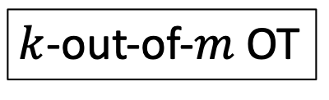
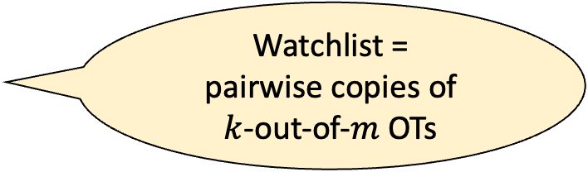
What can be achieved in three rounds?
Watchlist =
pairwise copies of
$k$-out-of-$m$ OTs
$k$-out-of-$m$ OT
Sender
Receiver
Achieve standard simulation security against malicious senders
Achieve super-polynomial simulation security against malicious receivers
Notes:
Let’s take a step back and see what can be achieved in three rounds.
For this purpose, let’s first consider a three round protocol for implementing the k-out-of-m OT functionality. Note that one can view watchlist protocol as an execution of k-out--of-m OT protocol between each pair of parties.
In a three-round protocol for a k-out-of-m OT between a sender and a receiver, the first round message is sent by the sender, the second round message is sent by the receiver and the final round message is sent by the sender. The receiver can use the transcript and its secret state to learn the output.
As the sender is sending the first and the third round messages in the protocol, one can potentially rewind the second round message multiple times and extract the effective sender inputs used by a malicious party. Therefore, it is possible to achieve standard simulation security against malicious senders. On the other hand, the receiver is sending a single message in the protocol. Hence, at best one can hope to extract the malicious receiver’s input in super-polynomial time and achieve super-polynomial time simulation security.

Slide 20
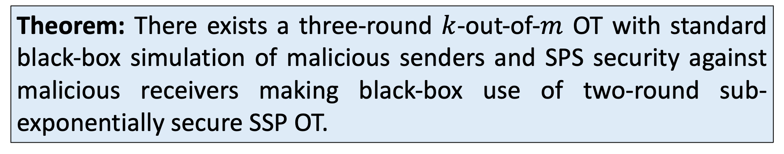
What can be achieved in three rounds?
Need to overcome
non-malleability issues
Extend to watchlists
Theorem: There exists a three-round $k$-out-of-$m$ OT with standard black-box simulation of malicious senders and SPS security against malicious receivers making black-box use of two-round sub-exponentially secure SSP OT.
Notes:
This is precisely what we do. We give a construction of a three round k-out-of-m OT construction that satisfies standard simulation security against malicious sender and SPS security against malicious receiver by making black-box use of a two-round sub-exponentially secure SSP OT scheme.
We also extend this protocol to compute the watchlist functionality. This is non-trivial as we have to take care of non-malleability issues but we will ignore these issues for the sake of this talk.

Slide 21
Instantiating IPS with 3-round Watchlist
Only gives a final protocol
with SPS security
Three-round watchlist protocol with SPS security
Three-round robust inner protocol
Notes:
Let’s instantiate the IPS compiler with a three round watchlist protocol.
We have a three-round robust inner protocol.. We start the execution of the watchlist before the first round message is sent in the inner protocol so that it can complete before the final round message is sent. This ensures that the parties can perform the consistency checks before sending the final round message.
While this seems to work, there is a serious underlying issue. Specifically, we are only able to give a super-polynomial time simulator for the overall protocol. This is because the three-round watchlist protocol only has SPS simulation security against malicious receivers.
To give a polynomial-time simulator, we somehow need to extract the receiver inputs used by corrupt parties in the watchlist execution in polynomial time. However, this task seems impossible and we are stuck.

Slide 22
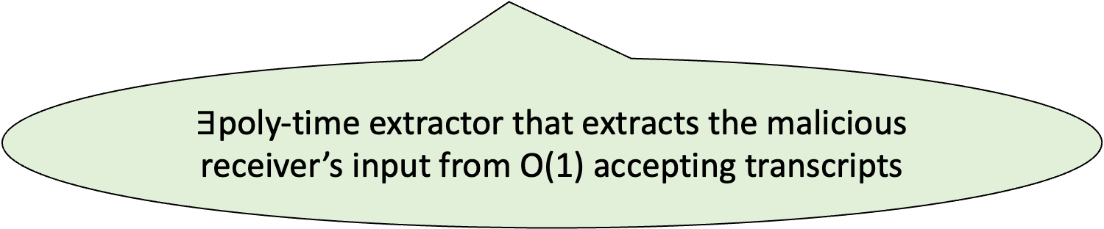
Promise-Style Extraction
[Badrinarayanan-Goyal-Jain-Kalai-Khurana-Sahai’18]
Need to ensure that the malicious receiver input is consistent!
$k$-out-of-$m$ OT
Sender
Receiver
$∃$poly-time extractor that extracts the malicious receiver’s input from O(1) accepting transcripts
Notes:
To get out of this conundrum, we consider a weaker extraction guarantee. Specifically, we make use of promise-style extraction which was introduced in the work of Badrinarayan et al. to construct weaker notions of zero-knowledge arguments. To understand this notion, let us once again consider the k-out-of-m OT protocol between a receiver and a sender. We already saw the interaction pattern for a three message protocol. In a protocol that additionally allows a promise-style extraction, we run another three-message protocol in parallel but in the opposite direction. This additional protocol satisfies the following. Given a constant number of accepting transcripts, there exists a polynomial time extractor that extracts the malicious receiver input.
Note that this extraction guarantee holds only if the malicious receiver sends at least one valid third round message. If an adversary receives the final round message from the honest sender but does not reply with a valid third round message, then this promise-style extraction provides no security guarantees against such adversaries. (In the sense of being unable to extract.)
Constructing such a promise-style extractor is non-trivial since we need to ensure that the malicious-receiver’s input used in these two executions are consistent.

Slide 23
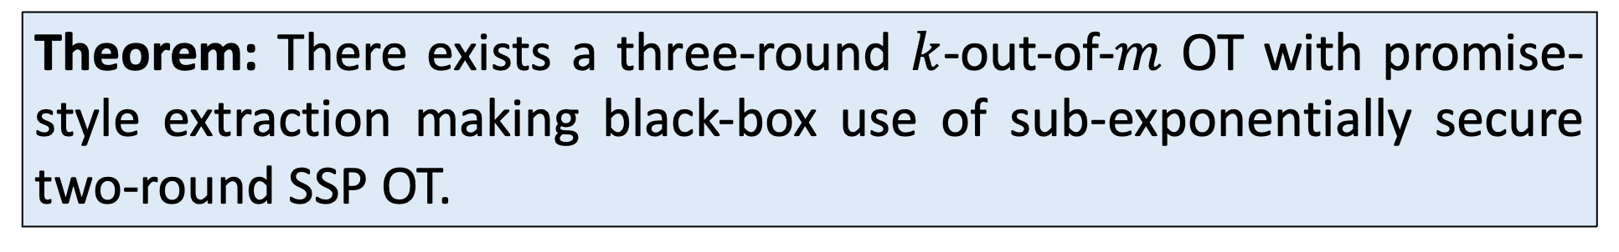
Promise-Style Extraction
[Badrinarayanan-Goyal-Jain-Kalai-Khurana-Sahai’18]
Need to overcome
non-malleability issues
Extend to watchlists
Theorem: There exists a three-round $k$-out-of-$m$ OT with promise-style extraction making black-box use of sub-exponentially secure two-round SSP OT.
Notes:
Nevertheless, we give a construction of such a scheme making black-box use of sub-exponentially secure two-round SSP OT.
As before, we also extend this to get a watchlist protocol in three rounds. Again, this involves solving significant non-malleability issues and I will refer you to the paper for the details.

Slide 24
Final Protocol
What if the adversary does not send a valid third round message?
How to generate a constant number of accepting transcripts?
Promise-style extraction
Three-round watchlist protocol
Three-round robust inner protocol
Notes:
Let’s look at our final protocol.
We make use of a three-round robust inner protocol along with a three-round watchlist protocol satisfying SPS security against malicious receivers. In parallel, we also run the three-round promise style-extraction protocol.
However, there are a couple of major points we need to address. The first is what if the adversary does not send a valid third round message? In that case, the promise-style extraction fails, so how do we simulate?
The second is that in the case where the adversary sends a valid third round message, how do we get a constant number of accepting transcripts?
We will answer both these questions together by giving a high-level overview of the proof.

Slide 25
Conclusion
First round-optimal black-box protocol in the plain model
Our final simulator is poly-time even though we make use of
super-poly simulators in intermediate hybrids
  Technique can have other applications
Open questions
  Black-box construction from polynomial hardness?
  Black-box use of two-round semi-honest OT? Four-round malicious OT?
  Simpler approaches?

Slide 26
Thank you! https://eprint.iacr.org/2023/1173

