Slide 1
HyperPlonk:
Plonk with Linear-Time Prover and High-Degree Custom Gates
Binyi Chen, Benedikt Bünz, Dan Boneh, Zhenfei Zhang
Espresso Systems, Stanford

Slide 2







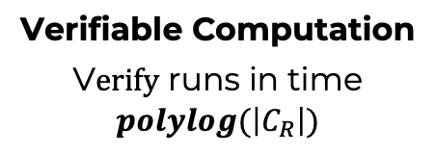
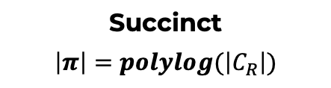





Zero Knowledge Succinct Non-Interactive
Argument of Knowledge
(ZK-SNARK)
Public instance $x$
[GMR ’86,BFM ’88, ALMSS’92, Kilian’92, Micali’00, IKO’07, GGPR’13,…]
Setup$\left(C_{R}\right)→(pk,vk)$
Private witness $w$
Inputs:
$$\left(x, w\right)∈R$$
$$x$$
$C_{R}$ - circuit computing $R$
𝜋
V$erify\left(vk,x,π\right)→Accept/Reject$
Prove$\left(pk,x,w\right)→π$
Prover
Verifier
Knowledge Sound
infeasible to produce valid 𝝅 if prover doesn’t know w
Zero knowledge
the 𝝅 doesn’t reveal anything about w
Succinct
$$\left|π\right|=polylog(\left|C_{R}\right|)$$
Verifiable Computation
V$erify$ runs in time $polylog(\left|C_{R}\right|)$

Slide 3


Rollup
Today: every miner must verify every posted Tx
verify
π
verify
all Tx
verify all Tx
⇒ short proof π
verify
π
verify
all Tx
summary, π
Rollup Server
verifying proof (SNARK) is much easier than verifying 10K Tx

Slide 4
Ethereum Rollup
Requires:
Fast prover for large statements (minimal overhead)
Small proof size and efficient verification (checked in smart contract)
Powerful circuit constraint systems (e.g., high-deg/lookup gates)
Hardware-friendliness (highly parallelizable, low memory requirements)

Slide 5


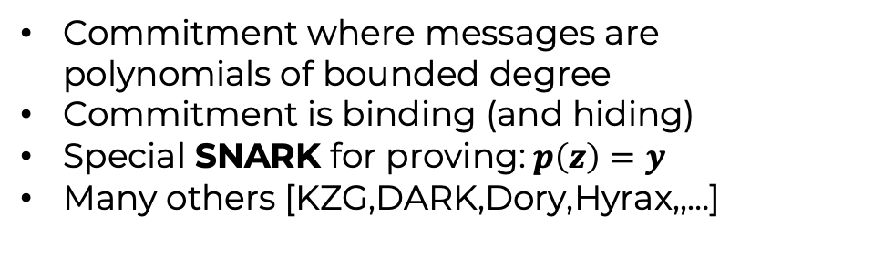


Modern SNARK Recipe
PolyIOP
Polynomial Commitment
$$(p\left(X\right))$$
$$p\left(X\right)=a+bX+cX^{2}+…$$
$$π:p\left(z\right)=y$$
Prover
Verifier
Prover
Verifier
(ZK)-Proof protocol for circuits where prover sends polynomials
Verifier evaluates polynomials at points
Polynomials may be long and expensive to evaluate
Commitment where messages are polynomials of bounded degree
Commitment is binding (and hiding)
Special SNARK for proving:$p\left(z\right)=y$
Many others [KZG,DARK,Dory,Hyrax,,…]
PolyIOP Theorem [CHMMVW19,BFS19]
PolyIOP for circuit + Polynomial Commitment = SNARK for circuit

Slide 6
Our Contributions
HyperPlonk+ PolyIOP
  Linear-time prover, no use of FFT-friendly field
    The first linear-time SNARK that has expressive gate support and small proof size
    Hardware-optimization friendly
  Native high-degree custom gate support
    Better support than Plonk [GWC19]
  Lookup gate support
    The first linear-time PolyIOP for the lookup relation!
Towards strict linear-time SNARKs: Orion+ PCS
  Improve opening size of the state-of-the-arts (Orion & Brakedown)
    5MB proof -> <10KB proof
Active industry deployment/development
  E.g., ETH Foundation/Scroll actively develop it for future zkEVM solutions
Notes:
In this talk, we answer the previous question affirmatively and introduce a new family of proof systems called HyperPlonk+. To highlight some of its cool features, we note that
high-deg support
Lookup gate support
Linear-time prover without FFT. Not the first linear-time SNARK, but the first linear-prover SNARK that support useful gates lik…
Not only theoretical construction but concretely efficient: attracts many active industry developments

Slide 7


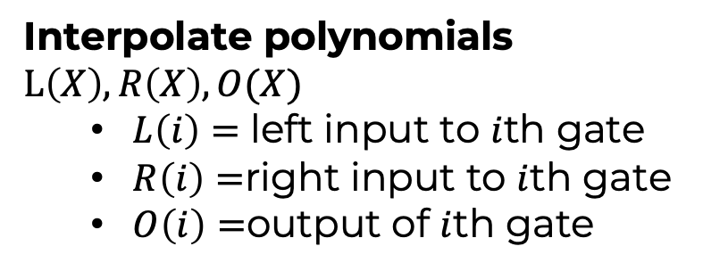

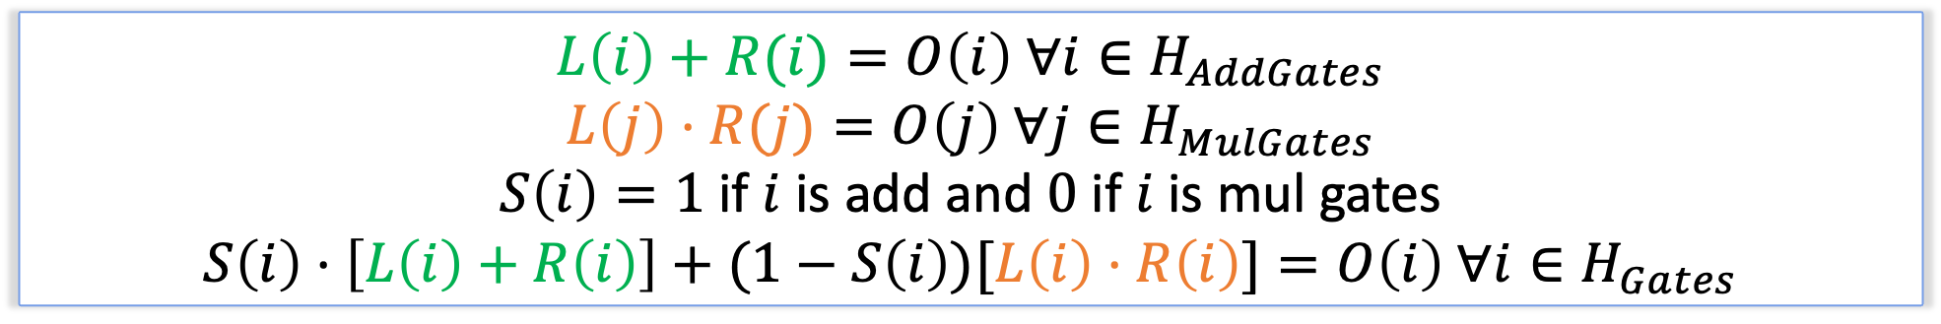



Plonk PIOP[GWC19]
Circuit (Additions and Multiplications)
Polynomial Equations
77
Interpolate polynomials $L\left(X\right),R\left(X\right),O(X)$
  $L\left(i\right)=$ left input to $i$th gate
  $R\left(i\right)=$right input to $i$th gate
  $O\left(i\right)=$output of $i$th gate
$$\text{×}$$
(Gate 2)
11
7
(Gate 0)
$$+$$
$$+$$
(Gate 1)
5
6
6
1
$$x1$$
$$x2$$
$$w1$$
5
6
1
example input
Circuit Check
$$L\left(i\right)+R(i)=O\left(i\right) ∀i∈H_{AddGates}$$
$$L\left(j\right)⋅R(j)=O\left(j\right) ∀j∈H_{MulGates}$$
$S\left(i\right)=1$ if $i$ is add and $0$ if $i$ is mul gates
$$S\left(i\right)⋅\left[L\left(i\right)+R\left(i\right)\right]+(1−S\left(i\right))[L\left(i\right)⋅R\left(i\right)]=O\left(i\right) ∀i∈H_{Gates}$$

Slide 8
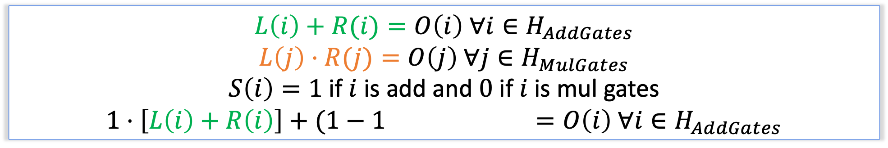
Plonk PIOP[GWC19]
Circuit (Additions and Multiplications)
Polynomial Equations
77
Interpolate polynomials $L\left(X\right),R\left(X\right),O(X)$
  $L\left(i\right)=$ left input to $i$th gate
  $R\left(i\right)=$right input to $i$th gate
  $O\left(i\right)=$output of $i$th gate
$$\text{×}$$
(Gate 2)
11
7
(Gate 0)
$$+$$
$$+$$
(Gate 1)
5
6
6
1
$$x1$$
$$x2$$
$$w1$$
5
6
1
example input
Circuit Check
$$L\left(i\right)+R(i)=O\left(i\right) ∀i∈H_{AddGates}$$
$$L\left(j\right)⋅R(j)=O\left(j\right) ∀j∈H_{MulGates}$$
$S\left(i\right)=1$ if $i$ is add and $0$ if $i$ is mul gates
$$1⋅\left[L\left(i\right)+R\left(i\right)\right]+(1−1)[L\left(i\right)⋅R\left(i\right)]=O\left(i\right) ∀i∈H_{AddGates}$$

Slide 9
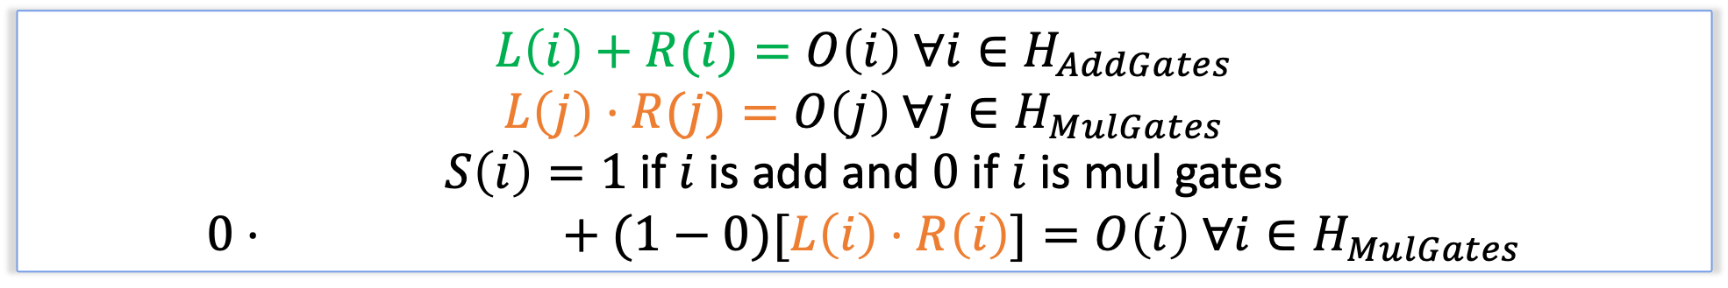
Plonk PIOP[GWC19]
Circuit (Additions and Multiplications)
Polynomial Equations
77
Interpolate polynomials $L\left(X\right),R\left(X\right),O(X)$
  $L\left(i\right)=$ left input to $i$th gate
  $R\left(i\right)=$right input to $i$th gate
  $O\left(i\right)=$output of $i$th gate
$$\text{×}$$
(Gate 2)
11
7
(Gate 0)
$$+$$
$$+$$
(Gate 1)
5
6
6
1
$$x1$$
$$x2$$
$$w1$$
5
6
1
example input
Circuit Check
$$L\left(i\right)+R(i)=O\left(i\right) ∀i∈H_{AddGates}$$
$$L\left(j\right)⋅R(j)=O\left(j\right) ∀j∈H_{MulGates}$$
$S\left(i\right)=1$ if $i$ is add and $0$ if $i$ is mul gates
$$0⋅\left[L\left(i\right)+R\left(i\right)\right]+(1−0)[L\left(i\right)⋅R\left(i\right)]=O\left(i\right) ∀i∈H_{MulGates}$$

Slide 10
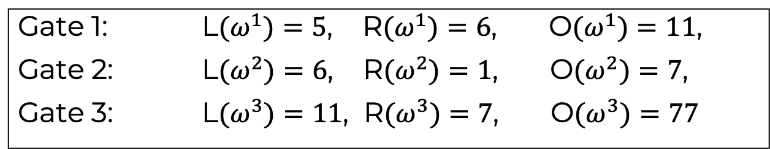
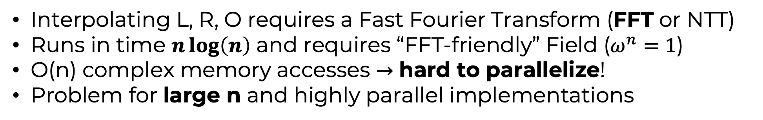
Plonk: Encoding Polynomials
Circuit trace
Polynomials
Gate 1: 5 , 6 , 11
Gate 2: 6 , 1 , 7
Gate 3: 11, 7, 77
Gate 1: L$(ω^{1})=5$, R$(ω^{1})=6$, O$(ω^{1})=11$,
Gate 2: L${(ω}^{2})=6$, R$(ω^{2})=1$, O$(ω^{2})=7$,
Gate 3: L$(ω^{3})=11$, R$(ω^{3})=7$, O$(ω^{3})=77$
$L\left(X\right)=86+45X+78X^{2}, R\left(X\right)=64+64X+X^{2},O\left(X\right)=47+43X+3X^{2}$ $∈𝔽_{113}$ for $w=15$
Interpolating L, R, O requires a Fast Fourier Transform (FFT or NTT)
Runs in time $n\log\left(n\right)$ and requires “FFT-friendly” Field ($ω^{n}=1$)
O(n) complex memory accesses $→$ hard to parallelize!
Problem for large n and highly parallel implementations
Notes:
Plonk uses univariate polynomials to interpolate the columns of the matrix so that it can conveniently conduct polynomial equation checks later.

Slide 11
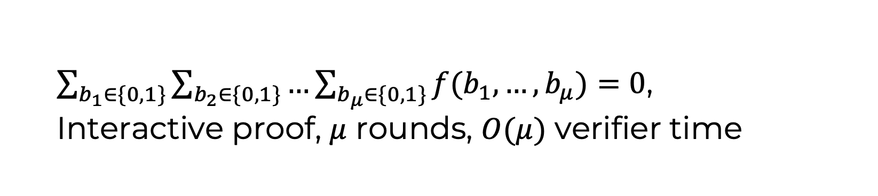
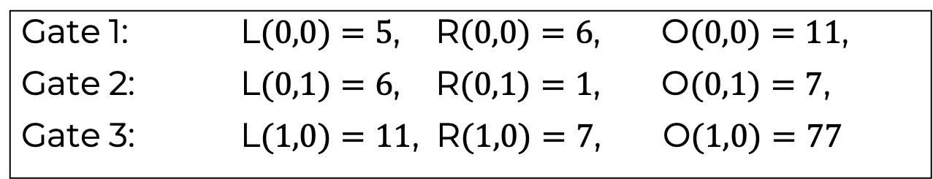



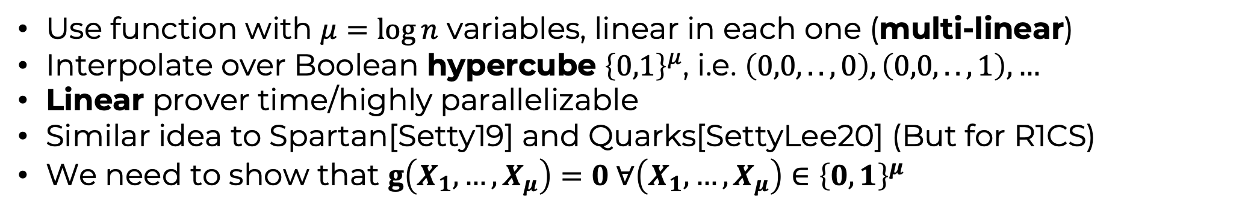
HyperPlonk: Encoding Multi-linear functions
Circuit trace
Polynomials
Gate 1: 5 , 6 , 11
Gate 2: 6 , 1 , 7
Gate 3: 11, 7, 77
Gate 1: L$(0,0)=5$, R$(0,0)=6$, O$(0,0)=11$,
Gate 2: L$(0,1)=6$, R$(0,1)=1$, O$(0,1)=7$,
Gate 3: L$(1,0)=11$, R$(1,0)=7$, O$(1,0)=77$
$$L\left(X,Y\right)=5+X+6Y$$
$$R\left(X,Y\right)=6−5X+Y$$
$$O\left(X,Y\right)=11−4X+66Y$$
Use function with $μ=\log{n}$ variables, linear in each one (multi-linear)
Interpolate over Boolean hypercube ${\left\{0,1\right\}}^{μ}$, i.e. $\left(0,0,..,0\right),\left(0,0,..,1\right),…$
Linear prover time/highly parallelizable
Similar idea to Spartan[Setty19] and Quarks[SettyLee20] (But for R1CS)
We need to show that $g\left(X_{1},…,X_{μ}\right)=0 ∀\left(X_{1},…,X_{μ}\right)∈{\left\{0,1\right\}}^{μ}$
Key Tool: SumCheck protocol[LFKN’92]
$\sum_{b_{1}∈\{0,1\}}{\sum_{b_{2}∈\{0,1\}}{…\sum_{b_{μ}∈\{0,1\}}{f(b_{1},…,b_{μ})}}}=0$,
Interactive proof, $μ$ rounds, $O(μ)$ verifier time
Notes:
Plonk uses univariate polynomials to interpolate the columns of the matrix so that it can conveniently conduct polynomial equation checks later.

Slide 12







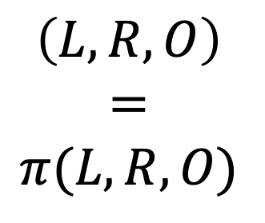

Wiring Identity Check
[GWC19]
The computation trace:
84
L
R
O
(Gate 3)
$$\text{+}$$
inputs: 5, 6, 1
Gate 0: 5 , 6 , 11
Gate 1: 6 , 1 , 7
Gate 2: 11, 7, 77
Gate 3: 77 , 7 , 84
$$\left(L, R, O\right)$$
$$=$$
$$π(L, R, O)$$
77
(Gate 2)
$$\text{×}$$
7
11
7
(Gate 0)
$$+$$
$$+$$
(Gate 1)
5
6
1
6
for some fixed permutation $π$
$$x1$$
$$x2$$
$$w1$$
All slots with the same color
should have identical values!
Notes:
Besides proving gate computation correctness, we also need to ensure that different gate values are consistent if they are connected by the same wire.
For example, the output of Gate 1 should be the same as the right input of Gate 2, which should all be value 7.
And more generally, all slots here with the same color should have identical values.
Inspired by Plonk, we note that this can be translated into a prescribed permutation relation, where we check that L, R, O’s values are invariant after applying a prescribed permutation.

Slide 13

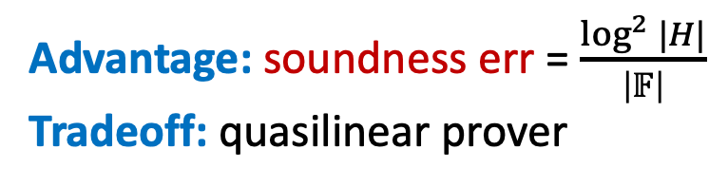




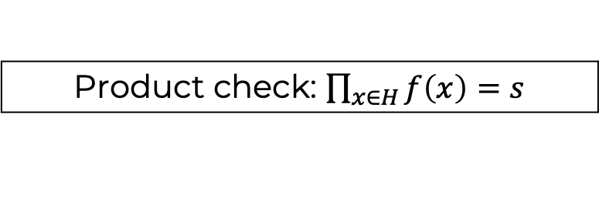

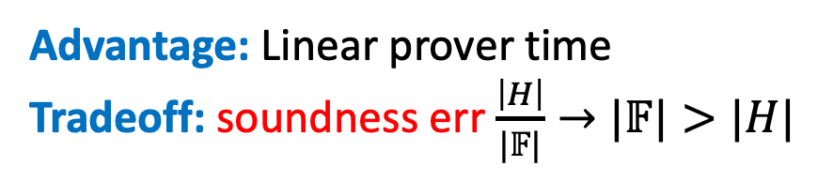
Permutation Check
Prove $\left(L, R, O\right)=π(L, R, O)$ for some fixed permutation $π$
Approach 1:
Permutation check: $f\left(x\right)=f\left(π\left(x\right)\right)∀x∈H$
Approach 2:
Multi-set check
$${\left\{(f_{i},i)\right\}}_{i∈H}={\left\{(f_{i},π_{i})\right\}}_{i∈H}$$
Zero check
$$f\left(x\right)−f\left(\tilde{π}\left(x\right)\right)∀x∈H$$
Need $Char\left(𝔽\right)>\left|H\right|$
$$\tilde{π}=mle\left(π\right)$$
Product check: $\prod_{x∈H}{f\left(x\right)=s}$
degree blowup
Zero check
$$f\left(x\right)=0 ∀x∈H$$
$2log\left|H\right|$-round sum check
Naïve prover: quadratic runtime
Our result: quasilinear proving time
Advantage: Linear prover time
Tradeoff: soundness err $\frac{\left|H\right|}{|𝔽|}→|𝔽|>|H|$
Advantage: soundness err = $\frac{\log^{2}{|H|}}{\left|𝔽\right|}$
Tradeoff: quasilinear prover
Notes:
Sufficient to design a protocol for permutation relation, and we introduce 2 approaches
first approach: inspired by Plonk
Perm check -> multi-set check, where the goal is to prove that 2 sets of tuples are identical. E.g., here we want to prove the set of pairs (fi, i) is the same as the set of pairs (fi, pi_i).
Mset check -> product check
Finally, prod check -> zero check in the multilinear setting
Advantage
Tradeoff: can’t use fields with small chars like 2^64

Slide 14
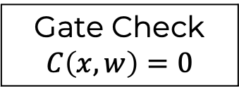
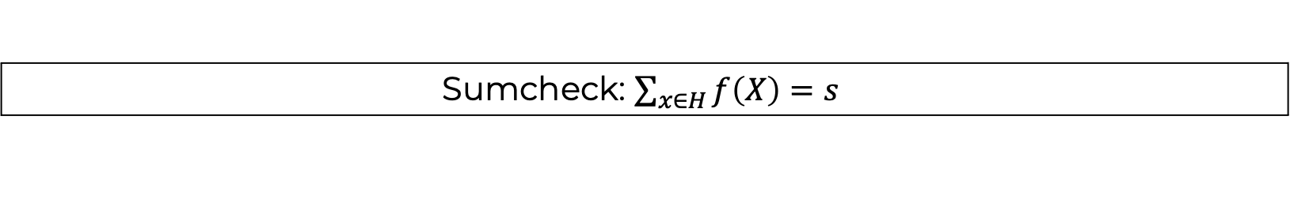

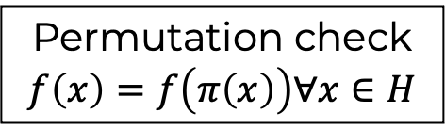

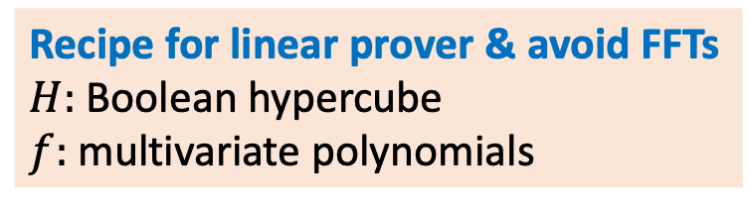
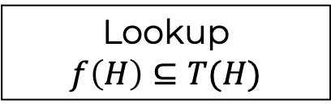
Hyperplonk: Components
Recipe for linear prover & avoid FFTs
$H:$ Boolean hypercube
$f:$ multivariate polynomials
Hyperplonk
Hyperplonk+
Permutation check
$$f\left(x\right)=f\left(π\left(x\right)\right)∀x∈H$$
Lookup
$$f\left(H\right)⊆T(H)$$
Gate Check
$$C\left(x,w\right)=0$$
Multi-set check
$${\left\{(x_{1,i},x_{2,i})\right\}}_{i∈H}={\left\{(y_{1,i},y_{2,i})\right\}}_{i∈H}$$
Product check: $\prod_{x∈H}{f\left(x\right)=s}$
Zero check
$$f\left(x\right)=0 ∀x∈H$$
Sumcheck: $\sum_{x∈H}{f\left(X\right)=s }$
Notes:
general and modular framework for designing PolyIOPs for different relations
to achieve linear prover and avoid FFTs, the key here is to use Boolean hypercube as the embedding set H and use multi-variate polynomials for sumchecks.

Slide 15

Hyperplonk: High-degree Gates
$$S\left(y\right)⋅\left[L\left(y\right)+R\left(y\right)\right]+\left(1−S\left(y\right)\right)⋅[L\left(y\right)⋅R\left(y\right)]=O\left(y\right) ∀y∈H_{gates}$$
The gate formula can be more general
e.g. more selectors and more different custom gates
high degree, e.g., $L{\left(y\right)}^{5}+R(y)$
$$S\left(y\right)⋅\left[L\left(y\right)+R\left(y\right)\right]+\left(1−S\left(y\right)\right)⋅[G(L\left(y\right),R\left(y\right))]=O\left(y\right) ∀y∈H_{gates}$$
Benefit: reduce the size of the circuit/witness -> faster prover
E.g.: ECC addition, Rescue hash, etc…
Notes:
Recall the simplified Plonk formula: a degree-3 formula
In practice, we can use other types of gates with much higher degree, example L^5 + R.
more generally, we can embed more custom gate types using different selectors
useful because we can constrain certain functions using a much smaller circuit
e.g., ECC addition, Rescue round functions, and more

Slide 16
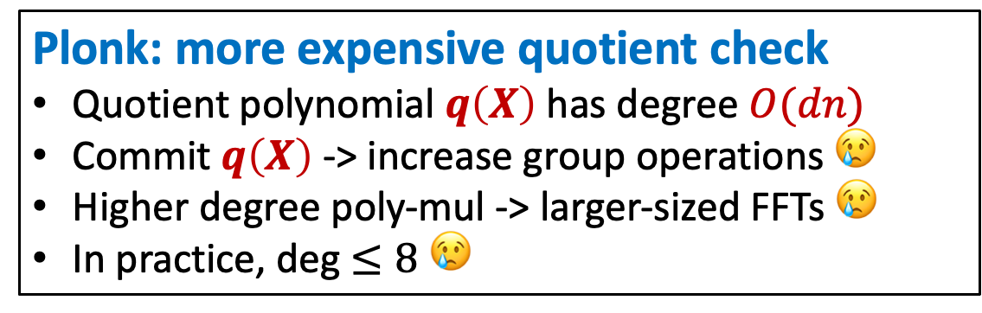
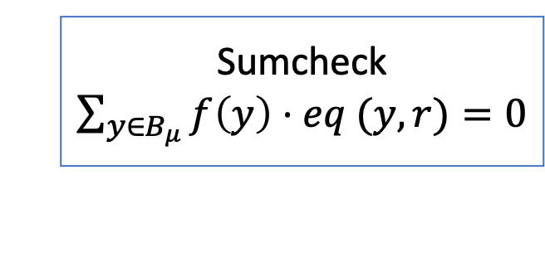

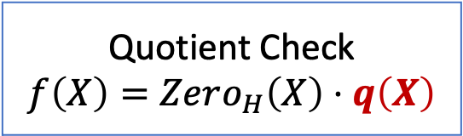
Hyperplonk: High-degree Gates
Plonk: more expensive quotient check
Quotient polynomial $q\left(X\right)$ has degree $O(dn)$
Commit $q\left(X\right)$-> increase group operations 😢
Higher degree poly-mul -> larger-sized FFTs 😢
In practice, deg $≤8$ 😢
Quotient Check
$f\left(X\right)=Zero_{H}\left(X\right)⋅q\left(X\right)$
V.S.
Hyperplonk: efficient multivariate sumcheck
Only $\tilde{O}(dn)$field-operations 🎉
Allows much higher degree 🎉
Sumcheck
$\sum_{y∈B_{μ}}{f\left(y\right)⋅eq (y, r)}=0$
Notes:
Plonk can also support high-degree custom gates, but a great advantage of HyperPlonk is that it can support high-degree gates at a much less cost.
Commit a quotient poly that has degree dn
First, increases # group ops from n to dn, significant when d is high
Also needs to higher degree poly mul, involves large-sized FFTs
In practice, the cusom gate doesn’t have a very high degree
In comparison, HyperPlonk uses sumcheck which involves no quotient polynomial. And instead of having O(dn) group operations, it only needs to do O(dn) field operations which is much faster.

Slide 17
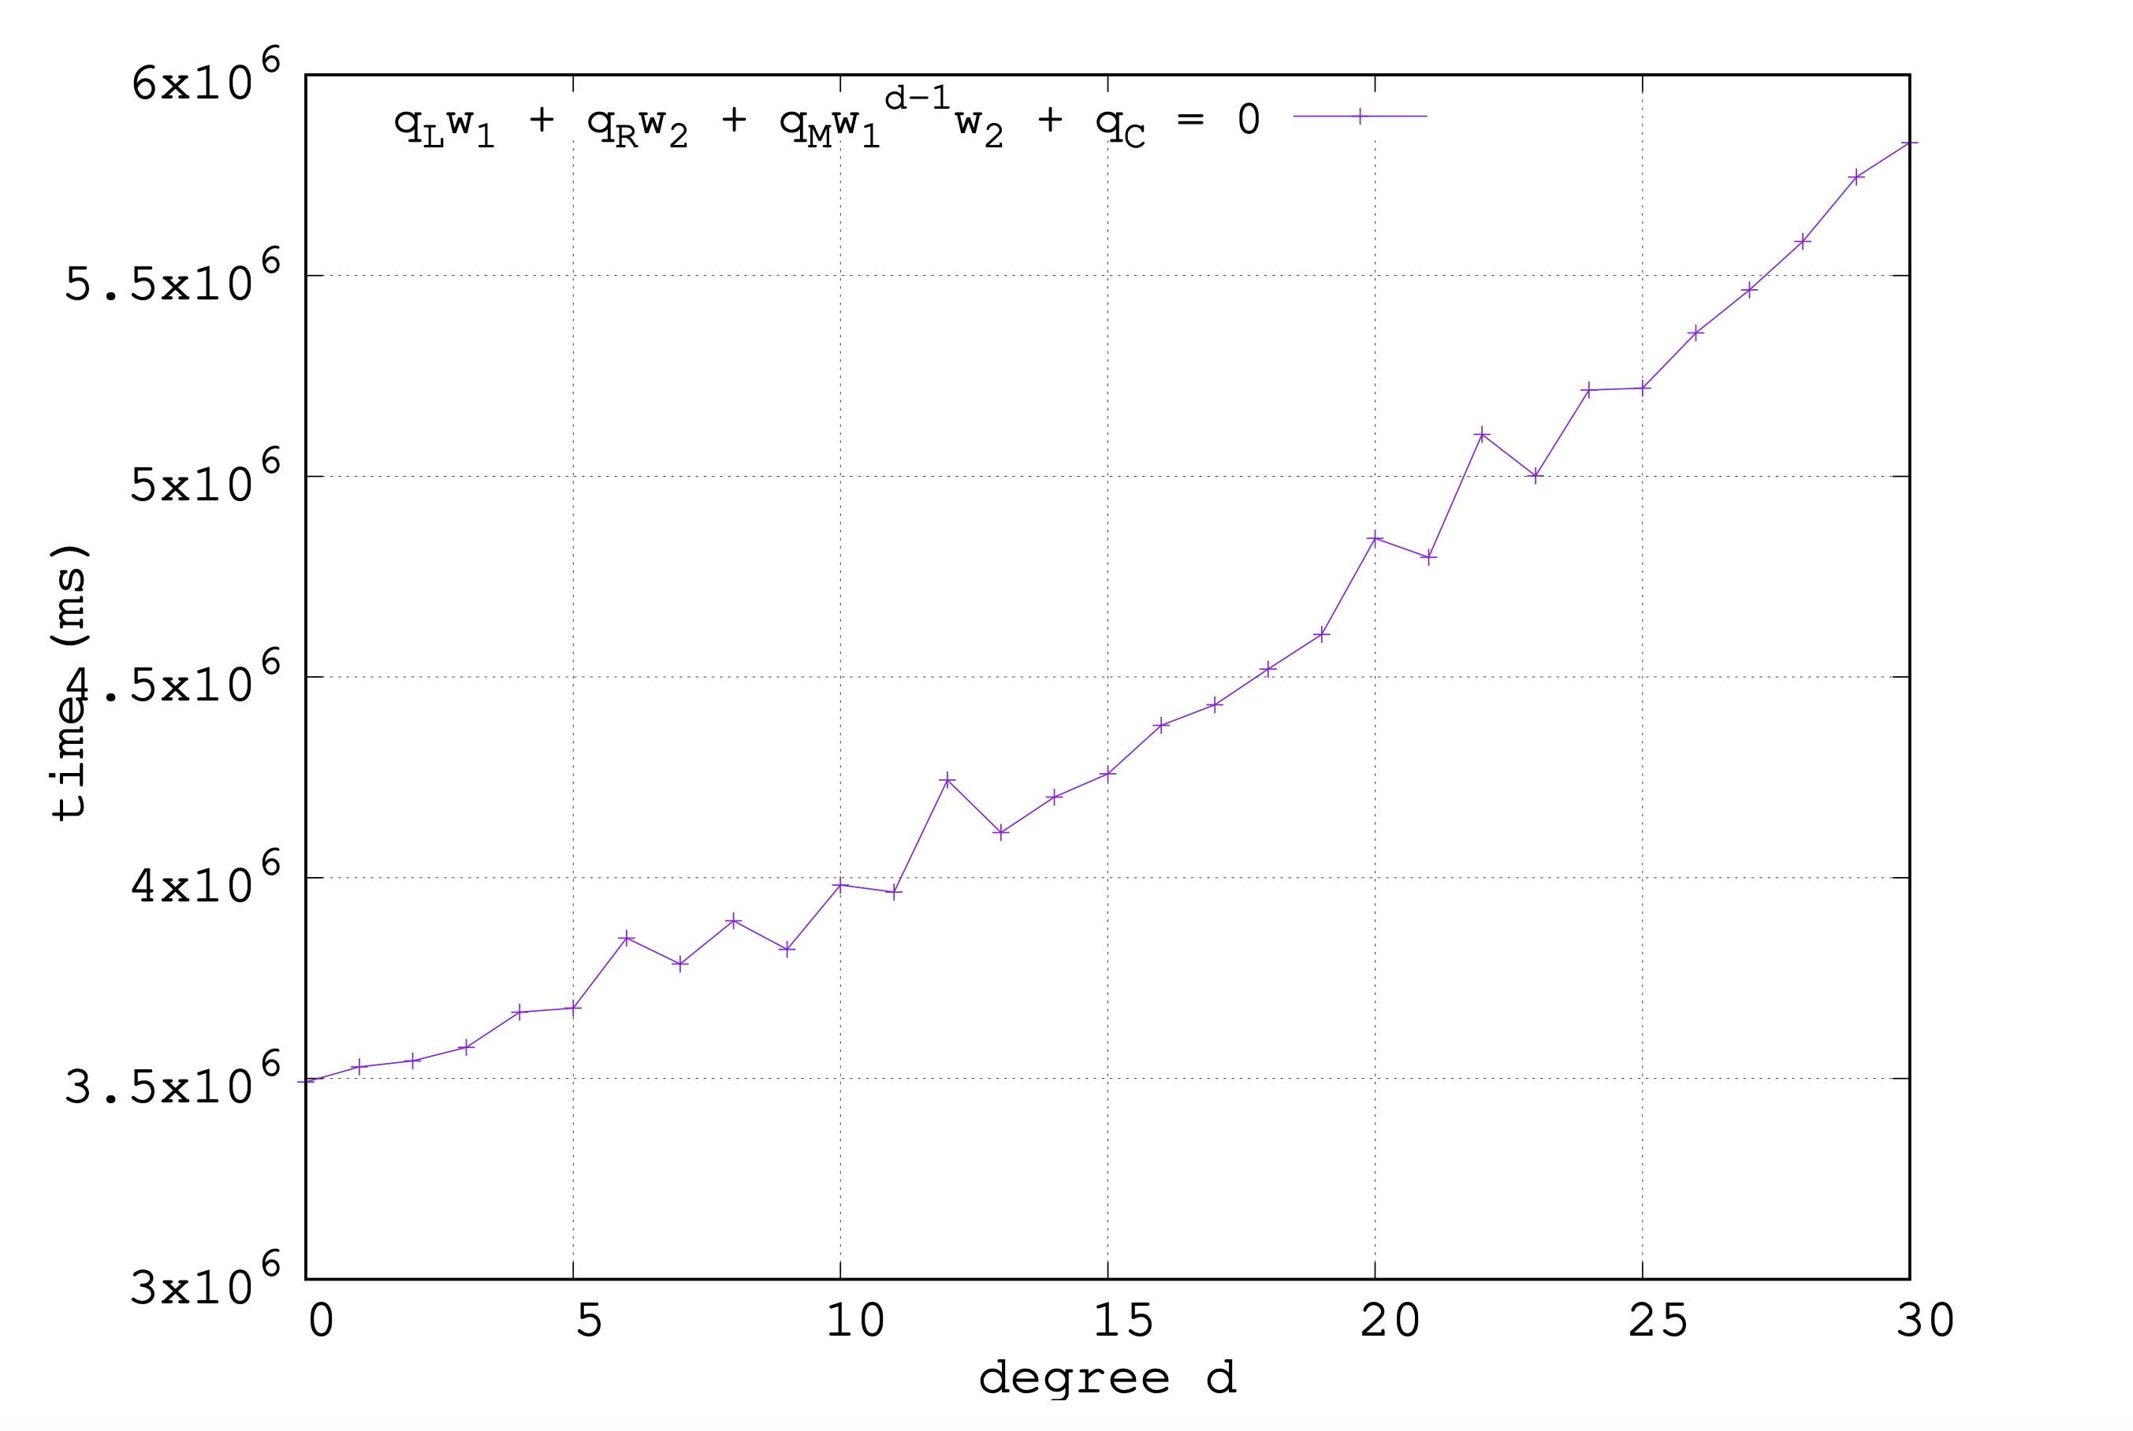
Evaluations: High-degree Gates
Degree 32 is only 30% more expensive than degree 2
Notes:
As we can see, when we increase the gate degree from 2 to 32, the proving cost is only 30% more expensive. This also justifies that HyperPlonk can more easily support high-degree gates.

Slide 18





Lookup Gates
Expensive to express
with arithmetic gates
Range check:
11
$$∈\{0,1,…,2^{16}\}$$
0
1
2
…
2¹⁶-1
$$x∈[0..2^{16})$$
(Gate i)
$$+$$
5
6
1 lookup gate suffices!
Bit operation:
(0,0,0)
…
(5,6,3)
…
(15,8,7)
$$\left(x,y,z\right)∈{\left\{0,1\right\}}^{8}×{\left\{0,1\right\}}^{8}×{\left\{0,1\right\}}^{8}$$
3=011
Why so useful:
Efficient random memory accessing
Reuse precomputed correlated tuples
(Gate i)
$$⊕$$
5=101
6=110
precomputed
precomputed
Notes:
Before delving into the technical details, let’s see why lookup gates are useful
1. range-check: addition/mul gate: bit decomposition; lookup table: single lookup gate
2. Simulating bit ops (ubiquitous in hashing): given a table that stores all the possible input-output tuples, we only need a single lookup gate to check that the tuple (x, y, z) is in the table
3. More applications, like …
4. Why useful

Slide 19

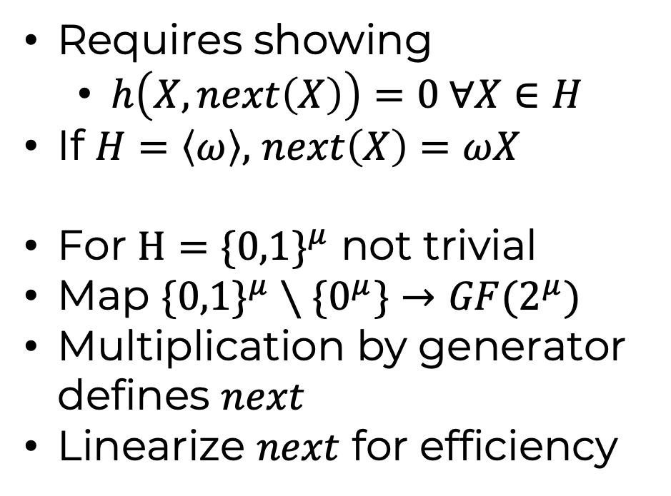


Shift in Boolean Hypercube
Lookup relation
Shift
$$f$$
1
1
3
2
$$T$$
1
2
3
4
Requires showing
  $h\left(X,next\left(X\right)\right)=0 ∀X∈H$
If $H=\left\langle ω\right\rangle ,$ $next\left(X\right)=ωX$
For $H=\{0,1\}^{μ}$ not trivial
Map $\{0,1\}^{μ}∖\{0^{μ}\}→GF(2^{μ})$
Multiplication by generator defines $next$
Linearize $next$ for efficiency
$$⊆$$
precomputed
Notes:
Before delving into the technical details, let’s see why lookup gates are useful
1. range-check: addition/mul gate: bit decomposition; lookup table: single lookup gate
2. Simulating bit ops (ubiquitous in hashing): given a table that stores all the possible input-output tuples, we only need a single lookup gate to check that the tuple (x, y, z) is in the table
3. More applications, like …
4. Why useful

Slide 20
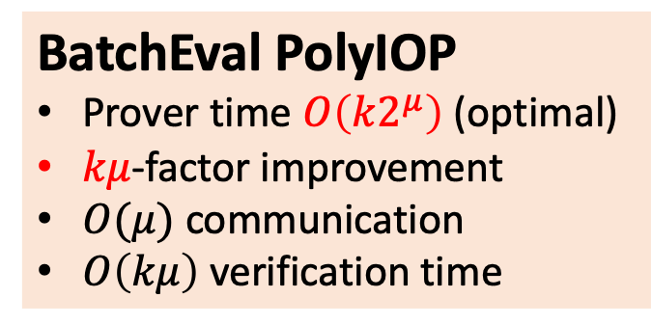
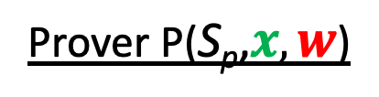

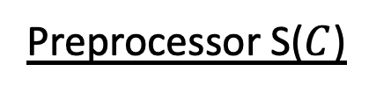

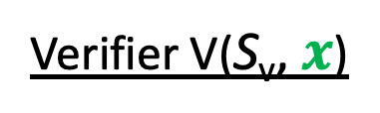
The last Mile to Success: Batching
Preprocessor S($C$)
oracle
$$S\left(\vec{x}\right),π\left(\vec{x}\right)$$
Prover P($\text{S}\text{p}\text{,}x, w$)
can be a single commitment
Verifier V($\text{S}\text{v}\text{, }x$)
oracle
$$L(\vec{x}), R(\vec{x}), O(\vec{x})$$
BatchEval PolyIOP
Prover time $O\left(k2^{μ}\right)$ (optimal)
$kμ$-factor improvement
$O(μ)$ communication
$O\left(kμ\right)$ verification time
PolyIOP for gate check
The underlying Sumchecks
can be batched
PolyIOP for wiring check
many PCS eval proofs 😢
PolyIOP for batch evaluate
14+ poly eval queries?
🎉
A single PCS eval proof
in the SNARK
A single evaluation query
on a multilinear polynomial
Notes:
1. before describing the lookup protocol, let’s check an important last step for making HyperPlonk concretely efficient
2. Preprocessing phase -> Online phase -> The verifier asks many eval queries to multi oracles
3. the number of queries can be a lot even for the vanilla Plonk constraint system, and it can be even more if we use a more complicated custom gate. The consequence is that when we compile the PolyIOP with a PCS, the prover needs to compute many evaluation opening proofs, which can be concretely inefficient
4. To remedy this, we present a new PolyIOP that transforms multiple multilinear polynomial evaluation queries into a single evaluation query, hence the PCS only needs to compute a single opening proof.
5. this PolyIOP is highly efficient and significantly improves the state-of-the-art

Slide 21
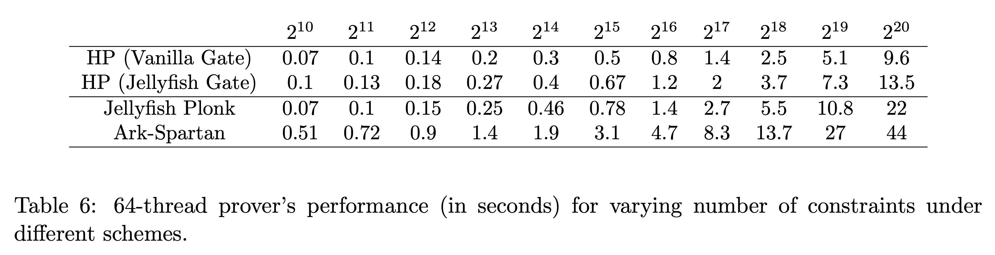
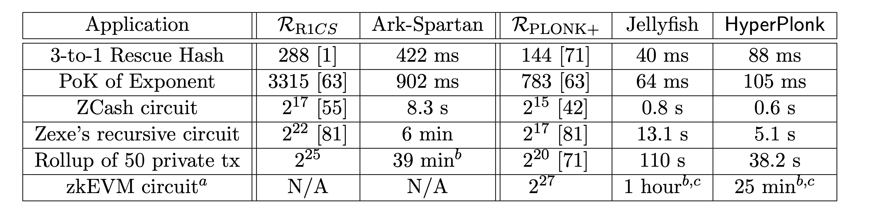
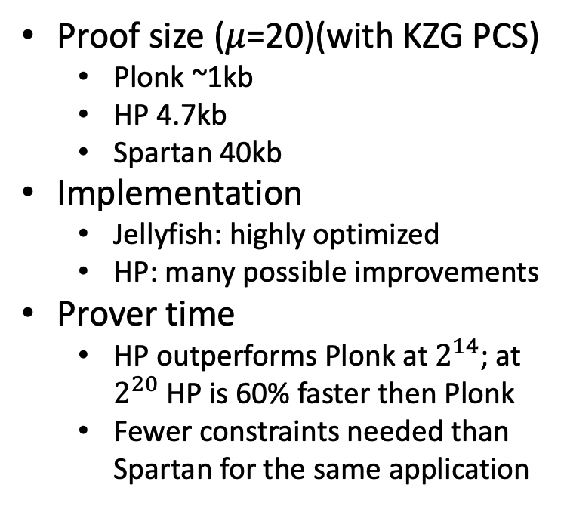
Evaluations
Proof size ($μ$=20)(with KZG PCS)
  Plonk ~1kb
  HP 4.7kb
  Spartan 40kb
Implementation
  Jellyfish: highly optimized
  HP: many possible improvements
Prover time
  HP outperforms Plonk at $2^{14}$; at $2^{20}$ HP is 60% faster then Plonk
  Fewer constraints needed than Spartan for the same application
Notes:
highlight that the resulting scheme is highly efficient in practice.
the proof size is logarithmic, but it’s still quite small and less than 5KB for all practical circuit sizes. much better than a lot of SNARK schemes that have linear-time prover.
proving time is also concretely fast. E.g., a proof-of-concept implementation is already 60% faster than a highly optimized Plonk implementation for circuit size 1 million. And we believe it can be even faster on hardware because group-multi-exponentiations, sumcheck, and multilinear evaluations are all very hardware-friendly.
Because of the use of high-degree gates and lookup gates, compared to traditional constraint systems like R1CS, our scheme has more succinct circuits for many interesting applications. As a result, even if there is a R1CS-based SNARK that is as fast as HyperPlonk given the same number of constraints, the HyperPlonk’s proving time for most applications will still be much faster.

Slide 22


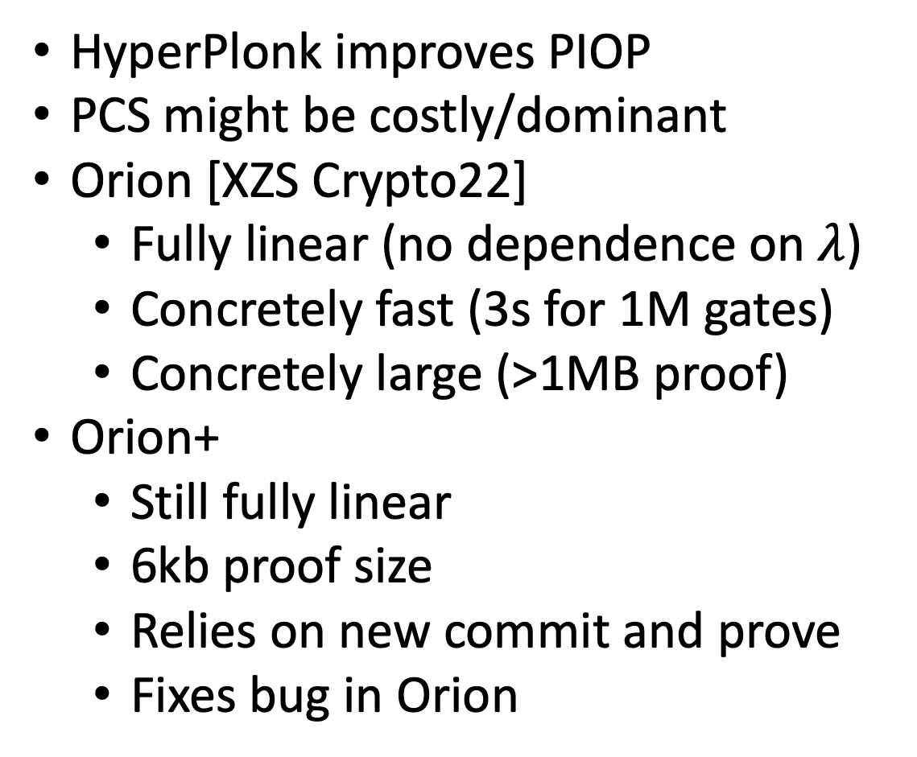
There is More
Polynomial Commitment
HyperPlonk improves PIOP
PCS might be costly/dominant
Orion [XZS Crypto22]
  Fully linear (no dependence on $λ$)
  Concretely fast (3s for 1M gates)
  Concretely large (>1MB proof)
Orion+
  Still fully linear
  6kb proof size
  Relies on new commit and prove
  Fixes bug in Orion
$$(p\left(X\right))$$
$$π:p\left(z\right)=y$$
Prover
Verifier

Slide 23
Questions?

