Slide 1
Unique-Path Identity Based Encryption With Applications to Strongly Secure Messaging
Eurocrypt 2023
AIT Austrian Institute of Technology, Austria
Paul Rösler, Daniel Slamanig, Christoph Striecks

Slide 2
Messaging with Key Updates
Key-Updatable KeyEncapsulationMechanism
Used in prior work [PRC18,JSC18,BRVAC20]
Equivalent to messaging™ [BRVAC20]
Stronger than “UPKE” (diverging)
Forward Secrecy
Diverging
$$t$$

Slide 3
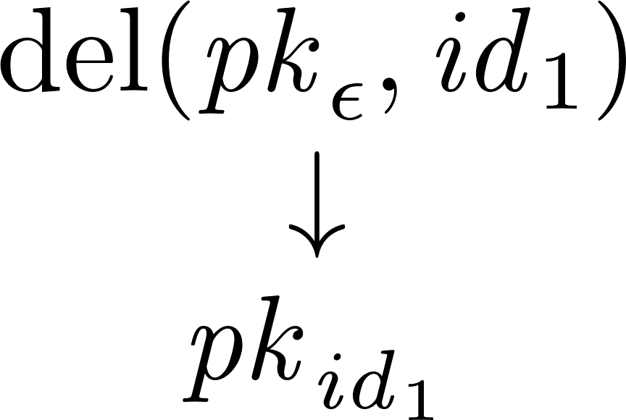
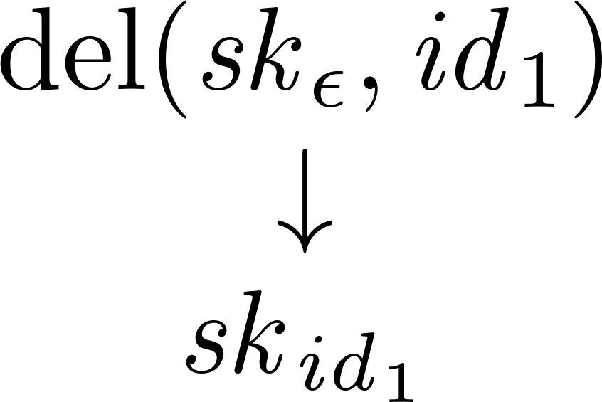
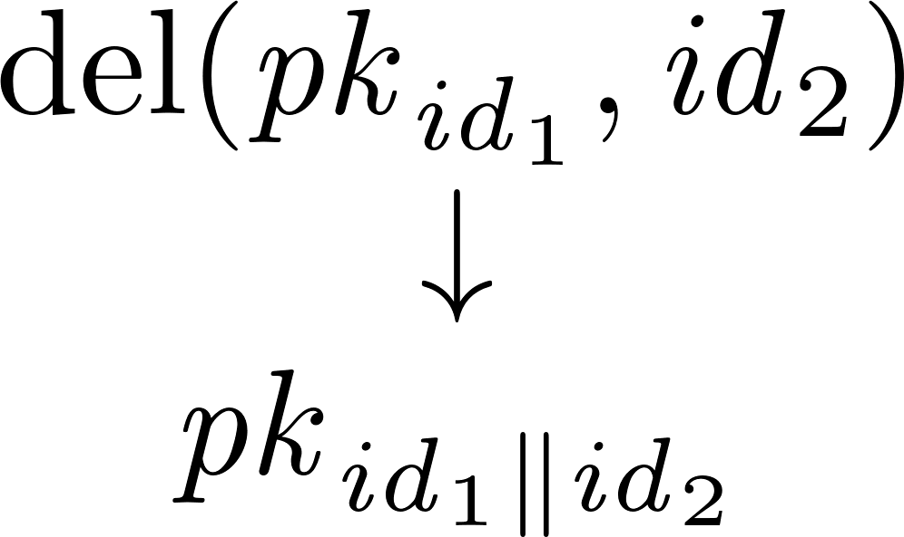
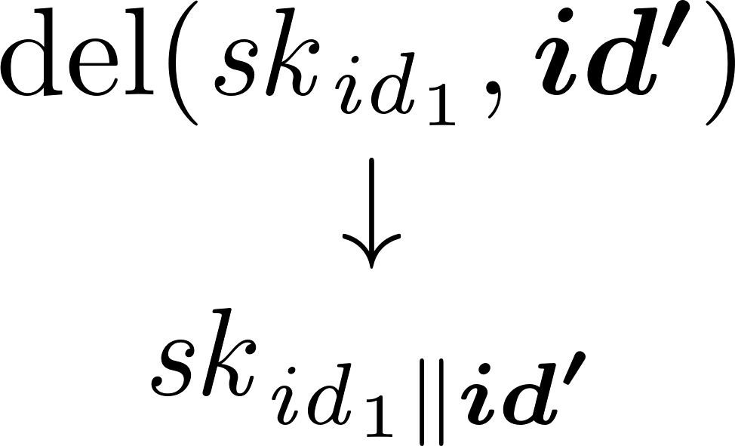
KU-KEM from Unique-Path IBE

Slide 4
KU-KEM from Unique-Path IBE
Unique-Path IdentityBasedEncapsulation
The same as Hierarchical IBE
Only one delegation per secret key
→ Unique secret-key path
So far:
HIBE ⇒ UPIBE
We: IBE ⇒ Bounded Depth UPIBE Bounded Depth HIBE ⇒ UPIBE

Slide 5
Building UPIBE: Bounded Depth q
1
2
1
2
=
=
3
4
3
4
1
1
2
2
3
3
4
4
1 IBE Key Pair per UPIBE depth

Slide 6
Building UPIBE: Bounded Depth q
1
2
1
=
3
4
1
1
id₁||0
id₁||1
1
2
id₁||0
=
1
id₁||1
4
3
id₁

Slide 7
Building UPIBE: Bounded Depth q
1
2
2
=
3
4
2
2
id₂||0
id₂||1
1
2
2
id₁||0
id₂||0
=
1
=
1
2
id₁||1
4
id₁||1
id₂||1
3
3
4
id₁
id₁||id₂

Slide 8
Building UPIBE: Bounded Depth q
1
2
=
3
4
1
2
2
id₁||0
id₂||0
=
1
=
1
2
=
1
2
id₁||1
4
id₁||1
id₂||1
id₁||1
id₂||1
3
3
4
3
4
id₁
id₁||id₂
id₁||id₂||id₃
id₃||0
3
id₃||1

Slide 9
Building UPIBE: Bounded Depth q
1
2
=
3
4
1
2
3
4
1
2
=
id₁||1
id₂||1
1
1
2
2
3
3
3
id₁||0
id₁||1
id₂||0
id₂||1
id₃||0
id₃||1
id₃||0

Slide 10
Building UPIBE: Bounded Depth q
1
2
=
=
1
2
id₁||1
id₂||1
id₁||1
id₂||1
3
4
3
id₁||id₂||id₃
id₃||0
3
id₃||0
id₃||1

Slide 11
Building UPIBE: Bounded Depth q
Why 1 IBE instance per depth?
→ No Compilation
=
1
2
id₁||1
id₂||1
4
3
id₁||id₂||id₃
id₃||0
3
id₃||1
id₁
id₂
id’
id₃
id₃
=
1
2
id₁||1
id’||1
3
4
id₁||id’||id₃
id₃||0
3
id₃||1

Slide 12
Building UPIBE: Bounded Depth q
Why 1 IBE instance per depth?
→ No Compilation
Why 2 delegations per instance?
→ No Prefix
=
1
2
id₁||1
id₂||1
4
3
id₁||id₂||id₃
id₃||0
3
id₃||1
=
1
2
id₁||1
id₂||1
4
id₁||id₂||id₃||id’
id’||0
3
4
id₃||1
id’||1

Slide 13
Building UPIBE: Unbounded Depth
*
*
=
=
=
Dynamic Delegation via “FS-PKE”
Single Bounded-Depth HIBE
Multi-Delegation Epochs
=
*
*

Slide 14
Summary & Outlook
Bounded Depth UPIBE
From 2-Bounded Collusion IBE
From DDH:
Unbounded Depth UPIBE
From κ-Bounded Depth HIBE
Using ROM from Selective
→ Exploit Structure to Aggregate?
1
2
1
2
*
*
=
=
3
4
3
4
=
1
2
id₁||1
id₂||1
3
id₃||0
ia.cr/2023/248

Slide 15
Building UPIBE: Bounded Depth q
1
2
3
=
3
4
3
3
id₃||0
id₃||1
1
2
2
id₁||0
id₂||0
=
1
=
1
2
=
1
2
id₁||1
4
id₁||1
id₂||1
id₁||1
id₂||1
3
3
4
3
4
id₁
id₁||id₂
id₁||id₂||id₃
id₃||0
3
id₃||1

Slide 16
Building UPIBE: Bounded Depth q
Why 1 IBE instance per depth?
→ No Compilation
=
1
2
id₁||1
id₂||1
4
3
id₁||id₂||id₃
id₃||0
3
id₃||1
id₁
id₂
id’
id₃
id₃
=
1
2
id₁||1
id’||1
3
4
id₁||id’||id₃
id₃||0
3
id₃||1

Slide 17
Building UPIBE: Bounded Depth q
Why 1 IBE instance per depth?
→ No Compilation
Why weaker than HIBE?
→ More Corruptions
=
1
2
id₁||1
id₂||1
4
3
id₁||id₂||id₃
id₃||0
3
id₃||1
id₁||id’||id₃
id₁||id₂||id₃
id’’||id₂

Slide 18
Building UPIBE: Bounded Depth q
Why 1 IBE instance per depth?
→ No Compilation
Why weaker than HIBE?
→ More Corruptions
Why 2 delegations per instance?
→ No Extension
=
1
2
id₁||1
id₂||1
4
3
id₁||id₂||id₃
id₃||0
3
id₃||1
=
1
2
id₁||1
id₂||1
4
id₁||id₂||id₃||id’
id’||0
3
4
id₃||1
id’||1

Slide 19
Building UPIBE: Bounded Depth q
1
2
=
For CCA secure UPIBE:
KEM Combiners [GHPPKC18]
3
4
1
2
3
4
1
2
=
id₁||1
id₂||1
1
1
2
2
3
3
3
id₁||0
id₁||1
id₂||0
id₂||1
id₃||0
id₃||1
id₃||0

Slide 20
Building UPIBE: Bounded Depth q
1
2
=
3
4
1
1
2
id₁||0
=
1
1
1
id₁||1
3
4
id₁||0
id₁||1
id₁

Slide 21
Building UPIBE: Bounded Depth q
1
2
id₁||0
=
1
id₁||1
4
3
id₁
2
2
id₂||0
=
1
2
2
2
id₁||1
id₂||1
3
4
id₂||0
id₂||1
id₁||id₂

Slide 22
Summary & Outlook
Instantiation of Bounded-Depth UPIBE via Bounded-Collusion IBE
Efficient DDH based
Several Open Questions:
Exploit algebraic structure of (H)IBE constructions for better efficiency
Generalize our ideas
Get in touch if you’re interested

Slide 23
●

Slide 24
●

Slide 25
●

Slide 26
Messaging with key updates
Active attacks directly influence key updates => diverge
Strong primitive called “Key-Updatable KEM” necessary
Much stronger than UPKE (latter only updates but no diverging)
So far trivially based on HIBE: update = delegation
UPIBE: Special case of HIBE: 1 delegation/secret key
Bounded-collusion HIBE with bound=1
Bounded-depth UPIBE from (bounded-collusion) IBE:
Easy: 1 IBE per delegation
Tricky parts:
encrypt to all instances so far (reason: no extension to prior fork)
Delegate two types of secret keys: one for current level, one for all prior levels
Bounded-collusion: two delegations per instance
Using KEM combiners for CCA security
Unbounded-depth UPIBE from (bounded-depth) IBE:
Add dynamic delegation tree on top of prior idea (similar to FS-PKE)
Add dynamic epoch depth to trade depth against width
Prior trivial construction is a special case of our new construction
Several Open Questions:
Exploit algebraic structure of (H)IBE constructions for better efficiency
Generalize our ideas
Get in touch if you’re interested

Slide 27
Messaging with Key Updates
Messaging with key updates
Active attacks directly influence key updates => diverge
Strong primitive called “Key-Updatable KEM” necessary
Much stronger than UPKE (latter only updates but no diverging)
So far trivially based on HIBE: update = delegation

Slide 28
KU-KEM from HIBE: UPIBE
UPIBE: Special case of HIBE: 1 delegation/secret key
Bounded-collusion HIBE with bound=1

Slide 29
UPIBE: Special HIBE
UPIBE: Special case of HIBE: 1 delegation/secret key
Bounded-collusion HIBE with bound=1

Slide 30
Building UPIBE: Bounded Depth
Bounded-depth UPIBE from (bounded-collusion) IBE:
Easy: 1 IBE per delegation
Tricky parts:
encrypt to all instances so far (reason: no extension to prior fork)
Delegate two types of secret keys: one for current level, one for all prior levels
Bounded-collusion: two delegations per instance
Using KEM combiners for CCA security

Slide 31
Building UPIBE: Unbounded Depth
Unbounded-depth UPIBE from (bounded-depth) IBE:
Add dynamic delegation tree on top of prior idea (similar to FS-PKE)
Add dynamic epoch depth to trade depth against width
Prior trivial construction is a special case of our new construction

