Slide 1
Non-uniformity, quantum advice, and quantum random oracle
Eurocrypt 2023
Qipeng Liu
Simons Institute for the Theory of Computing
https://eprint.iacr.org/2022/1384
presented by Takashi Yamakawa

Slide 2
(Informal) Grover’s search can not be sped up, even with quantum advice (Informal) Salting defeats non-uniform attacks, even with quantum advice
Notes:
Let me talk about two main takeaways from the talk.

Slide 3
Cryptographic Hash
A function $H$ that outputs a digest (of $n$ bits, $N=2^{n}$)
Public, known to everyone
Satisfy desired properties for different crypto applications
Collision Resistance
One-wayness/Proof of work
Other ideal properties
message
$$H$$
digest
Notes:
In this talk, we will study the security of hash function, which has applications to daily Internet use, blockchains and many others.
A hash function is a function H that takes an arbitrary length input and outputs a digest.
Publicly known, everyone can get the code and evaluate on its own device.
A good hash function needs to satisfy ...
like proof of work.
A good choice is SHA2 or SHA3, which perform really great in practice. However, they are hard to work with. In other words, it is difficult to analyze the concrete security of SHA2 and SHA3.
A solution was proposed by Bellare and Rogaway, which is the random oracle methodology. It says that, for natural applications of hash functions, the hash function can be modeled as a random function and an adversary only has oracle access to this function. This captures all the generic attacks and indeed, for SHA2 and SHA3, best attacks are often generic.
ROM gives a clean and beautiful way to analyze hash functions.

Slide 4
Random Oracle Methodology Bellare-Rogaway 93
$f:\left[N\right]→\left[N\right]$ is a uniformly random function
Random oracle methodology (heuristics):
For most of ``natural’’ applications of hash functions
for the best possible instantiation of $f$
``Plus’’ for ROM: simple proofs, precise bounds
$$f$$
$$(H)$$
$$≈$$
$$A$$
$$B$$
OWFs: $\frac{T}{N}$
PRGs: $\frac{1}{2}+\frac{T}{N}$
CRHFs: $\frac{T^{2}}{N}$
security in practice
security in the ROM
Notes:
Facing with the difficulties,
Clean and beautiful model
Security in practice with the best possible hash function is the same as security in the ROM
Only generic attacks
Here T is the running time or number of queries.

Slide 5
Cracks in the ROM Unruh07, DGK17, CDGS17…
Mismatch between ROM and practical attacks (with preprocessing)
ROM
Practical Attacks
CRHF
$\frac{T^{2}}{N}$
$1$ (by hardcode a collision)
$\frac{ST}{N}+{\left(\frac{S^{2}T}{N^{2}}\right)}^{1/3}$ (rainbow table)
OWF
$\frac{T}{N}$
[Hellman 80, Oechslin 03]
Notes:
Cracks in the beautiful model.
Rainbow table: a data structure of size S (viewed as a piece of advice)
It is a very beautiful attack but I wont have time to talk about it today.
If you do not know how it works, I highly recommend you to learn it.
Use two symbols to denote it in the rest of the talk.

Slide 6
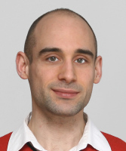
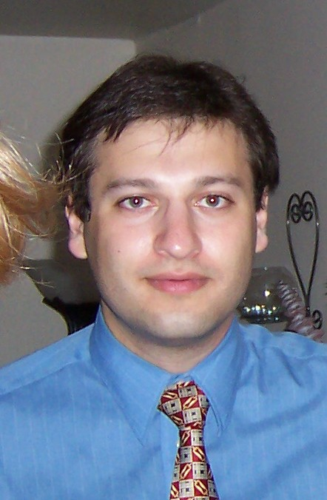
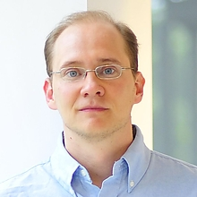
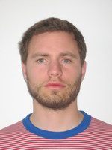
Fixing Cracks Unruh07, DGK17, CDGS17…
Can we save the beautiful ROM from non-uniform attacks?
YES!
…
Unruh
Guo
Katz
Dodis
Coretti
Steinberger
Notes:
As we have seen the simplicity of ROM, we would really like to save ROM from non-unform attacks.
But is that really possible?

Slide 7
Fixing Cracks Unruh07, DGK17, CDGS17…
ROM: $f:\left[N\right]→[N]$
(Two-stage) non-uniform attackers $A_{1},A_{2}$
$A_{1}$ is unbounded
produces bounded (oracle-dependent) advice $σ$
$A_{2}^{f}(σ,⋅)$ is bounded
Parameters $S, T$
Cracks fixed!
Security bounds in the ROM, against $(S, T)$ attackers
$$A_{1}^{f}$$
$$σ$$
$$A_{2}^{f}$$
Notes:
S is too large, trivial.
Similarly, for T.
So we care about a tradeoffs for S and T.

Slide 8
Fixing Cracks Unruh07, DGK17, CDGS17…
CDGS17: salting ``generically’’ defeats preprocessing attacks
Salting is needed
Non-uniform security
in the ROM
Practical Attacks
CRHF
$1$
$1$ (by hardcode a collision)
$\frac{ST}{N}+{\left(\frac{S^{2}T}{N^{2}}\right)}^{1/3}$(rainbow table)
OWF
$\frac{ST}{N}$
[Hellman 80, Oechslin 03]
Barriers for filling the gap, [Corrigan-Gibbs, Kogan 18]
Notes:
Filling the gap implies solving some other open problems for circuit lower bounds and communication complexity.
Everything we know, using the examples of OWF, CRHF, salting.

Slide 9
01101
01101
0100
01101
01001
01000
01101
11111
11101
010011
11101
01111
Notes:
Switch to quantum world.

Slide 10
Non-Uniform Quantum Attacks NABT15, CGLQ20, GLLZ20…
$f:\left[N\right]→[N]$
(Two-stage) non-uniform attackers $A_{1},A_{2}$
$A_{1}^{f}$ is unbounded
produces bounded (oracle-dependent) advice $σ$
Classical or quantum advice
$A_{2}^{|f⟩}(σ,⋅)$ is bounded ($T$ queries)
$$A_{1}^{f}$$
$$σ$$
$$A_{2}^{|f⟩}$$
01001
Notes:
A_1 has only classical oracle access, because unbounded, so same!

Slide 11
Non-Uniform Security Upper bound (algorithms)
OWFs:
With S bits of advice $σ$, being the rainbow table,
Run the rainbow table algorithm with $σ$
Or, run the Grover’s search without advice
Advantage is $\frac{ST}{N}+\frac{S^{2}T}{N^{2}}+\frac{T^{2}}{N}$
Does advice help quantum algorithms?
Rainbow table
Grover’s
Notes:
Before looing at some lower bounds, let us think of algorithms.
The first thing you may want to do is to try to quantize rainbow table and speed Grover's search.
The best we are aware of, for a long time.

Slide 12
Non-Uniform Security NABT15, CGLQ20, GLLZ20…
 | CGLQ20 classical advice | CGLQ20 quantum advice
OWFs | $$\frac{ST+T^{2}}{N}$$ | $${\left(\frac{ST+T^{2}}{N}\right)}^{1/3}$$
PRGs | $$\frac{1}{2}+{\left(\frac{ST}{N}+\frac{T^{2}}{N}\right)}^{1/3}$$ | $$\frac{1}{2}+{\left(\frac{S^{5}T}{N}+\frac{{S^{4}T}^{2}}{N}\right)}^{1/19}$$
Salting | defeats preprocessing | ``somewhat’’ defeats preprocessing
Notes:
salting: extra piece of data feed into a hash function, prevent from preprocessing attack in practice.

Slide 13
Does quantum advice really help?

Slide 14
Our Results

Slide 15
Non-Uniform Security
 | CGLQ20 classical advice | CGLQ20 quantum advice | This Work quantum advice
OWFs | $$\frac{ST+T^{2}}{N}$$ | $${\left(\frac{ST+T^{2}}{N}\right)}^{1/3}$$ | $$\frac{ST+T^{2}}{N}$$
PRGs | $$\frac{1}{2}+{\left(\frac{ST}{N}+\frac{T^{2}}{N}\right)}^{1/3}$$ | $$\frac{1}{2}+{\left(\frac{S^{5}T}{N}+\frac{{S^{4}T}^{2}}{N}\right)}^{1/19}$$ | $$\frac{1}{2}+{\left(\frac{ST}{N}+\frac{T^{2}}{N}\right)}^{1/3}$$
Salting | defeats preprocessing | ``somewhat’’ defeats preprocessing | defeats preprocessing
Notes:
OWF: there is no such a quantum rainbow table. The best you can do is basically using classical advice to do rainbow table, or run Grover’s search algorithm. Even quantum advice does not help this task.
Salting: Let me explain more about the last result.

Slide 16
Main Ideas
$f$
$f$
$f(x_{i})$
$${x′}_{i}$$
Inspired by [MW05]
Non-uniform for the multi-instance game:
Given non-uniform (classical advice $σ$) $A$ w.p. $δ$,
For each $i∈[g]$:
Run $A^{f}\left(σ,f\left(x_{i}\right)\right)$
achieves a probability $≈δ^{g}$
Alternating measurement game:
Challenger has $σ$ (a quantum state) over system $A$
Appends ${\left|+\right\rangle }_{X}≔\sum_{x}{|x⟩}$ to $σ$
For each $i∈[g]$:
If $i$ is odd, measures $XA$ on $(Π_{0},Π_{1})$
If $i$ is even, measures $XA$ on $({IsU}_{0},{IsU}_{1})$
Adversary wins iff $b_{1}=⋯b_{g−1}=b_{g}=0$
Does not work when $σ$ is quantum!
Outputting $x_{i}^{′}$ may destroy $σ$.

Slide 17
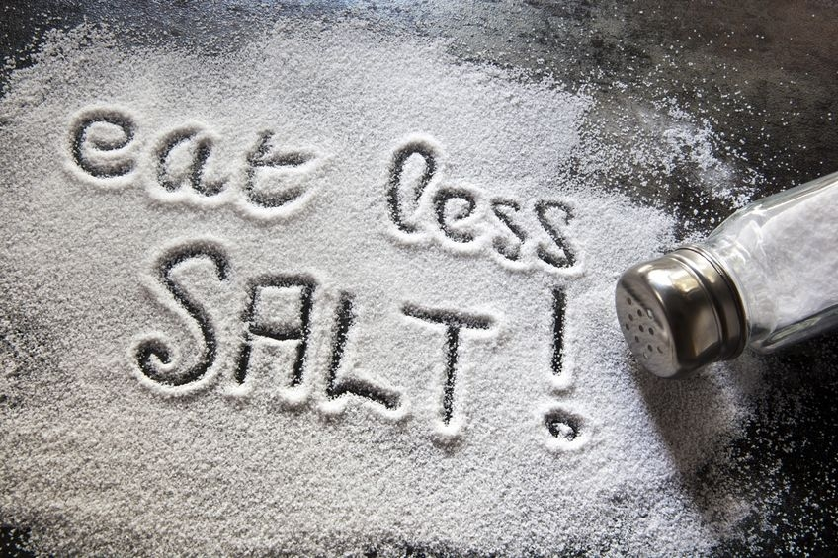
Takeaways (informal)
For many natural security games based on hash functions,
BQP/poly and BQP/qpoly adversaries achieve the same power (generically)
Salting defeats any preprocessing attacks
more
For a certain contrived game and $T=0$, quantum advice is exponentially better.
Based on a recent work by [Yamakawa, Zhandry22]
Notes:
Contrived game: .. Although we do not achieve a separation in the general case, we believe it is helpful for understanding quantum advice and may help to achieve a general separation in the future.

Slide 18
Subsequent Work
Does quantum advice have more power than classical advice?
[Aaronson, Kuperberg07]: Separation relative to quantum oracles
Open: Separation relative to (quantumly-accessible) classical oracles?
[Li, Liu, Pelecanos, Yamakawa23]: Separation relative to classically-accessible classical oracles
Also separate QMA and QCMA
Based on the contrived separation in the case of T=0 in this work.
BQP/poly≠BQP/qpoly?

Slide 19
Thank you!
https://eprint.iacr.org/2022/1384

