Slide 1
A New Framework for Quantum Oblivious Transfer
Amit Agarwal
James Bartusek
Dakshita Khurana
Nishant Kumar
UIUC
UC Berkeley
UIUC
UIUC

Slide 2
In memory of Nishant Kumar (December 2, 1994 – April 10, 2022)

Slide 3
Background: Wiesner’s Proposal (1968)

Slide 4
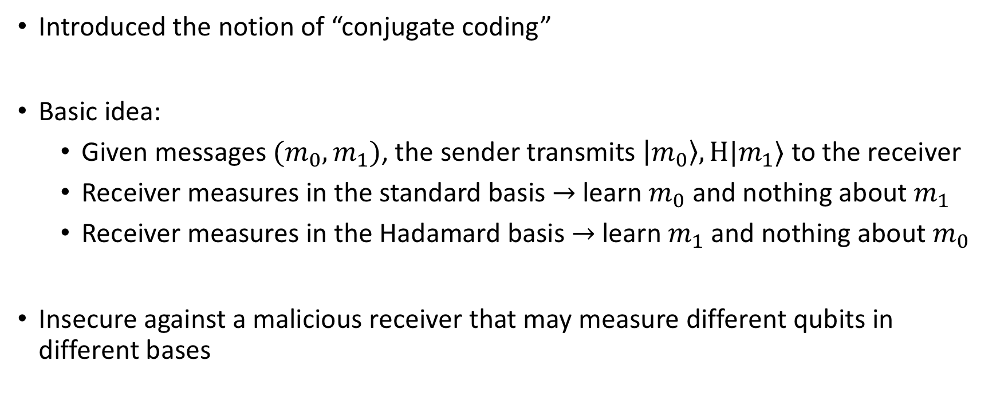
Background: Wiesner’s Proposal (1968)
Introduced the notion of “conjugate coding”
Basic idea:
  Given messages $(m_{0},m_{1})$, the sender transmits $\left|m_{0}\right\rangle ,H|m_{1}⟩$ to the receiver
  Receiver measures in the standard basis $→$ learn $m_{0}$ and nothing about $m_{1}$
  Receiver measures in the Hadamard basis $→$ learn $m_{1}$ and nothing about $m_{0}$
Insecure against a malicious receiver that may measure different qubits in different bases

Slide 5
Background: Follow-ups to [Wie68]
[Crépeau-Kilian 88]: Introduced a template that makes use of interaction and commitments to obtain plausibly secure OT
[Damgård-Fehr-Lunemann-Salvail-Schaffner 09, Bouman-Fehr 10]: Established security of the CK88 template when instantiated with an “ideal” commitment (equivocal and extractable)
[Grilo-Lin-Song-Vaikuntanathan 21]: Constructed (post-quantum) ideal commitments from one-way functions
[B-Coladangelo-Khurana-Ma 21]: Constructed (post-quantum) ideal commitments from the black-box use of “standard” commitments

Slide 6
Background: Follow-ups to [Wie68]
[Crépeau-Kilian 88]: Introduced a template that makes use of interaction and commitments to obtain plausibly secure OT
Is it necessary?
If so, how much?
Crypto is necessary: [Lo-Chau 97, Mayers 97]
Standard commitments are sufficient: [BCKM21]

Slide 7
Background: Interaction in Quantum OT
[Wie68]: Proposed a non-interactive protocol, but insecure
[CK88] Template: 7 messages assuming the ideal commitment is non-interactive
[GLSV21 / BCKM21]: Polynomial-round protocols in the plain model
[GLSV21]: Constant-round protocol from OWF in the CRS model

Slide 8
This work
How much interaction is really required for Quantum Oblivious Transfer?
Quantum Oblivious Transfer: an OT protocol that makes use of quantum communication but no public-key cryptography
Without quantum communication, it is believed that public-key cryptography is necessary for OT [Impagliazzo-Rudich 90]

Slide 9
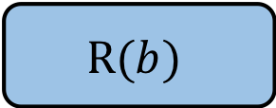
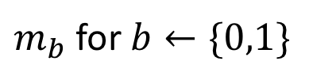
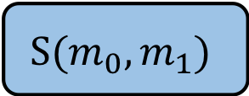



Results
We design protocols that are unconditionally simulation-secure in the Quantum Random Oracle Model
Result I: Three-message chosen-input string OT
Result II: One-message random-receiver-choice bit OT in the shared EPR pairs model
$$S(m_{0},m_{1})$$
$$R(b)$$
$$m_{b}$$
EPR Pairs
$$S(m_{0},m_{1})$$
$$R$$
$m_{b}$ for $b←\{0,1\}$
bits

Slide 10
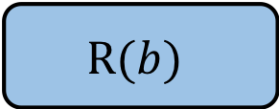
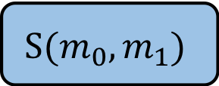
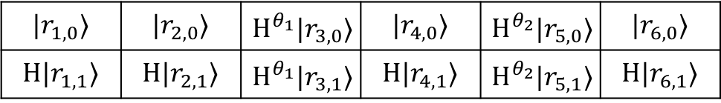
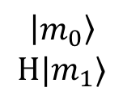
Techniques
Starting point: [Wie68] proposal
Our protocol
  First message:
$$\left|m_{0}\right\rangle$$
$$H|m_{1}⟩$$
Need to guarantee that Receiver measures both states in the same basis
$$S(m_{0},m_{1})$$
$$R(b)$$
$$|r_{1,0}⟩$$ | $$|r_{2,0}⟩$$ | $$H^{θ_{1}}|r_{3,0}⟩$$ | $$|r_{4,0}⟩$$ | $$H^{θ_{2}}|r_{5,0}⟩$$ | $$|r_{6,0}⟩$$
$$H|r_{1,1}⟩$$ | $$H|r_{2,1}⟩$$ | $$H^{θ_{1}}|r_{3,1}⟩$$ | $$H|r_{4,1}⟩$$ | $$H^{θ_{2}}|r_{5,1}⟩$$ | $$H|r_{6,1}⟩$$

Slide 11
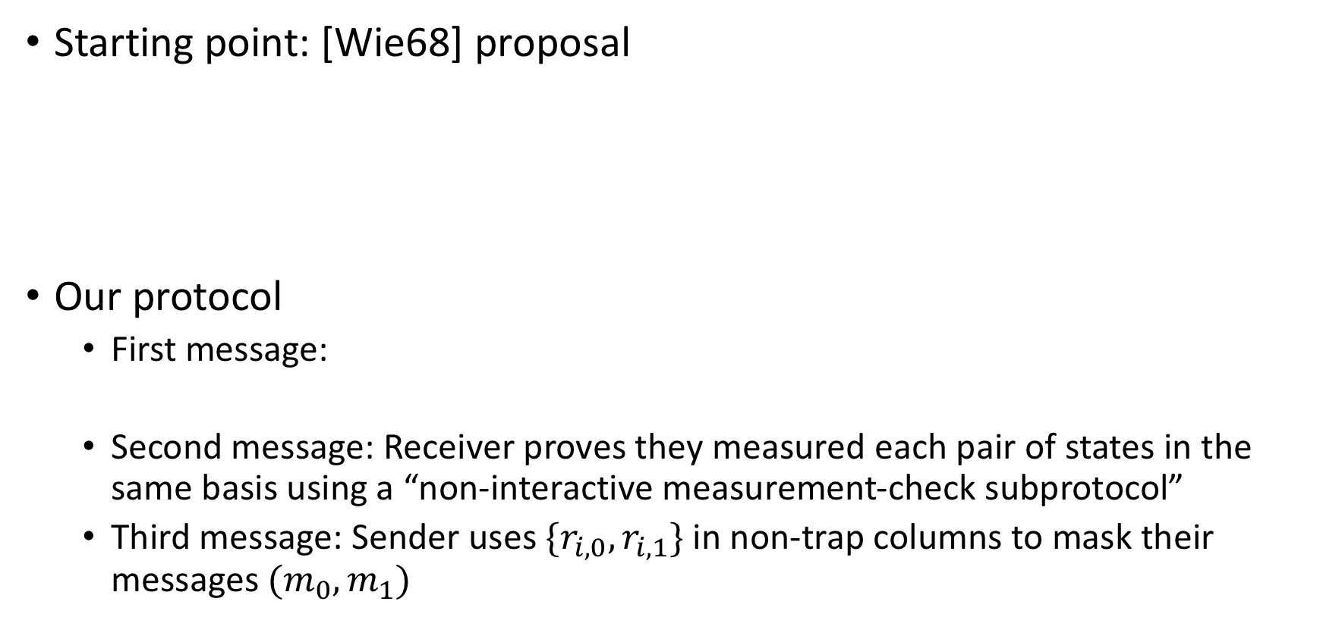
Techniques
The “fixed basis” framework: our first message consists of states in fixed bases (except for trap positions), while [CK88] and follow-ups begin with a message consisting of states encoded in random bases
Starting point: [Wie68] proposal
Our protocol
  First message:
  Second message: Receiver proves they measured each pair of states in the same basis using a “non-interactive measurement-check subprotocol”
  Third message: Sender uses $\{r_{i,0},r_{i,1}\}$ in non-trap columns to mask their messages $(m_{0},m_{1})$
$$\left|m_{0}\right\rangle$$
$$H|m_{1}⟩$$
Need to guarantee that Receiver measures both states in the same basis
$$S(m_{0},m_{1})$$
$$R(b)$$
Trap positions
$$|r_{1,0}⟩$$ | $$|r_{2,0}⟩$$ | $$H^{θ_{1}}|r_{3,0}⟩$$ | $$|r_{4,0}⟩$$ | $$H^{θ_{2}}|r_{5,0}⟩$$ | $$|r_{6,0}⟩$$
$$H|r_{1,1}⟩$$ | $$H|r_{2,1}⟩$$ | $$H^{θ_{1}}|r_{3,1}⟩$$ | $$H|r_{4,1}⟩$$ | $$H^{θ_{2}}|r_{5,1}⟩$$ | $$H|r_{6,1}⟩$$

Slide 12
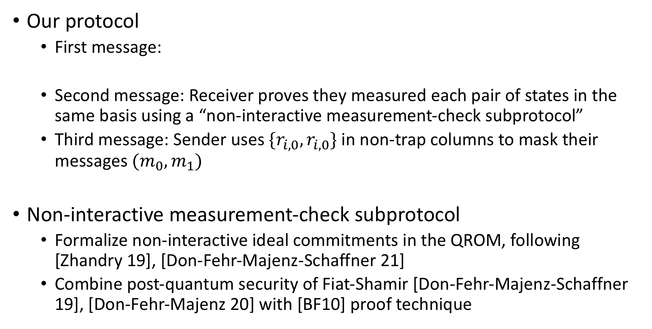
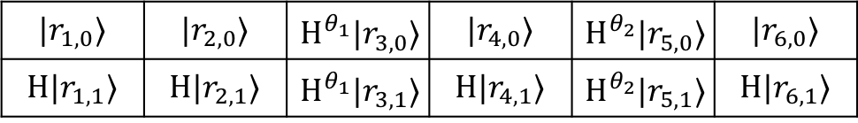
Techniques
Trap positions
Our protocol
  First message:
  Second message: Receiver proves they measured each pair of states in the same basis using a “non-interactive measurement-check subprotocol”
  Third message: Sender uses $\{r_{i,0},r_{i,0}\}$ in non-trap columns to mask their messages $(m_{0},m_{1})$
Non-interactive measurement-check subprotocol
  Formalize non-interactive ideal commitments in the QROM, following [Zhandry 19], [Don-Fehr-Majenz-Schaffner 21]
  Combine post-quantum security of Fiat-Shamir [Don-Fehr-Majenz-Schaffner 19], [Don-Fehr-Majenz 20] with [BF10] proof technique
$$|r_{1,0}⟩$$ | $$|r_{2,0}⟩$$ | $$H^{θ_{1}}|r_{3,0}⟩$$ | $$|r_{4,0}⟩$$ | $$H^{θ_{2}}|r_{5,0}⟩$$ | $$|r_{6,0}⟩$$
$$H|r_{1,1}⟩$$ | $$H|r_{2,1}⟩$$ | $$H^{θ_{1}}|r_{3,1}⟩$$ | $$H|r_{4,1}⟩$$ | $$H^{θ_{2}}|r_{5,1}⟩$$ | $$H|r_{6,1}⟩$$

Slide 13


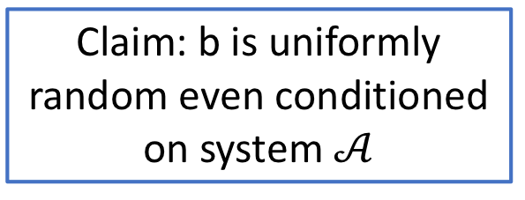
Techniques
Compile to one-message protocol in shared EPR pairs model
  Replace first quantum message with shared EPR pairs
  Remove third message and apply non-interactive OT reversal [Ishai-Kilian-Nissim-Petrank 03]
Crucial technical tool: the (unseeded) XOR randomness extractor
Two-register quantum system
$$𝒜$$
$$ℬ$$
Supported on standard basis states with low Hamming weight
Claim: b is uniformly random even conditioned on system $𝒜$
Measure in Hadamard basis and XOR the resulting bits together
b
Used in a follow-up work [B-Khurana 22] in the context of certified deletion

Slide 14
Follow-up work
[Colisson-Muguruza-Speelman 23]
  Two-round OT without public-key cryptography
  Instantiation in the QROM assuming an appropriate hash function assumption
[B-Khurana-Srinivasan 23]
  One-message random-receiver-choice string OT in the shared EPR pairs model
  Implies one-message secure computation of any unidirectional (classical or quantum) computation in the shared EPR pairs model
  Two-round MPC without public-key cryptography in the shared EPR pairs model

Slide 15
Still open
Two-message OT unconditionally secure in the QROM?
Two-round MPC without public-key cryptography in the CRS model (i.e. without shared EPR pairs)?

Slide 16
Thanks for listening!

