Slide 1
A Theory of Composition for Differential Obliviousness
Mingxun Zhou, Elaine Shi, T-H. Hubert Chan, Shir Maimon
CMU, HKU, Cornell
Eurocrypt 2023

Slide 2
Oblivious Algorithms
Protect the privacy of the execution trace (e.g., memory access pattern)
The algorithm
Execution Trace
Notes:
Start with the motivation and application

Slide 3
Current Landscape of Oblivious Algorithms
Practical Deployment
Signal’s contact discovery uses PathORAM
Limitations:
Logarithmic overhead barrier
Padding running time/output length to worst case
Notes:
Give some generic background on oblivious algorithms, you can mention the signal deployment.
Oblivious algorithms: you can think of it as randomly permuting the encrypted data entries, and adding decoy accesses to hide the items of interest. But the important thing is to do it in a provably secure manner, so we can have mathematical guarantees of security
Although oblivious algorithms have become very practical, they have two drawbacks:
1) for many computational tasks, there’s often a logarithmic overhead barrier
2) in cases where the running time/output length also leaks information, you have to pad the running time/output length to the worst case over all possible inputs.
This can incur polynomial blowup.
E.g., two-way database join takes quadratic time in the worst case, but for most cases in practice, a non-private algorithm should take only linear or quasilinear time

Slide 4
Differential Privacy (DP) [DMF+06]
Quantify privacy loss rigorously
how much random noise is enough to protect privacy?
Huge success in last decade
Cynthia Dwork
Gödel Prize (2017)

Slide 5
Differential Obliviousness(DO) [CCMS17]
Protect the privacy of the execution trace with Differential Privacy
The algorithm
Execution Trace

Slide 6
DO algorithms can fundamentally overcome the barriers for fully oblivious algorithms
Database Join:
$O(n^{2})$--> near linear
Merging, Range Queries
$O(\log^{2}{n) }$--> $\tilde{O}(\log{\log{n) }}$
… …
Also avoiding the worst-case padding ☺

Slide 7
What hinders DO from wide adoption? 🤨
Lack of Composability!

Slide 8
Applications
A New, Composable DO notion
Why DO lacks composability

Slide 9
Applications
A New, Composable DO notion
Why DO lacks composability
Notes:
Grey out two

Slide 10
Composability: A fundamental feature of Differential Privacy
Standard DP Algorithms
Modularized Design
Track Privacy Loss
Theory Development
Practical Deployment

Slide 11
Composability: a fundamental feature of DO?
Expectation

Slide 12
Basic DO is NOT composable
Hard to design
No privacy accounting

Slide 13
M
Input X
Output Y
E.g., the memory
access pattern
View V
Notes:
`

Slide 14
M
Input X
Output Y
View V
Fully Oblivious:
For any two inputs X, X’,
the views V and V’ are indistinguishable
Notes:
`

Slide 15
M
Input X
Output Y
View V
Differentially Oblivious:
For any neighboring inputs $X\sim X′$
Fully Oblivious:
For any two input X, X’,
the views V and V’ are indistinguishable
Notes:
`

Slide 16
M
Input X
Output Y
View V
Differentially Oblivious:
For any neighboring input $X\sim X′$,
the distribution of
view V and V’ are “similar”.
Fully Oblivious:
For any two input X, X’,
the view V and V’ are indistinguishable
Notes:
`

Slide 17
M
Input X
Output Y
View V
$\left(ε,δ\right)$-Differentially Oblivious:
For any neighboring inputs $X\sim X′$,
the views V and V’ are $\left(ε,δ\right)$-DP:
For any subset S,
$$\operatorname{Pr}\left[V ∈S\right]≤e^{ε}\operatorname{Pr}\left[V^{′}∈S\right] + δ$$
Fully Oblivious:
For any two inputs X, X’,
the views V and V’ are indistinguishable
Notes:
`

Slide 18
$(ε_{1}, δ_{1}$)-DO
$(ε_{2}, δ_{2}$)-DO
Input $X$
$$Y$$
Output $Z$
$$M_{1}$$
$$M_{2}$$
View $V_{1}$
View $V_{2}$
Is $M_{2}(M_{1}())$ still DO?
No guarantee…
Notes:
`

Slide 19
Composition Example: DO Selection Algorithm
Name | GPA | Dept
Alice | 4.0 | CS
Bob | 2.0 | CS
Carl | 4.0 | Math
Name | Dept
Alice | CS
Carl | Math
Name
Alice
Select GPA >= 3
Select Dept=CS
$$M_{1}$$
$$M_{2}$$
View $V_{1}$
View $V_{2}$

Slide 20
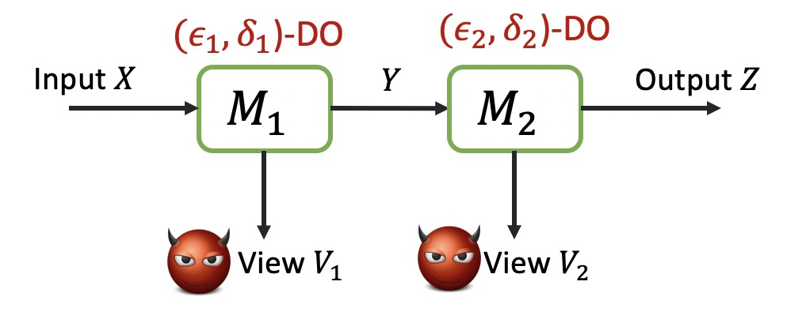
DO Composition
Post-processing in DP
$(ε_{1}, δ_{1}$)-DP
Input $X$
$$Y$$
$$Z$$
$$M_{1}$$
$$M_{2}$$
Notes:
`

Slide 21
DO Composition
Adaptive Composition in DP
$(ε_{1}, δ_{1}$)-DP
$(ε_{2}, δ_{2}$)-DP
Input $X$
$$Y$$
$$Z$$
$$M_{1}$$
$$M_{2}$$
Notes:
`

Slide 22
Example: DO Selection w.r.t Hamming Distance Neighboring
Name | GPA | Dept
Alice | 4.0 | CS
Bob | 2.0 | CS
Carl | 4.0 | Math
Name | Dept
Alice | CS
Carl | Math
Name
Alice
Select GPA >= 3
Select Dept=CS
Name | GPA | Dept
Alice | 4.0 | CS
Bob | 3.0 | CS
Carl | 4.0 | Math
Name | Dept
Alice | CS
Bob | CS
Carl | Math
Name
Alice
Bob
Select GPA >= 3
Select Dept=CS

Slide 23
Example: DO Selection w.r.t Hamming Distance Neighboring
Name | GPA | Dept
Alice | 4.0 | CS
Bob | 2.0 | CS
Carl | 4.0 | Math
Name | Dept
Alice | CS
Carl | Math
Select GPA >= 3
Name | GPA | Dept
Alice | 4.0 | CS
Bob | 3.0 | CS
Carl | 4.0 | Math
Name | Dept
Alice | CS
Bob | CS
Carl | Math
Select GPA >= 3

Slide 24
DO Selection w.r.t Hamming Distance Neighboring [CCMS17]
Name | GPA | Dept
Alice | 4.0 | CS
Bob | 2.0 | CS
Carl | 4.0 | Math
Name | Dept
Alice | CS
Carl | Math
Select GPA >= 3
Hamming Distance = 1
Name | GPA | Dept
Alice | 4.0 | CS
Bob | 3.0 | CS
Carl | 4.0 | Math
Name | Dept
Alice | CS
Bob | CS
Carl | Math
Select GPA >= 3

Slide 25
DO Selection w.r.t Hamming Distance Neighboring [CCMS17]
Name | GPA | Dept
Alice | 4.0 | CS
Bob | 2.0 | CS
Carl | 4.0 | Math
Name | Dept
Alice | CS
Carl | Math
Select GPA >= 3
View 1
$$≈$$
Hamming Distance = 1
View’ 1
Name | GPA | Dept
Alice | 4.0 | CS
Bob | 3.0 | CS
Carl | 4.0 | Math
Name | Dept
Alice | CS
Bob | CS
Carl | Math
Select GPA >= 3

Slide 26
DO Selection w.r.t Hamming Distance Neighboring [CCMS17]
Name | GPA | Dept
Alice | 4.0 | CS
Bob | 2.0 | CS
Carl | 4.0 | Math
Name | Dept
Alice | CS
Carl | Math
Select GPA >= 3
Hamming
Distance = ??
Name | GPA | Dept
Alice | 4.0 | CS
Bob | 3.0 | CS
Carl | 4.0 | Math
Name | Dept
Alice | CS
Bob | CS
Carl | Math
Select GPA >= 3

Slide 27
DO Selection w.r.t Hamming Distance Neighboring [CCMS17]
Name | GPA | Dept
Alice | 4.0 | CS
Bob | 2.0 | CS
Carl | 4.0 | Math
Name | Dept
Alice | CS
Carl | Math
Name
Alice
Select GPA >= 3
Select Dept=CS
View 2
Hamming
Distance = ??
$$≉$$
View’ 2
Name | GPA | Dept
Alice | 4.0 | CS
Bob | 3.0 | CS
Carl | 4.0 | Math
Name | Dept
Alice | CS
Bob | CS
Carl | Math
Name
Alice
Bob
Select GPA >= 3
Select Dept=CS

Slide 28
Why not composable?
Given neighboring inputs:
The outputs may not be neighboring!
Our Solution: Neighbor-preserving DO!

Slide 29
Applications
A New, Composable DO notion
Why DO lacks composability

Slide 30
How to compose
Why not composable
What is Differential Obliviousness
Notes:
Change the roadmap to
The one like the previous one, with application

Slide 31
Intuition
How to compose DO algorithms
=
1) Finding the right definition for neighbor preserving;
2) Proving it to be composable.

Slide 32
First Attempt: Strongly Neighbor-Preserving DO
$M_{1}$is $(ε_{1}, δ_{1}$)-DO
If $X\sim X′$ , then $M_{1}\left(X\right){\sim M}_{1}(X′)$
Example:
DO selection w.r.t Hamming distance 1 neighbors
+
DO selection w.r.t Hamming Distance Edit distance 1 neighbors

Slide 33
Composing DO Selection w.r.t Edit Distance Neighboring
Name | GPA | Dept
Alice | 4.0 | CS
Bob | 2.0 | CS
Carl | 4.0 | Math
Name | Dept
Alice | CS
Carl | Math
Name
Alice
Select GPA >= 3
Select Dept=CS
Hamming
Distance
View 2
$$≈$$
Edit Distance = 1
View’ 2
Name | GPA | Dept
Alice | 4.0 | CS
Bob | 3.0 | CS
Carl | 4.0 | Math
Name | Dept
Alice | CS
Bob | CS
Carl | Math
Name
Alice
Bob
Select GPA >= 3
Select Dept=CS

Slide 34
First Attempt: Strongly Neighbor-Preserving DO
$M_{1}$is $(ε_{1}, δ_{1}$)-DO
If $X\sim X′$ , then $M_{1}\left(X\right){\sim M}_{1}(X′)$
Too stringent. ☹️

Slide 35
Example of why it’s too stringent

Slide 36
$(ε,δ)$-Neighbor Preserving DO (Simplified ver.)
$M_{1}$ is $(ε,δ)$-DO
If $X\sim X′$, then for any subset $S⊆𝒴$,
$$\operatorname{Pr}\left[M_{1}\left(X\right)∈S\right]≤e^{ε}\operatorname{Pr}\left[M_{1}\left(X′\right)∈N(S)\right]+δ.$$
$N(S)$ is the neighbor set to $S$:
It contains all $y′$ such that there exists $y∈S$ and $y′\sim y$
Notes:
Assuming the output and the view are independent

Slide 37
$$\operatorname{Pr}\left[M_{1}\left(X\right)∈S\right]≤e^{ε}\operatorname{Pr}\left[M_{1}\left(X′\right)∈N(S)\right]+δ.$$
$$N(S)$$
$$S$$

Slide 38
Neighbor Preserving Differential Oblivious
Input $X$
$$Y$$
$$M_{1}$$
$(ε_{2}, δ_{2})$-neighbor preserving(NP)
View $V_{1}$
$(ε_{1}, δ_{1}$)-DO
$M_{1}$ is $\left(ε_{1}+ε_{2},δ_{1}+δ_{2}\right)$-NPDO

Slide 39
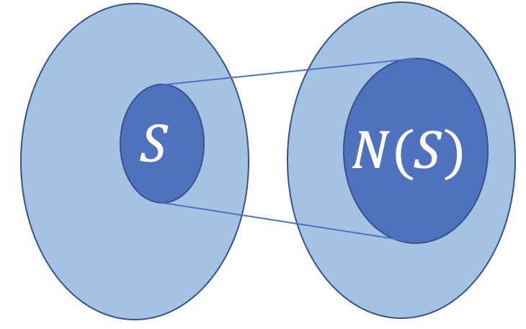
Key Lemma: A Generalized Hall’s Theorem
$$\operatorname{Pr}\left[M_{1}\left(X\right)∈S\right]≤$$
$$e^{ε}\operatorname{Pr}\left[M_{1}\left(X′\right)∈N(S)\right]+δ.$$
Exists an $\left(ε,δ\right)$-matching between the distributions of
$M_{1}\left(X\right)$ and $M_{1}\left(X′\right)$
$$⇔$$
Notes:
More details can be found in the paper.

Slide 40
Main Theorem 1
$(ε_{1}, δ_{1})$-NPDO
$(ε_{2}, δ_{2})$-DO
$$X$$
$$Y$$
$$Z$$
$$M_{1}$$
$$M_{2}$$
$$V_{1}$$
$$V_{2}$$
Then $M_{2}(M_{1}())$ is $\left(ε_{1}+ε_{2},δ_{1}+δ_{2}\right)$-DO.

Slide 41
Main Theorem 2
$(ε_{1}, δ_{1})$-NPDO
$(ε_{2}, δ_{2})$-NPDO
$$X$$
$$Y$$
$$Z$$
$$M_{1}$$
$$M_{2}$$
$$V_{1}$$
$$V_{2}$$
Then $M_{2}(M_{1}())$ is $\left(ε_{1}+ε_{2},δ_{1}+δ_{2}\right)$- NPDO.

Slide 42
In short
DO + DO --> No guarantee
NPDO + DO --> DO
NPDO + NPDO --> NPDO

Slide 43
NPDO:
Composable
Modularized Design
Privacy accounting
Theory Development
Practical Deployment

Slide 44
Vanilla DO:
Not composable
Hard to design
No privacy accounting
NPDO:
Composable
Modularized Design
Privacy accounting

Slide 45
Key Lemma: A Generalized Hall’s Theorem
$$\operatorname{Pr}\left[M_{1}\left(X\right)∈S\right]≤$$
$$e^{ε}\operatorname{Pr}\left[M_{1}\left(X′\right)∈N(S)\right]+δ.$$
Exists an $\left(ε,δ\right)$-matching between the distributions of
$M_{1}\left(X\right)$ and $M_{1}\left(X′\right)$
$$⇔$$
Notes:
More details can be found in the paper.

Slide 46
Applications
A New, Composable DO notion
Why DO lacks composability
Notes:
Grey out two

Slide 47
DO Database Operations
Adore: Differentially Oblivious Relational Database Operators [QJSS+23]
Not composable
Our framework provide guidelines to enable composition!

Slide 48
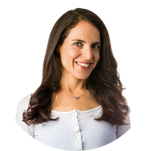
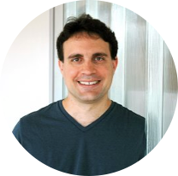
Privacy Amplification by Shuffling
Theorem [FMT21]:
$R(∙)$ is any $ε_{0}$-DP randomizer,
$S()$ is a perfect shuffler
Then $S(R\left(∙\right),R\left(∙\right)…,R\left(∙\right))$ is an $(ε,δ)$-DP mechanism with $ε≪ε_{0}$.
Shuffle
$$R(x_{1})$$
$$R(x_{2})$$
$$R(x_{3})$$
$$R(x_{4})$$
$$R(x_{5})$$
Notes:
Try to use more intuitive text

Slide 49
Federated Learning with Shuffling
Aggregate and update
Distributed Machine Learning
Anonymity -> stronger privacy
Optimal privacy amplification by shuffling[FMT22]
Shuffle
Local Gradient Vectors :
Dataset 1
Dataset 2
Dataset 3
Dataset 4
Dataset 5
49

Slide 50
A DO shuffler is asymptotically cheaper than a fully oblivious shuffle 😀
[GKLX21][BHMS21]
But the privacy guarantee is weaker😔
Privacy amplification with a DO shuffler? 🤨

Slide 51
Privacy Amplification by Shuffling
Shuffle
Example:
Local: $ε_{0}=1$
Shuffle: $ε≈\sqrt{3/n}$
Much better privacy!
$$R(x_{1})$$
$$R(x_{2})$$
$$R(x_{3})$$
$$R(x_{4})$$
$$R(x_{5})$$

Slide 52
Optimal Privacy Amplification with DO-Shuffle
Theorem (Ours):
$R(∙)$ is any $ε_{0}$-DP randomizer,
$S()$ is an $(ε_{1},δ_{1})$-DO shuffler against $t$-corrupted users
Then $S(R\left(∙\right),R\left(∙\right)…,R\left(∙\right))$ is an
$(ε+ε_{1},δ+δ_{1})$-DO mechanism:
$$ε≈\sqrt{\frac{e^{ε_{0}}\log{\frac{1}{δ}} }{n−t}}$$
DO-Shuffle
Asymptotically Optimal!
$$R(x_{1})$$
$$R(x_{2})$$
$$R(x_{3})$$
$$R(x_{4})$$
$$R(x_{5})$$
Extends [GKLX21]
Notes:
Match the shuffle model results

Slide 53
Optimal Privacy Amplification with DO-Shuffle
Our result:
Local private mechanism is NPDO mechanism with “privacy amplification potential”.
Then NPDO + DO shuffle -> DO
DO-Shuffle
$$R(x_{1})$$
$$R(x_{2})$$
$$R(x_{3})$$
$$R(x_{4})$$
$$R(x_{5})$$
Extends [GKLX21]
Notes:
Match the shuffle model results

Slide 54
Recap
We provided the framework for composable DO algorithms
Neighbor-preserving DO ☺
Future Direction
Building NPDO Algorithm Library
More Real World Applications
Thank you!
mingxunz@andrew.cmu.edu

Slide 55
Alice
Bob
...
Carl

Slide 56
No
Alice
Name | Smoke
Alice | No
Bob | Yes
Carl | No
Yes
Bob
No
...
Carl

Slide 57
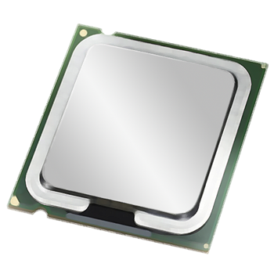
No
Alice
Name | Smoke
Alice | Np
Bob | Yes
Carl | No
Name | Smoke
Bob | Yes
Yes
Bob
“Select Smoke = Yes”
No
...
Carl
Secure CPU

Slide 58
No
Alice
Name | Smoke
Alice | Np
Bob | Yes
Carl | No
Name | Smoke
Bob | Yes
Yes
Bob
“Select Smoke = Yes”
No
...
Carl
Secure CPU

Slide 59
No
Alice
Name | Smoke
Alice | No
Bob | Yes
Carl | No
Name | Smoke
Bob | Yes
Yes
Bob
“Select Smoke = Yes”
No
...
Carl
Secure CPU

Slide 60
No
Alice
Name | Smoke
Alice | No
Bob | Yes
Carl | No
Name | Smoke
Bob | Yes
Yes
Bob smokes!
Bob
“Select Smoke = Yes”
No
...
Access patterns to even encrypted data leak sensitive information.
Carl
Secure CPU

Slide 61
No
Alice
Name | Smoke
Alice | No
Bob | Yes
Carl | No
Name | Smoke
Bob | Yes
Yes
Bob
“Obliviously Select Smoke=Yes”
No
...
Carl
Secure CPU

Slide 62
No
Alice
Name | Smoke
Alice | No
Bob | Yes
Carl | No
Name | Smoke
Bob | Yes
Yes
Bob
“Obliviously Select Smoke=Yes”
No
...
Carl
Secure CPU

Slide 63
Future Work
Advanced composition for DO (on-going work)
Renyi-DO (on-going work)
Composition if view/output are in uncountably infinite space
Thank you!
mingxunz@andrew.cmu.edu
Notes:
Thank you email

Slide 64
Thank you!
Summarize slides
2. future problem?

Slide 65
Roadmap
What is Differentially Oblivious Algorithm
Why not composable?
How to compose
Applications
New algorithm: Stable Compaction
New theorem: Optimal Privacy Amplification by DO shuffler

Slide 66
Guideline
What is oblivious algorithm (the exec, view abstraction)
What is differential obliviousness and why it has advantages
A simple example why the previous algorithms do not compose
Neighbors is no longer neighbors!
Introduce NPDO
With an example
The matching version, with pictures
An application: compaction w/ edit distance
An application: optimal shuffle DP

Slide 67
$$Pr\left[ ∈S\right]≤e^{ε}Pr\left[ ∈S\right]+δ$$
For any set $S$:
Memory
≈
Algorithm
(e.g., data analytics)
Database

Slide 68
Example: DO Selection w.r.t Hamming Distance Neighboring
Name | GPA | Dept
Alice | 4.0 | CS
Bob | 2.0 | CS
Carl | 4.0 | Math
Name | Dept
Alice | CS
Carl | Math
Name
Alice
Select GPA >= 3
Select Dept=CS
Name | GPA | Dept
Alice | 4.0 | CS
Bob | 3.0 | CS
Carl | 4.0 | Math
Name | Dept
Alice | CS
Bob | CS
Carl | Math
Name
Alice
Bob
Select GPA >= 3
Select Dept=CS

Slide 69
Main Theorem
Suppose $M_{1}$ is $\left(ε_{1},δ_{1}\right)$-NPDO:
If $M_{2}$ is $\left(ε_{2}, δ_{2}\right)$-DO,
the composition is $\left(ε_{1}+ε_{2},δ_{1}+δ_{2}\right)$-DO
If $M_{2}$ is $\left(ε_{2}, δ_{2}\right)$-NPDO, then
the composition is $\left(ε_{1}+ε_{2},δ_{1}+δ_{2}\right)$-NPDO

Slide 70
Differentially Oblivious Shuffle

Slide 71
Differentially Oblivious Shuffle Model
DO-Shuffle
DO-Shuffle

Slide 72
Differentially Oblivious Shuffle Model
Deniability for the sources of the messages
ϵ, δ
≈
DO-Shuffle
DO-Shuffle

Slide 73
Our work: A Composition Framework for DO algorithms
Before:
Not composable
After:
Composable
Modulization

Slide 74
Age 10
Alice
Name | Age
Alice | 10
Bob | 30
Carl | 12
Age 30
Bob
“Select Age >= 30”
...
Age 12
Carl
Secure CPU

Slide 75
Age 10
Alice
Name | Age
Alice | 10
Bob | 30
Carl | 12
Age 30
Bob
“Select Age >= 30”
...
Age 12
Carl
Secure CPU

Slide 76
Age 10
Alice
Name | Age
Alice | 10
Bob | 30
Carl | 12
Age 30
Bob
“Select Age >= 30”
...
Age 12
Carl
Secure CPU

Slide 77
...

Slide 78
...
Secure CPU

Slide 79
Access patterns to even encrypted data leak sensitive information.
Secure CPU

Slide 80
Non-oblivious Algorithm
Access patterns to even encrypted data leak sensitive information.
Trusted Execution Environment
(Intel SGX, ARM TrustZone…)
Encrypted DB
Notes:
application

Slide 81
Oblivious Algorithm
Access patterns are indistinguishable
for different inputs
Trusted Execution Environment
(Intel SGX, ARM TrustZone…)
Encrypted DB
81

Slide 82
Oblivious Algorithm
Specific purpose:
Oblivious sorting, shuffling, sampling…
General Purpose:
Oblivious RAM!
Any program can be made oblivious with
$O(\log{n)}$ to $O(\log^{2}{n)}$
overhead
$Ω\left(\log{n}\right)$ overhead
Padding to worst case ->
higher overhead

Slide 83
Relax the obliviousness notion?
Differential Obliviousness(DO)! [CCMS17]
Still provide meaningful privacy
Improve efficiency
Notes:
citation

Slide 84
But the privacy guarantee is constrained…

Slide 85
Memory
Algorithm
(e.g., data analytics)
randomized
Database

Slide 86
Memory
Algorithm
(e.g., data analytics)
Neighboring input DBs
Database

Slide 87
Memory
Algorithm
(e.g., data analytics)
Database

Slide 88
Access patterns on neighboring DBs must be similar
Memory
≈
Algorithm
(e.g., data analytics)
Database

Slide 89
Efficiency Improvement by DO
Sorting, merging, sampling…
Overhead ⬇️ from $O(\log{n)}$ to $O(log log{n)}$ [CCMS17]
Shuffling
Overhead ⬇️ from $O(poly(n))$ to $O(log{n)}$ [GKLX21] [BHMS21]
DP-ORAM[WCM16]
2x-10x faster than ORAM

Slide 90
Name | Oblivious Overhead | DO Overhead
Stable Sorting | $$\log{n}$$ | $$log log{n}$$
Merging | $$\log{n}$$ | $$log log{n}$$
Shuffling | $$poly(n)$$ | $$\log{n}$$ | Distributed Setting
ORAM | $$\log{n}$$ | $$\log{n}$$ | DO version is 2x-10x faster
Specific purpose:
$O(n\log{\log{n)}}$Stable Sorting
$O(n\log{\log{n)}}$Merging
$O(n\log{ n)}$Distributed Shuffling
General Purpose:
DP-ORAM

Slide 91
What is missing?
🤨
Composability of DO!
Notes:
It seems like differential obliviousness should have a pretty bright future. But what is missing?

Slide 92
Composability is important!
Vanilla DO: Not composable
Hard to design
No privacy accounting
NPDO: Composable
Modularized design
Enable privacy accounting

Slide 93
Composability is important!
Vanilla DO: Not composable
Hard to design
No privacy accounting
Standard DP: Composable
Modularized design
Enable privacy accounting

