Slide 1
Speed-Stacking Fast Sublinear Zero-Knowledge Proofs for Disjunctions
Aarushi Goel
Mathias Hall-Andersen
Gabriel Kaptchuk
Nicholas Spooner
EUROCRYPT 2023

Slide 2
Zero Knowledge Proofs [GMR85]
$$L∈NP$$
$$x∈L$$
..
..
..
Prover
Okay, I believe you
Verifier

Slide 3
Zero Knowledge Proofs [GMR85]
Soundness
$$L∈NP$$
Cheating prover cannot give accepting proof if $x∉L$
$$x∈L$$
..
..
Zero knowledge
..
Verifier should not learn the secret witness
Prover
Verifier

Slide 4
Public-Coin Interactive Zero-Knowledge Proofs
$$L∈NP$$
Verifier only sends random messages
$$x∈L$$
Honest verifier zero-knowledge
..
..
Can be made non-interactive in the random oracle model [FS87]
$$Π$$
..
Prover
Verifier

Slide 5
Public-Coin Interactive Zero-Knowledge Proofs
Sublinear
$$L∈NP$$
Verifier only sends random messages
$$x∈L$$
Honest verifier zero-knowledge
$$Π$$
Can be made non-interactive in the random oracle model [FS87]
Prover
Verifier
Proof size (and sometimes verification time) is sublinear in the size of computation being proven.

Slide 6
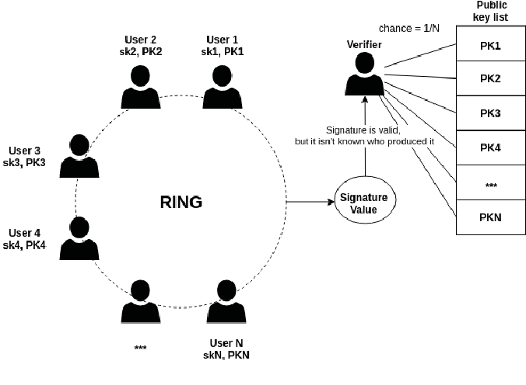
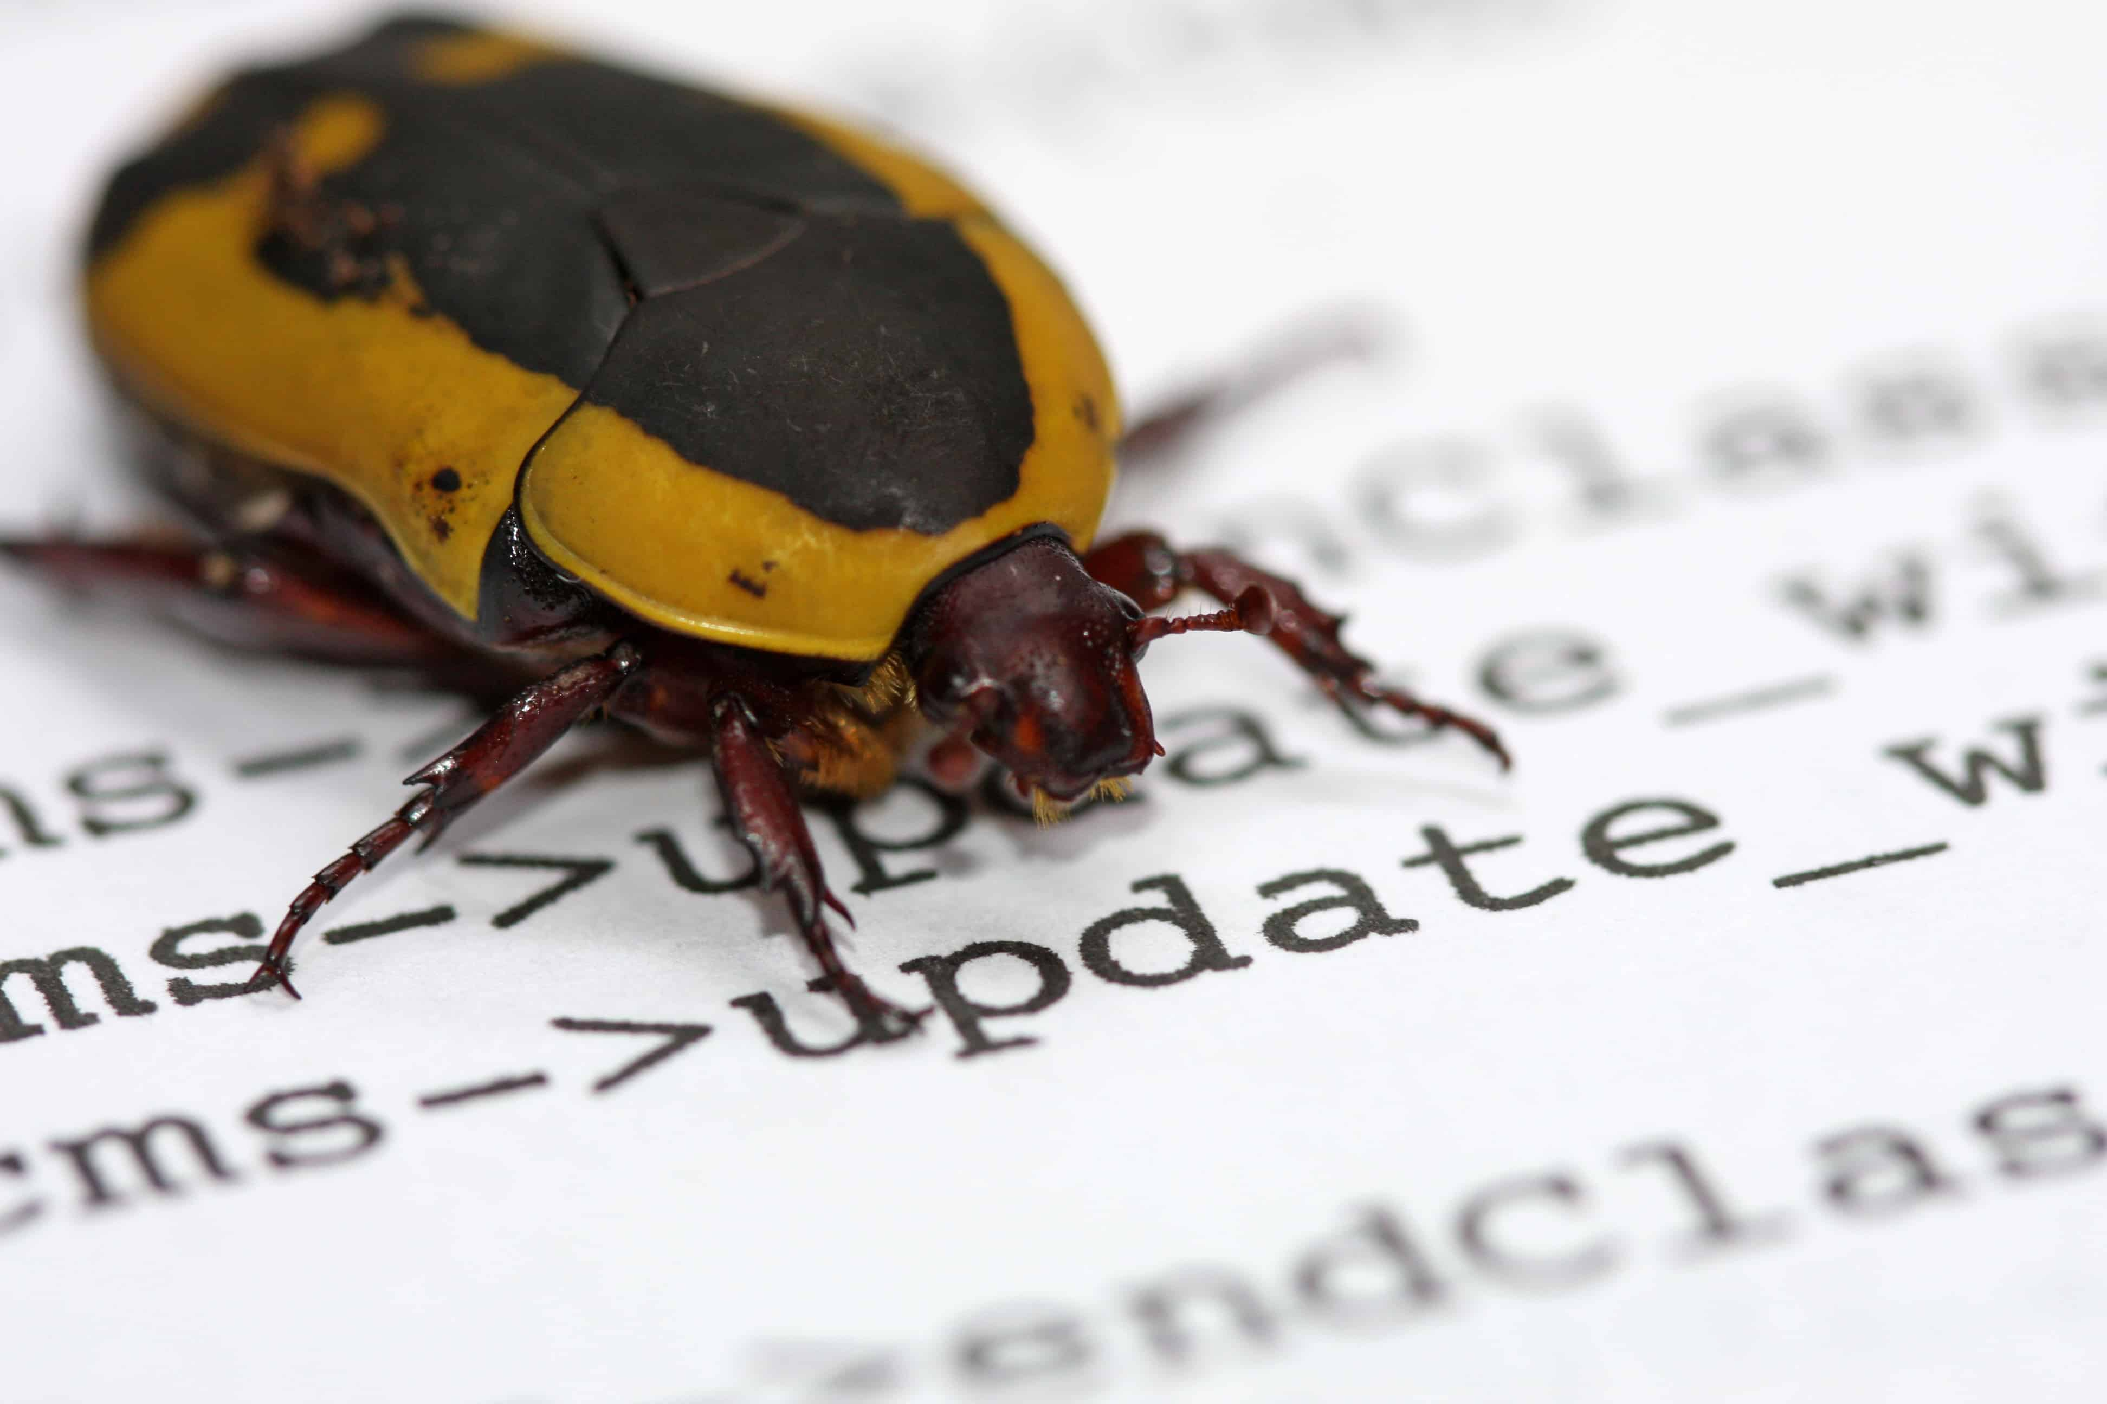
Disjunctive Statements
$$x_{1}∈L_{1}$$
$$or$$
$$x_{2}∈L_{2}$$
$$or$$
$$x_{3}∈L_{3}$$
$$or$$
$$x_{4}∈L_{4}$$
$$or$$
$$x_{5}∈L_{5}$$
$$or$$
$$x_{6}∈L_{6}$$
Why care about disjunctions?
Ring Signatures [RST01]
/Confidential Transactions
Proving existence of bugs in code [HK20]
Verifying authenticity of images in media [NT16]

Slide 7
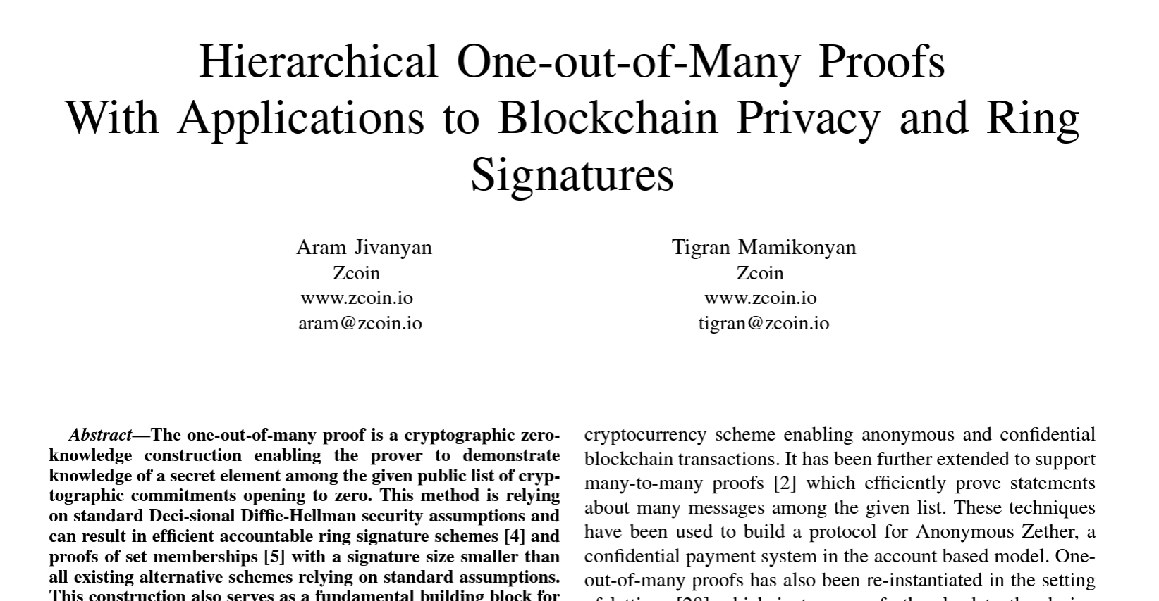
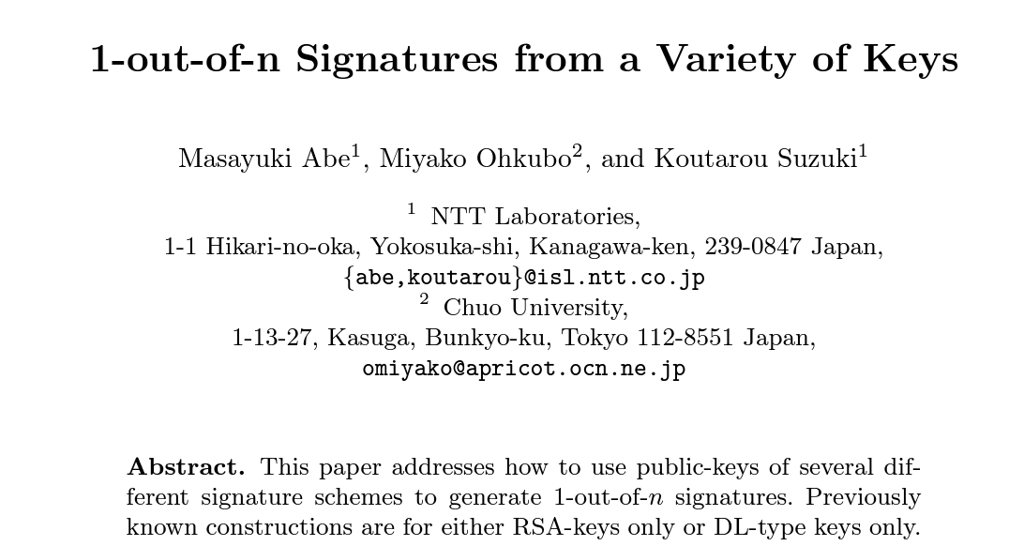
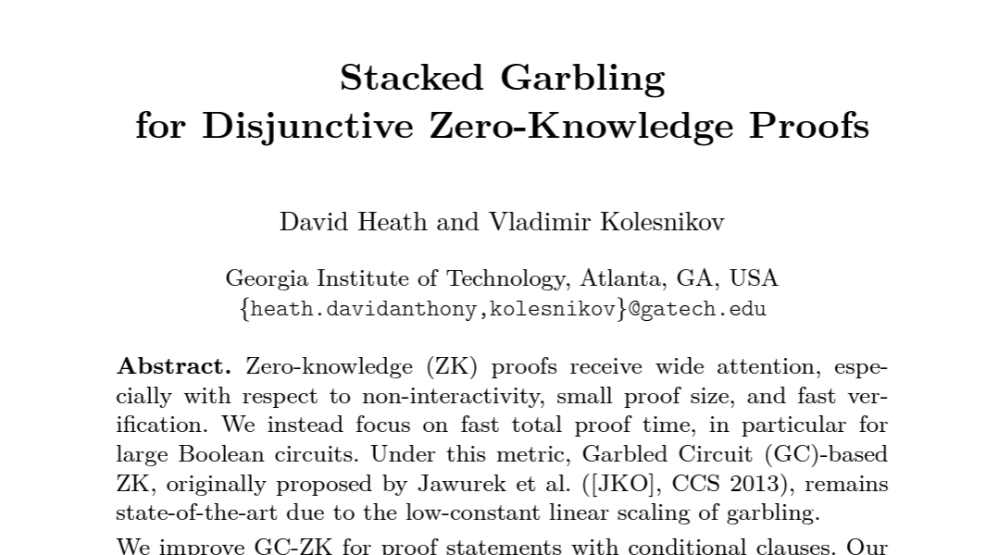
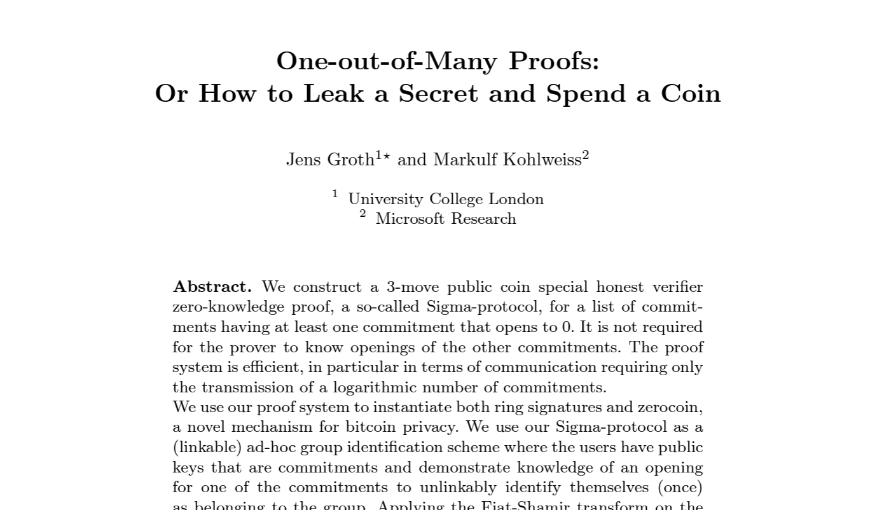
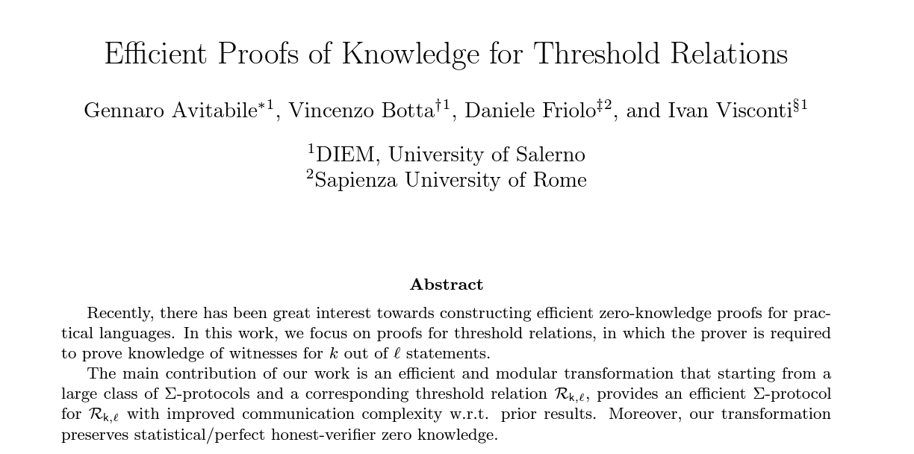
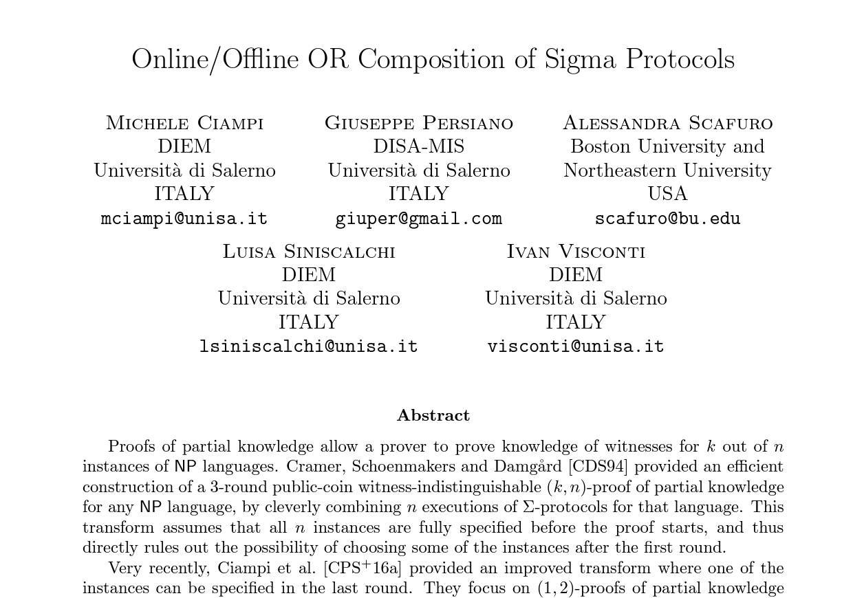
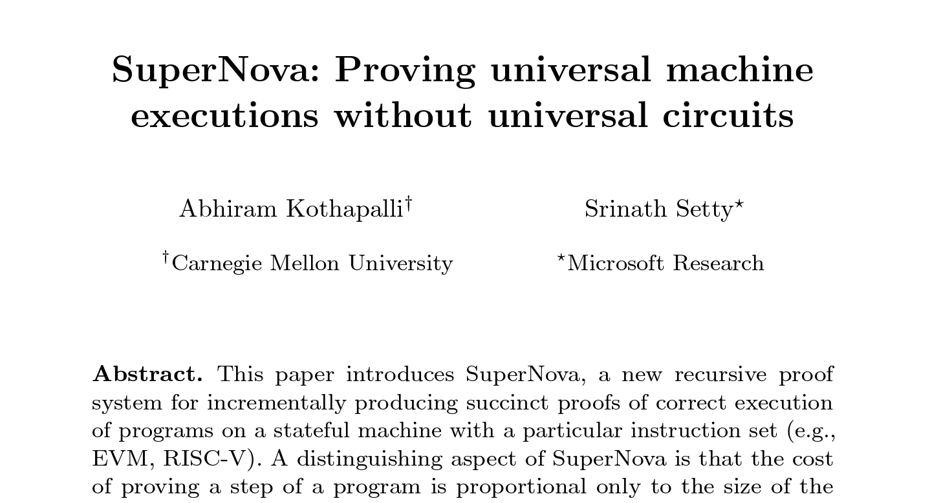
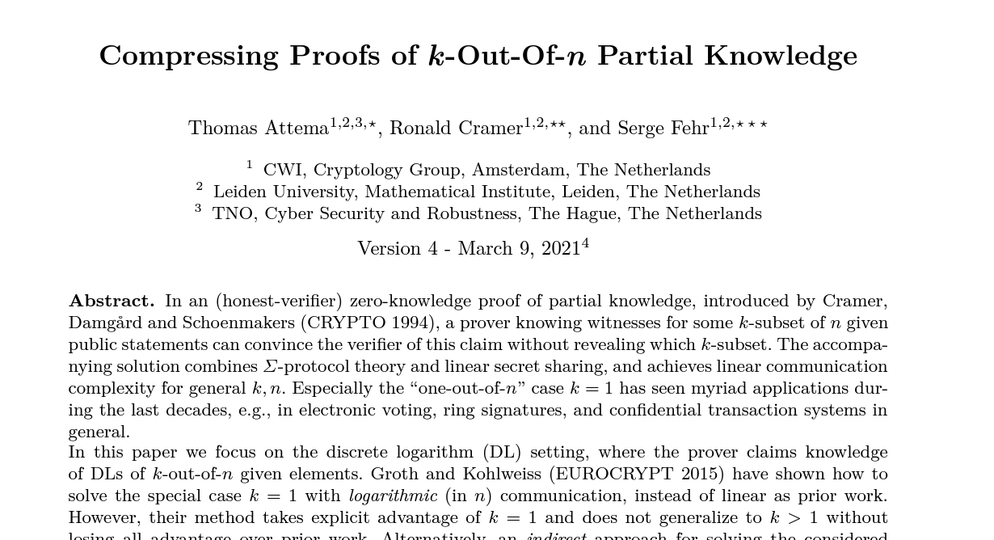
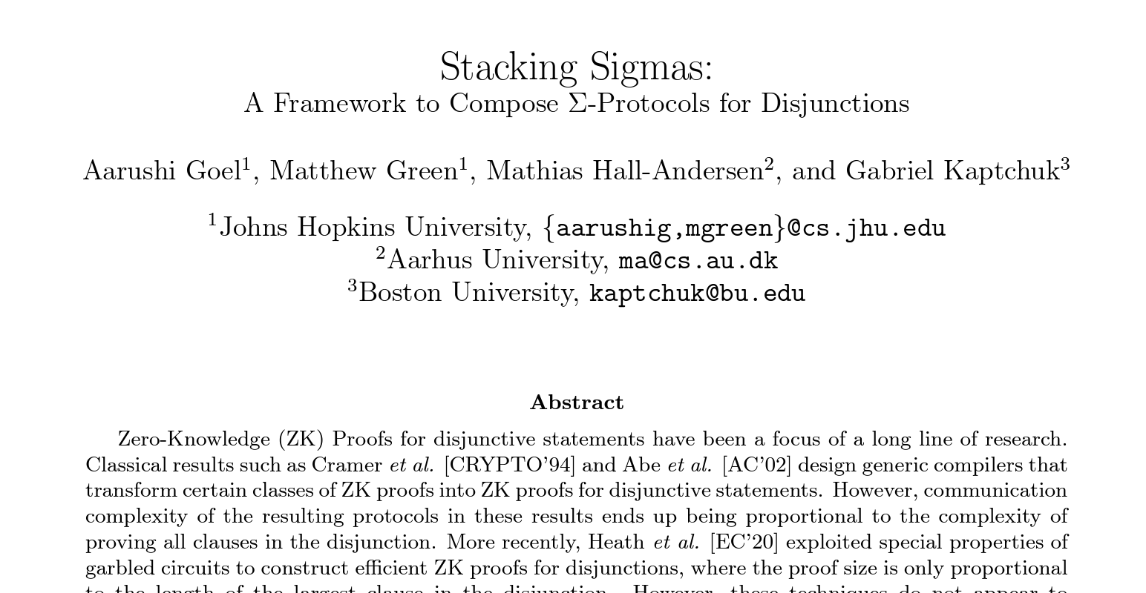
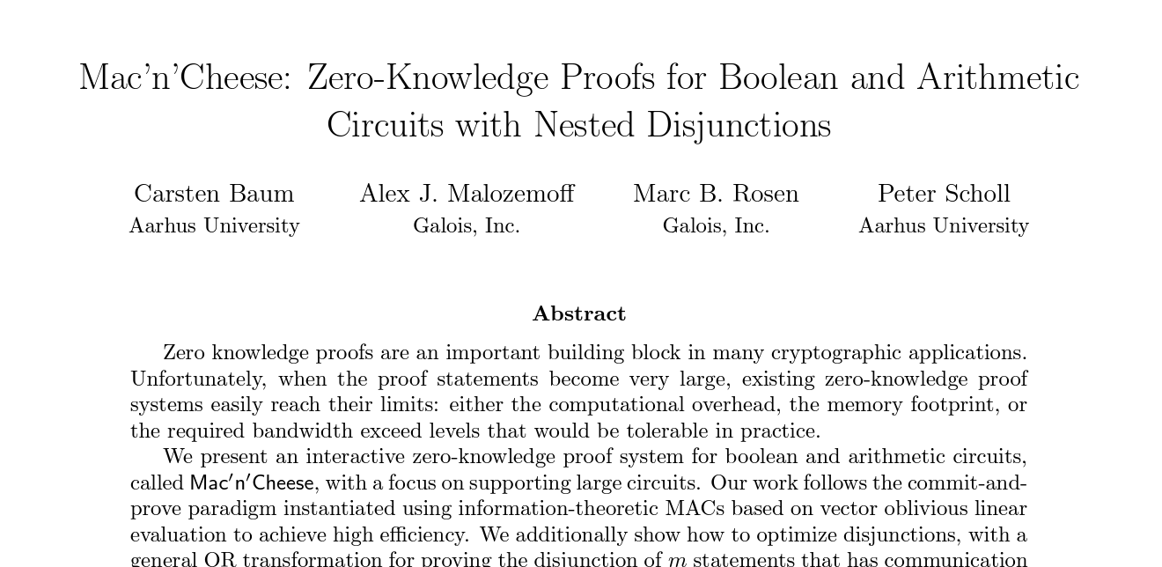
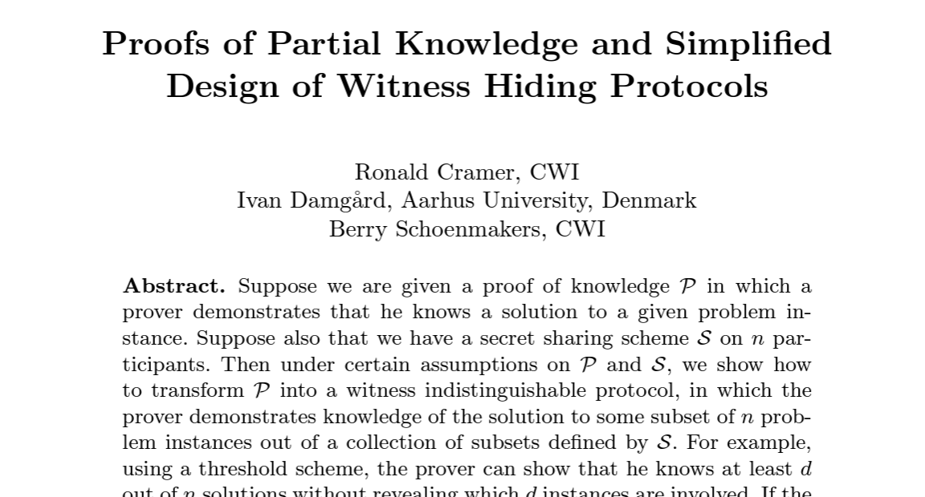
A Lot of Work on Disjunctive Zero-Knowledge

Slide 8
Question?
Can we design a framework to efficiently compose
sublinear zero-knowledge proofs for disjunctions?

Slide 9
Question?
Can we design a framework to efficiently compose
sublinear zero-knowledge proofs for disjunctions?
(Public-coin ZK-IP)

Slide 10
Composing Public-Coin ZK-IP for Disjunctions
$$x_{1}∈L_{1}$$
$$x_{2}∈L_{2}$$
$$x_{3}∈L_{3}$$
$$x_{4}∈L_{4}$$
$$x_{5}∈L_{5}$$
$$x_{6}∈L_{6}$$
$$Π_{1}$$
$$Π_{2}$$
$$Π_{3}$$
$$Π_{4}$$
$$Π_{5}$$
$$Π_{6}$$

Slide 11
Composing Public-Coin ZK-IP for Disjunctions
$$x_{1}∈L_{1}$$
$$or$$
$$x_{2}∈L_{2}$$
$$or$$
$$x_{3}∈L_{3}$$
$$or$$
$$x_{4}∈L_{4}$$
$$or$$
$$x_{5}∈L_{5}$$
$$or$$
$$x_{6}∈L_{6}$$
$$Π_{6}$$
$$Π_{3}$$
$$Π_{2}$$
$$Π_{1}$$
$$Π_{5}$$
$$Π_{4}$$
New Proof

Slide 12
Composing Public-Coin ZK-IP for Disjunctions
$$x_{1}∈L_{1}$$
$$or$$
$$x_{2}∈L_{2}$$
$$or$$
$$x_{3}∈L_{3}$$
$$or$$
$$x_{4}∈L_{4}$$
$$or$$
$$x_{5}∈L_{5}$$
$$or$$
$$x_{6}∈L_{6}$$
$$Π_{6}$$
$$Π_{3}$$
$$Π_{2}$$
$$Π_{1}$$
$$Π_{5}$$
[CDS94, AOS02]
$$Π_{4}$$
$Σ$-Protocols
New Proof

Slide 13
Composing Public-Coin ZK-IP for Disjunctions
Stacking
$$x_{1}∈L_{1}$$
$$or$$
$$x_{2}∈L_{2}$$
$$or$$
$$x_{3}∈L_{3}$$
$$or$$
$$x_{4}∈L_{4}$$
$$or$$
$$x_{5}∈L_{5}$$
$$or$$
$$x_{6}∈L_{6}$$
$$Π_{6}$$
$$Π_{6}$$
$$Π_{3}$$
$$Π_{3}$$
$$Π_{2}$$
$$Π_{2}$$
$$Π_{1}$$
$$Π_{1}$$
$$Π_{5}$$
[CDS94, AOS02]
$$Π_{5}$$
[GGHK22]
$$Π_{4}$$
$$Π_{4}$$
$Σ$-Protocols
$Σ$-Protocols
New proof where size only depends on one clause
New Proof

Slide 14
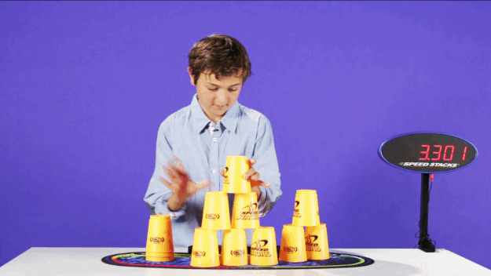
Our Goal
Speed-Stacking Sublinear Public-Coin ZK-IP for Disjunctions

Slide 15
Our Results
Extend stacking framework [GGHK22] to multi-round public-coin ZK-IP
Show that many existing sublinear proof systems are stackable
Resulting proof size = Proof size for a single clause + log (# clauses)
Resulting prover time = Prover time for a single branch + time to simulate remaining clauses
In sublinear proofs: Simulation time < Prover time
$⇒$Faster prover time for disjunctions

Slide 16
Recall: Stacking $Σ$-Protocols
[G-Green-Hall-Andersen-Kaptchuk 22]

Slide 17
Stacking $Σ$-Protocols for Disjunctions [GGHK22]
$$x_{1}∈L_{1}$$
$$or$$
$$x_{2}∈L_{2}$$
$$or$$
$$x_{3}∈L_{3}$$
Prover has $w_{2}$
$$a_{1}$$
$$a_{2}$$
$$a_{3}$$
$$c_{1}$$
$$c_{2}$$
$$c_{3}$$
Prover
Verifier
$$z_{1}$$
$$z_{2}$$
$$z_{3}$$
$$Σ$$
$$Σ$$
$$Σ$$

Slide 18
Stacking $Σ$-Protocols for Disjunctions [GGHK22]
$$x_{1}∈L_{1}$$
$$or$$
$$x_{2}∈L_{2}$$
$$or$$
$$x_{3}∈L_{3}$$
Prover has $w_{2}$
$$a_{1}$$
$$a_{2}$$
$$a_{3}$$
$$c$$
Prover
Verifier
$$z_{1}$$
$$z_{2}$$
$$z_{3}$$

Slide 19
Stacking $Σ$-Protocols for Disjunctions [GGHK22]
$$x_{1}∈L_{1}$$
$$or$$
$$x_{2}∈L_{2}$$
$$or$$
$$x_{3}∈L_{3}$$
Prover has $w_{2}$
$$a_{1}$$
$$a_{2}$$
$$a_{3}$$
$$c$$
Prover
Verifier
$$z_{1}$$
$$z_{2}$$
$$z_{3}$$
??
Prover can compute these messages
??

Slide 20
Stackable $Σ$-Protocols [GGHK22]
$$a$$
Stackable Property 1:
Extended Honest Verifier ZK
$$c$$
Stackable Property 2: (Recyclable third round message)
Step 1:
Sample $c$
$$z$$
For a fixed $c$:
$z$ is similarly distributed for $x_{1},x_{2},x_{3}$
Step 2:
deterministic
Verifier
Compute$z a$
Prover

Slide 21
Stacking $Σ$-Protocols for Disjunctions [GGHK22]
$$x_{1}∈L_{1}$$
$$or$$
$$x_{2}∈L_{2}$$
$$or$$
$$x_{3}∈L_{3}$$
Prover has $w_{2}$
$$a_{1}$$
$$a_{2}$$
$$a_{3}$$
$$c$$
Prover
Verifier
$$z_{1}$$
$$z_{2}$$
$$z_{3}$$
??
Prover can compute these messages
??

Slide 22
Stacking $Σ$-Protocols for Disjunctions [GGHK22]
$$x_{1}∈L_{1}$$
$$or$$
$$x_{2}∈L_{2}$$
$$or$$
$$x_{3}∈L_{3}$$
Prover has $w_{2}$
$$Com($$
$$)$$
$$⊥$$
$$a_{2}$$
$$⊥$$
$$c$$
Prover
Verifier
$$z_{2}$$
$$, op$$
Compute $z_{2}$
Compute $a_{1},a_{2}, a_{3}$using ${c,z}_{2}$
Simulate $a_{1},a_{3}$ using $c,z_{2}$
Check if $com, op$ are consistent with ${[a}_{1},a_{2}, a_{3}]$
$op=$ Equivocate $com$ to ${[a}_{1},a_{2}, a_{3}]$
Check ${(x}_{1},a_{1},c,z_{2}),{(x}_{2},a_{2},c,z_{2}),$ ${(x}_{3},a_{3},c,z_{2})$

Slide 23
Partially-Binding Vector Commitments [GGHK22]
$$Com($$
$$v_{1}$$
…..
$$)$$
$$v_{2}$$
$$v_{n}$$
$1$-out-of-$n$ position is binding. Rest can be equivocated.
Binding position is fixed at the time of commitment.
Binding position remains hidden from the receiver.
[GGHK22] propose an efficient construction based on Pedersen Commitments [Ped91]

Slide 24
Stacked $Σ$-Protocol [GGHK22]
$$x_{1}∈L_{1}$$
$$or$$
$$x_{2}∈L_{2}$$
$$or$$
$$x_{3}∈L_{3}$$
Prover has $w_{2}$
$$Com($$
$$)$$
$$⊥$$
$$a_{2}$$
$$⊥$$
$$c$$
Prover
Verifier
$$z_{2}$$
$$, op$$
Communication = proof size for proving a single branch + size of commitment + size of opening
Can be short
At least linear in the length of the vector
Can be made logarithmic!!

Slide 25
Our Approach
Stacking Multi-Round ZK-IP

Slide 26
Review: Stacking approach for $Σ$-Protocols
Deterministically computable given $x,c,z$
$$a$$
$$c$$
$$z$$
Prover
Recyclable across clauses
Verifier

Slide 27
Multi-Round ZK-IP
Which messages are recyclable and which ones are deterministically computable?
$$x∈L$$
$$m_{1}$$
$$c_{1}$$
$$m_{2}$$
Prover
Verifier
$$c_{2}$$
.
.
.
$$m_{k}$$

Slide 28
Multi-Round ZK-IP
$$x∈L$$
$m_{rand,1}$ $m_{det,1}$
$$c_{1}$$
$m_{rand,2}$ $m_{det,2}$
Prover
Verifier
$$c_{2}$$
.
.
.
Can be simulated independent of the instance $x$ and hence are recyclable!
Can be computed deterministically, given the instance $x$ and $m_{rand}$ messages
$m_{rand,k}$ $m_{det,k}$

Slide 29
Stacking Multi-Round ZK-IP
$$x_{1}∈L_{1}$$
$$or$$
$$x_{2}∈L_{2}$$
$$or$$
$$x_{3}∈L_{3}$$
Prover has $w_{2}$
$$m_{rand,11}$$
$$m_{det,11}$$
$$m_{rand,21}$$
$$m_{det,21}$$
$$m_{rand,31}$$
$$m_{det,31}$$
$$c_{11}$$
$$c_{21}$$
$$c_{31}$$
$$m_{rand,12}$$
$$m_{det,12}$$
$$m_{rand,22}$$
$$m_{det,22}$$
$$m_{rand,32}$$
$$m_{det,32}$$
Prover
Verifier
$$c_{12}$$
$$c_{22}$$
$$c_{32}$$
.
.
.
.
.
.
.
.
.
$$m_{rand,1k}$$
$$m_{det,1k}$$
$$m_{rand,2k}$$
$$m_{det,2k}$$
$$m_{rand,3k}$$
$$m_{det,3k}$$
$${Π }_{1}$$
$${Π }_{2}$$
$${Π }_{3}$$

Slide 30
Stacking Multi-Round ZK-IP
$$x_{1}∈L_{1}$$
$$or$$
$$x_{2}∈L_{2}$$
$$or$$
$$x_{3}∈L_{3}$$
Prover has $w_{2}$
$$m_{rand,11}$$
$$m_{det,11}$$
$$m_{rand,21}$$
$$m_{det,21}$$
$$m_{rand,31}$$
$$m_{det,31}$$
$$c_{1}$$
$$m_{rand,12}$$
$$m_{det,12}$$
$$m_{rand,22}$$
$$m_{det,22}$$
$$m_{rand,32}$$
$$m_{det,32}$$
Prover
Verifier
$$c_{2}$$
.
.
.
.
.
.
.
.
.
$$m_{rand,1k}$$
$$m_{det,1k}$$
$$m_{rand,2k}$$
$$m_{det,2k}$$
$$m_{rand,3k}$$
$$m_{det,3k}$$

Slide 31
Stacking Multi-Round ZK-IP
$$x_{1}∈L_{1}$$
$$or$$
$$x_{2}∈L_{2}$$
$$or$$
$$x_{3}∈L_{3}$$
Prover has $w_{2}$
$$m_{rand,21}$$
, $Com($
$$⊥$$
$$m_{det,21}$$
$$⊥$$
$$)$$
$$c_{1}$$
$$m_{rand,22}$$
, $Com($
$$⊥$$
$$m_{det,22}$$
$$⊥$$
$$)$$
Prover
Verifier
$$c_{2}$$
.
.
.
Before the last round:
Simulate all remaining deterministic messages
Simulate all deterministic messages
Equivocate all commitments to the updated vectors
Checks all commitments and transcripts
$$m_{rand,2k}$$
${op}_{1},{op}_{2},$ ${op}_{3}$

Slide 32
Analyzing Complexity
Communication = proof size for proving a single branch + $k ×$size of commitment + size of openings
Computation time = time to prove a single branch + $\text{time} \text{to} \text{compute}$deterministic messages for all branches
If time to simulate $m_{det,ij}$ << time to prove a single branch: We can get sublinear computation times

Slide 33
Examples of Stackable Multi-round ZK-IP
Many sublinear proof systems!
Folding Arguments
Interactive Oracle Proofs
Stactal
[GHKS23]
Bulletproofs
[BBBPWM18]
Compressed Σ-Protocols
[AC20, ACF21]
Aurora
[BCRSVW19]
Fractal
[COS20]
No meaningful speedup
Sim same speed as prover
No asymptotic speedup
Significant concrete speedup
Sim only field operations
Small asymptotic speedup
Significant concrete speedup
Re-use low-degree test across clauses
Design non-trivial extension with constant time simulation
Significant asymptotic speedup

Slide 34
Conclusion
Extend stacking framework [GGHK22] to multi-round public-coin ZK-IP
Show that many existing sublinear proof systems are stackable
Resulting proof size = Proof size for a single clause + log (# clauses)
Resulting prover time = Prover time for a single branch + time to simulate remaining clauses
In sublinear proofs: Simulation time < Prover time
$⇒$Faster prover time for disjunctions

Slide 35
Thanks! eprint.iacr.org/2022/1419

