Slide 1
Black-Box Reusable NISC with Random Oracles
Yuval Ishai, Technion
Dakshita Khurana, UIUC
Amit Sahai, UCLA
Akshayaram Srinivasan, TIFR
Presented by: Paul Lou, UCLA

Slide 2
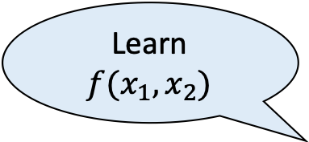
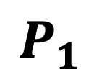
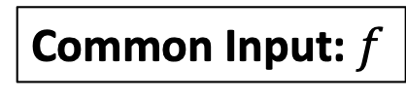
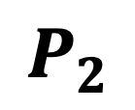
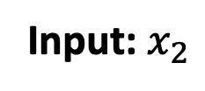
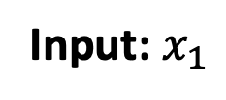
Secure Two-party Computation
[Yao 86]
Minimize Round Complexity
Learn $f(x_{1},x_{2})$
Common Input: $f$
Receiver
$$P_{1}$$
$$P_{2}$$
Sender
Malicious Adversaries
Input: $x_{1}$
Input: $x_{2}$
Correctness: $P_{1}$ learns $f(x_{1},x_{2})$ at the end of the protocol.
Receiver Security: $P_{2}$ learns no information about $x_{1}$.
Sender Security: $P_{1}$ learns no information about $x_{2}$ apart from $f(x_{1},x_{2})$.
Notes:
Let me start this talk by recalling the setting of secure two-party computation.
Here, there are two parties, P_1 and P_2. They have private inputs x_1 and x_2 respectively. They also have a description of a function f as common input. We would like P_1 to learn the output of f applied on (x_1,x_2). In the secure computation literature, P_1 is called the receiver and P_2 is called the sender. For computing this output, the parties run a two-party distributed computation protocol.
Intuitively, we want this protocol to satisfy three properties:
The first is the correctness requirement which states that at the end of the protocol execution, P_1 learns the output of f applied on their private inputs.
The second property is the receiver security which requires that P_2 learns no information about P_1’s private input x_1.
The third property is sender security which requires that P_1 learns no information about x_2 except f(x_1,x_2)
We want all the three properties to hold against malicious adversaries and the security and correctness properties are modeled in the real world/ideal world paradigm.
One of the major goals in designing such secure computation protocols is to minimize the number of rounds of interaction.

Slide 3

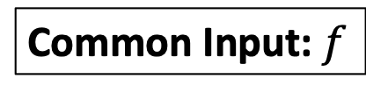
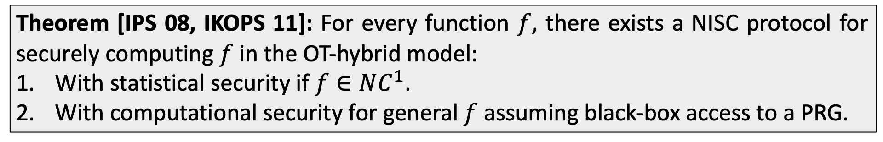

Non-Interactive Secure Computation
[Ishai-Prabhakaran-Sahai 08, Ishai-Kushilevitz-Ostrovsky-Prabhakaran-Sahai 11]
Learn $f(x_{1},x_{2})$
Round Optimal
Common Input: $f$
$$msg_{1}$$
Receiver
$$P_{1}$$
$$P_{2}$$
Sender
$$msg_{2}$$
Input: $x_{1}$
Input: $x_{2}$
Theorem [IPS 08, IKOPS 11]: For every function $f$, there exists a NISC protocol for securely computing $f$ in the OT-hybrid model:
With statistical security if $f∈NC^{1}$.
With computational security for general $f$ assuming black-box access to a PRG.
Notes:
Towards this goal, the works of Ishai-Prabhakaran-Sahai and Ishai-Kushilevitz-Ostrovsky-Prabhakaran-Sahai introduced the notion of non-interactive secure computation (NISC).
We again consider the setting of secure two-party computation.
In a NISC protocol, P_1 generates a first round message msg_1 using its private input x_1. P_2 uses this message as well as its own private input to generate the second round message msg_2. P_1 can decode this sender’s message to learn f(x_1,x_2). Such two message protocols are known to be round-optimal.
It should be noted that if we only care about semi-honest adversaries, then Yao’s protocol already satisfies the required security properties. Additionally, if we replace semi-honest OT with a malicious-secure OT protocol, then the same protocol already satisfies security against malicious receivers. So, the main challenge is to protect against a malicious sender without compromising on the receiver security.
Explain: convert semi-honest to malicious. NIZK non-black box use, super expensive, huge computational cost
These works showed that for every function f, there exists a NISC protocol for securely computing f in the OT-hybrid model, with statistical security if f \in NC^1 and with computational security for general functions f assuming black-box access to a PRG.
Note that this can be achieved if we make use of NIZK. However, the non-triviality stems from the fact that the protocol makes black-box use of OT and a PRG.

Slide 4
Non-Interactive Secure Computation
[Ishai-Prabhakaran-Sahai 08, Ishai-Kushilevitz-Ostrovsky-Prabhakaran-Sahai 11]
Severe limitations for several important use cases
Several Exciting applications
Notes:
Non-interactive secure computation is one of the central concepts in the area of secure computation. It has several exciting applications and it has been optimized for several use cases. Despite this, the vanilla NISC protocol has severe limitations and cannot be directly used for several important use cases.

Slide 5
Motivating Scenario
Notes:
Let me explain one such scenario.
Consider a patient who is waiting for an organ transplant. The DNA sequence of this patient must be matched with that of a potential donor and only if they match the doctors can go ahead with the transplant.

Slide 6
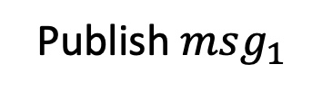
Motivating Scenario
Match or
No match
Publish $msg_{1}$
$$msg_{2}$$
Notes:
However, DNA sequences are highly sensitive information and cannot be published in the clear.
For this purpose, we can use a NISC protocol. Specifically, a hospital can take the DNA information of the patient and encode this using the first round message of the NISC protocol. When a potential donor comes, we can encode the DNA information of the donor using the sender message and send this to the hospital. The hospital can decode the sender message and learn if there is a match or not.

Slide 7
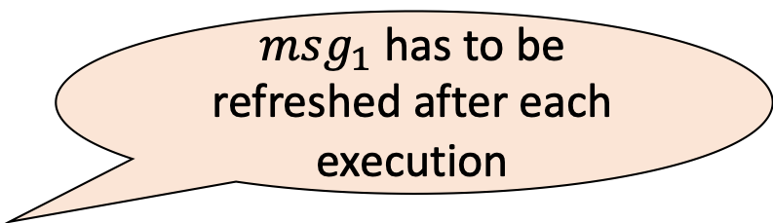
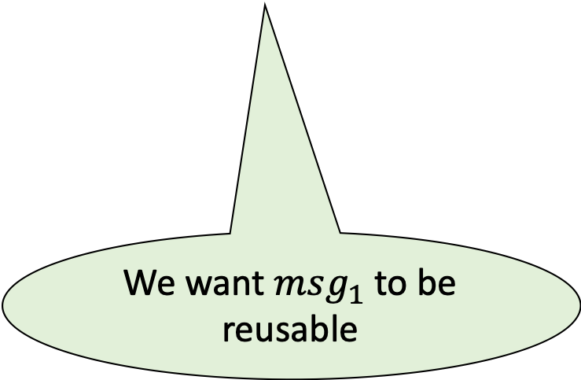
Motivating Scenario
No match
$msg_{1}$ has to be refreshed after each execution
Publish $msg_{1}$
$$msg_{2}$$
We want $msg_{1}$ to be reusable
Notes:
Suppose there is a match, then we are done. But if it is not a match, then we need to refresh the first round message so that it could be used with another potential donor. This creates severe limitations as one needs to send a new encoding of the patient’s private information for matching with each donor.
Ideally, we want the first round message to be reusable.

Slide 8
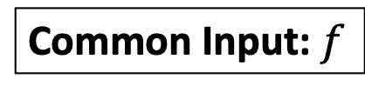

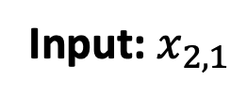


Reusable Non-Interactive Secure Computation
[Ishai-Kushilevitz-Ostrovsky-Prabhakaran-Sahai 11,
Chase-Dodis-Ishai-Kraschewski-Liu-Ostrovsky-Vaikuntanathan 19]
Learn $f(x_{1},x_{2,1})$
Common Input: $f$
$$msg_{1}$$
Receiver
$$P_{1}$$
$$P_{2,1}$$
Sender
$$msg_{2,1}$$
Input: $x_{1}$
Input: $x_{2,1}$
Notes:
To overcome this limitation, the works of Ishai et al and Chase et al. considered the problem of reusable NISC protocol.
Here, there is a receiver P_1 with private input x_1. The receiver has a function f in mind. The receiver generates an encoding of its private input and publishes this encoding on a bulletin board.
Now, the first sender comes with private input x_{2,1} and this sender sends a single message msg_{2,1} by using the published first round message and its own private input. The receiver can decode this sender’s message to learn f(x_1,x_{2,1}).

Slide 9

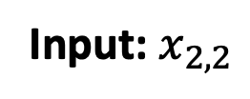
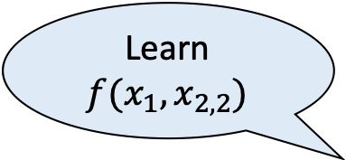

Reusable Non-Interactive Secure Computation
[Ishai-Kushilevitz-Ostrovsky-Prabhakaran-Sahai 11,
Chase-Dodis-Ishai-Kraschewski-Liu-Ostrovsky-Vaikuntanathan 19]
Learn $f(x_{1},x_{2,2})$
Common Input: $f$
$$msg_{1}$$
Receiver
$$P_{1}$$
$$P_{2,2}$$
Sender
$$msg_{2,2}$$
Input: $x_{1}$
Input: $x_{2,2}$
Notes:
After this, a second sender comes with private input x_{2,2} and this sender sends a single message msg_{2,2} by using the published first round message and its own private input. Note that the published first round message does not change across these executions. The receiver can decode this sender’s message to learn f(x_1,x_{2,2}).

Slide 10
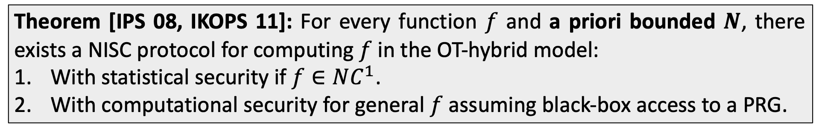

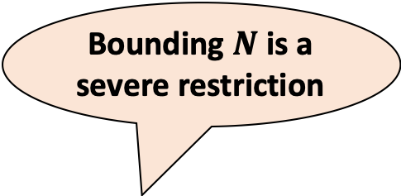
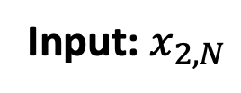


Reusable Non-Interactive Secure Computation
[Ishai-Kushilevitz-Ostrovsky-Prabhakaran-Sahai 11,
Chase-Dodis-Ishai-Kraschewski-Liu-Ostrovsky-Vaikuntanathan 19]
Learn $f(x_{1},x_{2,N})$
Bounding $N$ is a severe restriction
Common Input: $f$
$$msg_{1}$$
Receiver
$$P_{1}$$
$$P_{2,N}$$
Sender
$$msg_{2,N}$$
Input: $x_{1}$
Input: $x_{2,N}$
Theorem [IPS 08, IKOPS 11]: For every function $f$ and a priori bounded $N$, there exists a NISC protocol for computing $f$ in the OT-hybrid model:
With statistical security if $f∈NC^{1}$.
With computational security for general $f$ assuming black-box access to a PRG.
Notes:
This continues for N executions. The receiver learns the outputs of the function f applied on its fixed input and each one of the sender inputs.
The works of Ishai et al. can be modified to be secure with N reuses where N is a priori bounded. A trivial way to achieve bounded reusability is to run N copies of the single use protocol in parallel. The work of Ishai et al. give a solution with an additive overhead of N rather a multiplicative overhead.
However, bounding N severely limits the functionality and additionally, the size of the messages grow with N.

Slide 11
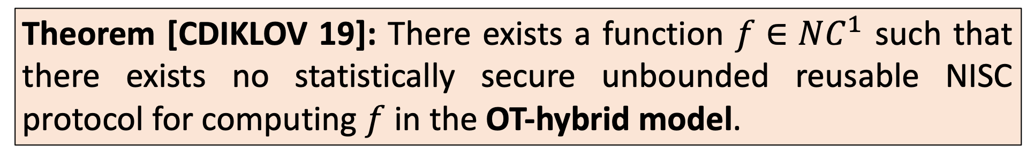
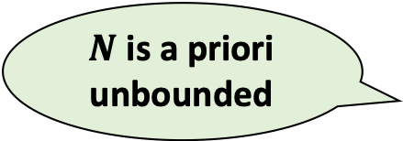
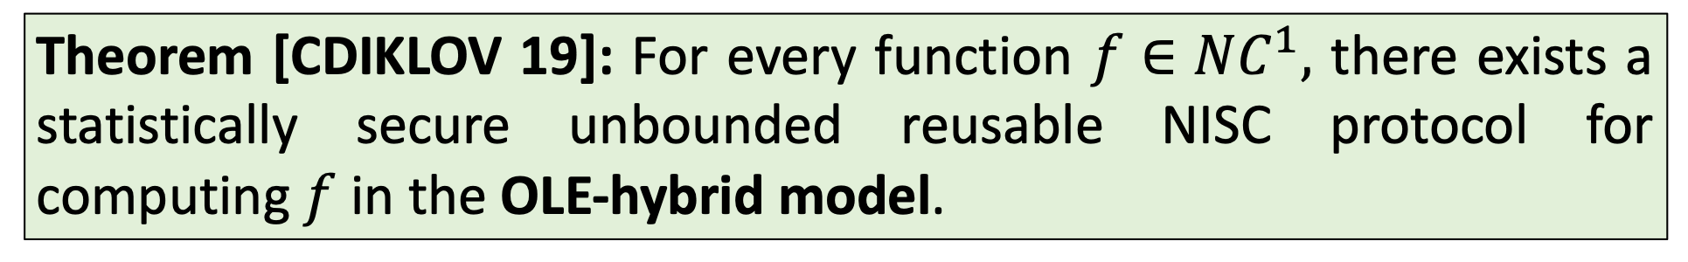
Unbounded Reusable NISC
[Chase-Dodis-Ishai-Kraschewski-Liu-Ostrovsky-Vaikuntanathan 19]
$N$ is a priori unbounded
Theorem [CDIKLOV 19]: There exists a function $f∈NC^{1}$ such that there exists no statistically secure unbounded reusable NISC protocol for computing $f$ in the OT-hybrid model.
Arithmetic analogue of OT
Theorem [CDIKLOV 19]: For every function $f∈NC^{1},$ there exists a statistically secure unbounded reusable NISC protocol for computing $f$ in the OLE-hybrid model.
Notes:
To overcome this limitation, the work of Chase et al. studied the notion of unbounded reusable NISC protocol. By unbounded, I mean that the number of reuses given by N is a priori unbounded.
Unfortunately, they showed that it is impossible to construct unbounded reusable NISC for general functions in the OT-hybrid model. This must be contrasted with the single-use or bounded NISC results which can be constructed in the OT-hybrid model. Specifically, they showed that there exists a function f \in NC1 such that no statistically secure unbounded NISC exists for computing f in the OT-hybrid model.
Somewhat surprisingly, they also showed that this impossibility can be overcome in the OLE hybrid model. Specifically, they showed that for every f \in NC^1, there exists a statistically secure unbounded reusable NISC protocol for computing f in the OLE-hybrid model. Here, OLE is the arithmetic analogue of OT.
Stronger model of OLE-hybrid, can overcome this.

Slide 12
Limitations
OLE is much more expensive to implement than OT.
The flavor of OLE needed is only known from DCR.
Protocol for computing general circuits requires non-black-box use of PRG.
Notes:
However, this positive result has several limitations.
First, OLE is much more expensive to implement both asymptotically and concretely than OT.
Second, the flavor of OLE that is needed for instantiating the protocol of Chase et al. is only known from the DCR assumption.
Finally, the protocol given in their work for computing general circuits requires non-black-box use of PRG.

Slide 13
Our Goal
Construct unbounded reusable NISC protocol for computing general circuits
Efficiently instantiable from a wide variety of standard cryptographic assumptions
Makes black-box use of the underlying cryptographic primitives
Notes:
Given these limitation, our goal is to construct unbounded reusable NISC protocol for computing general circuits that is (1) efficiently instantiable from a wide variety of standard cryptographic assumptions and (2) makes black-box use of the underlying cryptographic primitives.

Slide 14
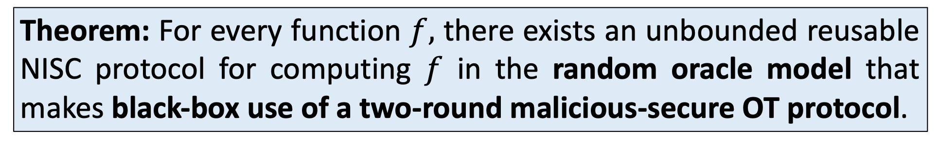
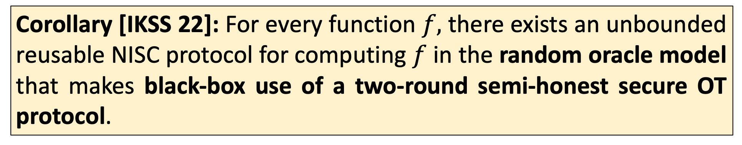
Our Results
[Ishai-Khurana-Sahai-Srinivasan 23]
Theorem: For every function $f,$ there exists an unbounded reusable NISC protocol for computing $f$ in the random oracle model that makes black-box use of a two-round malicious-secure OT protocol.
Corollary [IKSS 22]: For every function $f,$ there exists an unbounded reusable NISC protocol for computing $f$ in the random oracle model that makes black-box use of a two-round semi-honest secure OT protocol.
Notes:
We obtain the following main result.
For every function f, there exists an unbounded reusable NISC protocol for computing f in the random oracle model that makes black-box use of a two-round malicious-secure OT protocol.
IKSS 22 showed how to construct a malicious secure OT protocol in the random oracle from black-box access to a two-round semi-honest secure OT protocol. Hence, as a corollary we obtain the same result in the random oracle model by making black-box use of a two-round semi-honest secure OT protocol

Slide 15
Discussion on the results
[Ishai-Khurana-Sahai-Srinivasan 23]
Didn’t [CDIKLOV 19] prove that this is impossible?
No! [CDIKLOV 19] only rules out constructions in the
OT-hybrid model against unbounded sender.
Black-Box use of two-round OT
(settling for computational security)
More efficient than OLE
Random Oracle
Notes:
Let me make some key observations about our results.
You might all be wondering why isn’t out main result ruled out by the CDIKLOV 19 impossibility?
I would like to clarify that it is not the case. Specifically, CDIKLOV 19 showed that it is impossible to construct an unbounded reusable NISC in the OT-hybrid model against a computationally unbounded sender. However, in our result, we make black-box use of a two-round OT protocol and thus, settle for computational security. In addition to this, we also make use of a random oracle.
There is one crucial difference between the OT-hybrid model and black-box use of two-round OT which will allow us to overcome this impossibility result. We will illustrate this main difference later in the talk.
Furthermore, two-round OT protocol is much more efficient than two-round OLE

Slide 16
Discussion on the results
[Ishai-Khurana-Sahai-Srinivasan 23]
Can be instantiated from a wide-variety of cryptographic assumptions
CDH
[BM 90]
LWE
[Regev 05]
Factoring
[BM 90]
LPN
[DGHMW 20]
Notes:
Second, our main result can be instantiated from a wide variety cryptographic assumptions.
These include CDH, factoring, LWE and LPN.

Slide 17
Discussion on the results
[Ishai-Khurana-Sahai-Srinivasan 23]
Our protocol works in the ROM
First Construction of Reusable NISC for general circuits that makes black-box use of cryptography.
[CDIKLOV 19] protocol for general circuits makes non-black-box use of PRG.
Open Problem: Extend this to OLE-hybrid model without RO.
Notes:
Finally, we give the first construction of a reusable NISC for general circuits that makes black-box use of cryptography.
Note that CDIKLOV 19 protocol for computing general circuits makes non-black-box use of a PRG.
Our protocol works in the random oracle model and it is an interesting open problem to extend this result to the OLE hybrid model without making use of a random oracle.

Slide 18
More Results
Notes:
In addition to the main results in constructing an unbounded reusable NISC, we provide several other results in the context of reusable secure computation.

Slide 19



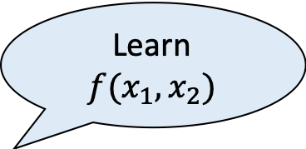
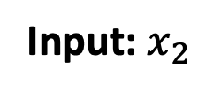

Two-sided NISC
[Ishai-Khurana-Sahai-Srinivasan 22]
Both parties learn the output
Learn $f(x_{1},x_{2})$
Learn $f(x_{1},x_{2})$
Common Input: $f$
$$msg_{1}^{1}$$
$$msg_{1}^{2}$$
$$P_{1}$$
$$P_{2}$$
$$msg_{2}^{1}$$
$$msg_{2}^{2}$$
Input: $x_{1}$
Input: $x_{2}$
Theorem [IKSS 22]: For every function $f$, there exists a two-sided NISC protocol for securely computing $f$ that makes black-box use of a two-round malicious secure OT.
Notes:
We consider the problem of two-sided NISC protocol.
Here, there are two parties P_1 and P_2 with private inputs x_1 and x_2 respectively. The parties also have a description of a function f as common input.
In contrast to the standard NISC setting where only P_1 gets the output, we want both parties to learn the output in the two-sided version.
In such a protocol, both parties send a first round message encoding their private inputs. Using the received first round message and their secret state, they send a second round message. The parties can decode the transcript privately to learn f(x_1,x_2). Note that we cannot achieve two-sided security by running two instances of a one-sided protocol in parallel but in opposite directions. This is because there is no way to ensure that the parties are using the same inputs in both instances of the one-sided protocol.
The work of IKSS22 showed that for every function f, there exists a two-sided NISC protocol for securely computing f that makes black-box use of a two-round malicious secure OT.
Today I will tell you about a more simplistic model of two-sided NISC, but the authors also consider a more general definition both the two-sided example I’ll show you today and the one-sided. I encourage to check out the paper.

Slide 20
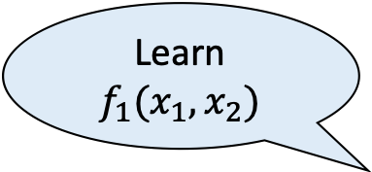
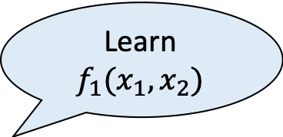
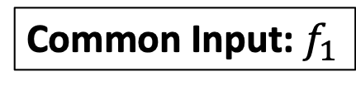


Reusable Two-sided NISC
[Ishai-Khurana-Sahai-Srinivasan 23]
Does not depend on the function
Learn $f_{1}(x_{1},x_{2})$
Learn $f_{1}(x_{1},x_{2})$
Common Input: $f_{1}$
$$msg_{1}^{1}$$
$$msg_{1}^{2}$$
$$P_{1}$$
$$P_{2}$$
$$msg_{2}^{1}[f_{1}]$$
$$msg_{2}^{2}[f_{1}]$$
Input: $x_{1}$
Input: $x_{2}$
Notes:
In this work, we extend the standard two-sided NISC protocol to the reusable setting.
In this reusable setting, again there are two parties with private inputs x_1 and x_2. The parties now generate a first round message using only their private inputs. Specifically, the first round message does not depend on the function to be computed. Now, the parties receive the description of a function f_1 as common input and they send a second round message using their secret state and the description of the function f_1. The parties can decode this transcript to learn f_1(x_1,x_2).

Slide 21




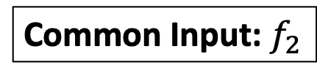
Reusable Two-sided NISC
[Ishai-Khurana-Sahai-Srinivasan 23]
Learn $f_{2}(x_{1},x_{2})$
Learn $f_{2}(x_{1},x_{2})$
Common Input: $f_{2}$
$$msg_{1}^{1}$$
$$msg_{1}^{2}$$
$$P_{1}$$
$$P_{2}$$
$$msg_{2}^{1}[f_{2}]$$
$$msg_{2}^{2}[f_{2}]$$
Input: $x_{1}$
Input: $x_{2}$
Notes:
This can continue for many executions where in each execution

Slide 22

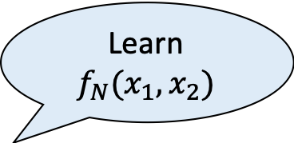


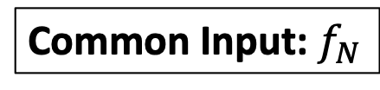
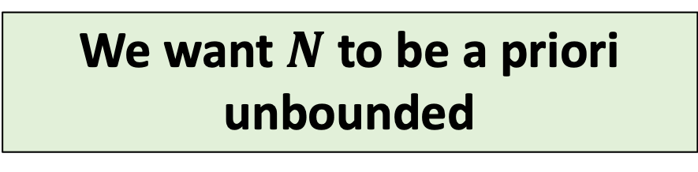
Reusable Two-sided NISC
[Ishai-Khurana-Sahai-Srinivasan 23]
Learn $f_{N}(x_{1},x_{2})$
Learn $f_{N}(x_{1},x_{2})$
Common Input: $f_{N}$
$$msg_{1}^{1}$$
$$msg_{1}^{2}$$
$$P_{1}$$
$$P_{2}$$
$$msg_{2}^{1}[f_{N}]$$
$$msg_{2}^{2}[f_{N}]$$
Input: $x_{1}$
Input: $x_{2}$
We want $N$ to be a priori unbounded
Notes:
The parties receive a description of a new function f_N. The parties use the same first round message and generate a new second round message for each new function to be computed. We want the number of executions given by N to be a priori unbounded.

Slide 23
Our Results
[Ishai-Khurana-Sahai-Srinivasan 23]
Theorem: There exists an unbounded two-sided reusable NISC protocol for computing general functions in the random oracle model that makes black-box use of a two-round malicious-secure OT protocol and additively homomorphic commitments.
Theorem: If the parties are allowed to maintain an updateable state across every execution, then we can remove the additional assumption of additively homomorphic commitments.
Notes:
In the two-sided setting, we construct a reusable NISC protocol for computing general functions that makes black-box use of a two-round malicious secure OT protocol and additively homomorphic commitments.
We also show that if we allow the parties to maintain an updateable state across every execution, then we can remove the additional assumption of additively homomorphic commitments and get a protocol that only makes black-box use of two-round malicious OT.

Slide 24
How to overcome the impossibility result from [CDIKLOV 19]?
Notes:
In the remaining time, let me explain how to overcome the impossibility result from CDIKLOV 19 by making black-box use of two-round malicious secure OT protocol.

Slide 25
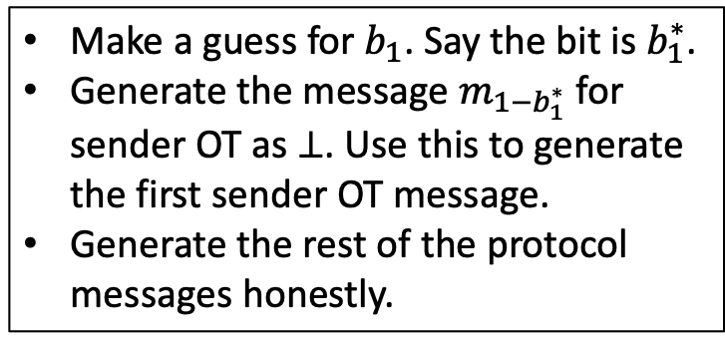
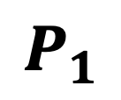
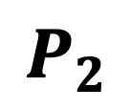
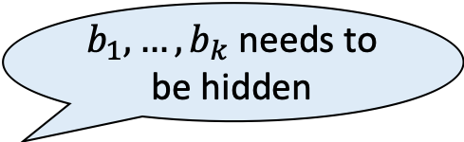
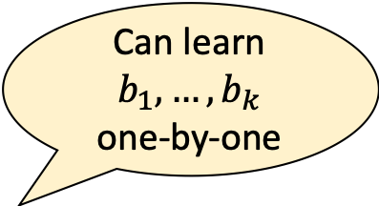

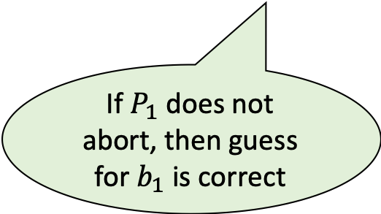
Intuition behind the Impossibility Result
Fixed across all executions
$b_{1},…,b_{k}$ needs to be hidden
Can learn $b_{1},…,b_{k}$
one-by-one
$$OT_{1}\left(b_{1}\right), OT_{1}\left(b_{2}\right),…, OT_{1}(b_{k})$$
$$P_{1}$$
$$P_{2}$$
Make a guess for $b_{1}$. Say the bit is $b_{1}^{∗}$.
Generate the message $m_{1−b_{1}^{∗}}$for sender OT as $⊥$. Use this to generate the first sender OT message.
Generate the rest of the protocol messages honestly.
If $P_{1}$ does not abort, then guess for $b_{1}$ is correct
Notes:
Let me first give the main intuition behind the impossibility result for natural NISC protocols
Consider a NISC protocol in the OT hybrid model. The receiver P_1 encodes its input in a certain way and makes parallel calls to the OT oracle by sending the bits b_1,…,b_k. For security, we need all these bits to be hidden from the view of the sender. This first round message is fixed across all iterations. Now consider a malicious sender P_2.
P_2 can work as follows: It first makes a guess for b_1 randomly and say the guessed value is b^*_1. It generates the message m_{1-b^*_1} which is the sender message for the first OT execution as \bot and generates m_{b^*_1} honestly. It uses these two strings to generate the first sender OT message. It generates the rest of the protocol messages honestly.
Now, if the guess was correct then P_1 continues the execution as in the honest case and then computes the output. However, if the guess was incorrect, then in natural NISC protocols , P_1 aborts. Thus, depending on whether P_1 aborts or not, P_2 infers the value of b_1.
In the reusable setting, P_2 can mount this attack for each b_i and learn all the b_i’s. This completely violates the honest receiver security.
B1,…,bk is some encoding of the P1’s private message.

Slide 26
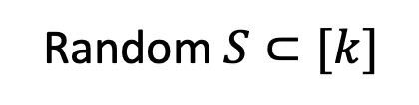

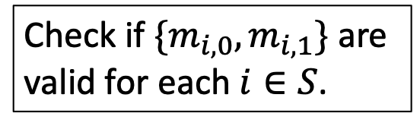
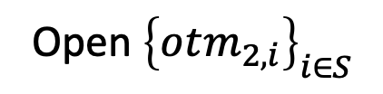
Overcoming the Impossibility Result
$$OT_{1}\left(b_{1}\right), OT_{1}\left(b_{2}\right),…, OT_{1}(b_{k})$$
$$P_{1}$$
$$P_{2}$$
$$otm_{2,1},…,otm_{2,k}$$
Random $S⊂[k]$
Increases the number of rounds
Ensures that more than 90% of sender OT messages are valid
Open ${\left\{otm_{2,i}\right\}}_{i∈S}$
Check if $\{m_{i,0},m_{i,1}\}$ are valid for each $i∈S$.
Impossible in the OT-hybrid model! Key to overcoming the impossibility!
Notes:
To prevent this attack, we must somehow ensure that all the sender OT messages encode valid inputs.
Let’s see how to accomplish this by making black-box use of two-round OT. I would like to clarify that we cannot do this for all OT sender messages but we can ensure that a large fraction of the messages. This turns out to be sufficient for our purposes.
The sender first generates the second round OT messages and sends this to the receiver. After this, the receiver chooses a random subset S of the OT executions and sends this set to the sender. The sender opens each one of the OT messages corresponding to the the set S. By opening, we mean that the sender reveals the input and randomness used in generating the messages. The receiver then checks if the messages encoded in the chosen executions are all valid. This ensures that more than 90% of the executions are valid with overwhelming probability. Note that such a check is impossible to make in the OT hybrid model. Specifically, there is no way to check if the sender inputs used in any OT execution is valid if the OT is treated as an oracle. This is the key distinction that helps in overcoming the previous impossibility.
However, this approach seems to increase the number of rounds and we are no longer in the two message setting. (Secret sharings)

Slide 27

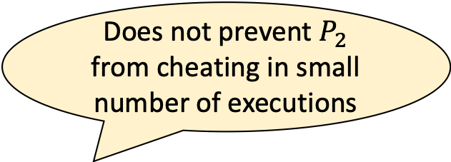
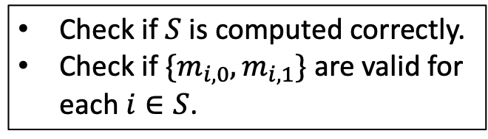
Overcoming the Impossibility Result
We ensure that the outcomes from a small number of cheating executions can be corrected.
Does not prevent $P_{2}$ from cheating in small number of executions
$$OT_{1}\left(b_{1}\right), OT_{1}\left(b_{2}\right),…, OT_{1}(b_{k})$$
$$P_{1}$$
$$P_{2}$$
$$otm_{2,1},…,otm_{2,k}$$
$$S=H(otm_{2,1},…,otm_{2,k})$$
Ensures that more than 90% of sender OT messages are valid
Use Fiat-Shamir heuristic
Open ${\left\{otm_{2,i}\right\}}_{i∈S}$
Check if $S$ is computed correctly.
Check if $\{m_{i,0},m_{i,1}\}$ are valid for each $i∈S$.
Notes:
But the number of rounds can be collapsed using the Fiat-Shamir heuristic by computing the subset S as the output of an hash function applied on the second round sender messages. The receiver now checks if the set S is computed correctly and then performs the same checks as before. If the hash function is correlation-interactable, this ensures that more than 90% of the executions are computed correctly.
However, there is still a subtle issue. Specifically, this does not prevent P_2 from cheating in a small number of executions. In the reusable setting, P_2 could potentially cheat in a small number of executions in each reuse and could use the information from each reuse to break the receiver security.
We prevent this by ensuring that the outcomes from a small number of cheating executions can be corrected and this does not provide any non-trivial information about the values encoded in the receiver OT message. We refer to the paper for more details.
S is computed as the hash of the second round message.
In order to overcome P2 from cheating in small number of executions, the authors use standard error correction properties of Shamir Secret Sharing.
Even in a single use setting, P2 learns 10%. P2 has to guess a large subset jointly by secret sharing.
In the resuable setting, P2 can just repeatedly attack which prevents any sort of statistical security.

Slide 28
Conclusion
We gave new constructions of reusable NISC and reusable two-sided NISC protocols.
Instantiable from almost all known standard assumptions in cryptography.
Open Problems:
  Remove random oracles from the construction
  Remove the need for additively homomorphic commitments from the two-sided protocol.
  Improve the concrete efficiency.

Slide 29
Thank you for your attention!

