Slide 1
Context Discovery and Commitment Attacks How to Break CCM, EAX, SIV, and More
Sanketh Menda, Julia Len, Paul Grubbs, and Thomas Ristenpart
Eurocrypt 2023
Notes:
Thank you for the introduction.
I am glad to be here. Today, I’ll share some new developments in AEAD security.

Slide 2
Authenticated Encryption with Associated Data (AEAD)
Context:
Key K
Nonce N (e.g., random IV or counter)
Associated data A (e.g., network header)
Shared out of band.
K, N, A
K, N, A
C = AEAD.Enc(K,N,A,M)
Can observe and manipulate.
Sender
Recipient
Meddler-in-the-middle
Standardized
AES-GCM
ChaCha20/Poly1305
AES-GCM-SIV
Provably Secure
Confidentiality
Authenticity
Notes:
Our story starts with authenticated encryption with associated data also known as AEAD.
This is one of the most fundamental primitives. It is used everywhere from TLS to cloud storage to end-to-end encrypted messaging.
It enables a sender and a recipient with a shared context to exchange messages over an insecure channel.
Here, the context consists of a key, a nonce like a random IV or a counter, and an associated data like a network header. The key must be shared out-of-band, the nonce and the associated data can be shared out-of-band or shared with the ciphertext. This allows sending encrypted messages to the recipient with confidentiality and authenticity.
We have many schemes that achieve these goals including AES-GCM, ChaCha20/Poly1305, and AES-GCM-SIV. These schemes are standardized and widely deployed. If you are using encryption, chances are you are using one of these schemes.
Finally, these schemes have security proofs showing that they achieve confidentiality and authenticity in the presence of a meddler-in-the-middle like a network adversary who can observe and manipulate ciphertexts.

Slide 3
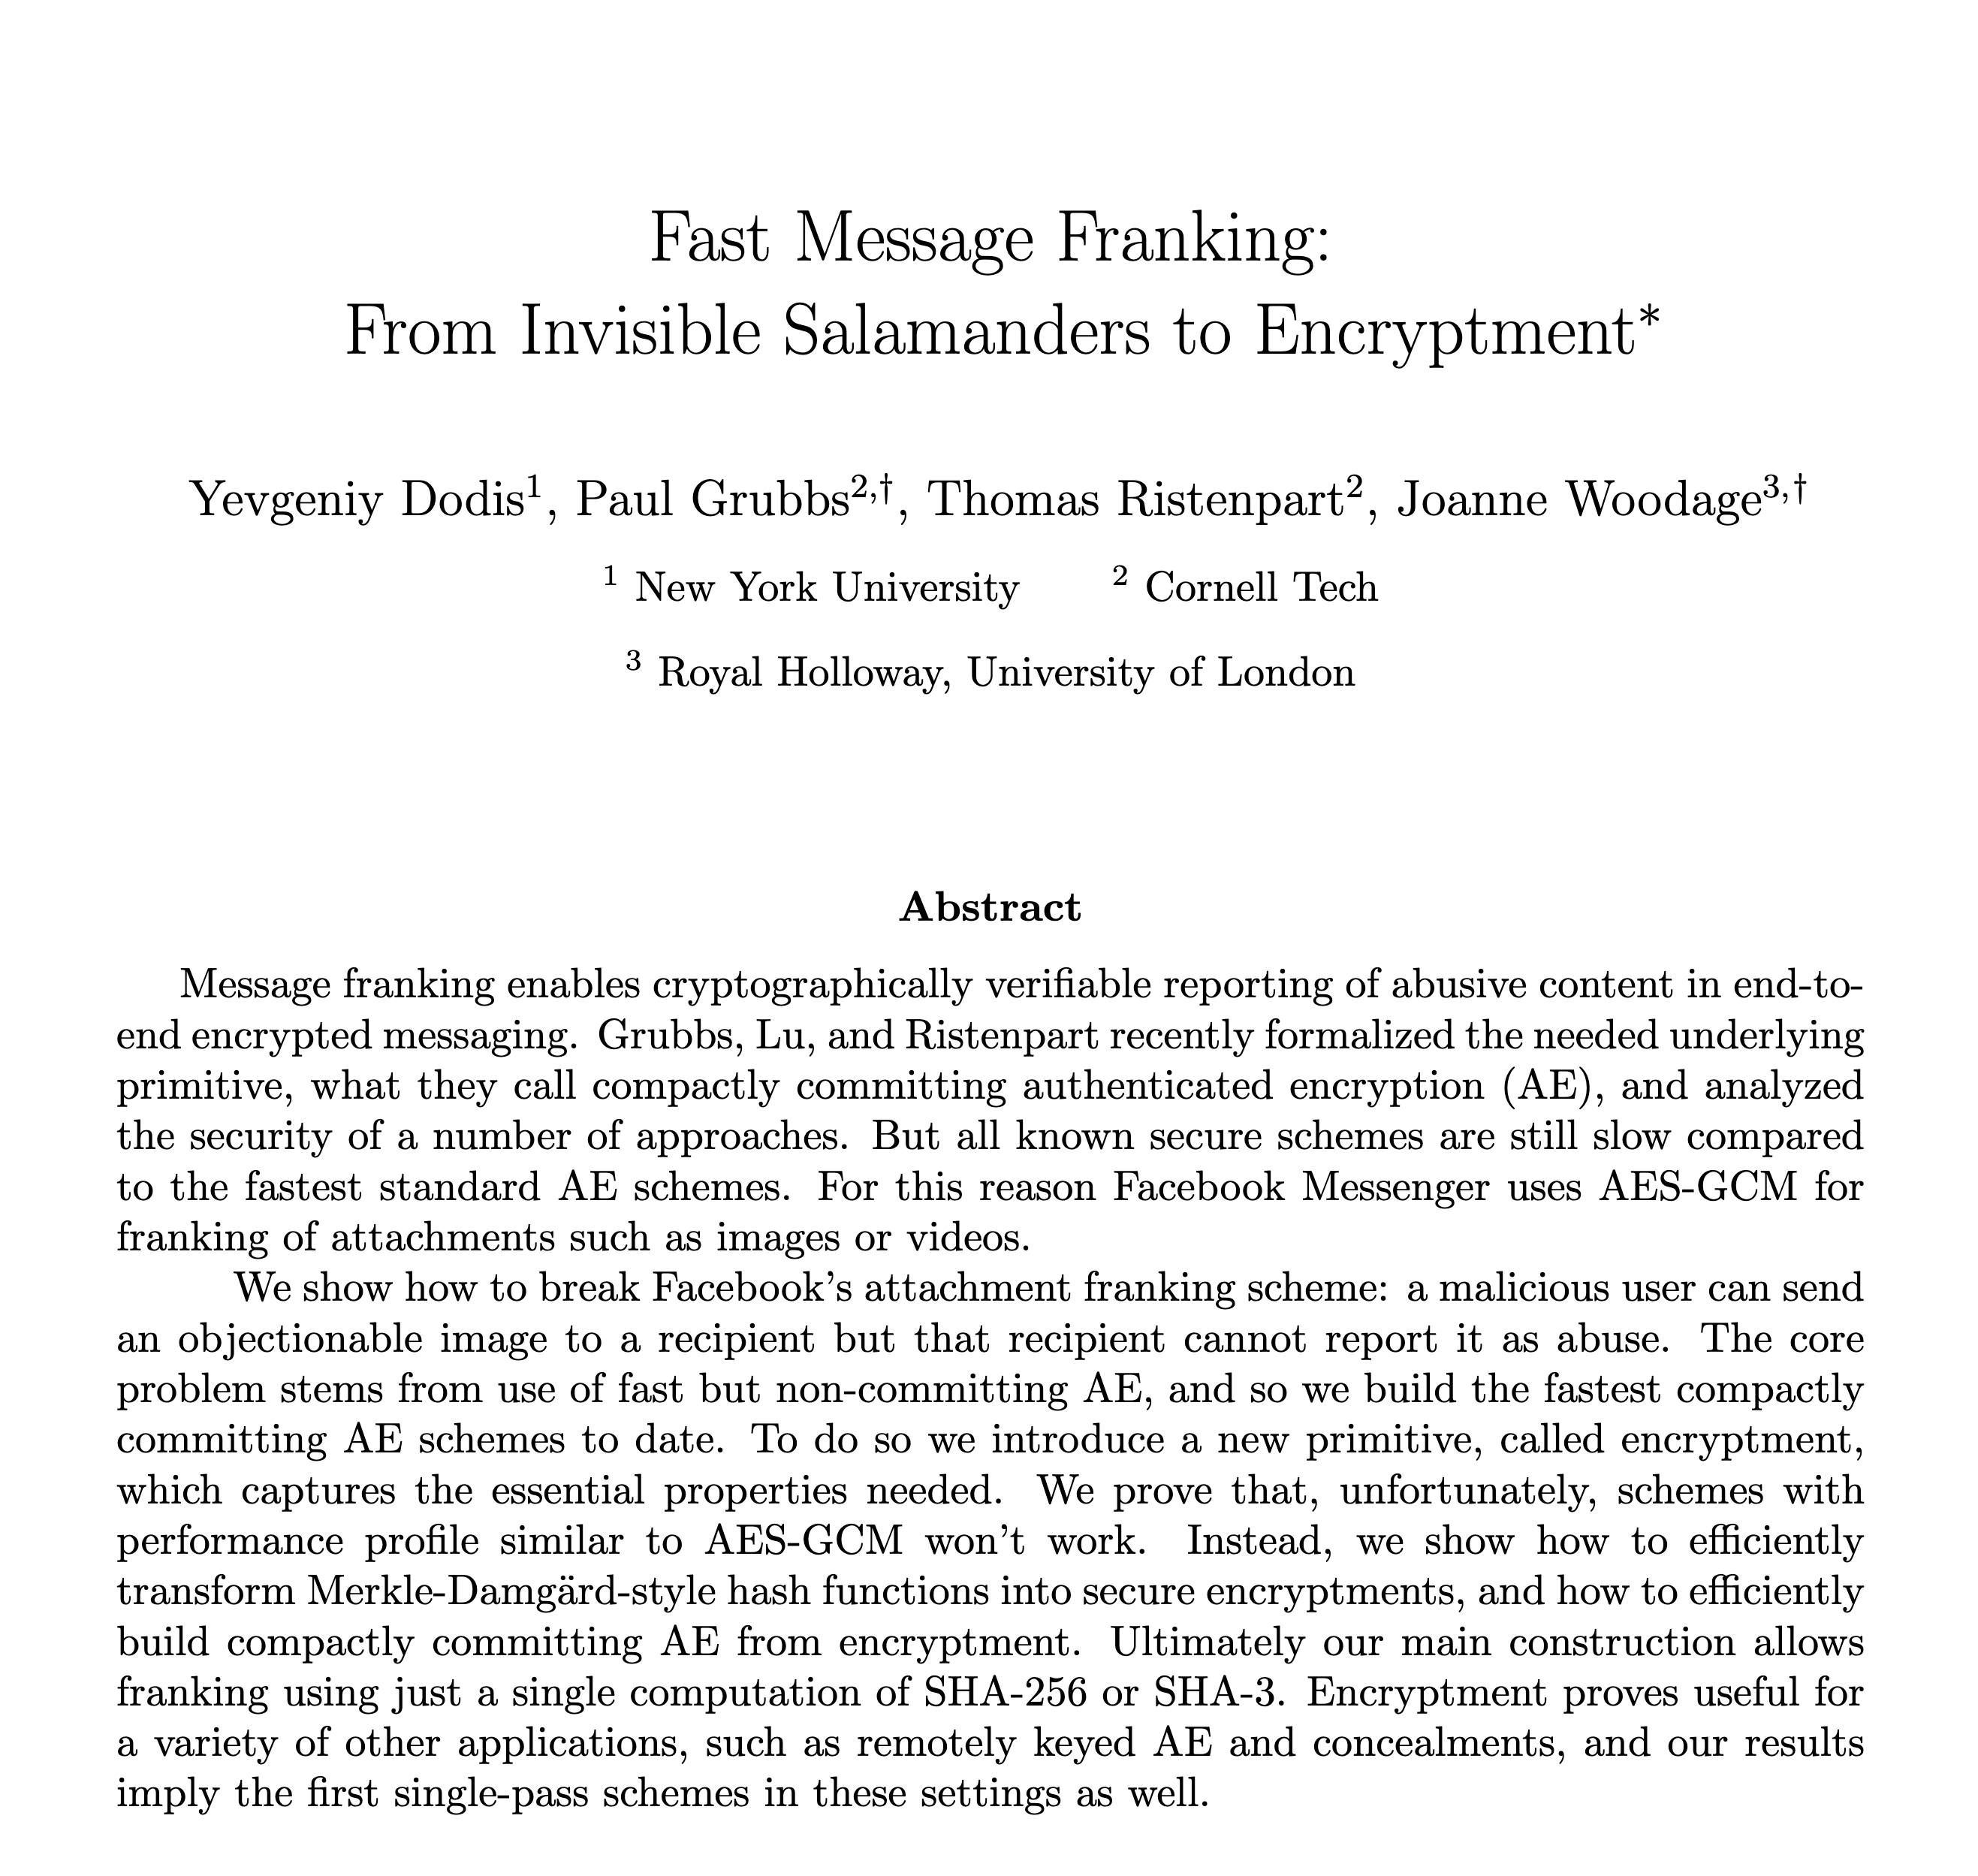
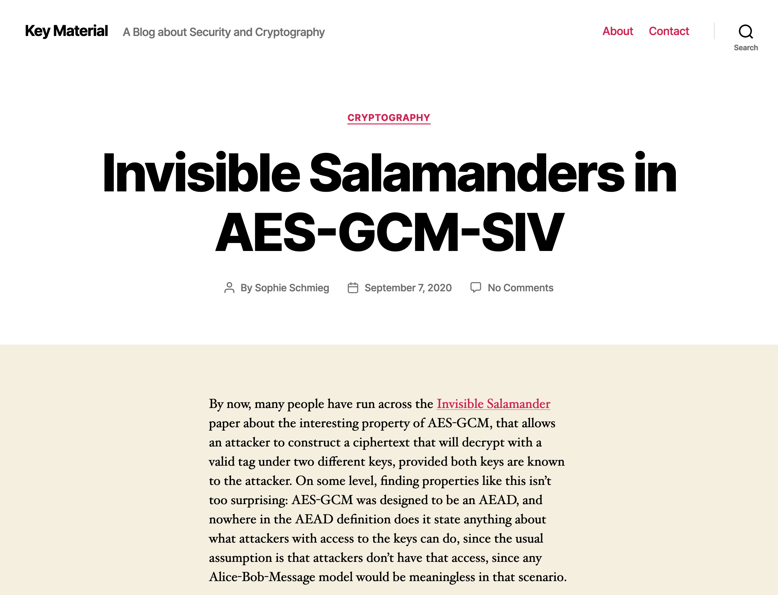
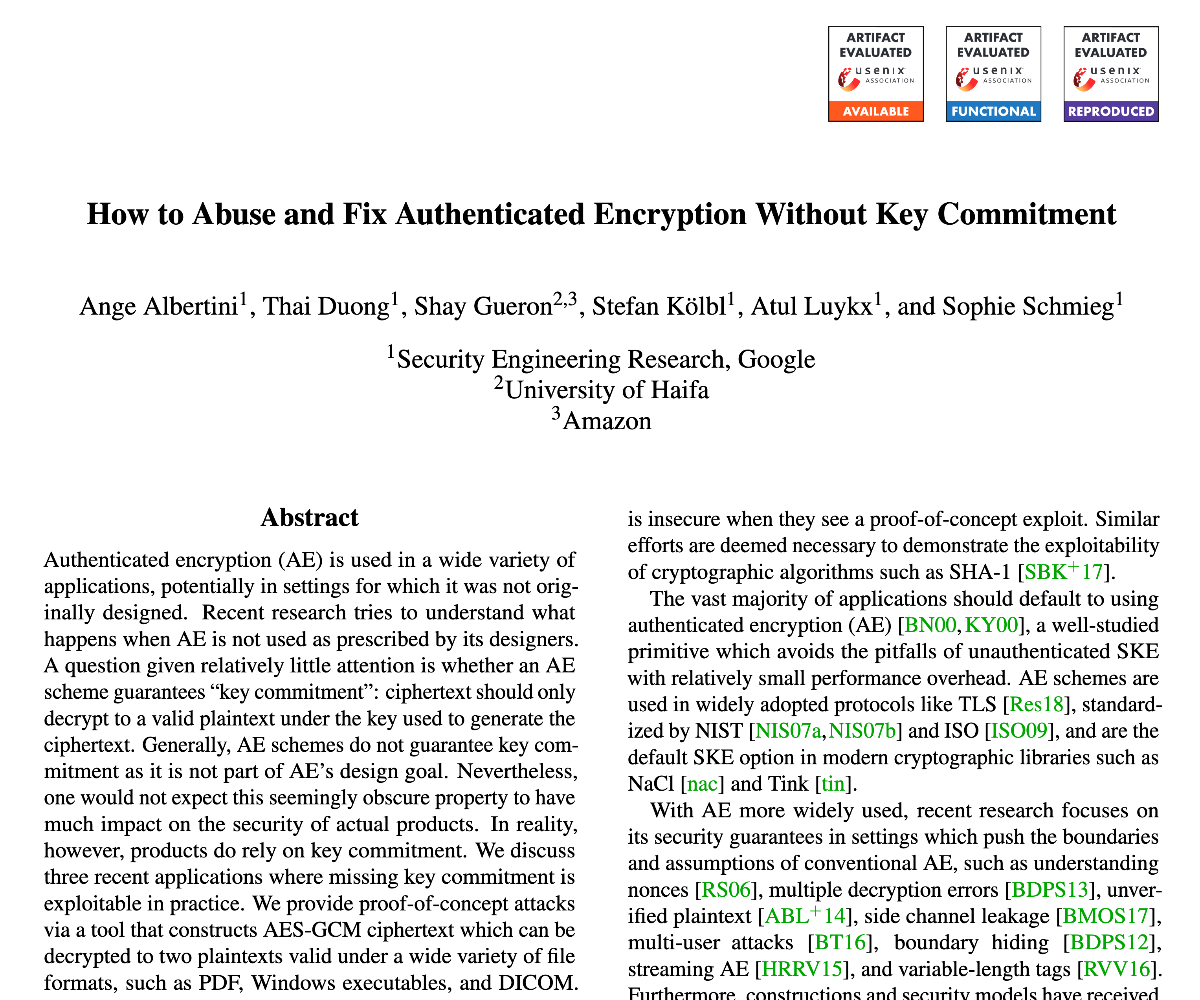
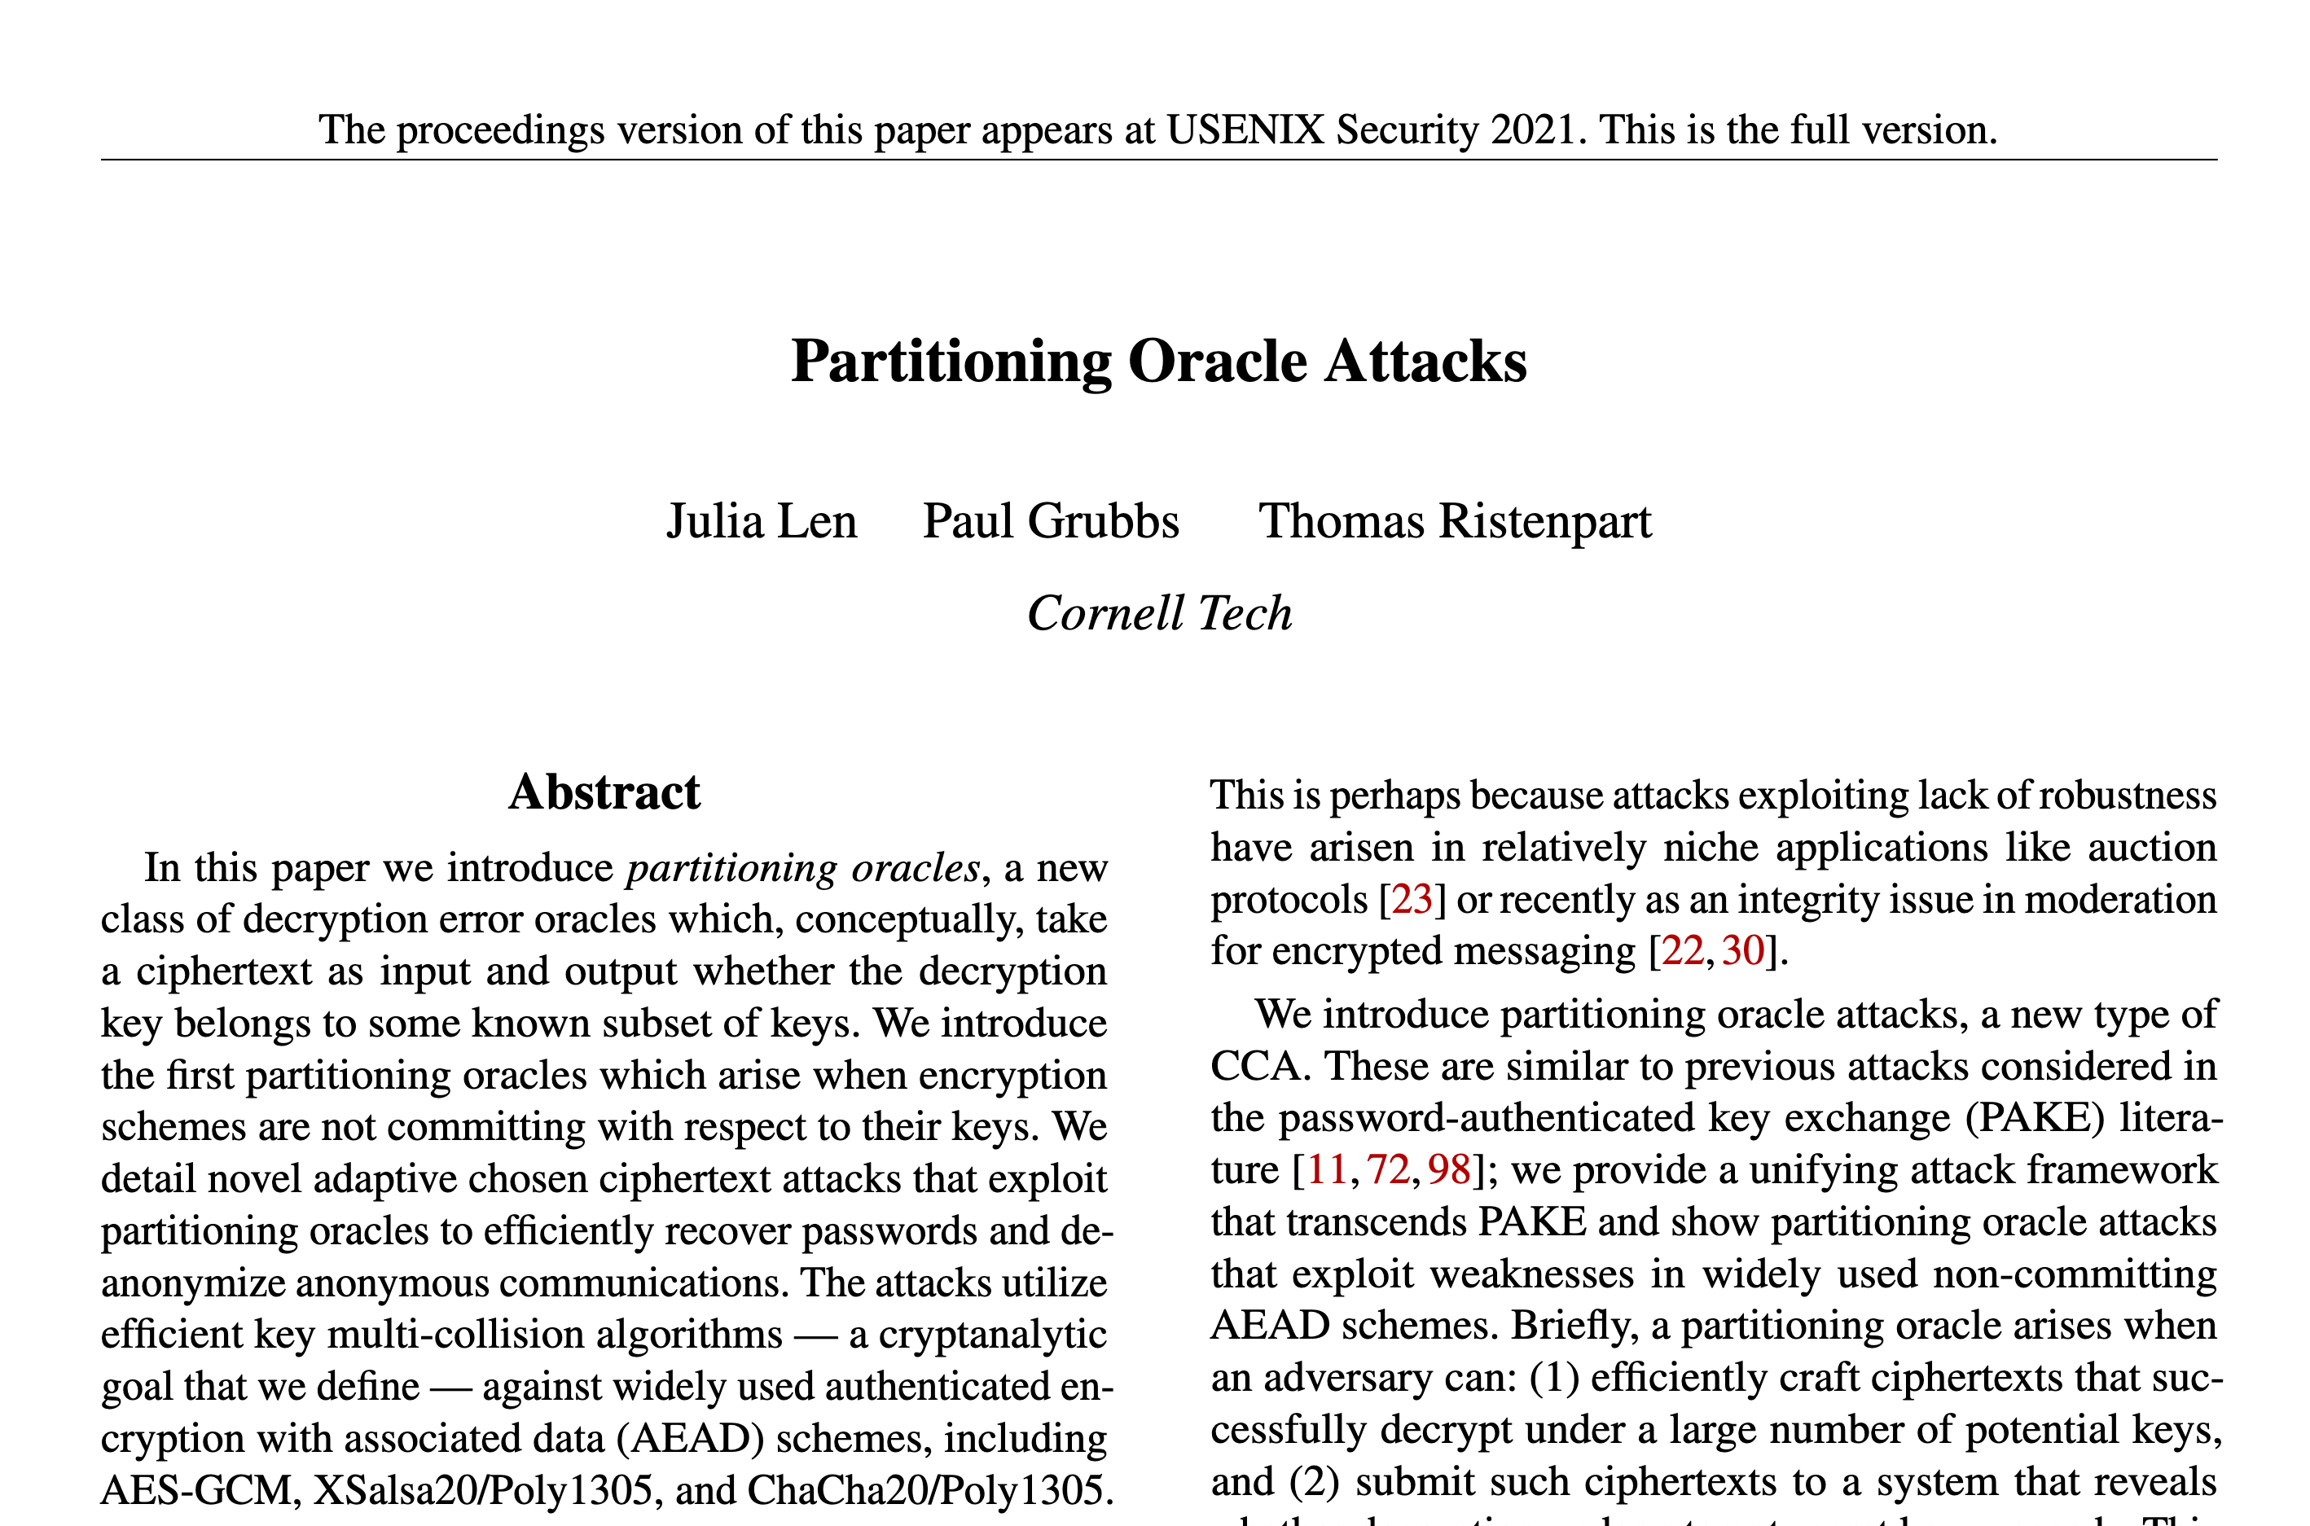
Recent Attacks on AEAD
These attacks work in new threat models!
These attacks exploit lack of key commitment: An adversary can find keys K₁, K₂ and ciphertext C s.t. C can be decrypted under both keys
Notes:
[Show screenshots] But, in recent years, we have a surge of attacks on our use of AEAD.
These attacks target the most widely used schemes like those on the previous slide. This is especially concerning because we have built protocols assuming that AEAD is a solved problem.
What’s going on under the hood is that these attacks highlight new threat models that deviate from the traditional model of a meddler-in-the-middle.
In particular, these attacks exploit AEAD schemes that have lack of key commitment:
Meaning that an adversary can find two keys and a ciphertext such that the ciphertext can be decrypted under both keys
These attacks showed that many popular AEAD schemes do *not* have this property

Slide 4
Context Commitment Security [BH22]
For AEAD, computationally efficient to find
(K₁, N₁ , A₁), (K₂, N₂, A₂) and C
such that decryption
M₁ $←$ AEAD.Dec(K₁, N₁, A₁, C)
M₂ $←$AEAD.Dec(K₂, N₂, A₂, C)
succeeds.
Context
committing
Key
committing
Notes:
Bellare and Hoang later generalized this notion by introducing context commitment.
This definition says that it is important to commit to the entire encryption context, meaning the key, the nonce, and the associated data, not just the key
So more formally, this definition asks that if it is computationally efficient to find two contexts (key, nonce, and associated data triples) and a ciphertext such that the ciphertext decrypts correctly under both contexts.
Context commitment is a strictly stronger security property than key commitment

Slide 5
Commitment Attacks (Before this Paper)
Scheme | Key Committing | Context Committing
GCM | [GLR17, DGRW19] | ↪️
AES-SIV
CCM
EAX
OCB3 | [ADGKLS20] | ↪️
PaddingZeros | [ADGKLS20]
KeyHashing | [ADGKLS20]
CAU-C1 | [BH22]
Notes:
So in our work, we resolve these open questions by demonstrating new key commitment attacks against AES-SIV, CCM, and EAX
We also show context committing attacks against the key committing schemes that have been proposed by Albertini et al. and Bellare and Huang

Slide 6
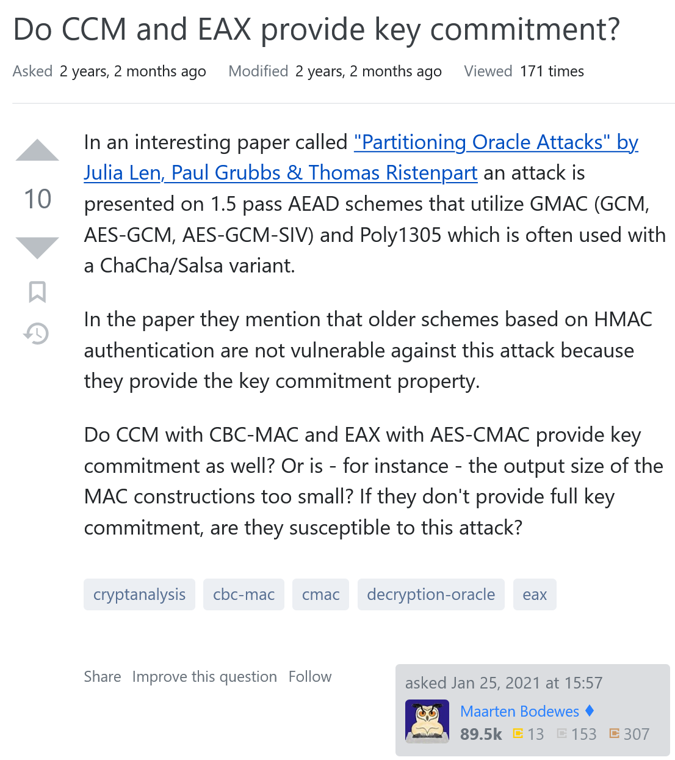
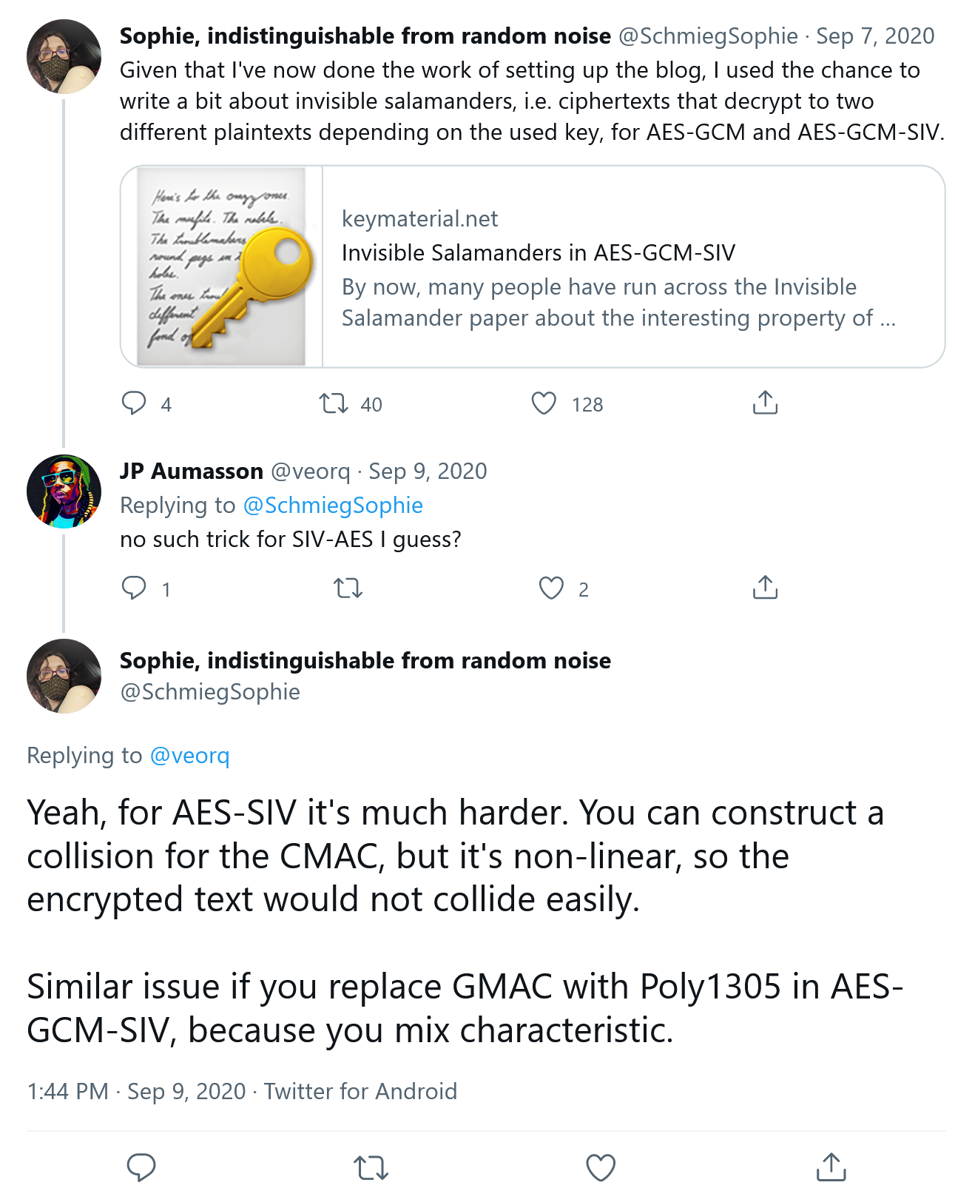
Notes:
In fact, over the past few years, we saw this pop up as questions on both Cryptography Stack Exchange and on Twitter

Slide 7
Commitment Attacks (After this Paper)
Scheme | Key Committing | Context Committing
GCM | [GLR17, DGRW19] | ↪️
AES-SIV | ✨ | ↪️✨
CCM | ✨ | ↪️✨
EAX | ✨ | ↪️✨
OCB3 | [ADGKLS20] | ↪️
PaddingZeros | [ADGKLS20] | ✨
KeyHashing | [ADGKLS20] | ✨
CAU-C1 | [BH22] | ✨
✨ = new result
Notes:
So in our work, we resolve these open questions by demonstrating new key commitment attacks against AES-SIV, CCM, and EAX
We also show context committing attacks against the key committing schemes that have been proposed by Albertini et al. and Bellare and Huang

Slide 8
Our Contributions
New granular framework for context commitment
New context commitment security notion: context discovery
Context discovery attacks against GCM, OCB3, EAX, CCM, SIV
Key commitment attack against the original SIV mode
Notes:
For the rest of this presentation, I’ll go over our four key contributions.
First, we introduce a new granular framework for context commitment, from the perspective of attacks.
We then demonstrate the usefulness of that framework by discussing two key committing attacks against the original SIV.
Also inspired by the framework, we introduce a new context commitment security notion termed context discovery which implies context commitment.
Finally, I’ll go over a context discovery attack for EAX, but in our work we also show context discovery attacks against GCM, OCB3, CCM, and SIV.

Slide 9
Our Contributions
New granular framework for context commitment
New context commitment security notion: context discovery
Context discovery attacks against GCM, OCB3, EAX, CCM, SIV
Key commitment attack against the original SIV mode
Notes:
I’ll begin by introducing our new definitional framework for context commitment

Slide 10
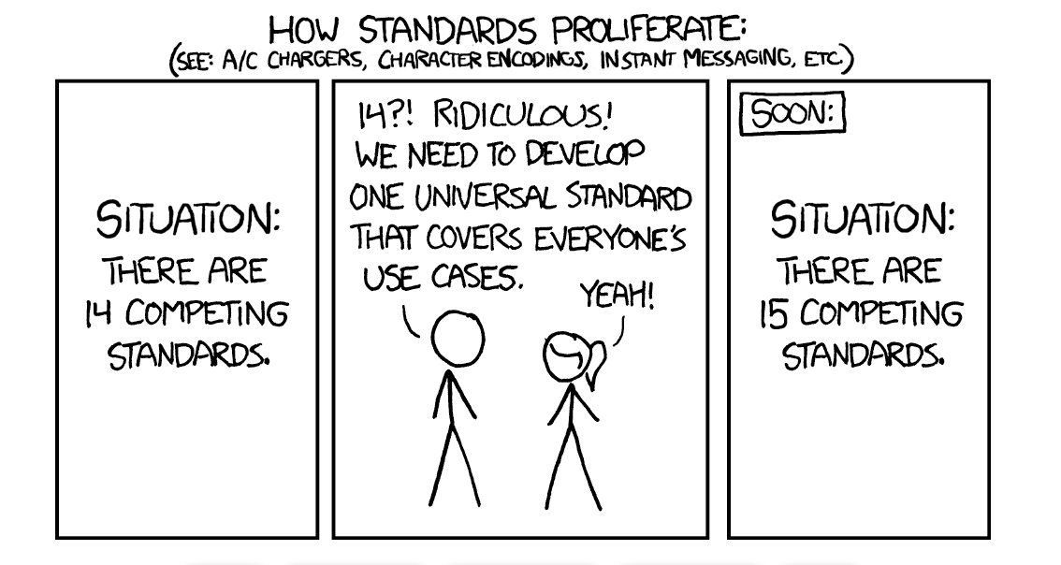
Don’t we already have committing security definitions?
definitions
definition
definitions
definitions
https://xkcd.com/927/
Notes:
So you might be thinking now – ”doesn’t there already exist a context committing security definition? Why do we need more definitions?” as so poignantly implied by this XKCD comic
To answer this, *yes* the existing context committing definition by Bellare and Hoang is what should be targeted when trying to prove security. For more on this, see Sanketh’s talk from Real World Crypto talk.
However, we found that the definition does not really allow granularity when trying to understand context committing attacks
So for one thing in practice, there will be application-specific restrictions which mean that attackers will not have full control over the decryption context
For another thing, we found that historically definitions related to AEAD commitment have been ambiguous

Slide 11
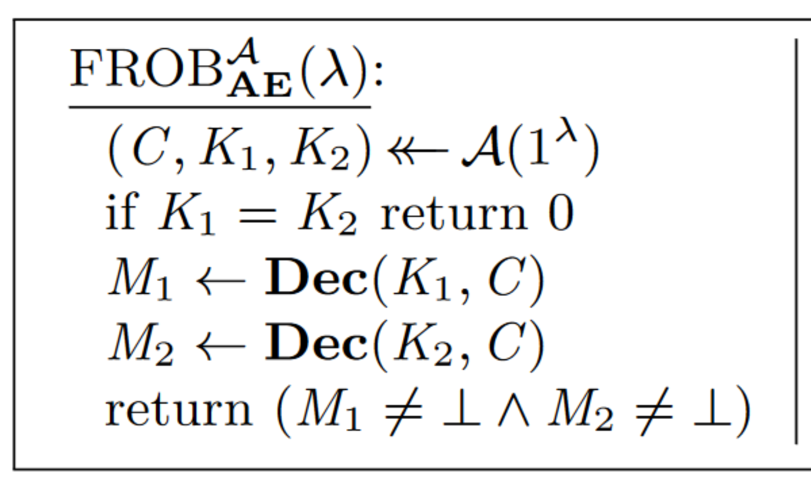
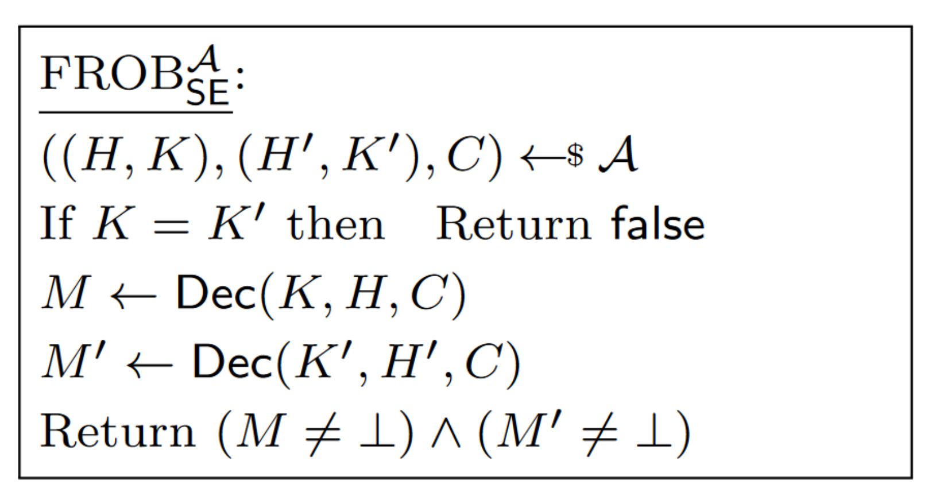
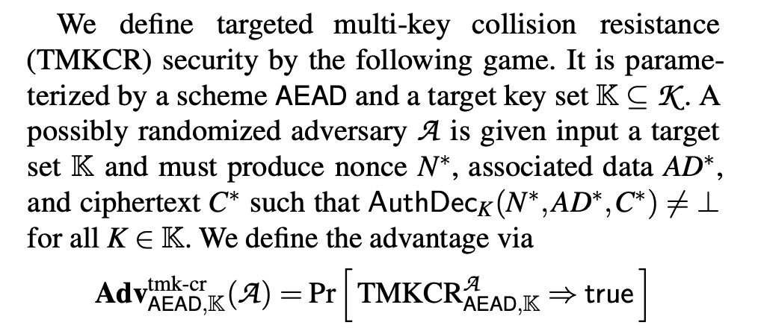
Ambiguity in Key Commitment Definitions
[FOR17] doesn’t mention associated data, and implicitly requires the same nonce.
[GLR17] allows different associated data, but still implicitly requires the same nonce.
[LGR20] requires same nonces and associated data.
Notes:
In particular the first definition of key commitment due to Farshim et al. assumes randomized authenticated encryption without associated data.
The nonce is embedded in the ciphertext and since the ciphertext is the same across the decryption contexts, the nonce is the same.
Grubbs et al. extended the definition to randomized authenticated encryption with associated data, resolving ambiguity about the associated data. Specifically, they chose to allow different associated data across the decryptions.
Also in our prior work on partitioning oracle attacks, we found it necessary for both the nonce and associated data to be the same for our attacks to work and structured our definitions accordingly
Note that these are all definitions of the same concept “key commitment” which makes it hard for the community to classify attacks.

Slide 12
Granular Framework for Context Committing Security
For AEAD, computationally efficient to find
(K₁, N₁, A₁), (K₂, N₂, A₂) and C
such that decryption
M₁$←$ AEAD.Dec(K₁, N₁, A₁, C)
M₂ $←$AEAD.Dec(K₂, N₂, A₂, C)
succeeds.
Notes:
To explain our framework, let’s go back to the definition for context committing security
On top of this, we’ll add three levels of granularity that will allow us to specify a more precise set of definitions

Slide 13
Granular Framework for Context Committing Security Step 1: Arbitrary Predicates
For AEAD, computationally efficient to find
(K₁, N₁, A₁), (K₂, N₂, A₂) and C
such that
P((K₁, N₁, A₁), (K₂, N₂, A₂)) for predicate P
and decryption
M₁$←$ AEAD.Dec(K₁, N₁, A₁, C)
M₂ $←$AEAD.Dec(K₂, N₂, A₂, C)
succeeds.
Notes:
First we parameterize our definition with a predicate that is evaluated over the contexts
This allows us to capture additional constraints over the contexts that can occur in practice and affect the context committing attack
So what then are the predicates of interest here?

Slide 14
Granular Framework for Context Committing Security Step 1: Arbitrary Predicates
For AEAD, computationally efficient to find
(K₁, N₁, A₁), (K₂, N₂, A₂) and C
such that
P((K₁, N₁, A₁), (K₂, N₂, A₂)) for predicate P
and decryption
M₁$←$ AEAD.Dec(K₁, N₁, A₁, C)
M₂ $←$AEAD.Dec(K₂, N₂, A₂, C)
succeeds.
Notion | Predicate
Context Commitment | (K₁, N₁ , A₁) ≠ (K₂, N₂, A₂)
Notes:
If we have as our predicate that the two contexts are not equal, then we recover the original context committing notion

Slide 15
Granular Framework for Context Committing Security Step 1: Arbitrary Predicates
For AEAD, computationally efficient to find
(K₁, N₁, A₁), (K₂, N₂, A₂) and C
such that
P((K₁, N₁, A₁), (K₂, N₂, A₂)) for predicate P
and decryption
M₁$←$ AEAD.Dec(K₁, N₁, A₁, C)
M₂ $←$AEAD.Dec(K₂, N₂, A₂, C)
succeeds.
Notion | Predicate
Context Commitment | (K₁, N₁ , A₁) ≠ (K₂, N₂, A₂)
CMT-k | K₁ ≠ K₂
CMT-n | N₁ ≠ N₂
CMT-a | A₁ ≠ A₂
Permissive
Notes:
The next 3 predicates of interest are those that focus on in the inequality of the 3 individual context components
So our CMT-k definition simply checks that for the contexts provided, their keys are different, with no restrictions on the nonces or associated data
This specifically captures the notion of key commitment as defined by Bellare and Hoang, while CMT-n and CMT-a are new definitions
Because these set of notions do not place restrictions on the other context components not specified, we call them permissive

Slide 16
Granular Framework for Context Committing Security Step 1: Arbitrary Predicates
For AEAD, computationally efficient to find
(K₁, N₁, A₁), (K₂, N₂, A₂) and C
such that
P((K₁, N₁, A₁), (K₂, N₂, A₂)) for predicate P
and decryption
M₁$←$ AEAD.Dec(K₁, N₁, A₁, C)
M₂ $←$AEAD.Dec(K₂, N₂, A₂, C)
succeeds.
Notion | Predicate
Context Commitment | (K₁, N₁ , A₁) ≠ (K₂, N₂, A₂)
CMT-k | K₁ ≠ K₂
CMT-n | N₁ ≠ N₂
CMT-a | A₁ ≠ A₂
CMT-k* | K₁ ≠ K₂ ∧ (N₁ , A₁) = (N₂, A₂)
CMT-n* | N₁ ≠ N₂ ∧ (K₁ , A₁) = (K₂, A₂)
CMT-a* | A₁ ≠ A₂ ∧ (K₁ , N₁) = (K₂, N₂)
Permissive
Restrictive
Notes:
A related set of notion are those that are restrictive, in which it requires that the other unnamed context components must be equal
So for instance, our CMT-k* definition requires that the two keys must be different and that the nonces and associated data are the same
This CMT-k* definition therefore captures our notion of key commitment from Partitioning Oracle Attacks, while CMT-n* and CMT-a* are new
Overall, the value in having predicates here is that this allows for a much more precise set of definitions which capture requirements of various settings we’ve seen previously in the literature
But one drawback with this definition is that it does not allow us to capture settings where a portion of the context is pre-selected

Slide 17
Granular Framework for Context Committing Security Step 2: Target Selection
For AEAD, given
K₁, K₂ $←{ \left\{0,1\right\}}^{k}$ [target selection]
computationally efficient to find
(K₁, N₁, A₁), (K₂, N₂, A₂) and C
such that
P((K₁, N₁, A₁), (K₂, N₂, A₂)) for predicate P
and decryption
M₁$←$ AEAD.Dec(K₁, N₁, A₁, C)
M₂ $←$AEAD.Dec(K₂, N₂, A₂, C)
succeeds.
Notion | Predicate
Context Commitment | (K₁, N₁ , A₁) ≠ (K₂, N₂, A₂)
CMT-k | K₁ ≠ K₂
CMT-n | N₁ ≠ N₂
CMT-a | A₁ ≠ A₂
CMT-k* | K₁ ≠ K₂ ∧ (N₁ , A₁) = (N₂, A₂)
CMT-n* | N₁ ≠ N₂ ∧ (K₁ , A₁) = (K₂, A₂)
CMT-a* | A₁ ≠ A₂ ∧ (K₁ , N₁) = (K₂, N₂)
$
Permissive
Restrictive
Notes:
So we next add to the definition what we call target selection
This allows us to specify settings where parts of the context are generated in specific ways, like for instance if a particular setting requires the keys to be randomly generated

Slide 18
Granular Framework for Context Committing Security Step 2: Target Selection
For AEAD, given
C$←$ AEAD.Enc(K₁, N₁, A₁, M₁) [target selection]
and not given
K₁, N₁, A₁ [target hiding]
computationally efficient to find
(K₂, N₂, A₂)
such that
P((K₁, N₁, A₁), (K₂, N₂, A₂)) for predicate P
and decryption
M₁$←$ AEAD.Dec(K₁, N₁, A₁, C)
M₂ $←$AEAD.Dec(K₂, N₂, A₂, C)
succeeds.
Notion | Predicate
Context Commitment | (K₁, N₁ , A₁) ≠ (K₂, N₂, A₂)
CMT-k | K₁ ≠ K₂
CMT-n | N₁ ≠ N₂
CMT-a | A₁ ≠ A₂
CMT-k* | K₁ ≠ K₂ ∧ (N₁ , A₁) = (N₂, A₂)
CMT-n* | N₁ ≠ N₂ ∧ (K₁ , A₁) = (K₂, A₂)
CMT-a* | A₁ ≠ A₂ ∧ (K₁ , N₁) = (K₂, N₂)
Permissive
Restrictive
Notes:
And then finally we specify more granularity with target hiding
This allows us to specify which parts of the context that were pre-selected are either given to or hidden from the adversary
So here for example, we can specify a definition where one context (K1, N1, A1) is chosen for a message M1 and the ciphertext is computed from this
But this context used to generate the ciphertext is hidden from the adversary.
And so the adversary must now find a separate context that decrypts the ciphertext

Slide 19
Granular Framework for Context Committing Security Step 2: Target Selection
For AEAD, given
C$←$ AEAD.Enc(K₁, N₁, A₁, M₁) [target selection]
and not given
K₁, N₁, A₁ [target hiding]
computationally efficient to find
(K₂, N₂, A₂)
such that
P((K₁, N₁, A₁), (K₂, N₂, A₂)) for predicate P
and decryption
M₁$←$ AEAD.Dec(K₁, N₁, A₁, C)
M₂ $←$AEAD.Dec(K₂, N₂, A₂, C)
succeeds.
Notion | Predicate
Context Commitment | (K₁, N₁ , A₁) ≠ (K₂, N₂, A₂)
CMT-k | K₁ ≠ K₂
CMT-n | N₁ ≠ N₂
CMT-a | A₁ ≠ A₂
CMT-k* | K₁ ≠ K₂ ∧ (N₁ , A₁) = (N₂, A₂)
CMT-n* | N₁ ≠ N₂ ∧ (K₁ , A₁) = (K₂, A₂)
CMT-a* | A₁ ≠ A₂ ∧ (K₁ , N₁) = (K₂, N₂)
Permissive
Restrictive
This looks like preimage resistance.
Notes:
And I want to quickly point out here that this looks a bit like a sort of preimage resistance definition for AEAD,
Which we’ll see in a bit will inspire a new definition related to this

Slide 20
Our Contributions
New granular framework for context commitment
New context commitment security notion: context discovery
Context discovery attacks against GCM, OCB3, EAX, CCM, SIV
Key commitment attack against the original SIV mode
Notes:
So I know that these are a lot of new definitions I’ve just thrown at you, but if you take anything away something from this part, it’s that our definitions
Enable us to more precisely define various settings that might happen in practice and so better model attacks
But before we get into that

Slide 21
Our Contributions
New granular framework for context commitment
New context commitment security notion: context discovery
Context discovery attacks against GCM, OCB3, EAX, CCM, SIV
Key commitment attack against the original SIV mode
Notes:
I’ll cover our key commitment attack against SIV

Slide 22
SIV vs. GCM for CMT-k* attacks
Recall: CMT-k* means nonces and associated data of both contexts must be the same
GCM uses a highly-structured polynomial MAC
Finding CMT-k* attack is easy: this is just solving a simple system of 2 linear equations
SIV does not use a polynomial MAC so we can’t adapt the attacks we already have…

Slide 23
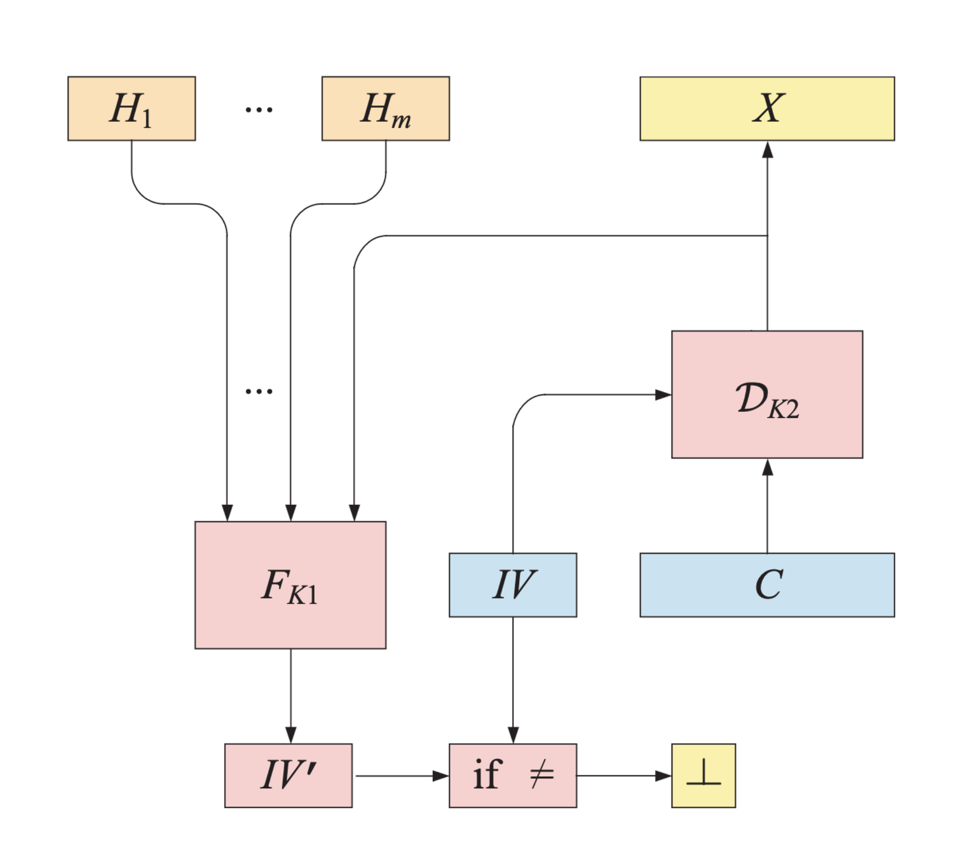
The Original SIV Mode
CTR mode with “synthetic IV” in ciphertext as initial counter
For simplicity, we assume no associated data
Use CTR mode with key K2 to decrypt the ciphertext and recover message.
Recompute the “synthetic IV” from the message using S2V[CMAC] with key K1.
Compare this computed synthetic IV with that stored as part of the ciphertext:
If they are different, then reject.
Otherwise, return message.
C = C’ || IV
[RS07] https://web.cs.ucdavis.edu/~rogaway/papers/siv.pdf

Slide 24
The Original SIV Mode
For simplicity, we assume no associated data
Use CTR mode with key K2 to decrypt the ciphertext and recover message.
Recompute the “synthetic IV” from the message using S2V[CMAC] with key K1.
Compare this computed synthetic IV with that stored as part of the ciphertext:
If they are different, then reject.
Otherwise, return message.
[RS07] https://web.cs.ucdavis.edu/~rogaway/papers/siv.pdf

Slide 25
The Original SIV Mode
For simplicity, we assume no associated data
Use CTR mode with key K2 to decrypt the ciphertext and recover message.
Recompute the “synthetic IV” from the message using S2V[CMAC] with key K1.
Compare this computed synthetic IV with that stored as part of the ciphertext:
If they are different, then reject.
Otherwise, return message.
[RS07] https://web.cs.ucdavis.edu/~rogaway/papers/siv.pdf

Slide 26
CMT-k* attack on SIV
For simplicity, we’ll consider 1-block ciphertexts with no associated data or nonce
Goal: Find two keys (K1, K2)$≠$(K1’, K2’) and ciphertext C (of the form C’ || IV) so that decryption of C under both keys succeeds
This means that the computed synthetic IV’s match the stored IV that is part of ciphertext C
$$IV=CMAC\left(K1, C^{′}⊕E_{K2}\left(IV\right)\right)=CMAC\left(K1^{′}, C^{′}⊕E_{K2^{′}}\left(IV\right)\right)$$

Slide 27
CMT-k* attack on SIV
For simplicity, we’ll consider 1-block ciphertexts with no associated data or nonce
Goal: Find two keys (K1, K2)$≠$(K1’, K2’) and ciphertext C $←$C’ || IV such that:
$$\left(E_{K1}^{−1}\left(IV\right)⊕\left(2⋅E_{K1}\left(0^{n}\right)\right)⊕E_{K1}\left(2⋅E_{K1}\left(0^{n}\right)\right)\right)⊕E_{K2}\left(IV\right)$$
$⊕\left(E_{K1^{′}}^{−1}\left(IV\right)⊕\left(2⋅E_{K1^{′}}\left(0^{n}\right)\right)⊕E_{K1^{′}}\left(2⋅E_{K1^{′}}\left(0^{n}\right)\right)\right)⊕E_{K2^{′}}\left(IV\right)=0^{n}$
If we model block cipher E as an ideal cipher, then this looks very close to the Generalized Birthday Problem!
Notes:
And when we simplify this equation and rearrange terms we finally get an equation that looks like this, where we need to find K1, K2, K1’, and K2’ that satisfies this equation
[click] and when we looked at this equation, we realized that if we model the block cipher as an ideal cipher, then this looks very close to the Generalized Bday Problem

Slide 28
CMT-k* attack on SIV: Using Generalized Birthday Problem
For simplicity, we’ll consider 1-block ciphertexts with no associated data or nonce
4-list Birthday Problem:
Given lists L1, L2, L3, L4 of elements drawn uniformly and independently at random from ${\left\{0,1\right\}}^{n}$, find x1$∈$L1, x2$∈$L2, x3$∈$L3, x4$∈$L4 s.t. x1 $⊕$ x2 $⊕$ x3 $⊕$ x4 = 0^{n}
Wagner gives the k-tree algorithm to solve this in $O(2^{n/3}$) space and time [W02]
$$\left(E_{K1}^{−1}\left(IV\right)⊕\left(2⋅E_{K1}\left(0^{n}\right)\right)⊕E_{K1}\left(2⋅E_{K1}\left(0^{n}\right)\right)\right)⊕E_{K2}\left(IV\right)$$
$⊕\left(E_{K1^{′}}^{−1}\left(IV\right)⊕\left(2⋅E_{K1^{′}}\left(0^{n}\right)\right)⊕E_{K1^{′}}\left(2⋅E_{K1^{′}}\left(0^{n}\right)\right)\right)⊕E_{K2^{′}}\left(IV\right)=0^{n}$
Problem: These values are not drawn uniformly and independently at random from ${\left\{0,1\right\}}^{n}$
$$F_{1}(K1)⊕F_{2}(K2)⊕F_{3}(K1^{′})⊕F_{4}(K2^{′})=0^{n}$$
Notes:
And so we can take this equation we have here and we could model each term as a pseudorandom function evaluated on each key and so we’d just have to pick our keys, evaluate the functions, and then generate our lists that way
[click] But this isn’t a pseudorandom function since our block cipher is a pseudorandom permutation for each key. This means the values we’d get in our lists are not drawn uniformly and independently at random and so we can’t use Wagner’s algorithm here

Slide 29
CMT-k* attack on SIV: Using Generalized Birthday Problem
For simplicity, we’ll consider 1-block ciphertexts with no associated data or nonce
We show that we can upper bound the distinguishability between the distribution formed by the values chosen to make the list and uniformly random distribution
We then show we can apply Wagner’s k-tree algorithm with the distributions we have and still have high probability of finding collisions
We show that with high probability we can find a collision in time ~2⁵³, making it practical and sufficiently damaging to rule out SIV as suitable for contexts where key commitment matters

Slide 30
Our Contributions
New granular framework for context commitment
New context commitment security notion: context discovery
Context discovery attacks against GCM, OCB3, EAX, CCM, SIV
Key commitment attack against the original SIV mode
Notes:
I’ll cover our key commitment attack against SIV

Slide 31
Our Contributions
New granular framework for context commitment
New context commitment security notion: context discovery
Context discovery attacks against GCM, OCB3, EAX, CCM, SIV
Key commitment attack against the original SIV mode
Notes:
I’ll briefly mention our context discovery notion and some attacks here

Slide 32
Revisiting the Framework for Context Committing Security
For AEAD, given
C$←$ AEAD.Enc(K₁, N₁, A₁, M₁) [target selection]
and not given
K₁, N₁, A₁ [target hiding]
computationally efficient to find
(K₂, N₂, A₂)
such that
P((K₁, N₁, A₁), (K₂, N₂, A₂)) for predicate P
and decryption
M₁$←$ AEAD.Dec(K₁, N₁, A₁, C)
M₂ $←$AEAD.Dec(K₂, N₂, A₂, C)
succeeds.
Notion | Predicate
Context Commitment | (K₁, N₁ , A₁) ≠ (K₂, N₂, A₂)
CMT-k | K₁ ≠ K₂
CMT-n | N₁ ≠ N₂
CMT-a | A₁ ≠ A₂
CMT-k* | K₁ ≠ K₂ ∧ (N₁ , A₁) = (N₂, A₂)
CMT-n* | N₁ ≠ N₂ ∧ (K₁ , A₁) = (K₂, A₂)
CMT-a* | A₁ ≠ A₂ ∧ (K₁ , N₁) = (K₂, N₂)
Permissive
Restrictive
This looks like preimage resistance.
Notes:
So remember I brought up this context committing definition and said this looks a lot like a sort of preimage resistance definition

Slide 33
Context Discoverability Security
CDY Security
For AEAD, given
C [target selection]
computationally efficient to find
K, N, A
such that decryption
M$←$AEAD.Dec(K, N, A, C)
succeeds.
Notes:
Well we realized that this would actually be useful to have as its own definition, especially since its much simpler to understand and model
So our context discoverability or CDY security definition simply asks whether an adversary, given a ciphertext, can compute a context such that the context successfully decrypts the ciphertext

Slide 34
Context Discoverability Security
CDY Security
Context Discoverability security is to Context Committing security for AEAD as preimage resistance is to collision-resistance for hash functions
We also show that if an AEAD scheme is “context compressing” (meaning: ciphertexts are decryptable under more than one context), then Context Committing security implies Context Discoverability security
We show Context Discoverability attacks for CCM, EAX, SIV, GCM, and OCB3
Context Discoverability allows us to better communicate attacks and threat models
For AEAD, given
C [target selection]
computationally efficient to find
K, N, A
such that decryption
M$←$AEAD.Dec(K, N, A, C)
succeeds.

Slide 35
Conclusion
Full version available on eprint:
https://ia.cr/2023/526
Scheme | Key Committing | Context Committing
GCM | [GLR17, DGRW19] | ↪️
AES-SIV | ✨ | ↪️✨
CCM | ✨ | ↪️✨
EAX | ✨ | ↪️✨
OCB3 | [ADGKLS20] | ↪️
PaddingZeros | [ADGKLS20] | ✨
KeyHashing | [ADGKLS20] | ✨
CAU-C1 | [BH22] | ✨
✨ = new result

Slide 36
References
[W02] | David Wagner. A Generalized Birthday Problem. https://www.iacr.org/archive/crypto2002/24420288/24420288.pdf
[FOR17] | Pooya Farshim, Claudio Orlandi, and Răzvan Roşie. Security of Symmetric Primitives under Incorrect Usage of Keys. ia.cr/2017/288
[GLR17] | Paul Grubbs, Jiahui Lu, and Thomas Ristenpart. Message franking via committing authenticated encryption. ia.cr/2017/664
[DGRW19] | Yevgeniy Dodis, Paul Grubbs, Thomas Ristenpart, and Joanne Woodage. Fast message franking: From invisible salamanders to encryptment. ia.cr/2019/016
[LGR20] | Julia Len, Paul Grubbs, and Thomas Ristenpart. Partitioning Oracle Attacks. ia.cr/2020/1491
[ADGKLS20] | Ange Albertini, Thai Duong, Shay Gueron, Stefan Kölbl, Atul Luykx, and Sophie Schmieg. How to Abuse and Fix Authenticated Encryption Without Key Commitment. ia.cr/2020/1456
[BH22] | Mihir Bellare and Viet Tung Hoang. Efficient schemes for committing authenticated encryption. ia.cr/2022/268
[RS07] | Philip Rogaway and Thomas Shrimpton. The SIV Mode of Operation for Deterministic Authenticated-Encryption (Key Wrap) and Misuse-Resistant Nonce-Based Authenticated-Encryption. https://web.cs.ucdavis.edu/~rogaway/papers/siv.pdf

