Slide 1
Succinct Vector, Polynomial, and Functional Commitments from Lattices
Hoeteck Wee and David Wu
April 2023

Slide 2
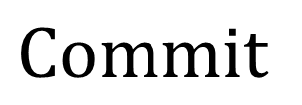
Functional Commitments
$$x$$
$$Commit$$
“commitment”
$$σ$$
“opening”
$$π$$
$$Open+Verify$$
$$f(x)$$
$$σ$$
$$x$$

Slide 3
Functional Commitments
$$x$$
$$Commit$$
“commitment”
$$σ$$
$$Commit\left(crs,x\right)→\left(σ,st\right)$$
Takes a common reference string and commits to a message
Outputs commitment $σ$ and commitment state $st$

Slide 4
Functional Commitments
$$π$$
$$Open+Verify$$
$$f(x)$$
$$σ$$
$$x$$
$$Commit\left(crs,x\right)→\left(σ,st\right)$$
$$Open\left(st,f\right)→π$$
Takes the commitment state and a function $f$ and outputs an opening $π$
$$Verify\left(crs,σ,\left(f,y\right),π\right)→0/1$$
Checks whether $π$ is valid opening of $σ$ to value $y$ with respect to $f$

Slide 5
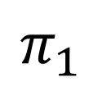
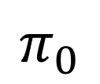
Functional Commitments
$$π$$
$$Open+Verify$$
$$f(x)$$
$$σ$$
$$x$$
Binding: efficient adversary cannot open $σ$ to two different values with respect to the same $f$
$$π_{0}$$
$$\left(f,y_{0}\right)$$
$$Verify\left(crs,σ,\left(f,y_{0}\right),π_{0}\right)=1$$
$$σ$$
$$π_{1}$$
$$\left(f,y_{1}\right)$$
$$Verify\left(crs,σ,\left(f,y_{1}\right),π_{1}\right)=1$$

Slide 6
Functional Commitments
$$π$$
$$Open+Verify$$
$$f(x)$$
$$σ$$
$$x$$
Hiding: commitment $σ$ and opening $π$ only reveal $f\left(x\right)$
Succinctness: commitments and openings should be short
Short commitment: $\left|σ\right|=poly\left(λ,log \left|x\right|\right)$
Short opening: $\left|π\right|=poly\left(λ,\log\left|x\right|,\left|f\left(x\right)\right|\right)$
Special cases: vector commitments, polynomial commitments

Slide 7
Functional Commitment Constructions
(not an exhaustive list!)
Scheme
Function Class
Assumption
[Mer87]
vector commitment
collision-resistant hash functions
[LY10, CF13, LM19, GRWZ20]
vector commitment
$q$-type pairing assumptions
[CF13, LM19, BBF19]
vector commitment
groups of unknown order
[PPS21]
vector commitment
short integer solutions (SIS)
[KZG10, Lee20]
polynomial commitment
$q$-type pairing assumptions
[BFS19, BHRRS21, BF23]
polynomial commitment
groups of unknown order
[LRY16]
Boolean circuits
collision-resistant hash functions + SNARKs
non-falsifiable, non-black box

Slide 8
Functional Commitment Constructions
(not an exhaustive list!)
Scheme
Function Class
Assumption
[Mer87]
vector commitment
collision-resistant hash functions
[LY10, CF13, LM19, GRWZ20]
vector commitment
$q$-type pairing assumptions
[CF13, LM19, BBF19]
vector commitment
groups of unknown order
[PPS21]
vector commitment
short integer solutions (SIS)
[KZG10, Lee20]
polynomial commitment
$q$-type pairing assumptions
[BFS19, BHRRS21, BF23]
polynomial commitment
groups of unknown order
[LRY16]
Boolean circuits
collision-resistant hash functions + SNARKs
[LRY16]
linear functions
$q$-type pairing assumptions
[ACLMT22]
constant-degree polynomials
$k$-$R$-ISIS assumption (falsifiable)
This work
vector commitment
short integer solutions (SIS)
supports private openings, commitments to large values, linearly-homomorphic

Slide 9
Functional Commitment Constructions
(not an exhaustive list!)
Scheme
Function Class
Assumption
[Mer87]
vector commitment
collision-resistant hash functions
[LY10, CF13, LM19, GRWZ20]
vector commitment
$q$-type pairing assumptions
[CF13, LM19, BBF19]
vector commitment
groups of unknown order
[PPS21]
vector commitment
short integer solutions (SIS)
[KZG10, Lee20]
polynomial commitment
$q$-type pairing assumptions
[BFS19, BHRRS21, BF23]
polynomial commitment
groups of unknown order
[LRY16]
Boolean circuits
collision-resistant hash functions + SNARKs
[LRY16]
linear functions
$q$-type pairing assumptions
[ACLMT22]
constant-degree polynomials
$k$-$R$-ISIS assumption (falsifiable)
This work
vector commitment
short integer solutions (SIS)
This work
Boolean circuits
$BASIS_{struct}$ assumption (falsifiable)
$BASIS_{struct}$ assumption less structured than [ACLMT22]

Slide 10
Functional Commitment Constructions
(not an exhaustive list!)
Scheme
Function Class
Assumption
[Mer87]
vector commitment
collision-resistant hash functions
[LY10, CF13, LM19, GRWZ20]
vector commitment
$q$-type pairing assumptions
[CF13, LM19, BBF19]
vector commitment
groups of unknown order
[PPS21]
vector commitment
short integer solutions (SIS)
[KZG10, Lee20]
polynomial commitment
$q$-type pairing assumptions
[BFS19, BHRRS21, BF23]
polynomial commitment
groups of unknown order
[LRY16]
Boolean circuits
collision-resistant hash functions + SNARKs
[LRY16]
linear functions
$q$-type pairing assumptions
[ACLMT22]
constant-degree polynomials
$k$-$R$-ISIS assumption (falsifiable)
This work
vector commitment
short integer solutions (SIS)
This work
Boolean circuits
$BASIS_{struct}$ assumption (falsifiable)
Concurrent works [BCFL22, dCP23]: lattice-based constructions of functional commitments for Boolean circuits

Slide 11
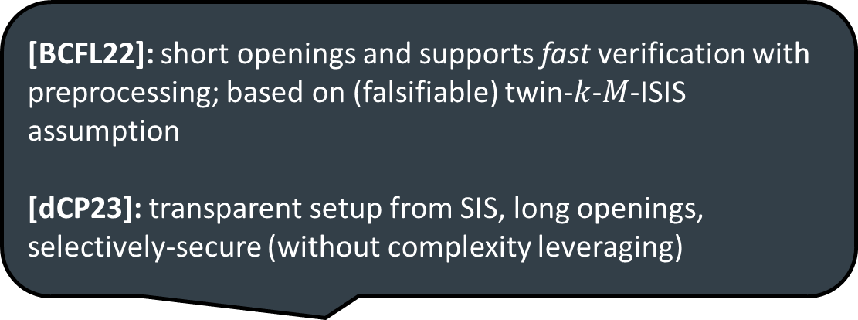
Functional Commitment Constructions
(not an exhaustive list!)
Scheme
Function Class
Assumption
[Mer87]
vector commitment
collision-resistant hash functions
[LY10, CF13, LM19, GRWZ20]
vector commitment
$q$-type pairing assumptions
[CF13, LM19, BBF19]
vector commitment
groups of unknown order
[PPS21]
vector commitment
short integer solutions (SIS)
[KZG10, Lee20]
polynomial commitment
$q$-type pairing assumptions
[BFS19, BHRRS21, BF23]
polynomial commitment
groups of unknown order
[BCFL22]: short openings and supports fast verification with preprocessing; based on (falsifiable) twin-$k$-$M$-ISIS assumption
[dCP23]: transparent setup from SIS, long openings, selectively-secure (without complexity leveraging)
[LRY16]
Boolean circuits
collision-resistant hash functions + SNARKs
[LRY16]
linear functions
$q$-type pairing assumptions
[ACLMT22]
constant-degree polynomials
$k$-$R$-ISIS assumption (falsifiable)
This work
vector commitment
short integer solutions (SIS)
This work
Boolean circuits
$BASIS_{struct}$ assumption (falsifiable)
Concurrent works [BCFL22, dCP23]: lattice-based constructions of functional commitments for Boolean circuits

Slide 12
Framework for Lattice Commitments
Captures and generalizes previous lattice-based functional commitments [PPS21, ACLMT22]
Common reference string (for inputs of length $ℓ$):
$$A_{i}$$
$$u_{ij}$$
$$t_{j}$$
matrices $A_{1},…,A_{ℓ}∈ℤ_{q}^{n×m}$
target vectors $t_{1},…,t_{ℓ}∈ℤ_{q}^{n}$
auxiliary data: short preimages $u_{ij}$ where $A_{i}u_{ij}=t_{j}$ for $i≠j$

Slide 13
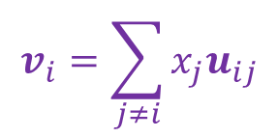
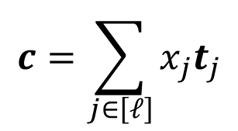
Framework for Lattice Commitments
Captures and generalizes previous lattice-based functional commitments [PPS21, ACLMT22]
Common reference string (for inputs of length $ℓ$):
$$A_{i}$$
$$u_{ij}$$
$$t_{j}$$
matrices $A_{1},…,A_{ℓ}∈ℤ_{q}^{n×m}$
target vectors $t_{1},…,t_{ℓ}∈ℤ_{q}^{n}$
auxiliary data: short preimages $u_{ij}$ where $A_{i}u_{ij}=t_{j}$ for $i≠j$
Commitment to $x∈ℤ_{q}^{ℓ}$:
Opening to value $y$ at index $i$:
$$c=\sum_{j∈\left[ℓ\right]}{x_{j}t_{j}}$$
short $v_{i}$ such that $c=y⋅t_{i}+A_{i}v_{i}$
Honest opening:
Correct as long as $x$ is short
$$v_{i}=\sum_{j≠i}{x_{j}u_{ij}}$$
$$c=x_{i}t_{i}+\sum_{j≠i}{x_{j}t_{j}}$$
$$=x_{i}t_{i}+\sum_{j≠i}{x_{j}A_{i}u_{ij}}$$
linear combination of target vectors
$$=x_{i}t_{i}+A_{i}v_{i}$$

Slide 14
Framework for Lattice Commitments
Captures and generalizes previous lattice-based functional commitments [PPS21, ACLMT22]
Common reference string (for inputs of length $ℓ$):
$$A_{i}$$
$$u_{ij}$$
$$t_{j}$$
matrices $A_{1},…,A_{ℓ}∈ℤ_{q}^{n×m}$
target vectors $t_{1},…,t_{ℓ}∈ℤ_{q}^{n}$
auxiliary data: short preimages $u_{ij}$ where $A_{i}u_{ij}=t_{j}$ for $i≠j$
[PPS21]: $A_{i}$ and $t_{i}$ are random
suffices for vector commitments (from SIS)
[ACLMT22]: $A_{i}$ and $t_{i}$ are structured
suffices for functional commitments for constant-degree polynomials (from $k$-$R$-ISIS)

Slide 15
Our Approach
Captures and generalizes previous lattice-based functional commitments [PPS21, ACLMT22]
Verification invariant: $c=A_{i}v_{i}+x_{i}t_{i}$
$$∀i∈[ℓ]$$
for a short $v_{i}$
Our approach: rewrite $ℓ$ relations as a single linear system
$$\left[\begin{matrix}A_{1} & & & −I_{n} \\ & ⋱ & & ⋮ \\ & & A_{ℓ} & −I_{n}\end{matrix}\right]⋅\left[\begin{matrix}v_{1} \\ ⋮ \\ \begin{aligned}v_{ℓ} \\ c\end{aligned}\end{matrix}\right]=\left[\begin{matrix}−x_{1}t_{1} \\ ⋮ \\ {−x}_{ℓ}t_{ℓ}\end{matrix}\right]$$
$I_{n}$ denotes the identity matrix

Slide 16
Our Approach
Captures and generalizes previous lattice-based functional commitments [PPS21, ACLMT22]
Verification invariant: $c=A_{i}v_{i}+x_{i}t_{i}$
$$∀i∈[ℓ]$$
for a short $v_{i}$
Our approach: rewrite $ℓ$ relations as a single linear system
$$\left[\begin{matrix}A_{1} & & & −G \\ & ⋱ & & ⋮ \\ & & A_{ℓ} & −G\end{matrix}\right]⋅\left[\begin{matrix}v_{1} \\ ⋮ \\ \begin{aligned}v_{ℓ} \\ \hat{c}\end{aligned}\end{matrix}\right]=\left[\begin{matrix}{−x}_{1}t_{1} \\ ⋮ \\ {−x}_{ℓ}t_{ℓ}\end{matrix}\right]$$
“powers of two matrix”
$$G=\left[\begin{matrix}1 & 2 & ⋯ & 2^{⌊log{q}⌋} & & & & & \\ & & & & ⋱ & & & & \\ & & & & & 1 & 2 & ⋯ & 2^{\left\lfloor \log{q}\right\rfloor }\end{matrix}\right]$$
For security and functionality, it will be useful to write $c=G\hat{c}$

Slide 17
Our Approach
Captures and generalizes previous lattice-based functional commitments [PPS21, ACLMT22]
Verification invariant: $c=A_{i}v_{i}+x_{i}t_{i}$
$$∀i∈[ℓ]$$
for a short $v_{i}$
Our approach: rewrite $ℓ$ relations as a single linear system
$$\left[\begin{matrix}A_{1} & & & −G \\ & ⋱ & & ⋮ \\ & & A_{ℓ} & −G\end{matrix}\right]⋅\left[\begin{matrix}v_{1} \\ ⋮ \\ \begin{aligned}v_{ℓ} \\ \hat{c}\end{aligned}\end{matrix}\right]=\left[\begin{matrix}{−x}_{1}t_{1} \\ ⋮ \\ {−x}_{ℓ}t_{ℓ}\end{matrix}\right]$$
Common reference string:
matrices $A_{1},…,A_{ℓ}∈ℤ_{q}^{n×m}$
target vectors $t_{1},…,t_{ℓ}∈ℤ_{q}^{n}$
auxiliary data:
cross-terms $u_{ij}←A_{i}^{−1}\left(t_{j}\right)$

Slide 18

Our Approach
Captures and generalizes previous lattice-based functional commitments [PPS21, ACLMT22]
Verification invariant: $c=A_{i}v_{i}+x_{i}t_{i}$
$$∀i∈[ℓ]$$
for a short $v_{i}$
Our approach: rewrite $ℓ$ relations as a single linear system
$$\left[\begin{matrix}A_{1} & & & −G \\ & ⋱ & & ⋮ \\ & & A_{ℓ} & −G\end{matrix}\right]⋅\left[\begin{matrix}v_{1} \\ ⋮ \\ \begin{aligned}v_{ℓ} \\ \hat{c}\end{aligned}\end{matrix}\right]=\left[\begin{matrix}{−x}_{1}t_{1} \\ ⋮ \\ {−x}_{ℓ}t_{ℓ}\end{matrix}\right]$$
Common reference string:
matrices $A_{1},…,A_{ℓ}∈ℤ_{q}^{n×m}$
target vectors $t_{1},…,t_{ℓ}∈ℤ_{q}^{n}$
auxiliary data:
cross-terms $u_{ij}←A_{i}^{−1}\left(t_{j}\right)$
trapdoor for $B_{ℓ}$
$$B_{ℓ}$$
Trapdoor for $B_{ℓ}$ can be used to sample short solutions $x$ to the linear system $B_{ℓ}x=y$ (for arbitrary $y$)

Slide 19
Our Approach
Captures and generalizes previous lattice-based functional commitments [PPS21, ACLMT22]
Verification invariant: $c=A_{i}v_{i}+x_{i}t_{i}$
$$∀i∈[ℓ]$$
for a short $v_{i}$
Our approach: rewrite $ℓ$ relations as a single linear system
Committing to an input $x$:
$$\left[\begin{matrix}A_{1} & & & −G \\ & ⋱ & & ⋮ \\ & & A_{ℓ} & −G\end{matrix}\right]⋅\left[\begin{matrix}v_{1} \\ ⋮ \\ \begin{aligned}v_{ℓ} \\ \hat{c}\end{aligned}\end{matrix}\right]=\left[\begin{matrix}{−x}_{1}t_{1} \\ ⋮ \\ {−x}_{ℓ}t_{ℓ}\end{matrix}\right]$$
Use trapdoor for $B_{ℓ}$ to jointly sample a solution $v_{1},…,v_{ℓ},\hat{c}$
$c=G\hat{c}$ is the commitment and $v_{1},…,v_{ℓ}$ are the openings
$$B_{ℓ}$$
Supports commitments to arbitrary (i.e., large) values over $ℤ_{q}$

Slide 20
Our Approach
Captures and generalizes previous lattice-based functional commitments [PPS21, ACLMT22]
Verification invariant: $c=A_{i}v_{i}+x_{i}t_{i}$
$$∀i∈[ℓ]$$
for a short $v_{i}$
Our approach: rewrite $ℓ$ relations as a single linear system
Committing to an input $x$:
$$\left[\begin{matrix}A_{1} & & & −G \\ & ⋱ & & ⋮ \\ & & A_{ℓ} & −G\end{matrix}\right]⋅\left[\begin{matrix}v_{1} \\ ⋮ \\ \begin{aligned}v_{ℓ} \\ \hat{c}\end{aligned}\end{matrix}\right]=\left[\begin{matrix}{−x}_{1}t_{1} \\ ⋮ \\ {−x}_{ℓ}t_{ℓ}\end{matrix}\right]$$
Use trapdoor for $B_{ℓ}$ to jointly sample a solution $v_{1},…,v_{ℓ},\hat{c}$
$c=G\hat{c}$ is the commitment and $v_{1},…v_{ℓ}$ are the openings
$$B_{ℓ}$$
Supports statistically private openings
(commitment + opening hides unopened positions)

Slide 21
Computational Binding
Captures and generalizes previous lattice-based functional commitments [PPS21, ACLMT22]
Verification invariant: $c=A_{i}v_{i}+x_{i}t_{i}$
$$∀i∈[ℓ]$$
Our scheme
for a short $v_{i}$
Adversary that breaks binding can solve SIS with respect to $A_{i}$
(technically $A_{i}$ without the first row – which is equivalent to SIS with dimension $n−1$)
given $A←ℤ_{q}^{n×m}$, hard to find
short $x≠0$ such that $Ax=0$

Slide 22
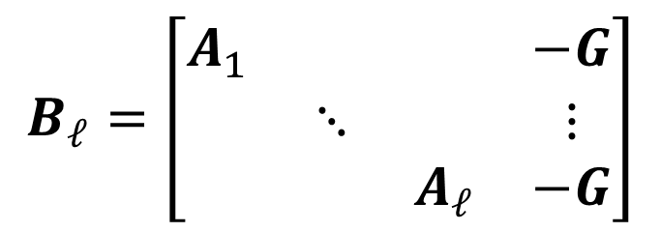
Basis-Augmented SIS (BASIS) Assumption
Captures and generalizes previous lattice-based functional commitments [PPS21, ACLMT22]
Verification invariant: $c=A_{i}v_{i}+x_{i}t_{i}$
$$∀i∈[ℓ]$$
Our scheme
for a short $v_{i}$
Adversary that breaks binding can solve SIS with respect to $A_{i}$
Basis-augmented SIS (BASIS) assumption:
SIS is hard with respect to $A_{i}$ given a trapdoor (a basis) for the matrix
$$B_{ℓ}=\left[\begin{matrix}A_{1} & & & −G \\ & ⋱ & & ⋮ \\ & & A_{ℓ} & −G\end{matrix}\right]$$

Slide 23
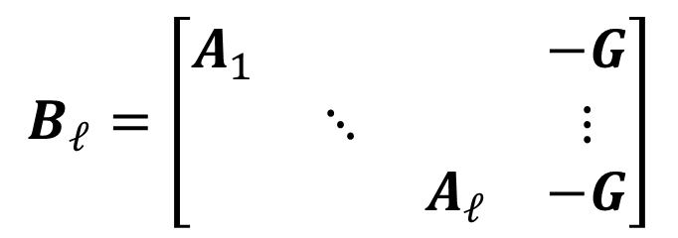

Basis-Augmented SIS (BASIS) Assumption
SIS is hard with respect to $A_{i}$ given a trapdoor (a basis) for the matrix
$$B_{ℓ}=\left[\begin{matrix}A_{1} & & & −G \\ & ⋱ & & ⋮ \\ & & A_{ℓ} & −G\end{matrix}\right]$$
When $A_{1},…,A_{ℓ}←ℤ_{q}^{n×m}$ are uniform and independent:
hardness of SIS implies hardness of BASIS
(follows from standard lattice trapdoor extension techniques)
$$\begin{matrix}A_{1} & & & & −G \\ & A_{2} & & & −G \\ & & ⋱ & & ⋮ \\ & & & A_{ℓ} & −G\end{matrix}$$
Sketch for $i=1$:
Sample $A_{2},…,A_{ℓ}$ with trapdoors
$$B_{ℓ}=$$
Use trapdoors for $A_{2},…,A_{ℓ}$ and $G$ to trapdoor for $B_{ℓ}$

Slide 24
Basis-Augmented SIS (BASIS) Assumption
SIS is hard with respect to $A_{i}$ given a trapdoor (a basis) for the matrix
$$B_{ℓ}=\left[\begin{matrix}A_{1} & & & −G \\ & ⋱ & & ⋮ \\ & & A_{ℓ} & −G\end{matrix}\right]$$
When $A_{1},…,A_{ℓ}←ℤ_{q}^{n×m}$ are uniform and independent:
hardness of SIS implies hardness of BASIS
Implication: vector commitment that supports committing to large values and private openings based on SIS
Previously: could only commit to small values and without hiding

Slide 25
Functional Commitments for Circuits
Setting: commit to an input $x∈{\left\{0,1\right\}}^{ℓ}$, open to $f(x)$
($f$ can be an arbitrary Boolean circuit)
Starting point: lattice-based homomorphic commitments
[GSW13, BGGHNSVV14, GVW15]
Let $A∈ℤ_{q}^{n×m}$ be an arbitrary matrix
$$C_{1}=AV_{1}+x_{1}G$$
homomorphic evaluation
$$⋮$$
$$C_{f}=AV_{f}+f\left(x\right)⋅G$$
$$C_{ℓ}=AV_{ℓ}+x_{ℓ}G$$
[GVW15]: $C_{i}$ is a commitment to $x_{i}$ with (short) opening $V_{i}$
$C_{f}$ is a commitment to $f(x)$ with (short) opening $V_{f}$

Slide 26
Functional Commitments for Circuits
Setting: commit to an input $x∈{\left\{0,1\right\}}^{ℓ}$, open to $f(x)$
($f$ can be an arbitrary Boolean circuit)
Starting point: lattice-based homomorphic commitments
[GSW13, BGGHNSVV14, GVW15]
Let $A∈ℤ_{q}^{n×m}$ be an arbitrary matrix
$$C_{1}=AV_{1}+x_{1}G$$
[GVW15]: long commitments (linear in $\left|x\right|$)
$C_{1},…, C_{ℓ}$ are independent
$$⋮$$
$$C_{ℓ}=AV_{ℓ}+x_{ℓ}G$$
Our approach: compress $C_{1},…,C_{ℓ}$ into a single $\hat{C}$
[GVW15]: $C_{i}$ is a commitment to $x_{i}$ with (short) opening $V_{i}$
We will define $C_{i}=W_{i}^{−1}G\hat{C}$ where $W_{i}∈ℤ_{q}^{n×n}$ is part of the common reference string

Slide 27
Functional Commitments for Circuits
Setting: commit to an input $x∈{\left\{0,1\right\}}^{ℓ}$, open to $f(x)$
($f$ can be an arbitrary Boolean circuit)
$$C_{1}=AV_{1}+x_{1}G$$
$$W_{1}^{−1}G\hat{C}=AV_{1}+x_{1}G$$
$$G\hat{C}=W_{1}AV_{1}+x_{1}W_{1}G$$
$$⋮$$
$$⋮$$
$$⋮$$
$$C_{ℓ}=AV_{ℓ}+x_{ℓ}G$$
$$W_{ℓ}^{−1}G\hat{C}=AV_{ℓ}+x_{ℓ}G$$
$$G\hat{C}=W_{ℓ}AV_{ℓ}+x_{ℓ}W_{ℓ}G$$
$$\left[\begin{matrix}A_{1} & & & −G \\ & ⋱ & & ⋮ \\ & & A_{ℓ} & −G\end{matrix}\right]⋅\left[\begin{matrix}V_{1} \\ ⋮ \\ \begin{aligned}V_{ℓ} \\ \hat{C}\end{aligned}\end{matrix}\right]=\left[\begin{matrix}−x_{1}W_{1}G \\ ⋮ \\ −x_{ℓ}W_{ℓ}G\end{matrix}\right]$$
$$A_{i}=W_{i}A$$
Our approach: commitment is $\hat{C}$ and set $C_{i}=W_{i}^{−1}G\hat{C}$

Slide 28

Functional Commitments for Circuits
Setting: commit to an input $x∈{\left\{0,1\right\}}^{ℓ}$, open to $f(x)$
($f$ can be an arbitrary Boolean circuit)
As in the case of vector commitments, we can publish a trapdoor for $B_{ℓ}$ in the CRS
(along with the matrices $W_{1},…,W_{ℓ}$)
$$B_{ℓ}$$
$$\left[\begin{matrix}A_{1} & & & −G \\ & ⋱ & & ⋮ \\ & & A_{ℓ} & −G\end{matrix}\right]⋅\left[\begin{matrix}V_{1} \\ ⋮ \\ \begin{aligned}V_{ℓ} \\ \hat{C}\end{aligned}\end{matrix}\right]=\left[\begin{matrix}−x_{1}W_{1}G \\ ⋮ \\ −x_{ℓ}W_{ℓ}G\end{matrix}\right]$$
$$A_{i}=W_{i}A$$
Homomorphic computation + opening verification now proceed as in [GVW15]

Slide 29
Functional Commitments from Lattices
Security follows from BASIS assumption with a structured matrix:
SIS is hard with respect to $A$ given a trapdoor (a basis) for the matrix
$$B_{ℓ}=\left[\begin{matrix}A_{1} & & & −G \\ & ⋱ & & ⋮ \\ & & A_{ℓ} & −G\end{matrix}\right]$$
where $A_{i}=W_{i}A$ where $W_{i}←ℤ_{q}^{n×n}$ and $A←ℤ_{q}^{n×m}$
Falsifiable assumption but does not appear to reduce to standard SIS
$ℓ=1$ case does follow from plain SIS
Open problem: Understanding security or attacks when $ℓ>1$

Slide 30
Extensions
Our functional commitment:
$$\left[\begin{matrix}A_{1} & & & −G \\ & ⋱ & & ⋮ \\ & & A_{ℓ} & −G\end{matrix}\right]⋅\left[\begin{matrix}V_{1} \\ ⋮ \\ \begin{aligned}V_{ℓ} \\ \hat{C}\end{aligned}\end{matrix}\right]=\left[\begin{matrix}{−x}_{1}W_{1}G \\ ⋮ \\ −x_{ℓ}W_{ℓ}G\end{matrix}\right]$$
Fast verification: for linear functions (captures polynomial commitments), can preprocess and support fast verification
Aggregation: can aggregate openings to $f_{1},…, f_{T}$ into single opening
[see paper for details]

Slide 31
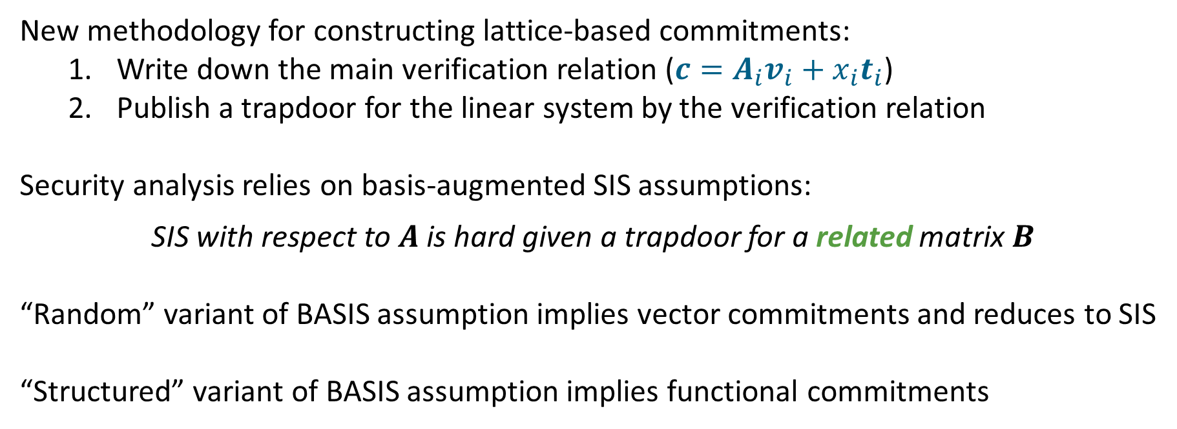
Summary
New methodology for constructing lattice-based commitments:
Write down the main verification relation ($c=A_{i}v_{i}+x_{i}t_{i}$)
Publish a trapdoor for the linear system by the verification relation
Security analysis relies on basis-augmented SIS assumptions:
SIS with respect to $A$ is hard given a trapdoor for a related matrix $B$
“Random” variant of BASIS assumption implies vector commitments and reduces to SIS
“Structured” variant of BASIS assumption implies functional commitments

Slide 32
Open Questions
Analyzing BASIS family of assumptions (new reductions to SIS or attacks)
Describe and analyze knowledge variants of the assumption or the constructions
Reducing CRS size: functional commitments with linear-size CRS?
Constructing lattice-based subvector commitments
Thank you!
https://eprint.iacr.org/2022/1515

Slide 33
Concurrent Work
Consider a bivariate function $F\left(x,y\right)$
commit to input $x$
open at $y$ to the value $F(x,y)$
$F$ is computable by a circuit of depth $d$ and width $w$
After preprocessing, verifier running time is sublinear in $\left|x\right|,\left|y\right|,\left|F\right|$
Fast
Verification
Scheme
$$\left|crs\right|$$
$$\left|com\right|$$
$$\left|open\right|$$
Assumption
Transparent
[dCP23]
$$\left|y\right|$$
$$1$$
$$\left|y\right|$$
SIS
✖
✓
[BCFL22]
$$w^{5}$$
$$1$$
$$1$$
twin-$k$-$M$-ISIS
✓
✖
This work
$${\left|x\right|}^{2}$$
$$1$$
$$1$$
$$BASIS_{struct}$$
✖
✖
All comparisons ignoring $poly\left(λ,d\right)$ factors

