Slide 1
Analyzing security of PAKE
Password-Authenticated TLS via OPAQUE and Post-Handshake Authentication
Julia Hesse
IBM Research - Europe Switzerland
Stanisław Jarecki
UC Irvine
US
Hugo Krawczyk
Algorand Foundation
US
Christopher Wood
Cloudflare
US

Slide 2
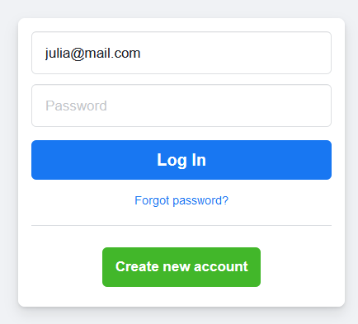
It‘s 2023 and we‘re still...

Slide 3
Just a normal day.

Slide 4
The ugly truth: 99,99% of servers use „password-over-TLS“
Establish a TLS connection to your provider
Send your cleartext password to the provider
Provider hashes and compares against his database of hashed passwords
jke34s!443
jke34s!443
Dk39!!k-.
a-!!.?..
a-!!.?..
Dk39!!k-.
a-!!.?..
jke34s!443
Dk39!!k-.

Slide 5
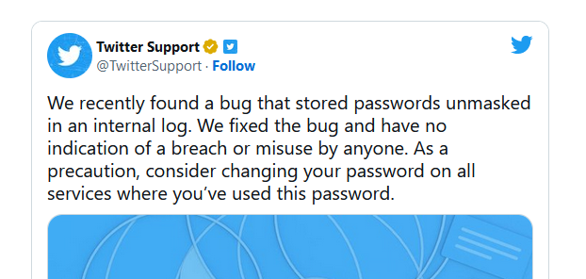
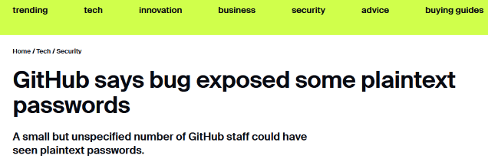
Do you still trust your providers with your passwords?

Slide 6
Secure password authentication, a short guide
Establish a secure connection (channel) to your provider
Convince this provider of password knowledge without leaking any additional information about the password

Slide 7
We have the tools to do secure password authentication!
$$pw$$
$$Hash(pw)$$
aPAKE
$$K$$
$$K$$
$$+ key confirmation$$
Asymmetric Password-Authenticated Key Exchange

Slide 8
Trivial solution? „aPAKE-over-TLS“
TLS channel
Meta‘s pw DB:
Bob, Hash(pw)
Dave, Hash(pw‘)
...
$$pw$$
aPAKE
0/1
Establish TLS channel
Run aPAKE + key confirmation over the channel
Provider does not see cleartext password
Knowledge of password (e.g., hash preimage) proven

Slide 9
Trivial solution? „aPAKE-over-TLS“
TLS channel
Meta‘s pw DB:
0/1
Bob, Hash(pw)
Dave, Hash(pw‘)
...
aPAKE
Establish TLS channel
Run aPAKE + key confirmation over the channel
Provider does not see cleartext password
Knowledge of password (e.g., hash preimage) proven
...but who knows it, actually?
Efficiency – we‘re exchanging a PAKE key on top of TLS keys
$$pw$$

Slide 10
Better: TLS-OPAQUE
Bob
TLS channel
Meta‘s pw DB:
Bob, Hash(pw)
Dave, Hash(pw‘)
...
$$pw$$
TLS-OPAQUE offers post-handshake password authentication
https://datatracker.ietf.org/doc/html/draft-sullivan-tls-opaque-01

Slide 11
This work
A modular analysis of TLS-OPAQUE

Slide 12
TLS Handshake: an „empty“ channel to start from
Both parties know the TLS master secret MS (qualifies them as “endpoints“)
→ Would like to bind further authentication to this knowledge!
→ Derive a unique channel binder $CB←HKDF(MS)$

Slide 13
Building block: TLS Exported Authenticators (EA)
$$pk$$
$$nonce$$
$$\left(pk,sk\right)$$
$$K←HKDF(CB)$$
$$σ←Sign_{sk}{\left(Hash(CB, nonce)\right)}^{}$$
$$K←HKDF(CB)$$
$$mac←MAC_{K}(σ,CB,nonce)$$
$$σ, mac, pk$$
$$Verify σ, mac$$
Post-handshake public-key authentication using SIGMA (Sign-and-Mac)
RFC here: https://datatracker.ietf.org/doc/rfc9261/

Slide 14
From passwords to public keys: OPAQUE (registration)
$$pw$$
$$K←{\left\{0,1\right\}}^{λ}$$
$$\left(pk,sk\right)←KeyGen\left(λ\right)$$
$$\left(pk′,sk′\right)←KeyGen\left(λ\right)$$
$$pw$$
$$K$$
Oblivious PRF
$$rw=PRF_{K}(pw)$$
$$pk′$$
$$env=Enc_{rw}\left(sk,pk^{′}\right)$$
Bob‘s pw file at Meta:
$$"Bob", env, pk$$
$$env "OPAQUE envelope"$$
$$pk^{′}, sk^{′} of Meta$$
$$pk of Bob$$
$$K PRF key$$

Slide 15
From passwords to public keys: OPAQUE (retrieval)
Bob‘s pw file at Meta:
$$env "OPAQUE envelope"$$
$$pw$$
$$pk^{′}, sk^{′} of Meta$$
$$Hi, I^{′}m Bob!$$
$$pk of Bob$$
$$K PRF key$$
$$pw$$
$$K$$
Oblivious PRF
$$rw=PRF_{K}(pw)$$
$$env$$
$$\left(sk,pk^{′}\right)←Dec_{rw}\left(env\right)$$
Result: static DH key pairs for Bob + Meta
Device-independent: Bob can forget his secret key and retrieve it again from the password
Meta never saw the password
OPAQUE does not require secure channels, nor a PKI – can run out-of-band

Slide 16
TLS-OPAQUE: Putting things together
TLS Handshake
+
Exported Authenticators (EA)
+
This work
pw-to-pk conversion through
OPAQUE envelopes
=
TLS-OPAQUE
Post-Handshake oblivious
password authentication
https://datatracker.ietf.org/doc/html/draft-sullivan-tls-opaque-01

Slide 17
TLS-OPAQUE: A modular analysis
formalize this!
TLS Handshake
abstraction
Unauthenticated (secure) channel with unique „binder“
+
+
formalize this!
prove this!
Exported Authenticators (EA)
abstraction
Post-Handshake public-key authentication
+
This work
+
pw-to-pk conversion through
OPAQUE envelopes
pw-to-pk conversion through
OPAQUE envelopes
=
prove this!
=
formalize this!
TLS-OPAQUE
Post-Handshake oblivious
password authentication
abstraction
https://datatracker.ietf.org/doc/html/draft-sullivan-tls-opaque-01
get this for „free“!

Slide 18
TLS-OPAQUE, modularized
Channel
with binder
Post-handshake
pk authentication
TLS-OPAQUE
OPRF
OPAQUE envelopes

Slide 19
TLS-OPAQUE, modularized
TLS
EA
TLS-OPAQUE
DH-based
OPRF
OPAQUE envelopes

Slide 20
TLS-OPAQUE, modularized
IKEv2
EA
TLS-OPAQUE
DH-based
OPRF
OPAQUE envelopes

Slide 21
TLS-OPAQUE, modularized
TLS
EA
TLS-OPAQUE
Post-quantum
OPRF
OPAQUE envelopes
replacements preserve the security proof

Slide 22
Summary of our results
Security of TLS Exported Authenticators (EA) – RFC 9261
EA is a secure post-handshake public-key authentication method
“Proof of Knowledge“ of secret key by channel endpoints
Relies on the uniqueness of TLS-MS on sessons with at least one honest party
Security of TLS-OPAQUE
TLS-OPAQUE is a secure post-handshake password authentication method
“Proof of Knowledge“ of password (or OPAQUE-sk) by channel endpoints
Dropping the AKE part of OPAQUE is fine – no need for a full PAKE!
Strong password protection: server does not learn anything beyond correct/wrong
First formal analysis and security modeling of a replacement for password-over-TLS
Modular analysis
First universally composable security models for post-handshake authentication
Formal treatment of “exportable“ public keys
Easy to substitute post-quantum instantiations of the current DH-based components (e.g., the OPRF), while preserving the proof
https://ia.cr/2023/220

