Slide 1
Functional Commitments for All Functions from SIS with Transparent Setup
Leo de Castro
MIT
Chris Peikert
University of Michigan

Slide 2
This Talk
Functional Commitments for All Functions
Post-Quantum Security: Relies only on standard lattice assumption SIS.
Transparent Setup: Public parameter is just a single random matrix.
Fast, Simple Verification: The verifier just checks one linear relation.

Slide 3
This Talk: Roadmap
PART 1
Functional Commitment Construction & Security Proof
PART 2
Using the construction.
Features: Stateless updateability and composability
Efficient specializations: vector commitments, accumulators, polynomial commitments, etc.

Slide 4
Part 1: Functional Commitment Construction

Slide 5
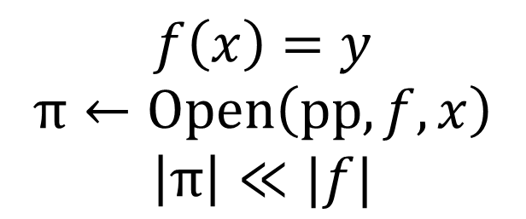
What is a functional commitment?
Prover
Function family F
$$pp←Setup{(1}^{\text{λ}})$$
Verifier
$$c←Commit(pp, f∈F)$$
$$\left|c\right|≪|f|$$
$$c$$
$$x$$
$$f\left(x\right)=y$$
$$π←Open\left(pp, f, x\right)$$
$$\left|π\right|≪|f|$$
$$y,π$$
$$Accept/Reject←Verify(pp, c, x, y,π)$$
Notes:
First defined in LRY16 (Libert, Ramanna, Yung). Motivated by generalizing special cases (vector commitments, polynomial commitments, etc.). Complexity of Verify should be less than running f.
Mention that everything here is reusable…

Slide 6
Security: (Selective) Evaluation Binding
The following game should be hard to win.
$$x^{∗} ←Adv(1^{\text{λ}})$$
$$pp ←Setup(1^{\text{λ}})$$
$$c^{∗},\left(y_{1}, π_{1}\right),\left(y_{2}, π_{2}\right)←Adv(pp)$$
$Adv$ wins if
$y_{1}≠y_{2}$ and $Accept←Verify\left(pp,c^{∗},x^{∗},y_{b},π_{b}\right)$ for $b∈\{0,1\}$
Notes:
We focus on selective security, but adaptive security follows from complexity leveraging.

Slide 7
Functional Commitment Applications
Specializations
Vector commitments [LY10], Linear commitments [LRY16],
Polynomial commitments [KZG10], Key-value commitments [BBF19], etc.
Applications
Verifiable outsourcing of storage [BGV11]
Authenticated Streaming [PSTY13]
Accumulators, Updateable ZK sets & databases [BdM93, MRK03, Lis05]
Pseudonymous Credentials [KZG10]
Stateless transaction validation for cryptocurrencies [CPSZ18]
Proof-carrying data, SNARGs & SNARKs [BFS20, BDFG21]
Delegation of committed programs [GSW23]

Slide 8
Prior Work: Functional Commitments
Non-falsifiable Assumptions [LRY16]: Short commitment + SNARG for NP
Falsifiable Assumptions
All constructions limited to “linearizable” functions (vectors, polynomials, key-value maps, etc.) [KZG10, LY10, CF13, PST13, LRY16].
[PPS21]: functional commitments for all functions, but requires online authority.
Authority releases “opening keys” for all opened inputs $x$ using system trapdoor.
Open Problem from [PPS21]: Construct functional commitments for all functions without any authority.
Notes:
Non-falsifiable construction: The witness for the SNARG is the function f + randomness such that the commitment opening is valid that f evaluated on the chosen input is the claimed output.
Peikert, Pepin, Sharp

Slide 9
Our Results
Functional Commitments for All Functions
Post-Quantum Security: Only assumption is SIS.
Transparent Setup: Public parameter is just a single random matrix.
Linear Verification: $Verify$ simply checks a single SIS relation $AS=Y$.
More features: Stateless Updateability and Composability
Efficient Specialization: Vector commitments, accumulators, polynomial commitments, etc.

Slide 10
Concurrent Work
Scheme | Assumption | Transparent Setup? | Succinct Commitment? | Succinct Opening? | Fast Verification?
[BCFL22]
[WW23]
This Work
Twin-k-M-SIS (new)
No
No
Yes
Yes
Basis Struct (new)
No
Yes
Yes
No
SIS
(standard)
Yes
Yes
No
Yes
Notes:
Balbas et al. chainable functional commitments.
Wee and Wu later in this conference.
“new” means introduced in the work.
“succinct” here means ~O(1)
“fast” means faster than running the function

Slide 11
Background: Short Integer Solution (SIS)
The normal-form ${SIS}_{n, q,m,β}$ problem
Given a uniformly random matrix $A∈ℤ_{q}^{n×m}$, find a non-zero integral vector $z=(x∈ℤ^{m},e∈ℤ^{n})$ such that $Ax=e (mod q)$ and $\left\|z\right\|≤ β$.
Secure Parameters (intuition) [Ajt96, MR04, GPV08]
$A∈ℤ_{q}^{n×m}$ is a wide matrix, $m=poly\left(n, log q\right)$
$β$ is roughly $q/O(n)$.

Slide 12
Homomorphic Computation Scheme
Implicit in / derived from many works [GSW13, BV14, BGG+14, AP14, GVW15a, GVW15b, PS19, PPS21].
Fix a matrix $C$. Let $f$ be any function and let $x$ be an input to $f$.
$$\left(C −Encode(x)\right)⋅S_{f,x}= C_{f} −Encode(f\left(x\right))$$
$C_{f}$is efficiently computable and depends only on $C$ and $f$.
$S_{f,x}$ is short and efficiently computable from $C, f, x$.
https://eprint.iacr.org/2022/1368
Notes:
Encode() is just a matrix embedding. Emphasize lack of secrets and randomness. All prior works use some form of randomness here, but we get rid of all randomness in this equation.

Slide 13
Functional Commitment Construction
$$\left(C −Encode(x)\right)⋅S_{f,x}= C_{f} −Encode(f\left(x\right))$$
Uniformly random $C←Setup{(1}^{\text{λ}})$
$C_{f}←Commit(C, f)$
$S_{f,x}←Open\left(C, f, x\right)$
$Accept/Reject←Verify(C,C_{f}, x, y,S_{f,x})$
Verification simply checks that $S_{f,x}$ is short and
$$\left(C −Encode(x)\right)⋅S_{f,x}= C_{f} −Encode(f\left(x\right))$$

Slide 14
Security Proof from SIS
SIS Challenge $C$ (uniformly random matrix)
$$x^{∗} ←Adv(1^{\text{λ}})$$
$$pp ←C′=C+Encode(x^{∗})$$
$$C^{∗},\left(y_{1}, S_{1}\right),\left(y_{2}, S_{2}\right)←Adv(pp)$$
$$C^{′}−Encode(x^{∗})=C$$
$C⋅S_{1}=C^{∗}−Encode(y_{1})$ and $C⋅S_{2}=C^{∗}−Encode\left(y_{2}\right)$
$$C⋅\left(S_{1}−S_{2}\right)=Encode\left(y_{2} −y_{1}\right) ≠0$$
Some column of $Encode\left(y_{2} −y_{1}\right)$ is short.

Slide 15
Part 2: Features & Specializations

Slide 16
Stateless Updates: Linear
$$\left(C −Encode(x)\right)⋅S_{f,x}= C_{f} −Encode(f\left(x\right))$$
Goal: Update commitment to $f$ to a commitment to $f+g$.
$$C_{g}=Commit\left(C, g\right)$$
$$S_{g,x}=Open(C, g, x)$$
$$\left(C −Encode(x)\right)⋅\left(S_{f,x}+S_{g,x}\right)= C_{f}+C_{g}−Encode(f\left(x\right)+g(x))$$
Update is just sending $C_{g}$. No need to remember $f$ or $C_{f}$.
Notes:
This follows from the linear verification. The only extra requirement is that Encode is an additive homomorphism.

Slide 17
Stateless Updates: Arbitrary Composition
$$\left(C −Encode(x)\right)⋅S_{f,x}= C_{f} −Encode(f\left(x\right))$$
Goal: Update commitment (and proofs) for $f$ to ones for $g∘f$.
Prover does not need to know $f$, only $C_{f}$ (and $S_{f,x}$, $f\left(x\right)$).
Key Idea: $C ←C_{f}$
$$\left(C −Encode(x)\right)⋅S_{f,x}⋅S_{g,f\left(x\right)}=\left(C_{f} −Encode\left(f\left(x\right)\right)\right)⋅S_{g,f\left(x\right)}= C_{g∘f} −Encode\left(\left(g∘f\right)\left(x\right)\right)$$

Slide 18
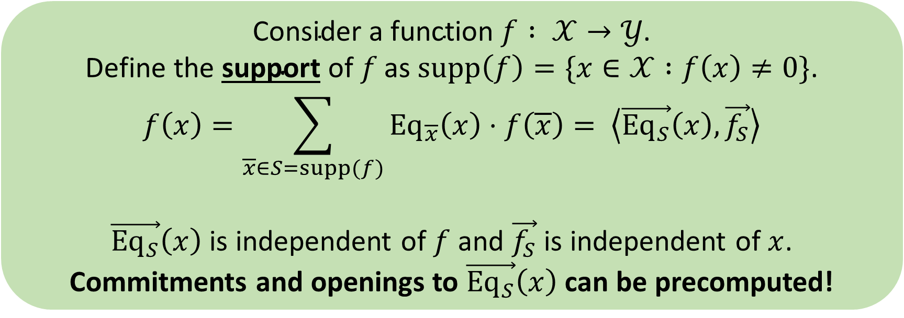
Specialization via Point Functions
$${Eq}_{\overline{x}}\left(x\right)=\left\{\begin{aligned}1 if x=\overline{x} \\ 0 otherwise\end{aligned}\right.$$
$$\text{Consider} \text{a} \text{function} f : 𝒳→𝒴\text{.}$$
$$\text{Define} \text{the} \text{support} \text{of} f \text{as} supp\left(f\right)=\{x∈𝒳 :f\left(x\right)≠0\}\text{.}$$
$$f\left(x\right)=\sum_{\overline{x}∈S=supp(f)}{{Eq}_{\overline{x}}\left(x\right)⋅f\left(\overline{x}\right)}= \left\langle \vec{{Eq}_{S}}\left(x\right), \vec{f_{S}}\right\rangle$$
$\vec{{Eq}_{S}}\left(x\right)$ is independent of $f$ and $\vec{f_{S}}$ is independent of $x$.
Commitments and openings to $\vec{{Eq}_{S}}\left(x\right)$ can be precomputed!
Notes:
Make sure the context is clear. Looking ahead to key-value maps. Emphasize that the commitments to the Eq_S functions can be precomputed without knowing the vector f_S. Openings can be similarly precomputed. This precomputation makes all online commitments and openings linear operations.

Slide 19
Highly Versatile Framework
$$f\left(x\right)=\sum_{\overline{x}∈S=supp(f)}{{Eq}_{\overline{x}}\left(x\right)⋅f\left(\overline{x}\right)}= \left\langle \vec{{Eq}_{S}}\left(x\right), \vec{f_{S}}\right\rangle$$
Vector Commitment: vector in $ℳ^{d}$ becomes $f :\left[d\right]→\left[ℳ\right]$
Accumulator: set $S⊂𝒰$ becomes $f :𝒰→\{0,1\}$
Key-Value Commitment: Mapping from keys $𝒦$to values $𝒱$ becomes $f :𝒦→𝒱$
Polynomial Commitment: Replace ${Eq}_{\overline{x}}$ with ${Pow}_{i}\left(x\right)= x^{i}$
Notes:
All of these specializations inherit the stateless composability.

Slide 20
Thank you!
$$\left(C −Enc(x)\right)⋅S_{f,x}= C_{f} −Enc(f\left(x\right))$$
https://eprint.iacr.org/2022/1368.pdf

Slide 21
Specialization: Vector Commitments

Slide 22
Specialization: Vector Commitments
Vector $m∈ℳ^{d}$
Function class $\{f :\left[d\right]→\left[ℳ\right]\}$
$$f_{m}\left(i\right)= m_{i}$$
Write $f$as a linear function of its support.
$$f_{m}\left(x\right)=\sum_{\overline{x}∈[d]}{{Eq}_{\overline{x}}\left(x\right)⋅f_{m}\left(\overline{x}\right)}= \left\langle \vec{{Eq}_{[d]}}\left(x\right), m\right\rangle$$

Slide 23
Specialization: Vector Commitments
$$f_{m}\left(x\right)=\sum_{\overline{x}∈[d]}{{Eq}_{\overline{x}}\left(x\right)⋅f_{m}\left(\overline{x}\right)}= \left\langle \vec{{Eq}_{[d]}}\left(x\right), m\right\rangle$$
Precompute commitments $C_{{Eq}_{i}}$ to ${Eq}_{i}$ for all $i∈[d]$
Precompute openings $S_{{Eq}_{i}, j}$ to ${Eq}_{i}\left(j\right)$ for all $i,j∈[d]$
Fixed precomputation for all vectors!
Commitment to $m∈ℳ^{d}$ is $C_{f_{m}}= \sum_{i∈[d] }{m_{i}⋅ C_{{Eq}_{i}}}$
Opening to an index $j$ is $S_{f_{m},j }= \sum_{i∈[d] }{m_{i}⋅S_{{Eq}_{i}, j}}$

Slide 24
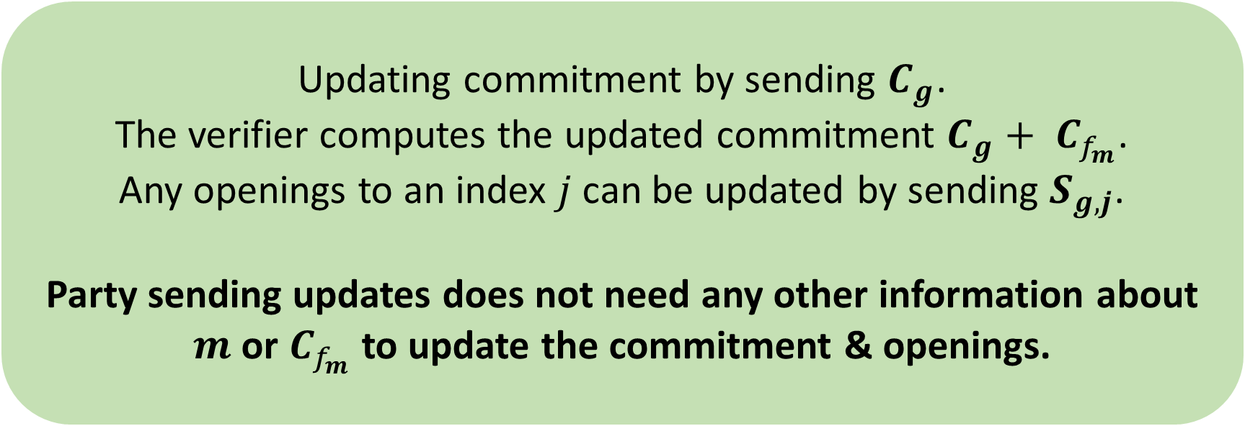
Specialization: Vector Commitments Stateless Updateability
Goal: Change $m_{i}$ to $m_{i}^{′}$
Equivalent to shifting $f_{m}$ by ${g\left(x\right)= \left(m_{i}^{′}\text{ − }m_{i}\right)Eq}_{i}(x)$
Updating commitment by sending $C_{g}$.
The verifier computes the updated commitment $C_{g}+ C_{f_{m}}$.
Any openings to an index $j$ can be updated by sending $S_{g, j}$.
Party sending updates does not need any other information about $m$ or $C_{f_{m}}$ to update the commitment & openings.

Slide 25
General Specialization Framework
Key-Value Commitment

Slide 26
Specialization: Key-Value Commitment
Function class $\{f :𝒦→𝒱\}$
Defines a map of keys to values $f_{S}$ where $S⊂𝒦$.
$$f_{S}\left(x\right)=\sum_{\overline{x}∈S}{{Eq}_{\overline{x}}\left(x\right)⋅f_{S}\left(\overline{x}\right)}= \left\langle \vec{{Eq}_{S}}\left(x\right),\vec{f_{S}}\right\rangle$$
Add a new $(k,v)∈𝒦×𝒱$ by adding a commitment to $v⋅{Eq}_{k}$.
Removal of $(k,v)$is just subtracting the commitment to ${v⋅Eq}_{k}$.
Update $(k,v)$ to $(k,v′)$ adding the commitment to ${(v^{′}−v)⋅Eq}_{k}$.
Notes:
General framework that encompasses many applications.

