Slide 1
On Differential Privacy and
Adaptive Data Analysis with
Bounded Space
Itai Dinur
+Uri Stemmer +David Woodruff +Samson Zhou
EUROCRYPT 2023

Slide 2
Outline
Results:
First space lower bound for differentially private (DP) algorithms
First space lower bound for the “adaptive data analysis” (ADA) problem
Technique:
Define and construct a multi-instance leakage-resilient (MILR) encryption scheme
Enables lifting sampling lower bounds for DP and ADA to space lower bounds

Slide 3
Outline
Results:
First space lower bound for differentially private (DP) algorithms
First space lower bound for the “adaptive data analysis” (ADA) problem
Technique:
Define and construct a multi-instance leakage-resilient (MILR) encryption scheme
Enables lifting sampling lower bounds for DP and ADA to space lower bounds

Slide 4
Multi-instance leakage-resilient (MILR) encryption scheme
Symmetric encryption scheme with multiple keys withstanding key leakage in particular way
n instances of underlying symmetric encryption scheme, each with independent λ-bit key
“Offline” phase
Adversary gets preliminary access to keys and stores summary z of s < n·λ bits
“Online” phase
Each instance independently sets public parameter
Adversary obtains encryptions of plaintexts under n keys
(Optimal) Security requirement
Given z, public params, all but ≈ s/λ plaintexts remain computationally hidden
pr₁
pr₂
pr_{n}
k₁
k₂
k_{n}
z
…
c₁
c₂
c_{n}

Slide 5
Multi-instance leakage-resilient (MILR) encryption scheme
Our construction
Public parameter = seed for extractor used to hash λ-bit key to smaller encryption key
Information theoretic security proof
Pre-sampling technique (borrowed from time-space tradeoffs) + leftover hash lemma variant
pr₁
pr₂
pr_{n}
k₁
k₂
k_{n}
z
…
k'₁
k’₂
k’_{n}
c₁
c₂
c_{n}

Slide 6
Outline
Results:
First space lower bound for differentially private (DP) algorithms
First space lower bound for the “adaptive data analysis” (ADA) problem
Technique:
Define and construct a multi-instance leakage-resilient (MILR) encryption scheme
Enables lifting sampling lower bounds for DP and ADA to space lower bounds

Slide 7
Differential privacy
(Dwork, McSherry, Nissim, Smith 2006) | What is differential privacy?
Random algorithm $𝓜$ is $\left(ε,δ\right)$-DP if for every pair of datasets $D,D^{′}$ that differ on single data point and every event $F$ $$\operatorname{Pr}\left[𝓜\left(D\right)∈F\right]≤e^{ε}⋅\operatorname{Pr}\left[𝓜\left(D^{′}\right)∈F \right]+δ$$
$$D$$
$$D′$$
X₁
X₁
X₂
X’₂
X₃
X₃
X₄
X₄
.
.
.
.
.
.
X_{n}
X_{n}

Slide 8
Result 1: Differential privacy requires more space
Consider algorithm $𝓜$that aims to answer query $q$ w.r.t. dataset $D$
“Offline” phase
$𝓜$has space $s$ if before obtaining query, it shrinks $D$ to summary $z$ of at most $s$ bits
“Online” phase
$𝓜$ obtains $q$ and answers it (with no additional access $D$)
Requirements
Utility: $∀$fixed dataset $D$and $∀$fixed query $q$, $𝓜\left(D,q\right)$ is (close to) accurate
Privacy: $∀$ neighboring datasets $D,D^{′}$ and $∀$ query $q,$ $𝓜\left(D,q\right)≈_{\left(ε,δ\right)}𝓜\left(D^{′},q\right)$

Slide 9
Result 1: Differential privacy requires more space
Theorem: Let $d$ be a parameter controlling the size of the problem. There exists a problem $P$ such that:
$P$ can be solved non-privately using $polylog\left(d\right)$ bits of space
$P$ can be solved privately using sample and space complexity $\tilde{O}\left(√d\right)$
Assuming OWFs, every efficient private algorithm for $P$ must have space complexity $\tilde{Ω}\left(√d\right)$
Even if its sample complexity is a large polynomial in $d$
Remarks:
By 2: trivial algorithm stores $√d$ samples in summary z
By 3: there is no better algorithm even if more samples are available
Notes:
Note: algorithm has enough samples to solve the problem

Slide 10
Result 1: Differential privacy requires more space
Lower bound idea (Property 3 of Theorem)
Use MILR scheme to lift known sampling lower bounds for DP to space lower bounds
Sketch:
Let $G$ be a “sampling hard” problem: every DP algorithm for $G$ requires dataset of size ≥$n$
Construct “space hard” problem $P$:
Dataset $D$ contains $t$ keys of MILR scheme
Query $q$ encrypted instance of $G$ (each entry encrypted with different key)
By the properties of our MILR scheme: for $𝓜$ with s space, all but ≈ s samples remain hidden 𝓜 solving $P$ with space $s<n,$solves $G$ with $<n$ samples (contradiction)

Slide 11
Result 1: Differential privacy requires more space
Specific “sampling hard” problem G
1-way marginals with parameter d
Input: $D$ = ({0,1}^{d})*
Output: $\vec{a}∈{[0,1]}^{d}$ approximating average input vectors (within small $L_{∞}$)
Properties (theorem):
1. $G$ can be solved non-privately using $polylog\left(d\right)$ samples (by sampling vectors) ->
$P$ can be solved non-privately using $polylog\left(d\right)$ bits of space (storing $polylog\left(d\right)$ keys in z)
2. $G \text{can} \text{be} \text{solved} \text{privately} \text{using}\tilde{ O}\left(√d\right) \text{samples} \text{−}\text{>}$
$$P \text{can} \text{be} \text{solved} \text{privately} \text{using}\tilde{ O}\left(√d\right) \text{bits} \text{of} \text{space}\text{ (}\text{by} \text{storing}\tilde{ O}\left(√d\right) \text{keys} \text{in} \text{z}\text{)}$$
3. $G$ “sampling hard” problem for DP ->
$P$ “space hard” problem for DP

Slide 12
Outline
Results:
First space lower bound for differentially private (DP) algorithms
First space lower bound for the “adaptive data analysis” (ADA) problem
Technique:
Define and construct a multi-instance leakage-resilient (MILR) encryption scheme
Enables lifting sampling lower bounds for DP and ADA to space lower bounds

Slide 13
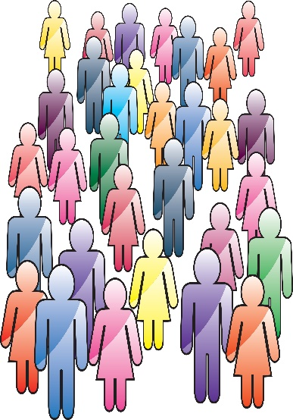
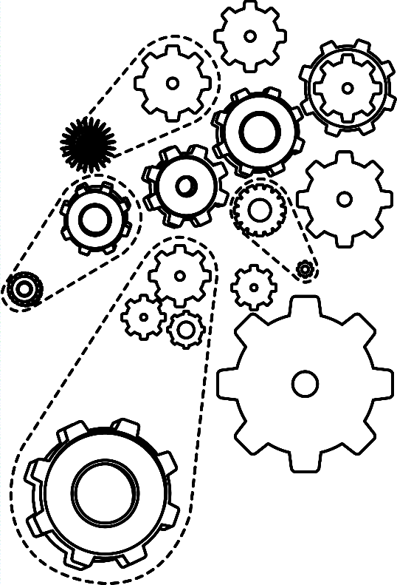
What is the ADA problem? [Dwork, Feldman, Hardt, Pitassi, Reingold, Roth 2015]
Adaptive data analysis
Data analyst
Unknown dist. $𝕯$
over domain $X$
Algorithm $𝓜$
$$h_{1}:X→\left[0,1\right]$$
$$a_{1}∈\left[0,1\right]$$
Sample $S∼𝕯^{t}$
Containing $t$ iid samples from $𝕯$
$$h_{2}:X→\left[0,1\right]$$
$$a_{2}∈\left[0,1\right]$$
$$⋮$$
$$h_{k}:X→\left[0,1\right]$$
$$a_{k}∈\left[0,1\right]$$
Goal: w.h.p. $∀j∈\left\{1,…,k\right\}: a_{j}≈𝔼_{x∼𝕯}\left[h_{j}\left(x\right)\right]$ (accuracy w.r.t 𝕯)
Question: what is the number of samples $t$ that $𝓜$ needs to ensure accuracy?

Slide 14
Adaptive data analysis
Known bounds (informal):
Upper bound: [Dwork, Feldman, Hardt, Pitassi, Reingold, Roth 2015] [Bassily, Nissim, Smith, Steinke, Stemmer, Ullman 2016]
$∃$ efficient algorithm that answers $k$ adaptive queries using $t=O\left(\sqrt{k}\right)$ samples
Lower bound: [Hardt and Ullman 2014] [Steinke Ullman 2014]
$∀$ efficient algorithm that answers $k$ adaptive queries must use $t=Ω\left(\sqrt{k}\right)$ samples
(assuming OWF)

Slide 15
Is there a more fundamental bottleneck than sampling for ADA?
Result 2: Adaptive data analysis is about space
The ADA problem with bounded space:
“Offline” phase
Algorithm $𝓜$ initially gets full description of underlying distribution $𝕯$
$𝓜$ shrinks description to summary $z$of length equivalent to $t$samples from $𝕯$
Define space complexity of $𝓜$ to be the size of $z$ in bits
“Online” phase requirement
$𝓜$ needs to accurately answer $k$ adaptive queries using $z ($without additional access to $𝕯)$
Does summary 𝒛 give $𝓜$ more power over mechanisms that only obtain $t$ samples from $𝕯$?

Slide 16
Does summary 𝒛 give $𝓜$ more power over mechanisms that only obtain $t$ samples from $𝕯$?
Result 2: Adaptive data analysis is about space
Theorem (informal)
Every efficient algorithm that answers $k$ adaptive queries must have space complexity at least $Ω\left(\sqrt{k}\right)$ (assuming OWF)
Namely, can’t do better than store $t$samples from $𝕯$, even when description is fully available
Proof uses the MILR encryption scheme (details in paper)
Notes:
Note: It's not that the mechanism did not get enough information about the underlying distribution. Rather, it cannot shrink this information in a way that allows for efficiently answering $k$ adaptive queries

Slide 17
Summary / Open problems
Results:
First space lowers bounds for DP algorithms\“adaptive data analysis” problem
Technique:
Define and construct a multi-instance leakage-resilient (MILR) encryption scheme
Enables lifting sampling lower bounds for DP and ADA to space lower bounds
Open problems:
Space lower bound for privately solving a problem with short output?
Space lower bounds for DP\ADA without computational assumptions?

Slide 18
Thanks for your attention!

