Slide 1
A Lower Bound on the Length of Signatures Based on Group Actions and Generic Isogenies
Dan Boneh¹, Jiaxin Guan², and Mark Zhandry^{2,3}
1 Stanford University
2 Princeton University
3 NTT Research, Inc.

Slide 2
A Lower Bound on the Length of Signatures
Based on
Group Actions and Generic Isogenies

Slide 3
Hardness Assumptions

Slide 4
Post-Quantum Cryptography
Most constructions are from (structured) Lattices
Group-Action-Based
Cryptography

Slide 5
Cryptographic Group Actions [Cou06, ADMP21]
Identity e: e * x = x for all x
G
X
Compatibility: (gh) * x = g * (h * x)
for all g, h, x
Group G
Set X
Discrete log: Given x, y = g * x, find g
*: G × X → X
Sub-Exponential [Kup05, Reg04, Kup13, Pei20]
Notes:
Couviegnes; Alamati, De Feo, Montgomery, Patranabis

Slide 6
Isogeny-Based Cryptography
An isogeny is a surjective group morphism between two elliptic curves
Group Actions derived from isogeny graphs of elliptic curves [Cou06, RS06]
Constructions from supersingular isogeny graphs [JF11, FJP14] to avoid the sub-exponential quantum algorithms for DLog
Recent attacks on key exchange protocols based on SIDH [CD22, MM22, Rob22]
SIDH is not a group action
Does not affect other isogeny-based protocols such as SeaSign [DG19, DPV19], CSI-FiSh[BKV19, EKP20, CS20] and SQISign [DKL⁺20, DLW22]
Notes:
Rostovtsev and Stolbunov

Slide 7
A Lower Bound on the Length of Signatures
Based on Group Actions and Generic Isogenies

Slide 8
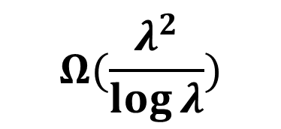
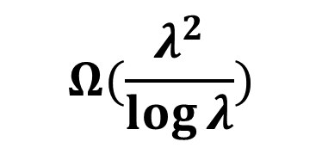
Our Result
Maurer’s Generic Group Model [Mau05]
Group-Action-Based ID Protocol
$$Ω(\frac{λ^{2}}{\log{λ}})$$
ID Protocols
Signature Impossible [DHH⁺21]
Shoup’s Generic Group Model [Sho97]
Group-Action-Based Signature
$$Ω(\frac{λ^{2}}{\log{λ}})$$
Implies Random Oracles [ZZ21]

Slide 9
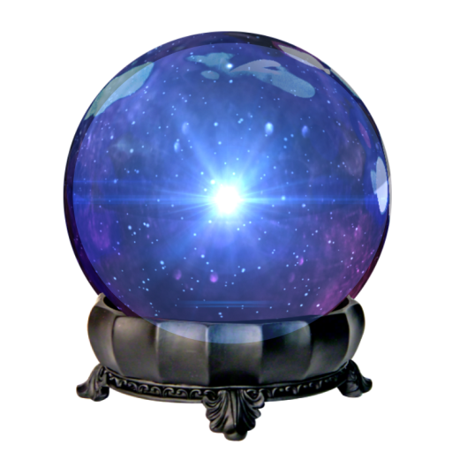
ID Protocol (w/ group action oracle)
1/0
P(pk, sk)
V(pk)
1
t
V(pk)

Slide 10
Our Main Theorem
If a public coin ID protocol in the black box group action model has completeness C, P set elements in the public key, and N set elements in the transcript, then for an adversary with access to a polynomial t number of transcripts, the soundness error S is bounded by:
$$S≥\left(C−\frac{P}{t}−\frac{1}{poly}\right)×P^{−N}$$
S ≥ C - P/t
S ≥ P^{-N}
$$P+N≥Ω(\frac{λ}{\log{λ}})$$
$$P≈t$$

Slide 11
Proof Intuition
$$\left(C−\frac{P}{t}−\frac{1}{poly}\right)×P^{−N}$$
a₁
a₂
a₃
a₄
…
a_{N}
a₁
= h *
x₁
pk
x₁
x₂
x₃
x₄
…
x_{P}
a₁
= h’ *
a₂

Slide 12
Conclusion
Lower Bound of 𝛀(𝝀^{𝟐}/𝐥𝐨𝐠⁡ 𝝀) for group-action based signatures
How to circumvent our lower bound?
Signature schemes not from ID protocols
Non-generic use of group actions
Other hardness assumptions

Slide 13
Thank you!

