Slide 1
Private Polynomial Commitments and Applications to MPC
Rishabh Bhadauria, Carmit Hazay, Muthuramakrishnan Venkitasramaniam, Wenxuan Wu, Yupeng Zhang
May 10th, 2023
Notes:
Hello everyone, my name is Wenxuan and today Ill be presenting our work Private polynomial commitments and pplications to MPC. This is a joint work with Rishabh, Carmit, Muthu and YUPENG

Slide 2
Polynomial commitment
$$f\left(x\right)=∑cixi$$
t
Commit(f)
Evaluation point: t
Y=f(t),$π$
Prover
Verifier
Correctness: If the prover is honest, then the proof they produce will check out
Binding: Different evaluation should result in difference proofs. Also different polynomials will result in difference commitment.
Hinding: No information can be extracted from the commitment
Notes:
Let me first go thought what a polynomial commitment scheme is. Poylnomial commitment allows a prover to commit to a polynomial and later reveal the evaluation of the polynomial on an arbitrary point along with proof of validity
加一些formal defniation，比如correctness， soundness。明确定义什么是polynomial commitment.
We want succinctness, 比如pi要比polynomial 小。

Slide 3
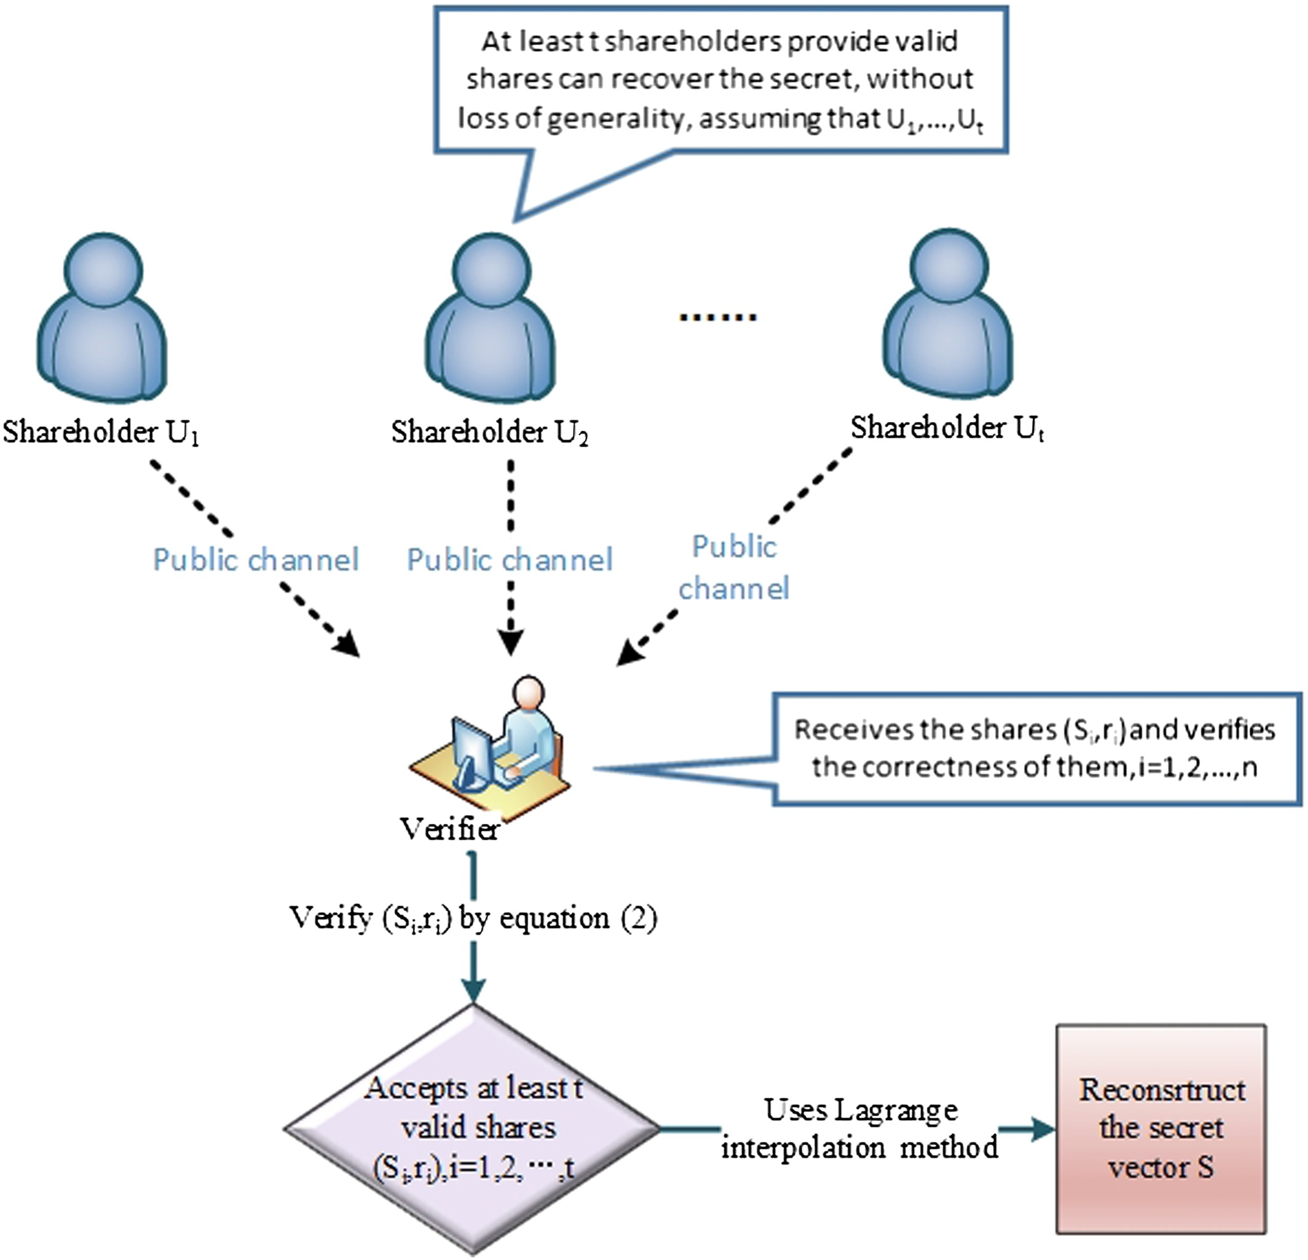
Why Polynomial commitment?
Verifiable Data Storage Verifiable secret sharing zero knowledge arguments
Notes:
Why are we interested in PC? Because it has been a useful building block to construct cryptographic protocol such as Verfifiable data storage, verfifable secret sharing and zero knowledge proof.

Slide 4
Our work: Private Polynomial commitment
$Enc$($f\left(x\right)$)
Commit(Enc(f))
Evaluation point: t
f(t),$π$
Prover
Verifier
Polynomial is unknown to prover!
Evaluation point only known to Prover, not verifier.
Notes:
In our work. we consider a different setting where the polynomial is unknown to the prover and is encrypted. Moreover, the evaluation points are committed by the prover and may not be publicly known to the verifier. This setting is very common in MPC where both the polynomial and the evaluation points must remain private as they are defined based on the parties’ inputs.

Slide 5
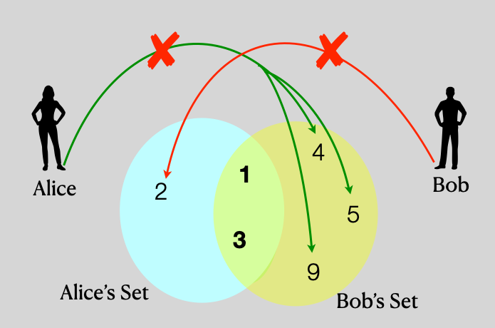
Application
P₂
P₃
.
. Q(x)
.
P_{n}
DOPE
t P₁
Q(t)
Distributed Oblivious Polynomial Evaluation
MPSI with malicious security
Notes:
Private polynomial commitment can be a building block to many applications. One is the something called the distributed oblivious polynomial evaluation. Basically, what it does is that we have paty P1 trying to find the evaluation of Q(t), where the polynomial Q is an aggregated polynomial from the other n-1 parties. By using our PPCOM scheme, Q() is encrypted and P1 can also prove to the verfier that aggregated polynomial Q(t) is correctly constructed. Then every other Ps and run a distributed decryption to find Q(t).
The second application is MPSI. In this problem, we want to find the intersection of multiple parties input set without revealing anything that is not in the common set.
In fact, we can use the approach from our first application to build our MPSI protocol. I will talk more about this construction toward the end of my presentation.

Slide 6
Contribution
Definition:
New notion private polynomial commitment scheme (PPCOM)
Construction:
Single and batch version of PPCOM
A new MPSI protocol based on PPCOM
Benchmark:
Evaluation result of both our PPCOM and MPSI
Notes:
For our contribution, We first give our new definition on the notion of private polynomial commitment scheme
We implemented a few variant of our protocol. Including single point evaluation and multi-point evaluation. We also implemented a MPSI protocol that is based on our PPCOM
We benchmarked our experiment result.

Slide 7
Private Polynomial Commitment Scheme
a = {a₀,a₁,a₂,…,a_{n}}
b = {b₀,b₁,b₂,…,b_{n}}
Eval point: t
Eval vec: T = {1,t,t²,t³,…,t^{n}}
Pks
ck1 = {g₀,g₁,g₂,…,g_{n,}} $∈G$
ck2 = {h₀,h₁,h₂,…,h_{n}} $∈G$
ck3 = u
c = <a,b> = $∑$a_{i}b_{i}
IPA[BBB+18]
a,b
proof
com(a) = $\prod_{i=0}^{n}{\text{g}\text{i} \text{a}\text{[}\text{i}\text{]}}$
com(b) = $\prod_{i=0}^{n}{\text{h}\text{i} \text{b}\text{[}\text{i}\text{]}}$
com = com(a)com(b)u^{c}
Notes:
We will use something called an innerproduct argument as a building block for our ppcom scheme. The ipa is work down by bunz, bootle and boneh. What it does is that it allows a prover to prove to the verifier that he know secret vector a and b such that <a,b> = c. For this presentation, I will not go thru the details on how it works. If you are interested, you can refer to their paper. Its called bulletproof.
But one thing to take away is that for this IPA to work, we need homomorphic commitment, because there are step in which where the prover and verifier needs to combine or compute on top of the commitments. In this original version, a and b are plaintext, and the commitment of those as well as their combined commitment are Pedersen’s commitment.
So why we are interested in this? That is because we observe that evaluation of an univariate polynomial is just an inner product between its coeff vector and a evaluation vector.

Slide 8
Private Polynomial Commitment Scheme
Coeff = {c₀,c₁,c₂,…,c_{n}}
[BBS04] encryption scheme:
Pk: $p,g,h,u,v∈G1$
Sk: $x,y,z∈Zp$
st. $ux=h, vy=h,hz=g$
Choose rand $r,s←Zp$
Enc(m) = (u^{r},v^{s}, g^{m}h^{r+s}) = (a,b,c)
Dec(a,b,c) = (c/a^{x}b^{y}) = g^{m}
plus an exhaustive search to find m.
Notes:
But, in our setting, the coeff vector is hidden from the prover, aka an encryption. So we need to find a suitable encryption scheme. We will use this encryption from this paper. The encryption in this scheme is a tuple of 3 values. To decrypt it, you divide the 3rd term by the product of the first 2 terms. Then do a exhaustive search to find plaintext m. For it to work, we need small plaintext domain, which is provided in our experiment setting. The reason we use this encryption is that the part with message itself is a Pedersen’s commitment and homomorphic. Which is suitable in our IPA.

Slide 9
Private Polynomial Commitment Scheme
Coeff = {c₀,c₁,c₂,…,c_{n}}
C = Enc(Coeff)= {g^{c0}h^{r}, g^{c1}h^{r}, g^{c2}h^{r}, … ,g^{cn}h^{r}}
T = {1,t,t²,t³,…,t^{n}}
Pks
ck1 = {w₀,w₁,w₂,…,w_{n,} w_{r}} $∈G2$
ck2 = {v₀,v₁,v₂,…,v_{n},v_{r}} $∈G1$
g,h,r,a,b
cy = <C,T> = $∏C$_{i}^{Ti}
IPA[BMM+21]
Enc(C(x)),T
proof
com(C) = $e(wr,r)\prod_{i=0}^{n}{e(C\left[i\right],wi)}$
com(T) = h^{r} $\prod_{i=0}^{n}{\text{v}\text{i}\text{T}\text{[}\text{i}\text{]}}$
com = com(C) * e(com(T),a) * e(cy,b)
Notes:
Back to our IPA. Here coeff vectors are encrypted, and evaluation vector is public. The innerproduct of them is just the product of Ci raised to Ti.
Then prover needs to commit these two vectors. For T, its just pedersens commitment. For C, we used pairing based commitment, which is a product of pairing between Ci and wi. As well as a randomness on the outside. We can also combine these commitments in such fashion.
Also inside the IPA, there are operations like inner products, multiplications. They are transformed into these fashion. In fact, this is already done by the same author as an extension of the previous work.

Slide 10
Private Polynomial Commitment Scheme
Eval vec: T = {1,t,t²,t³,…,t^{n}}
Is T well-formed?
y = C(t)
Linear Test
Quadratic Test
+
Notes:
So are we done? The answer is no. Because the prover is trying o convince the verifier its polynomial evaluation at a point t, not innerproduct of two vectors. So he needs to also convince the verifier that T is well formed. For this, we provide two tests for it. Linear and Quadratic.
– the linearity test and quadratic test.

Slide 11
Is T well formed?
$$\left[\begin{matrix}1 & 0 & 0 & … \\ 0 & 1 & 0 & ⋯ \\ 0 & 0 & 1 & … \\ ⋮ & ⋮ & ⋮ & ⋱\end{matrix}\right]$$
$$\left[\begin{matrix}1 & 0 & 0 & … \\ 1 & 0 & 0 & ⋯ \\ 1 & 0 & 0 & … \\ ⋮ & ⋮ & ⋮ & ⋱\end{matrix}\right]$$
$$\left[\begin{matrix}0 & 1 & 0 & … \\ 0 & 0 & 1 & ⋯ \\ 0 & 0 & 0 & … \\ ⋮ & ⋮ & ⋮ & ⋱\end{matrix}\right]$$
A = B = C =
Notes:
For Linear Test, Prover will define 3 selector matrices A, B and C as such.
A is an identity matrix
B is an matrix where the first col is 1s but rest are 0
C is A shifted to the right. ST that

Slide 12
Linear Test for batch evaluation
$$\left[\begin{matrix}1 & 0 & 0 & … \\ 0 & 1 & 0 & ⋯ \\ 0 & 0 & 1 & … \\ ⋮ & ⋮ & ⋮ & ⋱\end{matrix}\right]$$
T = $\left[\begin{matrix}t00 & t11 & t20 & … \\ t01 & t12 & t21 & ⋯ \\ t02 & t13 & t23 & … \\ ⋮ & ⋮ & ⋮ & ⋱\end{matrix}\right]$
T =$\left[\begin{matrix}t0 \\ t1 \\ t2 \\ ⋮\end{matrix}\right]$
A =
S=$\left[\begin{matrix}s1 & s2 & …\end{matrix}\right]$
S*A*T*U = S*X*U
U=$\left[\begin{matrix}u1 & u2 & …\end{matrix}\right]$
<S_{A}T_{U}> - <S,X_{U}> = 0
Pick x
x
A = S_{A}+x⁻¹*S
B = T_{U} – x*X_{U}
Some cross terms
Compute:
<A,B> com(<A,B>)
Notes:
Since we implemented the batch evaluation version of our protocol, we might as well show you the full version of this part. In this case, T is no longer just a vector, but a 2-d evaluation matrix.

Slide 13
Quadratic Test
Try to prove that X$∘$Y = Z
We couldn’t reduce this to a single inner product, but instead a sum of multiple inner product
For detail, please refer to our paper.
Notes:
For the time being, I don’t have enough time to go through this step by detail. So here are some take aways.
We are trying to prove X* Y = Z.
We reduced this constraint into a sum of multiple ipa
For details, you can refer to our paper.

Slide 14
Complexity
Communication:
O(log d) for single point
O(m+ log d) for m points
Computation :
O(md) + O(d) for prover
O(m+d) for verifier
Space:
O(m+d) for prover
O(m) for verifier
Notes:
Here is our complexity of PPCOM.
D means the degree of the polynomial and m is the number of evaluation point.

Slide 15
2PSI step 1
M₀= {m₀₀,m₀₁,…,m_{0n}}
M₁= {m₁₀,m₁₁,…,m_{1n}}

Slide 16
2PSI step 2
Enc(P1)
P₁= interpolate(M₁)

Slide 17
2PSI step 3
PPCOM
M₀, Enc(P(M₀))
proof
Dec(Enc(P(M₀))) = zero?
Set intersection

Slide 18
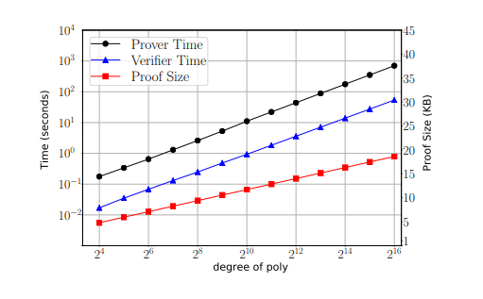
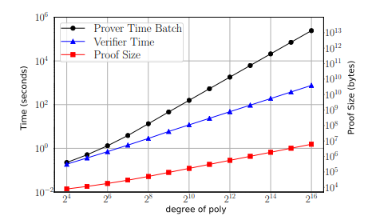
Experimentation result

Slide 19
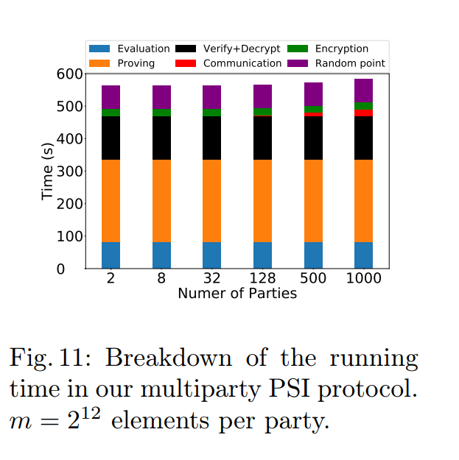
Experimentation result

Slide 20
Summary
PPCOM:
Polynomials can be hidden to both parties
Evaluation point can be hidden to verifier
Efficient Batch Evaluation
MPSI
Scalable to many parties
Email: ww6726@tamu.edu

