Slide 1
On Homomorphic Secret Sharing from Polynomial-Modulus LWE
Thomas Attema, Pedro Capitão and Lisa Kohl
9th May 2023

Slide 2
Homomorphic Secret Sharing (HSS)
$$x$$
$$Share$$
Correctness: $Rec\left({Eval}_{P}{(x}_{A}\right),{Eval}_{P}{(x}_{B}))=P\left(x\right)$
Security: $x_{A}$ hides $x$; $x_{B}$ hides $x$
Alice
Bob
$$x_{A}$$
$$x_{B}$$
A strong and useful form of reconstruction is additive reconstruction:
$$Rec\left(y_{A},y_{B}\right)=y_{A}+y_{B}$$
$${Eval}_{P}$$
$${Eval}_{P}$$
$$y_{A}$$
$$y_{B}$$
Example – Linear functions:
$x=x_{A}+x_{B}$
${Eval}_{P}(x_{i}) =P(x_{i})$
$Rec\left(y_{A},y_{B}\right)=y_{A}+y_{B}$
$$Rec$$
$$P(x)$$

Slide 3
Branching programs
Computational model:
Arithmetic circuits with restricted multiplication – intermediate values can only be multiplied by input values
$$+$$
$$×$$
Includes classes LOGSPACE, NC¹
2-Party HSS for branching programs from DDH [Boyle,Gilboa,Ishai’16], LWE [Boyle,Kohl,Scholl’19], Paillier [Orlando,Scholl,Yakoubov’21]

Slide 4
BKS multiplication procedure
[Boyle,Kohl,Scholl’19]
Input values $x$ encoded as $c^{x}=Enc(pk,x∙sk)$;
Intermediate values $y$ encoded as ${[y∙sk]}_{A}$, ${[y∙sk]}_{B}$: $y∙sk={[y∙sk]}_{A}+{[y∙sk]}_{B}$
Local multiplication procedure for $x∙y$:
$$c^{x}$$
$$?$$
$$\left\langle {[y∙sk]}_{i},c^{x}\right\rangle ={\left[\frac{q}{p} (x∙y∙sk)+e\right]}_{i}$$
$${\left[x∙y∙sk\right]}_{i}$$
$${[y∙sk]}_{i}$$
Share conversion

Slide 5
Share conversion (simplified)
Problem: How can we locally go from
$$u_{A}+u_{B}=\frac{q}{p}m+e(mod{q)}$$
to
$z_{A}+z_{B}=m(mod{q)}$?
plaintext modulus
$$p<q$$
ciphertext/LWE modulus

Slide 6
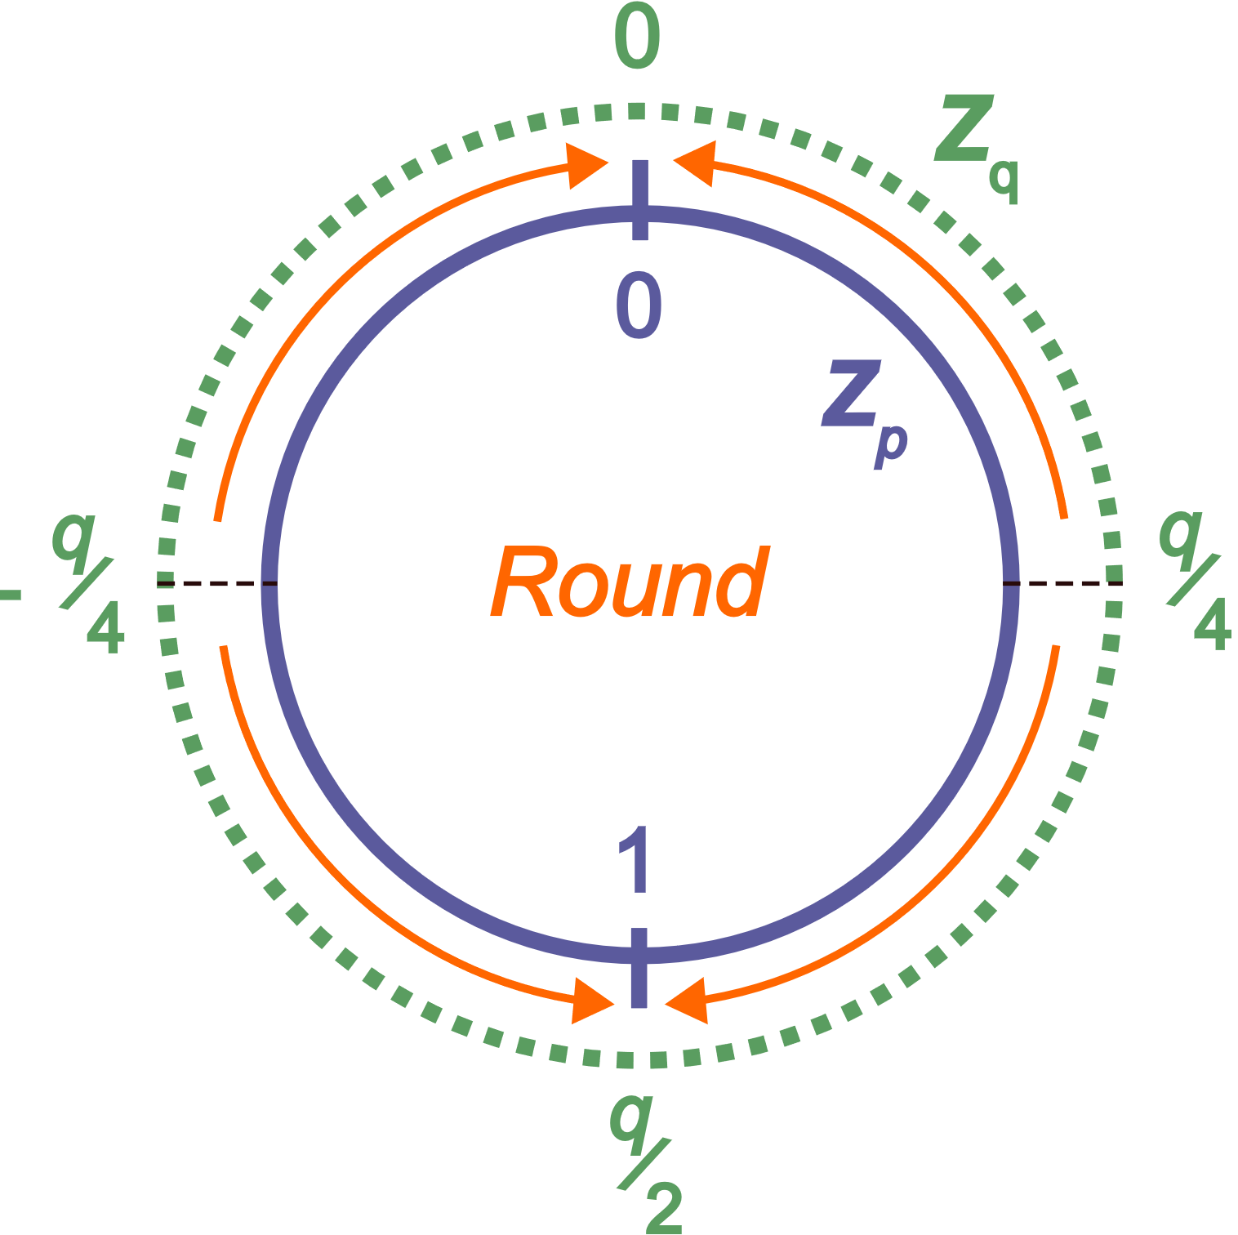
BKS share conversion
$v=$Round($u$) $=\left\lfloor \right.u∙p/q\left. \right\rceil$
$z=$Lift($v$) $=v$
$$u_{A}+u_{B}=\frac{q}{p}m+e(mod{q)}$$
Round
$$v_{A}+v_{B}=m(mod{p)}$$
Lift
$$z_{A}+z_{B}=m(mod{q)}$$

Slide 7
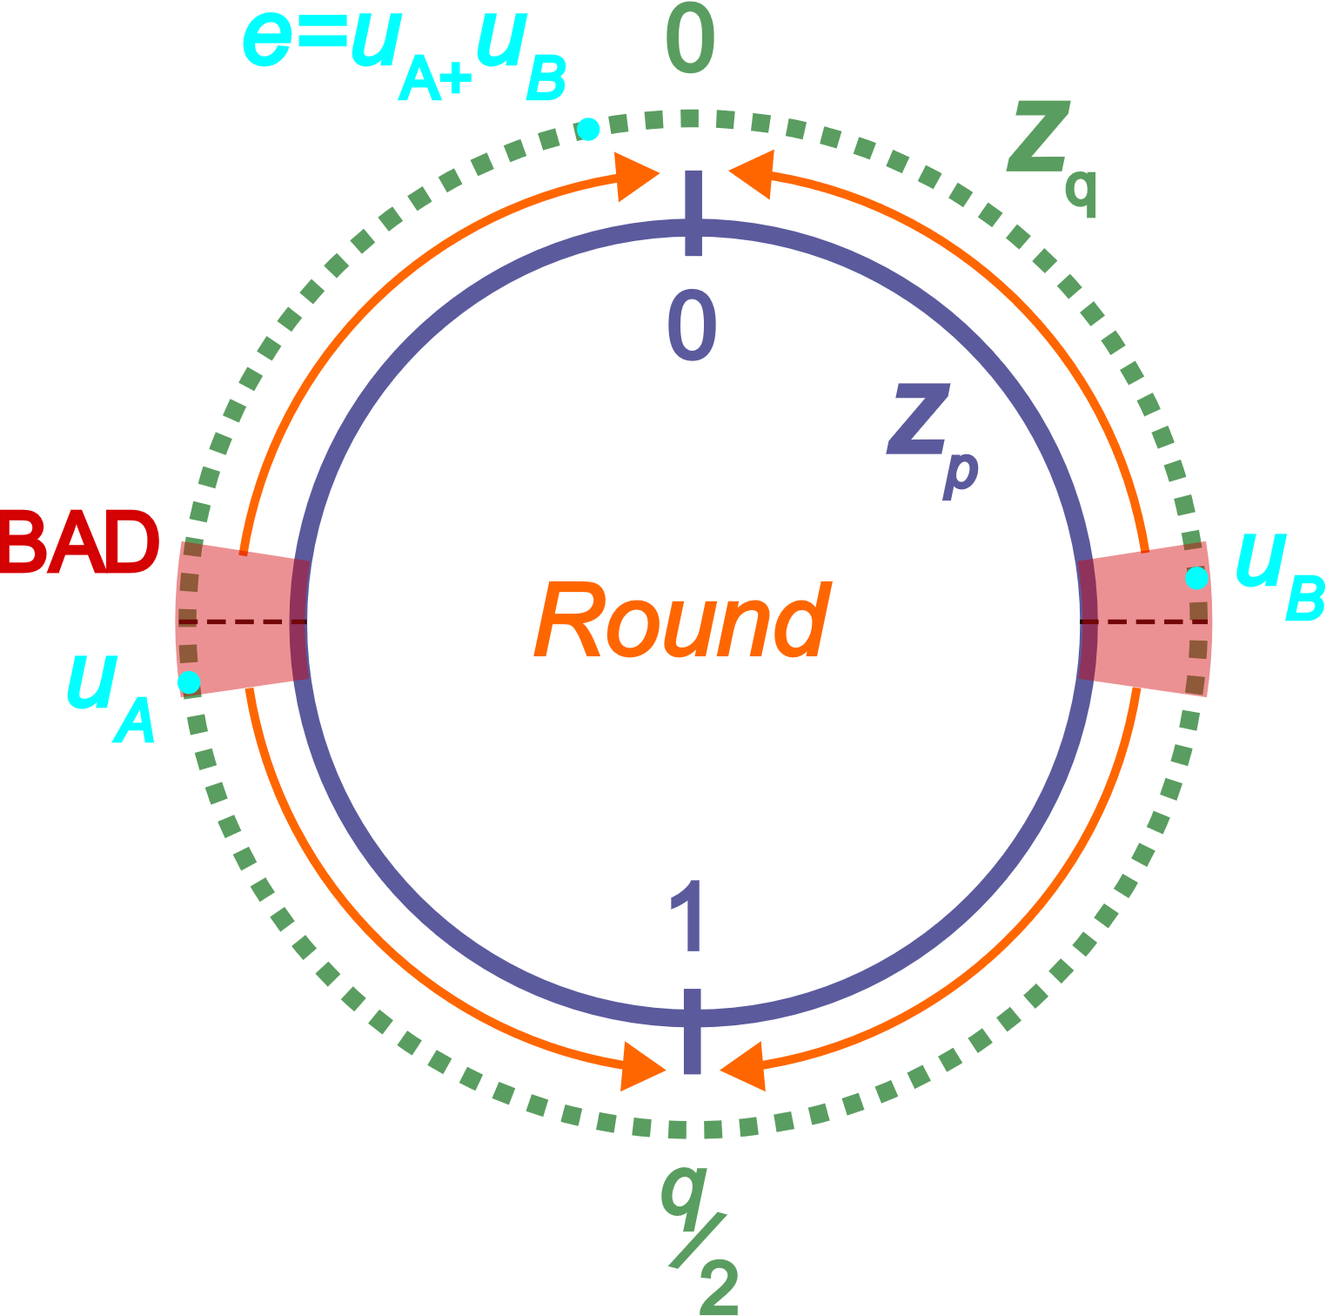
Correctness errors: Round
Suppose $\left|e\right|≤B_{err}, m=0,$
$$u_{A}+u_{B}=\frac{q}{p}m+e(mod{q)}.$$
If $u_{A},u_{B}∈$BAD we can have
$$\text{R}\text{(}u_{A}\text{)}+\text{R}\text{(}u_{B}\text{)}=1+0≠m(mod{p)}$$
$$Pr⁡[u_{A}∈\text{BAD}{]=\frac{\text{|}\text{BAD}\text{|}}{q}=B_{err}\frac{p}{q}.}$$

Slide 8
Correctness errors
Error probability (per multiplication operation) is
$${O\left( \frac{p}{q}+\frac{B_{max}}{p}\right).}$$
from rounding
from lifting
if we want additive reconstruction
Negligible error requires $q≫p≫B_{max}$
superpolynomial gaps

Slide 9
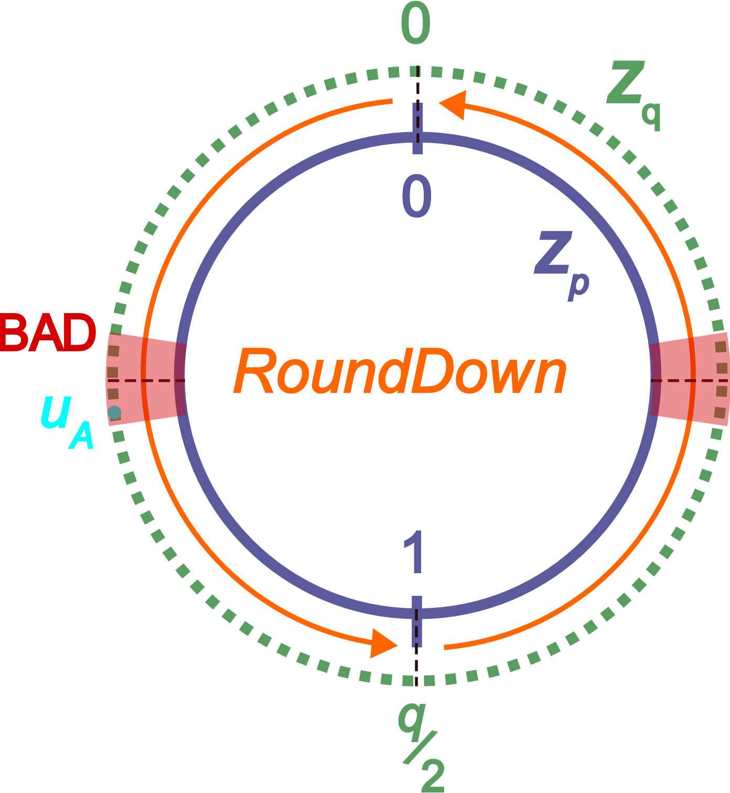
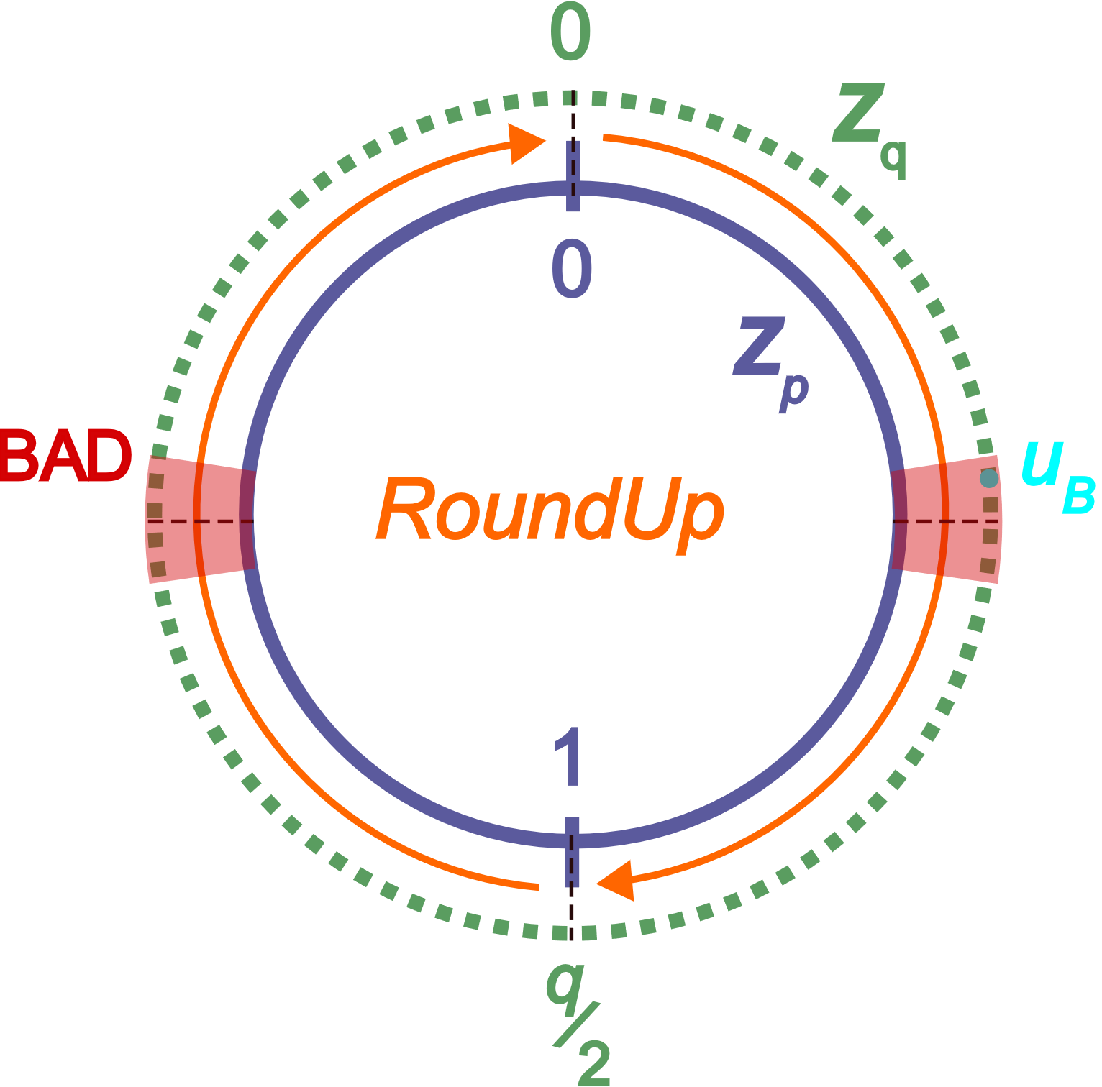
Our work: Alternative Rounding
Alice:
RoundDown($u_{A}$) $=\left\lfloor u_{A}∙p/q\right\rfloor$
Bob:
RoundUp($u_{B}$) $=\left\lceil u_{B}∙p/q\right\rceil$
“I’m in BAD”
“I’m in BAD”
“I was in BAD”
Succeeds even for shares in BAD (but fails for shares close to a multiple of $q/p$)

Slide 10
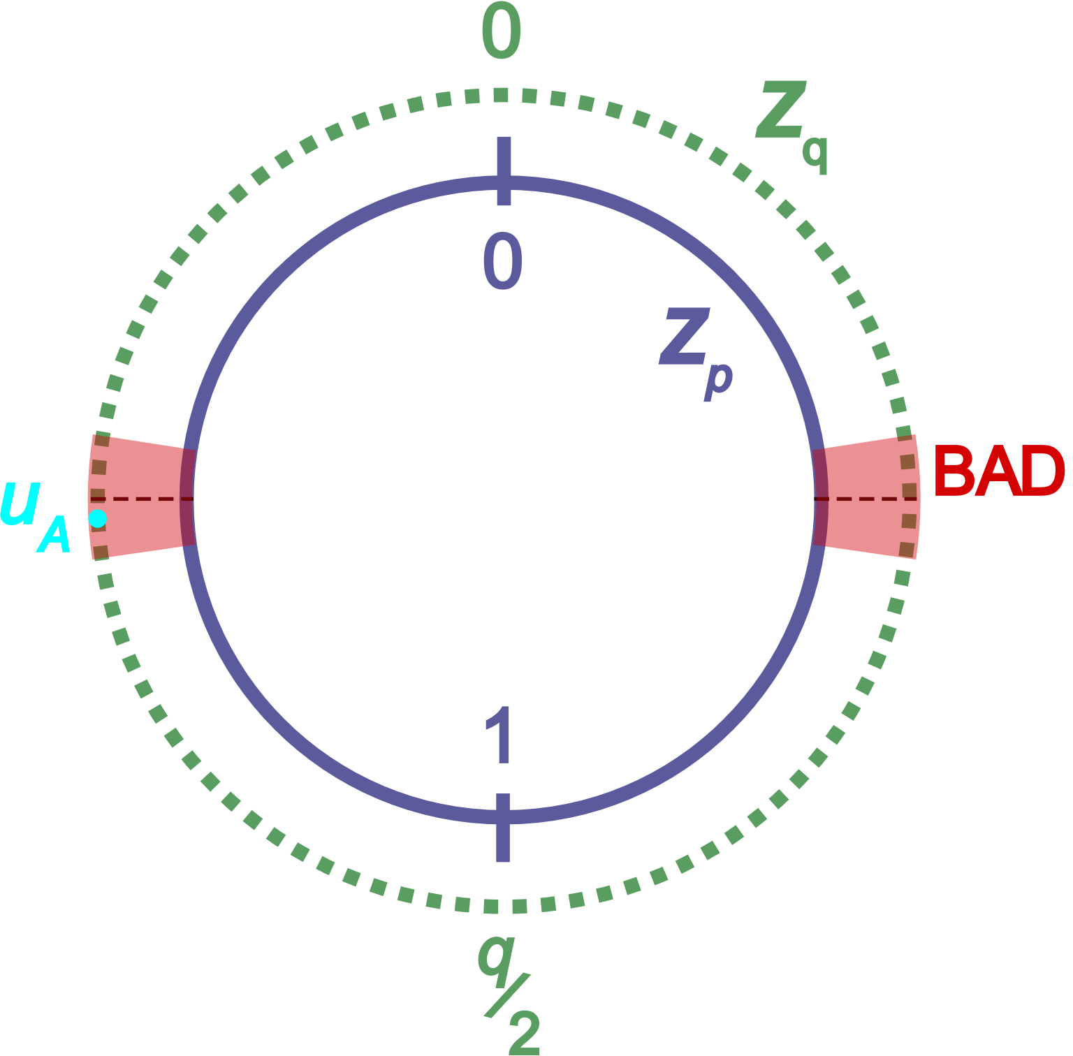
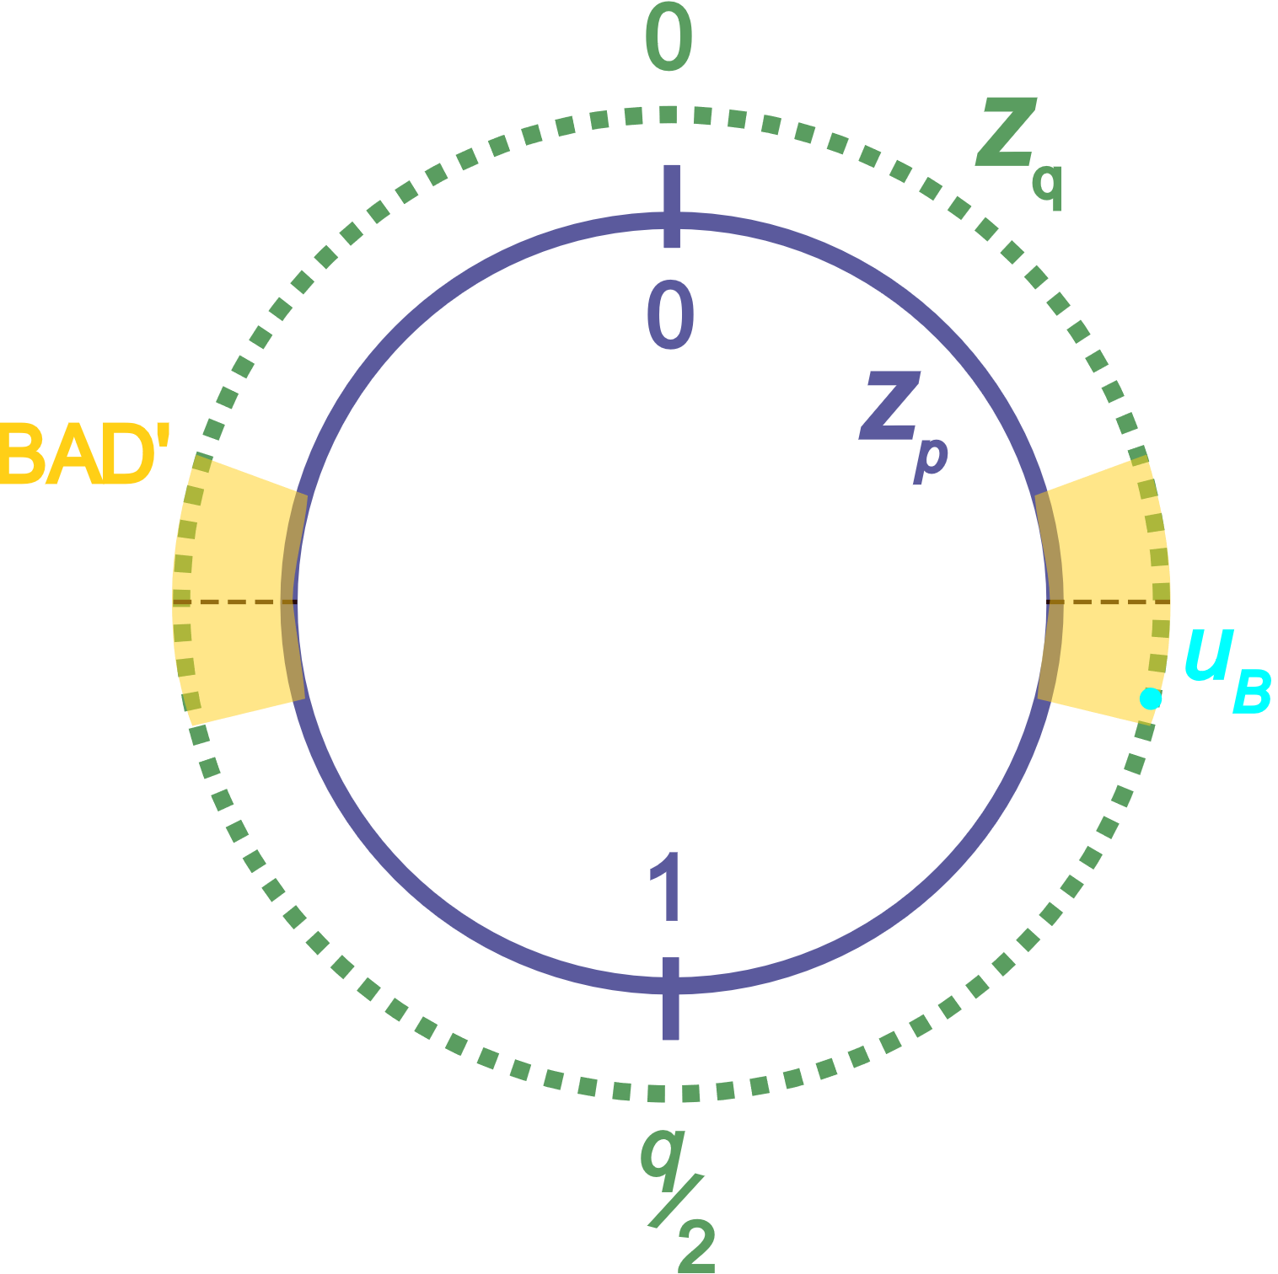
Alternative Rounding
$$\text{|}\text{BAD}\text{′}\text{|}=\text{2}\text{|}\text{BAD}\text{|}={2B}_{err}∙p$$
Alice:
Bob:
Note: $u_{B}∉$BAD’ ${⇒u}_{A}∉$BAD $⇒$both can use Round

Slide 11
Alternative Rounding
$$\text{|}\text{BAD}\text{′}\text{|}=\text{2}\text{|}\text{BAD}\text{|}={2B}_{err}∙p$$
Alice:
Bob:
$u_{A}∈$BAD?
$u_{B}∈$ $\text{BAD}\text{′}$?
No
Yes
No
Yes
Round($u_{A}$)
RoundDown($u_{A}$)
Round($u_{B}$)
RoundUp($u_{B}$)
Round($u_{B}$)
Probability of this case is ${2B}_{err}\frac{p}{q}$
Note: $u_{B}∉$BAD’ ${⇒u}_{A}∉$BAD $⇒$both can use Round
Similar procedure for Lifting!

Slide 12
Reconstruction
Alice
Bob
$$\left(z_{B,1},000000\right)$$
$$\left(z_{B,2},000001\right)$$
$$\left(z_{B,3},001000\right)$$
$$\left(z_{B,4},001010\right)$$
$$(z_{A},001000)$$
$$∈Z_{q}$$
sequence of flags
(0 for “near” rounding, 1 for “up/down” rounding)
Output $z=z_{A}+z_{B,3}$

Slide 13
Summary of Results
2-party HSS for branching programs from LWE with small modulus
New technique for error prevention
Perfect correctness at the cost of variable running time
Relaxed reconstruction, suitable for e.g. 2-server private database queries
Efficiency improvement over [BKS19] (4x shorter shares)

Slide 14
Thank you!

