Slide 1
Security Analysis of RSA-BSSA
Anna Lysyanskaya
Brown University
(This work was supported by Apple Inc.)

Slide 2
Blind Signatures: What?
Key generation algorithm as in a regular digital signature
Verification algorithm as in a regular digital signature
Signing is a protocol between a user and a signer
User’s input is PK and message m, signer’s input is SK User’s output is sig, signer receives no output
Blindness: (high-level) signer learns nothing

Slide 3
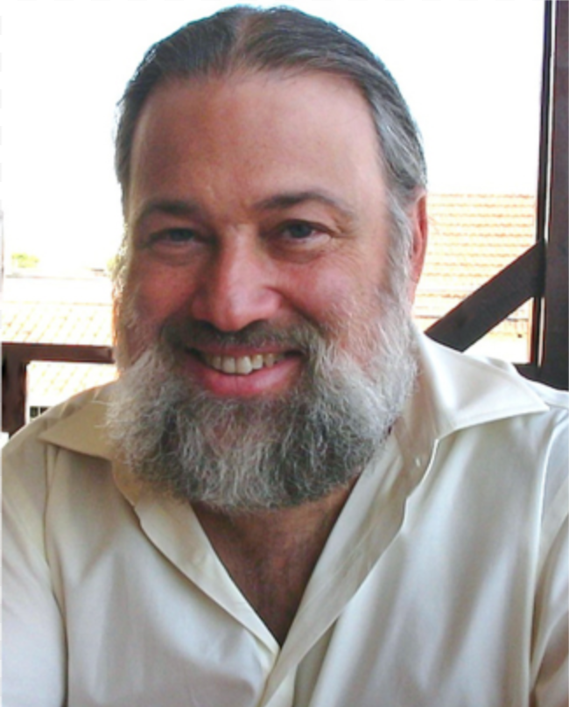
Blind Signatures: Why?
Proposed by David Chaum in 1982 to digitally represent money

Slide 4
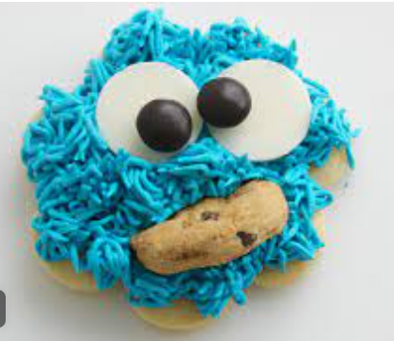
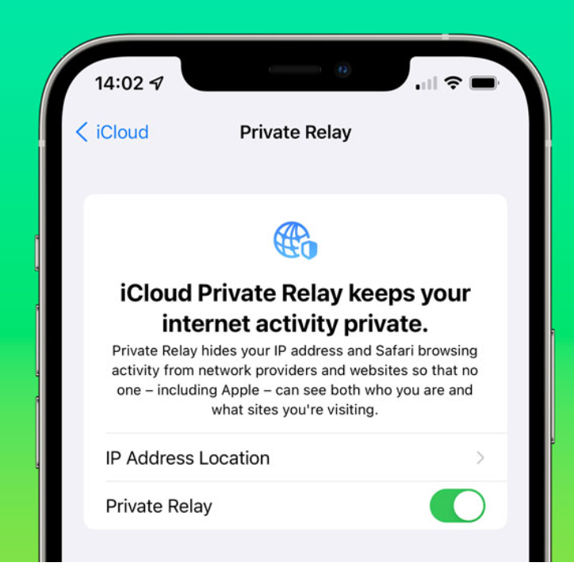
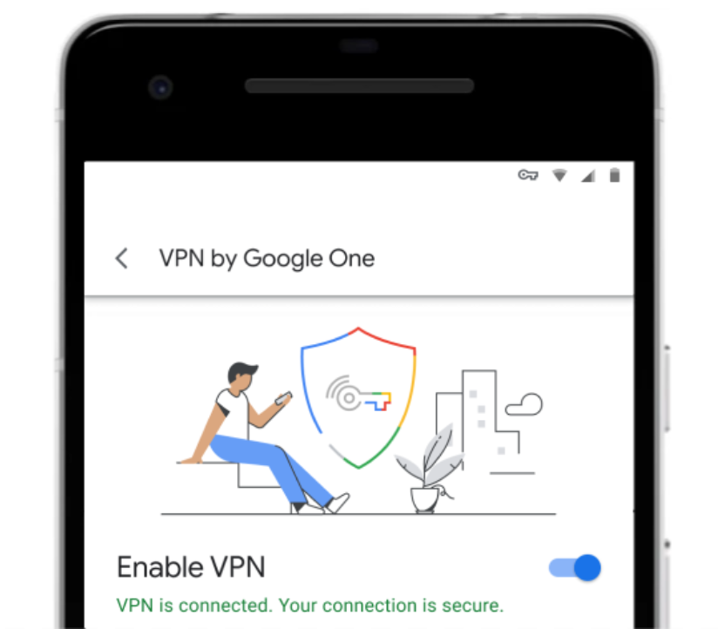
Blind Signatures: Why now?
Suddenly important!
Online advertising platforms want to use them for accounting purposes
This is part of phasing out third-party cookies
Google is using them as tokens in a privacy-preserving VPN service
Apple is using them to let you navigate the Internet anonymously

Slide 5
Our Focus: RSA-BSSA
IETF draft by Denis, Jacobs and Wood
BSSA stands for ``blind signature scheme with appendix”
The first proposal for an IETF-standardized blind signature scheme
Easy to implement and use in practice, leveraging existing libraries for RSA-PSS
PSS stands for ``probabilistic signature scheme” [Bellare,Rogaway]
Widely used because it’s part of IETF’s PKCS#1 standard
Used in Apple’s Private Relay which allows you to browse the Web anonymously
The blind sig is an unforgeable token that convinces the network that you’re a valid customer

Slide 6
Summary of Results
RSA-BSSA is strongly one-more-unforgeable
Under a relatively established assumption (one-more-RSA [BNPS’03])
In the random-oracle model
Not quantum-resistant, so may need to be revisited once quantum computing is real
NOTE: this only affects unforgeability, not blindness
RSA-BSSA IETF first draft (from March 2021) could not be proven to satisfy blindness
- But blindness can be satisfied with relatively minor modifications
Blind-RSA-FDH [Bellare,Namprempre,Pointcheval,Semanko’03] does not satisfy blindness either!
Both Blind-RSA-FDH and RSA-BSSA.1 satisfy a new weaker notion of security – that of a blind token

Slide 7
Blind Signatures: Definition
KeyGen generates the signer’s PK and SK.
Sign is a protocol. Here, focus on two-round blind signatures, so signing protocol consists of three algorithms: Blind, Bsig, Finalize.
Verify(PK, msg, sig) accepts or rejects a signature.
USER(PK,msg) SIGNER(SK)
1. (blinded_msg, inv) = Blind(PK, msg)
2. blinded_sig = Bsig(SK, blinded_msg)
3. sig = Finalize(PK, inv, blinded_sig)
blinded_msg
blinded_sig

Slide 8
Blind Signatures: Definition
KeyGen generates the signer’s PK and SK.
Sign is a protocol. Here, focus on two-round blind signatures, so signing protocol consists of three algorithms: Blind, Bsig, Finalize.
Verify(PK, msg, sig) accepts or rejects a signature.
USER(PK,msg) SIGNER(SK)
1. (blinded_msg, inv) = Blind(PK, msg)
2. blinded_sig = Bsig(SK, blinded_msg)
3. sig = Finalize(PK, inv, blinded_sig)
blinded_msg
blinded_sig

Slide 9
Blind Signatures: Definition
Correctness
Unforgeability
Blindness

Slide 10
Blind Signatures: Unforgeability
Malicious user
Challenger = honest signer
PK
blinded_msg[1]
blinded_sig[1]
blinded_msg[L]
Strong one-more-unforgeability:
Pr[Malicious user wins] = negligible
blinded_sig[L]
Output: (msg1,sig1), …, (msgN,sigN)
WIN if these are distinct and > L of them pass verification

Slide 11
What About Many Round Protocols?
Malicious user
PK
Challenger = honest signer
blinded_msg[1,1]
blinded_sig[1,2]
blinded_msg[1,3]
blinded_sig[1,4]
blinded_msg[L,1]
blinded_sig[L,2]
blinded_msg[L,3]
Sequential strong one-more-unforgeability:
Pr[Malicious user wins] = negligible
blinded_sig[L,4]
Output: (msg1,sig1), …, (msgN,sigN)
WIN if these are distinct and > L of them pass verification

Slide 12
What About Many Round Protocols?
Malicious user
PK
Challenger = honest signer
blinded_msg[1,1]
blinded_msg[2,1]
blinded_sig[1,2]
blinded_sig[L,2]
Concurrent strong one-more-unforgeability:
Pr[Malicious user who schedules protocol messages wins] = negligible
blinded_msg[L,3]
blinded_sig[L,4]
blinded_msg[1,3]
blinded_sig[1,4]
Output: (msg1,sig1), …, (msgN,sigN)
WIN if these are distinct and > L of them pass verification

Slide 13
Observation: if a two-round blind signature is sequentially strong one-more-unforgeable, then it is also concurrently so.
(Fun fact: some popular sequentially unforgeable 3-round blind sigs were recently shown to be vulnerable in the concurrent setting! [BLLOR21])

Slide 14
Blind Signatures: Definition
Correctness
Unforgeability
Blindness

Slide 15
Blind Signatures: Blindness
Challenger – honest user
Malicious signer
PK, msg0, msg1
blinded_msg[b],
blinded_msg[1-b]
b = randomly chosen bit
Blindness:
Pr[Malicious signer wins] = ½ + negligible
blinded_sig[b]
blinded_sig[1-b]
If both sigs verify, sig0, sig1
Output: b’
WIN if b = b’

Slide 16
Blind Signatures: Definition’s History
One-More-Unforgeability
First try: Pointcheval and Stern ‘96
Improvement by Schroeder and Unruh ‘12
Blindness
First try: Juels, Luby, Ostrovsky ‘97
Improvement by Abdalla, Namprempre and Neven ‘06

Slide 17
RSA-BSSA version 1
KeyGen outputs an RSA key pair: PK = (N,e) and SK = d such that ed = 1 mod phi(N)
Hash functions Hash*: {0,1}*->{0,1}^{k},
Hash : {0,1}^{lenM} -> {0,1}^{k},
MGF: {0,1}k->{0,1}^{lenDB}
Sign protocol: TBA
Verify(PK, msg, sig) works the same way as RSA-PSS - Compute EM = sig^{e} mod N - Check that EM PSS-Decodes to the correct message msg

Slide 18
RSA-BSSA version 1 – Sign protocol
USER(PK,msg) SIGNER(SK)
1. (blinded_msg, inv) = Blind(PK, msg)
2. blinded_sig = Bsig(SK, blinded_msg)
3. sig = Finalize(PK, inv, blinded_sig)
blinded_msg
blinded_sig

Slide 19
RSA-BSSA version 1 – Sign protocol
USER(PK,msg) SIGNER(SK)
1. EM <- PSS-Encode(msg) blinded_msg = EM r^{e} mod N, inv = r
2. blinded_sig = blinded_msg^{d} mod N
3. sig = blinded_sig / r
blinded_msg
blinded_sig

Slide 20
Theorem: If the one-more-RSA assumption holds, then RSA-BSSA is strongly one-more-unforgeable in the random-oracle model.

Slide 21
Proof:
Reduction B solving one-more-RSA
N,e
One-more-RSA challenger [BPNS03]
Adversary A breaking RSA-BSSA
N,e
z_{j}=blinded_msg_{j}
blinded_msg_{j}
blinded_sig_{j}=x_{j}
x_{j}=z_{j}^{d} mod N
Hash*(msg_{l})
Random mHash_{l}
Hash(M_{i})
Hit me!
H_{i} from y_{i}
Challenge y_{i}
MGF(H_{i})
Derive from y_{i}
Output signatures {msg_{i},sig_{i}}
Solutions {s_{i}}

Slide 22
Proof:
Reduction B solving one-more-RSA
One-more-RSA challenger [BPNS03]
Adversary A breaking RSA-BSSA
Hash(M_{i})
Hit me!
H_{i} from y_{i}
Challenge y_{i}
MGF(H_{i})
Derive from y_{i}
Output signatures {msg_{i},sig_{i}}
Solutions {s_{i}}

Slide 23
Proof:
WANT: sig_{i}^{e} = y_{i}, so L+1 sigs breaks one-more RSA
Reduction B solving one-more-RSA
One-more-RSA challenger [BPNS03]
Adversary A breaking RSA-BSSA
Hash(M_{i})
Hit me!
H_{i} from y_{i}
Challenge y_{i}
MGF(H_{i})
Derive from y_{i}
Output signatures {msg_{i},sig_{i}}
Solutions {s_{i}}

Slide 24
Proof:
WANT: sig_{i}^{e} = y_{i}, so L+1 sigs breaks one-more RSA
WANT: PSS-Decode(y_{i},msg_{i}) = msg_{i}
Reduction B solving one-more-RSA
One-more-RSA challenger [BPNS03]
Adversary A breaking RSA-BSSA
Hash(M_{i})
Hit me!
H_{i} from y_{i}
Challenge y_{i}
MGF(H_{i})
Derive from y_{i}
Output signatures {sig_{i}}
Solutions {s_{i}}

Slide 25
PSS Encoding [Bellare,Rogaway + IETF]
msg
Hash*
M =
Padding1
mHash = Hash(msg)
salt
Hash
DB=
Padding2
salt
DB means “Data block”
+
MaskGeneratingFunction
H = Hash(M’)
EM =
MaskedDB = DB XOR MGF(H)
H
BC

Slide 26
PSS Decoding
msg
Hash*
M =
Padding1
mHash = Hash(msg)
salt
Hash
DB=
Padding2
salt
Correct if get H
+
MaskGeneratingFunction
H
EM =
MaskedDB = DB XOR MGF(H)
H
BC

Slide 27
Proof:
WANT: sig_{i}^{e} = y_{i}, so N+1 sigs breaks one-more RSA
WANT: PSS-Decode(y_{i},msg_{i}) = msg_{i}
Reduction B solving one-more-RSA
One-more-RSA challenger [BPNS03]
One-more-RSA challenger [BPNS03]
Adversary A breaking RSA-BSSA
Hash(M_{i})
Hash(M_{i})
Hit me!
Hit me!
H_{i} from y_{i}
Challenge y_{i}
Challenge y_{i}
MGF(H_{i})
Derive from y_{i}
Output signatures {sig_{i}}
Solutions {s_{i}}

Slide 28
Proof:
WANT: sig_{i}^{e} = y_{i}, so N+1 sigs breaks one-more RSA
WANT: PSS-Decode(y_{i},msg_{i}) = msg_{i}
Reduction B solving one-more-RSA
One-more-RSA challenger [BPNS03]
One-more-RSA challenger [BPNS03]
Adversary A breaking RSA-BSSA
M_{i} =
Padding1
mHash = Hash(msg)
salt
Hash(M_{i})
Hash(M_{i})
Hit me!
Hit me!
H_{i} from y_{i}
Challenge y_{i}
Challenge y_{i}
MGF(H_{i})
Derive from y_{i}
Output signatures {sig_{i}}
Solutions {s_{i}}

Slide 29
Proof:
WANT: sig_{i}^{e} = y_{i}, so N+1 sigs breaks one-more RSA
WANT: PSS-Decode(y_{i},msg_{i}) = msg_{i}
Reduction B solving one-more-RSA
One-more-RSA challenger [BPNS03]
One-more-RSA challenger [BPNS03]
Adversary A breaking RSA-BSSA
M_{i} =
Padding1
mHash = Hash(msg)
salt
Hash(M_{i})
Hash(M_{i})
Hit me!
Hit me!
H_{i} from y_{i}
Challenge y_{i}
Challenge y_{i}
MGF(H_{i})
Derive from y_{i}
y_{i} =EM_{i}=
MaskedDB = DB XOR MGF(H)
H
BC
Output signatures {sig_{i}}
Solutions {s_{i}}

Slide 30
msg_{i}
Hash*
M_{i} =
Padding1
mHash_{i}
salt_{i}
DB=
Padding2
salt_{i}
+
MaskGeneratingFunction
H_{i}
y_{i} = EM_{i} =
MaskedDB_{i}
H_{i}
BC

Slide 31
Reduction B solving one-more-RSA
One-more-RSA challenger [BPNS03]
One-more-RSA challenger [BPNS03]
Adversary A breaking RSA-BSSA
Program MGF: MGF(H_{i})=MaskedDB_{i} XOR DB_{i}
Hash(M_{i})
Hash(M_{i})
Hit me!
Hit me!
H_{i} from y_{i}
Challenge y_{i}
Challenge y_{i}
MGF(H_{i})
MGF(H_{i})
Derive from y_{i}
Program from y_{i}
Output signatures {sig_{i}}
Solutions {s_{i}}

Slide 32
msg_{i}
Hash*
M_{i} =
Padding1
mHash_{i}
salt_{i}
Hash
DB=
Padding2
salt_{i}
Correct if get H_{i}
+
MaskGeneratingFunction
H_{i}
y_{i} = EM_{i} =
MaskedDB_{i}
H_{i}
BC

Slide 33
Reduction B solving one-more-RSA
One-more-RSA challenger [BPNS03]
One-more-RSA challenger [BPNS03]
Adversary A breaking RSA-BSSA
Program MGF: MGF(H_{i})=MaskedDB_{i} XOR Db_{i}
Program Hash: Hash(M_{i})=H_{i}
Hash(M_{i})
Hash(M_{i})
Hit me!
Hit me!
H_{i} from y_{i}
H_{i} from y_{i}
Challenge y_{i}
Challenge y_{i}
MGF(H_{i})
MGF(H_{i})
Derive from y_{i}
Program from y_{i}
Output signatures {sig_{i}}
Solutions {s_{i}}

Slide 34
Theorem: If the one-more-RSA assumption holds, then RSA-BSSA is strongly one-more-unforgeable in the random-oracle model.

Slide 35
RSA-BSSA version 1 - Blindness
Theorem: If N,e are such that e is relatively prime to phi(N), then blindness holds.
USER(PK,msg) SIGNER(SK)
1. EM <- PSS-Encode(msg) blinded_msg = EM r^{e} mod N, inv = r
2. blinded_sig = blinded_msg^{d} mod N
3. sig = blinded_sig / r
blinded_msg
blinded_sig

Slide 36
RSA-BSSA version 1 - Blindness
Theorem: If N,e are such that e is relatively prime to phi(N), then blindness holds.
Proof: blinded_msg is a random element of Z_{N}*

Slide 37
RSA-BSSA version 1 – (no) Blindness
Theorem: If N,e are such that e is relatively prime to phi(N), then blindness holds.
Not good enough: adversary may make N=p₁p₂p₃…p_{t} such that e|p_{i}-1 for each of them
Then blinded_msg = EMr^{e} reveals t*log(e) bits of information about EM for random r.
WHY? Number theory: think mod p_{i} for each p_{i}. Have e equivalence classes over Z_{pi}.
blinded_msg = EMr^{e} (mod p_{i}) falls in the same equivalence class as EM mod p_{i}
These bits may allow to recover H and salt

Slide 38
blinded_msg
EM =
MaskedDB = DB XOR MGF(H)
H
BC

Slide 39
msg₀
Hash*
M =
Padding1
mHash
salt
Hash
DB=
Padding2
salt
b=0 if get H
+
MaskGeneratingFunction
H
blinded_msg
EM =
MaskedDB = DB XOR MGF(H)
H
BC

Slide 40
RSA-BSSA version 1 – (no) blindness
This is not an attack – don’t know how to do this in polynomial time!
But also don’t know how to rule it out
Yet, we want PROVABLE blindness

Slide 41
Fixes: RSA-BSSA versions 2 and 3
Version 2: msg = (real_msg, additional_salt). mHash = Hash(msg) hides real_msg

Slide 42
msg₀, additional_salt₀
Hash*
M =
Padding1
??????
salt
Hash
DB=
Padding2
salt
b=0 if get H
+
MaskGeneratingFunction
H
blinded_msg
EM =
MaskedDB = DB XOR MGF(H)
H
BC

Slide 43
Fixes: RSA-BSSA versions 2 and 3
Version 3: PK includes a proof that e is relatively prime to phi(N). In the RO model this is not too onerous [GRSB19].

Slide 44
New property: blind token
Challenger – honest user
Malicious signer
PK, MSpace
blinded_msg[b],
blinded_msg[1-b]
m₀ <- MSpace, m₁ <- MSpace b = randomly chosen bit
blinded_sig[b]
blinded_sig[1-b]
Blind token-ness:
Pr[Malicious signer wins] = ½ + negligible
If both sigs verify, (m₀,sig₀), (m₁,sig₁)
Output: b’
WIN if b = b’

Slide 45
Theorem: RSA-BSSA v.1 is a blind token.
Theorem: Blind-RSA-FDH is a blind token.

Slide 46
Summary of Results
RSA-BSSA is strongly one-more-unforgeable
Under a relatively established assumption (one-more-RSA)
In the random-oracle model
Not quantum-resistant, so may need to be revisited once quantum computing is real
NOTE: this only affects unforgeability, not blindness
RSA-BSSA IETF first draft (from March 2021) could not be proven to satisfy blindness
- But blindness can be satisfied with relatively minor modifications
Blind-RSA-FDH [Bellare,Namprempre,Pointcheval,Semanko’03] does not satisfy blindness either!
Both Blind-RSA-FDH and RSA-BSSA.1 satisfy a new weaker notion of security – that of a blind token

