Slide 1
A Lightweight Identification Protocol Based on Lattices
Presentation by Thomas Pöppelmann. Joint work with Samed Düzlü, Juliane Krämer, and Patrick Struck of University of Regensburg

Slide 2
Table of contents
1
Motivation
2
Our construction
3
Evaluation

Slide 3
The identification problem
Verifier: A party that wants to check the identity of a party
Prover: The party that interacts with the verifier as the asserted party proving its identity
Practical application:
Prevent counterfeit
Batteries
Chips
Machine parts

Slide 4
Some known solutions in practice
Symmetric keys
Enc_{S}(nonce)
Dec_{S}(nonce)
nonce
Verifier
Prover
Public-key encryption
Enc_{PK}(nonce)
Dec_{SK}(nonce)
nonce
Verifier
Prover
Digital signatures
nonce
Sig_{SK}(nonce)
Sig_{SK}(nonce)
Verifier
Prover

Slide 5
Practical requirements
Practical requirements towards a post-quantum identification protocol
Active security
Protection against physical attacks
Asymmetric scheme (secret only in Prover)

Slide 6
Things are different for post-quantum cryptography (PQC)
In Elliptic Curve Crypto signatures and encryption/Diffie-Hellman cost roughly the same and physical protection is well understood
With the new PQC schemes, signatures are getting much more expensive than PKEs/KEMs
Lattice-based PKE/KEM schemes are expensive to protect against side-channel attacks due to properties of the Fujisaki-Okamoto (FO) transform

Slide 7
Table of contents
1
Motivation
2
Our construction
3
Evaluation

Slide 8
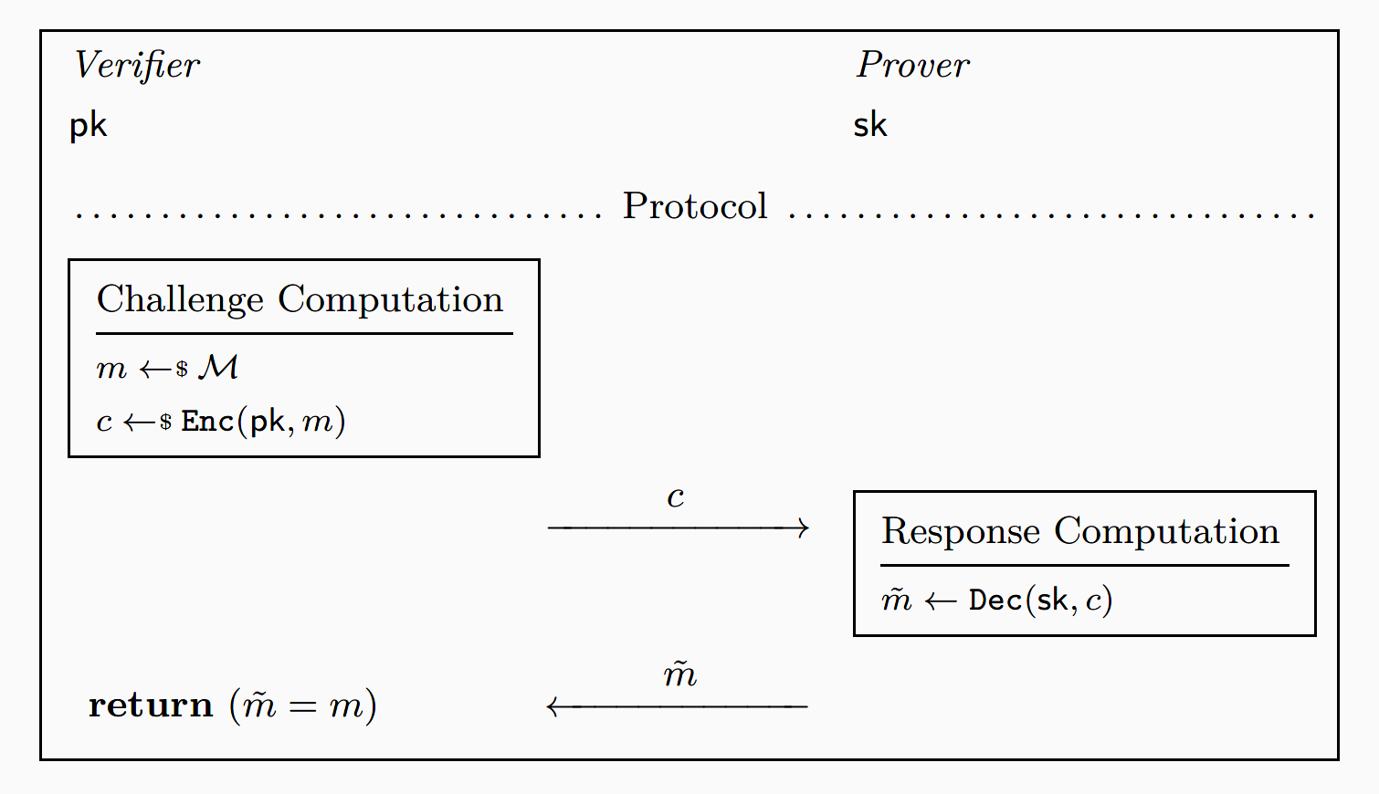
Starting point: Naïve construction
Instantiation with Kyber requires
FO-transform for active security

Slide 9
Rationale for FO transform
Goal of the FO transform: Check that the ciphertext was honestly generated
The CPA-secured decryption of Kyber is quite straightforward to protect and relatively fast
But in CCA-secure lattice-based KEMs like Kyber the re-encryption is sensitive to physical attacks
Re-encryption operates on secret-dependent data
Re-encryption requires operations that are complex and hard to protect like binomial sampling, hashing, masked comparison, etc.

Slide 10
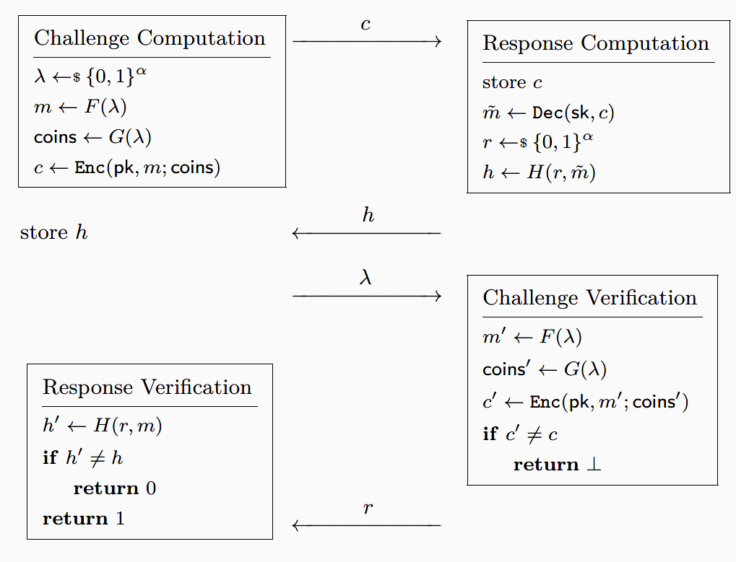
Protocol
Our approach
Move from a 2-pass protocol to a 4-pass protocol
Prover decrypts a challenge and commits on the response but doesn’t provide it
Verifier provides randomness used to generate challenge
Prover re-computes the ciphertext using randomness from Verifier
If ciphertext was honestly generated the full response is provided and checked

Slide 11
Table of contents
1
Motivation
2
Our construction
3
Evaluation

Slide 12
Implementation based on Kyber
Implementation on ARM Cortex-M4 using pq-clean or pqm4 with the m4fspeed variant
Kyber version Kyber768 is used for measurement and comparison later
Caution: We are comparing non-masked vs. x-order masked implementations but this is not sufficient to be secured in practice (e.g., due to fault attacks, template attacks, etc.)

Slide 13
Results for functional implementation
Implemented using the pqm4 library with m4fspeed.
No difference in cycle counts between our approach and CCA-Kyber as expected (re-encryption is still required)
Signature approach using Dilithium much slower

Slide 14
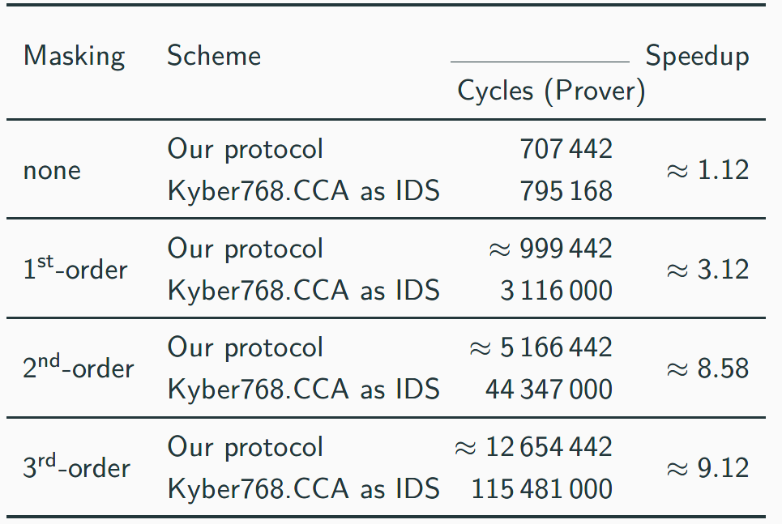
Advantage with masking
Protocol becomes more advantageous when increasing the masking order for improves side-channel protection -> Less sensitive code to protect

Slide 15
Conclusion
We gave an approach to use Kyber in as ID/authentication protocol in a practical setting
Consideration:
Tradeoff 2-pass vs. 4-pass vs. cost of side-channel hardening?
Benefit depends on ability of community to improve protection of Kyber against attacks
Thank you for your attention
https://ia.cr/2023/222
See also http://crypt-gen.com/ for GPT-2 based paper abstract generator

