Slide 1




MEGA
Malleable Encryption Goes Awry
Why E2EE Cloud Storage is hard
Lessons Learnt from
Cryptanalysis of the MEGA Cloud Storage
by Miro Haller, Matilda Backendal & Kenny Paterson

Slide 2
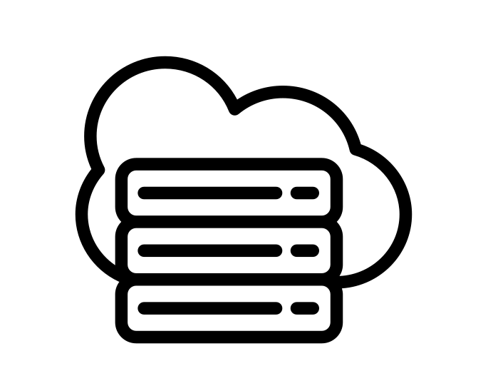






Cloud storage, for better and for worse
Key known to the cloud
Advantages
Outsource storage
Easy file access and back-up
Sharing and collaboration
and disadvantages…
Privacy
Secure channel (e.g. TLS)
Key known only to the user
Notes:
Let’s talk about the advantages of cloud storage.
Using a cloud storage allows you to outsource storage of your files from your device, such that they are available online, can be accessed from multiple devices and also provides a back-up of your files.
Additionally, files stored in the cloud, can be easily shared with other people, and many providers even offer real-time collaborative editing of the files.
For these reasons and more, cloud storage has become extremely popular.
However, there is one main drawback: lack of privacy.
Your data is no longer only on your device. Rather it is being transported over a network and stored at a server, neither of which are entities that you necessarily trust.
For the transport, we have secure channels. Additionally, files are usually encrypted at rest. However, and this is the crucial point, they are usually encrypted with a key known to the service provider. This means that the provider could both view plaintext data and modify it, if they felt so inclined.
The straightforward solution to this is instead encrypt the files before they are uploaded to the cloud. This is known as “client side encryption” and enables E2EE cloud storage, where only the users who know the keys have access to the plaintext files.

Slide 3

End-to-End Encryption: Why do we care?
Without E2EE: Cloud provider can
  …read sensitive files
  …perform analytics and serve targeted advertising
  …be hacked by malicious external actors
With E2EE: Even a malicious cloud cannot
  …access user data
  …modify user files
SECURITY
FEATURES
Image from: https://dayoftheshirt.com/shirts/93714/have-your-cake-and-eat-it-too-teeturtle
Notes:
Why do we care about E2EE cloud storage?
Without E2EE: cloud provider has direct access to user data and can…
Read sensitive files
Perform analytics
Additionally, even if the provider is not malicious, the lack of E2EE means that they could be hacked…
With E2EE: Even a malicious or compromised cloud does not have any access to user data.
E2EE is a “best of both worlds” scenario: it gives the benefits of outsourced storage, with the security guarantees of local storage!

Slide 4
Threat model and scope
Security goals:
  Confidentiality and integrity
Out of scope:
  Availability
  User anonymity
  Targeted dictionary attacks on user password
  Serving malicious JavaScript
malicious JS
Actively malicious or compromised
password
victim
Notes:
In order to achieve this, the system needs to provide data confidentiality and integrity.
And all of this is in a threat model where the cloud is actively malicious, or compromised.
In this strong threat model there are some trivial attacks that a malicious cloud can perform, which we consider out of scope.
Availability
User anonymity: we don’t try to hide which account accesses which files. (Pseudonymity might be possible, i.e. hiding the mapping between users and their accounts.)
Dictionary attacks on user password​
Serve malicious JavaScript. It’s an interesting problem to try to integrity-protect the JS code, but not something we try to solve here.

Slide 5
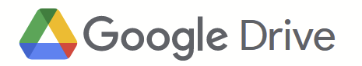
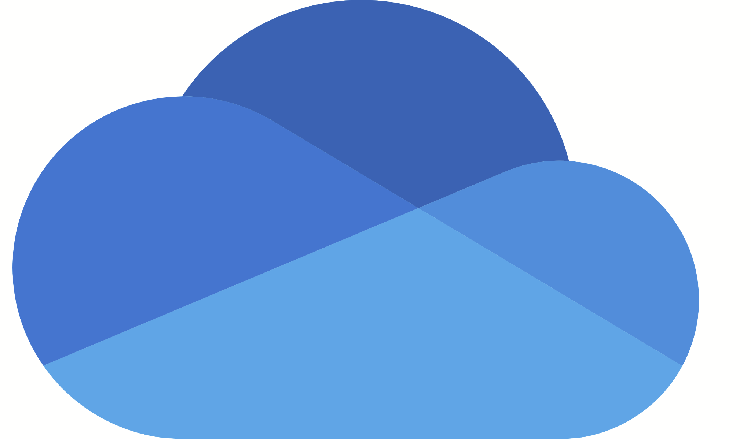



Consumer cloud storage
Provider | Active users
 | > 1 billion
 | 0.5 – 1 billion
 | > 850 million
 | >700 million
Sources:
Google Drive (2018): https://techcrunch.com/2018/07/25/google-drive-will-hit-a-billion-users-this-week/?guccounter=1
OneDrive (2015, 2022): https://www.computerworld.com/article/3003140/microsofts-onedrive-changes-follow-the-money.html, https://news.microsoft.com/bythenumbers/en/give
iCloud (2018): https://www.cnbc.com/2018/02/11/apple-could-sell-icloud-for-the-enterprise-barclays-says.html
Dropbox (2022): https://dropbox.gcs-web.com/news-releases/news-release-details/dropbox-announces-second-quarter-fiscal-2022-results
Notes:
Miro: what do we say here?

Slide 6
Consumer cloud storage lacks privacy
Provider | Active users | E2EE
 | > 1 billion | ❌
 | 0.5 – 1 billion | ❌
 | > 850 million | ❌
 | >700 million | ❌
Sources:
Google Drive (2018): https://techcrunch.com/2018/07/25/google-drive-will-hit-a-billion-users-this-week/?guccounter=1
OneDrive (2015, 2022): https://www.computerworld.com/article/3003140/microsofts-onedrive-changes-follow-the-money.html, https://news.microsoft.com/bythenumbers/en/give
iCloud (2018): https://www.cnbc.com/2018/02/11/apple-could-sell-icloud-for-the-enterprise-barclays-says.html
Dropbox (2022): https://dropbox.gcs-web.com/news-releases/news-release-details/dropbox-announces-second-quarter-fiscal-2022-results
Notes:
Why don’t the big providers aim for E2EE? It’s not trivial, and comes with some inherent challenges.

Slide 7

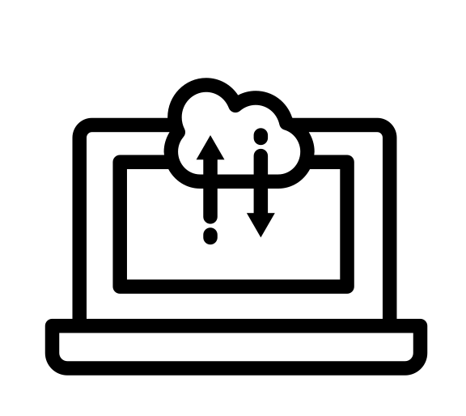
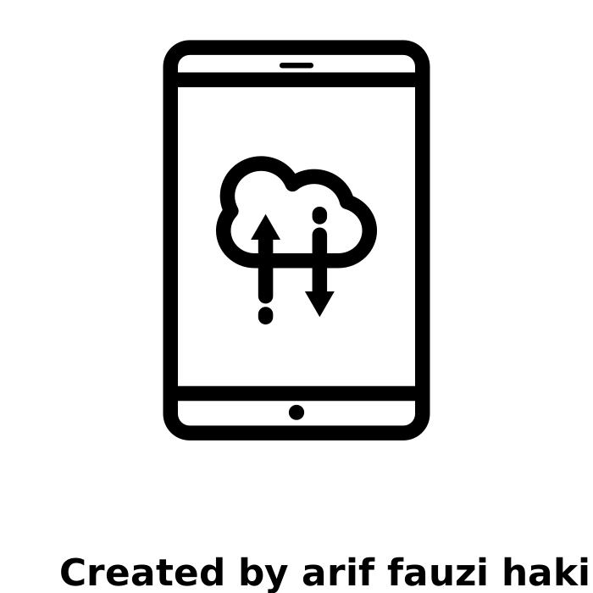


Client-side encryption: How hard can it be?
Problem #1: key management
Want: data available from any device
Challenge: transfer via untrusted provider
Solution: encrypt the keys
Files encrypted by the user
???
Notes:
How do we communicate keys between devices? Without assuming a direct channel between the devices, the keys must be transferred via the untrusted cloud! Clearly this cannot happen in the clear, so the keys must themselves be encrypted. But that means that users must have key encryption keys, which must also be available on all devices. (It turtles all the way down!)
However, we have an out-of-band channel between the devices, namely the user. If the user remembers the key, then we have a solution.

Slide 8
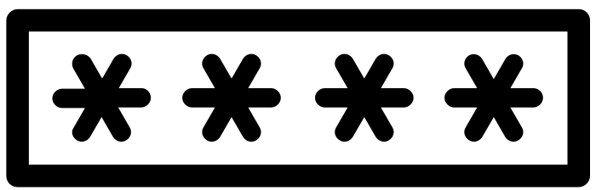

Client-side encryption: How hard can it be?
Problem #2: users are not good key managers
Solution: passwords
Files encrypted by the user
???
Notes:
Unfortunately, users are not good key managers. It is not easy for humans to remember cryptographic keys

Slide 9

Client-side encryption: How hard can it be?
Problem #2: users are not good key managers
Solution: passwords
Challenge: passwords!
  Users are not good password managers either…
  Forgotten password ⇒ lost access
  Password leak/compromise ⇒ key recovery
?
Notes:
However, users are not good password managers either!
Password management is more critical in E2EE setting, because:
- Forgotten pwd => lost access. (This might imply that users choose bad passwords to remember them...)
Passwords have a long history of problems: low entropy & password recovery.
- Password leak/compromise leads to key recovery

Slide 10
Client-side encryption: How hard can it be?
Problem #3: sharing encrypted files
Want: keys shared across users
Challenge: establishing trusted channel
???
Alice
Bob
Notes:
Even if we have solution to the key management problem for a single user, we still have the problem of sharing files between users.
In order for a user to share an encrypted file, they also need to share the key.
The challenge is to establish a trusted channel between users, when the only connection point we can assume is the untrusted cloud provider.

Slide 11
MEGA's Design
Notes:
We’ve now established that E2EE cloud storage is desirable but not trivial to implement. Next, we look at how the cloud provider MEGA tries to address the challenges mentioned by Matilda.

Slide 12


Who is MEGA?
“MEGA does not have access to your password or your data.​”
https://mega.io/security
The largest E2EE cloud storage service
10+ million daily active users​
270+ million accounts​
130+ billion files
1000+ PB of stored data
Notes:
They are the 5th biggest cloud storage provider with over 270 million users and storing over 130 billion files.
What makes them interesting compared to their bigger competitors is that they advertise privacy and security. On their website, they emphasize this with statements like “MEGA does not have access to your password or your data.”
We now have a brief look at a simplified version of MEGA’s cryptographic design and how they tackle the challenges of E2EE cloud storage.

Slide 13
Setup*
Client uploads encrypted RSA secret key to the cloud to set up authentication.
password
RSA pk
Enc ( )
RSA sk
RSA.KeyGen
RSA
*strongly simplified
Notes:
We start with the registration of a new user.
The user generates an RSA key pair used for authentication.
The client uploads the RSA public key to the server.
However, the user also picks a password and uses it to encrypt the RSA secret key to make it available to other devices.

Slide 14
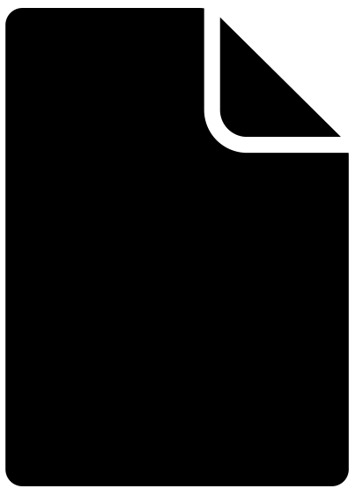
File upload*
The user locally generates a file encryption key and uploads the encrypted file and encrypted file key to the cloud.
password
Authenticate
Enc ( )
file
Enc ( )
file
Enc ( )
File
file
Enc ( )
KeyGen
file
file
*strongly simplified
Notes:
After registration, a user can upload a file by first authenticating to the server.
Then it generates a file key locally
and uses it to encrypt the file.
Next, it uploads the encrypted file to cloud.
Again, the client uses the password to encrypt the file key and uploads this to the cloud.
The reason why they we also upload the encrypted file key is to make it accessible from other devices devices.

Slide 15
File download*
The user retrieves the encrypted file and encrypted key material. They recover the file key using the password and decrypt the file.
Authenticate
password
Enc ( )
file
Enc ( )
file
Enc ( )
file
Enc ( )
file
file
*strongly simplified
Notes:
To download the file from a different device, the user
Authenticates to the server
Fetches the encrypted file and file key
Uses password to decrypt the file key
Use file key to decrypt file
Although Mega’s design is similar to the generic construction described by Matilda in the beginning, it has subtle flaws on the implementation level.

Slide 16
Cryptanalysis of MEGA
Notes:
Next, we will discuss cryptoanalytic results from our recent paper Malleable Encryption Goes Awry that will be published in S&P 2023

Slide 17
Attack 1: RSA key recovery*
MEGA's user authentication:
auth req
password
AES-ECB.Enc ( )
RSA sk
RSA.Enc (pad(SID))
RSA pk
SID
Session ID (SID)
AES-ECB is clearly a bad choice.
*strongly simplified
Notes:
We start with an attack where the malicious cloud provider recovers the RSA secret key of a user with a more efficient attack than just guessing the password.
For that we exploit the authentication protocol, so let’s look into it in a bit more details.
The client sends an auth request and fetches the encryption of the RSA secret key.
The server picks a session ID and encrypts it to the RSA public key of the user that tries to authenticate.
The client decrypts the RSA secret key and uses it to decrypt the session ID.
It sends back the SID to the server as proof that the user successfully recovered the RSA secret key.
AES-ECB is bad!

Slide 18

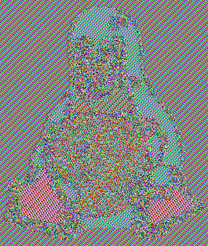
Attack 1: RSA key recovery*
MEGA's user authentication:
auth req
AES-ECB.Enc ( )
RSA sk
…
secret
=
RSA.Enc (pad(SID))
AES
AES
RSA pk
AES
AES
…
AES-ECB.Enc ( )
secret
=
SID
Building a key-recovery attack is still non-trivial.
AES-ECB is clearly a bad choice.
AES-ECB is clearly a bad choice.
*strongly simplified
Notes:
Maybe, some of you now think of a Linux penguin becausethat's the standard example of why one should not use AES-ECB. The encryption of the penguin is still a penguin just with funky colors.
However, it is not trivial to get a practical key recovery attack in our case.
There reason for that is that an RSA secret key is substantially different from a penguin.
If you encrypt a secret key with AES-ECB, you also split it into blocks and encrypt them individually.
However, the secret has high entropy unlike the penguin that repeats same blocks of pixels.
Thus, all blocks of the secret key are different with overwhelming probability.
Since AES-ECB is still a pseudo-random permutation you cannot infer anything about the plaintext from the ciphertext blocks without breaking AES.
So the problem is not, that AES-ECB is deterministic.
However what we can exploit is that blocks are encrypted independently!
The garbling of a single ciphertext block propagates and garbles a single plaintext block without affecting the rest of the plaintext.
In other words, the cipher is malleable.
The idea for our key recovery attack is to garble part of the RSA key and observe how the client uses it to learn something about the preserved parts of the secret key.
But how can we observe the client using the secret key?

Slide 19
Attack 1: RSA key recovery*
MEGA's user authentication:
auth req
AES-ECB.Enc ( )
RSA sk
RSA.Enc (pad(SID))
RSA pk
SID
Partial decryption oracle for chosen SID!
*strongly simplified
Notes:
Going back to the authentication protocol, we notice it gives us a partial decryption oracle!
The malicious server picks some ciphertext and, if the client decrypts successfully, get back part of the plaintext that the user recovered in the form of the session id.

Slide 20
Attack 1: RSA key recovery*
MEGA's user authentication:
auth req
AES-ECB.Enc ( )
RSA sk
RSA.Enc (pad(SID))
RSA pk
SID
malleability of the secret key
information from partial decryption oracle
binary search for RSA secret key
*strongly simplified
Notes:
Putting this together, the malicious server can modify the encryption of the rsa secret key by changing full AES-ECB blocks and then observe the client behaviour using the partial decryption oracle. It turns out that by smartly picking values for the session ID, the cloud provider can do a binary search for the RSA secret key.

Slide 21
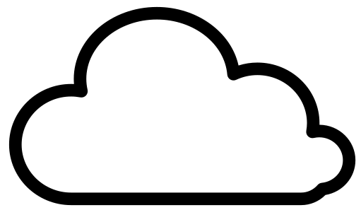
Attack 1: RSA key recovery
Impact:
  RSA key recovery in 512 logins*
Enables attack 2: file key recovery
  Adversary knows RSA key from Attack 1
  File keys are also encrypted with AES-ECB
AES-ECB
AES-ECB
file
RSA key pair
file keys
💡
Cut and paste AES-ECB ciphertext blocks from file key to RSA secret key ciphertext.
*Attacks only get better over time:
6 logins: Ryan, Heninger. PKC ’23.; 2 logins: Albrecht, Haller, Mareková, Paterson. Eurocrypt ‘23.
Notes:
The impact of this attack is that the malicious cloud provider can recover the RSA secret key in 512 login attempts. This was later improved to 6 and 2 queries.
However, looking at MEGA's key hierarchy, every file is encrypted with its own key so the provider cannot read them.
But it turns out that we can build a second attack to recover the file keys when the adversary already knows the RSA secret key.
The main observation here is that the file keys are also encrypted with AES-ECB under the same key.
So, we can essentially pretend that the file key is an RSA key and cut and paste the file key encryption into the rsa secret key ciphertext and learn the decryption through the vulnerable authentication protocol.

Slide 22
Attack 2: file key recovery*
auth req
RSA.Enc (pad(SID))
public
AES-ECB.Enc ( )
RSA sk
SID
fn(SID)=
key reuse
ciphertext malleability
partial decryption oracle
*strongly simplified
file key decryption
Notes:
To realize this attack, the cloud provider exploits that the same key is used to encrypt the file key and RSA secret key.
This allows the malicious provider to insert a file key ciphertext into the RSA key encryption that is exchanged during authentication.
Then it uses the partial RSA plaintext returned as the SID by the client to compute the file key.

Slide 23
Attack 2: file key recovery
Impact:
  Cheap AES-ECB decryption oracle
  This allows compromise of file (and other) keys
  And hence decryption of all user data!
file
RSA key pair
file keys
Notes:
Cheap AES-ECB decryption oracle.
Which, given an adversary already knows the rsa secret key, allows it to recover file keys and thus decrypt all user data.

Slide 24
Attacks
Mistakes to avoid
Attack 1: RSA key recovery
  Malleable secret key + oracle
Attack 2: file key recovery
  Cut and paste AES ctxt blocks
Attack 3: integrity attack
  File forgery under the “zero key”
Attack 4: framing attack
  Like attack 3, but not detectable
Attack 5: Bleichenbacher
  Adapted to MEGA’s RSA padding
No AE for key encryption
Missing key separation
Rolling your own crypto
No cryptographic agility
24
Notes:
Summarizing our attacks on MEGA and mistakes that should be avoided in E2EE cloud storage
The first attack exploits the malleability of key material outsourced to the cloud provider to recover a users RSA secret key
The root cause is that the rsa secret key ciphertext has no integrity protection because they do not use authenticated encryption.
We built on top of attack 1 decrypt arbitrary AES ciphertext blocks.
The problem is we can break the file encryption with a vulnerability in a completely separate part of the design, the auth protocol, because they reuse the same key.
In our paper, we have two additional attacks that allow an adversary to create ciphertexts for arbitrary files that decrypt successfully without that the adversary knowing the user's password.
The reason this is possible is that MEGA designed their own file encryption scheme that has non-standard structure that allows this attack.
Bleichenbacher RSA padding oracle adapted to MEGA’s custom padding scheme
Another instance of homegrown crypto
It's also a legacy issue: MEGA was aware that this part is vulnerable, however, they were not able to move away from it for backwards compatibility reasons.

Slide 25
Lessons from MEGA
Mistakes to avoid
Aim for E2EE
Have a bug bounty program
Collaborate during disclosure
Full mitigation impossible
  Re-encryption requires > 185 days
Recovery from compromise?
No AE for key encryption
Missing key separation
Rolling your own crypto
No cryptographic agility
No post-compromise security
25
Notes:
With that, we picked enough on MEGA and there are definitely several things they did right.
To begin with, they aimed for E2E encryption, unlike all the other large storage providers. So we are holding them to a high standard here.
They have a bug bounty program up and were very collaborative during responsible disclosure.
In fact, we enjoyed this process so much that we decided to write a second paper and break their patches to our attacks.
Joke aside, thinking about how to patching MEGA made us realize that fundamental changes are simply infeasible. Changing the file encryption algorithm would require over half a year to re-encrypt all files.
Furthermore, it is unclear how users can recover from a compromise.
Having seen the problems with MEGA's design

Slide 26
How To E2EE Cloud Storage
Notes:
a natrual question is how should e2ee cloud storage be designed?

Slide 27
Goals and challenges for E2EE cloud storage
Ideal properties
  Cryptographic agility
  Modularity
  Basic features: multi-device access, file sharing
  Advanced features: post-compromise security, forward security
Challenges
  Device support → key management
  Users handle keys, or passwords
  Key exchange between users
  Post-compromise and forward security for persistent data
Malicious storage provider: a strong threat model
  Today: cryptographic design from a malicious provider!
Notes:
Summarizing previous slides, ideally we’d like to have a system that provides
Cryptographic agility (to recover from vulnerable components in the design)
Modularity (to allow the system to be extended in a secure way)
Basic features: easy access to files from multiple devices, and you can share them with other users
Advanced features:
post-compromise security to recover from successful attacks, e.g., through key rotation
forward security to protect data against future attacks
However, there are challenges for achieving this, such as
To support multiple devices we need to manage keys across them
Which means users need to either manage keys, or passwords
To support file sharing, we need to exchange key with other user
Forward security is challenging to achieve. Unlike with messaging, where data is persistent. In messaging, you can protect exchanged messages with ephemeral keys. Once they’re deleted, the messages cannot be compromised. But in cloud storage, the data is persistent and the user expects to be able to access their data in the future.
A malicious clouder provider is a very strong threat model where we don't trust cloud provider for anything but availability.
But if you think about it, today, we trust the untrusted cloud provider to create a secure cryptographic design.

Slide 28
Looking ahead
Standardization effort…
  …involving various stakeholders
  …to design a well-analysed and practical E2EE cloud storage system
How do we interest providers?
Economic incentives: features, integration
Political incentives: data privacy laws
Notes:
A standard for cloud storage could build such a system and
that involves stakeholders from industry and academia
One open question is to collaborate with providers
It needs to make economic sense:
For instance, if all providers implement the same standard, they can no longer claim to be more secure than competitors
But maybe this is ok if they can still extend their storage with more features (in a secure way!) or provide better integrations
Political incentives like data privacy regulations can require the adoption of E2EE

Slide 29



Questions?
Thank you!
Paper: "MEGA: Malleable Encryption Goes Awry"
Website:
mega-awry.io
Attacks PoC:
github.com/MEGA-Awry
Additional references:
Icons from the Noun Project by: arif fauzi hakim, M Yudi Maulana, alrigel, Oh Rian, rukanicon, Тимур Минвалеев, Ami Ho, juli, Andrew Doane, Eucalyp, Symbolon, Adrien Coquet, Rediffusion

Slide 30
Backup Slides

Slide 31
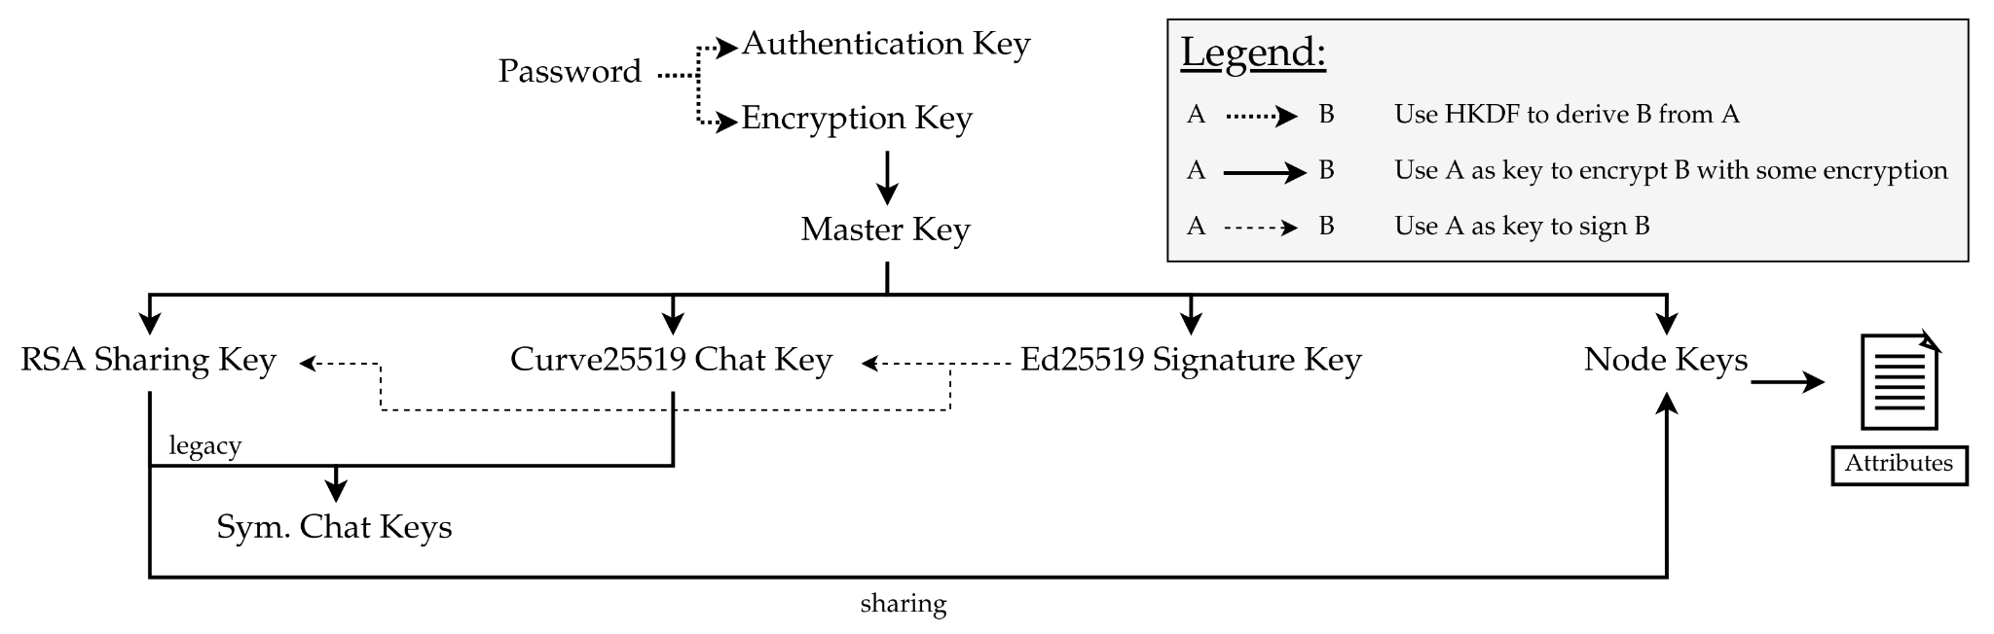
MEGA's Full Key Hierarchy

Slide 32
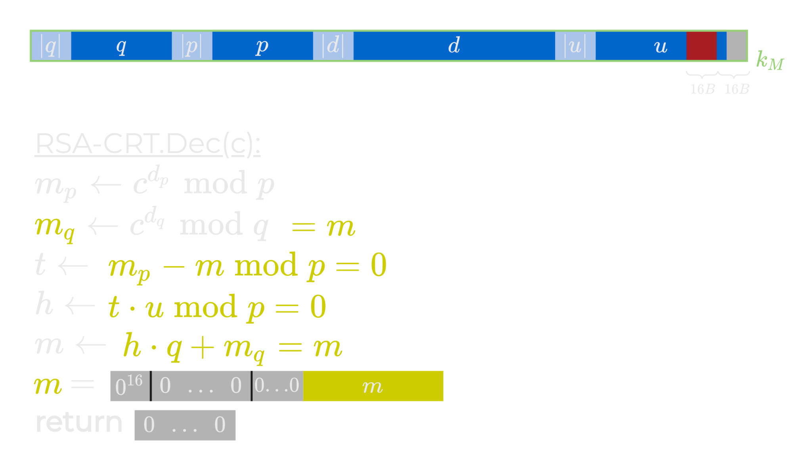
Attack 1: file key recovery
Case m < q:

Slide 33
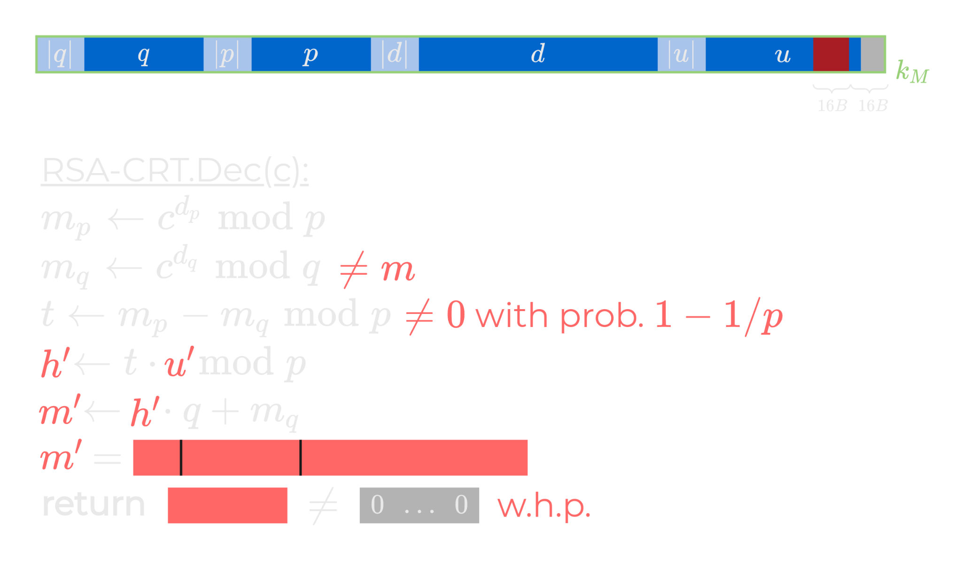
Attack 1: file key recovery
Case m ≥ q:

Slide 34
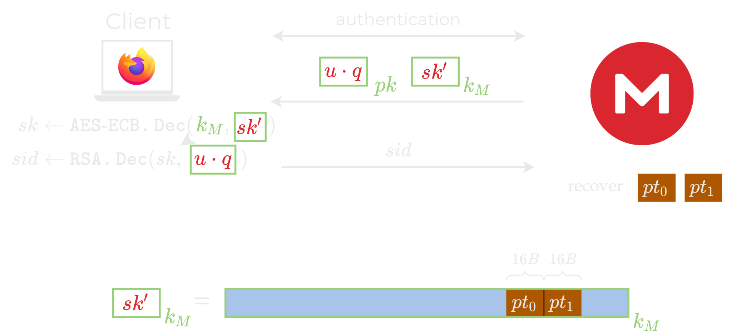
Attack 2: file key recovery

Slide 35
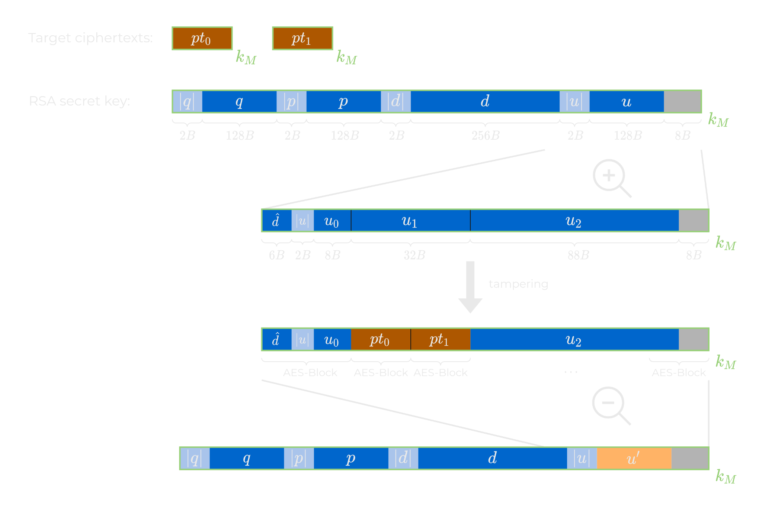
Attack 2: file key recovery

Slide 36
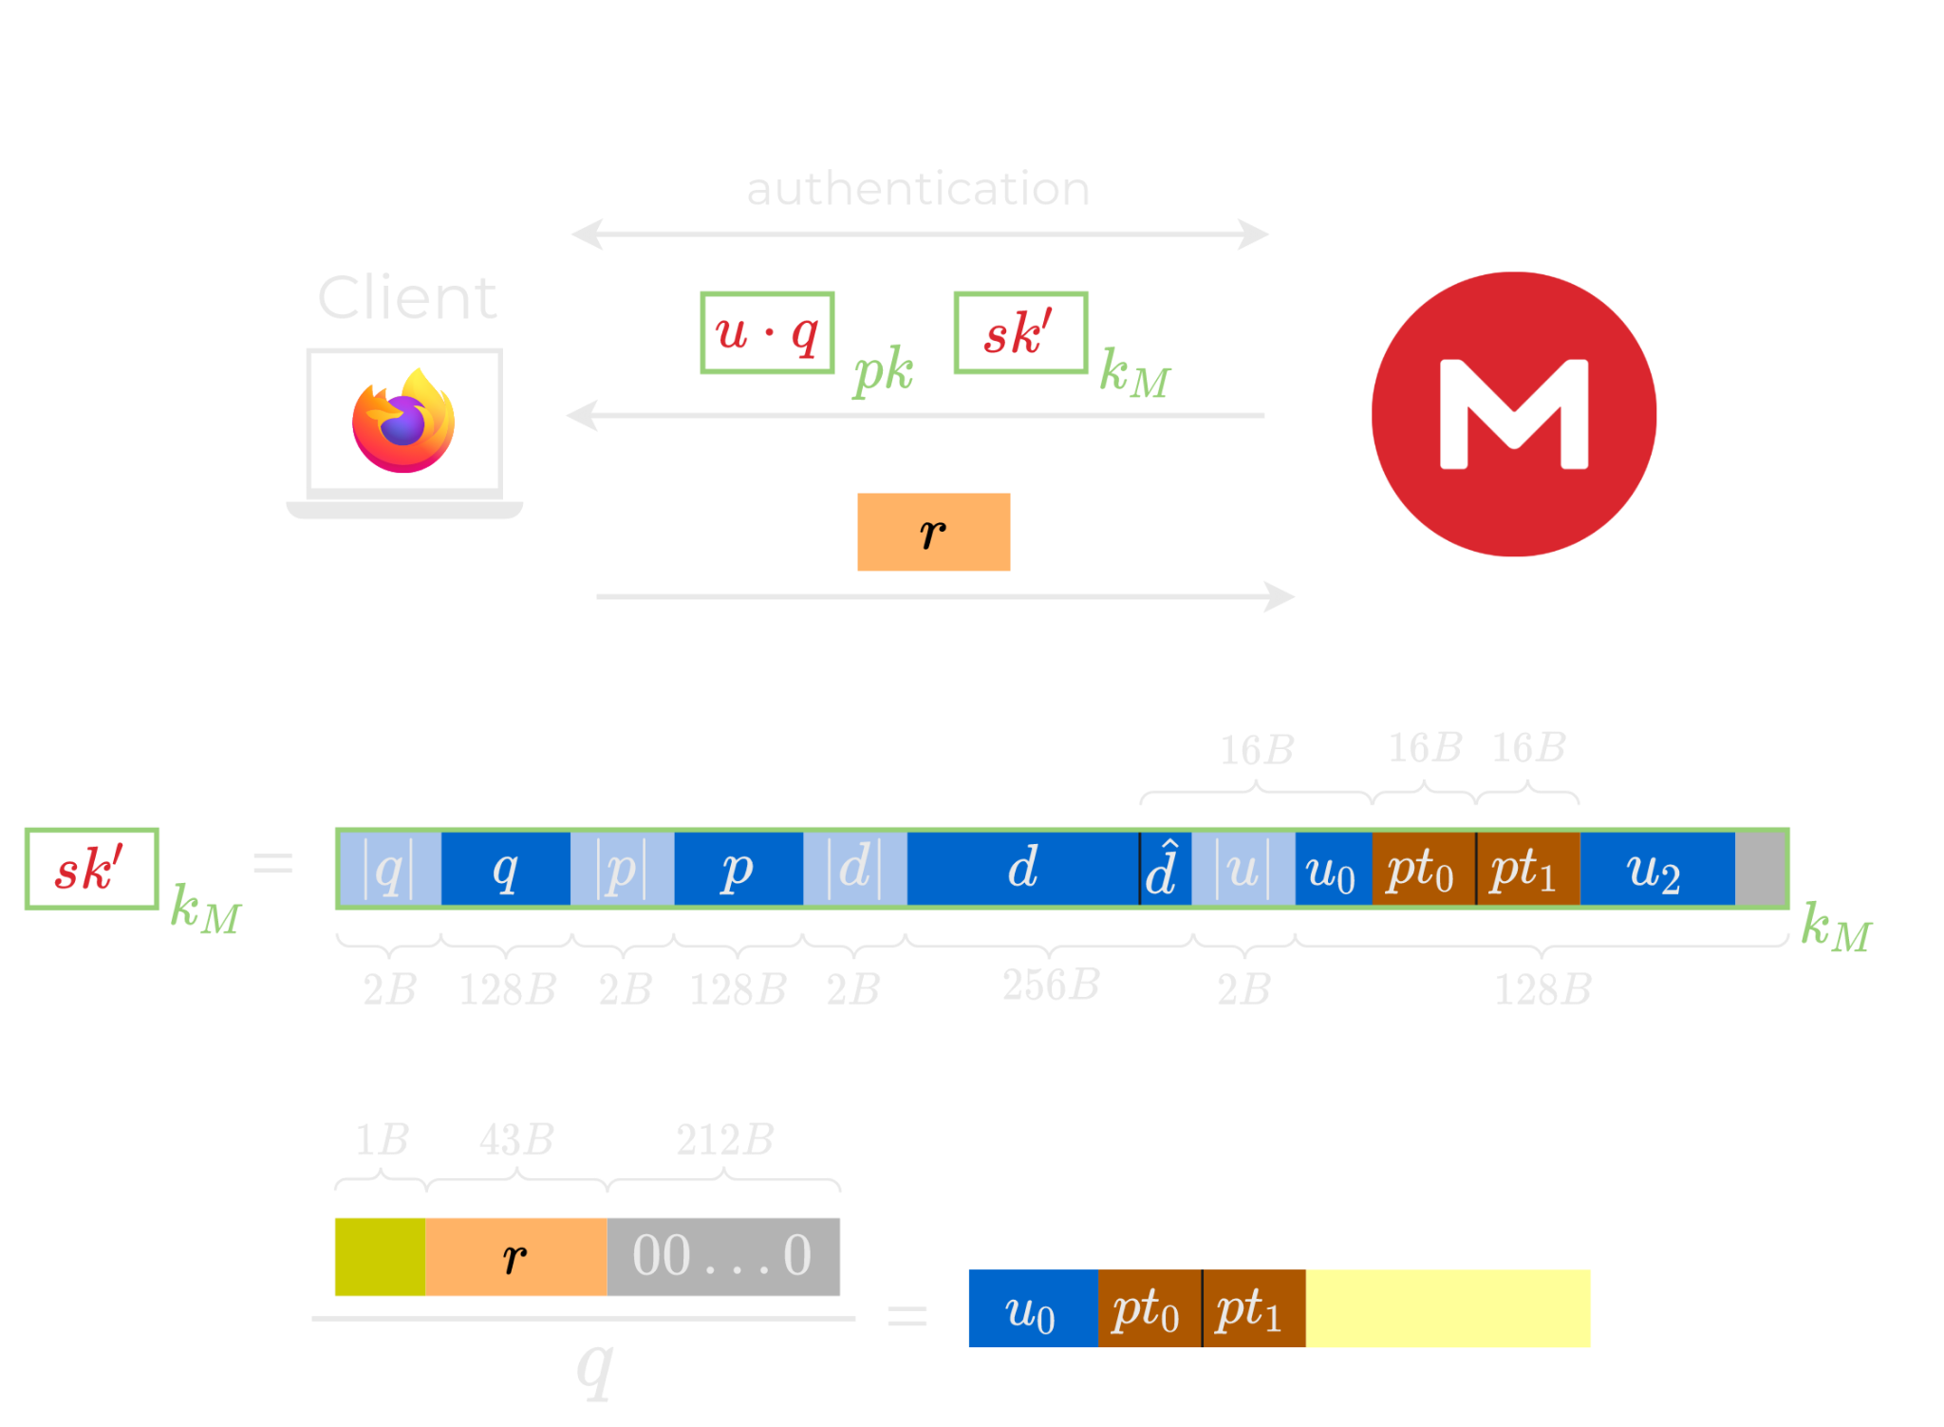
Attack 2: file key recovery
Guess the leading byte
Verify guesses with u₀
W.h.p., the approximate division by q recovers the target plaintext blocks pt₀ and pt₁​

Slide 37
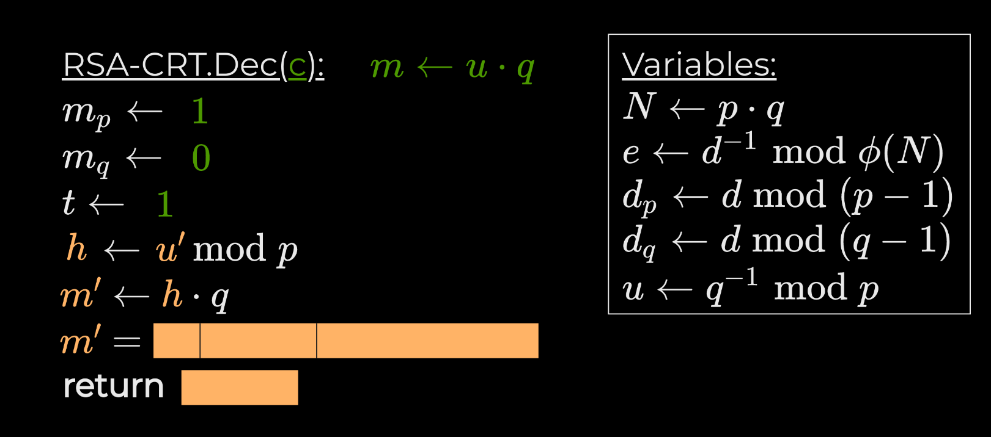
Attack 2: file key recovery

Slide 38
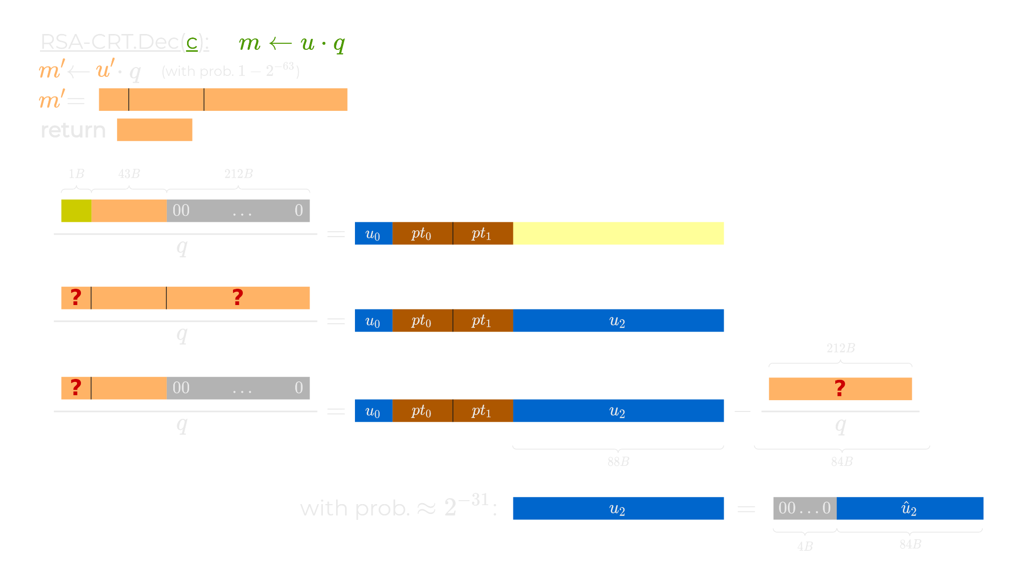
Attack 2: file key recovery

Slide 39
Haven't We Broken Everything Already?
Confidentiality is broken by attacks 1 & 2
What about integrity of files?
  Can someone upload a file to your cloud that looks like you uploaded it?
Potential problems include placing controversial, illegal, or compromising material in the victim's file storage

Slide 40
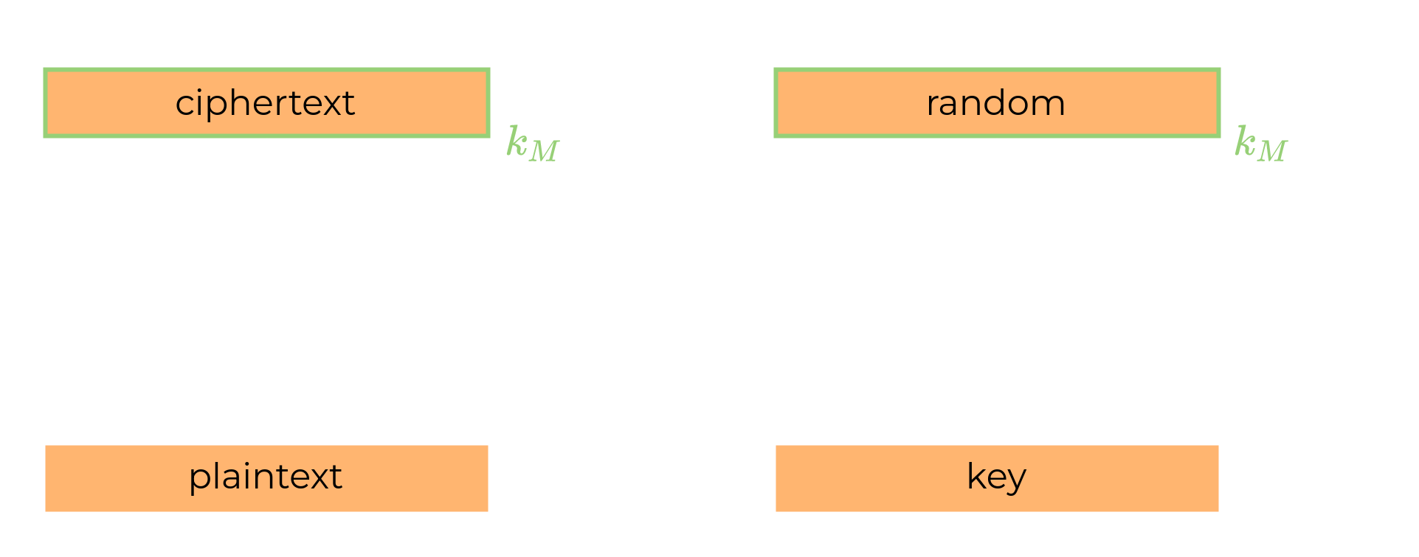
Attacks 3: Framing Attack

Slide 41
Attacks 3: Framing Attack

Slide 42
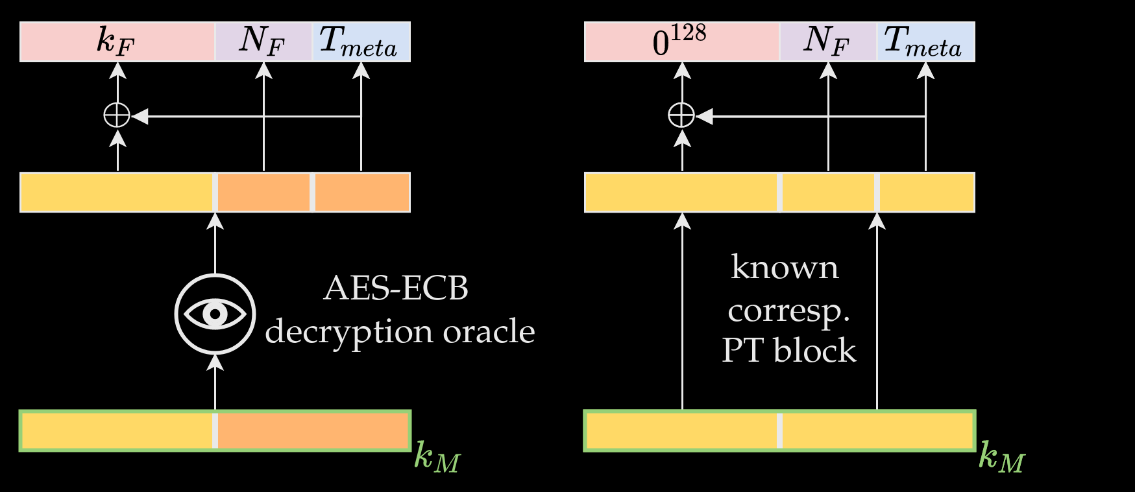
Attacks 3-4: Framing & Integrity

Slide 43
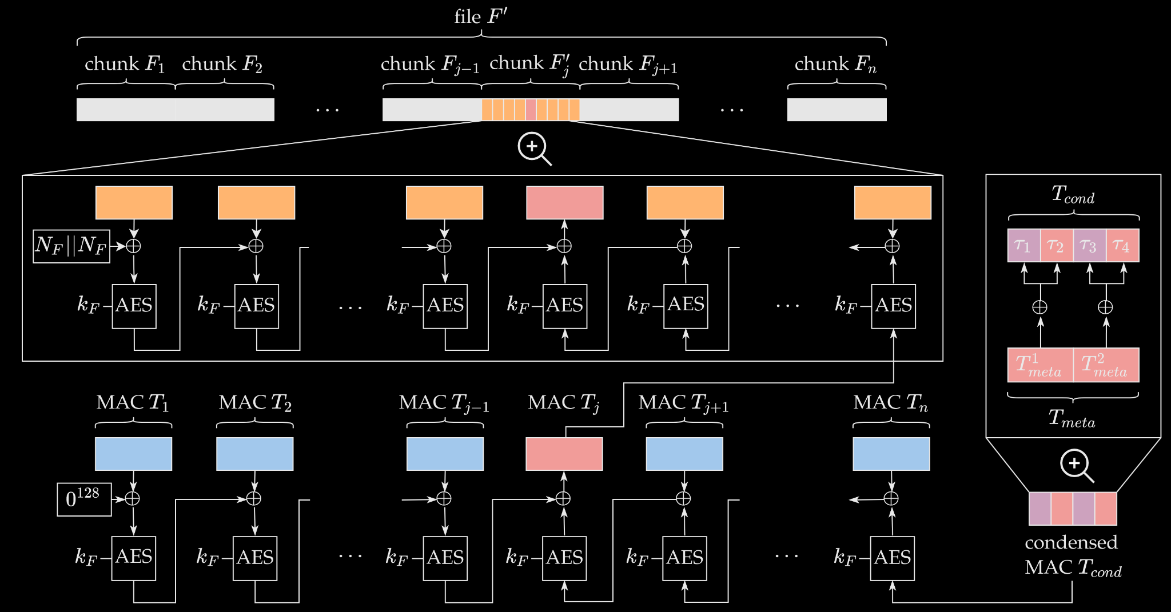
Attacks 3-4: Framing & Integrity
Notes:
Construct a CCM ciphertext given a tag and key.

Slide 44
Attacks 3-4: Framing vs. Integrity
 | Not Detectable | No Decryption Oracle
Framing Attack | ✅ | ❌
Integrity Attack | ❌ | ✅

Slide 45
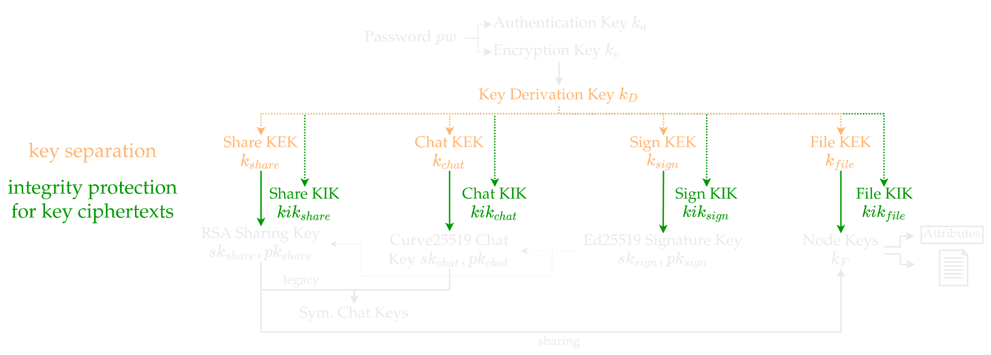
Proposed Immediate Countermeasures

Slide 46
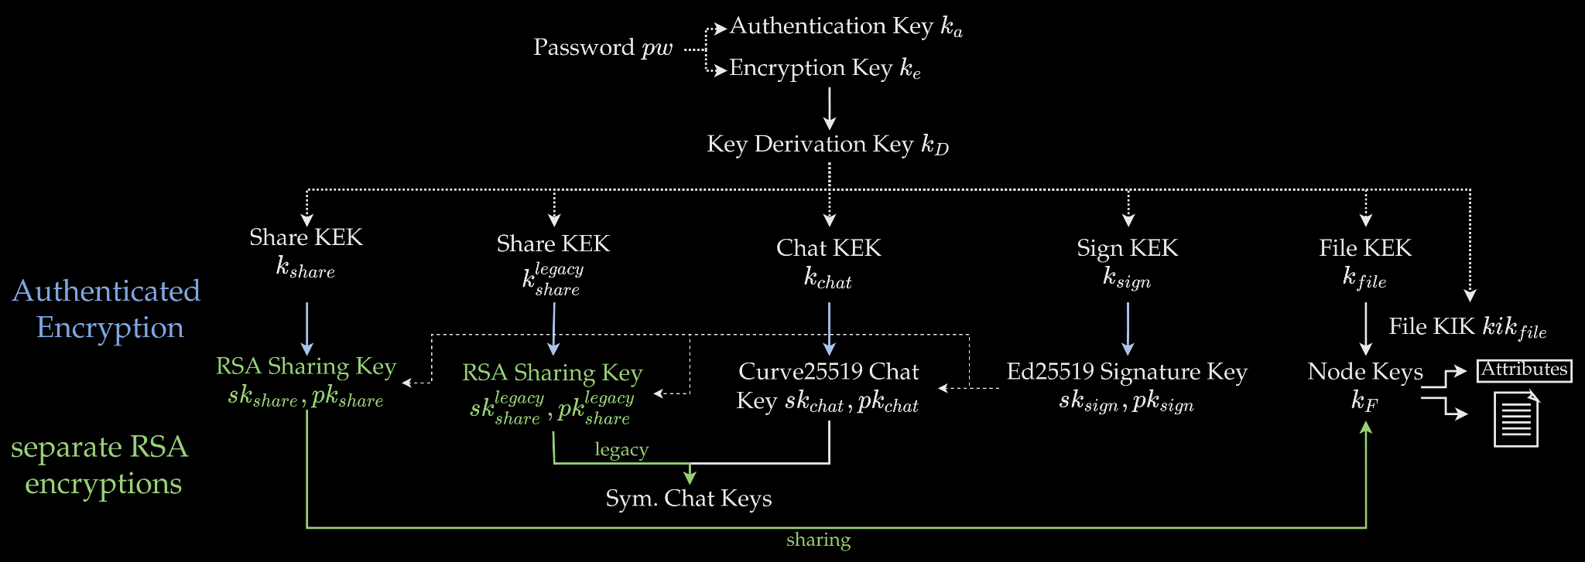
Proposed Minimal Countermeasures

Slide 47
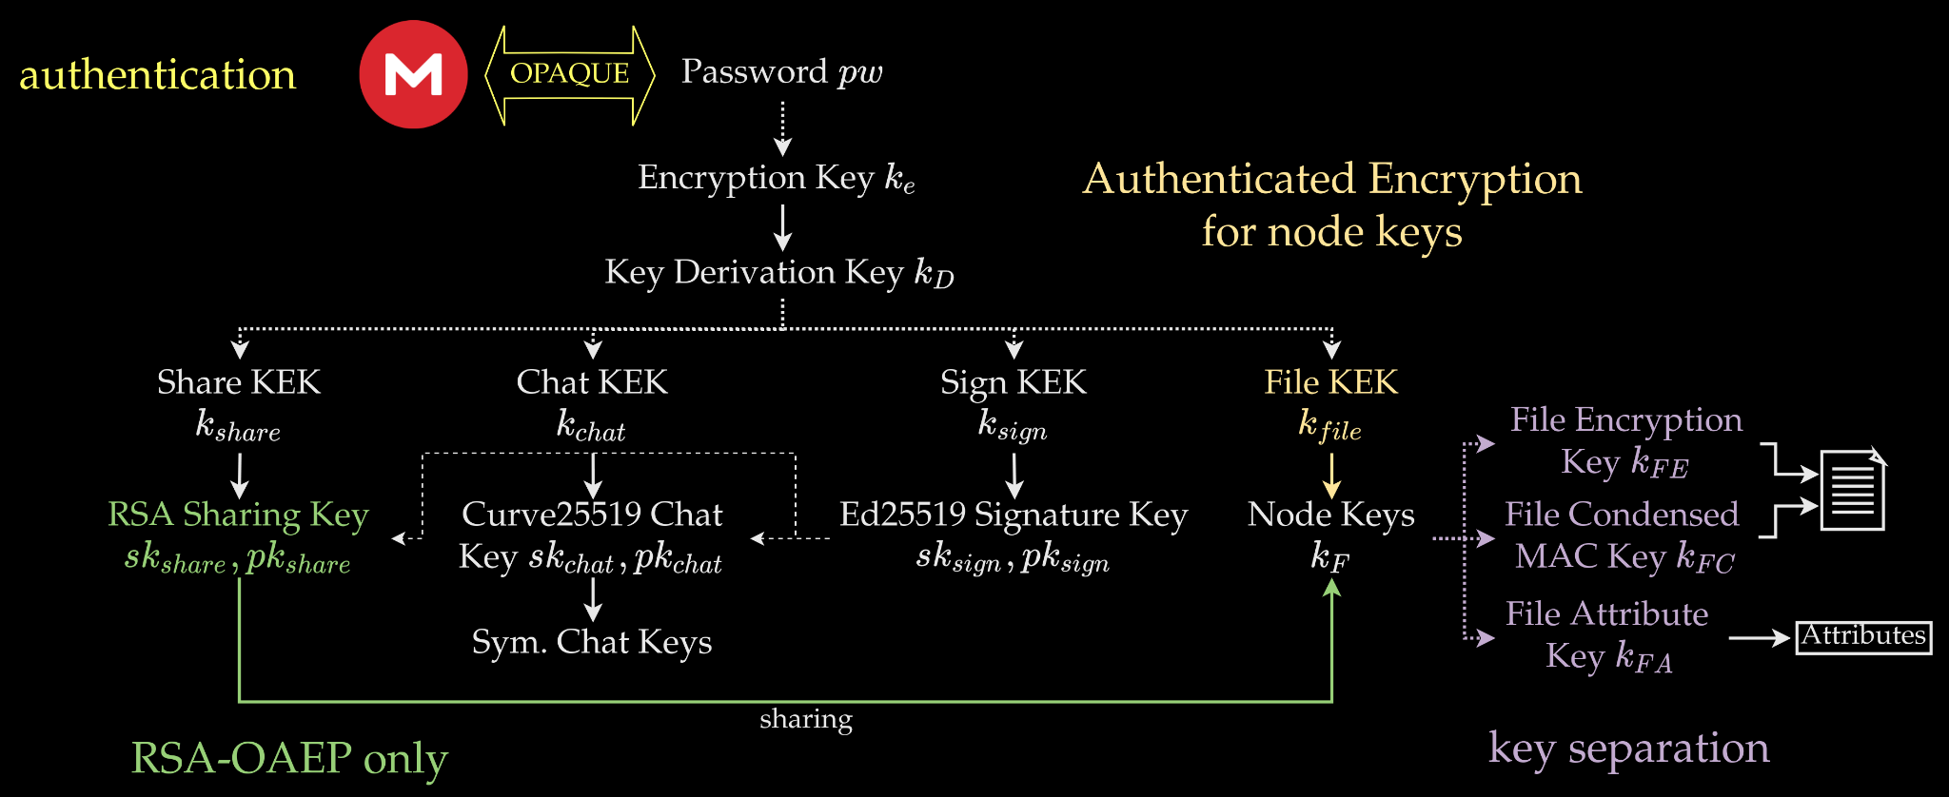
Proposed Recommended Countermeasures

