Slide 1
Portunus
Re-imagining access control in distributed
systems with Attribute-Based Encryption
Watson Ladd¹, Tanya Verma², Marloes Venema³, Armando Faz², Brendan McMillion, Avani Wildani², Nick Sullivan²
1Akamai (work done at Cloudflare), 2Cloudflare Research, 3University of Wuppertal
*Portunus was the ancient Roman god of 🔑, 🚪, 🐄 and ⚓

Slide 2
The Problem: Geographic access control
-> EU bank’s key is in every datacenter globally
-> But they want it only in EU

Slide 3
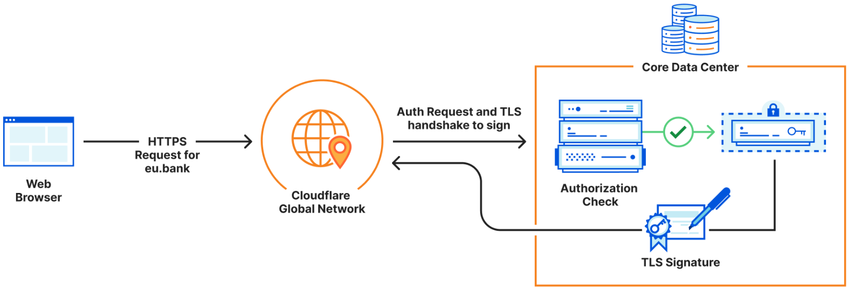
Complicated business logic in core
-> Round trip to core
-> Reduced fault tolerance

Slide 4
Different copies of KV store

Slide 5
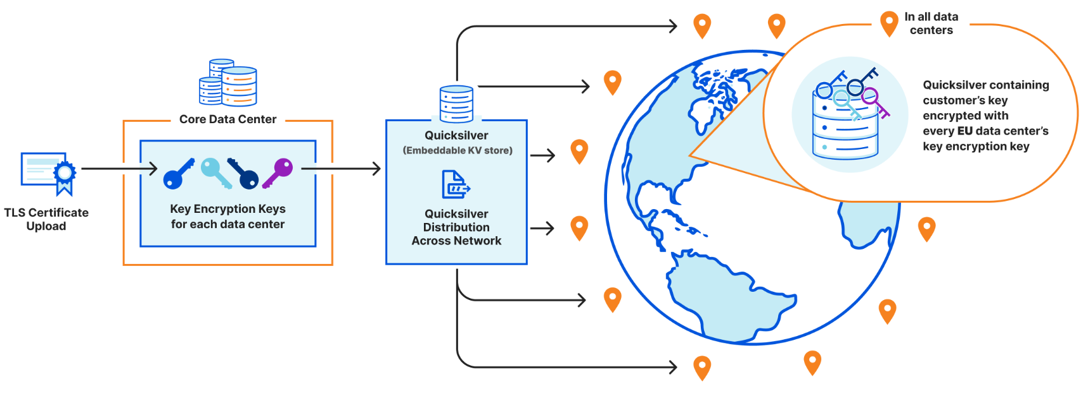
Naive crypto: each data center gets its own key
-> Storage overhead: hundreds of data centers x hundreds of machines/data center x millions of customer sites

Slide 6
System Requirements
Flexible policies | Changes to machines | Attribute additions
Low latency | Fault tolerance | Limited storage
Collusion resistance | Security against strong attackers | Key Rotation

Slide 7
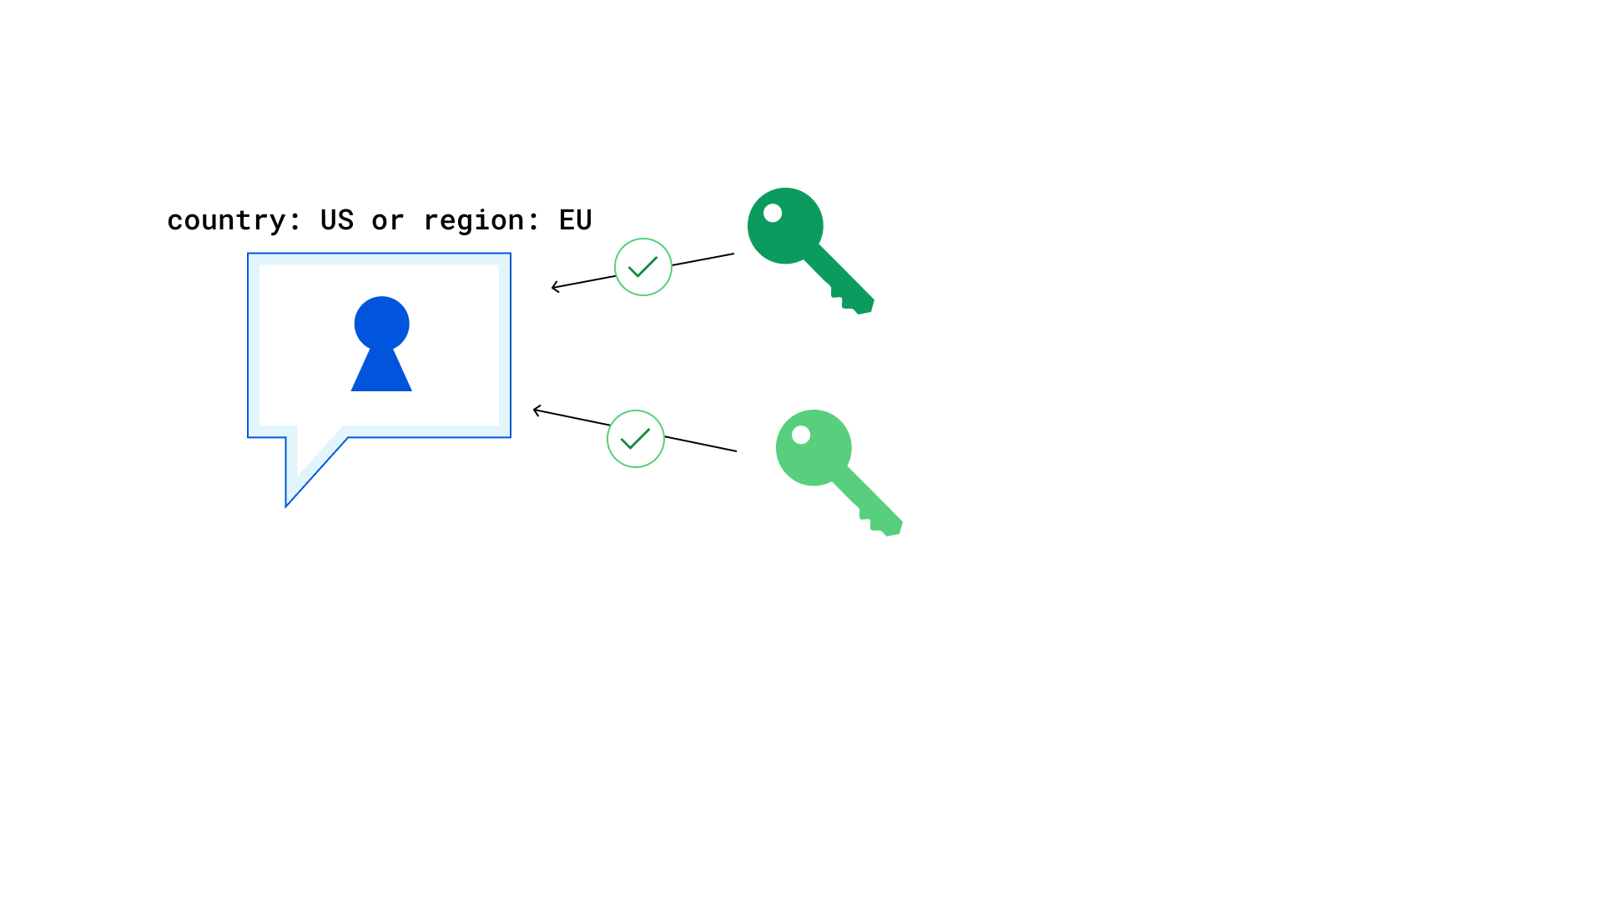
Ciphertext-Policy Attribute-Based Encryption

Slide 8
Language semantics
country: US or region: EU | Decryption is possible either in the 🇺🇸 or in the 🇪🇺
not (country: RU or country: BY) | Decryption is not possible in 🇷🇺 and 🇧🇾
country: US and security: high | Decryption is possible only in data centers within the 🇺🇸 that have a high level of security

Slide 9
Characteristics we’d like
Negation AND, OR and NOT
Large universe
Repeated attributes country: US or (region: EU and not country: NL)
Security against Chosen-Ciphertext Attacks

Slide 10
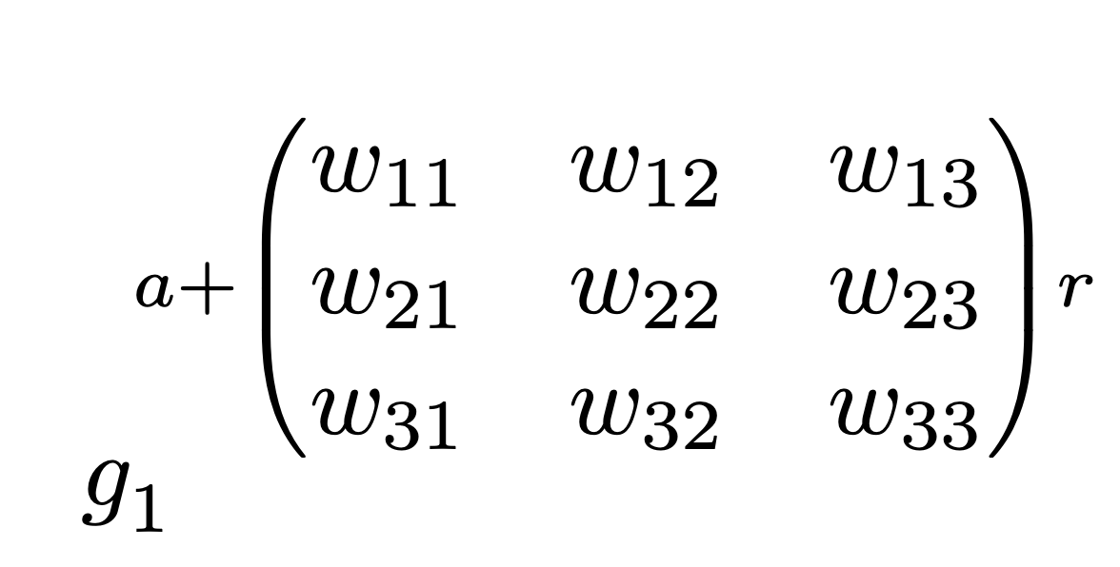
TKN20 scheme
Matrix Decisional Diffie-Hellman Assumption
CPA -> CCA2 using wildcards and Boneh-Katz transform
Open sourced in Cloudflare’s CIRCL library
Based on our optimized BLS12-381 pairing implementation
*Developed by Tomida, Kawahara & Nishimaki (2020)

Slide 11
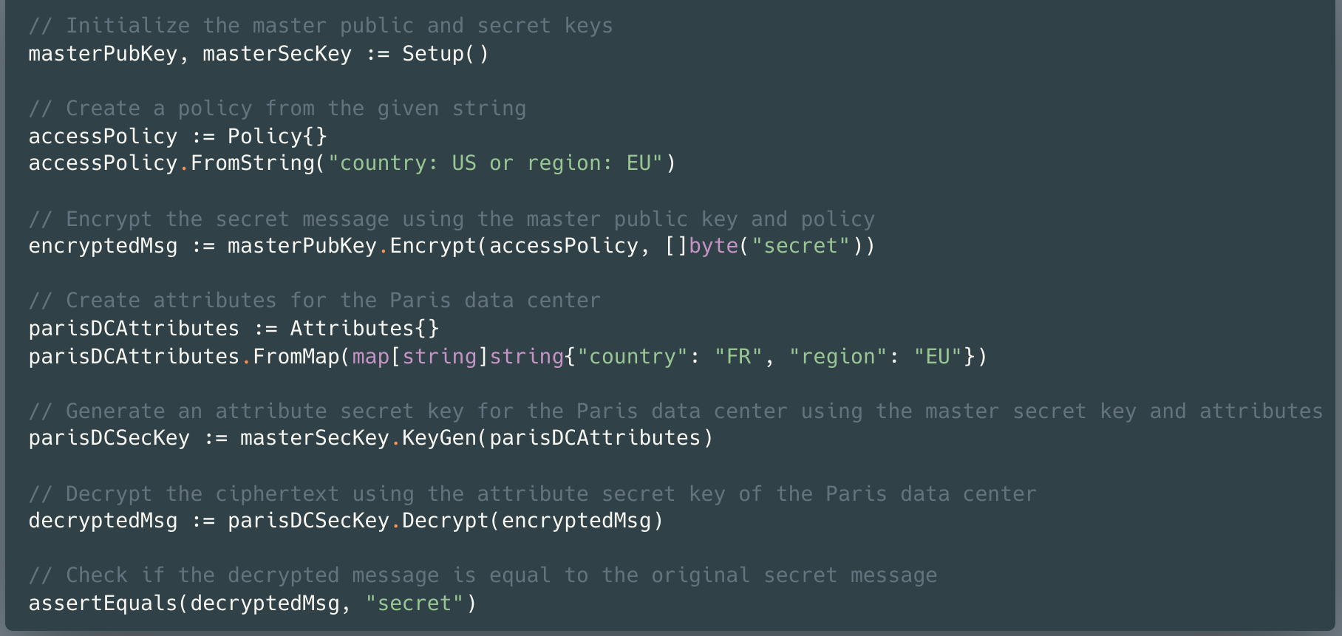
Example API usage

Slide 12
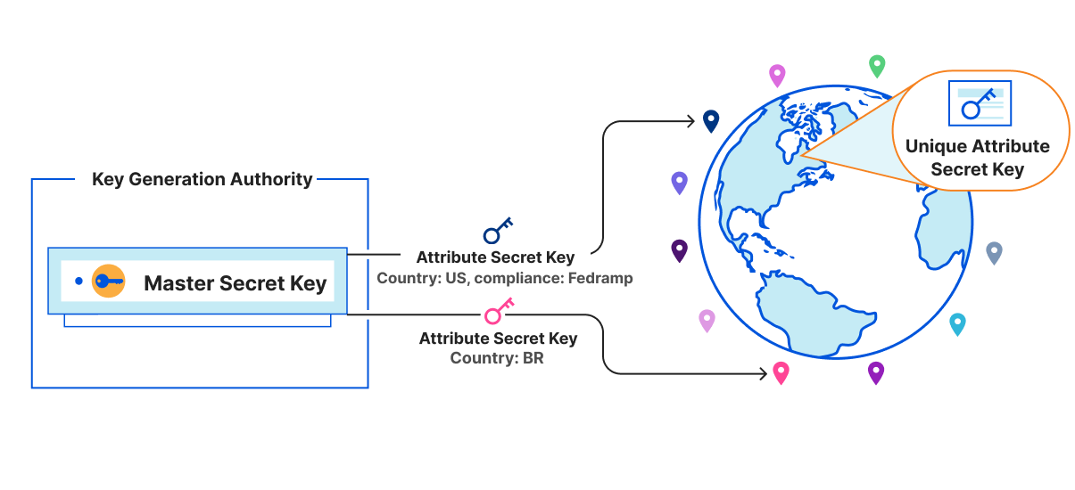
Key Distribution

Slide 13
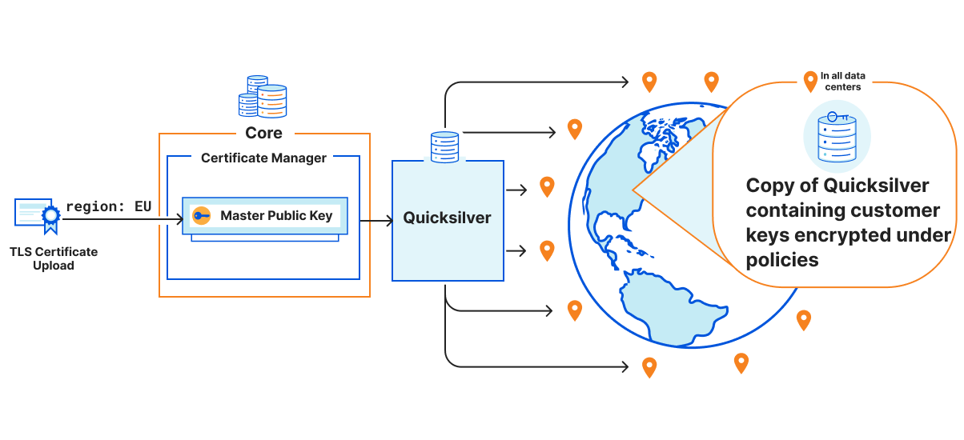
Encryption

Slide 14
Decryption using Attribute-Secret Key

Slide 15
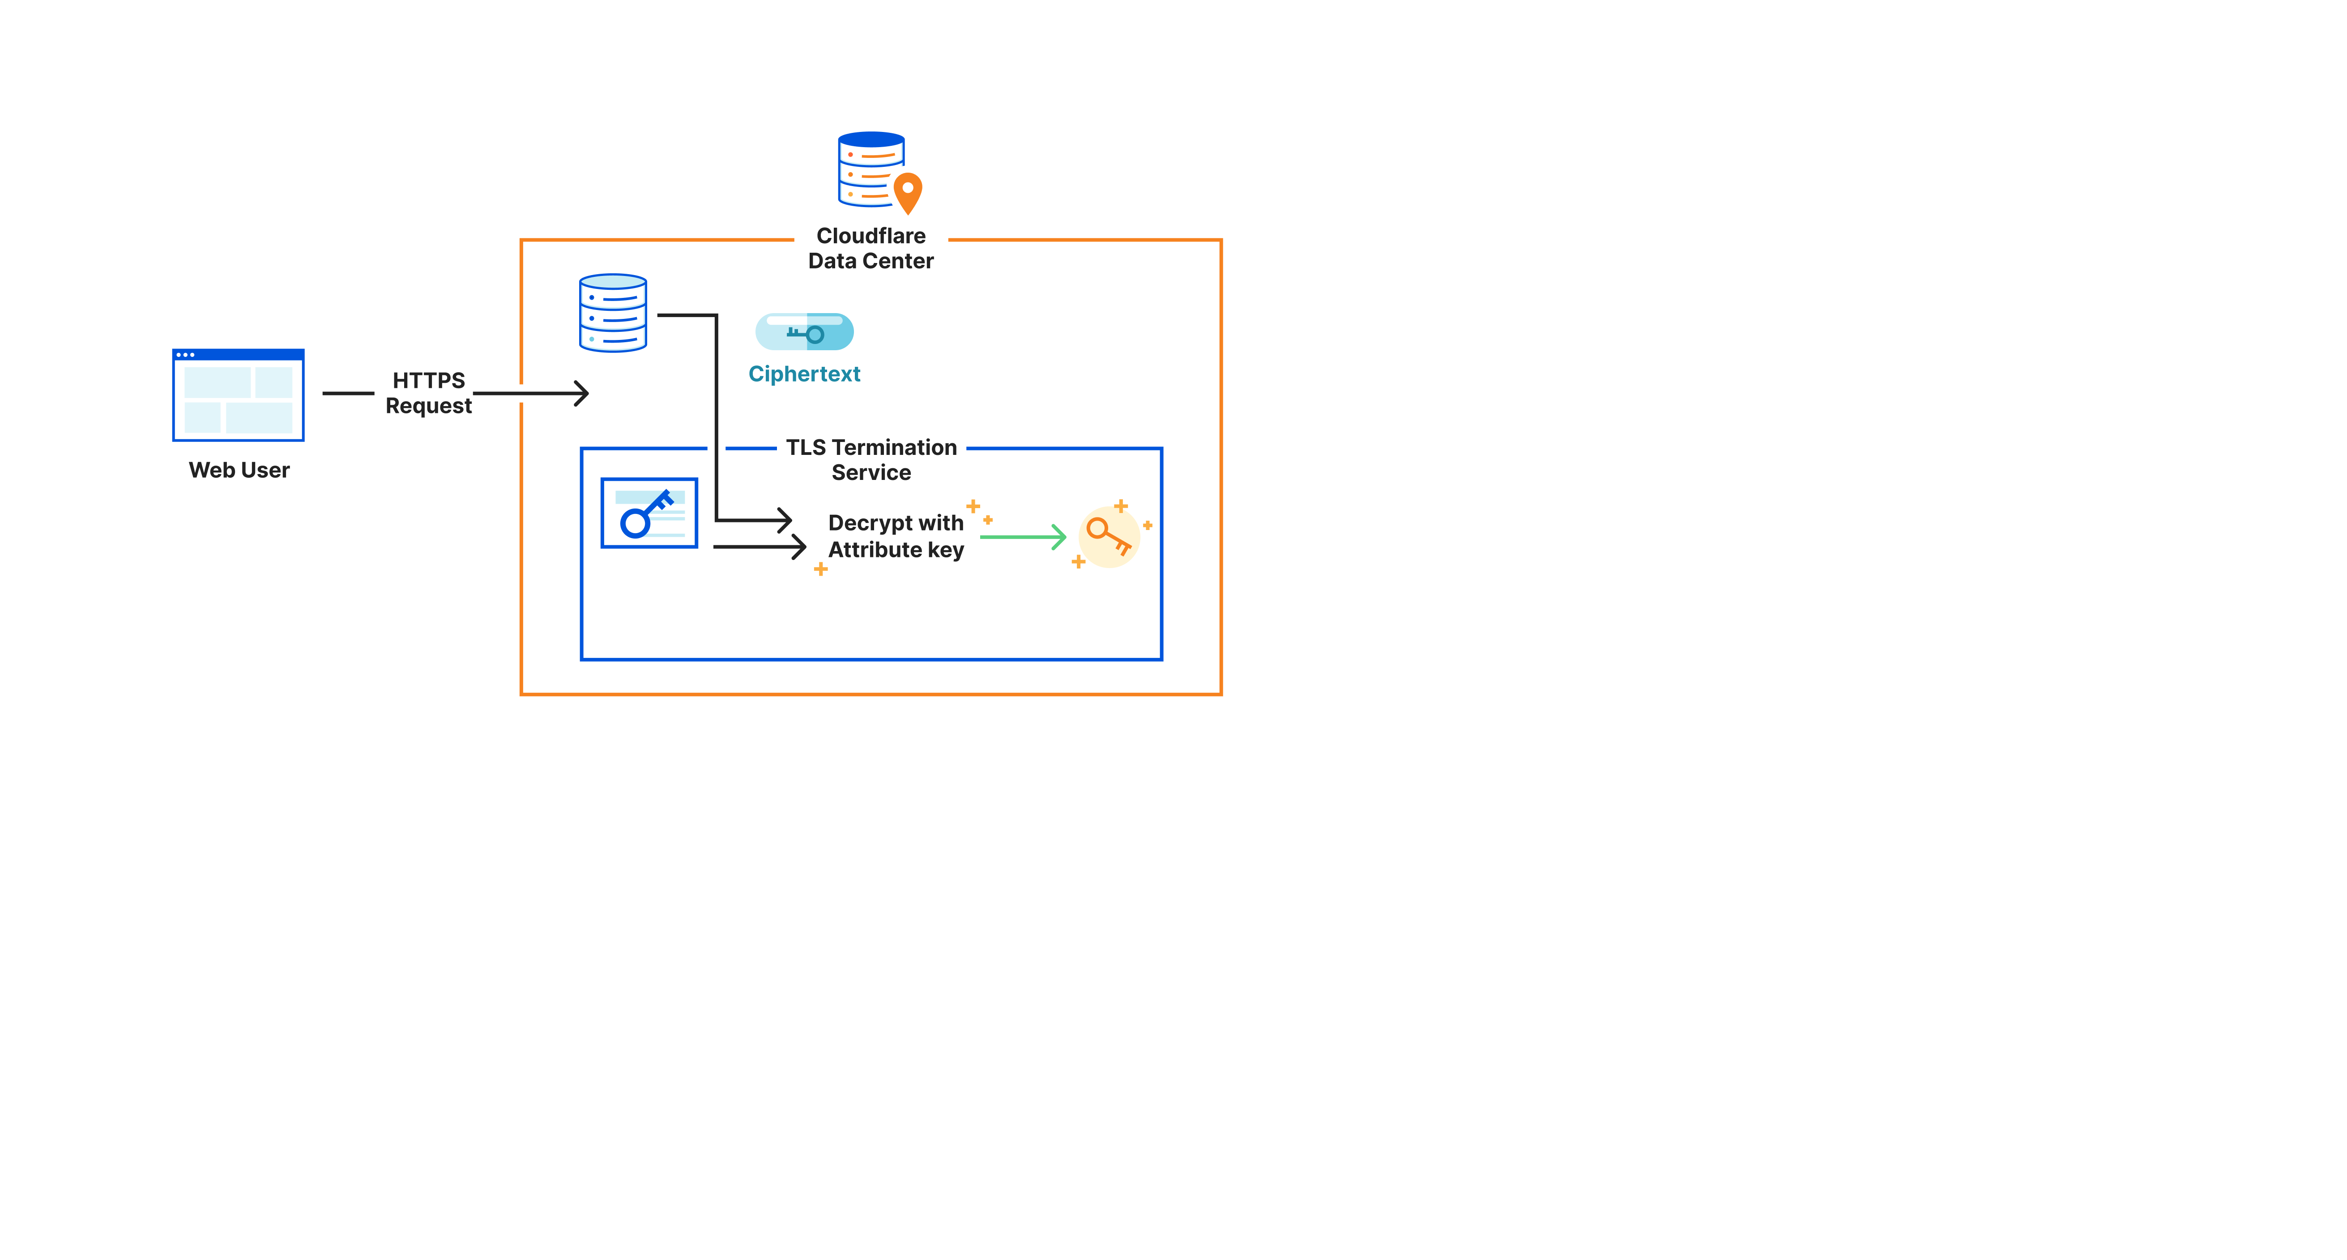
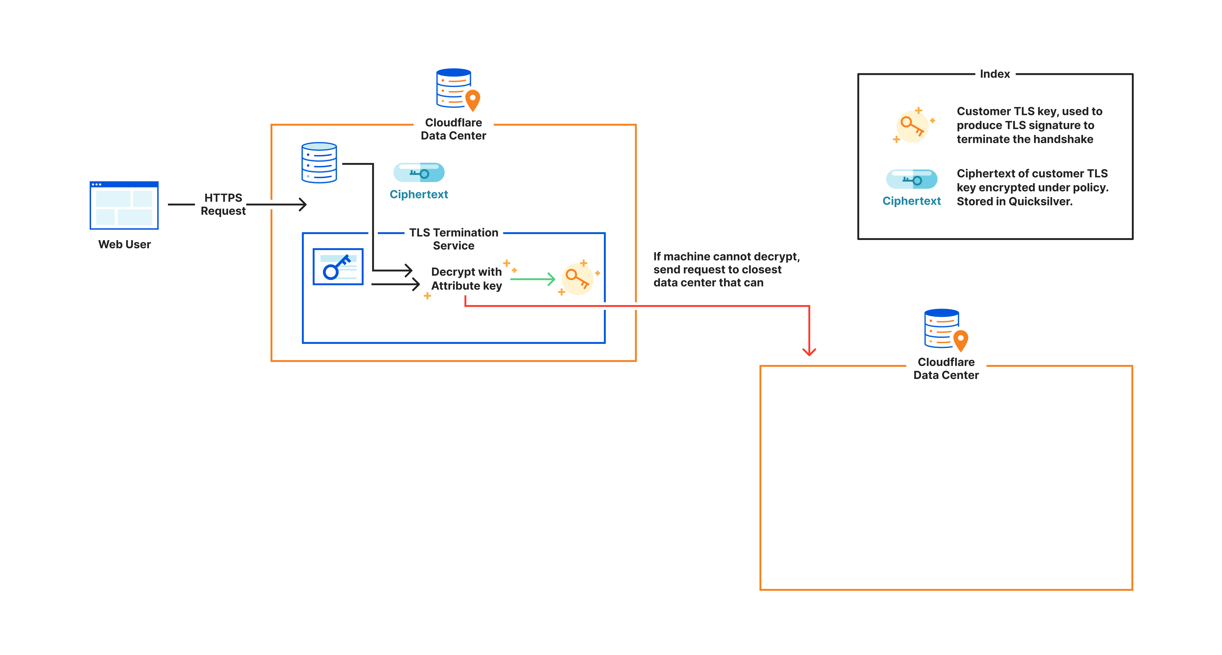
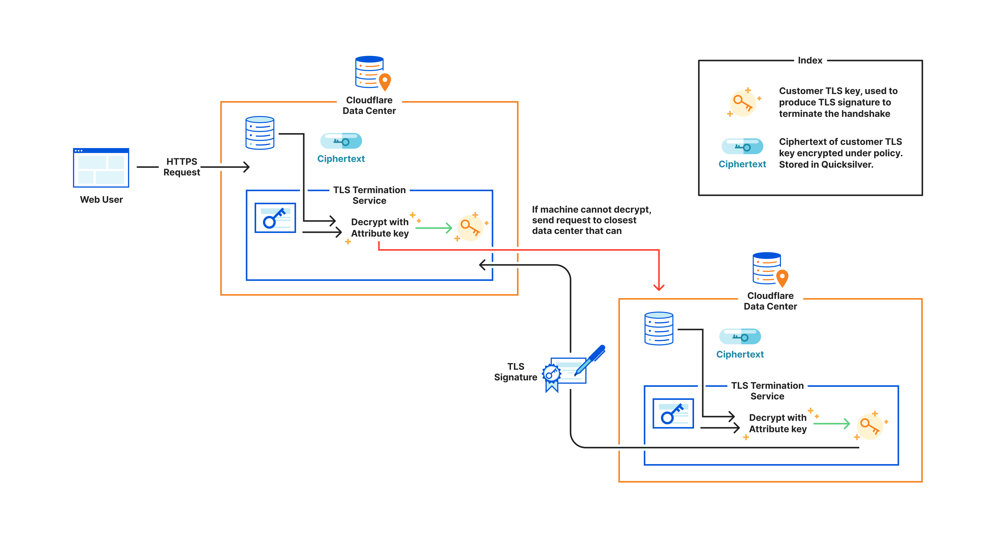

Slide 16
Performance: Isolating what matters
Attribute/Policy Size- ~3-4, we benchmark against 50 (in milliseconds)
Scheme | KeyGen | Encrypt 23B | Decrypt 23B
RSA-2048 | 117 | 0.043 | 1.26
X25519 | 0.045 | 0.093 | 0.046
Our scheme | 1796 | 704 | 62.4

Slide 17
Policy Keys
The antidote to the performance question
“Hybrid” encryption
X25519 keypairs for unique policies, use that to encrypt
Caching + policy keys = reduced decryption cost!
Ease of key rotation
# policy keys <<< # customer keys

Slide 18
Challenges
First attempt in 2016
No efficient ABE schemes that supported negation
Simulated ABE with a combination of identity-based encryption and broadcast encryption
No collusion resistance, still very inflexible
Translating a paper into usable & scalable code is very difficult!
Formidable notation can sometimes hide significant computation steps
Choosing parameters
Pairings are unfamiliar to many, and not standardized
Path to post-quantum ABE unclear

Slide 19
Feature Wishlist
Easier attribute changes
Gets tricky, particularly when negation is involved
Usable wildcard support
Dual system encryption used for groups
Convenient for strong security proofs
But decryption incurs a performance hit
Negation is important, please include it!
CCA2 vs CPA

Slide 20
Key Takeaways
Consider ABE for your distributed systems access control needs
Enables increased fault tolerance
No reliance on highly available central authority
Low latency
Peer to peer communication
Storage layer encryption => reduced accidental leaks
https://eprint.iacr.org/2023/094.pdf
https://blog.cloudflare.com/inside-geo-key-manager-v2/

