Slide 1
Generic-Group Lower Bounds via Reductions Between Geometric-Search Problems: With and Without Preprocessing
Benedikt Auerbach, Charlotte Hoffmann, Guillermo Pascual-Perez
Institute of Science and Technology Austria

Slide 2
Hardness of Assumptions in Groups
$$g^{x}$$
$$𝔾$$
$$x$$

Slide 3
The Generic Group Model
$$𝔾$$
x
$$𝒪$$

Slide 4
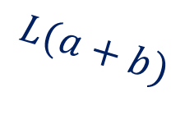
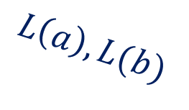
Shoup’s Generic Group Model [Sho97]
$$L:𝔾→{\left\{0,1\right\}}^{ℓ}$$
$$L\left(1\right),L(x)$$
$$𝔾$$
x
$$L\left(a\right),L(b)$$
$$𝒪_{L}$$
$$L(a+b)$$
Maurer’s Generic Group Model: No labels, abstract handles instead

Slide 5
GGM → Hardness Lower Bounds
Prove lower bounds on group operations required to solve a problem
Shoup’s GGM can be extended to preprocessing bounds [CK17,CDG18]
Transfer lower bounds between problems via reductions
$$𝒪_{L}$$
$$←L$$
$$L:𝔾→{\left\{0,1\right\}}^{ℓ}$$
$$s$$
$$𝒪_{L}$$
$$x→$$

Slide 6
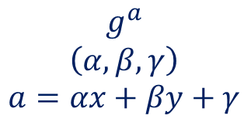
Transfer bounds via Algebraic Group Model [FKL18]
Our Contribution
algebraic
$$g,g^{x}, g^{y}$$
$$𝔾$$
Problem A
Problem B
New technique to transfer GGM lower bounds that is
usable in Shoup's GGM;
compatible with preprocessing bounds.
GGM lower bound
simple reductions
need: any generic adversary is algebraic -- only formally proven in Maurer’s GGM [FKL18, ZZK22, Zha22]
not compatible with preprocessing bounds
$$g^{a}$$
$$\left(α,β,γ\right)$$
$$a=αx+βy+γ$$

Slide 7
Technical Overview

Slide 8
Reduction via Geometric Search Problems
x
preprocessing
AGM
BF-GGM [CDG18]
GGM
Problem A
CDH
Problem B
geometric
problems [Yun15]
Geo-A
Geo-B
Geo-DL
Geo-CDH
information-theoretic lower bound

Slide 9
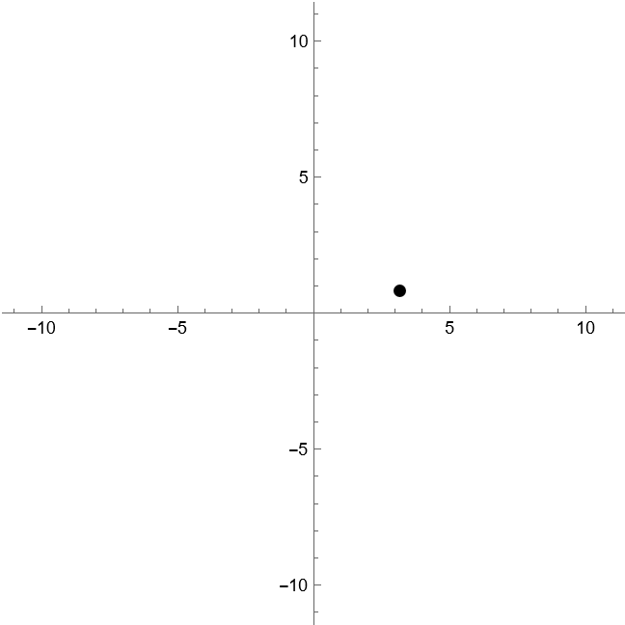
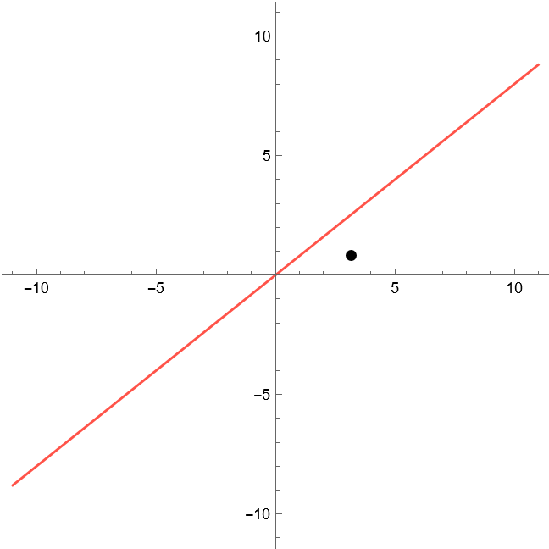
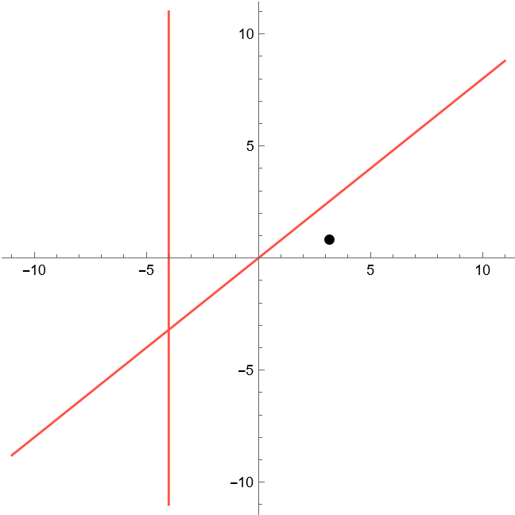
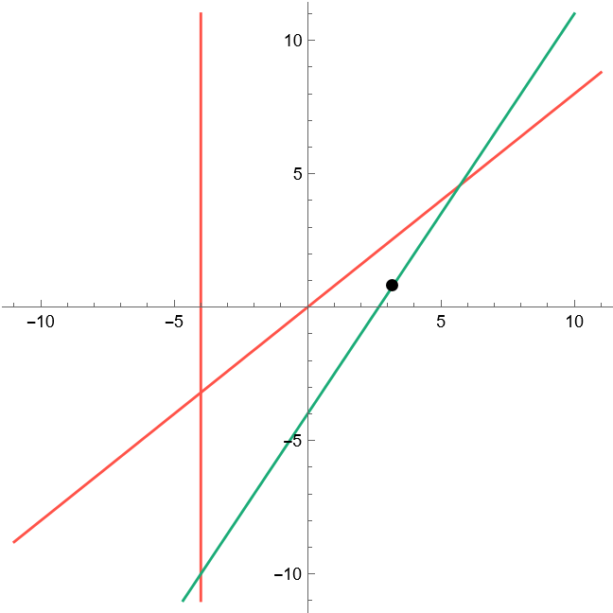
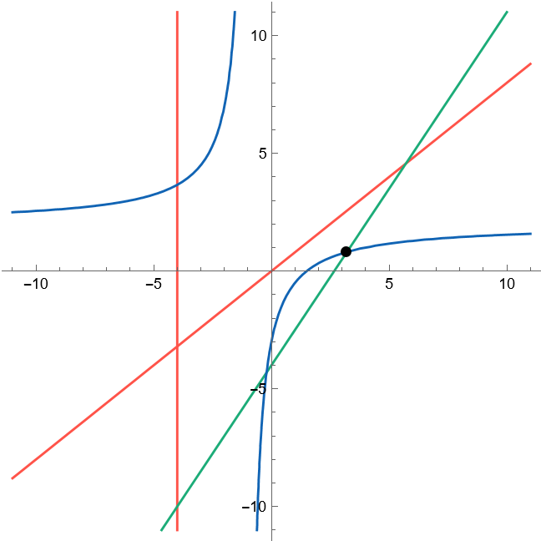
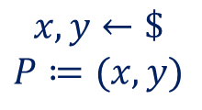
Geo-CDH
$$𝒞$$
$$𝒜$$
$$𝔽_{p}^{2}$$
In Paper
$$x,y←\$$$
$$P≔(x,y)$$
$x+4=0?$
$−3x+2y+8=0?$
$4x−5y=0?$
define geometric versions of (Multi-Instance) Uber problems
prove analogous lemma (in GGM and BF-GGM)
→ can be used in future work
$$0$$
$$1$$
$$P$$
$$2X−Y−3$$
$𝒜$ wins iff $XY−(2X−Y−3)$ has $P$ as root.
Lemma: Geo-CDH → CDH
line queries used to consistently simulate GGM oracle
output corresponds to target group element
GGM

Slide 10
Reduction via Geometric Search Problems
GGM
Problem B
geometric
problems
Geo-A
Geo-B
information theoretic lower bound

Slide 11
Geo-A → Geo-B
Observation: Many AGM reductions have natural analogue for geometric problems.
Reductions between geometric versions of
$q$DL → Uber (similar to AGM reduction of [BFL20])
$q$DL → $q$DHI
(m, m)-MI-gap-DL → (m, n)-MI-gap-CDH (similar to [AGK20])
2DL → BLS signatures (similar to [FKL18])
In Paper

Slide 12
Reduction via Geometric Search Problems
GGM
CDH
Problem B
geometric
problems
Geo-A
Geo-B
Geo-DL
Geo-CDH
information theoretic lower bound

Slide 13
Summary
We present new technique to transfer (preprocessing) lower bounds in the GGM.
We give new preprocessing lower bounds for several problems.
Open problems:
Adapt technique for decisional problems.
Extend BF-GGM [CDG18] to decisional oracles and bilinear groups.
Questions?

