Slide 1
DORAM revisited: Maliciously secure RAM-MPC with logarithmic overhead
Brett Falk | Daniel Noble | Rafail Ostrovsky | Matan Shtepel | Jacob Zhang
TCC 2023, Taiwan

Slide 2
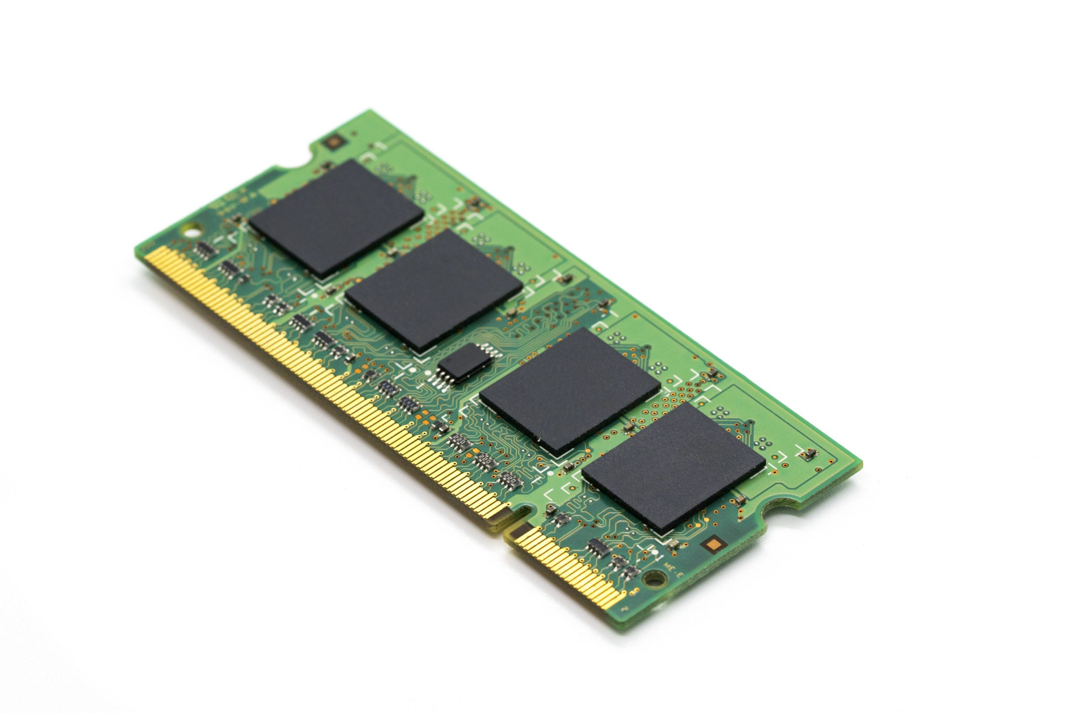
What is DORAM?
$$≅$$
$n$: Number of blocks
$d$: Block size
$κ$: Security parameter
$$Θ(\left(κ+d\right)\log{n})$$

Slide 3
DORAM from ORAM

Slide 4
DORAM, not from ORAM

Slide 5
Oblivious Hash Table
Items are stored in memory
Locations seem random
Each item can only be accessed ONCE

Slide 6
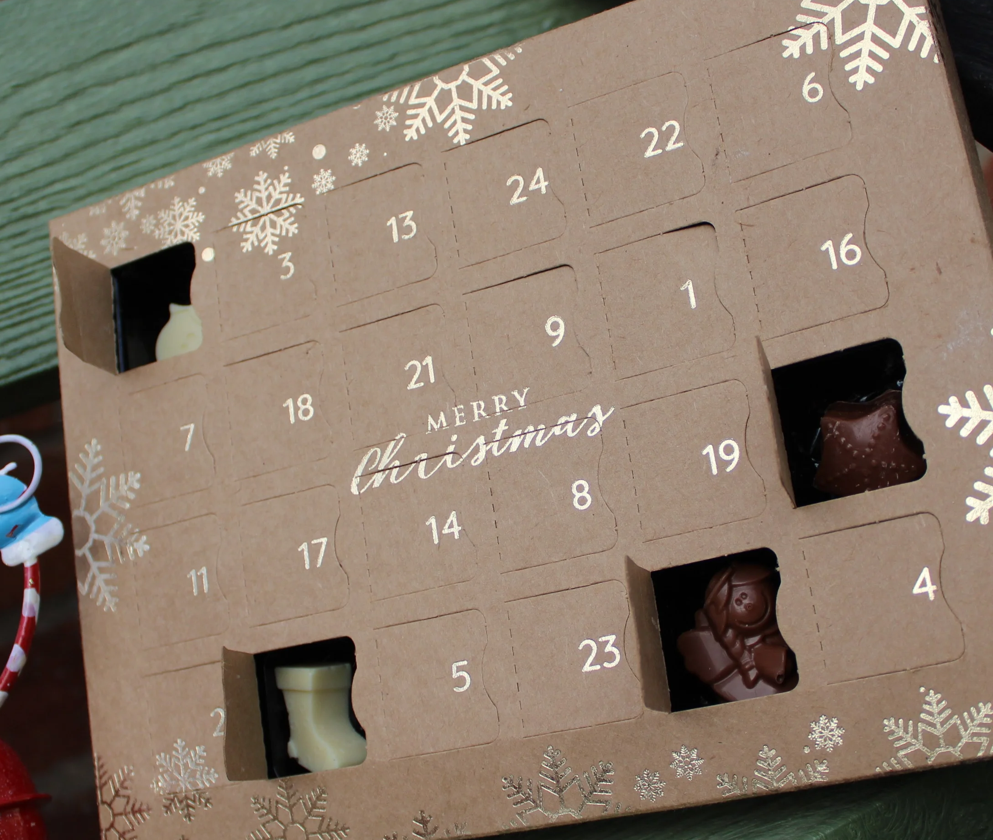
DORAM from OHTables
$$\frac{n}{2}$$
$$n$$
$$\frac{n}{4}$$
$$\frac{n}{8}$$
$$\frac{n}{16}$$
Read(PRF(k,x))
y_old
$$n$$
$$\frac{n}{2}$$
$$\frac{n}{4}$$
$$\frac{n}{8}$$
$$\frac{n}{16}$$
Write(x, y_new)

Slide 7
Building OHTables with 3 parties
$$PRF_{k_{1}}\left(x_{1}\right), …PRF_{k_{1}}\left(x_{n}\right)$$
$$PRF_{k_{2}}\left(x_{1}\right), …PRF_{k_{2}}\left(x_{n}\right)$$
$$π$$
$$x_{1}$$
$$x_{2}$$
$$x_{3}$$
$$x_{4}$$
$$x_{5}$$
$$π_{2}∘π_{1}=π$$
$$x_{6}$$

Slide 8
Building OHTables with 3 parties
$$x_{1}$$
$$x_{2}$$
$$π_{1}$$
$$x_{3}$$
$$x_{4}$$
$$x_{5}$$
$$x_{6}$$

Slide 9
Building OHTables with 3 parties
$$x_{1}$$
$$x_{2}$$
$$x_{3}$$
$$x_{4}$$
$$x_{5}$$
$$x_{6}$$

Slide 10
Building OHTables with 3 parties
$$x_{5}$$
$$x_{2}$$
$$x_{4}$$
$$x_{6}$$
$$x_{3}$$
$$x_{1}$$

Slide 11
Building OHTables with 3 parties
$$x_{5}$$
$$x_{2}$$
$$x_{4}$$
$$π_{2}$$
$$x_{6}$$
$$x_{3}$$
$$x_{1}$$

Slide 12
Building OHTables with 3 parties
$$x_{5}$$
$$x_{2}$$
$$x_{4}$$
$$x_{6}$$
$$x_{3}$$
$$x_{1}$$

Slide 13
Building OHTables with 3 parties
$$x_{2}$$
$$x_{4}$$
$$x_{1}$$
$$x_{6}$$
$$x_{5}$$
$$x_{3}$$

Slide 14
Building OHTables with 3 parties
$$x_{2}$$
$$x_{4}$$
$$x_{1}$$
$$x_{6}$$
$$x_{5}$$
$$x_{3}$$

Slide 15
Security against Malicious Parties
Want to check:
- Each item is in a valid location - All of the items are there
$$x_{2}$$
$$x_{1}$$
$$P\left(t\right)=Π_{i=1}^{n}(t −x_{i})$$
$$x_{2}$$
$${\hat{x}}_{1}$$
$$x_{4}$$
$${PRF_{k_{1}}(\hat{x}}_{i})≟i$$
$$∨$$
$$PRF_{k_{2}}\left({\hat{x}}_{i}\right)≟i$$
$$x_{2}$$
$$x_{4}$$
$${\hat{x}}_{2}$$
$$\hat{P}\left(t\right)=Π_{i=1}^{n}(t −{\hat{x}}_{i})$$
$$x_{1}$$
$$x_{3}$$
$$x_{1}$$
$${\hat{x}}_{3}$$
$$x_{6}$$
$$x_{4}$$
$$x_{6}$$
$${\hat{x}}_{4}$$
$$P\left(t\right)≟\hat{P}(t)$$
$$x_{5}$$
$$x_{5}$$
$$x_{5}$$
$${\hat{x}}_{5}$$
Shwartz-Zippel Lemma
$$x_{3}$$
$$x_{6}$$
$$x_{3}$$
$${\hat{x}}_{6}$$
BOOLEAN
$$Z_{2^{k}}$$
ARITHMETIC

Slide 16
Any Questions?
Kudos:
https://www.henleychocolates.co.uk/store/p223/plasticfreeadventcalendar.html

