Slide 1
Multilinear Schwartz-Zippel mod N and Lattice-Based Succinct Arguments
Benedikt Bünz
Joint work with Ben Fisch (Yale)
https://eprint.iacr.org/2022/458.pdf

Slide 2







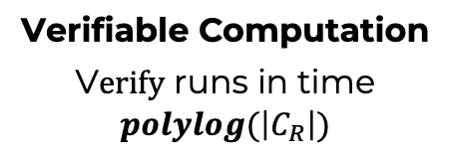
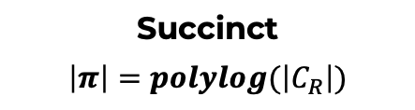





Zero Knowledge Succinct Non-Interactive
Argument of Knowledge
(ZK-SNARK)
Public instance $x$
[GMR ’86,BFM ’88, ALMSS’92, Kilian’92, Micali’00, IKO’07, GGPR’13,…]
Setup$\left(C_{R}\right)→(pk,vk)$
Private witness $w$
Inputs:
$$\left(x, w\right)∈R$$
$$x$$
$C_{R}$ - circuit computing $R$
𝜋
V$erify\left(vk,x,π\right)→Accept/Reject$
Prove$\left(pk,x,w\right)→π$
Prover
Verifier
Knowledge Sound
infeasible to produce valid 𝝅 if prover doesn’t know w
Zero knowledge
the 𝝅 doesn’t reveal anything about w
Succinct
$$\left|π\right|=polylog(\left|C_{R}\right|)$$
Verifiable Computation
V$erify$ runs in time $polylog(\left|C_{R}\right|)$

Slide 3
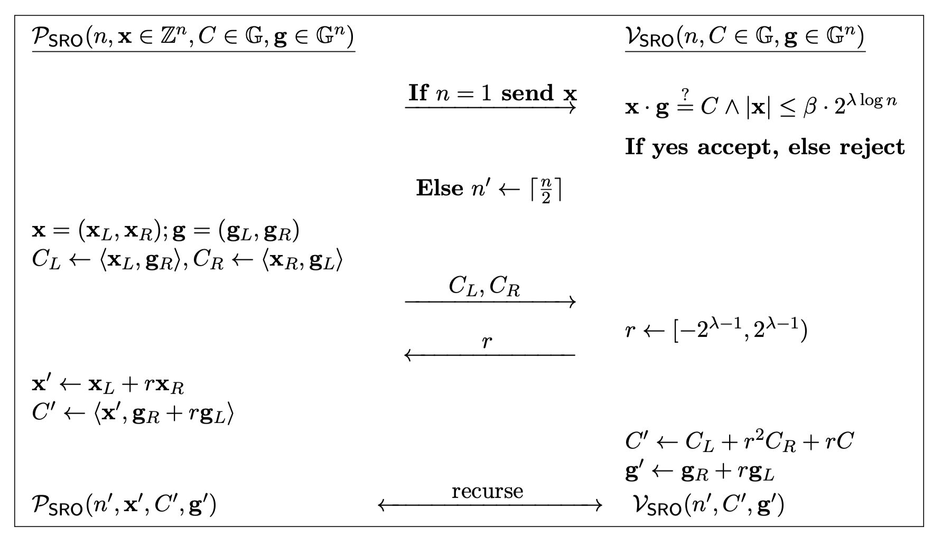
Two variants of folding protocols (Bulletproofs)
Bulletproofs: Succinct proof in discrete logarithm groups.
Not secure against quantum computers
Linear verification time
Lattice BP [BLNS20;ACK21b;AL21]
DARK (GUO BP)[BFS20]
Secure against QC 👍
Logarithmic verification👍
Low soundness (small challenge set)👎
  Requires repetition
  Larger proofs
  Less compatible with Fiat-Shamir
Broken👎
  Gap in proof [BHRRS21]
  Fix leads to larger proofs
  Also uses small challenges

Slide 4
Results
Show security of Lattice BP with exponential challenge sets
  Negligible soundness error
Unified treatment
New Schwartz-Zippel Lemma modulo composites
New soundness notion: Almost Special Soundness

Slide 5






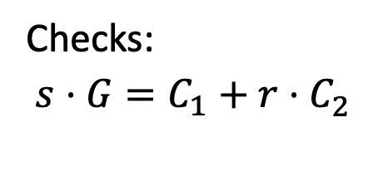
Bulletproofs/Folding Compression
$$\left(G∈(𝔾,+);C_{1},C_{2};α_{1},α_{2}\right):$$
$$α_{1}⋅G=C_{1}, α_{2}⋅G=C_{2}$$
$$C_{1},C_{2}$$
Random challenge $r∈[{0,2}^{λ})$
Peggy
Victor
Checks:
$$s⋅G=C_{1}+r⋅C_{2}^{}$$
$$s=α_{1}+r⋅α_{2}$$

Slide 6
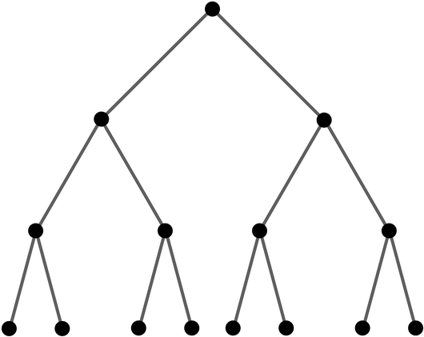



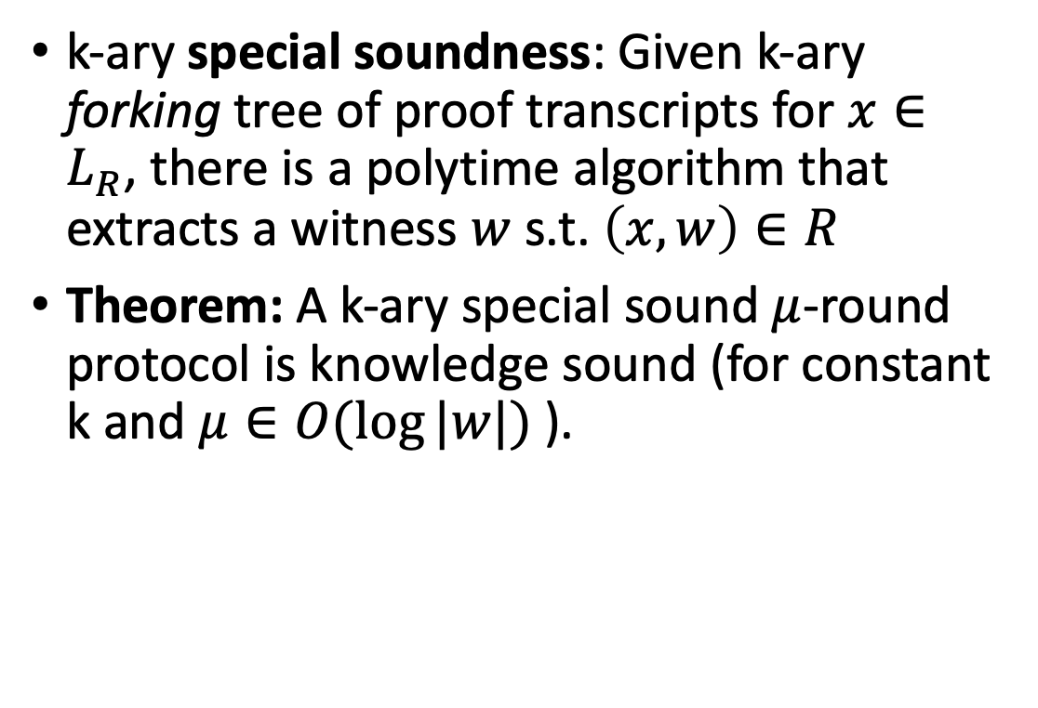


























Special Soundness
$$x$$
k-ary special soundness: Given k-ary forking tree of proof transcripts for $x∈L_{R}$, there is a polytime algorithm that extracts a witness $w$ s.t. $\left(x,w\right)∈R$
Theorem: A k-ary special sound$μ$-round protocol is knowledge sound (for constant k and $μ∈O(\log{|w|) }$).
$$α_{0}$$
$$α_{1}$$
$$m_{1}$$
$$m_{2}$$
$$α_{1,0}$$
$$α_{1,1}$$
$$α_{2,0}$$
$$α_{2,1}$$
$$m_{3}$$
$$m_{5}$$
$$m_{6}$$
$$m_{4}$$
$$α_{4,0}$$
$$α_{4,1}$$
$$α_{6,0}$$
$$α_{6,1}$$
$$α_{3,0}$$
$$α_{3,1}$$
$$α_{5,0}$$
$$α_{5,1}$$
$$m_{7}$$
$$m_{8}$$
$$m_{9}$$
$$m_{10}$$
$$m_{11}$$
$$m_{12}$$
$$m_{13}$$
$$m_{14}$$

Slide 7
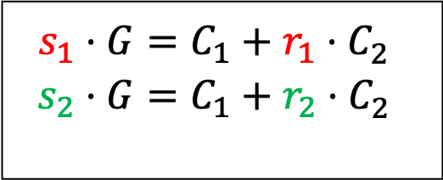
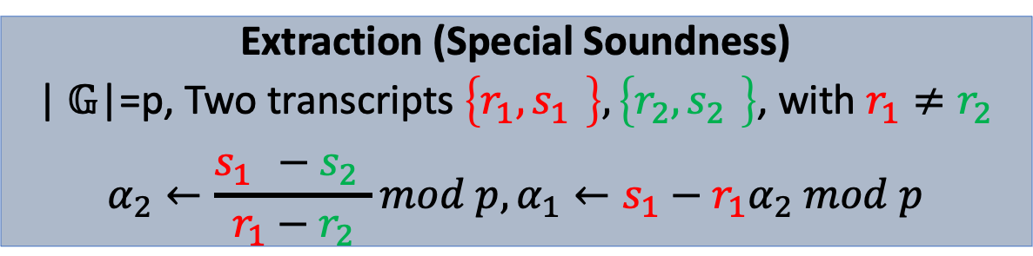
Bulletproofs/Folding Compression
$$\left(G∈(𝔾,+);C_{1},C_{2};α_{1},α_{2}\right):$$
$$α_{1}⋅G=C_{1}, α_{2}⋅G=C_{2}$$
$$C_{1},C_{2}$$
Random challenge $r∈[{0,2}^{λ})$
Peggy
Victor
Checks:
$$s⋅G=C_{1}+r⋅C_{2}^{}$$
$$s=α_{1}+r⋅α_{2}$$
Extraction (Special Soundness)
| $𝔾$|=p, Two transcripts $\left\{r_{1},s_{1}^{}\right\},\left\{r_{2},s_{2}^{}\right\}$, with $r_{1}≠r_{2}$
$$α_{2}←\frac{s_{1}^{}−s_{2}^{}}{r_{1}−r_{2}}mod p,α_{1}←s_{1}−r_{1}α_{2} mod p$$
$$s_{1}⋅G=C_{1}+r_{1}⋅C_{2}^{}$$
$$s_{2}⋅G=C_{1}+r_{2}⋅C_{2}^{}$$

Slide 8

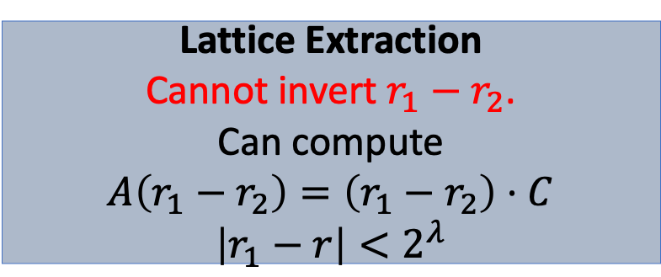
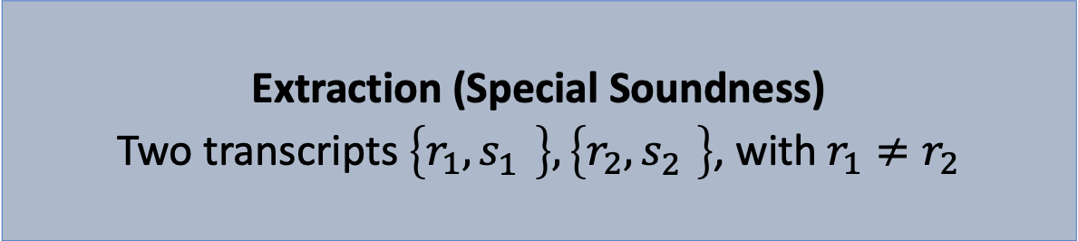
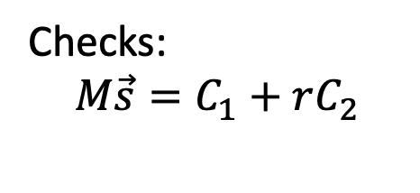
Lattice Bulletproofs
$$\left(M∈𝔽^{n×m};C_{1},C_{2};{\vec{α}}_{1},{\vec{α}}_{2}\right):M{\vec{α}}_{1}=C_{1},M{\vec{α}}_{1}=C_{1}$$
$$C_{1},C_{2}$$
Random challenge $r∈[{0,2}^{λ})$
Peggy
Victor
Checks:
$$M\vec{s}=C_{1}+rC_{2}$$
$$\vec{s}={\vec{α}}_{1}+r⋅{\vec{α}}_{2}$$
Extraction (Special Soundness)
Two transcripts $\left\{r_{1},s_{1}^{}\right\},\left\{r_{2},s_{2}^{}\right\}$, with $r_{1}≠r_{2}$
Lattice Extraction
Cannot invert $r_{1}−r_{2}$.
Can compute
$$A\left(r_{1}−r_{2}\right)=\left(r_{1}−r_{2}\right)⋅C$$
$$\left|r_{1}−r\right|<2^{λ}$$

Slide 9
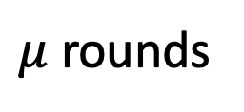

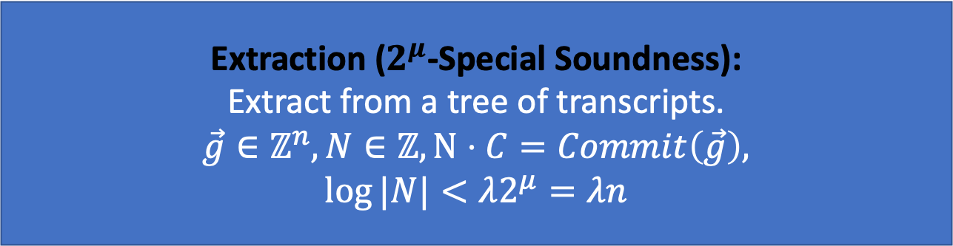

Compressed Sigma Protocols for Short Openings
$(C=Commit\left(\vec{f}\right),φ(\vec{f});\vec{f}∈ℤ^{n})$
Commitments
$μ$ rounds
Random challenge $r∈[{0,2}^{λ})$
DARK,
IPA (Bulletproofs)
Lattice-BP
Final commitment opening
Checks commitment/opening validity (small integer)
Extraction ($2^{μ}$-Special Soundness):
Extract from a tree of transcripts.
$$\vec{g}∈ℤ^{n},N∈ℤ,N⋅C=Commit\left(\vec{g}\right),$$
$$\log{|N|}<λ2^{μ}=λn$$

Slide 10

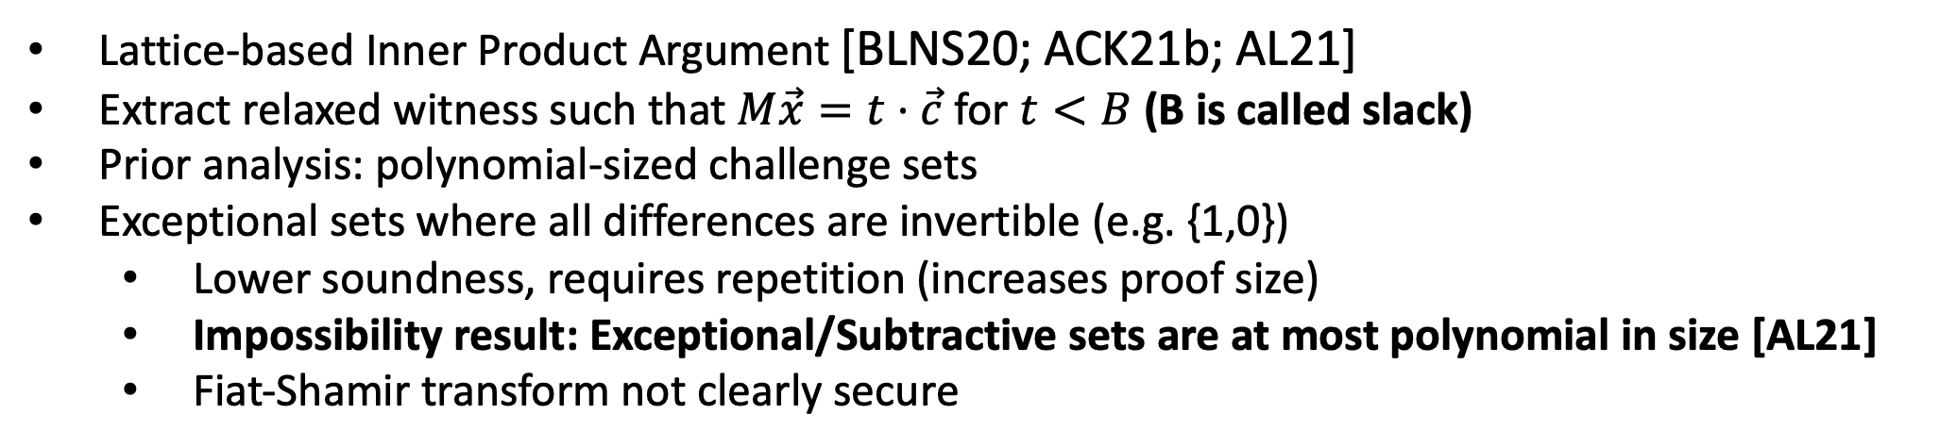
Lattice Bulletproofs
Integer SIS-Commitment:
$M\vec{x}=\vec{c} mod q$ for $\left|\left|\vec{x}\right|\right|≪q$
Lattice-based Inner Product Argument [BLNS20; ACK21b; AL21]
Extract relaxed witness such that $M\vec{x}=t⋅\vec{c}$ for $t<B$ (B is called slack)
Prior analysis: polynomial-sized challenge sets
Exceptional sets where all differences are invertible (e.g. {1,0})
  Lower soundness, requires repetition (increases proof size)
  Impossibility result: Exceptional/Subtractive sets are at most polynomial in size [AL21]
  Fiat-Shamir transform not clearly secure

Slide 11
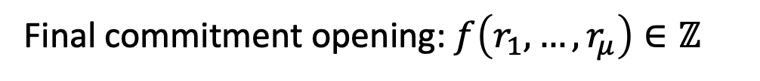
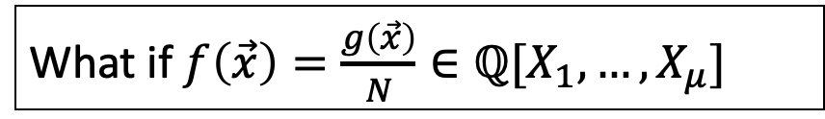
Adversarial/Attack Perspective
$(C=Commit\left(\vec{f}\right),φ(\vec{f});\vec{f}∈ℤ^{n})$
Commitments
$μ$ rounds
Random challenge $r∈[{0,2}^{λ})$
Final commitment opening: $f\left(r_{1},…,r_{μ}\right)∈ℤ$
Checks commitment/opening validity (small integer)
$f$ is multi-linear evaluation of $\vec{f}$ (protocol can be viewed as a sumcheck)
What if $f\left(\vec{x}\right)=\frac{g\left(\vec{x}\right)}{N}∈ℚ[X_{1},…,X_{μ}]$

Slide 12

Adversarial/Attack Perspective
$(C=Commit\left(\vec{f}\right),φ(\vec{f});\vec{f}∈ℤ^{n})$
Commitments
$μ$ rounds
Random challenge $r∈[{0,2}^{λ})$
Final commitment opening: $f\left(r_{1},…,r_{μ}\right)∈ℤ$
Checks commitment/opening validity (small integer)
Adv. succeeds with ‘rational’ witness $\vec{g}∈Z^{n},N∈Z$
if $\frac{g\left(r_{1},…,r_{μ}\right)}{N}$ is a small integer ($g\left(X_{1},…,X_{μ}\right)$ has coeffs $\vec{g}$).
But if $N≫2^{λ}$ this seems unlikely.

Slide 13
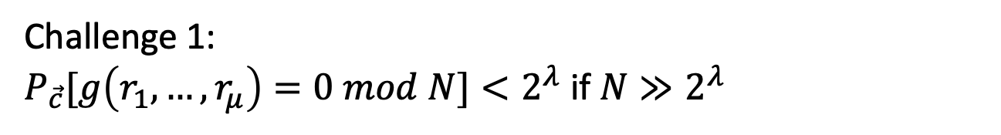

From Attack Perspective to Proof
Adv. succeeds with ‘rational’ witness $\vec{g}∈Z^{n},N∈Z$
if $\frac{g\left(r_{1},…,r_{μ}\right)}{N}$ is a small integer ($g\left(X_{1},…,X_{μ}\right)$ has coeffs $\vec{g}$).
But if $N≫2^{λ}$ this seems unlikely.
Challenge 1:
$P_{\vec{c}}[g\left(r_{1},…,r_{μ}\right)=0 mod N]<2^{λ}$ if $N≫2^{λ}$
New Schwartz Zippel Lemma modulo composites

Slide 14
Adversarial/Attack Perspective
Adv. succeeds with ‘rational’ witness $\vec{g}∈Z^{n},N∈Z$
if $\frac{g\left(r_{1},…,r_{μ}\right)}{N}$ is a small integer ($g\left(X_{1},…,X_{μ}\right)$ has coeffs $\vec{g}$).
But if $N≫2^{λ}$ this seems unlikely.
Challenge 2:
Special Soundness does not capture this perspective
Defining Almost Special Soundness
Implies Knowledge Soundness

Slide 15
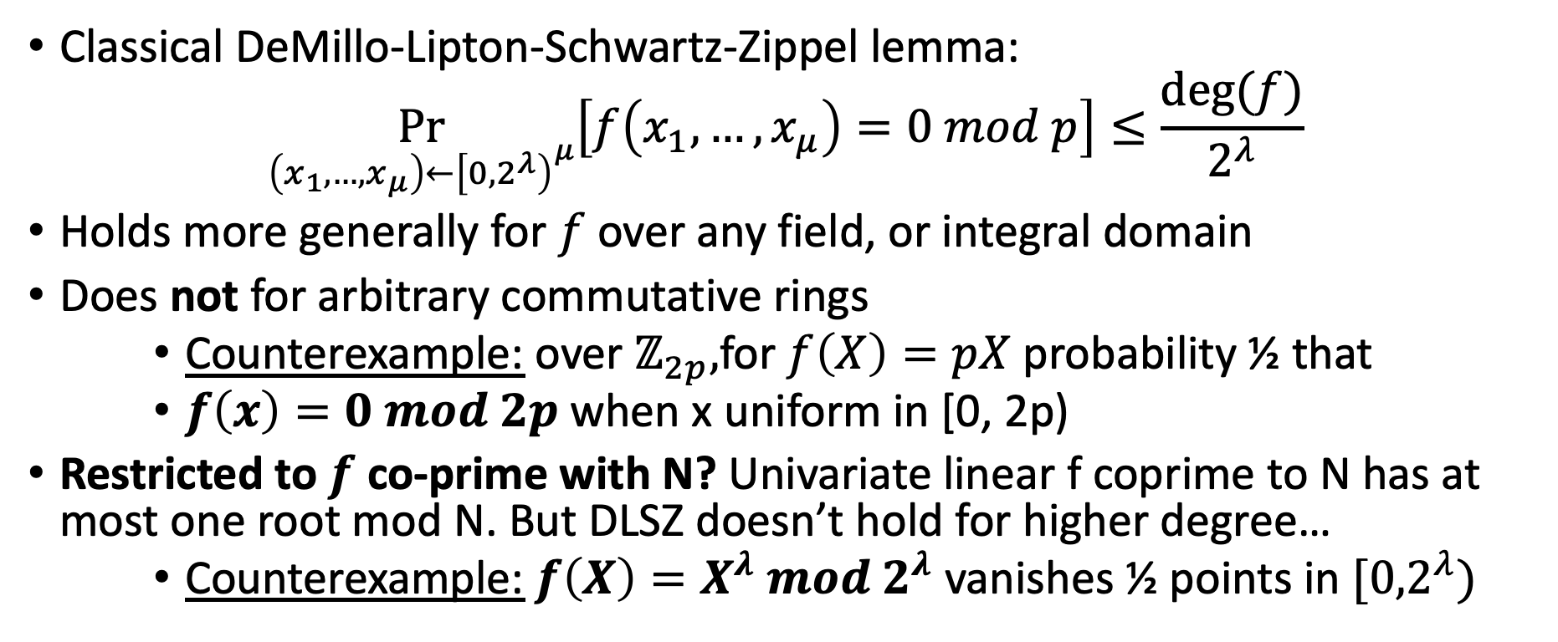
Classical Schwartz-Zippel
Classical DeMillo-Lipton-Schwartz-Zippel lemma:
$$\underset{\left(x_{1},…,x_{μ}\right)←{\left[{0,2}^{λ}\right)}^{μ}}{Pr}\left[f\left(x_{1},…,x_{μ}\right)=0 mod p\right]≤\frac{deg⁡(f)}{2^{λ}}$$
Holds more generally for $f$ over any field, or integral domain
Does not for arbitrary commutative rings
    Counterexample: over $ℤ_{2p},$for $f\left(X\right)=pX$ probability ½ that
    $f\left(x\right)=0 mod 2p$when x uniform in [0, 2p)
Restricted to $f$ co-prime with N? Univariate linear f coprime to N has at most one root mod N. But DLSZ doesn’t hold for higher degree…
    Counterexample: $f\left(X\right)=X^{λ} mod 2^{λ}$ vanishes ½ points in $[{0,2}^{λ})$

Slide 16
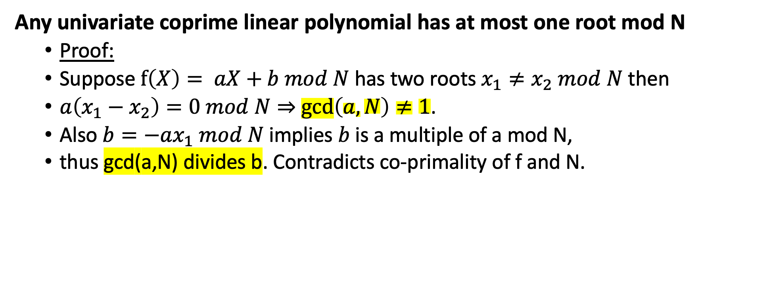
SZ for multilinear mod N
Any univariate coprime linear polynomial has at most one root mod N
  Proof:
  Suppose $f\left(X\right)= aX+b mod N$ has two roots $x_{1}≠x_{2} mod N$ then
  $a\left(x_{1}−x_{2}\right)=0 mod N⇒$ $\gcd\left(a,N\right)≠1$.
  Also $b=−ax_{1} mod N$implies $b$ is a multiple of a mod N,
  thus gcd(a,N) divides b. Contradicts co-primality of f and N.

Slide 17
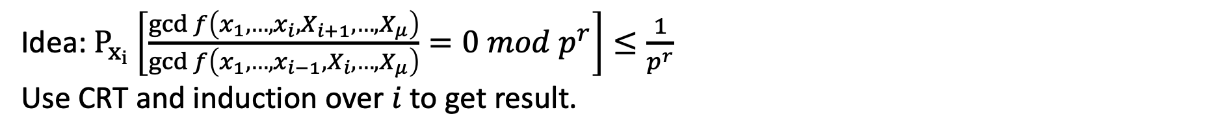
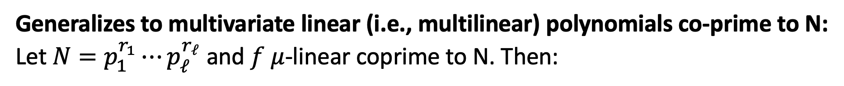
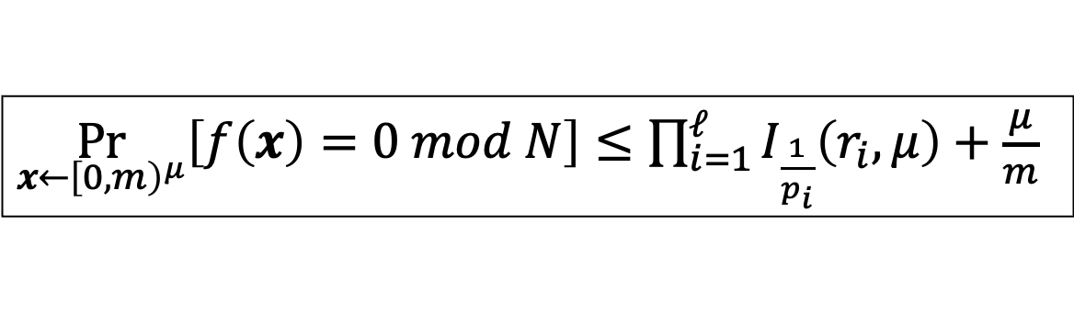
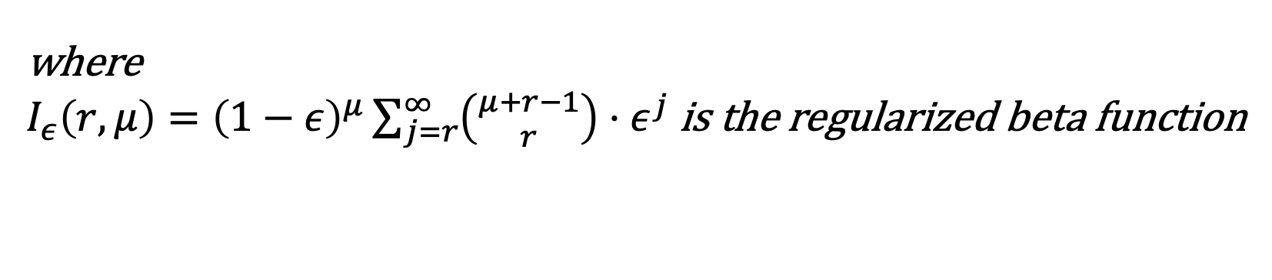
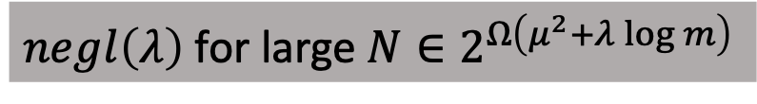
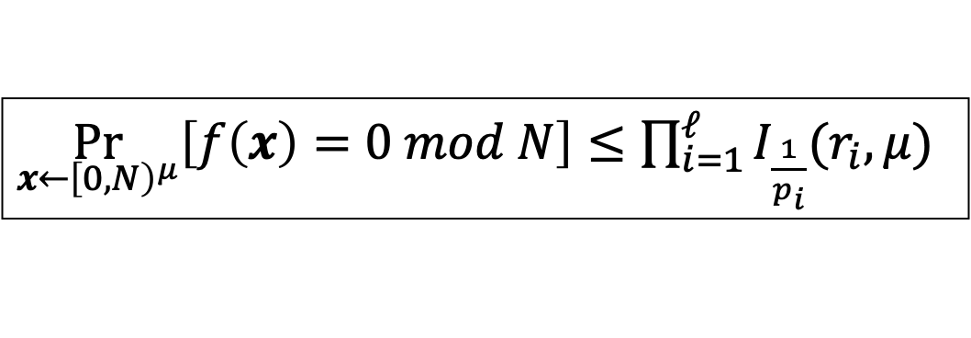
SZ for multilinear mod N
Generalizes to multivariate linear (i.e., multilinear) polynomials co-prime to N:
Let $N=p_{1}^{r_{1}}⋯p_{ℓ}^{r_{ℓ}}$ and $f$ $μ$-linear coprime to N. Then:
$\underset{x←{\left[0,N\right)}^{μ}}{Pr}\left[f\left(x\right)=0 mod N\right]≤\prod_{i=1}^{ℓ}{I_{\frac{1}{p_{i}}}(r_{i},μ)}$
$negl\left(λ\right)$ for large $N∈2^{Ω\left(μ^{2}+λ\log{m}\right)}$
Tight!
$\underset{x←{\left[0,m\right)}^{μ}}{Pr}\left[f\left(x\right)=0 mod N\right]≤\prod_{i=1}^{ℓ}{I_{\frac{1}{p_{i}}}\left(r_{i},μ\right)}+\frac{μ}{m}$
where
$I_{ε}\left(r, μ\right)={\left(1−ε\right)}^{μ}\sum_{j=r}^{∞}{\left({μ+r−1 \atop r}\right)}⋅ε^{j}$ is the regularized beta function
Idea: $P_{x_{i}}\left[\frac{\gcd{f\left(x_{1},…,x_{i},X_{i+1},…,X_{μ}\right)}}{\gcd{f\left(x_{1},…,x_{i−1},X_{i},…,X_{μ}\right)}}=0 mod p^{r}\right]≤\frac{1}{p^{r}}$
Use CRT and induction over $i$ to get result.

Slide 18
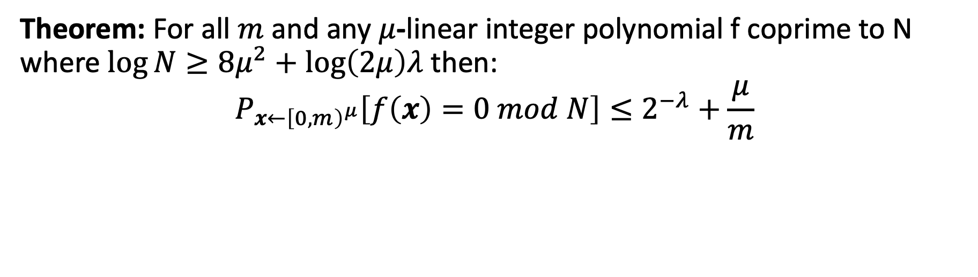
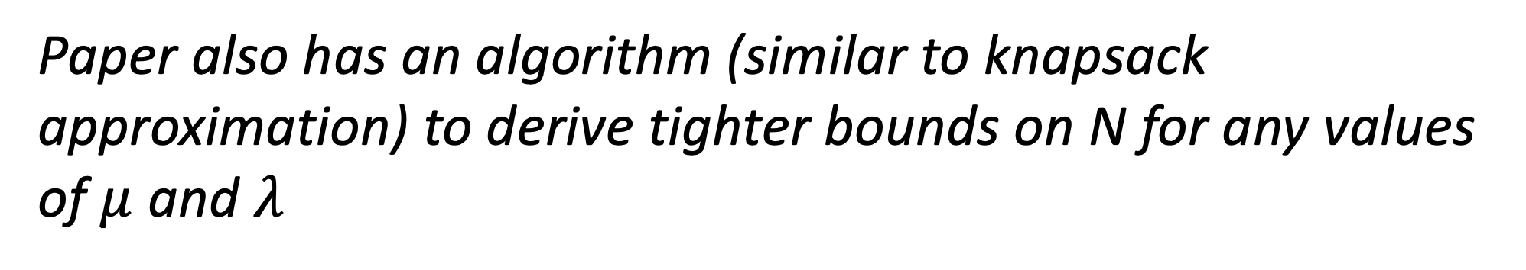
Inverse SZ for multilinear mod N
Theorem: For all $m$ and any $μ$-linear integer polynomial f coprime to N where $\log{N≥8μ^{2}+\log\left(2μ\right)λ}$ then:
$$P_{x←{\left[0,m\right)}^{μ}}\left[f\left(x\right)=0 mod N\right]≤2^{−λ}+\frac{μ}{m}$$
Paper also has an algorithm (similar to knapsack approximation) to derive tighter bounds on N for any values of $μ$ and $λ$

Slide 19
Computational Bound

Slide 20
Compressed Sigma Protocols for Short Openings
$(C=Commit\left(\vec{f}\right),φ(\vec{f});\vec{f}∈ℤ^{n})$
Commitments
$μ$ rounds
Random challenge $r∈[{0,2}^{λ})$
DARK,
IPA (Bulletproofs)
Lattice-BP
Final commitment opening
Checks commitment/opening validity (small integer)

Slide 21
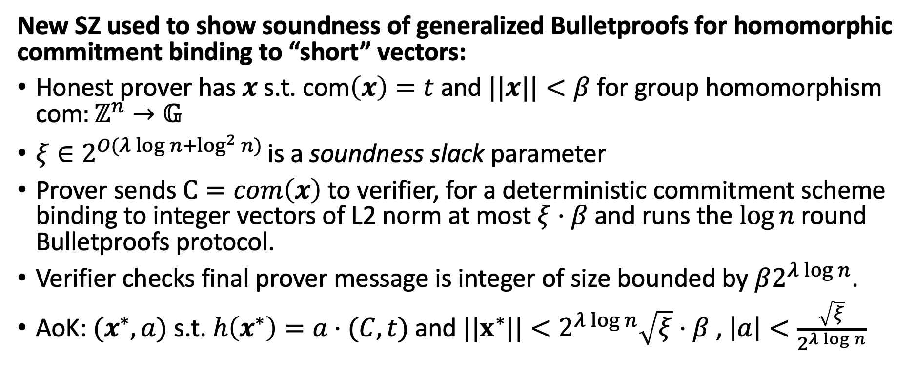
Application: PCS from Lattices
New SZ used to show soundness of generalized Bulletproofs for homomorphic commitment binding to “short” vectors:
Honest prover has $x$ s.t. com$\left(x\right)=t$ and $||x||<β$ for group homomorphism com$:ℤ^{n}→𝔾$
$ξ∈2^{O(λ\log{n+\log^{2}{n)}} }$is a soundness slack parameter
Prover sends $C=com\left(x\right)$ to verifier, for a deterministic commitment scheme binding to integer vectors of L2 norm at most $ξ⋅β$ and runs the $\log{n }$round Bulletproofs protocol.
Verifier checks final prover message is integer of size bounded by $β2^{λ\log{n}}$.
AoK: $(x^{∗},a)$ s.t. $h\left(x^{∗}\right)=a⋅(C,t)$ and $||x^{∗}||<2^{λ\log{n}}\sqrt{ξ}⋅β$ , $\left|a\right|<\frac{\sqrt{ξ}}{2^{λ\log{n}}}$

Slide 22
“Bulletproofs” (AoK Preimage)
2 Log n commitments
Implements PCS
  Interactive
In GUOs log Verifier

Slide 23
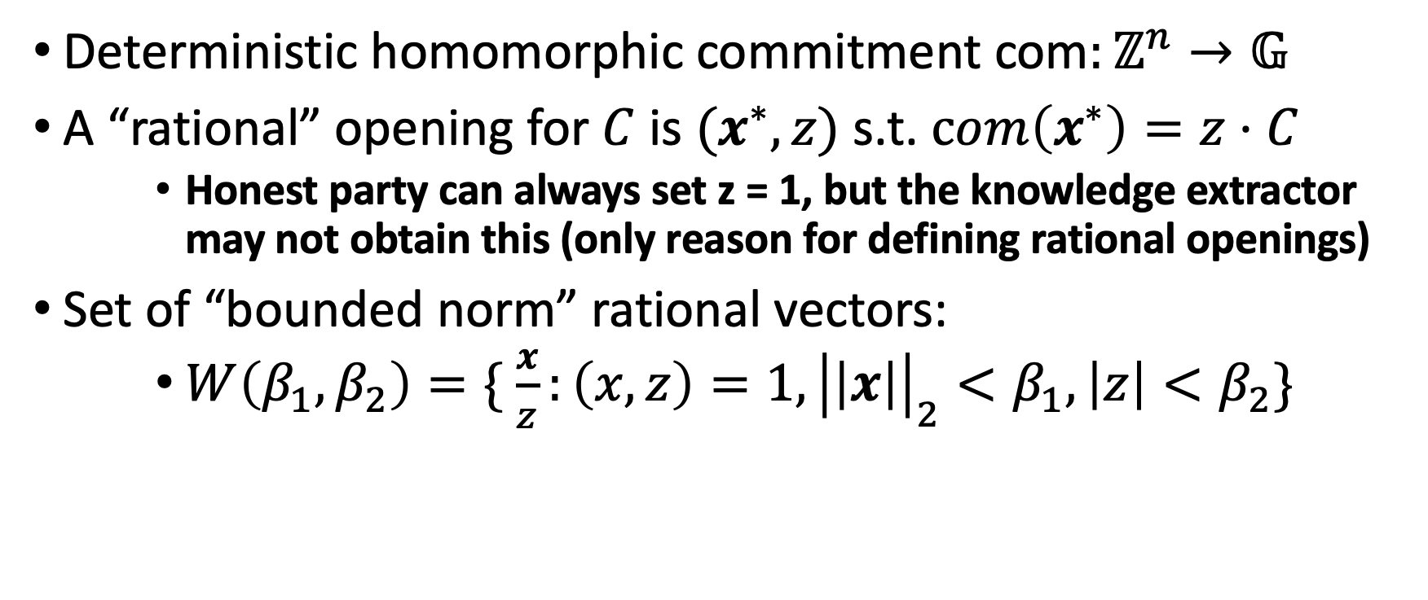
Rational Openings of Commitments
Deterministic homomorphic commitment com$:ℤ^{n}→𝔾$
A “rational” opening for $C$ is $(x^{∗},z)$ s.t. $com\left(x^{∗}\right)=z⋅C$
    Honest party can always set z = 1, but the knowledge extractor may not obtain this (only reason for defining rational openings)
Set of “bounded norm” rational vectors:
    $W\left(β_{1},β_{2}\right)=\{ \frac{x}{z}:\left(x,z\right)=1, {\left|\left|x\right|\right|}_{2}<β_{1},\left|z\right|<β_{2}\}$

Slide 24

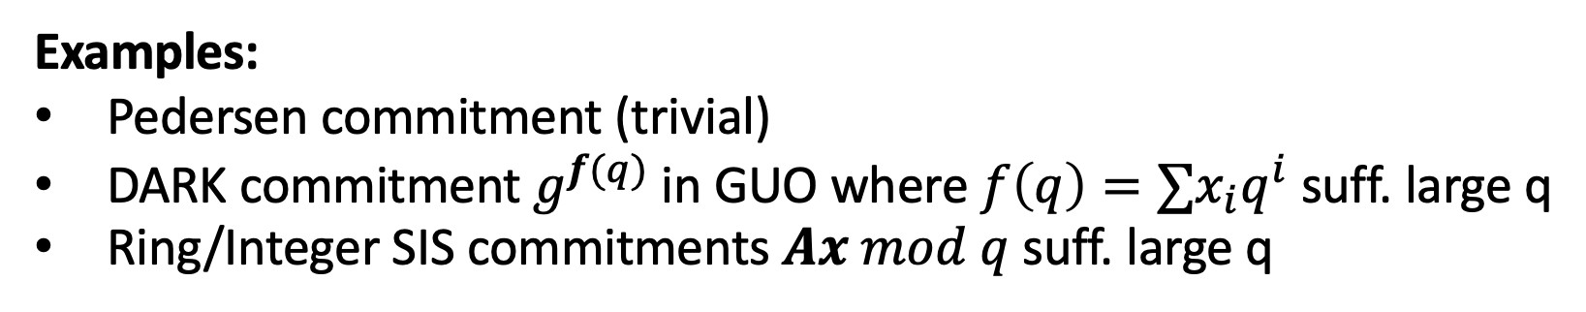
Rational binding
Lemma (informal)
If com$:ℤ^{n}→𝔾$binding (CR) over vectors L2 norm $β$ then binding under rational openings to $W\left(β_{1},β_{2}\right)$ where $β_{1}⋅β_{2}=β$
Examples:
Pedersen commitment (trivial)
DARK commitment $g^{f(q)}$in GUO where $f\left(q\right)=∑x_{i}q^{i}$ suff. large q
Ring/Integer SIS commitments $Ax mod q$ suff. large q

Slide 25
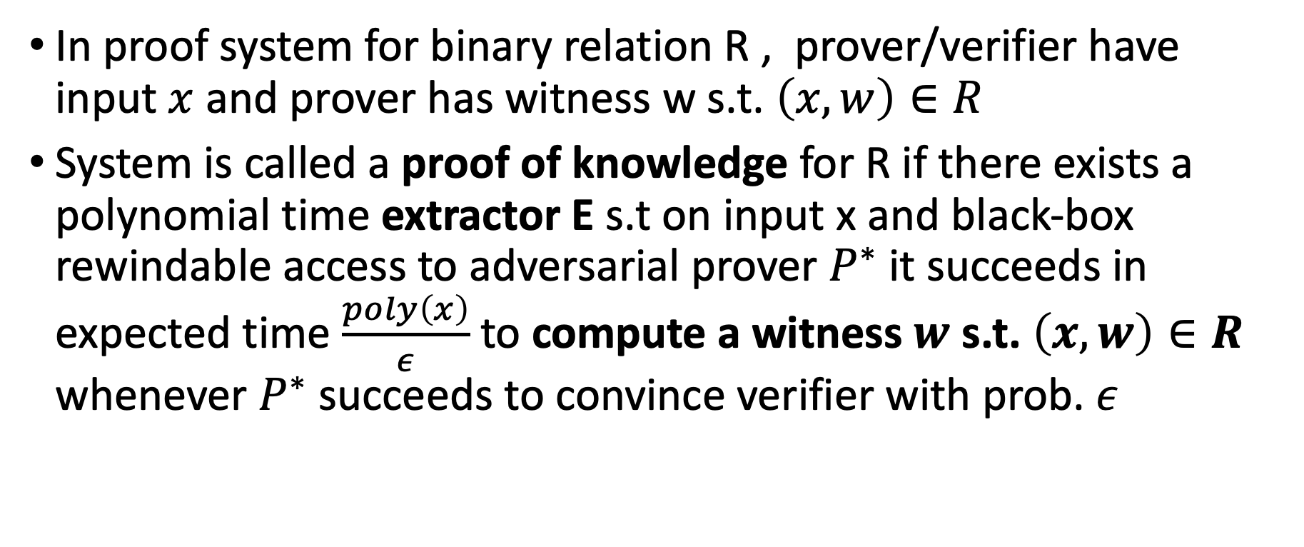
Knowledge Soundness
In proof system for binary relation R , prover/verifier have input $x$ and prover has witness w s.t. $\left(x,w\right)∈R$
System is called a proof of knowledge for R if there exists a polynomial time extractor E s.t on input x and black-box rewindable access to adversarial prover $P^{∗}$ it succeeds in expected time $\frac{poly\left(x\right)}{ε}$ to compute a witness $w$ s.t. $\left(x,w\right)∈R$ whenever $P^{∗}$ succeeds to convince verifier with prob. $ε$

Slide 26
Special Soundness
$$x$$
k-ary special soundness: Given k-ary forking tree of proof transcripts for $x∈L_{R}$, there is a polytime algorithm that extracts a witness $w$ s.t. $\left(x,w\right)∈R$
Theorem: A k-ary special sound$μ$-round protocol is knowledge sound (for constant k and $μ∈O(\log{|w|) }$).
$$α_{0}$$
$$α_{1}$$
$$m_{1}$$
$$m_{2}$$
$$α_{1,0}$$
$$α_{1,1}$$
$$α_{2,0}$$
$$α_{2,1}$$
$$m_{3}$$
$$m_{5}$$
$$m_{6}$$
$$m_{4}$$
$$α_{4,0}$$
$$α_{4,1}$$
$$α_{6,0}$$
$$α_{6,1}$$
$$α_{3,0}$$
$$α_{3,1}$$
$$α_{5,0}$$
$$α_{5,1}$$
$$m_{7}$$
$$m_{8}$$
$$m_{9}$$
$$m_{10}$$
$$m_{11}$$
$$m_{12}$$
$$m_{13}$$
$$m_{14}$$

Slide 27
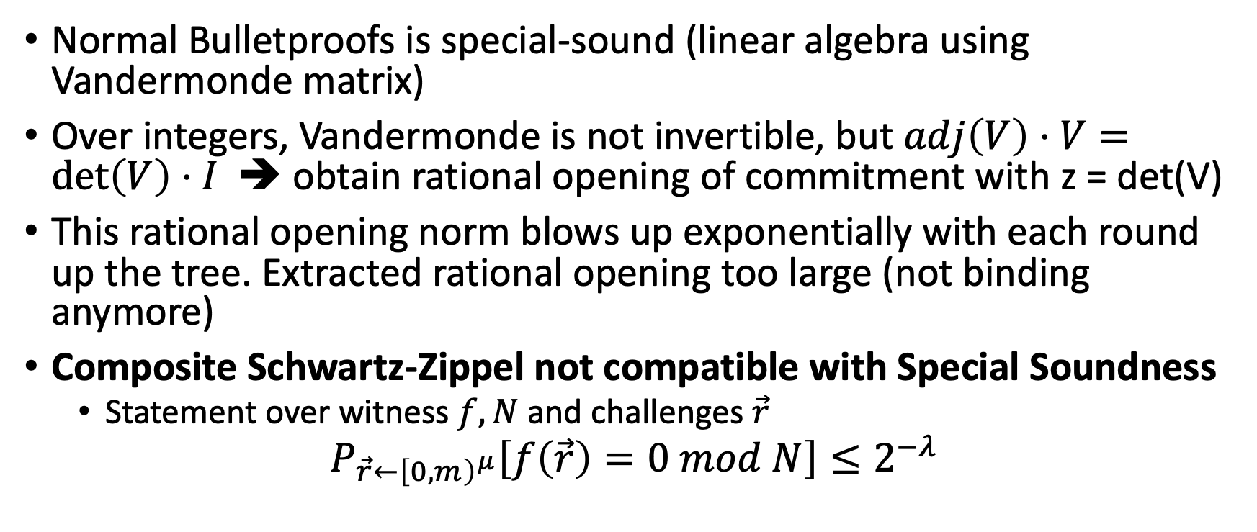
Bulletproofs with GUO/SIS not Special Sound
Normal Bulletproofs is special-sound (linear algebra using Vandermonde matrix)
Over integers, Vandermonde is not invertible, but $adj\left(V\right)⋅V=\det\left(V\right)⋅I$ ➔ obtain rational opening of commitment with z = det(V)
This rational opening norm blows up exponentially with each round up the tree. Extracted rational opening too large (not binding anymore)
Composite Schwartz-Zippel not compatible with Special Soundness
  Statement over witness $f,N$ and challenges $\vec{r}$
$$P_{\vec{r}←{\left[0,m\right)}^{μ}}\left[f\left(\vec{r}\right)=0 mod N\right]≤2^{−λ}$$

Slide 28
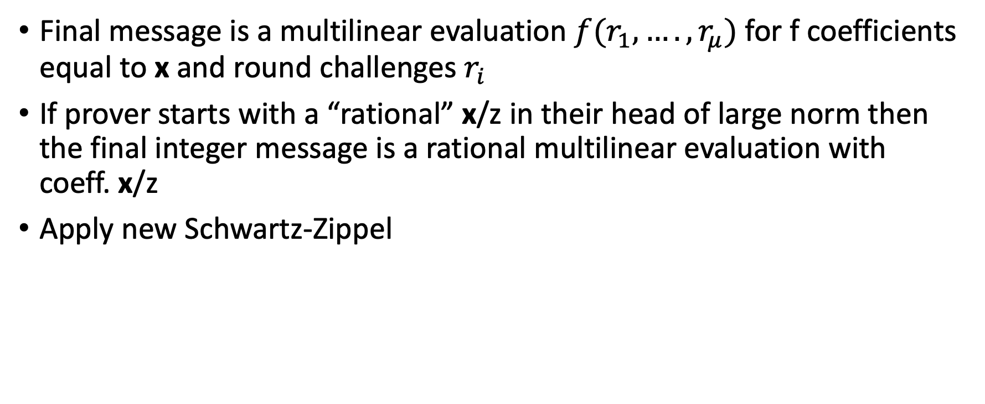
New Analysis Intuition
Final message is a multilinear evaluation $f(r_{1},….,r_{μ})$ for f coefficients equal to x and round challenges $r_{i}$
If prover starts with a “rational” x/z in their head of large norm then the final integer message is a rational multilinear evaluation with coeff. x/z
Apply new Schwartz-Zippel

Slide 29

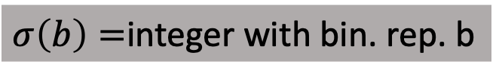
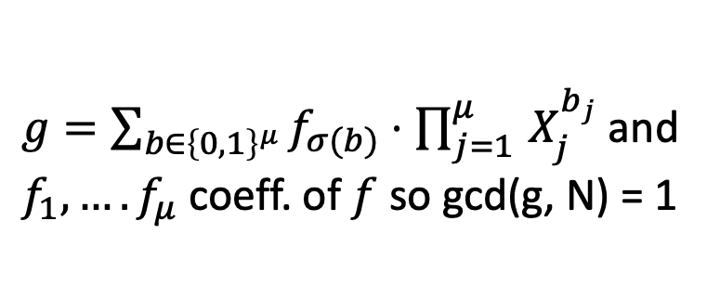
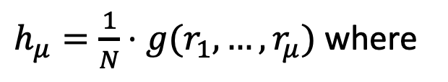

Security Analysis
Intuition why this is ok (i.e., factors must cancel during extraction and norm remains small)
Consider adversary starts with $h=\frac{f}{N}$ s.t. gcd(f,N) = 1 for very large N and runs the protocol receiving challenges $r_{1},…,r_{μ}$:
$h_{μ}=\frac{1}{N}⋅g(r_{1},…,r_{μ})$ where
$$h_{1}=h_{L}+r_{1}h_{R}$$
$$h_{2}=h_{1,L}+r_{2}h_{1,L}$$
…
$$h_{μ}=h_{μ−1,L}+r_{μ}h_{μ−1, R}$$
$g=\sum_{b∈{\left\{0,1\right\}}^{μ}}{f_{σ(b)}}⋅\prod_{j=1 }^{μ}{X_{j}^{b_{j}}}$and
$f_{1},….f_{μ}$ coeff. of $f$ so gcd(g, N) = 1
$σ\left(b\right)=$integer with bin. rep. b
Notes:
Ignore how the adversary manages to create the commitments to these rationals

Slide 30
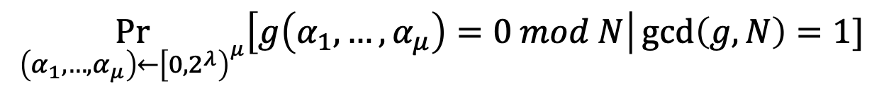

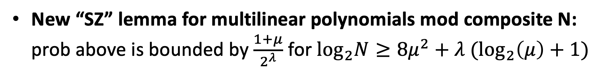
Analysis – New Schwartz-Zippel
Verifier will reject if last message is not an integer. Probability adversary’s $h_{μ}$ is an integer is:
$$\underset{\left(α_{1},…,α_{μ}\right)←{\left[{0,2}^{λ}\right)}^{μ}}{Pr}\left[g\left(α_{1},…,α_{μ}\right)=0 mod N\right|\gcd\left(g,N\right)=1]$$
New “SZ” lemma for multilinear polynomials mod composite N: prob above is bounded by $\frac{1+μ}{2^{λ}}$ for $\log_{2}N≥8μ^{2}+{λ (log}_{2}\left(μ\right)+1)$

Slide 31





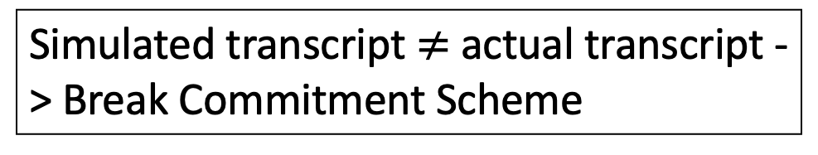







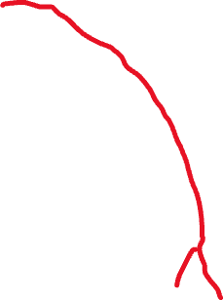









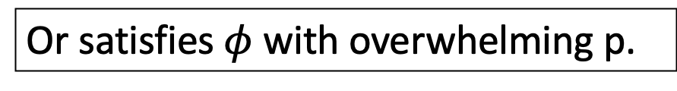


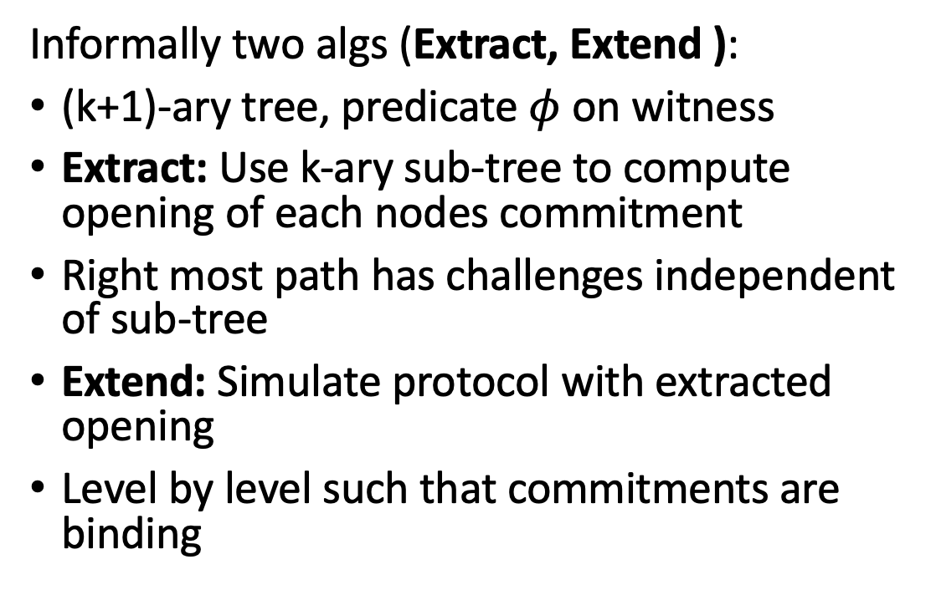











Almost Special Soundness
$$x$$
Informally two algs (Extract, Extend ):
(k+1)-ary tree, predicate $φ$ on witness
Extract: Use k-ary sub-tree to compute opening of each nodes commitment
Right most path has challenges independent of sub-tree
Extend: Simulate protocol with extracted opening
Level by level such that commitments are binding
$$α_{0}$$
$$α_{1}$$
$$m_{1}$$
$$m_{2}$$
$$α_{1,0}$$
$$α_{1,1}$$
$$α_{2,0}$$
$$α_{2,1}$$
$$m_{3}$$
$$m_{5}$$
$$m_{6}$$
$$m_{4}$$
$$α_{4,0}$$
$$α_{4,1}$$
$$α_{6,0}$$
$$α_{6,1}$$
$$α_{3,0}$$
$$α_{3,1}$$
$$α_{5,0}$$
$$α_{5,1}$$
$$m_{7}$$
$$m_{8}$$
$$m_{9}$$
$$m_{10}$$
$$m_{11}$$
$$m_{12}$$
$$m_{13}$$
$$m_{14}$$
Simulated transcript $≠$ actual transcript -> Break Commitment Scheme
Or satisfies $φ$ with overwhelming p.

Slide 32
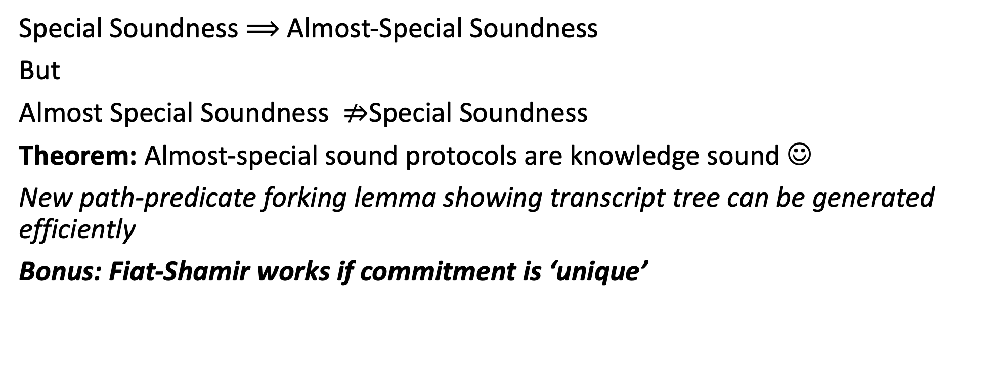
Almost Special Soundness
Special Soundness $⟹$ Almost-Special Soundness
But
Almost Special Soundness $⇏$Special Soundness
Theorem: Almost-special sound protocols are knowledge sound ☺
New path-predicate forking lemma showing transcript tree can be generated efficiently
Bonus: Fiat-Shamir works if commitment is ‘unique’

Slide 33
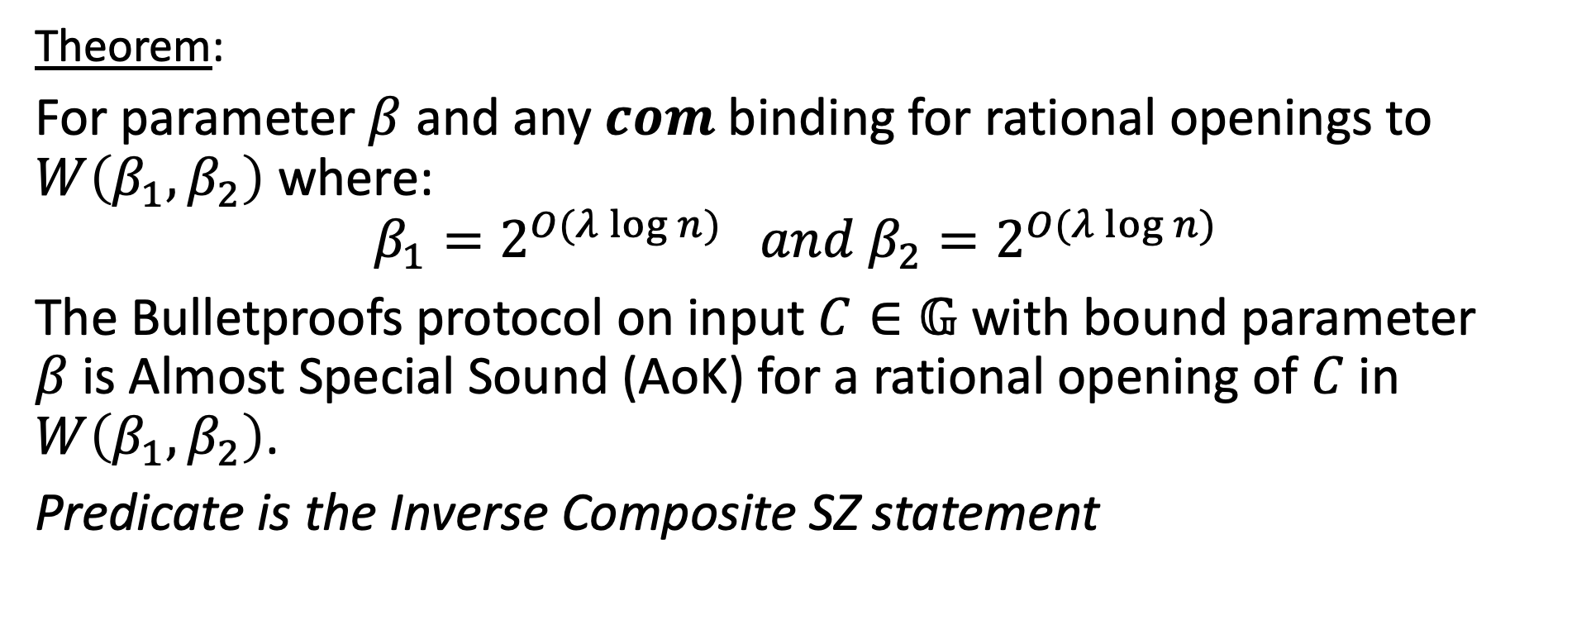
Bulletproofs AoK for Rational Binding
Theorem:
For parameter $β$ and any $com$ binding for rational openings to $W\left(β_{1},β_{2}\right)$ where:
$$β_{1}=2^{O(λ\log{n})} and β_{2}=2^{O(λ\log{n})}$$
The Bulletproofs protocol on input $C∈𝔾$ with bound parameter $β$is Almost Special Sound (AoK) for a rational opening of $C$ in $W\left(β_{1},β_{2}\right)$.
Predicate is the Inverse Composite SZ statement

Slide 34
Questions?

