Slide 1
Security Proofs for Key-Alternating Ciphers with Non-Independent Round Permutations
Liqing Yu
East China Normal University
Yusai Wu
Shanghai Qi Zhi Institute
Yu Yu
Shanghai Jiao Tong University
Zhenfu Cao
East China Normal University
Xiaolei Dong
East China Normal University
TCC 2023
Nov.29-Dec.2, Taipei

Slide 2




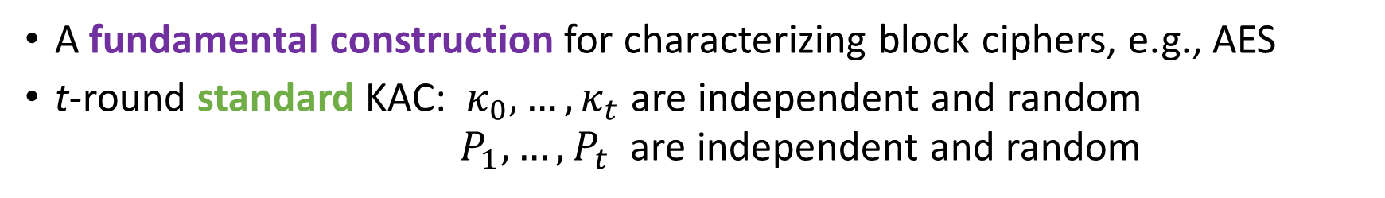







Key Alternating Ciphers (KACs)
(n-bit)
(n-bit)
(n-bit)
(n-bit)
(n-bit)
$$κ_{0}$$
$$κ_{1}$$
$$κ_{2}$$
$$κ_{t−1}$$
$$κ_{t}$$
$$x$$
$$P_{1}$$
$$P_{2}$$
$$⋯$$
$$P_{t}$$
$$y$$
(n-bit)
(n-bit)
t+1 round keys (secret)
t round permutations (public)
$$y=P_{t}(⋯P_{2}(P_{1}\left(x⊕κ_{0}\right)⊕κ_{1})⋯)⊕κ_{t}$$
A fundamental construction for characterizing block ciphers, e.g., AES
t-round standard KAC: $κ_{0},…, κ_{t}$ are independent and random
      $P_{1},…,P_{t}$ are independent and random

Slide 3
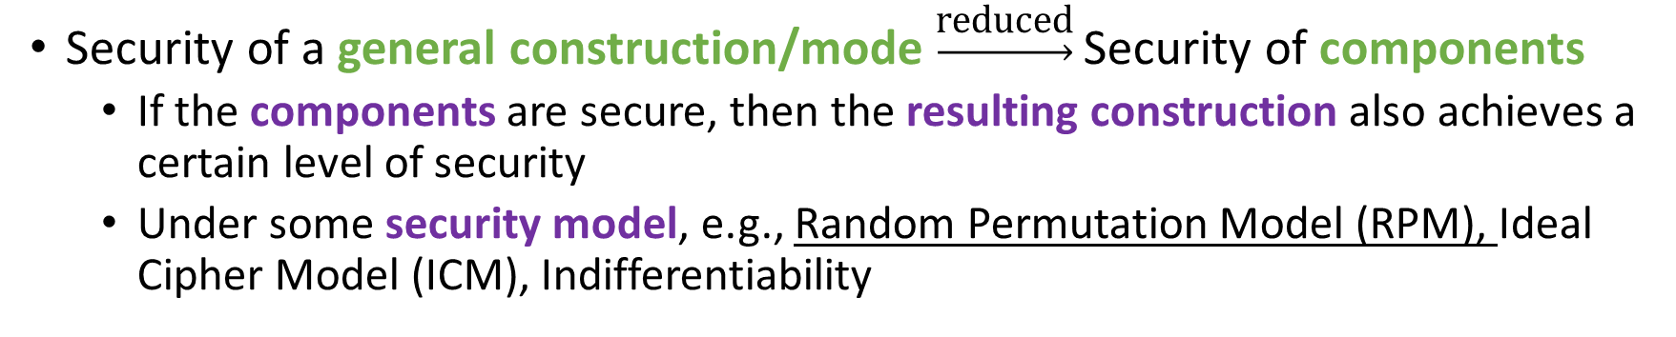
Provable Security in Symmetric Cryptography
Security of a general construction/mode $\underset{→}{\text{reduced}}$ Security of components
  If the components are secure, then the resulting construction also achieves a certain level of security
  Under some security model, e.g., Random Permutation Model (RPM), Ideal Cipher Model (ICM), Indifferentiability

Slide 4
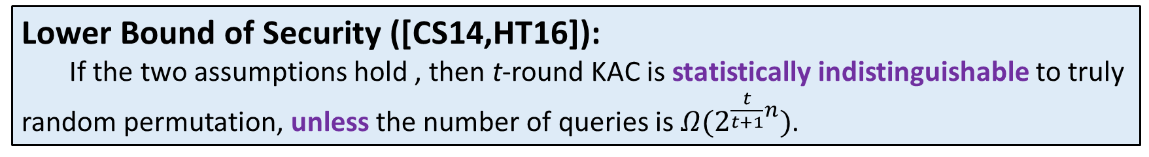
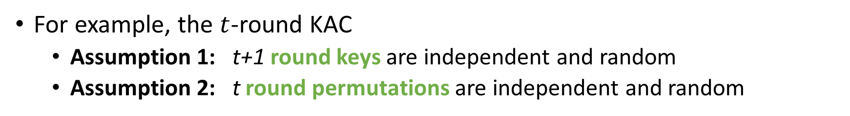
Provable Security of KACs (In RMP)
For example, the $t$-round KAC
  Assumption 1: t+1 round keys are independent and random
  Assumption 2: t round permutations are independent and random
Lower Bound of Security ([CS14,HT16]):
If the two assumptions hold , then t-round KAC is statistically indistinguishable to truly random permutation, unless the number of queries is $Ω(2^{\frac{t}{t+1}n})$.

Slide 5
Provable Security of KACs (In RMP)
For example, the $t$-round KAC
  Assumption 1: t+1 round keys are independent and random
  Assumption 2: t round permutations are independent and random
Lower Bound of Security ([CS14,HT16]):
If the two assumptions hold , then t-round KAC is statistically indistinguishable to truly random permutation, unless the number of queries is $Ω(2^{\frac{t}{t+1}n})$.
Note:
The proof is information-theoretic, not by reductions
Does not rely on any unproved hypotheses

Slide 6
Provable Security of KACs (In RMP)
For example, the $t$-round KAC
  Assumption 1: t+1 round keys are independent and random
  Assumption 2: t round permutations are independent and random
Question:
Whether the two assumptions can be weakened to better characterize practical ciphers?

Slide 7
Provable Security of KACs (In RMP)
For example, the $t$-round KAC
  Assumption 1: t+1 round keys are independent and random
  Assumption 2: t round permutations are independent and random
Question:
Whether the two assumptions can be weakened to better characterize practical ciphers?
Dream Version of t-round KAC (ref. AES):
t+1 round keys are deterministically generated from an n-bit random key
t round permutations are the same (√, this work)

Slide 8
Provable Security of KACs (In RMP)
For example, the $t$-round KAC
  Assumption 1: t+1 round keys are independent and random
  Assumption 2: t round permutations are independent and random
Question:
Whether the two assumptions can be weakened to better characterize practical ciphers?
Dream Version of t-round KAC (ref. AES):
t+1 round keys are deterministically generated from an n-bit random key
t round permutations are the same (√, this work)

Slide 9
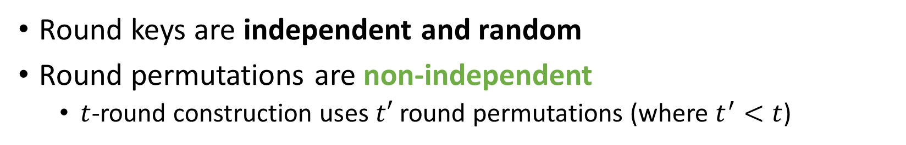
KAC-Type Constructions
Round keys are independent and random
Round permutations are non-independent
  $t$-round construction uses $t′$ round permutations (where $t^{′}<t$)

Slide 10











KAC-Type Constructions
Round keys are independent and random
Round permutations are non-independent
  $t$-round construction uses $t′$ round permutations (where $t^{′}<t$)
In particular, $t^{′}=1$, i.e., KAC with a single permutation (KACSP)
(n-bit)
(n-bit)
(n-bit)
(n-bit)
(n-bit)
$$κ_{0}$$
$$κ_{1}$$
$$κ_{2}$$
$$κ_{t−1}$$
$$κ_{t}$$
$$x$$
$$P$$
$$P$$
$$⋯$$
$$P$$
$$y$$
(n-bit)
(n-bit)
$$y=P(⋯P(P\left(x⊕κ_{0}\right)⊕κ_{1})⋯)⊕κ_{t}$$

Slide 11



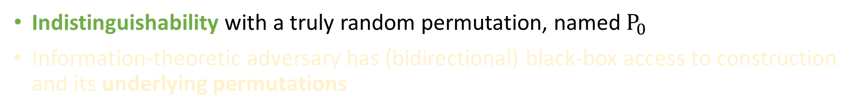



Random Permutation Model (RPM)
Indistinguishability with a truly random permutation, named $P_{0}$
Information-theoretic adversary has (bidirectional) black-box access to construction and its underlying permutations
Indistinguishability Game (t-round KAC)
(Construction)
(Construction)
$${KAC}^{P_{1},⋯,P_{t};κ_{0},⋯,κ_{t}}$$
$$P_{0}$$
$$+/−$$
$$+/−$$
WLOG deterministic
$$𝒟$$
$$𝒟$$
WLOG deterministic
Real World
Ideal World

Slide 12
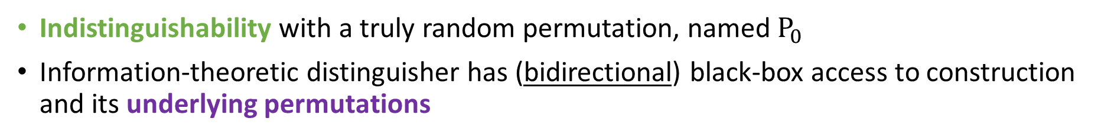
Random Permutation Model (RPM)
Indistinguishability with a truly random permutation, named $P_{0}$
Information-theoretic distinguisher has (bidirectional) black-box access to construction and its underlying permutations
Indistinguishability Game (t-round KAC)
(Construction)
(Construction)
$${KAC}^{P_{1},⋯,P_{t};κ_{0},⋯,κ_{t}}$$
$$P_{0}$$
$$+/−$$
$$+/−$$
WLOG deterministic
$$𝒟$$
$$𝒟$$
WLOG deterministic
Real World
Ideal World

Slide 13












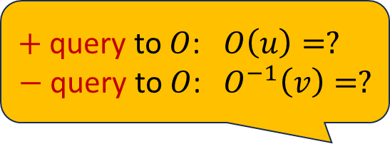


Random Permutation Model (RPM)
$+$ query to $O$: $O\left(u\right)=?$
$−$ query to $O$: ${ O}^{−1}\left(v\right)=?$
Indistinguishability with a truly random permutation, named $P_{0}$
Information-theoretic distinguisher has (bidirectional) black-box access to construction and its underlying permutations
Indistinguishability Game (t-round KAC)
Depends on
Independent of
(Construction)
(Primitives)
(Construction)
(Primitives)
$${KAC}^{P_{1},⋯,P_{t};κ_{0},⋯,κ_{t}}$$
$$P_{1}$$
$$P_{2}$$
$$⋯$$
$$P_{t}$$
$$P_{0}$$
$$P_{1}$$
$$P_{2}$$
$$⋯$$
$$P_{t}$$
$$+/−$$
$$+/−$$
$$+/−$$
$$+/−$$
$$+/−$$
$$+/−$$
$$+/−$$
$$+/−$$
WLOG deterministic
$$𝒟$$
$$𝒟$$
WLOG deterministic
Real World
Ideal World

Slide 14






Random Permutation Model (RPM)
$+$ query to $O$: $O\left(u\right)=?$
$−$ query to $O$: ${ O}^{−1}\left(v\right)=?$
Indistinguishability with a truly random permutation, named $P_{0}$
Information-theoretic distinguisher has (bidirectional) black-box access to construction and its underlying permutations
Indistinguishability Game (t-round KACSP)
(t-round KACSP)
Depends on
Independent of
(Construction)
(Primitive)
(Construction)
(Primitive)
$${KACSP}^{P;κ_{0},⋯,κ_{t}}$$
$$P$$
$$P_{0}$$
$$P$$
$$+/−$$
$$+/−$$
$$+/−$$
$$+/−$$
WLOG deterministic
$$𝒟$$
$$𝒟$$
WLOG deterministic
Real World
Ideal World

Slide 15
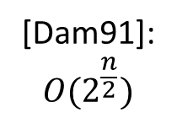
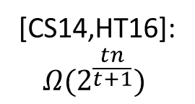
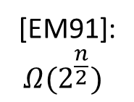

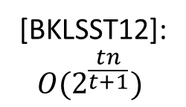
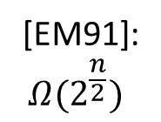
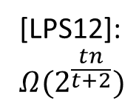


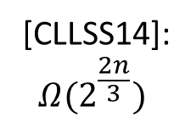

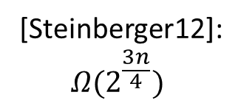


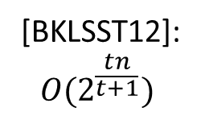
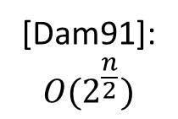

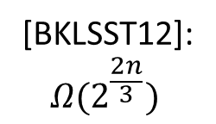

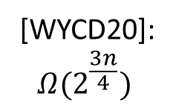
Known Security Bounds (In the RPM)
Upper Bounds
(attack)
[Dam91]:
$$O(2^{\frac{n}{2}})$$
[BKLSST12]:
$$O(2^{\frac{tn}{t+1}})$$
$$t=1$$
$$t=2$$
$$t=3$$
$$∀ t>3$$
KACs
Lower Bounds
(security proof)
[EM91]:
$$Ω(2^{\frac{n}{2}})$$
[BKLSST12]:
$$Ω(2^{\frac{2n}{3}})$$
[Steinberger12]:
$$Ω(2^{\frac{3n}{4}})$$
[LPS12]:
$$Ω(2^{\frac{tn}{t+2}})$$
[CS14,HT16]:
$$Ω(2^{\frac{tn}{t+1}})$$
Upper Bounds
(attack)
[Dam91]:
$$O(2^{\frac{n}{2}})$$
[BKLSST12]:
$$O(2^{\frac{tn}{t+1}})$$
$$t=1$$
$$t=2$$
$$t=3$$
$$∀ t>3$$
KACSPs
Lower Bounds
(security proof)
[EM91]:
$$Ω(2^{\frac{n}{2}})$$
[CLLSS14]:
$$Ω(2^{\frac{2n}{3}})$$
[WYCD20]:
$$Ω(2^{\frac{3n}{4}})$$
Unknown
(the proof is much more difficult)

Slide 16
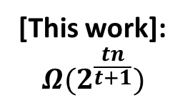
This Work (In the RPM)
Upper Bounds
(attack)
[Dam91]:
$$O(2^{\frac{n}{2}})$$
[BKLSST12]:
$$O(2^{\frac{tn}{t+1}})$$
$$t=1$$
$$t=2$$
$$t=3$$
$$∀ t>3$$
KACs
Lower Bounds
(security proof)
[EM91]:
$$Ω(2^{\frac{n}{2}})$$
[BKLSST12]:
$$Ω(2^{\frac{2n}{3}})$$
[Steinberger12]:
$$Ω(2^{\frac{3n}{4}})$$
[LPS12]:
$$Ω(2^{\frac{tn}{t+2}})$$
[CS14,HT16]:
$$Ω(2^{\frac{tn}{t+1}})$$
Upper Bounds
(attack)
[Dam91]:
$$O(2^{\frac{n}{2}})$$
[BKLSST12]:
$$O(2^{\frac{tn}{t+1}})$$
$$t=1$$
$$t=2$$
$$t=3$$
$$∀ t>3$$
KACSPs
Lower Bounds
(security proof)
[EM91]:
$$Ω(2^{\frac{n}{2}})$$
[CLLSS14]:
$$Ω(2^{\frac{2n}{3}})$$
[WYCD20]:
$$Ω(2^{\frac{3n}{4}})$$
(the proof is not that difficult)
`
[This work]:
$$Ω(2^{\frac{tn}{t+1}})$$
√ Tight

Slide 17
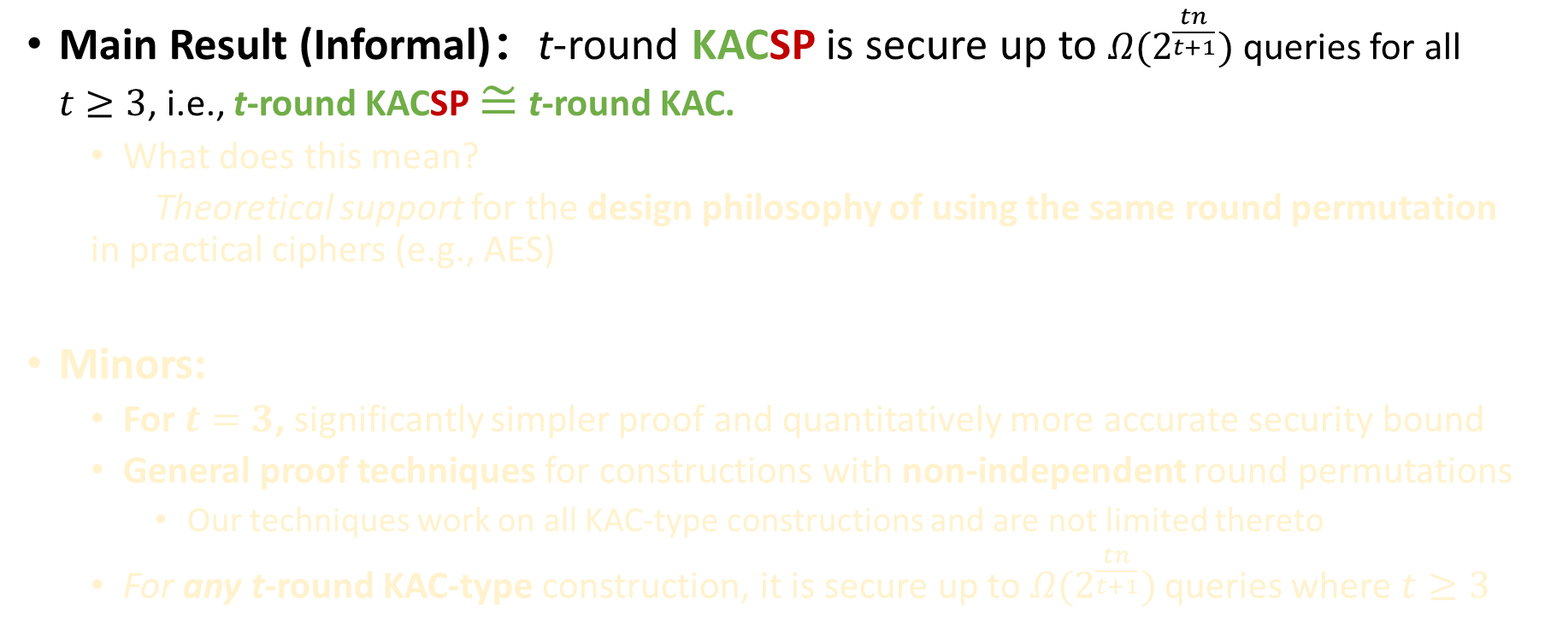
Our Contribution
Main Result (Informal)：t-round KACSP is secure up to $Ω(2^{\frac{tn}{t+1}})$ queries for all $t≥3$, i.e., t-round KACSP $≅$ t-round KAC.
  What does this mean?
  Theoretical support for the design philosophy of using the same round permutation in practical ciphers (e.g., AES)
Minors:
  For $t=3$, significantly simpler proof and quantitatively more accurate security bound
  General proof techniques for constructions with non-independent round permutations
    Our techniques work on all KAC-type constructions and are not limited thereto
  For any t-round KAC-type construction, it is secure up to $Ω(2^{\frac{tn}{t+1}})$ queries where $t≥3$

Slide 18
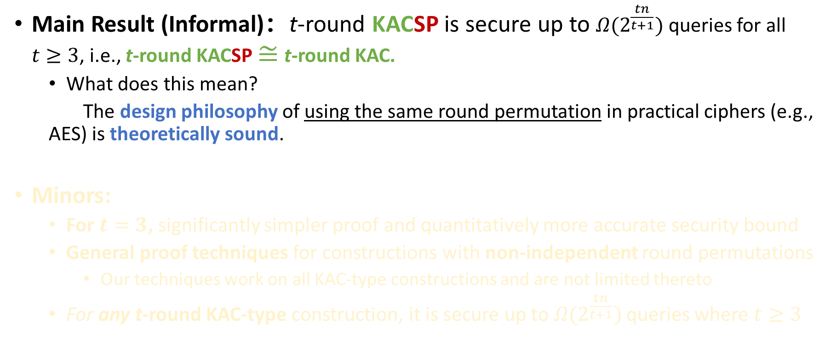
Our Contribution
Main Result (Informal)：t-round KACSP is secure up to $Ω(2^{\frac{tn}{t+1}})$ queries for all $t≥3$, i.e., t-round KACSP $≅$ t-round KAC.
  What does this mean?
  The design philosophy of using the same round permutation in practical ciphers (e.g., AES) is theoretically sound.
Minors:
  For $t=3$, significantly simpler proof and quantitatively more accurate security bound
  General proof techniques for constructions with non-independent round permutations
    Our techniques work on all KAC-type constructions and are not limited thereto
  For any t-round KAC-type construction, it is secure up to $Ω(2^{\frac{tn}{t+1}})$ queries where $t≥3$

Slide 19
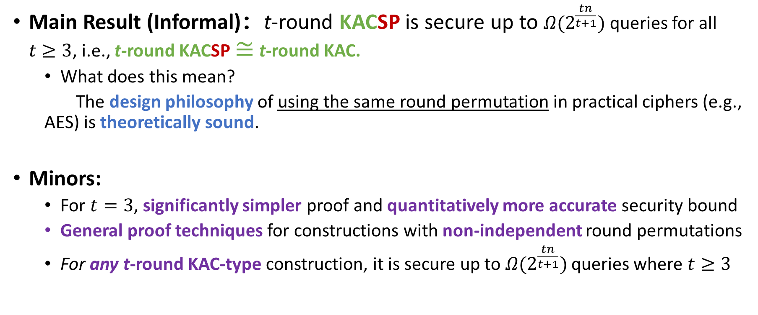
Our Contribution
Main Result (Informal)：t-round KACSP is secure up to $Ω(2^{\frac{tn}{t+1}})$ queries for all $t≥3$, i.e., t-round KACSP $≅$ t-round KAC.
  What does this mean?
  The design philosophy of using the same round permutation in practical ciphers (e.g., AES) is theoretically sound.
Minors:
  For $t=3$, significantly simpler proof and quantitatively more accurate security bound
  General proof techniques for constructions with non-independent round permutations
  For any t-round KAC-type construction, it is secure up to $Ω(2^{\frac{tn}{t+1}})$ queries where $t≥3$

Slide 20
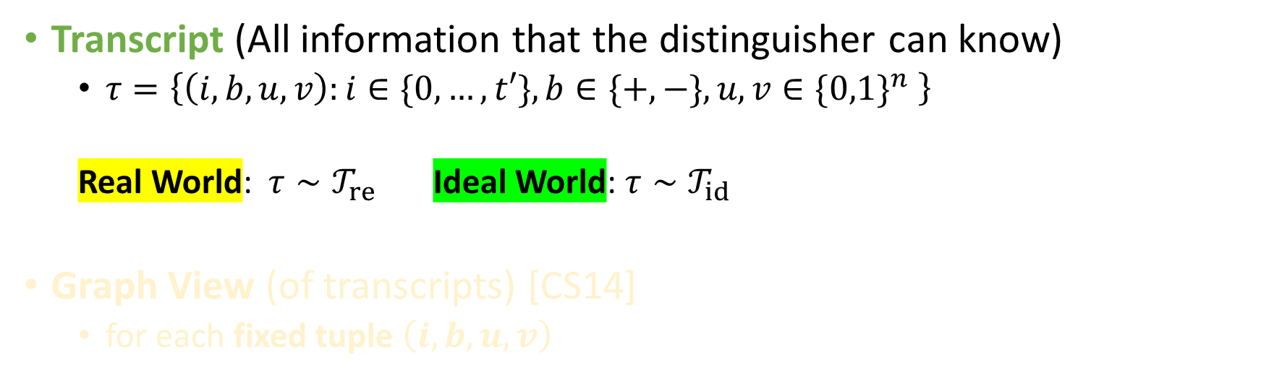
Proof Outline – Preliminaries
Transcript (All information that the distinguisher can know)
  $τ=\left\{\left(i,b,u,v\right):i∈\{0,…,t′\},b∈\{+,−\}, u,v∈{\{0,1\}}^{n} \right\}$
  Real World: $τ∼𝒯_{re}$ Ideal World: $τ∼𝒯_{id}$
Graph View (of transcripts) [CS14]
  for each fixed tuple $\left(i,b,u,v\right)$
Oracle Index
Forward/Backward
Query, Response

Slide 21



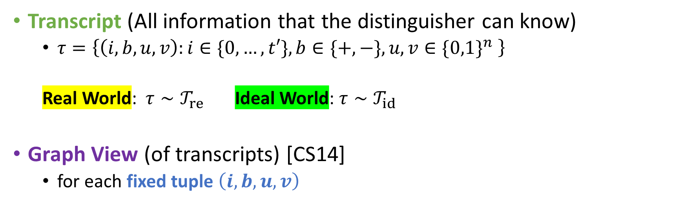
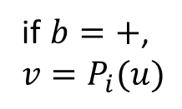

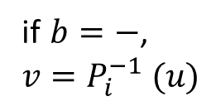


Proof Outline – Preliminaries
Transcript (All information that the distinguisher can know)
  $τ=\left\{\left(i,b,u,v\right):i∈\{0,…,t′\},b∈\{+,−\}, u,v∈{\{0,1\}}^{n} \right\}$
  Real World: $τ∼𝒯_{re}$ Ideal World: $τ∼𝒯_{id}$
Graph View (of transcripts) [CS14]
  for each fixed tuple $\left(i,b,u,v\right)$
Oracle Index
Forward/Backward
Query, Response
$$P_{i}$$
$$P_{i}$$
$$u$$
$$v$$
$$v$$
$$u$$
if $b=+$,
$v=P_{i}(u)$
if $b=−$,
$v=P_{i}^{−1} (u)$

Slide 22
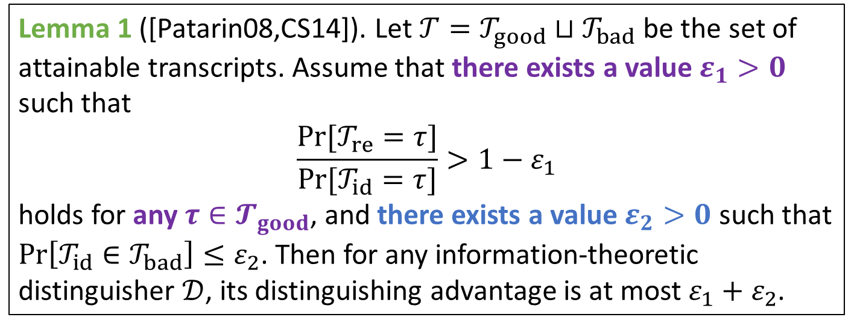

Proof Outline – Preliminaries
H-Coefficient Technique
Lemma 1 ([Patarin08,CS14]). Let $𝒯=𝒯_{good}⊔𝒯_{bad}$ be the set of attainable transcripts. Assume that there exists a value $ε_{1}>0$ such that
$$\frac{Pr⁡[𝒯_{re}=τ]}{Pr⁡[𝒯_{id}=τ]}>1−ε_{1}$$
holds for any $τ∈𝓣_{good}$, and there exists a value $ε_{2}>0$ such that $\operatorname{Pr}\left[𝒯_{id}∈𝒯_{bad}\right]≤ε_{2}$. Then for any information-theoretic distinguisher $𝒟$, its distinguishing advantage is at most $ε_{1}+ε_{2}$.
Security Proof
$$⟹$$
Combinatorial Probabilities

Slide 23
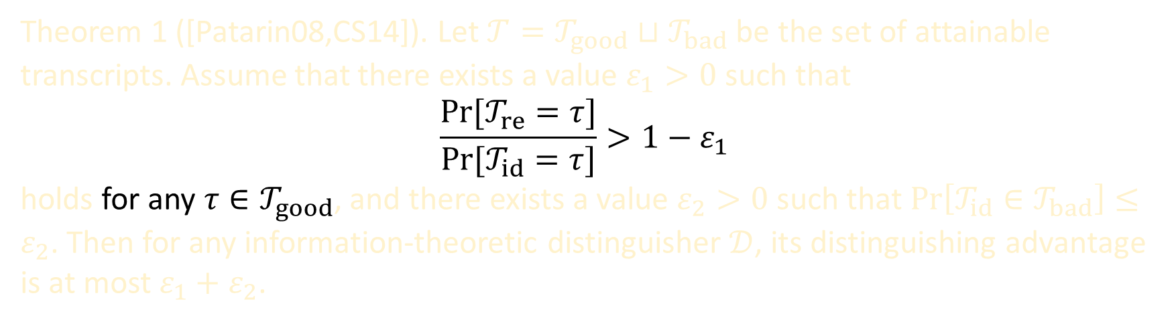
Proof Outline – Preliminaries
Main Challenge:
Basically a complex combinatorial problem
Theorem 1 ([Patarin08,CS14]). Let $𝒯=𝒯_{good}⊔𝒯_{bad}$ be the set of attainable transcripts. Assume that there exists a value $ε_{1}>0$ such that
$$\frac{Pr⁡[𝒯_{re}=τ]}{Pr⁡[𝒯_{id}=τ]}>1−ε_{1}$$
holds for any $τ∈𝒯_{good}$, and there exists a value $ε_{2}>0$ such that $\operatorname{Pr}\left[𝒯_{id}∈𝒯_{bad}\right]≤ε_{2}$. Then for any information-theoretic distinguisher $𝒟$, its distinguishing advantage is at most $ε_{1}+ε_{2}$.
Difficult
Trivial

Slide 24
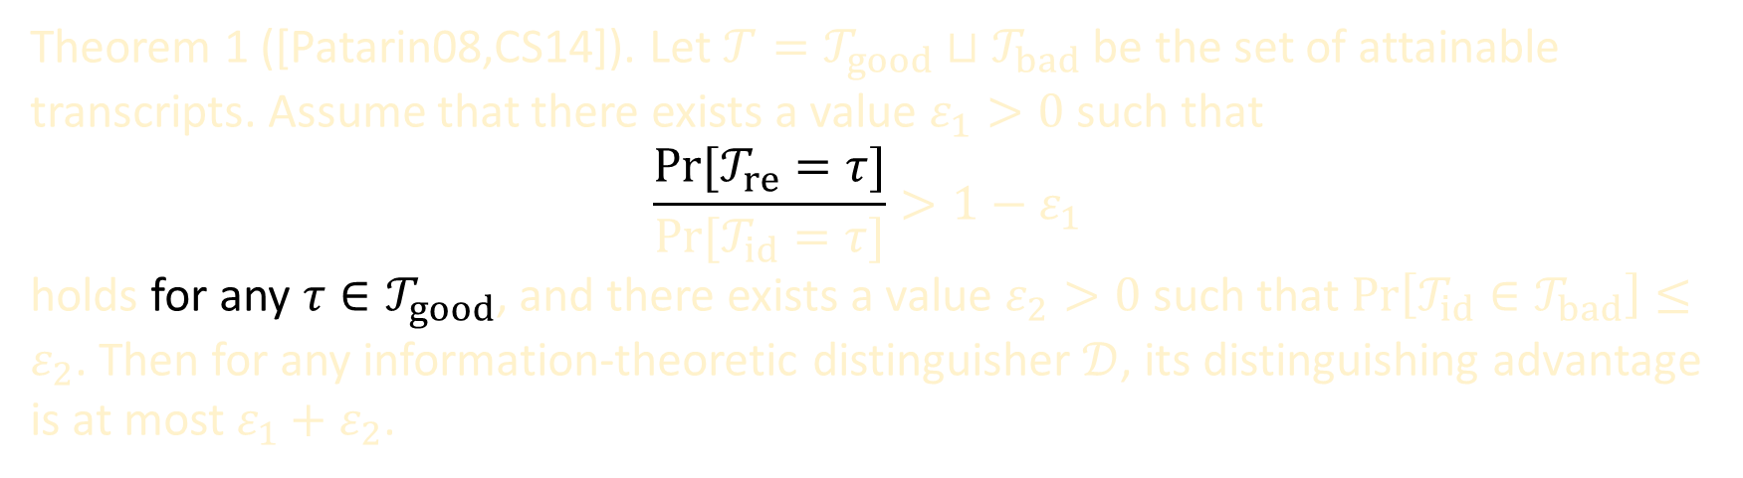
Proof Outline – Preliminaries
Main Challenge:
Essentially a complex combinatorial problem (our techniques focus on lower-bounding the probability of real world)
Theorem 1 ([Patarin08,CS14]). Let $𝒯=𝒯_{good}⊔𝒯_{bad}$ be the set of attainable transcripts. Assume that there exists a value $ε_{1}>0$ such that
$$\frac{Pr⁡[𝒯_{re}=τ]}{Pr⁡[𝒯_{id}=τ]}>1−ε_{1}$$
holds for any $τ∈𝒯_{good}$, and there exists a value $ε_{2}>0$ such that $\operatorname{Pr}\left[𝒯_{id}∈𝒯_{bad}\right]≤ε_{2}$. Then for any information-theoretic distinguisher $𝒟$, its distinguishing advantage is at most $ε_{1}+ε_{2}$.
Difficult

Slide 25










































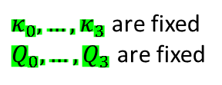














Proof Outline – Graph View of A Transcript
For 3-round KAC, a transcript $τ$ can be represented as follows
$$⊕κ_{0}$$
$$P_{1}$$
$$⊕κ_{1}$$
$$P_{2}$$
$$⊕κ_{2}$$
$$P_{3}$$
$$⊕κ_{3}$$
$$x_{1}$$
$$y_{1}$$
$$x_{2}$$
$$y_{2}$$
$$x_{3}$$
$$Q_{1}$$
$$⋮$$
$$⋮$$
$$⋮$$
$$⋮$$
$$y_{3}$$
$$Q_{0}$$
$$x_{4}$$
$$Q_{0}$$
$$y_{4}$$
$$x_{5}$$
(primitive
queries)
$$y_{5}$$
(constr.
queries)
$$x_{6}$$
(constr.
queries)
$$y_{6}$$
starting points
$$⋮$$
$$⋮$$
destinations
$$x_{q}$$
$$Q_{2}$$
$$Q_{3}$$
$$y_{q}$$
free points
(primitive
queries)
(primitive
queries)
$κ_{0},…,κ_{3}$ are fixed
$Q_{0},…, Q_{3}$ are fixed
$$⋮$$
$$⋮$$
$$⋮$$
$$⋮$$
$$⋮$$
$$⋮$$
$$⋮$$
$$⋮$$
$$2^{n}$$
$$κ_{0}$$
$$2^{n}$$
$$2^{n}$$
$$κ_{1}$$
$$2^{n}$$
$$2^{n}$$
$$κ_{2}$$
$$2^{n}$$
$$2^{n}$$
$$κ_{t}$$
$$x$$
$$P_{1}$$
$$P_{2}$$
$$P_{3}$$
$$y$$
(n-bit)
(n-bit)

Slide 26
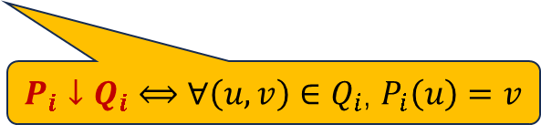
Proof Outline – The Key Probability
For 3-round KAC, the key probability w.r.t. a good transcript $τ$
$$⊕κ_{0}$$
$$P_{1}$$
$$⊕κ_{1}$$
$$P_{2}$$
$$⊕κ_{2}$$
$$P_{3}$$
$$⊕κ_{3}$$
$$x_{1}$$
$$y_{1}$$
$$x_{2}$$
$$y_{2}$$
$$x_{3}$$
$$Q_{1}$$
$$⋮$$
$$⋮$$
$$⋮$$
$$⋮$$
$$y_{3}$$
$$Q_{0}$$
$$x_{4}$$
$$Q_{0}$$
$$y_{4}$$
$$x_{5}$$
(primitive
queries)
$$y_{5}$$
(constr.
queries)
$$x_{6}$$
(constr.
queries)
$$y_{6}$$
starting points
$$⋮$$
$$⋮$$
destinations
$$x_{q}$$
$$Q_{2}$$
$$Q_{3}$$
$$y_{q}$$
free points
(primitive
queries)
(primitive
queries)
$κ_{0},…,κ_{3}$ are fixed
$Q_{0},…, Q_{3}$ are fixed
$$⋮$$
$$⋮$$
$$⋮$$
$$⋮$$
$$⋮$$
$$⋮$$
$$⋮$$
$$⋮$$
$$2^{n}$$
$$2^{n}$$
$$2^{n}$$
$$2^{n}$$
$$2^{n}$$
$$2^{n}$$
$$2^{n}$$
$p\left(τ\right)≔Pr⁡[x_{1}→y_{1}∧⋯∧x_{q}→y_{q}∣P_{1}↓Q_{1}∧P_{2}↓Q_{2}∧P_{3}↓Q_{3}∧κ_{0},…,κ_{3} \text{are} \text{fixed}]$,
where $P_{i}$’s are truly random permutations compatible with $Q_{i}$’s.
$P_{i}↓Q_{i}$ $⟺$ $∀\left(u,v\right)∈Q_{i}$, $P_{i}\left(u\right)=v$

Slide 27
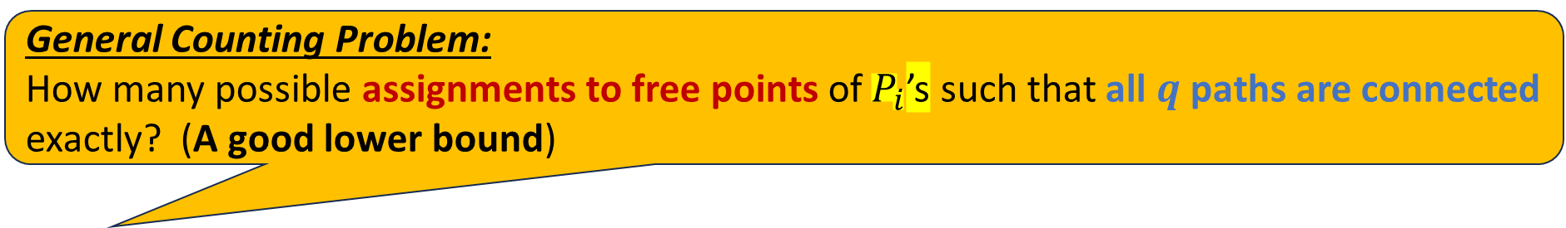
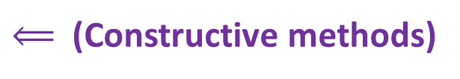
Proof Outline – The Key Probability
For 3-round KAC, the key probability w.r.t. a good transcript $τ$
$$⊕κ_{0}$$
$$P_{1}$$
$$⊕κ_{1}$$
$$P_{2}$$
$$⊕κ_{2}$$
$$P_{3}$$
$$⊕κ_{3}$$
$$x_{1}$$
$$y_{1}$$
$$x_{2}$$
$$y_{2}$$
$$x_{3}$$
$$Q_{1}$$
$$⋮$$
$$⋮$$
$$⋮$$
$$⋮$$
$$y_{3}$$
$$Q_{0}$$
$$x_{4}$$
$$Q_{0}$$
$$y_{4}$$
$$x_{5}$$
(primitive
queries)
$$y_{5}$$
(constr.
queries)
$$x_{6}$$
(constr.
queries)
$$y_{6}$$
starting points
$$⋮$$
$$⋮$$
destinations
$$x_{q}$$
$$Q_{2}$$
$$Q_{3}$$
$$y_{q}$$
free points
(primitive
queries)
(primitive
queries)
$κ_{0},…,κ_{3}$ are fixed
$Q_{0},…, Q_{3}$ are fixed
General Counting Problem:
How many possible assignments to free points of $P_{i}$’s such that all $q$ paths are connected exactly? (A good lower bound) $⟸$ (Constructive methods)
$$⋮$$
$$⋮$$
$$⋮$$
$$⋮$$
$$⋮$$
$$⋮$$
$$⋮$$
$$⋮$$
$⟸$ (Constructive methods)
$$2^{n}$$
$$2^{n}$$
$$2^{n}$$
$$2^{n}$$
$$2^{n}$$
$$2^{n}$$
$$2^{n}$$
$p\left(τ\right)≔Pr⁡[x_{1}→y_{1}∧⋯∧x_{q}→y_{q}∣P_{1}↓Q_{1}∧P_{2}↓Q_{2}∧P_{3}↓Q_{3}∧κ_{0},…,κ_{3} \text{are} \text{fixed}]$,
where $P_{i}$’s are truly random permutations compatible with $Q_{i}$’s.

Slide 28













Proof Outline – The Case of KACSP
For 3-round KACSP, the key probability w.r.t. a good transcript $τ$
$$⊕κ_{0}$$
$$P_{1}$$
$$⊕κ_{1}$$
$$P_{1}$$
$$⊕κ_{2}$$
$$P_{1}$$
$$⊕κ_{3}$$
$$x_{1}$$
$$y_{1}$$
$$x_{2}$$
$$y_{2}$$
$$x_{3}$$
$$⋮$$
$$⋮$$
Identical
$$⋮$$
$$⋮$$
$$⋮$$
$$⋮$$
$$y_{3}$$
$$Q_{0}$$
$$x_{4}$$
$$Q_{0}$$
$$y_{4}$$
(constr.
queries)
$$x_{5}$$
(constr.
queries)
$$y_{5}$$
$$x_{6}$$
$$y_{6}$$
starting points
$$⋮$$
$$⋮$$
destinations
$$x_{q}$$
$$Q_{1}$$
$$Q_{1}$$
$$Q_{1}$$
$$y_{q}$$
free points
(primitive
queries)
(primitive
queries)
(primitive
queries)
$κ_{0},…,κ_{3}$ are fixed
$Q_{0},…, Q_{3}$ are fixed
$$⋮$$
$$⋮$$
$$⋮$$
$$⋮$$
$$⋮$$
$$⋮$$
$$⋮$$
$$⋮$$
$$2^{n}$$
$$2^{n}$$
$$2^{n}$$
$$2^{n}$$
$$2^{n}$$
$$2^{n}$$
$$2^{n}$$
$p\left(τ\right)≔Pr⁡[x_{1}→y_{1}∧⋯∧x_{q}→y_{q}∣P_{1}↓Q_{1}∧κ_{0},…,κ_{3} \text{are} \text{fixed}]$,
where $P_{1}$ is truly random permutation compatible with $Q_{1}$.

Slide 29
Proof Outline – Main Difficulties in KACSP
For 3-round KACSP, the key probability w.r.t. a good transcript $τ$
$$⊕κ_{0}$$
$$P_{1}$$
$$⊕κ_{1}$$
$$P_{1}$$
$$⊕κ_{2}$$
$$P_{1}$$
$$⊕κ_{3}$$
$$x_{1}$$
$$y_{1}$$
$$x_{2}$$
$$y_{2}$$
$$x_{3}$$
$$⋮$$
$$⋮$$
Identical
$$⋮$$
$$⋮$$
$$⋮$$
$$⋮$$
$$y_{3}$$
$$Q_{0}$$
$$x_{4}$$
$$Q_{0}$$
$$y_{4}$$
(constr.
queries)
$$x_{5}$$
(constr.
queries)
$$y_{5}$$
$$x_{6}$$
$$y_{6}$$
starting points
$$⋮$$
$$⋮$$
destinations
$$x_{q}$$
$$Q_{1}$$
$$Q_{1}$$
$$Q_{1}$$
$$y_{q}$$
free points
(primitive
queries)
(primitive
queries)
(primitive
queries)
$κ_{0},…,κ_{3}$ are fixed
$Q_{0},…, Q_{3}$ are fixed
$$⋮$$
$$⋮$$
$$⋮$$
$$⋮$$
$$⋮$$
$$⋮$$
$$⋮$$
$$⋮$$
$$2^{n}$$
$$2^{n}$$
$$2^{n}$$
$$2^{n}$$
$$2^{n}$$
$$2^{n}$$
$$2^{n}$$
Each newly defined edge affects all rounds
One edge can be reused in different rounds

Slide 30






Proof Outline – Main Difficulties in KACSP
For 3-round KACSP, the key probability w.r.t. a good transcript $τ$
$$⊕κ_{0}$$
$$P_{1}$$
$$⊕κ_{1}$$
$$P_{1}$$
$$⊕κ_{2}$$
$$P_{1}$$
$$⊕κ_{3}$$
$$x_{1}$$
$$y_{1}$$
$$x_{2}$$
$$y_{2}$$
$$x_{3}$$
$$⋮$$
$$⋮$$
Identical
$$⋮$$
$$⋮$$
$$⋮$$
$$⋮$$
$$y_{3}$$
$$Q_{0}$$
$$x_{4}$$
$$Q_{0}$$
$$y_{4}$$
(constr.
queries)
$$x_{5}$$
(constr.
queries)
$$y_{5}$$
$$x_{6}$$
$$y_{6}$$
starting points
$$⋮$$
$$⋮$$
destinations
$$x_{q}$$
$$Q_{1}$$
$$Q_{1}$$
$$Q_{1}$$
$$y_{q}$$
free points
(primitive
queries)
(primitive
queries)
(primitive
queries)
$κ_{0},…,κ_{3}$ are fixed
$Q_{0},…, Q_{3}$ are fixed
$$⋮$$
$$⋮$$
$$⋮$$
$$⋮$$
$$⋮$$
$$⋮$$
$$⋮$$
$$⋮$$
$$u$$
$$v$$
$$u$$
$$v$$
$$u$$
$$v$$
$$2^{n}$$
$$2^{n}$$
$$2^{n}$$
$$2^{n}$$
$$2^{n}$$
$$2^{n}$$
$$2^{n}$$
Each newly defined edge affects all rounds
One edge can be reused in different rounds

Slide 31






Proof Outline – Main Difficulties in KACSP
For 3-round KACSP, the key probability w.r.t. a good transcript $τ$
$$⊕κ_{0}$$
$$P_{1}$$
$$⊕κ_{1}$$
$$P_{1}$$
$$⊕κ_{2}$$
$$P_{1}$$
$$⊕κ_{3}$$
$$x_{1}$$
$$y_{1}$$
$$x_{2}$$
$$y_{2}$$
$$x_{3}$$
$$⋮$$
$$⋮$$
Identical
$$⋮$$
$$⋮$$
$$⋮$$
$$⋮$$
$$y_{3}$$
$$Q_{0}$$
$$x_{4}$$
$$Q_{0}$$
$$y_{4}$$
(constr.
queries)
$$x_{5}$$
(constr.
queries)
$$y_{5}$$
$$x_{6}$$
$$y_{6}$$
starting points
$$⋮$$
$$⋮$$
destinations
$$x_{q}$$
$$Q_{1}$$
$$Q_{1}$$
$$Q_{1}$$
$$y_{q}$$
free points
(primitive
queries)
(primitive
queries)
(primitive
queries)
$κ_{0},…,κ_{3}$ are fixed
$Q_{0},…, Q_{3}$ are fixed
$$u_{1}$$
reused
$$v_{1}$$
$$u_{1}$$
reused
$$v_{1}$$
$$⋮$$
$$⋮$$
$$⋮$$
$$⋮$$
$$⋮$$
$$⋮$$
$$⋮$$
$$⋮$$
$$u_{2}$$
$$v_{2}$$
$$2^{n}$$
$$2^{n}$$
$$2^{n}$$
$$2^{n}$$
$$2^{n}$$
$$2^{n}$$
$$2^{n}$$
Each newly defined edge affects all rounds
One edge can be reused in different rounds

Slide 32






Proof Outline – Main Difficulties in KACSP
For 3-round KACSP, the key probability w.r.t. a good transcript $τ$
$$⊕κ_{0}$$
$$P_{1}$$
$$⊕κ_{1}$$
$$P_{1}$$
$$⊕κ_{2}$$
$$P_{1}$$
$$⊕κ_{3}$$
$$x_{1}$$
$$y_{1}$$
$$x_{2}$$
$$y_{2}$$
$$x_{3}$$
$$⋮$$
$$⋮$$
Identical
$$⋮$$
$$⋮$$
$$⋮$$
$$⋮$$
$$y_{3}$$
$$Q_{0}$$
$$x_{4}$$
$$Q_{0}$$
$$y_{4}$$
(constr.
queries)
$$x_{5}$$
(constr.
queries)
$$y_{5}$$
$$x_{6}$$
$$y_{6}$$
starting points
$$⋮$$
$$⋮$$
destinations
$$x_{q}$$
$$Q_{1}$$
$$Q_{1}$$
$$Q_{1}$$
$$y_{q}$$
free points
(primitive
queries)
(primitive
queries)
(primitive
queries)
$κ_{0},…,κ_{3}$ are fixed
$Q_{0},…, Q_{3}$ are fixed
$$u_{1}$$
reused
$$v_{1}$$
$$u_{1}$$
reused
$$v_{1}$$
$$⋮$$
$$⋮$$
$$⋮$$
$$⋮$$
$$⋮$$
$$u_{3}$$
$$⋮$$
$$⋮$$
$$v_{3}$$
$$⋮$$
$$u_{2}$$
$$v_{2}$$
$$2^{n}$$
$$2^{n}$$
$$2^{n}$$
$$2^{n}$$
$$2^{n}$$
$$u_{4}$$
$$2^{n}$$
$$2^{n}$$
$$v_{4}$$
Each newly defined edge affects all rounds
One edge can be reused in different rounds

Slide 33

Proof Outline – Main Difficulties in KACSP
For 3-round KACSP, the key probability w.r.t. a good transcript $τ$
$$⊕κ_{0}$$
$$P_{1}$$
$$⊕κ_{1}$$
$$P_{1}$$
$$⊕κ_{2}$$
$$P_{1}$$
$$⊕κ_{3}$$
$$x_{1}$$
$$y_{1}$$
$$x_{2}$$
$$y_{2}$$
$$x_{3}$$
$$⋮$$
$$⋮$$
Identical
$$⋮$$
$$⋮$$
$$⋮$$
$$⋮$$
$$y_{3}$$
$$Q_{0}$$
$$x_{4}$$
$$Q_{0}$$
$$y_{4}$$
(constr.
queries)
$$x_{5}$$
(constr.
queries)
$$y_{5}$$
$$x_{6}$$
$$y_{6}$$
starting points
$$⋮$$
$$⋮$$
destinations
$$x_{q}$$
$$Q_{1}$$
$$Q_{1}$$
$$Q_{1}$$
$$y_{q}$$
free points
(primitive
queries)
(primitive
queries)
(primitive
queries)
$κ_{0},…,κ_{3}$ are fixed
$Q_{0},…, Q_{3}$ are fixed
$$u_{1}$$
reused
$$v_{1}$$
$$u_{1}$$
reused
$$v_{1}$$
$$⋮$$
$$⋮$$
$$⋮$$
$$⋮$$
$$⋮$$
$$u_{3}$$
$$⋮$$
$$⋮$$
$$v_{3}$$
$$⋮$$
$$u_{2}$$
$$v_{2}$$
$$2^{n}$$
$$2^{n}$$
$$2^{n}$$
$$2^{n}$$
$$2^{n}$$
$$u_{4}$$
$$2^{n}$$
$$2^{n}$$
$$v_{4}$$
Each newly defined edge affects all rounds
One edge can be reused in different rounds
$$⟹$$
Extremely complicated when counting the number of connected paths

Slide 34
Proof Outline – Main Difficulties in KACSP
For 3-round KACSP, the key probability w.r.t. a good transcript $τ$
$$⊕κ_{0}$$
$$P_{1}$$
$$⊕κ_{1}$$
$$P_{1}$$
$$⊕κ_{2}$$
$$P_{1}$$
$$⊕κ_{3}$$
$$x_{1}$$
$$y_{1}$$
$$x_{2}$$
$$y_{2}$$
$$x_{3}$$
$$⋮$$
$$⋮$$
Identical
$$⋮$$
$$⋮$$
$$⋮$$
$$⋮$$
$$y_{3}$$
$$Q_{0}$$
$$x_{4}$$
$$Q_{0}$$
$$y_{4}$$
(constr.
queries)
$$x_{5}$$
(constr.
queries)
$$y_{5}$$
$$x_{6}$$
$$y_{6}$$
starting points
$$⋮$$
$$⋮$$
destinations
$$x_{q}$$
$$Q_{1}$$
$$Q_{1}$$
$$Q_{1}$$
$$y_{q}$$
free points
(primitive
queries)
(primitive
queries)
(primitive
queries)
$κ_{0},…,κ_{3}$ are fixed
$Q_{0},…, Q_{3}$ are fixed
$$u_{1}$$
reused
$$v_{1}$$
$$u_{1}$$
reused
$$v_{1}$$
$$⋮$$
$$⋮$$
$$⋮$$
$$⋮$$
$$⋮$$
$$u_{3}$$
$$⋮$$
$$⋮$$
$$v_{3}$$
$$⋮$$
$$u_{2}$$
$$v_{2}$$
$$2^{n}$$
$$2^{n}$$
$$2^{n}$$
$$2^{n}$$
$$2^{n}$$
$$u_{4}$$
$$2^{n}$$
$$2^{n}$$
$$v_{4}$$
Each newly defined edge affects all rounds
One edge can be reused in different rounds
$$⟹$$
Extremely complicated when counting the number of connected paths
Solution for Lower Bound:
Only use carefully-designed methods to construct paths, so that cross-influences don’t get out of control.

Slide 35

Key Ideas – A General Transformation
For 3-round KACSP, a good transcript $τ$ may contain different types of ($x_{i},y_{i}$)’s
$$⊕κ_{0}$$
$$P_{1}$$
$$⊕κ_{1}$$
$$P_{1}$$
$$⊕κ_{2}$$
$$P_{1}$$
$$⊕κ_{3}$$
$$x_{1}$$
$$y_{1}$$
$$x_{2}$$
$$y_{2}$$
$$x_{3}$$
$$⋮$$
$$⋮$$
$$⋮$$
$$⋮$$
$$⋮$$
$$⋮$$
$$y_{3}$$
$$Q_{0}$$
$$x_{4}$$
$$Q_{0}$$
$$y_{4}$$
$$x_{5}$$
$$y_{5}$$
$$x_{6}$$
$$y_{6}$$
starting points
$$⋮$$
$$⋮$$
destinations
$$x_{q}$$
$$Q_{1}$$
$$Q_{1}$$
$$Q_{1}$$
$$y_{q}$$
free points
$κ_{0},…,κ_{3}$ are fixed
$Q_{0},…, Q_{3}$ are fixed
$$⋮$$
$$⋮$$
$$⋮$$
$$⋮$$
$$⋮$$
$$⋮$$
$$⋮$$
$$⋮$$
$$2^{n}$$
$$2^{n}$$
$$2^{n}$$
$$2^{n}$$
$$2^{n}$$
$$2^{n}$$
$$2^{n}$$
$$2^{n}$$
A key technique to simplify the proofs: all types $⟹$ one type
It works for all KAC or KAC-type constructions

Slide 36
Key Ideas – A General Transformation
For 3-round KACSP, a good transcript $τ$ may contain different types of ($x_{i},y_{i}$)’s
$$⊕κ_{0}$$
$$P_{1}$$
$$⊕κ_{1}$$
$$P_{1}$$
$$⊕κ_{2}$$
$$P_{1}$$
$$⊕κ_{3}$$
$$x_{1}$$
$$y_{1}$$
$$x_{2}$$
$$y_{2}$$
$$x_{3}$$
$$⋮$$
$$⋮$$
$$⋮$$
$$⋮$$
$$⋮$$
$$⋮$$
$$y_{3}$$
$$Q_{0}$$
$$x_{4}$$
$$Q_{0}$$
$$y_{4}$$
$$x_{5}$$
$$y_{5}$$
$$x_{6}$$
$$y_{6}$$
starting points
$$⋮$$
$$⋮$$
destinations
$$x_{q}$$
$$Q_{1}$$
$$Q_{1}$$
$$Q_{1}$$
$$y_{q}$$
free points
$κ_{0},…,κ_{3}$ are fixed
$Q_{0},…, Q_{3}$ are fixed
$$⋮$$
$$⋮$$
$$⋮$$
$$⋮$$
$$⋮$$
$$⋮$$
$$⋮$$
$$⋮$$
$$2^{n}$$
$$2^{n}$$
$$2^{n}$$
$$2^{n}$$
$$2^{n}$$
$$2^{n}$$
$$2^{n}$$
$$2^{n}$$
A key technique to simplify the proofs: all types $⟹$ one type
It works for all KAC and KAC-type constructions

Slide 37

Key Ideas – A General Transformation
For 3-round KACSP, a good transcript $τ$ may contain different types of ($x_{i},y_{i}$)’s
$$⊕κ_{0}$$
$$P_{1}$$
$$⊕κ_{1}$$
$$P_{1}$$
$$⊕κ_{2}$$
$$P_{1}$$
$$⊕κ_{3}$$
Type-1: 1 missing-edge
$$x_{1}$$
$$y_{1}$$
Type-2: 1 missing-edge
$$x_{2}$$
$$y_{2}$$
$$x_{3}$$
$$⋮$$
$$⋮$$
$$⋮$$
$$⋮$$
$$⋮$$
$$⋮$$
$$y_{3}$$
Type-3: 2 missing-edges
$$Q_{0}$$
$$x_{4}$$
$$Q_{0}$$
$$y_{4}$$
Type-4: 1 missing-edge
$$x_{5}$$
$$y_{5}$$
Type-5: 2 missing-edges
$$x_{6}$$
$$y_{6}$$
$$⋮$$
$$⋮$$
Type-6: 3 missing-edges
$$x_{q}$$
$$Q_{1}$$
$$Q_{1}$$
$$Q_{1}$$
$$y_{q}$$
starting points
destinations
free points
$$⋮$$
$$⋮$$
$$⋮$$
$$⋮$$
$$⋮$$
$$⋮$$
$$⋮$$
$$⋮$$
$κ_{0},…,κ_{3}$ are fixed
$Q_{0},…, Q_{3}$ are fixed
$$2^{n}$$
$$2^{n}$$
$$2^{n}$$
$$2^{n}$$
$$2^{n}$$
$$2^{n}$$
$$2^{n}$$
$$2^{n}$$
A key technique to simplify the proofs: all types $⟹$ one type
It works for all KAC and KAC-type constructions

Slide 38
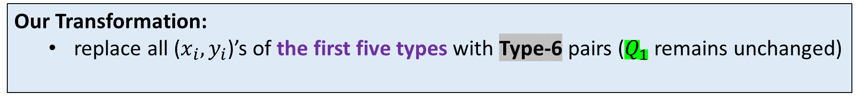
Key Ideas – A General Transformation
For 3-round KACSP, a good transcript $τ$ may contain different types of ($x_{i},y_{i}$)’s
$$⊕κ_{0}$$
$$P_{1}$$
$$⊕κ_{1}$$
$$P_{1}$$
$$⊕κ_{2}$$
$$P_{1}$$
$$⊕κ_{3}$$
Type-1: 1 missing-edge
$$x_{1}$$
$$y_{1}$$
Type-2: 1 missing-edge
$$x_{2}$$
$$y_{2}$$
$$x_{3}$$
$$⋮$$
$$⋮$$
$$⋮$$
$$⋮$$
$$⋮$$
$$⋮$$
$$y_{3}$$
Type-3: 2 missing-edges
$$Q_{0}$$
$$x_{4}$$
$$Q_{0}$$
$$y_{4}$$
Type-4: 1 missing-edge
$$x_{5}$$
$$y_{5}$$
Type-5: 2 missing-edges
$$x_{6}$$
$$y_{6}$$
$$⋮$$
$$⋮$$
Type-6: 3 missing-edges
$$x_{q}$$
$$Q_{1}$$
$$Q_{1}$$
$$Q_{1}$$
$$y_{q}$$
starting points
destinations
free points
$$⋮$$
$$⋮$$
$$⋮$$
$$⋮$$
$$⋮$$
$$⋮$$
$$⋮$$
$$⋮$$
$κ_{0},…,κ_{3}$ are fixed
$Q_{0},…, Q_{3}$ are fixed
$$2^{n}$$
$$2^{n}$$
$$2^{n}$$
$$2^{n}$$
$$2^{n}$$
$$2^{n}$$
$$2^{n}$$
$$2^{n}$$
Our Transformation:
  replace all ($x_{i},y_{i}$)’s of the first five types with Type-6 pairs ($Q_{1}$ remains unchanged)
  the replaced pairs are required to be connected in the most wasteful way！

Slide 39


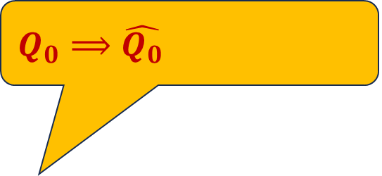










Key Ideas – A General Transformation
For 3-round KACSP, a good transcript $τ$ may contain different types of ($x_{i},y_{i}$)’s
$$⊕κ_{0}$$
$$P_{1}$$
$$⊕κ_{1}$$
$$P_{1}$$
$$⊕κ_{2}$$
$$P_{1}$$
$$⊕κ_{3}$$
$$x_{1}$$
$$y_{1}$$
$$x_{2}$$
$$y_{2}$$
$$x_{3}$$
$$⋮$$
$$⋮$$
$$⋮$$
$$⋮$$
$$⋮$$
$$⋮$$
$$y_{3}$$
$$x_{4}$$
$$y_{4}$$
$$x_{5}$$
$$y_{5}$$
$$x_{6}$$
$$y_{6}$$
$$⋮$$
$$⋮$$
Type-6: 3 missing-edges
$$x_{q}$$
$$Q_{1}$$
$$Q_{1}$$
$$Q_{1}$$
$$y_{q}$$
$$\hat{Q_{0}}$$
$${\hat{x}}_{1}$$
$$\hat{Q_{0}}$$
$${\hat{y}}_{1}$$
starting points
$${\hat{x}}_{2}$$
$${\hat{y}}_{2}$$
$${\hat{x}}_{3}$$
$$y_{3}$$
destinations
$${\hat{x}}_{4}$$
$Q_{0}⟹\hat{Q_{0}}$, not enough!
$${\hat{y}}_{4}$$
free points
$${\hat{x}}_{5}$$
$$⋮$$
$$⋮$$
$$⋮$$
$${\hat{y}}_{5}$$
$κ_{0},…,κ_{3}$ are fixed
$Q_{0},…, Q_{3}$ are fixed
$$⋮$$
$$⋮$$
$$⋮$$
$$⋮$$
$$⋮$$
$$2^{n}$$
$$2^{n}$$
$$2^{n}$$
$$2^{n}$$
$$2^{n}$$
$$2^{n}$$
$$2^{n}$$
$$2^{n}$$
Our Transformation:
  replace all ($x_{i},y_{i}$)’s of the first five types with Type-6 pairs ($Q_{1}$ remains unchanged)
  the replaced pairs are required to be connected in the most wasteful way！

Slide 40
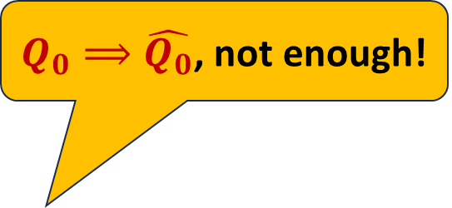
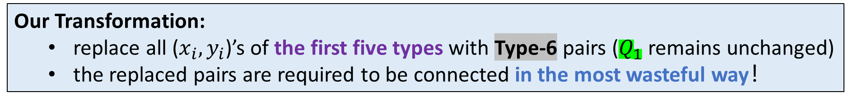
Key Ideas – A General Transformation
For 3-round KACSP, a good transcript $τ$ may contain different types of ($x_{i},y_{i}$)’s
$$⊕κ_{0}$$
$$P_{1}$$
$$⊕κ_{1}$$
$$P_{1}$$
$$⊕κ_{2}$$
$$P_{1}$$
$$⊕κ_{3}$$
$$x_{1}$$
$$y_{1}$$
$$x_{2}$$
$$y_{2}$$
$$x_{3}$$
$$⋮$$
$$⋮$$
$$⋮$$
$$⋮$$
$$⋮$$
$$⋮$$
$$y_{3}$$
$$x_{4}$$
$$y_{4}$$
$$x_{5}$$
$$y_{5}$$
$$x_{6}$$
$$y_{6}$$
$$⋮$$
$$⋮$$
Type-6: 3 missing-edges
$$x_{q}$$
$$Q_{1}$$
$$Q_{1}$$
$$Q_{1}$$
$$y_{q}$$
$$\hat{Q_{0}}$$
$${\hat{x}}_{1}$$
$$\hat{Q_{0}}$$
$${\hat{y}}_{1}$$
starting points
$${\hat{x}}_{2}$$
$${\hat{y}}_{2}$$
$${\hat{x}}_{3}$$
$$y_{3}$$
destinations
$${\hat{x}}_{4}$$
$Q_{0}⟹\hat{Q_{0}}$, not enough!
$${\hat{y}}_{4}$$
free points
$${\hat{x}}_{5}$$
$$⋮$$
$$⋮$$
$$⋮$$
$${\hat{y}}_{5}$$
$κ_{0},…,κ_{3}$ are fixed
$Q_{0},…, Q_{3}$ are fixed
$$⋮$$
$$⋮$$
$$⋮$$
$$⋮$$
$$⋮$$
$$2^{n}$$
$$2^{n}$$
$$2^{n}$$
$$2^{n}$$
$$2^{n}$$
$$2^{n}$$
$$2^{n}$$
$$2^{n}$$
Our Transformation:
  replace all ($x_{i},y_{i}$)’s of the first five types with Type-6 pairs ($Q_{1}$ remains unchanged)
  the replaced pairs are required to be connected in the most wasteful way！

Slide 41
Key Ideas – A General Transformation
For 3-round KACSP, a good transcript $τ$ may contain different types of ($x_{i},y_{i}$)’s
$$⊕κ_{0}$$
$$P_{1}$$
$$⊕κ_{1}$$
$$P_{1}$$
$$⊕κ_{2}$$
$$P_{1}$$
$$⊕κ_{3}$$
$$x_{1}$$
$$y_{1}$$
$$x_{2}$$
$$y_{2}$$
$$x_{3}$$
$$⋮$$
$$⋮$$
$$⋮$$
$$⋮$$
$$⋮$$
$$⋮$$
$$y_{3}$$
$$x_{4}$$
$$y_{4}$$
$$x_{5}$$
$$y_{5}$$
$$x_{6}$$
$$y_{6}$$
$$⋮$$
$$⋮$$
Type-6: 3 missing-edges
$$x_{q}$$
$$Q_{1}$$
$$Q_{1}$$
$$Q_{1}$$
$$y_{q}$$
$$\hat{Q_{0}}$$
$${\hat{x}}_{1}$$
$$\hat{Q_{0}}$$
$${\hat{y}}_{1}$$
starting points
$${\hat{x}}_{2}$$
$${\hat{y}}_{2}$$
$${\hat{x}}_{3}$$
$$y_{3}$$
destinations
$${\hat{x}}_{4}$$
$${\hat{y}}_{4}$$
free points
$${\hat{x}}_{5}$$
$$⋮$$
$$⋮$$
$$⋮$$
$${\hat{y}}_{5}$$
$κ_{0},…,κ_{3}$ are fixed
$Q_{0},…, Q_{3}$ are fixed
$$⋮$$
$$⋮$$
$$⋮$$
$$⋮$$
$$⋮$$
$$2^{n}$$
$$2^{n}$$
$$2^{n}$$
$$2^{n}$$
$$2^{n}$$
$$2^{n}$$
$$2^{n}$$
$$2^{n}$$
Always use new edges, and each edge can only be used exactly once
Our Transformation:
  replace all ($x_{i},y_{i}$)’s of the first five types with Type-6 pairs ($Q_{1}$ remains unchanged)
  the replaced pairs are required to be connected in the most wasteful way！

Slide 42
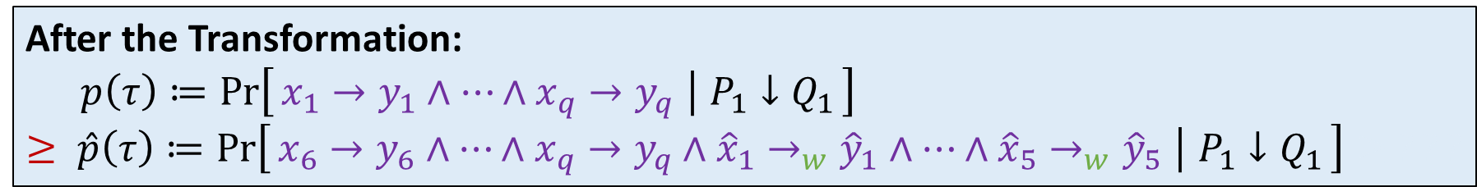
Key Ideas – A General Transformation
For 3-round KACSP, a good transcript $τ$ may contain different types of ($x_{i},y_{i}$)’s
$$⊕κ_{0}$$
$$P_{1}$$
$$⊕κ_{1}$$
$$P_{1}$$
$$⊕κ_{2}$$
$$P_{1}$$
$$⊕κ_{3}$$
$$x_{1}$$
$$y_{1}$$
$$x_{2}$$
$$y_{2}$$
$$x_{3}$$
$$⋮$$
$$⋮$$
$$⋮$$
$$⋮$$
$$⋮$$
$$⋮$$
$$y_{3}$$
$$x_{4}$$
$$y_{4}$$
$$x_{5}$$
$$y_{5}$$
$$x_{6}$$
$$y_{6}$$
$$⋮$$
$$⋮$$
Type-6: 3 missing-edges
$$x_{q}$$
$$Q_{1}$$
$$Q_{1}$$
$$Q_{1}$$
$$y_{q}$$
$$\hat{Q_{0}}$$
$${\hat{x}}_{1}$$
$$\hat{Q_{0}}$$
$${\hat{y}}_{1}$$
starting points
$${\hat{x}}_{2}$$
$${\hat{y}}_{2}$$
$${\hat{x}}_{3}$$
$$y_{3}$$
destinations
$${\hat{x}}_{4}$$
$${\hat{y}}_{4}$$
free points
$${\hat{x}}_{5}$$
$$⋮$$
$$⋮$$
$$⋮$$
$${\hat{y}}_{5}$$
$κ_{0},…,κ_{3}$ are fixed
$Q_{0},…, Q_{3}$ are fixed
$$⋮$$
$$⋮$$
$$⋮$$
$$⋮$$
$$⋮$$
$$2^{n}$$
$$2^{n}$$
$$2^{n}$$
$$2^{n}$$
$$2^{n}$$
$$2^{n}$$
$$2^{n}$$
$$2^{n}$$
After the Transformation:
$p\left(τ\right)≔\operatorname{Pr}\left[x_{1}→y_{1}∧⋯∧x_{q}→y_{q} ∣ P_{1}↓Q_{1}\right]$
$≥ \hat{p}\left(τ\right)≔\operatorname{Pr}\left[x_{6}→y_{6}∧⋯∧x_{q}→y_{q}∧{\hat{x}}_{1}→_{w}{\hat{y}}_{1}∧⋯∧{\hat{x}}_{5}→_{w}{\hat{y}}_{5} ∣ P_{1}↓Q_{1}\right]≥ ???$

Slide 43

Key Ideas – A General Transformation
For 3-round KACSP, a good transcript $τ$ may contain different types of ($x_{i},y_{i}$)’s
$$⊕κ_{0}$$
$$P_{1}$$
$$⊕κ_{1}$$
$$P_{1}$$
$$⊕κ_{2}$$
$$P_{1}$$
$$⊕κ_{3}$$
$$x_{1}$$
$$y_{1}$$
$$x_{2}$$
$$y_{2}$$
$$x_{3}$$
$$⋮$$
$$⋮$$
$$⋮$$
$$⋮$$
$$⋮$$
$$⋮$$
$$y_{3}$$
$$x_{4}$$
$$y_{4}$$
$$x_{5}$$
$$y_{5}$$
$$x_{6}$$
$$y_{6}$$
$$⋮$$
$$⋮$$
Type-6: 3 missing-edges
$$x_{q}$$
$$Q_{1}$$
$$Q_{1}$$
$$Q_{1}$$
$$y_{q}$$
$$\hat{Q_{0}}$$
$${\hat{x}}_{1}$$
$$\hat{Q_{0}}$$
$${\hat{y}}_{1}$$
starting points
$${\hat{x}}_{2}$$
$${\hat{y}}_{2}$$
$${\hat{x}}_{3}$$
$$y_{3}$$
destinations
$${\hat{x}}_{4}$$
$${\hat{y}}_{4}$$
free points
$${\hat{x}}_{5}$$
$$⋮$$
$$⋮$$
$$⋮$$
$${\hat{y}}_{5}$$
$κ_{0},…,κ_{3}$ are fixed
$Q_{0},…, Q_{3}$ are fixed
$$⋮$$
$$⋮$$
$$⋮$$
$$⋮$$
$$⋮$$
$$2^{n}$$
$$2^{n}$$
$$2^{n}$$
$$2^{n}$$
$$2^{n}$$
$$2^{n}$$
$$2^{n}$$
$$2^{n}$$
After the Transformation:
$p\left(τ\right)≔\operatorname{Pr}\left[x_{1}→y_{1}∧⋯∧x_{q}→y_{q} ∣ P_{1}↓Q_{1}\right]$
$≥ \hat{p}\left(τ\right)≔\operatorname{Pr}\left[x_{6}→y_{6}∧⋯∧x_{q}→y_{q}∧{\hat{x}}_{1}→_{w}{\hat{y}}_{1}∧⋯∧{\hat{x}}_{5}→_{w}{\hat{y}}_{5} ∣ P_{1}↓Q_{1}\right]≥ ???$
$$≥ ???$$

Slide 44
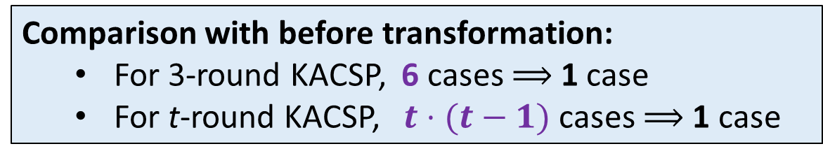
Key Ideas – A General Transformation
For 3-round KACSP, a good transcript $τ$ may contain different types of ($x_{i},y_{i}$)’s
$$⊕κ_{0}$$
$$P_{1}$$
$$⊕κ_{1}$$
$$P_{1}$$
$$⊕κ_{2}$$
$$P_{1}$$
$$⊕κ_{3}$$
$$x_{1}$$
$$y_{1}$$
$$x_{2}$$
$$y_{2}$$
$$x_{3}$$
$$⋮$$
$$⋮$$
$$⋮$$
$$⋮$$
$$⋮$$
$$⋮$$
$$y_{3}$$
$$x_{4}$$
$$y_{4}$$
$$x_{5}$$
$$y_{5}$$
$$x_{6}$$
$$y_{6}$$
$$⋮$$
$$⋮$$
Type-6: 3 missing-edges
$$x_{q}$$
$$Q_{1}$$
$$Q_{1}$$
$$Q_{1}$$
$$y_{q}$$
$$\hat{Q_{0}}$$
$${\hat{x}}_{1}$$
$$\hat{Q_{0}}$$
$${\hat{y}}_{1}$$
starting points
$${\hat{x}}_{2}$$
$${\hat{y}}_{2}$$
$${\hat{x}}_{3}$$
$$y_{3}$$
destinations
$${\hat{x}}_{4}$$
$${\hat{y}}_{4}$$
free points
$${\hat{x}}_{5}$$
$$⋮$$
$$⋮$$
$$⋮$$
$${\hat{y}}_{5}$$
$κ_{0},…,κ_{3}$ are fixed
$Q_{0},…, Q_{3}$ are fixed
$$⋮$$
$$⋮$$
$$⋮$$
$$⋮$$
$$⋮$$
$$2^{n}$$
$$2^{n}$$
$$2^{n}$$
$$2^{n}$$
$$2^{n}$$
$$2^{n}$$
$$2^{n}$$
$$2^{n}$$
Comparison with before transformation:
  For 3-round KACSP, 6 cases $⟹$ 1 case
  For t-round KACSP, $t⋅(t−1)$ cases $⟹$ 1 case

Slide 45




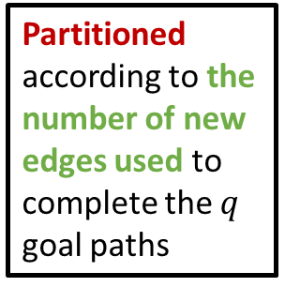

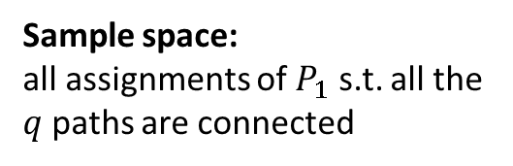

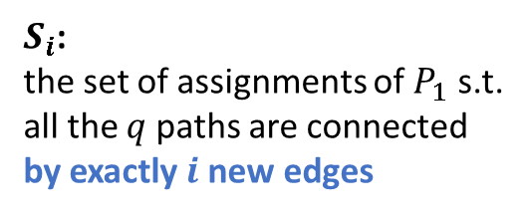
Key Ideas – Constructive Proof
Sample Space
$$S_{3q}$$
Sample space:
all assignments of $P_{1}$ s.t. all the $q$ paths are connected
$$S_{3q−1}$$
$$S_{3q−2}$$
Partitioned according to the number of new edges used to complete the $q$ goal paths
$$⋮$$
$$S_{3q−ℓ}$$
$S_{i}$:
the set of assignments of $P_{1}$ s.t. all the $q$ paths are connected by exactly$i$ new edges
$$⋮$$
Target probability:
$$\hat{p}\left(τ\right)≔\operatorname{Pr}\left[x_{6}→y_{6}∧⋯∧x_{q}→y_{q}∧{\hat{x}}_{1}→_{w}{\hat{y}}_{1}∧⋯∧{\hat{x}}_{5}→_{w}{\hat{y}}_{5} ∣ P_{1}↓Q_{1}\right]≥ ???$$

Slide 46
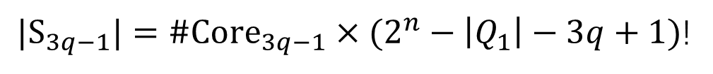
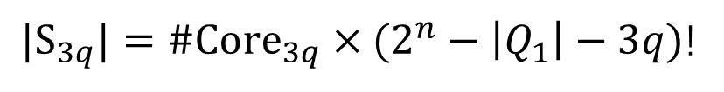
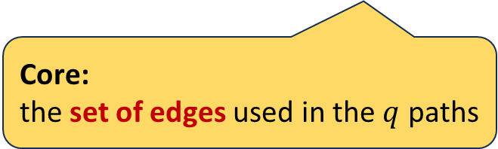
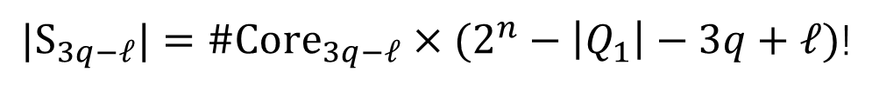
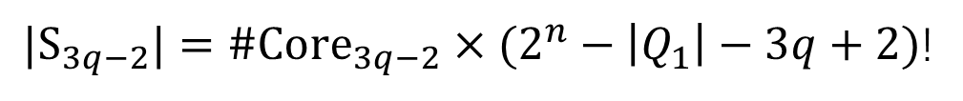
Key Ideas – Constructive Proof
Sample Space
${|S}_{3q}|=\#{Core}_{3q}×(2^{n}−\left|Q_{1}\right|−3q)$!
Sample space:
all assignments of $P_{1}$ s.t. all the $q$ paths are connected
${|S}_{3q−1}|=\#{Core}_{3q−1}×(2^{n}−\left|Q_{1}\right|−3q+1)$!
${|S}_{3q−2}|=\#{Core}_{3q−2}×(2^{n}−\left|Q_{1}\right|−3q+2)$!
Partitioned according to the number of new edges used to complete the $q$ goal paths
$$⋮$$
${|S}_{3q−ℓ}|=\#{Core}_{3q−ℓ}×(2^{n}−\left|Q_{1}\right|−3q+ℓ)$!
$S_{i}$:
the set of assignments of $P_{1}$ s.t. all the $q$ paths are connected by exactly$i$ new edges
Core:
the set of edges used in the $q$ paths
$$⋮$$
Target probability:
$$\hat{p}\left(τ\right)≔\operatorname{Pr}\left[x_{6}→y_{6}∧⋯∧x_{q}→y_{q}∧{\hat{x}}_{1}→_{w}{\hat{y}}_{1}∧⋯∧{\hat{x}}_{5}→_{w}{\hat{y}}_{5} ∣ P_{1}↓Q_{1}\right]≥ ???$$

Slide 47

Key Ideas – Constructive Proof
Sample Space
${|S}_{3q}|=\#{Core}_{3q}×(2^{n}−\left|Q_{1}\right|−3q)$!
$${Core}_{3q}$$
Sample space:
all assignments of $P_{1}$ s.t. all the $q$ paths are connected
${|S}_{3q−1}|=\#{Core}_{3q−1}×(2^{n}−\left|Q_{1}\right|−3q+1)$!
$${Core}_{3q−1}$$
$${Core}_{3q−1}$$
Partitioned according to the number of new edges used to complete the $q$ goal paths
${|S}_{3q−2}|=\#{Core}_{3q−2}×(2^{n}−\left|Q_{1}\right|−3q+2)$!
$$⋮$$
$$⋮$$
$${Core}_{3q−ℓ}$$
Each Core is explicitly constructed by well-designed methods
Summing-up the cardinalities
${|S}_{3q−ℓ}|=\#{Core}_{3q−ℓ}×(2^{n}−\left|Q_{1}\right|−3q+ℓ)$!
$S_{i}$:
the set of assignments of $P_{1}$ s.t. all the $q$ paths are connected by exactly$i$ new edges
$$⋮$$
Target probability:
$$\hat{p}\left(τ\right)≔\operatorname{Pr}\left[x_{6}→y_{6}∧⋯∧x_{q}→y_{q}∧{\hat{x}}_{1}→_{w}{\hat{y}}_{1}∧⋯∧{\hat{x}}_{5}→_{w}{\hat{y}}_{5} ∣ P_{1}↓Q_{1}\right]≥ ???$$

Slide 48
Key Ideas – Constructive Proof
${|S}_{3q}|=\#{Core}_{3q}×(2^{n}−\left|Q_{1}\right|−3q)$!
$${Core}_{3q}$$
Sample space:
all assignments of $P_{1}$ s.t. all the $q$ paths are connected
${|S}_{3q−1}|=\#{Core}_{3q−1}×(2^{n}−\left|Q_{1}\right|−3q+1)$!
$${Core}_{3q−1}$$
The constructed green part must be a lower bound of the Sample Space
$${Core}_{3q−1}$$
Partitioned according to the number of new edges used to complete the $q$ goal paths
${|S}_{3q−2}|=\#{Core}_{3q−2}×(2^{n}−\left|Q_{1}\right|−3q+2)$!
$$⋮$$
$$⋮$$
$${Core}_{3q−ℓ}$$
${|S}_{3q−ℓ}|=\#{Core}_{3q−ℓ}×(2^{n}−\left|Q_{1}\right|−3q+ℓ)$!
$S_{i}$:
the set of assignments of $P_{1}$ s.t. all the $q$ paths are connected by exactly$i$ new edges
Challenging task:
Obtain a good enough lower bound
$$⋮$$
Target probability:
$$\hat{p}\left(τ\right)≔\operatorname{Pr}\left[x_{6}→y_{6}∧⋯∧x_{q}→y_{q}∧{\hat{x}}_{1}→_{w}{\hat{y}}_{1}∧⋯∧{\hat{x}}_{5}→_{w}{\hat{y}}_{5} ∣ P_{1}↓Q_{1}\right]≥ ???$$

Slide 49
Technical Details
Full version: https://ia.cr/2023/1355
If you have any questions about this work, please feel free to drop us an e-mail

Slide 50
More Insights From Proofs
A sketch of the sample space
  The proportion of the most wasteful way decreases, as the dependence of round permutations increases
  The vast majority of reused edges are used exactly twice
Potential applications of proof techniques
  Work for all KAC and KAC-type constructions
  Security proofs for other constructions/modes with non-independent permutations should also no longer be a problem

Slide 51
More Insights From Proofs
A sketch of the sample space
  The proportion of the most wasteful way decreases, as the dependence of round permutations increases
  The vast majority of reused edges are used exactly twice
Potential applications of general proof techniques
  Work for all KAC and KAC-type constructions
  Security proofs for other constructions/modes with non-independent permutations should also no longer be a problem

Slide 52
Thank you!

