Slide 1
Blackbox Verifiable Computation
Amit Agarwal, Navid Alamati, Dakshita Khurana Srinivasan Raghuraman, Peter Rindal

Slide 2
Problem Description
Motivation
Client not willing to go through the burden of auditing the server’s code.
Server making frequent code updates.
Server wishing to keep it’s code private.
Server $(C_{f})$
$$f∈F$$
Client
$${(x}_{1}, …, x_{n})$$
$${(y}_{1}, …, y_{n})$$
Aim : Client would like to outsource the computation of function $f$ on a batch of $n$ inputs.
Properties
NEW
Completeness
Soundness
Efficient verification
Black-box verification
If the server is honest, then $$y_{1}, …, y_{n}=f\left(x_{1}\right), …, f\left(x_{n}\right)$$ always
If the server is malicious, then $y_{1}, …, y_{n}=f\left(x_{1}\right), …, f\left(x_{n}\right)$ OR Client aborts with high probability
The client’s running time should be sublinear in $n⋅T_{f},$where $T_{f}$ is the time complexity of computing $f$
The client’s protocol should be oblivious of the server’s circuit $C_{f}$
Notes:
Blackbox verification is motivated by natural use-cases such as client not willing to go through the burden of auditing the server’s code, server frequently performing code updates, server wanting to keep its code private etc
To formally capture the notion of “black-box verification”, we define a new model which we will see on the next slide.

Slide 3
Helper oracles
Oracle Aided Batch Verification (OBVC)
Function oracle
$$f$$
.
.
.
$$g_{1}$$
$$g_{m}$$
Server $(C_{f})$
$$f$$
Client
$${(x}_{1}, …, x_{n})$$
$${(y}_{1}, …, y_{n})$$
Aim : Client would like to outsource the computation of function $f$ on a batch of $n$ inputs.
Non-triviality: The combined time complexity of helper oracle functions, $g_{1}…, g_{m}$ , is asymptotically smaller than the time complexity of the function $f$
Efficient verification:
1. Number of oracle queries made by Client to the function oracle is $O(λ)$
2. Number of oracle queries made by Client to each helper oracle is $O(n λ)$
3. Running time of the client is $λ^{c}⋅o\left(n⋅T_{f}\right)$ where $c$is some fixed constant.
Notes:
We model these oracles in order to allow the client to have *limited* *black-box* access to information about the function (which will aid the verification process)
Collectively, the query constraints on the oracles and running time constraint ensure that the total workload on the client side (i.e. work done by the verifier + work done by the oracles) is less than computing f n times

Slide 4
Positive Result
Assuming Homomorphic encryption (HE), there exists a Blackbox verifiable computation scheme for the class of Random Self Reducible (RSR) functions.
Inspired from Program testing/correcting literature [BLR90]
High level Idea :
Use RSR property to achieve blackbox verification.
Use “cut-and-chose” check + Homomorphic Encryption + RSR to get efficient verification while retaining soundness.

Slide 5
Background on RSR
$K$-RSR for a function $f$ is defined by 2 algorithms :
RSR.Encode
RSR.Decode
Uniformly Random
$$u_{}^{1}$$
$$f$$
$$v_{}^{1}$$
.
.
.
.
.
.
.
.
.
$$x$$
RSR.Encode
RSR.Decode
$$y= f(x)$$
$$u^{k}$$
$$f$$
$$v_{}^{k}$$
$$k$$ | $$f$$
1 | DLOG
2 | All linear functions
2 | Legendre
2 | sine, cosine
2 | Integer division
2 | Modular exponentiation
4 | Matrix Multiplication over $𝔽$
4 | Polynomial multiplication over $𝔽$
Examples of RSR functions
Much “simpler” than $f$ :
$$T_{RSR.Encode}+T_{RSR.Decode}≪T_{f}$$
Notes:
Here K is a parameter which depends on the function.

Slide 6
Protocol
Let’s assume $f$ has $k=1$ RSR
$$RSR.Encode$$
$$RSR.Decode$$
$i^{th}$ column is formed by invoking RSR.Encode on $x_{i}$ independently $λ$ times
$$f$$
Server $(C_{f})$
Client
$${(x}_{1}, …, x_{n})$$
$$u_{1,1}$$ | $$…$$ | $$…$$ | $$u_{n, 1}$$
$$…$$ | $$…$$ | $$…$$ | $$…$$
$$…$$ | $$…$$ | $$…$$ | $$…$$
$$u_{1, λ}$$ | $$…$$ | $$…$$ | $$u_{n, λ}$$
$$M=Shuffle$$
Apply $C_{f}$ individually to each entry of $M$
$$M$$
$$M^{′}=$$
If this check passes, ALL columns in $N$ have majority correct values w.h.p
$$M′$$
$N = Reverse_Shuffle(M’)$
Apply “Cut and choose check” on $N$
For each $v$ : check $v\overset{?}{=}f(u)$
$$v_{1,1}$$ | $$…$$ | $$…$$ | $$v_{n,1}$$
$$…$$ | $$…$$ | $$…$$ | $$…$$
$$…$$ | $$…$$ | $$…$$ | $$…$$
$$v_{1,λ}$$ | $$…$$ | $$…$$ | $$v_{n,λ}$$
$$N=$$
Apply RSR.Decode on every cell
Perform majority decoding on each column to get $(y_{1}, …, y_{n})$
Notes:
The idea behind why soundness holds is the following: 1.) Either the server corrupts too many entries in the matrix M and ends up getting caught in the cut-and-chose check
2.) Or, it corrupts only a few entries. These few corrupted entries will be spread across different inputs (due to RSR and shuffling, the server doesn’t know which u originated from which x and hence it cannot selectively corrupt the u values corresponding to a given instance x_i) . Therefore we can apply error correction to get the right outputs.

Slide 7
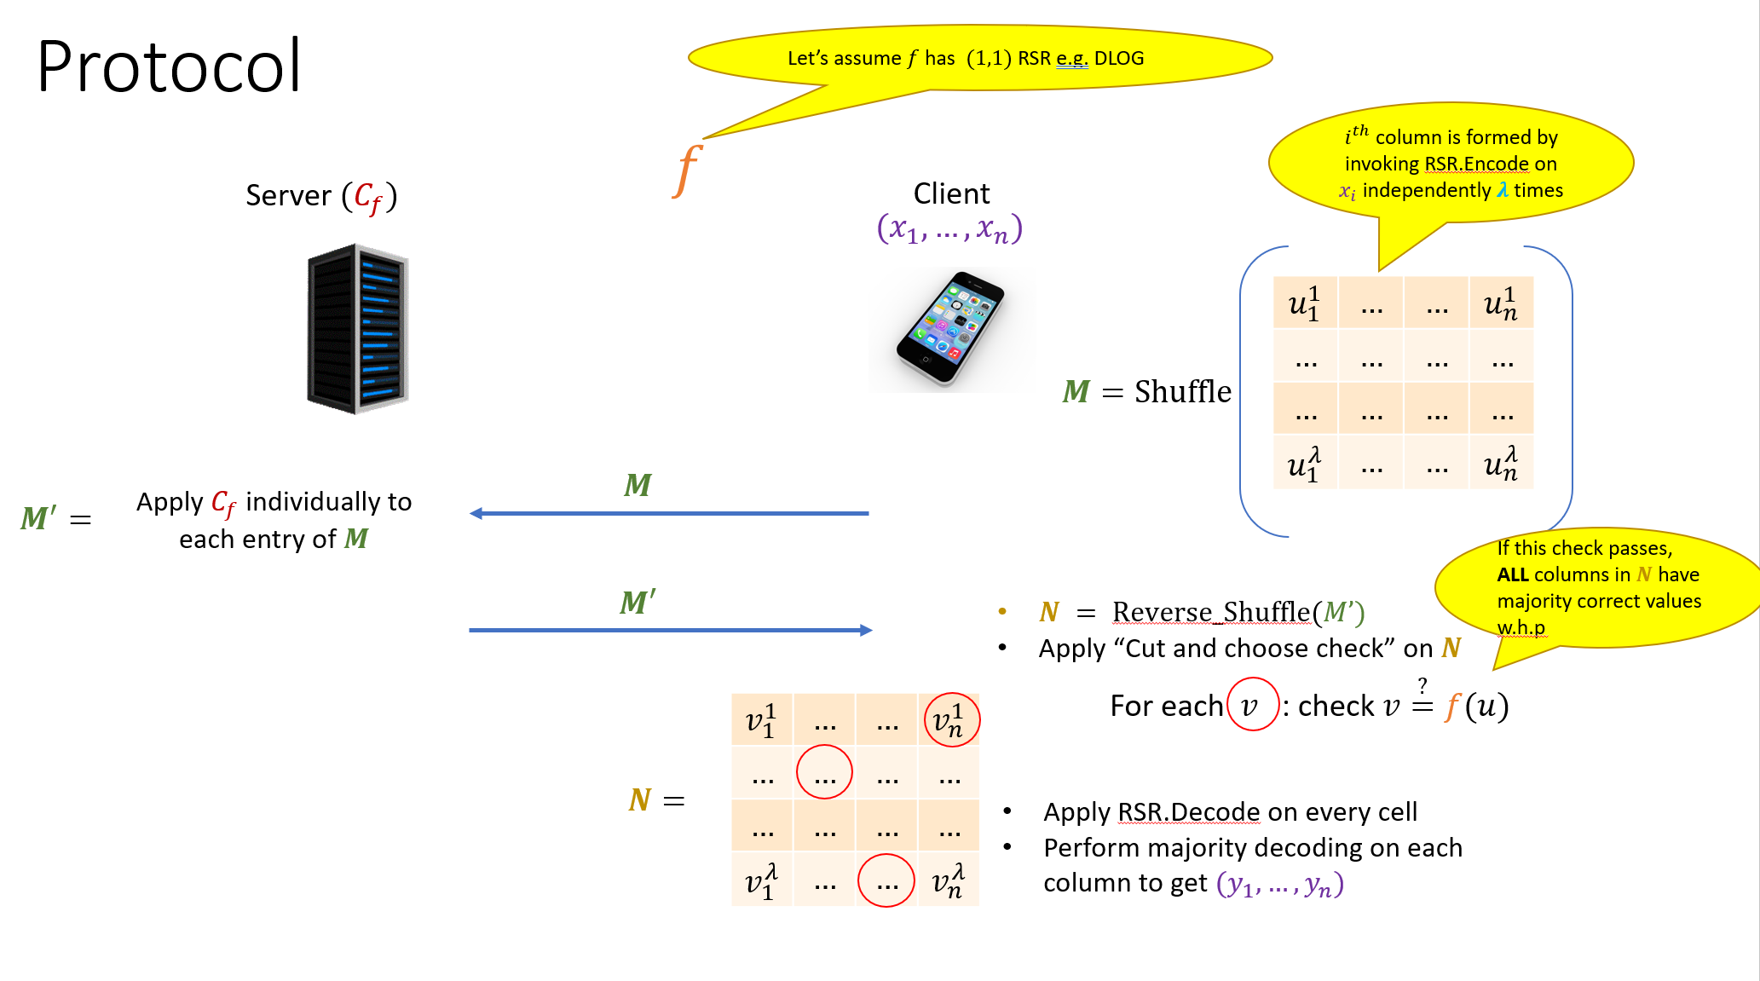
Observations
The client-side verification is completely oblivious of the server circuit $C_{f}$
Known SNARG techniques require Client and Server to agree on a fixed circuit for $f$ (and hence are not black-box)
How big should the size of “cut-and-choose” set should be ?
$\log^{2}{λ}$sized set suffices for negligible soundness error
Total workload on the verifier side:
$\log^{2}{λ}$ queries to
$n⋅λ$ queries to
$O(n⋅λ)$ local computation (shuffling, majority decoding)
Notes:
The total workload on the verifier side is asymptotically smaller than recomputing the function on n inputs.

Slide 8
Extending to $K$-RSR functions $(K>1)$
Main challenge: The outputs of RSR.Encode are not jointly random
Malicious prover can cheat by figuring out which $u$ values originated from which $x$ values.
Solution:
Encrypt each $u$ under a fresh public key and send shuffled encrypted $u$ values to the server.
To enable the prover to apply $f$ on the encrypted values, we need the encryption scheme to be homomorphic.
Verifier locally decrypts and performs cut-and-choose check as before.
Soundness Proof: Non-trivial (need to formalize a “no-signaling” guarantee)

Slide 9
Impossibility Result
Wishful aim : Tightly characterize the class of functions that admit OBVC scheme and those that do not.
Weaker aim : Show that a “large enough” function class cannot admit OBVC scheme.
Consider the function class $F_{λ} : \{ {\left\{0, 1\right\}}^{λ}→{\left\{0, 1\right\}}^{λ}\}$
We show that there does not exist a OBVC scheme for $F_{λ}$
Proof technique:
Turns out to be non-trivial as the helper oracles might contain arbitrary information about the function $f∈F_{λ}$
We use techniques based on prior work [CDGS18] to carefully formalize an impossibility proof.

Slide 10
Thanks

Slide 11
Extending to $K$-RSR functions $(K>1)$
Uniformly Random
$$u^{1}$$
Problematic!!
.
.
.
Joint distribution is NOT uniformly random
$$x$$
RSR.Encode
$$u^{k}$$
Uniformly Random
Shuffling these two values loses information about which $x$ each $u$ originated from
Shuffling these four values does not lose information about which $x$ each $u$ originated from
K=1 RSR
K=2 RSR
$$x_{1}$$
RSR.Encode
$$u_{1}^{1}$$
$$x_{1}$$
RSR.Encode
$$u_{1}^{1}$$
$$u_{1}^{2}$$
$$x_{2}$$
RSR.Encode
$$u_{2}^{1}$$
$$x_{2}$$
RSR.Encode
$$u_{2}^{1}$$
$$u_{2}^{2}$$

Slide 12
Idea
Encrypt each $u$ under a fresh public key and send shuffled encrypted $u$ values to the server.
To enable the prover to apply $f$ on the encrypted values, we need the encryption scheme to be homomorphic.
Verifier locally decrypts and performs cut-and-choose check as before.

Slide 13
Protocol
$$RSR.Encode$$
$$RSR.Decode$$
$i^{th}$ column is formed by invoking RSR.Encode on $x_{i}$ independently $λ$ times
$$f$$
Server $(C_{f})$
Client
$${(x}_{1}, …, x_{n})$$
$$u_{1,1}$$ | $$…$$ | $$…$$ | $$u_{n, 1}$$
$$…$$ | $$…$$ | $$…$$ | $$…$$
$$…$$ | $$…$$ | $$…$$ | $$…$$
$$u_{1, λ}$$ | $$…$$ | $$…$$ | $$u_{n, λ}$$
$$M=Shuffle$$
Apply $C_{f}$ individually to each entry of $M$
$$M$$
$$M^{′}=$$
If this check passes, ALL columns in $N$ have majority correct values w.h.p
$$M′$$
$N = Reverse_Shuffle(M’)$
Apply “Cut and choose check” on $N$
For each $v$ : check $v\overset{?}{=}f(u)$
$$v_{1,1}$$ | $$…$$ | $$…$$ | $$v_{n,1}$$
$$…$$ | $$…$$ | $$…$$ | $$…$$
$$…$$ | $$…$$ | $$…$$ | $$…$$
$$v_{1,λ}$$ | $$…$$ | $$…$$ | $$v_{n,λ}$$
$$N=$$
Apply RSR.Decode on every cell
Perform majority decoding on each column to get $(y_{1}, …, y_{n})$

Slide 14
Soundness Proof
Non-communicating Servers $(C_{f})$
No-signaling Servers $(C_{f})$
Client
Client
.
.
.
$${(x}_{1}, …, x_{n})$$
$${(x}_{1}, …, x_{n})$$
.
.
.
Homomorphic Encryption
Server $(C_{f})$
Client
$${(x}_{1}, …, x_{n})$$

Slide 15
Impossibility Result

Slide 16
Impossibility Result
Wishful aim : Tightly characterize the class of functions that admit OBVC scheme and those that do not.
Weaker aim : Show that a “large enough” function class cannot admit OBVC scheme.
Consider the function class $F_{λ} : \{ {\left\{0, 1\right\}}^{λ}→{\left\{0, 1\right\}}^{λ}\}$
We now consider an experiment where a function $f$ is sampled randomly from this class and OBVC scheme is executed on it
This experiment can be analyzed in the Random Oracle Model

Slide 17
$$f←F_{λ} : \{ {\left\{0, 1\right\}}^{λ}→{\left\{0, 1\right\}}^{λ}\}$$
$$f$$
.
.
.
$$g_{1}$$
$$g_{m}$$
Server $(C_{f})$
Client
$${(x}_{1}, …, x_{n})$$
$<n$queries
Idea : Switch to a world where the prover reprograms the value of $f$ at a random $x_{i}$ . If the client doesn’t query at $x_{i}$ , then the change will go un-noticed and prover will be able to cheat.
Issue: Helper oracles might contain auxiliary information about $f$
Notes:
We cannot directly apply lazy-sampling like argument where we say that points not queried by the client are independent of the client’s view.

Slide 18
Impossibility of OBVC
Impossibility in the Bit-fixing Random Oracle model
[CDGS18]
Impossibility in the Auxiliary-input Random Oracle model
Auxiliary input Random Oracle Model (AIRO) : The adversary is allowed to contain any arbitrary information about the Random Oracle as a preprocessing information.
Bit fixing Random Oracle Model (BFRO)
Introduced by [CDGS18] to aid the analysis of cryptographic protocols where adversary might have some preprocessing information about the Random Oracle.
Relaxes the AIRO by only allowing the preprocessing information to be dependent on some fixed number of Random Oracle points.

Slide 19
What is Verifiable Computation ?
$$f$$
Server $(C_{f})$
Client
$$x$$
$$x$$
$$y ≔f(x)$$
Proof $π$
Issue : Proof $π$ is “tied” to the circuit/code $C_{f}$ that the server is using
Proof of “correct computation of $y"$
Completeness: If the server is honest, then the proof $π$ is accepted by the client.
Soundness: If the server is malicious, then the proof $π$ is rejected by the client.
Efficiency: Work done by the verifier to check the proof $π$ must be less than recomputing the function from scratch

Slide 20
Extending to $\left(1, K\right)$ RSR functions
Client simply encrypts each cell using Homomorphic Encryption (HE) under a unique $pk$ , the server computes the function homomorphically, and then the client decrypts and performs cut-and-chose check.
A leveled HE scheme will suffice as we are only interested in outsourcing some fixed function $f$ at a time
Total running time of the verifier: $n⋅λ⋅\left(T_{RSR.Encode}+T_{RSR.Decode}+T_{HE.Encrypt}+T_{HE.Decrypt}\right)+ O\left(\log^{2}{λ}\right)⋅T_{f}$
Ongoing work:
Remove the need for HE using statistical mixing properties
Extending to larger classes of functions
Impossibility results for general class of functions

