Slide 1
Improved Polynomial Secret-Sharing Schemes
Amos Beimel, Oriol Farràs, and Or Lasri
Ben Gurion University and Universitat Rovira i Virgili
November 2023

Slide 2
Overview
Secret sharing scheme: useful tool in cryptography
Linear secret sharing scheme: useful for applications, less efficient
Polynomial secret-sharing schemes generalize linear secret-sharing schemes
  Known: Linear Secret Sharing < Degree-2 secret sharing < General Secret Sharing
Does the share size decrease as the degree of the polynomials grows?
  Our result: YES!
Tool:
  We construct a polynomial conditional disclosure of secrets (CDS) protocol

Slide 3
Organization
Definitions and background
Our results
High level Construction
Summary and open problems

Slide 4
Definitions and background

Slide 5
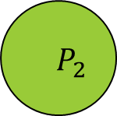

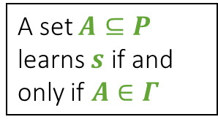

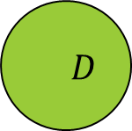
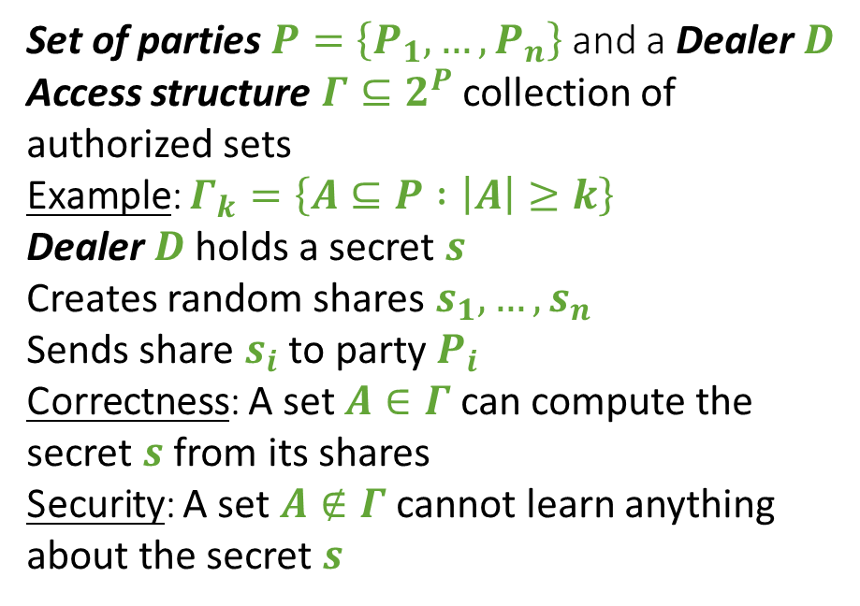


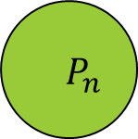

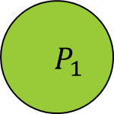

Secret-Sharing Schemes
[Shamir79, Blakley79, Ito-Saito-Nishizeki87]
              Set of parties $P=\left\{P_{1},…,P_{n}\right\}$ and a Dealer $D$
Access structure $Γ⊆2^{P}$collection of authorized sets
Example: $Γ_{k}=\left\{A⊆P :\left|A\right|≥k\right\}$
              Dealer $D$ holds a secret $s$
              Creates random shares $s_{1},…,s_{n}$
              Sends share $s_{i}$ to party $P_{i}$
Correctness: A set $A∈Γ$ can compute the secret $s$ from its shares
Security: A set $A∉Γ$ cannot learn anything about the secret $s$
$$D$$
$$s$$
A set $A⊆P$ learns $s$ if and only if $A∈Γ$
$$s_{1}$$
$$s_{2}$$
$$⋯$$
$$s_{n}$$
$$P_{1}$$
$$P_{2}$$
$$P_{n}$$
$$⋯$$

Slide 6
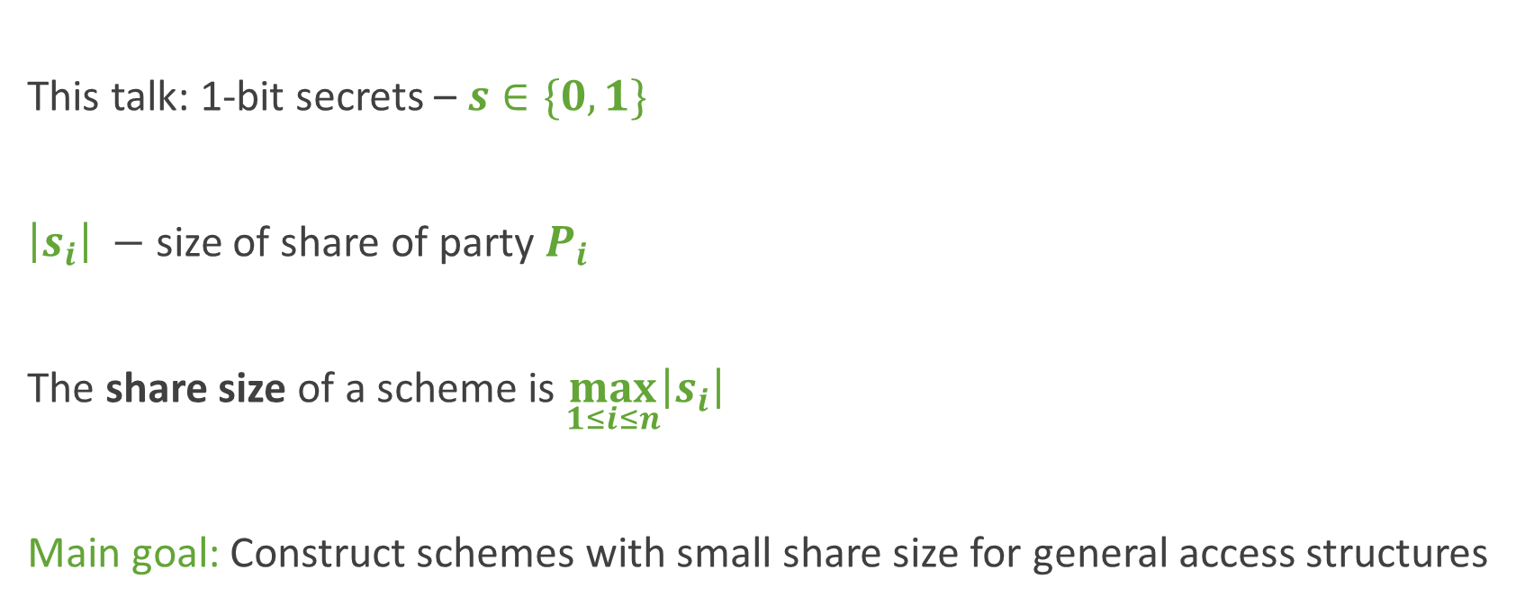
Share Size in Secret-Sharing Schemes
This talk: 1-bit secrets – $s∈\{0,1\}$
$\left|s_{i}\right|$ $−$ size of share of party $P_{i}$
The share size of a scheme is $\max_{1≤i≤n}\left|s_{i}\right|$
Main goal: Construct schemes with small share size for general access structures

Slide 7
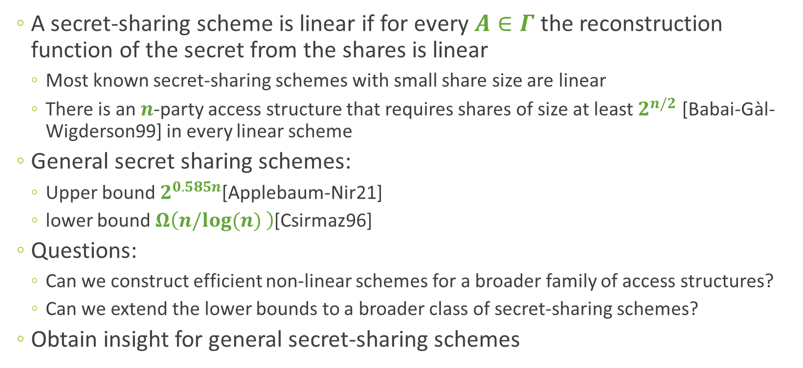
Polynomial Secret Sharing: Motivation
[Paskin-Radune20,Beimel-Othman-Peter22]
  A secret-sharing scheme is linear if for every $A∈Γ$the reconstruction function of the secret from the shares is linear
    Most known secret-sharing schemes with small share size are linear
    There is an $n$-party access structure that requires shares of size at least $2^{n/2}$ [Babai-Gàl-Wigderson99] in every linear scheme
  General secret sharing schemes:
    Upper bound $2^{0.585n}$[Applebaum-Nir21]
    lower bound $Ω\left(n/log(n) \right)$[Csirmaz96]
  Questions:
    Can we construct efficient non-linear schemes for a broader family of access structures?
    Can we extend the lower bounds to a broader class of secret-sharing schemes?
  Obtain insight for general secret-sharing schemes
General SS
Polynomial SS
Linear SS

Slide 8
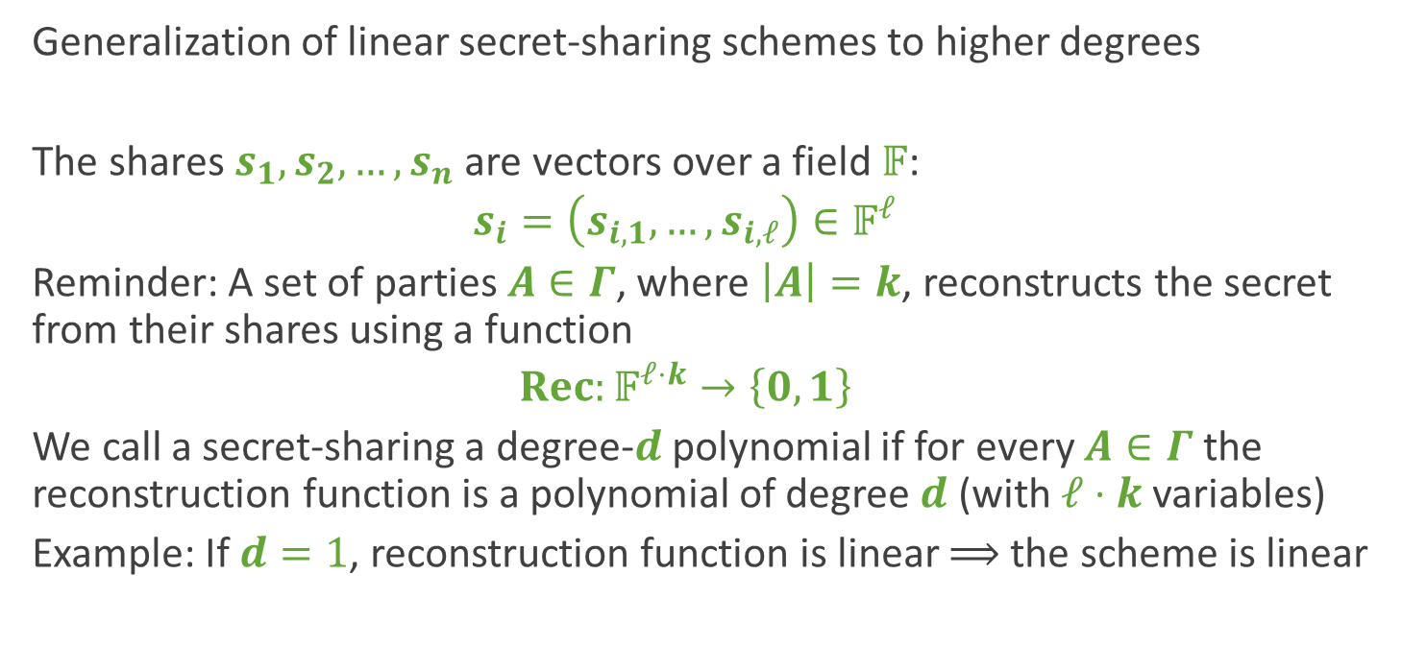
Polynomial Secret-Sharing Schemes
[Paskin-Cherniavsky-Radune20,Beimel-Othman-Peter22]
  Generalization of linear secret-sharing schemes to higher degrees
  ${\text{The} \text{shares} s_{1}, s_{2}, …,s}_{n}$ are vectors over a field $𝔽$:
  $$s_{i}=\left(s_{i,1},…,s_{i,ℓ}\right)∈𝔽^{ℓ}$$
  Reminder: A set of parties $A∈Γ$, where $\left|A\right|=k$, reconstructs the secret from their shares using a function
  $$Rec:𝔽^{ℓ⋅k}→\left\{0, 1\right\}$$
  We call a secret-sharing a degree-$d$ polynomial if for every $A∈Γ$the reconstruction function is a polynomial of degree $d$ (with $ℓ⋅k$ variables)
  Example: If $d=1$, reconstruction function is linear $⟹$ the scheme is linear

Slide 9

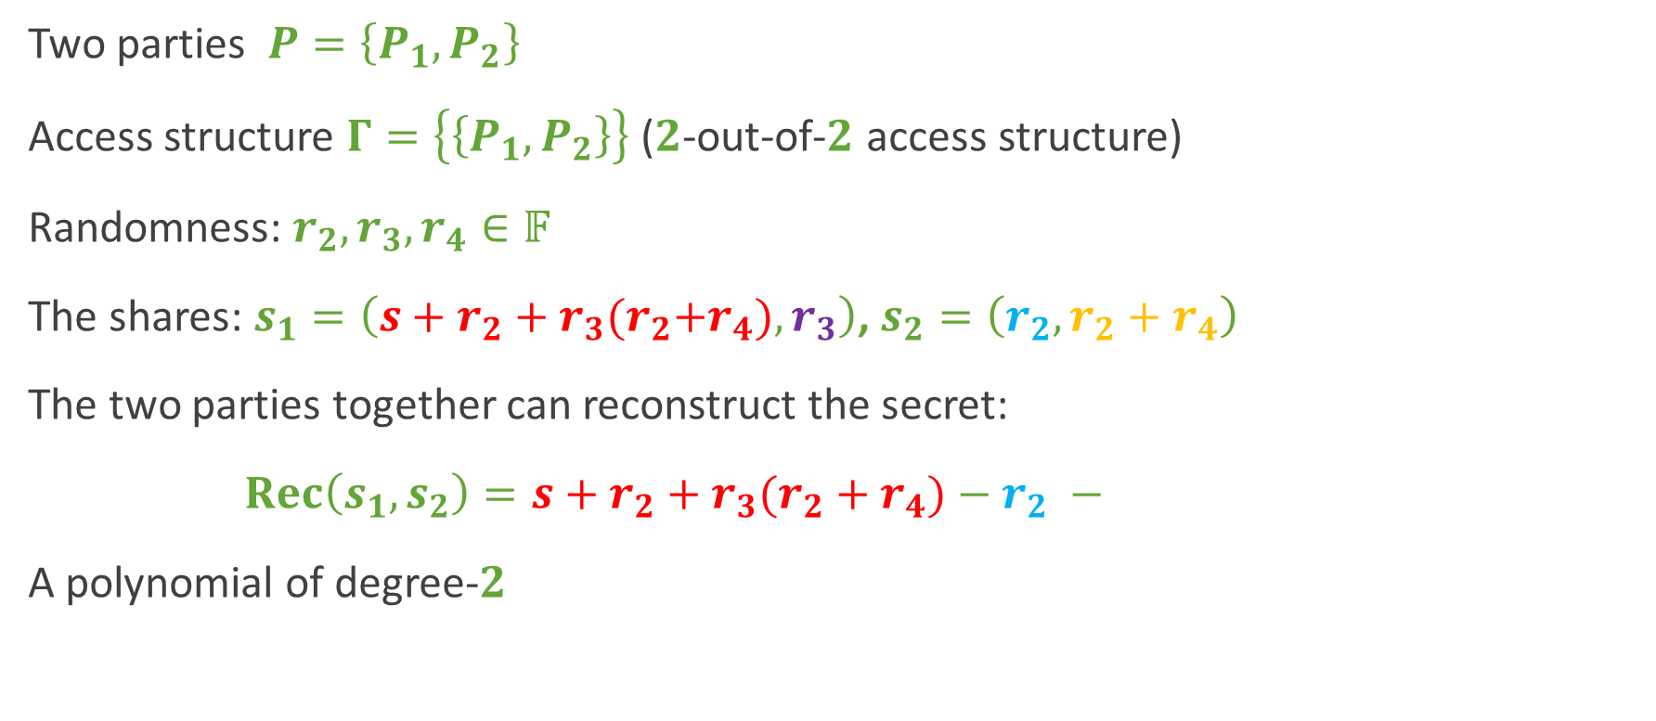
Example – Polynomial Secret-Sharing Scheme
Two parties $P=\left\{P_{1}, P_{2}\right\}$
Access structure $Γ=\left\{\left\{P_{1}, P_{2}\right\}\right\}$ ($2$-out-of-$2$ access structure)
Randomness: $r_{2}, r_{3}, r_{4}∈𝔽$
The shares: $s_{1}=\left(s+r_{2}+r_{3}{(r}_{2}+r_{4}), r_{3}\right)$, $s_{2}=\left(r_{2}, r_{2}+r_{4}\right)$
The two parties together can reconstruct the secret:
$Rec\left(s_{1}, s_{2}\right)=s+r_{2}+r_{3}(r_{2}+r_{4})−r_{2}$ $−$
A polynomial of degree-$2$
$$r_{3}⋅{(r}_{2}+r_{4})$$

Slide 10



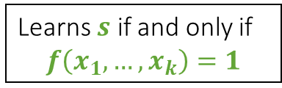





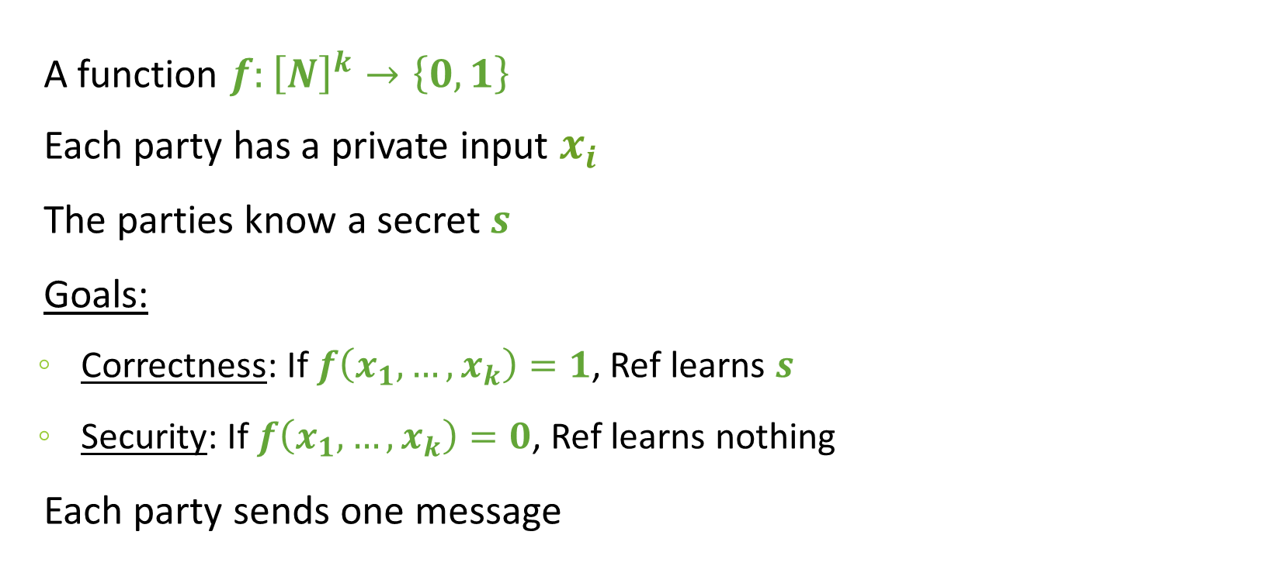











Conditional Disclosure of Secrets (CDS) [Gertner-Ishai-Kushilevitz-Malkin98]
$$x_{1}$$
$$,s$$
$$,r$$
$$x_{2}$$
$$,s$$
$$,r$$
$$⋯$$
$$x_{k}$$
$$,s$$
$$,r$$
A function $f:{\left[N\right]}^{k}→\left\{0,1\right\}$
Each party has a private input $x_{i}$
The parties know a secret $s$
Goals:
  Correctness: If $f\left(x_{1},…,x_{k}\right)=1$, Ref learns $s$
  Security: If $f\left(x_{1},…,x_{k}\right)=0$, Ref learns nothing
Each party sends one message
$$P_{1}$$
$$P_{2}$$
$$P_{k}$$
$$⋯$$
$$m_{1}$$
$$m_{2}$$
$$⋯$$
$$m_{k}$$
$$Ref$$
Learns $s$ if and only if
$$f\left(x_{1},…,x_{k}\right)=1$$
10

Slide 11
Applications of Secret-Sharing Schemes
              Original application:
                Storing sensitive information
              Today used in many secure protocols:
  Secure Multi-Party Computation (MPC)
  Attribute-based encryption (ABE)
  Threshold cryptography
  Access Control
  Oblivious transfer
  NP hardness of the partial minimal size (MCSP)
  …

Slide 12
Our results

Slide 13
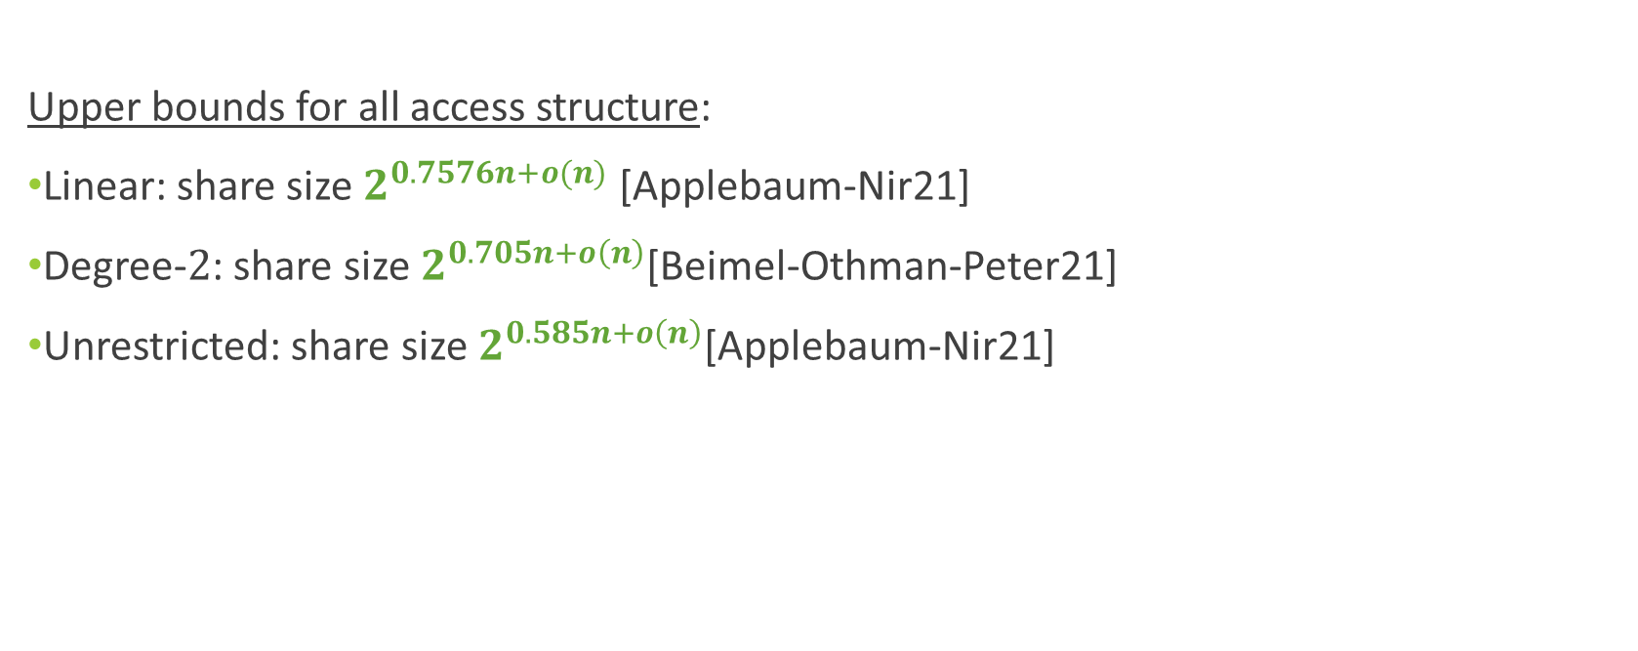
Previous Results – Secret-Sharing
Upper bounds for all access structure:
Linear: share size $2^{0.7576n+o(n)}$ [Applebaum-Nir21]
Degree-$2$: share size $2^{0.705n+o\left(n\right)}$[Beimel-Othman-Peter21]
Unrestricted: share size $2^{0.585n+o\left(n\right)}$[Applebaum-Nir21]

Slide 14
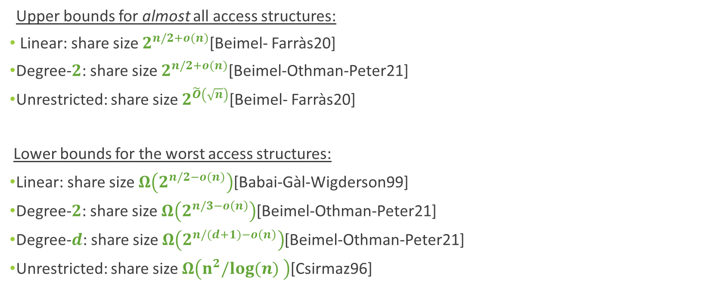
Previous Results - Secret-Sharing
Upper bounds for almost all access structures:
Linear: share size $2^{n/2+o(n)}$[Beimel- Farràs20]
Degree-$2$: share size $2^{n/2+o(n)}$[Beimel-Othman-Peter21]
Unrestricted: share size $2^{\tilde{O}\left(\sqrt{n}\right)}$[Beimel- Farràs20]
Lower bounds for the worst access structures:
Linear: share size $Ω\left(2^{n/2−o(n)}\right)$[Babai-Gàl-Wigderson99]
Degree-$2$: share size $Ω\left(2^{n/3−o\left(n\right)}\right)$[Beimel-Othman-Peter21]
Degree-$d$: share size $Ω\left(2^{n/(d+1)−o\left(n\right)}\right)$[Beimel-Othman-Peter21]
Unrestricted: share size $Ω\left(n^{2}/log(n) \right)$[Csirmaz96]

Slide 15
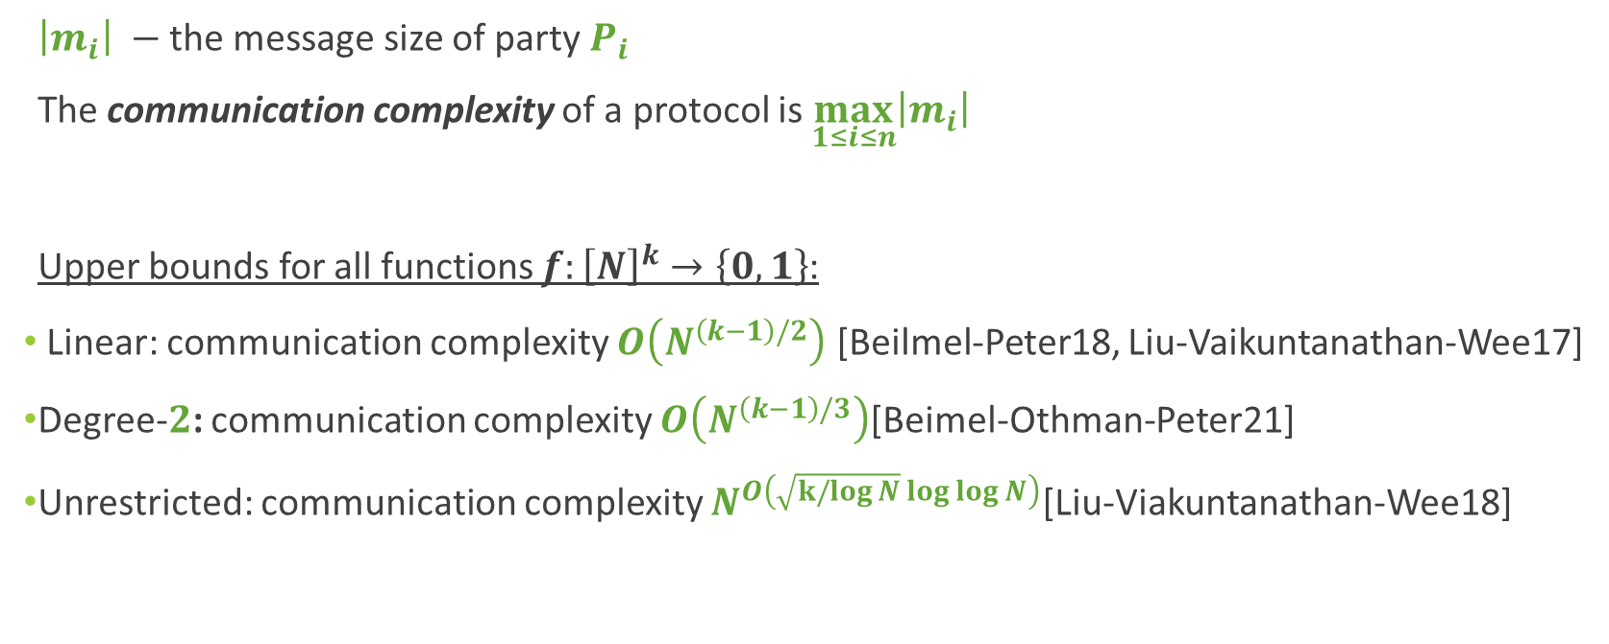
Previous Results – CDS Protocols
$\left|m_{i}\right|$ $−$ the message size of party $P_{i}$
The communication complexity of a protocol is $\max_{1≤i≤n}\left|m_{i}\right|$
Upper bounds for all functions $f:{\left[N\right]}^{k}→\left\{0, 1\right\}$:
Linear: communication complexity $O\left(N^{\left(k−1\right)/2}\right)$ [Beilmel-Peter18, Liu-Vaikuntanathan-Wee17]
Degree-$2$: communication complexity $O\left(N^{\left(k−1\right)/3}\right)$[Beimel-Othman-Peter21]
Unrestricted: communication complexity $N^{O\left(\sqrt{k/log{N}}\log{\log{N}}\right)}$[Liu-Viakuntanathan-Wee18]

Slide 16
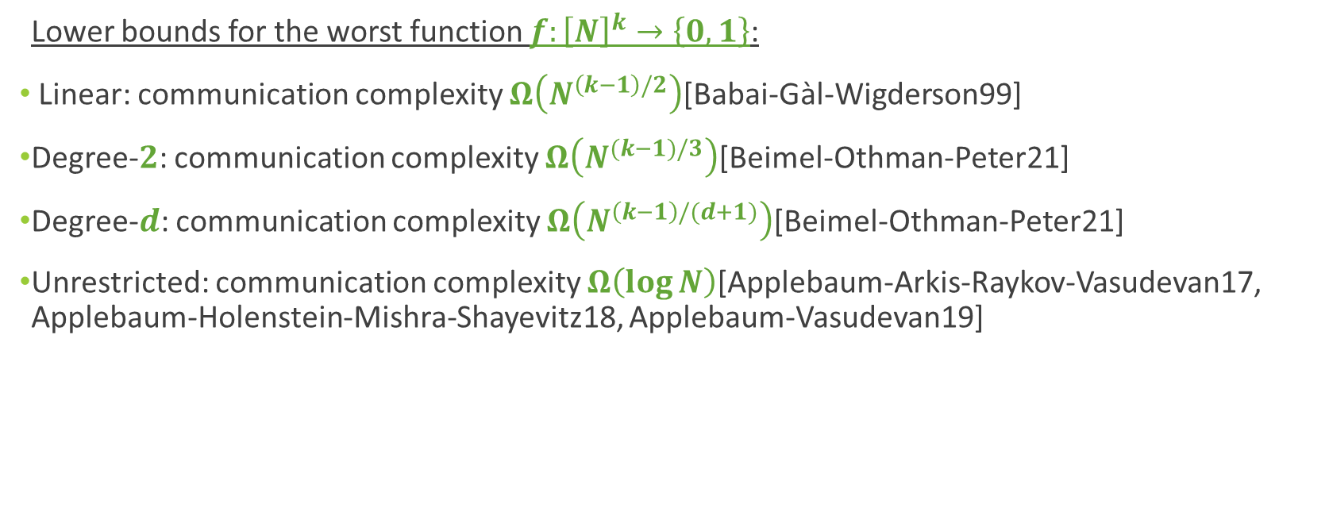
Previous Results – CDS Protocols
Lower bounds for the worst function $f:{\left[N\right]}^{k}→\left\{0, 1\right\}$:
Linear: communication complexity $Ω\left(N^{\left(k−1\right)/2}\right)$[Babai-Gàl-Wigderson99]
Degree-$2$: communication complexity $Ω\left(N^{(k−1)/3}\right)$[Beimel-Othman-Peter21]
Degree-$d$: communication complexity $Ω\left(N^{\left(k−1\right)/(d+1)}\right)$[Beimel-Othman-Peter21]
Unrestricted: communication complexity $Ω\left(\log{N}\right)$[Applebaum-Arkis-Raykov-Vasudevan17, Applebaum-Holenstein-Mishra-Shayevitz18, Applebaum-Vasudevan19]

Slide 17
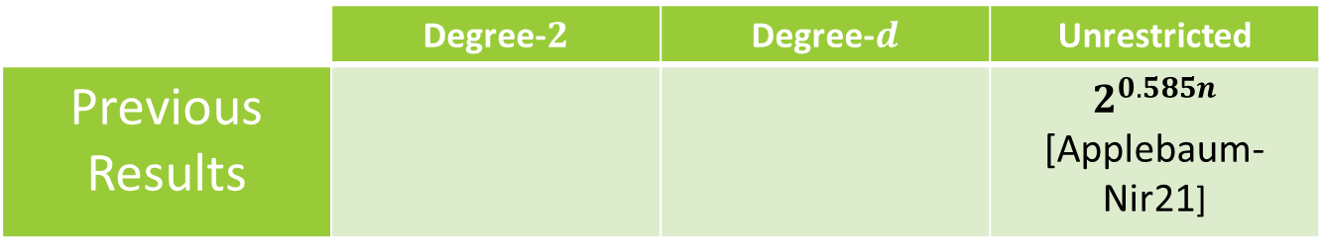

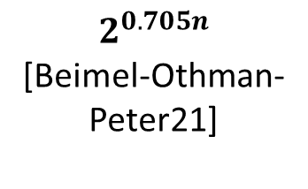
Our results – Secret Sharing
Thm1: Every $n$-party access structure can be realized by a secret-sharing scheme with degree-$d$ reconstruction with share size $2^{\left(0.585+c_{d}\right)n}$, where
$c_{d}=O(loglog d/log d)$
Improvement: Secret-sharing scheme for an arbitrary access structure with polynomial reconstruction of degree 243 and share size $2^{0.673n}$
 | Degree-$2$ | Degree-$d$ | Unrestricted
Previous Results |  |  | $2^{0.585n}$ [Applebaum-Nir21]
$$2^{0.705n}$$
[Beimel-Othman-Peter21]
No previous results

Slide 18



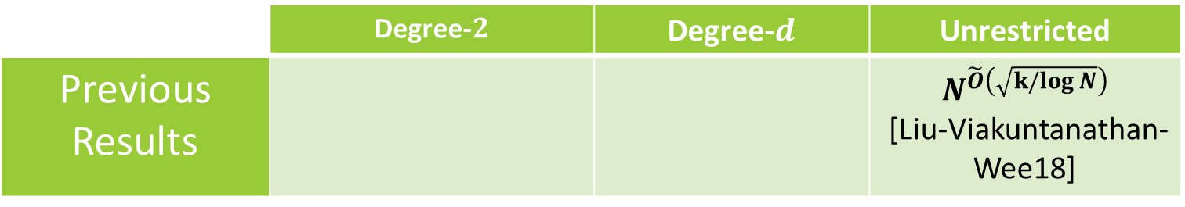
Our results – $k$-Server CDS
Thm2: For every $d > 0$ and function $f:{\left[N\right]}^{k}→\{0,1\}$, there is a degree-$d$ $k$-server CDS protocol for $f$, with communication complexity $N^{O\left(\left(k−1\right)⋅c_{d}\right)}$, where
$$c_{d}=O(loglog d/log d)$$
Lower bound degree-$d$: $Ω\left(N^{\left(k−1\right)/(d+1)}\right)$[Beimel-Othman-Peter21]
Improvement: $k$-server CDS protocol with polynomial reconstruction of degree 243 and communication complexity of $O\left(N^{(k−1)/4}\right)$
 | Degree-$2$ | Degree-$d$ | Unrestricted
Previous Results |  |  | $$N^{\tilde{O}\left(\sqrt{k/log{N}}\right)}$$ [Liu-Viakuntanathan-Wee18]
$$O\left(N^{\left(k−1\right)/3}\right)$$
[Beimel-Othman-Peter21]
No previous results

Slide 19
High level Construction

Slide 20
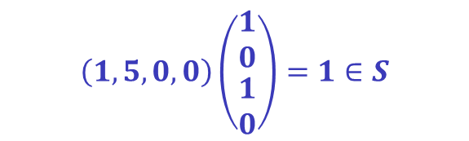

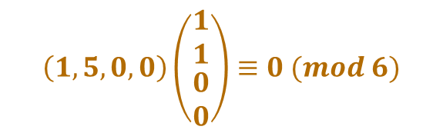




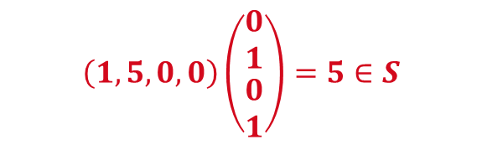
𝑆-matching vectors
  $m=p_{1}p_{2}$, $S⊆$ $ℤ_{m}∖\{0\}$
Definition:
${\left((u_{i}, v_{i})\right)}_{i=1}^{N}, u_{i}, v_{i}∈ℤ_{m}^{h}$ are $S$-matching vectors:
  $\left\langle u_{i}, v_{i}\right\rangle ≡0 \left(mod m\right)$ for every $i∈\left[N\right]$
  $\left\langle u_{i}, v_{i}\right\rangle mod m∈S$ for every $i≠j$
Example:
$m=6$, and $S=\{1, 5\}$
$u_{1}=(1,5,0,0)$
$u_{2}=\left(5,0,1,0\right)$
$u_{3}=\left(0,1,0,5\right)$
$$v_{1}=\left(1,1,0,0\right)$$
$$v_{2}=\left(1,0,1,0\right)$$
$$v_{3}=\left(0,1,0,1\right)$$
$$\left(1,5,0,0\right)\left(\begin{matrix}1 \\ 0 \\ \begin{aligned}1 \\ 0\end{aligned}\end{matrix}\right)=1∈S$$
$$\left(1,5,0,0\right)\left(\begin{matrix}0 \\ 1 \\ \begin{aligned}0 \\ 1\end{aligned}\end{matrix}\right)=5∈S$$
$$\left(1,5,0,0\right)\left(\begin{matrix}1 \\ 1 \\ \begin{aligned}0 \\ 0\end{aligned}\end{matrix}\right)≡0 (mod 6)$$

Slide 21

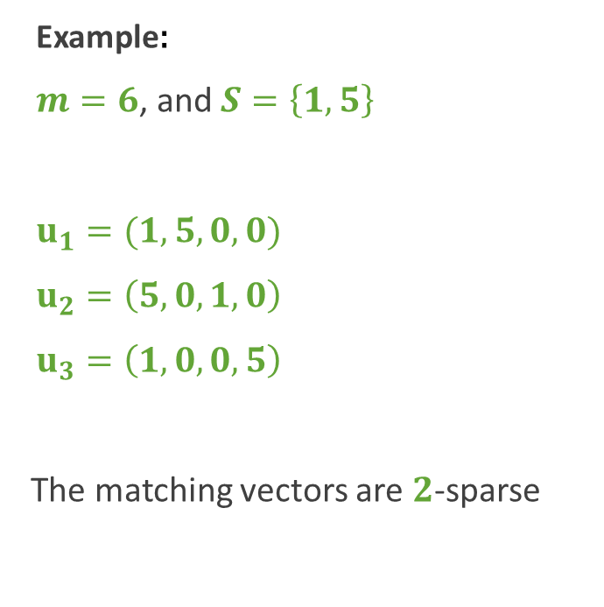








Sparse Matching Vectors
Definition:
We say that ${\left((u_{i}, v_{i})\right)}_{i=1}^{N}$ is $d$-sparse if for every $i∈\left[N\right]$:
$$\left|\{ℓ∈\left[h\right]:v_{i} \left[ℓ\right]≠0\}\right|≤d$$
Example:
$m=6$, and $S=\left\{1, 5\right\}$
$u_{1}=(1,5,0,0)$
$u_{2}=\left(5,0,1,0\right)$
$u_{3}=\left(1,0,0,5\right)$
The matching vectors are $2$-sparse
$$v_{1}=\left(1,1 ,0,0\right)$$
$$1,1$$
$$v_{2}=\left(1,0, 1,0\right)$$
$$1$$
$$1$$
$$1$$
$$1$$
$$v_{3}=\left(1,0,0,1\right)$$

Slide 22





Construction Flow
[Liu-Viakuntanathan-Wee17, Dvir-Gopi15]
[Liu-Viakuntanathan-Wee18]
[Liu-Viakuntanathan18,
Applebaum-Beimel-Nir-Peter20, Applebaum-Nir21]
$2$-Server CDS
Secret-Sharing schemes
Matching Vectors
$k$-server CDS
Polynomial
Secret-Sharing schemes
Polynomial
$2$-Server CDS
Sparse
Matching Vectors
Polynomial
$2$-Server CDS
Sparse
Matching Vectors
Polynomial
$k$-server CDS

Slide 23
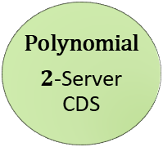
Construction Flow
Sparse
MV
Polynomial
$2$-Server CDS

Slide 24
Papers Flow
Construction of $2$-server CDS protocols with polynomial reconstruction, based on sparse matching vector family.
Construction of 𝟐-server CDS protocols with polynomial reconstruction, based on sparse matching vector family.
Constructions of Sparse matching vector families
Construction of $k$-server CDS protocols with polynomial reconstruction based on decomposed matching vector families.
Construction of 𝒌-server CDS protocols with polynomial reconstruction based on decomposed matching vector families.
Construction of the decompositions of the matching vector families.
Use of the reduction of [Beimel-Othman-Peter21] to get $k$-server $t$-RCDS with polynomial reconstruction from $k$-server CDS.
Use of the reduction of [Beimel-Othman-Peter21] to get 𝒌-server 𝒕-RCDS with polynomial reconstruction from 𝒌-server CDS.
Use of the reduction of [Applebaum-Nir21] to get secret-sharing scheme with polynomial reconstruction from $k$-server $t$-RCDS.
Use of the reduction of [Applebaum-Nir21] to get secret-sharing scheme with polynomial reconstruction from 𝒌-server 𝒕-RCDS.

Slide 25
Key observation
Sparse
Matching Vectors
Polynomial
CDS Protocol

Slide 26
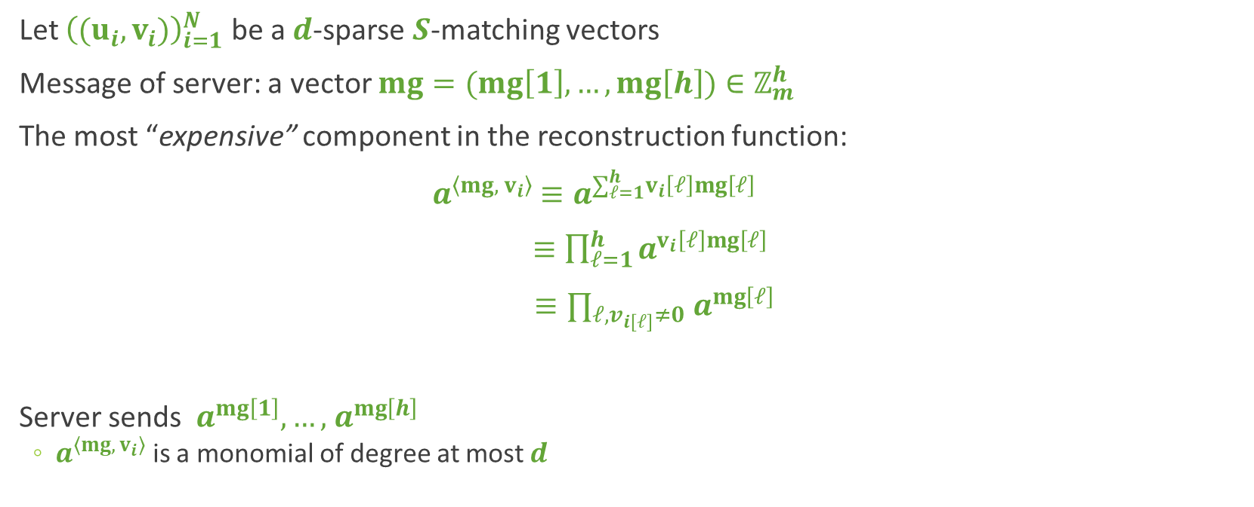
The reconstruction function
Let ${\left((u_{i}, v_{i})\right)}_{i=1}^{N}$ be a $d$-sparse $S$-matching vectors
Message of server: a vector $mg=(mg\left[1\right],…,mg\left[h\right])∈ℤ_{m}^{h}$
The most “expensive” component in the reconstruction function:
$a^{\left\langle mg, v_{i}\right\rangle }$ $≡a^{∑_{ℓ=1}^{h}v_{i}\left[ℓ\right]mg\left[ℓ\right] }$
$≡\prod_{ℓ=1}^{h}{a^{v_{i}\left[ℓ\right]mg\left[ℓ\right]}}$
$≡∏_{ℓ, v_{i\left[ℓ\right]}≠0}{ a}^{mg\left[ℓ\right]}$
Server sends ${ a}^{mg\left[1\right]},…,{ a}^{mg\left[h\right]}$
  $a^{\left\langle mg, v_{i}\right\rangle }$ is a monomial of degree at most $d$

Slide 27
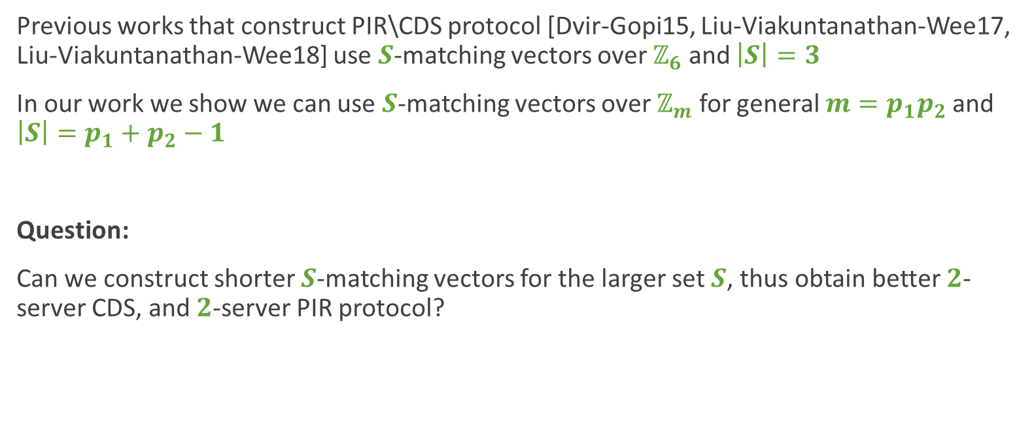
The matching vector set
Previous works that construct PIR\CDS protocol [Dvir-Gopi15, Liu-Viakuntanathan-Wee17, Liu-Viakuntanathan-Wee18] use $S$-matching vectors over $ℤ_{6}$ and $\left|S\right|=3$
In our work we show we can use $S$-matching vectors over $ℤ_{m}$ for general $m=p_{1}p_{2}$ and $\left|S\right|=p_{1}+p_{2}−1$
Question:
Can we construct shorter $S$-matching vectors for the larger set $S$, thus obtain better $2$-server CDS, and $2$-server PIR protocol?

Slide 28
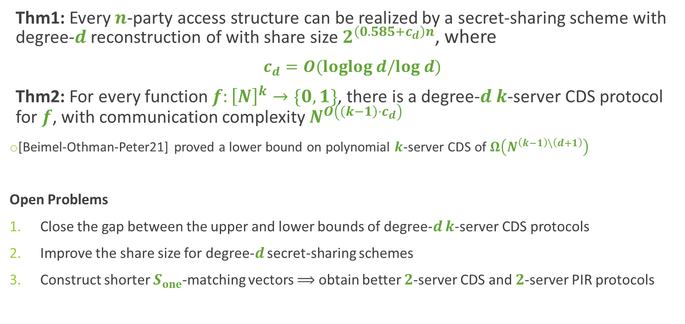
Conclusion and Open Problems
Thm1: Every $n$-party access structure can be realized by a secret-sharing scheme with degree-$d$ reconstruction of with share size $2^{\left(0.585+c_{d}\right)n}$, where
$c_{d}=O(loglog d/log d)$
Thm2: For every function $f:{\left[N\right]}^{k}→\{0,1\}$, there is a degree-$d$ $k$-server CDS protocol for $f$, with communication complexity $N^{O\left(\left(k−1\right)⋅c_{d}\right)}$
[Beimel-Othman-Peter21] proved a lower bound on polynomial $k$-server CDS of $Ω\left(N^{\left(k−1\right)\backslash \left(d+1\right)}\right)$
Open Problems
Close the gap between the upper and lower bounds of degree-$d$ $k$-server CDS protocols
Improve the share size for degree-$d$ secret-sharing schemes
Construct shorter $S_{one}$-matching vectors $⟹$ obtain better $2$-server CDS and $2$-server PIR protocols

Slide 29
Thanks!

Slide 30
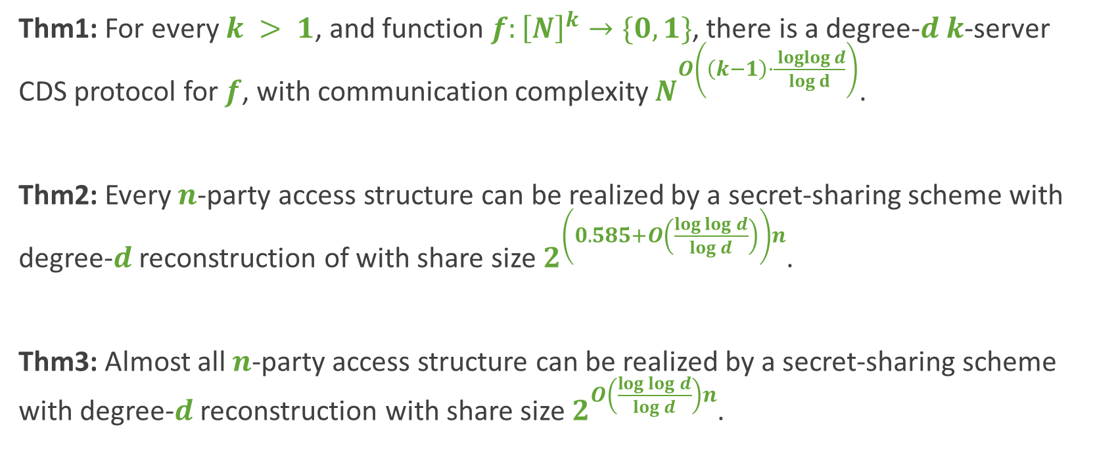
Our results
Thm1: For every $k > 1$, and function $f:{\left[N\right]}^{k}→\{0,1\}$, there is a degree-$d$ $k$-server CDS protocol for $f$, with communication complexity $N^{O\left(\left(k−1\right)⋅\frac{ loglog d}{log d}\right)}$.
Thm2: Every $n$-party access structure can be realized by a secret-sharing scheme with degree-$d$ reconstruction of with share size $2^{\left(0.585+O\left(\frac{\log{\log{d}}}{\log{d}}\right)\right)n}$.
Thm3: Almost all $n$-party access structure can be realized by a secret-sharing scheme with degree-$d$ reconstruction with share size $2^{O\left(\frac{\log{\log{d}}}{\log{d}}\right)n}$.

Slide 31
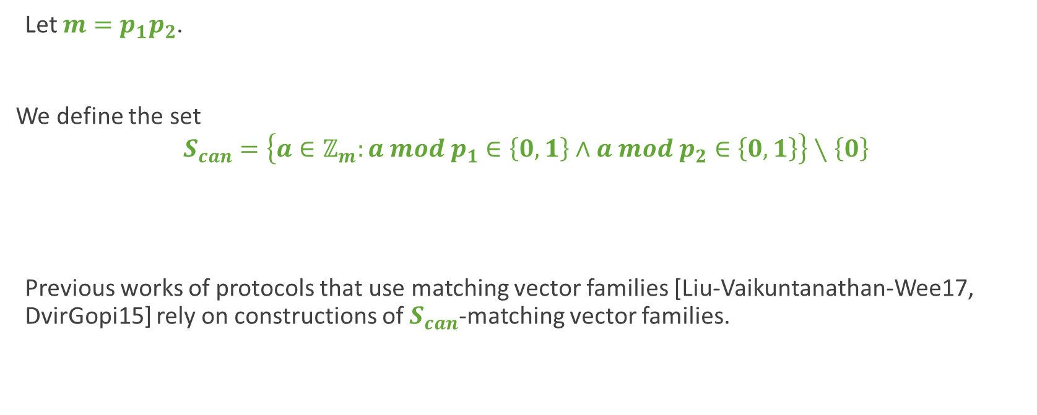
The matching vector set
Let $m=p_{1}p_{2}$.
We define the set
$$S_{can}=\left\{a∈ℤ_{m}:a mod p_{1}∈\left\{0, 1\right\}∧a mod p_{2}∈\left\{0, 1\right\}\right\}∖\left\{0\right\}$$
Previous works of protocols that use matching vector families [Liu-Vaikuntanathan-Wee17, DvirGopi15] rely on constructions of $S_{can}$-matching vector families.

Slide 32

The matching vector set
We define a new set
$S_{one}=\left\{a∈ℤ_{m}: a≡1\left(mod p_{1}\right)∨a≡\left(mod p_{2}\right)\right\}$
Example:
$p_{1}=2, p_{2}=3$, $S_{can}=\left\{1, 3, 4\right\}$, $S_{one}=\{1, 3, 4, 5\}$
Note that for every primes $p_{1}, p_{2}$:
      $\left|S_{can}\right|=3$,
      $\left|S_{one}\right|=p_{1}+p_{2}−1$,
      $S_{can}⊆S_{one}$.

Slide 33

The matching vector set
Observation:
Our CDS protocol can use any $S_{one}$-matching vector family over $𝔽_{m}$ for $m=p_{1}p_{2}$ such that $p_{1}|p_{2}−1$.
Using this observation, we construct another sparse matching vector family

Slide 34

The matching vector set
Question:
Can we construct $S_{one}$-matching vector family for some $p_{1}, p_{2}$ that are shorter from the current best $S_{can}$-matching vector families.

