Slide 1
Efficiently Testable Circuits without Conductivity
Mirza Ahad Baig, Suvradip Chakraborty, Stefan Dziembowski, Małgorzata Gałązka, Tomasz Lizurej, Krzysztof Pietrzak

Slide 2
Motivation

Slide 3
Efficiently Testable Circuit Compiler
Definition [BCD+23]: An Efficiently Testable Circuit Compiler $Κ:C →(\hat{C}, T)$ for a tampering class such that:
$\left|In\left(\hat{C}\right)\right|, \left|Out\left(\hat{C}\right)\right|=\left|In\left(C\right)\right|+c_{1}, |Out(C)|+c_{2}$
Functionally Equivalent: $C\left(x\right)=\hat{C}(x|\left|0^{c_{1}}\right)|_{|Out\left(C\right)|}$
Efficiently Testable: For any tampering $τ$
if $∃x: \hat{C}(x|\left|0^{c_{1}}\right)|_{|Out\left(C\right)|}≠{\hat{C}}^{τ}(x|\left|0^{c_{1}}\right)|_{|Out\left(C\right)|}$ ,
then $∃x^{′}∈T:\hat{C}\left(x^{′}\right)≠{\hat{C}}^{τ}(x′)$

Slide 4
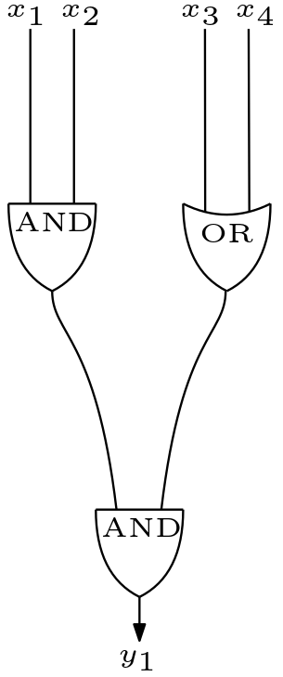
Circuit Model
Boolean Circuit
AND, OR, XOR, NOT

Slide 5
Tampering Model
Wire Tampering on all wires.
Every wire can be tampered in one of following:
Set to 0
Set to 1
Toggle
Do nothing

Slide 6
ETC [BCD+23]
Efficiently Testable Circuit Compiler for all circuits with only constant blowup in size.

Slide 7
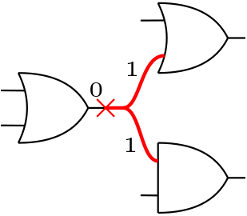
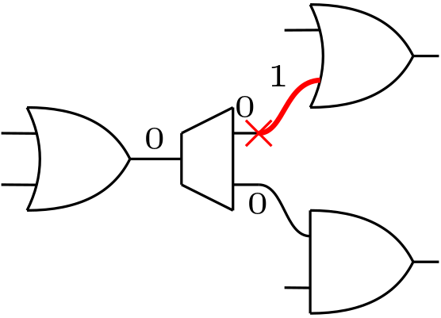
Limitation of ETC of [BCD+23]
Conductivity Assumption (also in [IPSW06])
Can we get ETC without conductivity?

Slide 8
Relaxed ETC
Allow randomness.
For any tampering $τ$
$\text{i}\text{f} ∃x:\hat{C}(x|\left|0^{c_{1}}\right)|_{|Out\left(C\right)|}≠{\hat{C}}^{τ}(x|\left|0^{c_{1}}\right)|_{|Out\left(C\right)|}$ ,
then $∃x^{′}∈T:Pr⁡[\hat{C}\left(x^{′}||R\right)≠{\hat{C}}^{τ}\left(x^{′} | \left|R\right)\right]≥constant$

Slide 9
Result
We achieve Efficiently Testable Circuit compiler for all circuits with wire tampering on all wires.
Size | #Additional Input | #Additional Output | #Random Bits | #Queries | Success Probability
$$23n+o(n)$$ | $$L∙\sqrt[L]{n}+5$$ | $$O(1)$$ | $$2∙L∙\sqrt[L]{n}$$ | $$2L∙6$$ | $$1/2L$$
$${24∙2}^{32}$$ | $$428$$ | $$1$$ | $$845$$ | $$192$$ | $$1/{32}$$

Slide 10
Compiler Outline
Compile circuit into a Gate Covered Circuit.
Compile to add compression layer.
Recursively apply compression.

Slide 11
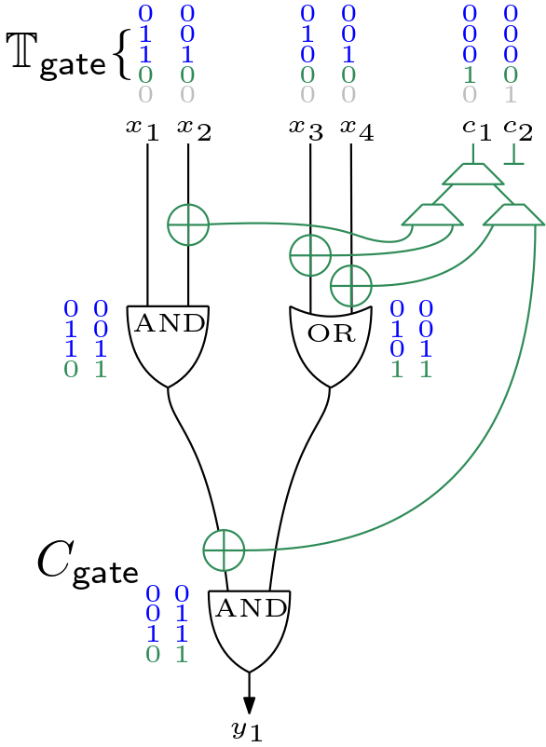
Gate Covering Set
Small set of test inputs called TestSet. (|TestSet|$≤$ 6)
Gates have all four combination of values on some input from TestSet.

Slide 12
Key Lemma
On inputs from $TestSet:$
Either the output is wrong.
Or there is information loss on some wire.
Information loss: Wire $w$ has information loss if ${val}_{x}\left(w\right)≠{val}_{x^{′}}\left(w\right)$but ${val}_{x}^{τ}\left(w\right)={val}_{x^{′}}^{τ}\left(w\right)$
$x, x^{′}∈TestSet$

Slide 13
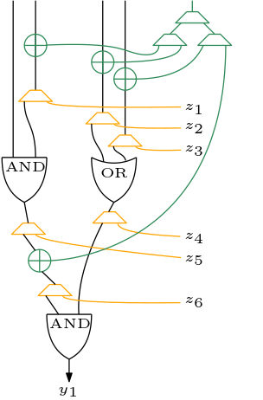
First Attempt
Copy all wires out.
Problem: Too many outputs.

Slide 14
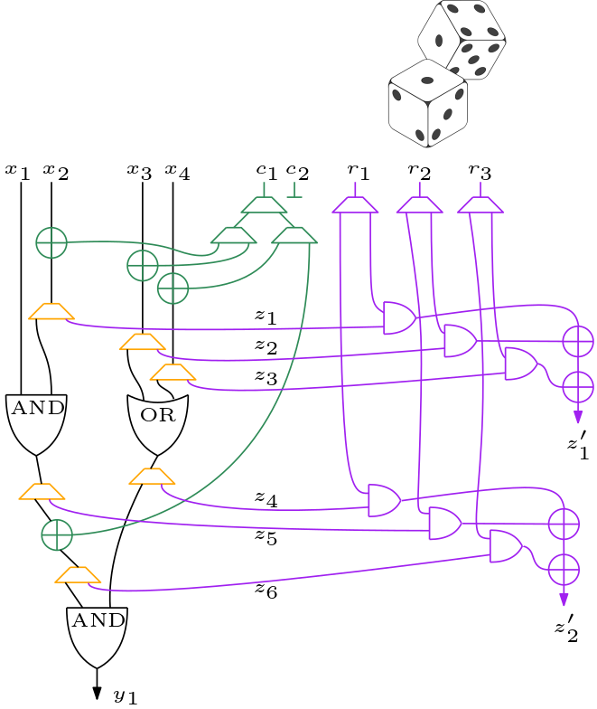
Inner Product Gadget
Compress using inner product.
Take inner product of copied out circuit wires with a random string.

Slide 15
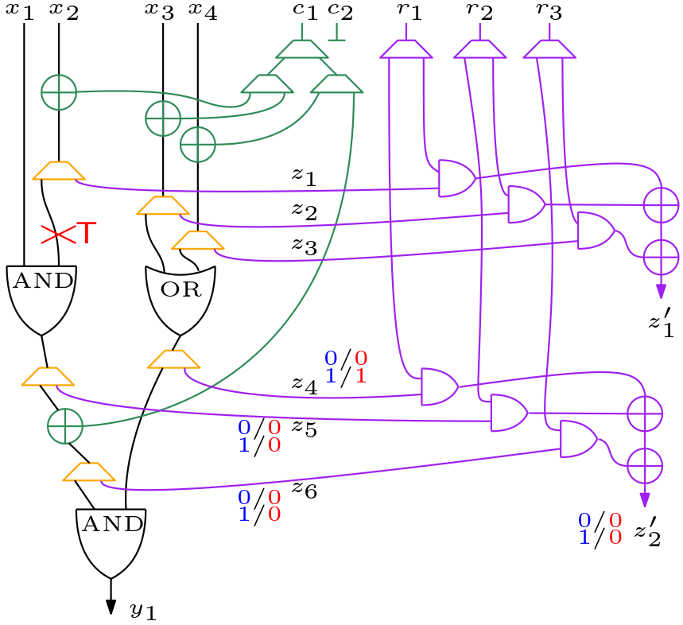
Information Loss
If tampering causes information loss on a wire it will show on the output of single compression layer with probability $1/2$.

Slide 16
Open Problems
Larger class of tampering attacks e.g. gate tampering?
Generalizing Circuit Models e.g. stateful circuits, arithmetic circuits?
Applications beyond Hardware Testing?

Slide 17
Thank You!
Questions?

