Slide 1
Public-Key Encryption, Local Pseudorandom Generators, and the Low-Degree Method
ANDREJ BOGDANOV OTTAWA
PRAVESH KOTHARI CMU
ALON ROSEN BOCCONI/REICHMAN
TCC | Dec 2023

Slide 2
In search of a new PKE
[Applebaum-Barak-Wigderson’10]:
Three public-key encryption candidates
Based on “different assumptions”
This work:
New “ABW-like” public-key encryption
Fine-grained (quasi-poly) security
Guided by the “low-degree method”
cryptography $↔$ hardness of statistical inference
Notes:
[Applebaum-Barak-Wigderson]:
Noisy 3LIN [FKO ’06]
Goldreich’s PRG + planted

Slide 3
“ABW-like” Public-key Encryption
Public key: A pseudorandom generator $F_{H}:$ ${\left\{0,1\right\}}^{n}→{\left\{0,1\right\}}^{m}$
$Enc\left(0\right):$ $F_{H}\left(x\right)$for random $x∈{\left\{0,1\right\}}^{n}$
$Enc\left(1\right):$ random $y∈{\left\{0,1\right\}}^{m}$
$Dec:$ Use “trapdoor” in $H$ to distinguish $Enc\left(0\right)$ from $Enc\left(1\right)$
The challenge: How to “plant” trapdoor in $H$
Statistical (ABW1): $PLANT≈_{s}H$
Computational (ABW2, this work): $PLANT≈_{c}H$
In either case:
$$F_{PLANT}\left(x\right)≈_{c}y$$
$$Enc\left(0\right)= =Enc\left(1\right)$$

Slide 4
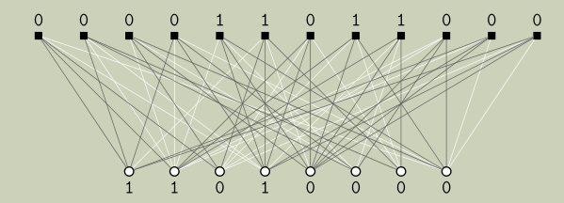
Goldreich’s Function $F_{H}\left(x\right)$
Input: $x∈{\left\{0,1\right\}}^{n}$
Output: $y∈{\left\{0,1\right\}}^{m}$
$m$ bits
$$H$$
$n$ bits

Slide 5
Goldreich’s Function $F_{H}\left(x\right)$
Input: $x∈{\left\{0,1\right\}}^{n}$
Output: $y∈{\left\{0,1\right\}}^{m}$
$$P\left(x_{1},x_{2},x_{3},x_{4},x_{5}\right)=x_{π\left(1\right)}⊕x_{π\left(2\right)}⊕x_{π\left(3\right)}⊕x_{π\left(4\right)}x_{π\left(5\right)}$$
$$y_{j}=P{\left(x\right|}_{H_{j}})$$
$$H$$
Notes:
= $\frac{1}{4}∙\left[x_{1}x_{2}x_{3}+x_{1}x_{2}x_{3}x_{4}+x_{1}x_{2}x_{3}x_{5}−x_{1}x_{2}x_{3}x_{4}x_{5}\right]$
More generally: $x_{1}⊕…⊕x_{d}⊕y_{1}⋯y_{k}$

Slide 6
Goldreich’s Function $F_{H}\left(x\right)$
Input: $x∈{\left\{0,1\right\}}^{n}$
Output: $y∈{\left\{0,1\right\}}^{m}$
$$P\left(x_{1},x_{2},x_{3},x_{4},x_{5}\right)=x_{π\left(1\right)}⊕x_{π\left(2\right)}⊕x_{π\left(3\right)}⊕x_{π\left(4\right)}x_{π\left(5\right)}$$
$$y_{j}=P{\left(x\right|}_{H_{j}})$$
$$H$$
Notes:
= $\frac{1}{4}∙\left[x_{1}x_{2}x_{3}+x_{1}x_{2}x_{3}x_{4}+x_{1}x_{2}x_{3}x_{5}−x_{1}x_{2}x_{3}x_{4}x_{5}\right]$
More generally: $x_{1}⊕…⊕x_{d}⊕y_{1}⋯y_{k}$

Slide 7
Pseudorandomness of $F_{H}\left(x\right)$
Claim: When $m≈n^{3/2}$ there is an efficient distinguisher*
(*) with advantage $1−o\left(1\right)$
Distinguisher:
View $F_{H}\left(x\right)$as “noisy” linear equations
When $m≈n^{3/2}$, equations “collide” (birthday)
XOR colliding equations to cancel out linear part
Remaining “noise” bit is 1/4-biased
Use bias to distinguish $F_{H}\left(x\right)$ from random
Notes:
Advantage can be even $n^{−o\left(1\right)}$

Slide 8
Short linear dependencies
Collisions $↔$length 2 linear dependencies mod 2
Linear dependency of length 2 $→$ bias ${\left(1/2\right)}^{2}$
Linear dependency of length $ℓ$ $→$ bias ${\left(1/2\right)}^{ℓ}$
short linear dependency $→$ large bias $→$ distinguisher
This work: Plant dependencies of length $ℓ_{0}=O\left(\log{n}\right)$

Slide 9
Short linear dependencies mod 2
$$n$$
$$\left(\begin{matrix}0 1 0 0 0 0 0 0 \\ \begin{aligned}0 0 0 0 1 0 0 0 \\ 0 0 1 0 0 0 1 0 \\ 1 0 0 0 0 0 0 0 \\ 0 0 0 1 0 0 1 0 \end{aligned} \\ \begin{aligned}0 1 0 0 0 0 0 0 \\ 0 0 0 0 0 1 0 0 \\ 1 0 0 0 1 0 0 0 \\ 0 0 1 0 0 0 0 0 \\ 0 0 0 1 0 0 0 0 \\ 0 1 0 0 0 1 0 0 \\ 1 0 0 0 0 0 0 0 \\ 0 0 1 0 0 1 0 0 \\ 0 0 0 0 0 1 0 0 \\ 0 1 0 0 0 0 0 0 \\ 0 1 0 1 0 0 0 0 \\ 1 0 0 0 1 0 0 0 \\ 0 0 0 1 0 0 1 0 \\ 0 1 0 0 0 0 0 0 \\ 1 0 0 0 0 0 0 1 \\ 0 0 0 0 1 0 0 0 \\ 1 0 0 0 0 0 1 0 \\ 0 0 0 1 0 0 0 0 \\ 0 0 0 1 0 0 0 0 \end{aligned}\end{matrix}\begin{matrix}1 0 0 0 0 1 0 0 \\ \begin{aligned}1 0 0 0 0 0 0 1 \\ 0 0 0 0 1 0 0 0 \\ 0 1 0 0 0 0 1 0 \\ 0 0 0 1 0 0 0 0\end{aligned} \\ \begin{aligned}0 1 0 0 0 1 0 0 \\ 1 0 0 0 1 0 0 0 \\ 0 0 0 0 0 0 0 1 \\ 0 0 1 0 0 0 0 1 \\ 1 0 0 1 0 0 0 0 \\ 0 0 0 0 0 1 0 0 \\ 0 0 0 1 0 0 0 1 \\ 0 0 0 1 0 0 0 0 \\ 0 1 0 0 0 0 1 0 \\ 1 0 0 0 0 1 0 0 \\ 0 0 0 0 0 0 1 0 \\ 0 0 1 0 0 0 0 0 \\ 0 0 0 0 0 1 0 0 \\ 0 1 0 0 0 0 0 1 \\ 0 1 0 0 0 0 0 0 \\ 0 1 0 0 0 1 0 0 \\ 0 0 0 0 1 0 0 0 \\ 0 0 1 0 0 0 0 1 \\ 1 0 0 0 0 1 0 0\end{aligned}\end{matrix}\right)$$
$$O\left(1\right)$$
$$1/poly\left(n\right)$$
$$n+1$$
$$m=n^{1.5−δ}$$
planted
$$n^{2δ}$$
$$O\left(\log{n}\right)$$
$$1−o\left(1\right)$$
[FKO’06]
Notes:
Conjecture: No $m^{o\left(\log{n}\right)}$–time algorithm can detect if a length-$O\left(\log{n}\right)$ linear dependency has been planted in $m$ 3-sparse $n$-dimensional linear equations mod 2

Slide 10
Hyperloops
$$\left(\begin{matrix}\begin{matrix}1 0 0 1 0 1 & ⋯ & 0 0 \\ 0 0 1 1 0 0 & ⋯ & 1 0 \\ 0 1 0 0 0 1 & ⋯ & 0 1\end{matrix} \\ 0 0 0 0 1 1 ⋯ 0 1 \\ \begin{aligned}1 0 1 0 1 0 ⋯ 0 0 \\ 0 1 0 0 0 1 ⋯ 1 0\end{aligned}\end{matrix}\right)$$
Definition: A hyperloop is a $3$-hypergraph in which each vertex has degree 2 (more generally, even degree)
length $ℓ$ hyperloop $↔$length $ℓ$ linear dependency
$$n$$
$$ℓ$$

Slide 11
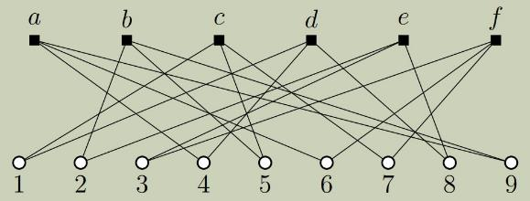
A Hyperloop
$$ℓ=6$$
$$n=9$$

Slide 12
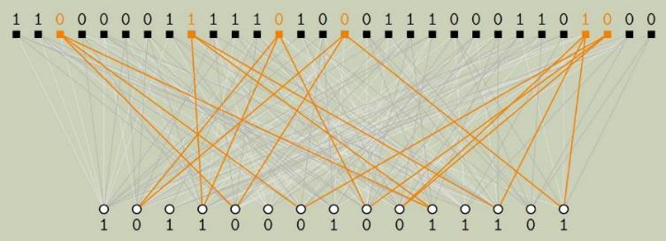
A Planted Hyperloop
Plant $n^{ε}$ identical hyperloops
Conjecture: indistinguishable from random $H$

Slide 13
Planted distribution
Conjecture: $PLANT≈_{c}H$ against $n^{Θ\left(\log{n}\right)}$ time
Sufficient for security (assuming $F_{H}$ is a PRG)
Not clear if necessary
$P$ and $Q$ are not statistically close
$Q$ unlikely to have $n^{ε}$ hyperloops of length $O\left(\log{n}\right)$

Slide 14
The low-degree method
If no degree-$d$ polynomial distinguishes then no $\left(\begin{aligned}n \\ d\end{aligned}\right)$-time algorithm distinguishes
For many high-dimensional product distributions best known distinguishers are low degree
Not sound: does not model algebraic attacks
Can be useful guide in “noisy linear algebra” type constructions with noticeable security error ($n^{−Θ\left(1\right)}$)
Notes:
does not model algebraic attacks: predicts that random n-bit strings of parities 0 and 1 are degree-(n − 1) indistinguishable

Slide 15
Low-degree distinguishers
Degree-$d$ $f$’s capture any “$d$-local” statistic
If $P$ and $Q$ are graphs then $f$ can count the number of copies of any subgraph with $d$ edges
A natural distinguisher:
test if $f\left(x\right)>t$ for some threshold $t$
Leap of faith:
${Adv}_{d}\left(P,Q\right)$ models advantage of $\left(\begin{aligned}m \\ d\end{aligned}\right)$-time
[BHKKSP’16, HKPRSS’17, H’18, KWB’19]

Slide 16
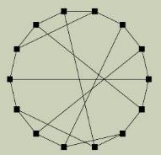
Small-set expanding hyperloops
No deg-$\left(1−ε\right)d$ distinguisher can detect this $ℓ_{0}=14$ vertex hyperloop with $Ω\left(1\right)$ advantage when $m<n^{3/2−1/8}$
$ℓ_{0}=14, δ=1/8, d=9$

Slide 17
Questions?

Slide 18
Statistical inference
Input: independent samples $X_{1},…,X_{m}$from some distribution $H_{1}$ with “planted” signal
Estimation (search): find signal
Hypothesis testing (decision): distinguish from some fixed null distribution $H_{0}$
Computational-to-statistical gaps:
impossible
hard(?)
easy
$$m_{stat}$$
$$m_{comp}$$
# samples

