Slide 1
Proactive Secret Sharing with Constant Communication
Brett Hemenway Falk | Daniel Noble | Tal Rabin
TCC 2023, Taiwan

Slide 2
Talk Outline
What is Proactive Secret Sharing
Lit Review
Expander Graphs
Private PSS with Constant Communication

Slide 4
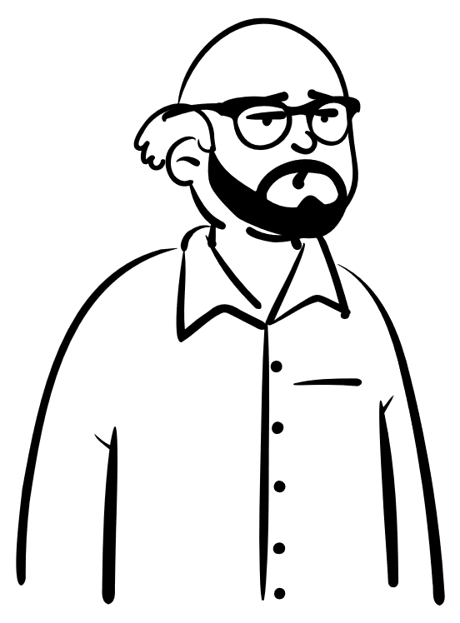
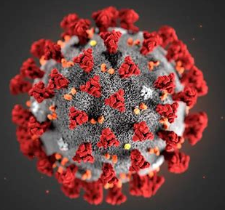
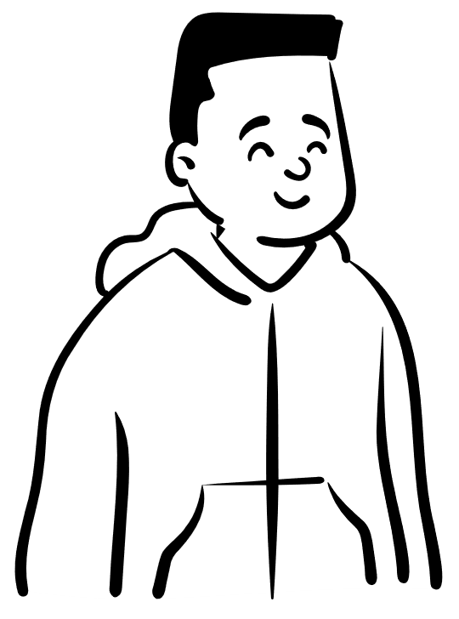

Slide 5
Proactive Secret Sharing
$m$-out-of-$n$ corruptions IN EVERY EPOCH

Slide 6
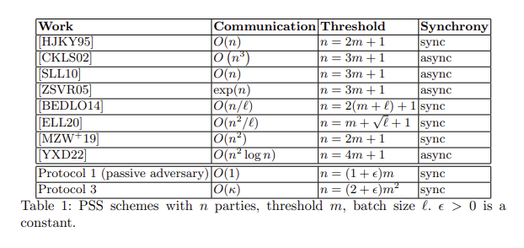
Prior Work

Slide 7
Expander Graphs
$$n=7$$
$$d=3$$

Slide 8
Expander Graphs
$$n=7$$
$$d=3$$

Slide 9
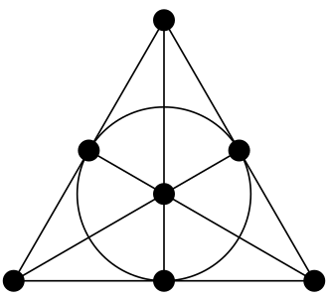
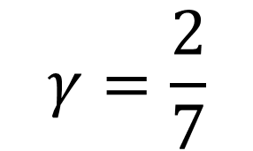
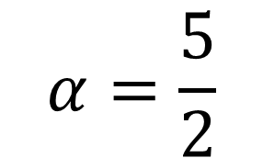
Expander Graphs
$$|S|=2$$
$$\left|N\left(S\right)\right|=5$$
$$n=7$$
$$d=3$$
$$α=\frac{5}{2}$$
$$γ=\frac{2}{7}$$
Heawood Graph
Fano Plane

Slide 10
Expander Graphs
$$n$$
$$d=Θ(1)$$
$$α=Θ(1)$$
$$γ=Θ(1)$$

Slide 11
PSS with Constant Comm. (passive)
$${Σ_{i=1}^{n}s}_{i}=s$$
$$s_{1}$$
$$s_{2}$$
$$s_{3}$$
$$s_{4}$$
$$s_{5}$$
$$s_{6}$$
$$s_{7}$$

Slide 12
PSS with Constant Comm. (passive)
$${Σ_{i=1}^{n}s}_{i}=s$$
$$s_{1,1}+s_{1,2}+s_{1,4}=s_{1}$$
$$s_{1,1}$$
$$s_{1}$$
$$s_{1,2}$$
$$s_{1,4}$$
$$s_{2}$$
$$s_{3}$$
$$s_{4}$$
$$s_{5}$$
$$s_{6}$$
$$s_{7}$$

Slide 13
PSS with Constant Comm. (passive)
$$s_{1,2}+s_{2,2}+s_{5,2}={\hat{s}}_{2}$$
$${Σ_{i=1}^{n}\hat{s}}_{i}=s$$
$$s_{1}$$
$${\hat{s}}_{1}$$
$$s_{1,2}$$
$$s_{2}$$
$${\hat{s}}_{2}$$
$$s_{2,2}$$
$$s_{5,2}$$
$$s_{3}$$
$${\hat{s}}_{3}$$
$$s_{4}$$
$${\hat{s}}_{4}$$
$$s_{5}$$
$${\hat{s}}_{5}$$
$$s_{6}$$
$${\hat{s}}_{6}$$
$$s_{7}$$
$${\hat{s}}_{7}$$

Slide 14
PSS with Constant Comm. (passive)
$$m=3$$

Slide 15
PSS with Constant Comm. (passive)
$$m=3$$

Slide 16
Thank you… Questions?
Kudos (images):
Among Us:
https://www.graphicpie.com/among-us-png-free/ https://1gamerdash.com/wp-content/uploads/2020/10/among-us-imposter-1536x864.jpg
Covid: https://ajmarciniak.wordpress.com/2021/07/23/australian-covid-madness/
Fano Plane: https://en.wikipedia.org/wiki/Fano_plane

