Slide 1
Immunizing Backdoored Pseudorandom Generators
Marshall Ball, Yevgeniy Dodis, Eli Goldin
NYU
Notes:
Hey everyone, I’m Eli, and today I’m going to talk about immunizing backdoored pseudoradnom generators.
This is joint work with my advisors Marshall Ball and Yevgeniy Dodis.

Slide 2
What is a PRG?
Notes:
To begin, I will first talk about what I mean by a pseudorandom generator, or PRG. Typically a PRG is some deterministic function which takes in a seed, a short string, and maps it to a longer “pseudorandom” string.

Slide 3
What is a PRG?
Notes:
To begin, I will first talk about what I mean by a pseudorandom generator, or PRG. Typically a PRG is some deterministic function which takes in a seed, a short string, and maps it to a longer “pseudorandom” string.

Slide 4
What is a PRG?
Notes:
To begin, I will first talk about what I mean by a pseudorandom generator, or PRG. Typically a PRG is some deterministic function which takes in a seed, a short string, and maps it to a longer “pseudorandom” string.

Slide 5
What is a PRG?
Notes:
To begin, I will first talk about what I mean by a pseudorandom generator, or PRG. Typically a PRG is some deterministic function which takes in a seed, a short string, and maps it to a longer “pseudorandom” string.

Slide 6
What is a PRG?
Notes:
For our purposes, we will consider an equivalent variant which is more useful in practice. In particular, a PRG in our setting will be an “online PRG”, which outputs its pseudorandom string over the course of many rounds. It will take in an initial state of a short random seed, and in each round it will output a new state and an output string. Taken all together, the output strings should be pseudorandom.
Most systems in the real world use online PRGs, and they theoretically equivalent to the more standard definition.
In practice, however, where does the algorithm for a PRG come from? In fact, most companies do not generate their own PRG from scratch. They generally trust an outside party

Slide 7
What is a PRG?
Notes:
Say, Spongebob, who publishes an algorithm as well as possibly a proof of security. Normally this is ok, Spongebob is an alright guy, but what would happen

Slide 8
When good PRGs go bad
Notes:
if Spongebob were evil?

Slide 9
When good PRGs go bad
Notes:
In particular, its possible that spongebob could install a backdoor into the PRG he publishes. That is, when creating the algorithm, he may also create a secret key such that, using the secret key, he can distinguish the output of the PRG from uniform. That is, it could be the case that the algorithm he publishes in fact is secure (with a proof of security even!) against anyone without access to the backdoor key, but is completely vulnerable to those with the backdoor.

Slide 10
When good PRGs go bad
Publicly secure
Notes:
In particular, its possible that spongebob could install a backdoor into the PRG he publishes. That is, when creating the algorithm, he may also create a secret key such that, using the secret key, he can distinguish the output of the PRG from uniform. That is, it could be the case that the algorithm he publishes in fact is secure (with a proof of security even!) against anyone without access to the backdoor key, but is completely vulnerable to those with the backdoor.

Slide 11
When good PRGs go bad
Publicly secure
Notes:
In particular, its possible that spongebob could install a backdoor into the PRG he publishes. That is, when creating the algorithm, he may also create a secret key such that, using the secret key, he can distinguish the output of the PRG from uniform. That is, it could be the case that the algorithm he publishes in fact is secure (with a proof of security even!) against anyone without access to the backdoor key, but is completely vulnerable to those with the backdoor.

Slide 12
When good PRGs go bad
Publicly secure
Insecure with
Notes:
In particular, its possible that spongebob could install a backdoor into the PRG he publishes. That is, when creating the algorithm, he may also create a secret key such that, using the secret key, he can distinguish the output of the PRG from uniform. That is, it could be the case that the algorithm he publishes in fact is secure (with a proof of security even!) against anyone without access to the backdoor key, but is completely vulnerable to those with the backdoor.

Slide 13
When good PRGs go bad
Publicly secure
Insecure with
Notes:
In particular, its possible that spongebob could install a backdoor into the PRG he publishes. That is, when creating the algorithm, he may also create a secret key such that, using the secret key, he can distinguish the output of the PRG from uniform. That is, it could be the case that the algorithm he publishes in fact is secure (with a proof of security even!) against anyone without access to the backdoor key, but is completely vulnerable to those with the backdoor.

Slide 14
When good PRGs go bad
These exist! [VV83]
These exist in the real world! [Dual EC PRG]
Big Question: How to prevent against backdoors?
Notes:
In fact, such a construction is possible as established by Valiant and Vazirani (check this).
*click* Not only that, this has actually happened in the real world. In particular, in (YEAR), the US government published the Dual EC PRG standard, with security based off of the Diffie-Hellman assumption. However, in 2013, the Snowden leaks revealed that the NSA had stored the randomness used to come up with the algorithm and could use this to break security. (CHECK THIS!)
*click* This leads to the central question of this work: how can you prevent backdoors?

Slide 15
Existing Solutions
Build your own PRG
Dangerous!
Rerandomize public parameters [RTYZ15]
Not always possible
Notes:
Well, you could always just build your own PRG from scratch. However, people writing code are, sadly, not always cryptographers, so this can lead to dangerous security issues.
Alternatively, [CITE] shows that rerandomizing the public parameters used by the algorithm will also remove any backdoor. However, given an explicit algorithm, it is not always clear which part of the algorithm is the public parameters, and so this is not always possible.

Slide 16
Immunizers [DGGJR15]
Notes:
Thus, in 2015, [CITE] proposed the idea of an immunizer. An immunizer is some function which takes in a backdoored pseudorandom string and replaces it with a non-backdoored variant.

Slide 17
Immunizers [DGGJR15]
Notes:
Formally, an immunizer is a function f which, when passed in round-by-round the output of any (possibly backdoored) PRG, produces a string which looks random to both the public and the person who came up with the PRG (and may have a backdoor).

Slide 18
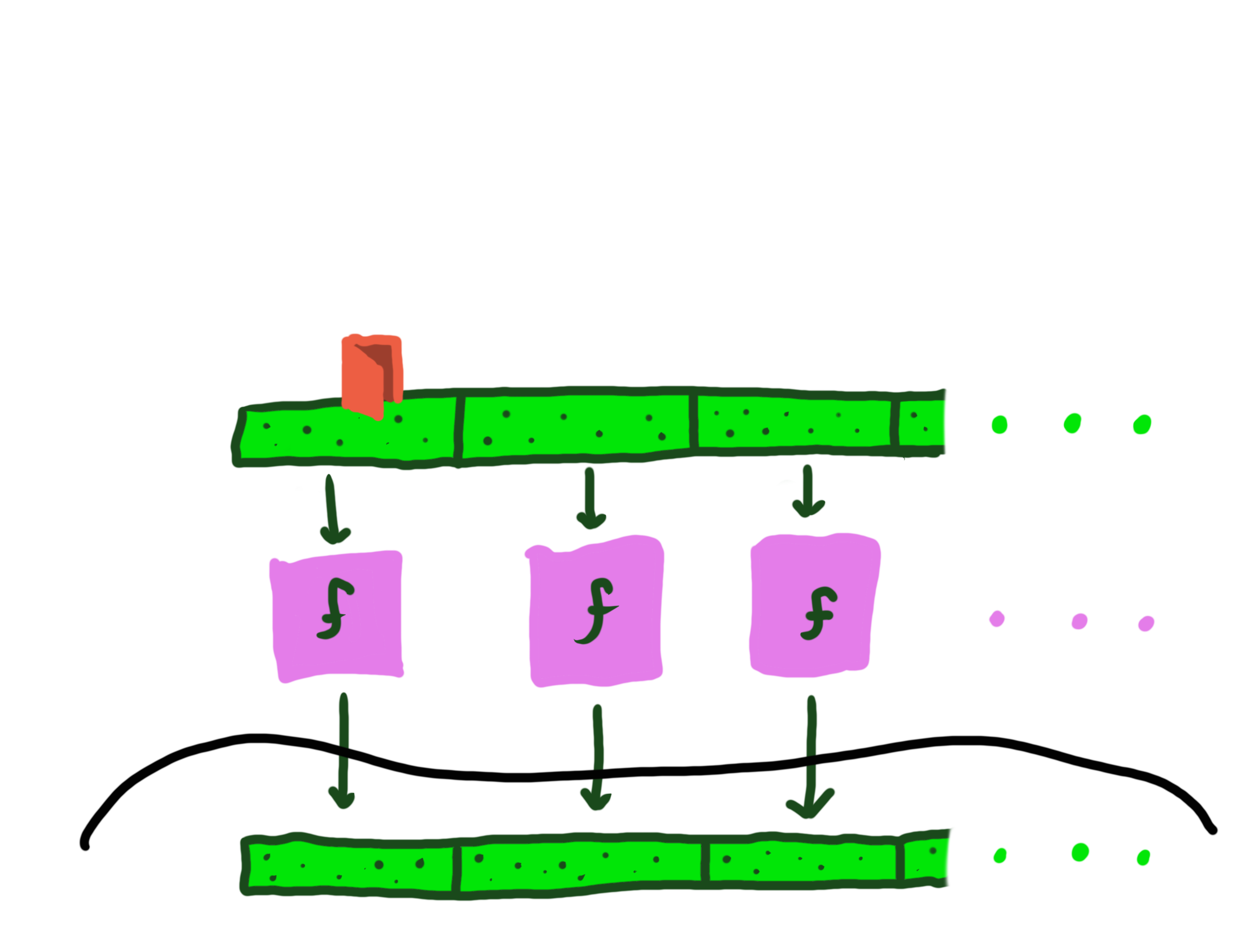
Immunizers
Notes:
Formally, an immunizer is a function f which, when passed in round-by-round the output of any (possibly backdoored) PRG, produces a string which looks random to both the public and the person who came up with the PRG (and may have a backdoor).

Slide 19
Immunizers
Notes:
Formally, an immunizer is a function f which, when passed in round-by-round the output of any (possibly backdoored) PRG, produces a string which looks random to both the public and the person who came up with the PRG (and may have a backdoor).

Slide 20
Immunizers
Notes:
Formally, an immunizer is a function f which, when passed in round-by-round the output of any (possibly backdoored) PRG, produces a string which looks random to both the public and the person who came up with the PRG (and may have a backdoor).

Slide 21
Immunizers [DGGJR15]
The same immunizer f should work for any backdoored PRG
Notes:
Formally, an immunizer is a function f which, when passed in round-by-round the output of any (possibly backdoored) PRG, produces a string which looks random to both the public and the person who came up with the PRG (and may have a backdoor).

Slide 22
Immunizers [DGGJR15]
The same immunizer f should work for any backdoored PRG
Notes:
Formally, an immunizer is a function f which, when passed in round-by-round the output of any (possibly backdoored) PRG, produces a string which looks random to both the public and the person who came up with the PRG (and may have a backdoor).

Slide 23
Immunizers [DGGJR15]
The same immunizer f should work for any backdoored PRG
Notes:
Formally, an immunizer is a function f which, when passed in round-by-round the output of any (possibly backdoored) PRG, produces a string which looks random to both the public and the person who came up with the PRG (and may have a backdoor).

Slide 24
Immunizers [DGGJR15]
The same immunizer f should work for any backdoored PRG
Notes:
Formally, an immunizer is a function f which, when passed in round-by-round the output of any (possibly backdoored) PRG, produces a string which looks random to both the public and the person who came up with the PRG (and may have a backdoor).

Slide 25
Immunizers [DGGJR15]
Constructions
Random oracle + salt
UCE (super strong primitive)
Notes:
CGGJR15 also introduces two constructions of immunizers. A random oracle salted with a seed chosen after the pseudorandom generator is designed is an effective immunizer. Immunizers can also be built from universal computational extractors, a fairly strong primitive for which it is unknown whether it can be achieved from standard assumptions.

Slide 26
Immunizers [DGGJR15]
Flaws
Cannot be deterministic
Standard model unknown
Notes:
Note that there are two major issues with immunizers. First of all, it is impossible to have a deterministic immunizer. That is, the immunizer must have some randomness which the immunized PRG cannot have access to (in other words the immunizer must be designed after the PRG).
Second of all, it is still unknown how to build immunizers from standard assumptions.
In this work, we try and remove these flaws (while preserving onlineness and efficiency) by generalizing the concept of an immunizer.

Slide 27
This work: 2-immunizers
Notes:
In particular, we define 2-immunizers. Instead of a single PRG output, a 2-immunizer will take in two PRG outputs, possibly with their own backdoors.

Slide 28
This work: 2-immunizers
Notes:
The 2-immunizer, just like a normal immunizer, will be some function f which, when applied in an online manner on BOTH inputs, produces a string appearing uniformly random even to those with access to both backdoors.
You can think of the input here as simply running some backdoored PRG twice on two different initial seeds, or you can think of it as running two different PRGs (and we consider both notions more explicitly in the actual paper).

Slide 29
This work: 2-immunizers
Focused question: Can we build 2-immunizers that are simple and deterministic from standard assumptions?
Notes:
Thus, the more focused question of our work is the following: can we build simple, deterministic 2-immunizers from standard assumptions?

Slide 30
Why do we think this is possible?
[BFM18, DFMT20]: evidence that XOR immunizes random oracles
Notes:
Now, why do we think this is possible? Well in fact prior work in similar models gives some evidence that we can do this easily. In particular [CITE] defines an idealized notion of a “backdoored random oracle”, that is a random oracle for which the adversary has some backdoored information about its truth table.

Slide 31
Why do we think this is possible?
[BFM18, DFMT20]: evidence that XOR immunizes random oracles
Notes:
They then provide evidence that the XOR of two backdoored random oracles is a random oracle without the backdoor (or at least is pseudorandom). That is, XOR is a 2-immunizer for the specific case when the PRGs are backdoored random oracles.

Slide 32
Our results
Focused question: Can we build 2-immunizers that are simple and deterministic from standard assumptions?
Result #1: XOR is not* a 2-immunizer
Result #2: Random oracle is a 2-immunizer
Result #3: Evidence against immunizers in the standard model
Notes:
We then prove three results in response to our main focused question.
First of all, unfortunately XOR is NOT a 2-immunizer for backdoored PRGs in generality.
Second of all, a random oracle (even unsalted!) is a 2-immunizer in our setting. This provides reasonable evidence that deterministic 2-immunizers exist and can be instantiated practically.
Countering this, however, we give a barrier against constructing a 2-immunizer form standard assumptions.

Slide 33
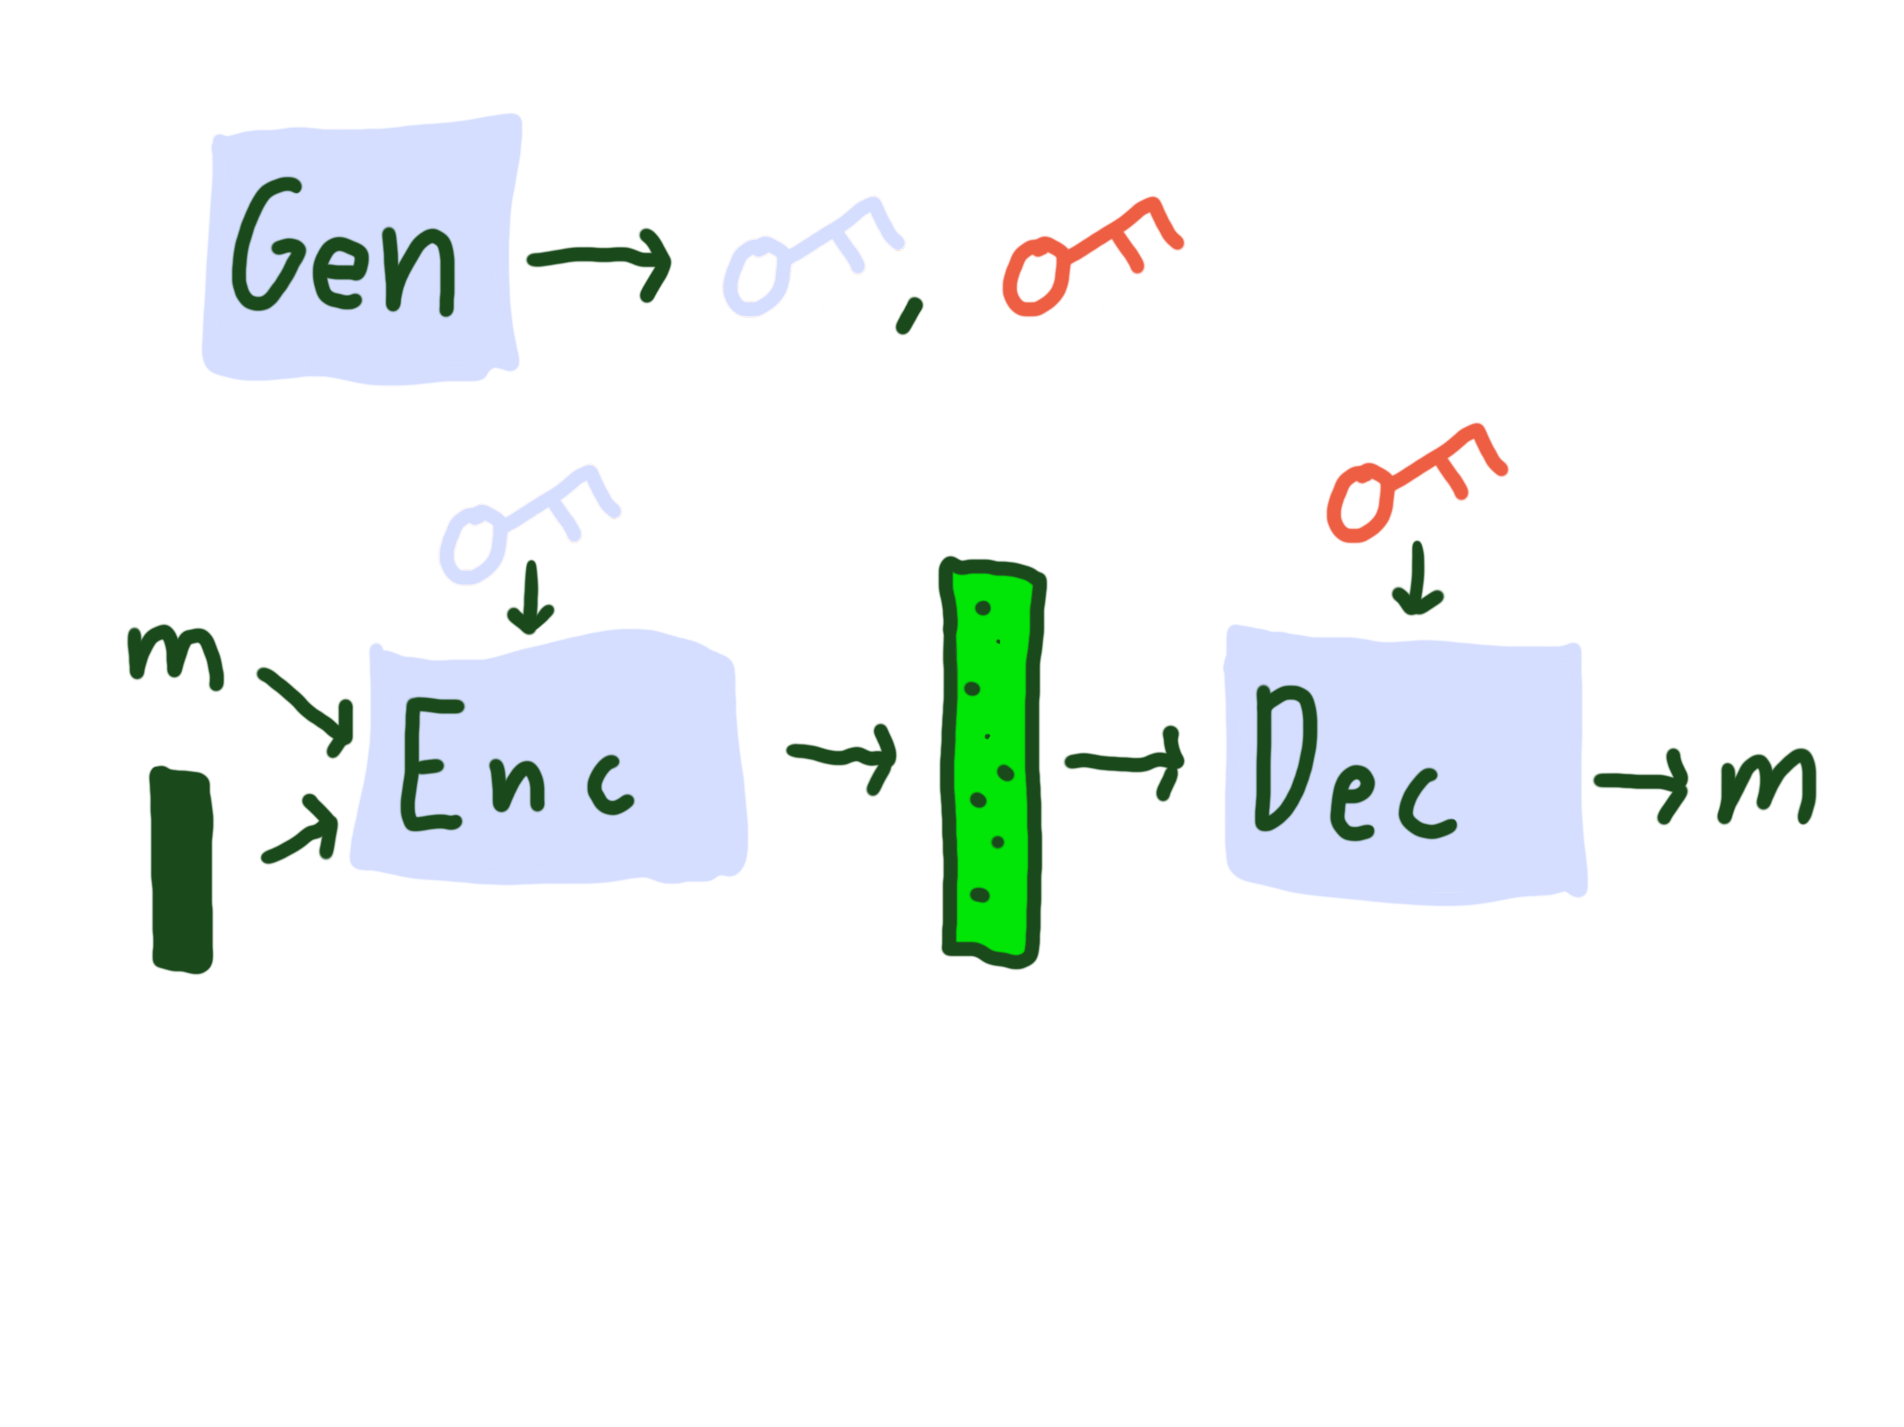
Result #1: XOR is not a 2-immunizer
Pseudorandom encryption
Notes:
To show that XOR is not a 2-immunizer, let me first describe a simple way to construct a backdoored PRG from something called “pseudorandom encryption”.
A pseudorandom encryption scheme is simply an encryption scheme where ciphertexts are pseudorandom. In particular, to parties only with access to the public key, ciphertexts should appear pseudorandom. However, to parties with the red private key, it should be possible to map ciphertexts back to their original messages.

Slide 34
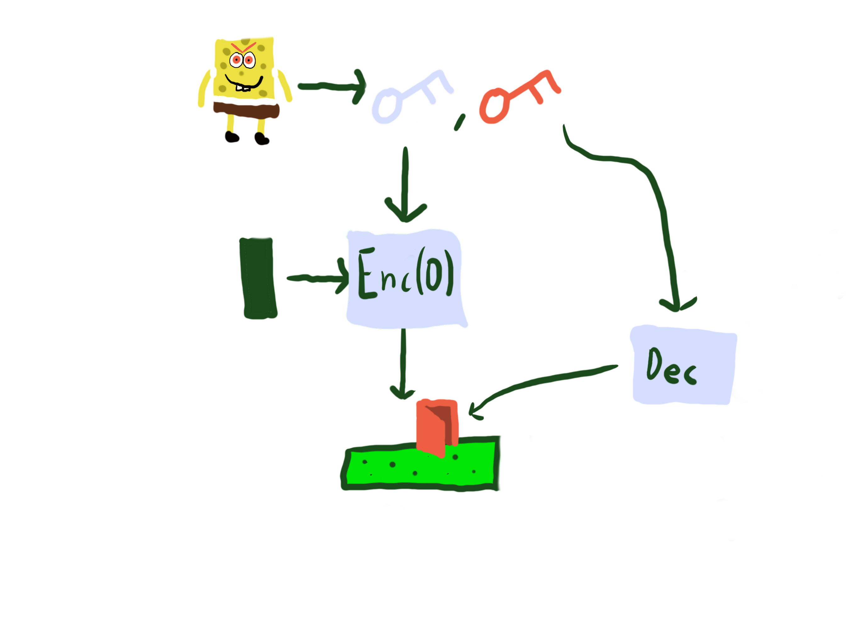
Result #1: XOR is not a 2-immunizer
Pseudorandom encryption IS a backdoored PRG
Notes:
Note that this really is exactly the same as a backdoored PRG. More formally, to build a backdoored PRG from pseudorandom encryption, evil spongebob will publish the public key as the description of the algorithm. To run the PRG, parties will simply encrypt 0 under the public key. This PRG is secure to the public just by nature of pseudorandomness of encryption, but spongebob, using his secret key, can test if an output comes from this PRG just be checking if it decrypts to 0.

Slide 35
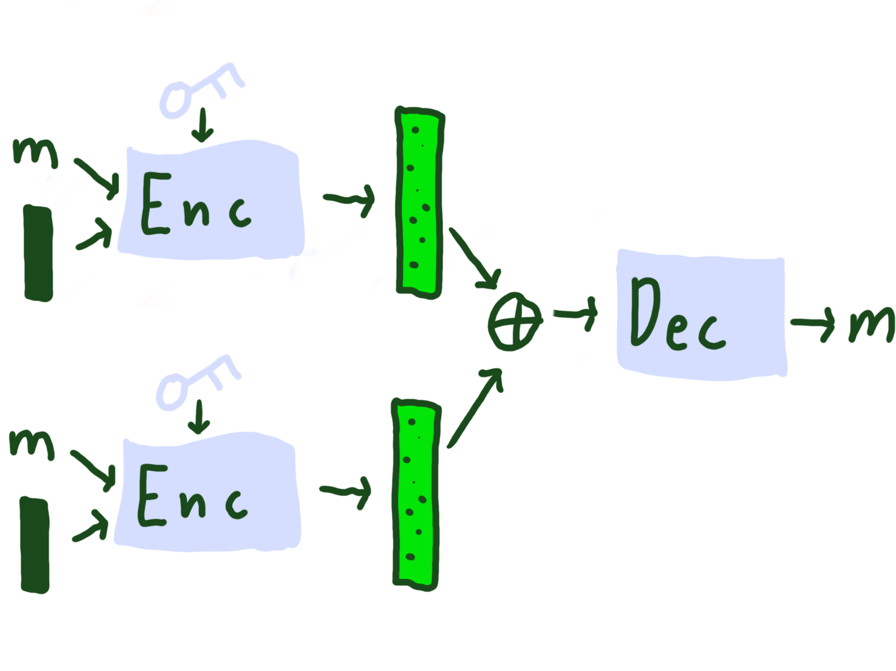
Result #1: XOR is not a 2-immunizer
What if ciphertexts are homomorphic?
Enc_{pk}(m) ⊕ Enc_{pk}(m) = Enc_{pk}(m)
Notes:
To show that XOR is not a 2-immunizer, we then ask the question of what happens if ciphertexts, in addition to being pseudorandom, are homomorphic (in a particular way)? That is, if the XOR of two encryptions of the same message under the same public key is also an encryption of the same message.

Slide 36
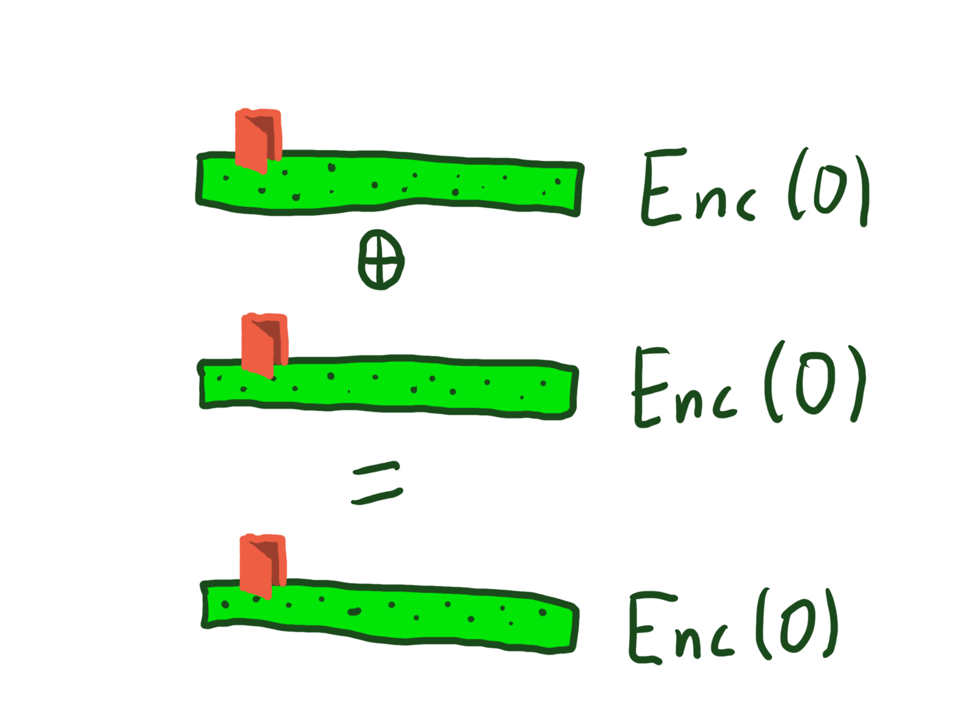
Result #1: XOR is not a 2-immunizer
What if ciphertexts are homomorphic?
Enc_{pk}(m) ⊕ Enc_{pk}(m) = Enc_{pk}(m)
Notes:
In that case, the XOR of two encryptions of 0 is also an encryption of 0, and so XOR will NOT remove the backdoor from the PRG which just outputs an encryption of 0.

Slide 37
Result #1: XOR is not a 2-immunizer
It is not hard to show that the encryption scheme from [Ale03] (based on variant of Learning Parity with Noise) is pseudorandom and homomorphic.
Notes:
In fact, based on reasonable assumptions, a public key encryption scheme which is both pseudorandom and appropriately homomorphic exists. In particular, it is not hard to show that the learning parity with noise based encryption scheme of Alekhnovich from 2003 satisfies both these properties. Thus, assuming this variant of learning parity with noise, XOR is not a 2-immunizer.

Slide 38
Result #2: Random oracle is a 2-immunizer
Proof sketch: No party of the game queries input to the random oracle.
Proof sketch: No party of the game queries input to the random oracle.
Why? Each PRG output is
unpredictable unless given the
seed. No party has access to
both seeds.
Notes:
On the other hand, we show that a random oracle IS a good 2-immunizer. Note that there is no salt needed for the 2 input case, so in practice a good hash function is a _deterministic_ two immunizer.
*click* Why does this work? The key intuition is that no party in the security game queries any of the backdoored inputs to the random oracle. Neither the adversary, the pseudorandom generator algorithm, nor spongebob will know the entirety of both backdoored pseudorandom outputs.
*click* Why is this the case? The idea is that each PRG output has to be unpredictable unless given the seed, otherwise the output is not pseudorandom even to the public. But nobody, not even the pseudorandom generators themselves, have access to both seeds, and so nobody can predict both of the random oracle inputs at the same time.

Slide 39
Result #3: No standard model immunizer
Falsifiable assumption: any assumption that can be expressed as a cryptographic game with an adversary.
Notes:
Our final result is to give evidence that it is hard to build 2-immunizers from standard assumptions. Before I talk about this, I’ll go through a few preliminaries.
A falsifiable assumption is any cryptographic assumption that can be expressed as a game with an adversary. Most standard assumptions fall into this category. For example, the discrete log assumption is the assumption that it is hard for an adversary to find the discrete log of a random group element.

Slide 40
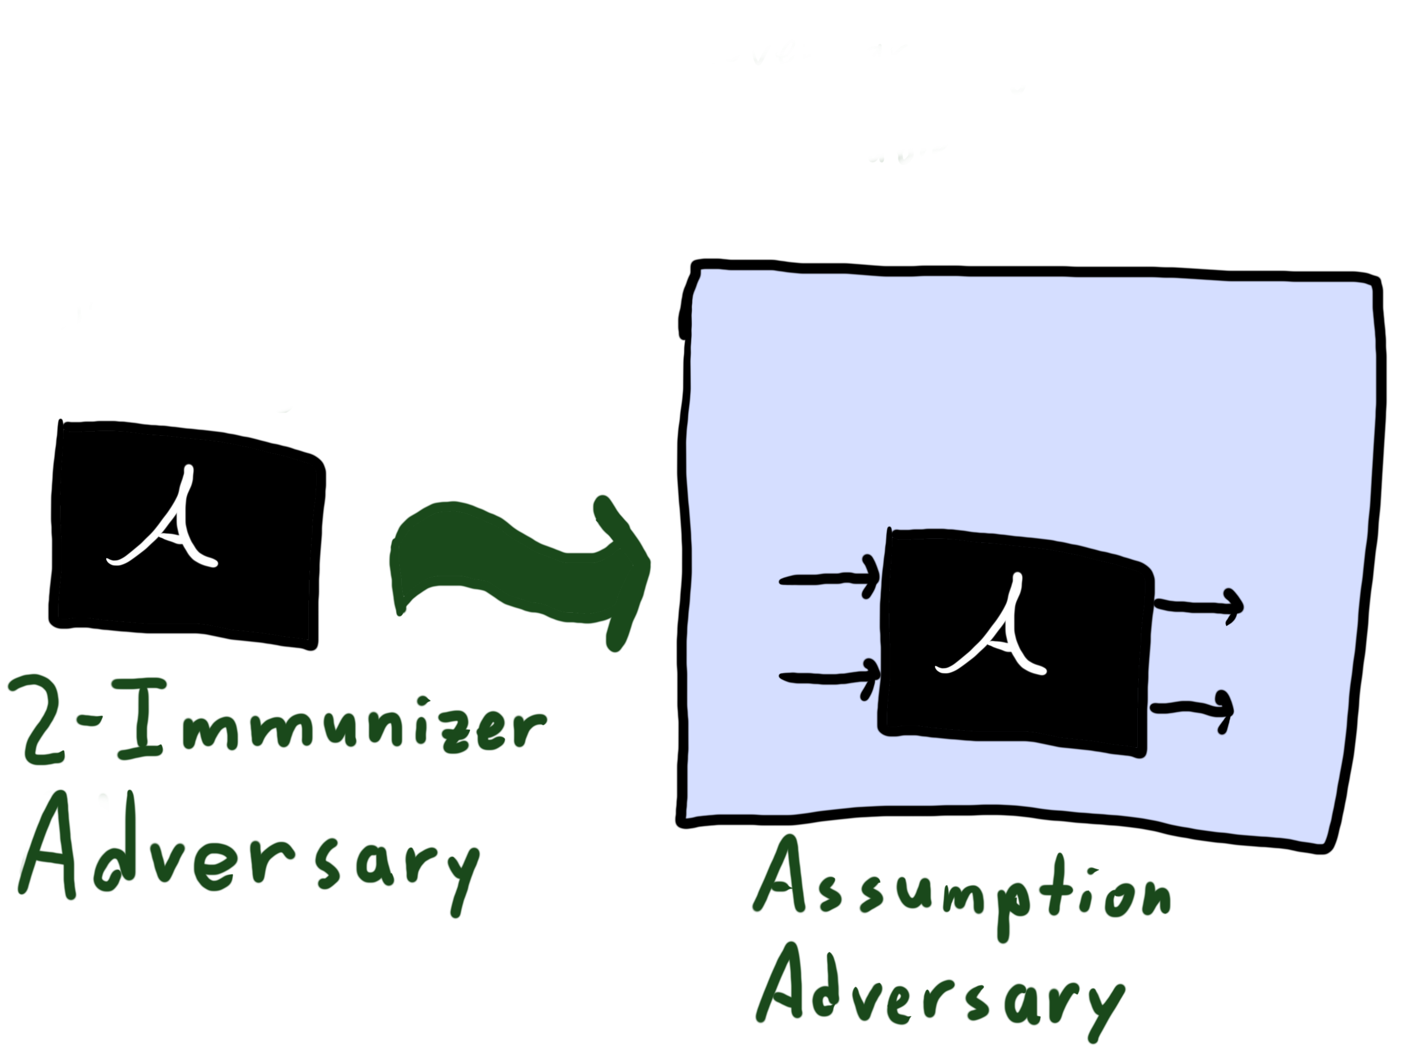
Result #3: No standard model immunizer
Black-box reduction:
Notes:
A black-box reduction is a common proof technique to show that a protocol is secure. In a black-box reduction, you pick some falsifiable assumption, then construct an adversary against that algorithm with query access to some black box A. Then, you show that as long as A is an adversary breaking your underlying protocol, then you get an adversary breaking the assumption.

Slide 41
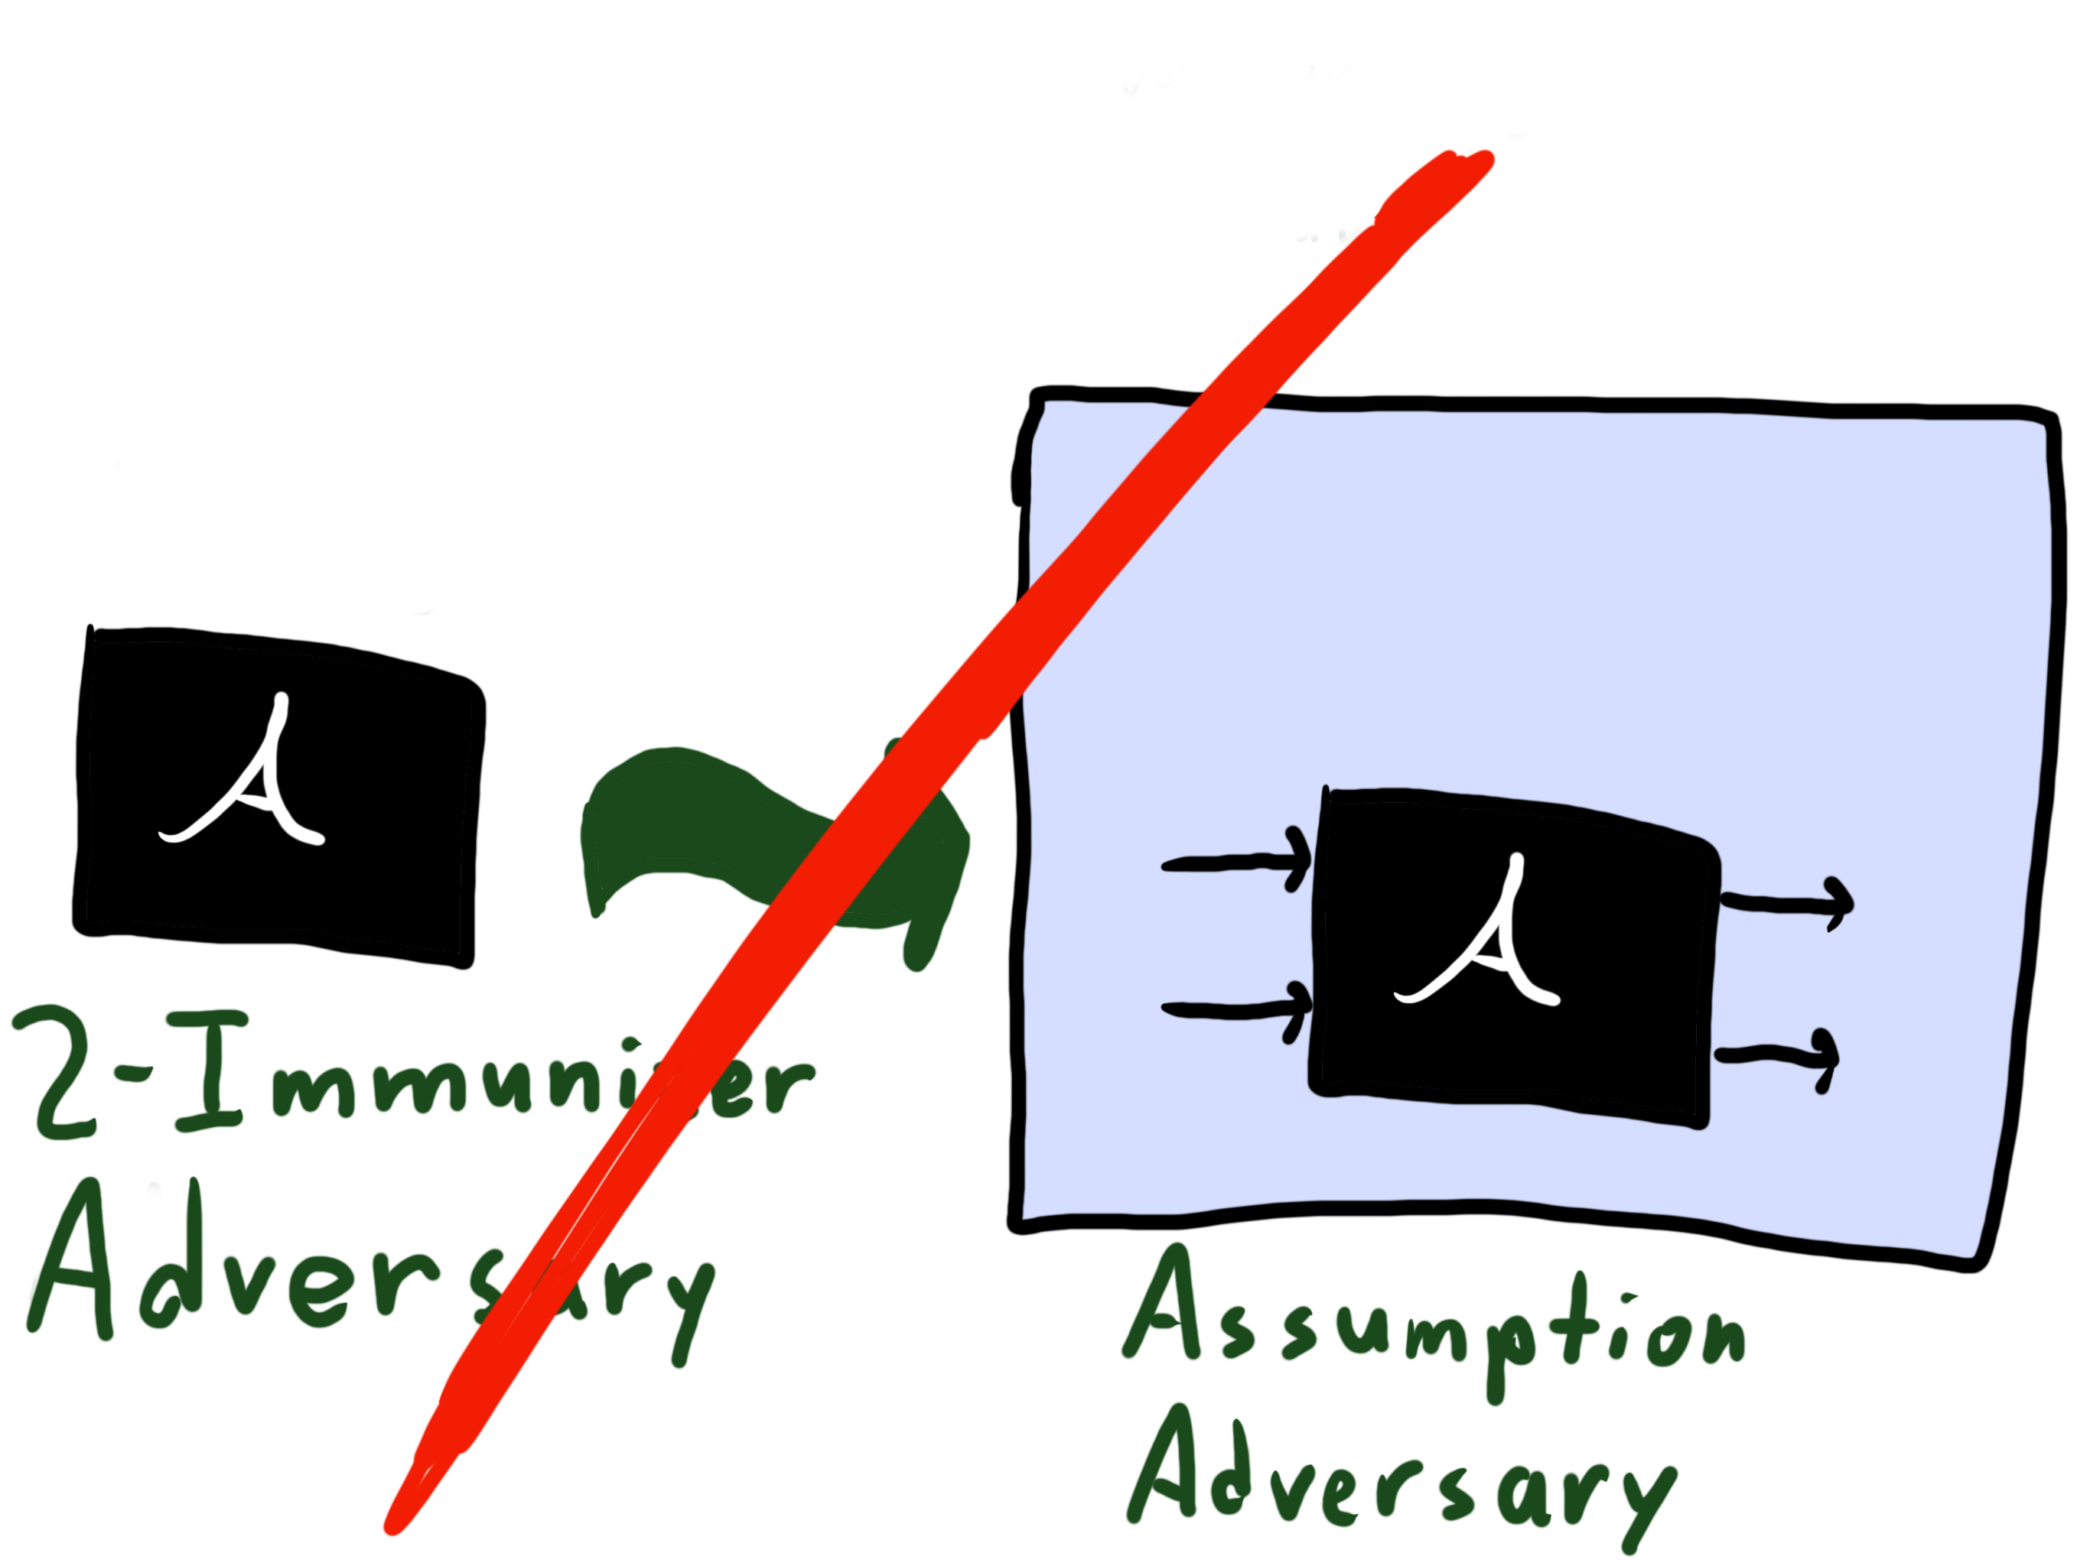
Result #3: No standard model immunizer
Caveat: immunizer must be highly dependent on its inputs
Black-box reduction:
Notes:
Our result is that you cannot use this proof technique to show that any 2-immunizer protocol is secure, regardless of the underlying assumption (as long as its efficiently falsifiable).
Since most proofs of security are black-box reduction, this provides a relatively strong barrier to actually building 2-immunizers in the standard model.
Note that there is a caveat here. Our proof technique only works if the immunizer “doesn’t ignore its inputs” (for the full formalization see our paper). This is a very strong condition, and most reasonable functions satisfy it (like inner product, collision resistant hash functions, …).

Slide 42
Result #3: No standard model immunizer
Black-box reduction:
Notes:
We also use the same techniques to show that black-box reductions cannot be used to prove security of any 1-immunizer (even seeded). In this setting, we no longer need the condition on the immunizer.

Slide 43
Venn-diagram of crypto
Notes:
So those are our results. But before I get to the open questions, I want to talk about something I will call the “Venn-diagram of crypto.”
In cryptography, there are some primitives which the theory community likes and some which practitioners like.
In particular, stuff like *click* public key encryption, *click* pseudorandom generators, *click* and collision-resistant hash functions are both efficient in practice AND can be built from theoretically reasonable assumptions.
On the other hand, for something like *click* indistinguishability obfuscation, we have theoretical constructions, but it is not really feasible to use this in practice. The same applies for *click* fully homomorphic encryption and *click* any primitive which outputs a quantum state.
The smallest category, then, is the primitives where practitioners are happy with existing results, but theoreticians aren’t. *click* An example of something in this category is SNARGs. We know how to build SNARGs using random oracles, and people actually use SNARGs in the real world. However, we still don’t have reasonable standard model constructions, and there is in fact a similar black-box separation (Gentry-Wichs).
*click* Our result, then, places immunizers (both for 1 source or many), squarely in the “practitioners happy” setting. We have a ready-to-go construction using a hash function, but there is strong evidence that it is hard to build immunizers from any cryptographic assumption us theoreticians would be happy with.

Slide 44
Open Questions
Can we remove the “highly-dependent on both inputs” condition from our black-box separation?
Can we bypass the separation? The condition acts as a hint.
Immunization in other settings?
Notes:
I’ll conclude by listing some open questions.
Is it possible to “fix” our separation, and remove the caveat that the immunizer should depend strongly on its inputs?
Or, is there some way to use this condition to actually build a standard model immunizer?
Finally, is it possible to remove backdoors for other cryptographic primitives? Collision-resistant hash functions? Private key encryption?

