Slide 1
Protecting Dilithium Against Leakage Revisited Sensitivity Analysis and Improved Implementations
Melissa Azouaoui, Olivier Bronchain, Gaëtan Cassiers, Clément Hoffmann, Yulia Kuzovkova, Joost Renes, Markus Schönauer, Tobias Schneider, François-Xavier Standaert and Christine van Vredendaal
contact: pqc@nxp.com
CHES 2023

Slide 2
Embedded cryptography and implementation attacks
Side-Channel Attacks (SCA)
Fault Attacks (FA)

Slide 3
Embedded cryptography and implementation attacks
Attacks
Current Asymmetric Cryptography
ECDSA
RSA ECC
Countermeasures
Deep understanding in both academia and industry from decades of research.
Practically secure and certified implementations.
Post-Quantum Cryptography
Dilithium
Kyber Falcon
SPHINCS+ XMSS
Active research area resulting in increasingly powerful attacks.
Early stage of academic research. Limited industrial results.

Slide 4
Do we know how to protect Dilithium?
Masking Publications
until October’22
8
Prior Work [MGTF19]
1
What needs to be protected?
ePrint 2022/1406
How should it be protected?
What are the bottlenecks?
How can it be fixed?

Slide 5
CRYSTALS-Dilithium
CRYSTALS Dilithium (ML-DSA)
Lattice-based digital signature scheme.
Based on MLWE and MSIS.
Based on Fiat-Shamir with aborts.
Polynomial ring $R_{q}=Z_{q}\left[X\right]/(X^{n}+1)$.
Caution:
Diagrams in this presentation are for illustration only.
We consider signing in this presentation. Key generation is detailed in the paper.
Needs SCA protection
No SCA protection needed

Slide 6
Overview of Dilithium Signature Generation
Output:
$σ=(z,$c,$h)$
Fiat-Shamir with Abort:
Generate $y$ from a seed
Create a challenge $c$
Compute the signature $z$
If signature is too large: repeat
$$A$$
$$w$$
$$Decompose$$
$w_{0}$
$$M$$
$$w_{\begin{aligned}1 \\ \end{aligned}}$$
$$s_{1}$$
$$Challenge$$
$$s_{2}$$
$$ρ′$$
$$c$$
$$h$$
$$SHAKE$$
$$Parsing$$
$$y$$
+
+
$$Compression$$
$$BoundCheck$$
$$BoundCheck$$
$$r$$
$$κ$$
$$z$$

Slide 7
Sensitivity Analysis

Slide 8
Sensitivity Analysis: Motivation
Why sensitivity analysis ?
Protecting Dilithium against side-channel attacks is expensive.
What is sensitivity analysis ?
Define the variables to protect within the implementation.
Define the appropriate countermeasure.
In the coming slides:
Corrected sensitivity analysis compared to previous work.
Comments on earlier version of this work (Leveling Dilithium).

Slide 9
Flawed Sensitivity analysis from [MGTF19]: Overview
Needs SCA protection
No SCA protection needed
$w$has to be protected
$$A$$
$$w$$
$$Decompose$$
$$w_{0}$$
$$w$$
$$w_{1}$$
$$M$$
$$s_{1}$$
$$Challenge$$
$$s_{2}$$
$\tilde{r}$ does NOT have to be protected after the bound check
$$ρ′$$
$$c$$
$$h$$
$$SHAKE$$
$$Parsing$$
$$y$$
+
+
$$Compression$$
$$BoundCheck$$
$$BoundCheck$$
$$\tilde{r}$$
$$κ$$
$$z$$
Notes:
Mention that it is signing

Slide 10
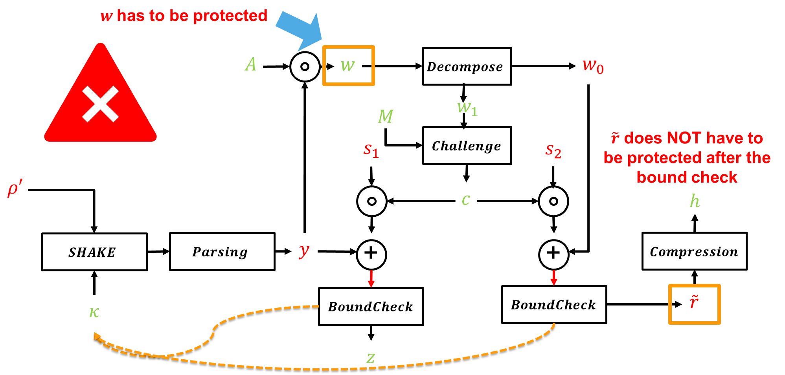
Flawed Sensitivity analysis from [MGTF19]: Explanation
Unmasking $\tilde{r}$
$\tilde{r}$ can be computed from public values only
$$Az −ct=α.w_{1}+\tilde{r}$$
It doesn‘t require SCA protection after bound checks
Protecting $w$
$y$ should not leak as leading to known attacks.
$y$ can be computed from $w$
$$w=A⋅y$$

Slide 11
Revisited Sensitivity analysis
$$A$$
$$w$$
$$Decompose$$
$$w_{0}$$
$$M$$
$$w_{1}$$
$$s_{1}$$
$$Challenge$$
$$s_{2}$$
$$ρ′$$
$$c$$
$$h$$
$$SHAKE$$
$$Parsing$$
$$y$$
+
+
$$Compression$$
$$BoundCheck$$
$$BoundCheck$$
$$\tilde{r}$$
$$κ$$
$$z$$

Slide 12
Tentative For leveling Dilithium
Goal of leveling:
Protect some intermediates with other countermeasures than masking.
Use weaker countermeasures with better performances.
Earlier version of this work:
Protect ephemeral intermediate variables $y$ and $w$ against Simple Power Analysis.
Rational based on hard-physical learning problems.
Use shuffling as a cheaper countermeasure.
Why does it not work:
Assumptions of hard-physical learning problems not met in Dilithium.
Dilithium has small-norm polynomials and not uniform polynomials.
We now assume that all the sensible variables are fully masked

Slide 13
Masking Gadgets

Slide 14
Rational for our masked implementation
Goal of masking gadgets:
Provide masked gadgets for all the parameter sets in the Dilithium round-3 submission.
Gadgets applicable with arbitrary order.
Reduce the clock cycles on a Cortex-M4 target.
Masking lattice-based cryptography [BC22]:
Lattice-based cryptography requires arithmetic and Boolean masking:
Reduce the number of conversion between type of masking.
Perform the operations in their “natural” field.
Using bitsliced masking gadgets enables efficient implementations:
Manipulate multiple coefficients simultaneously to fully use the bus-width.

Slide 15
Boolean and Arithmetic masking in Dilithium
Boolean masking
Arithmetic masking
Unprotected
$$M$$
$$A$$
$$w$$
$$Decompose$$
$$w_{0}$$
$$w_{1}$$
$$s_{1}$$
$$Challenge$$
$$s_{2}$$
$$ρ′$$
$$c$$
$$h$$
$$SHAKE$$
$$Parsing$$
$$y$$
+
+
$$Compression$$
$$BoundCheck$$
$$BoundCheck$$
$$\tilde{r}$$
$$κ$$
$$z$$

Slide 16
Benchmark details
Based on the PQM4 project with NUCLEO-L4R5ZI demonstration board.
TRNG of the microcontroller provides 32 fresh random bits every 53 cycles.
Mostly C implementation.
Optimized assembly for polynomial arithmetic and unprotected hash functions.
Benchmarks are for Dilithium Level-3 signature generation.
Compare performances with bitsliced versions gadgets with [MGTF19].

Slide 17
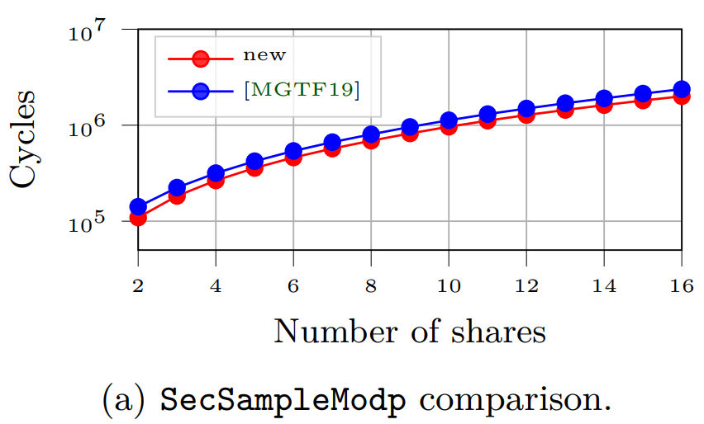
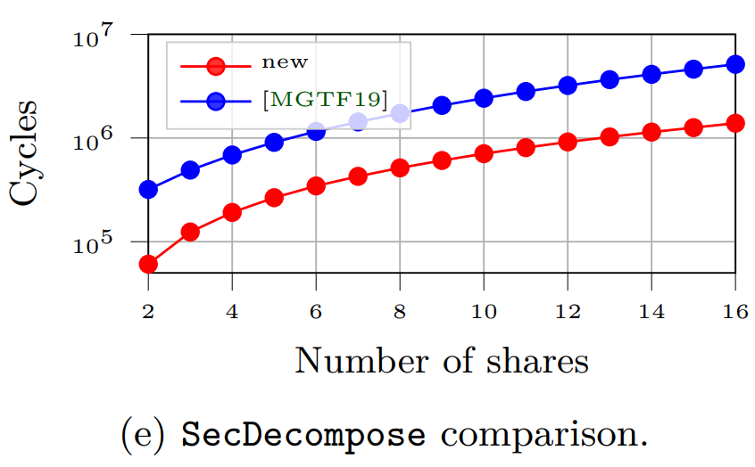
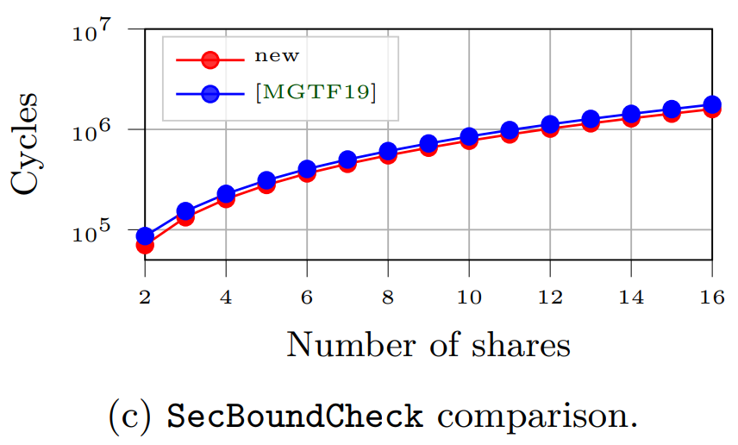
Gadgets improvements
 | SecBoundCheck | SecSampleModp | SecDecompose
Gain over [MGTF19] | 1.1$×$ | 1.2$×$ | 3.8$×$

Slide 18
Signature Generation Performances

Slide 19
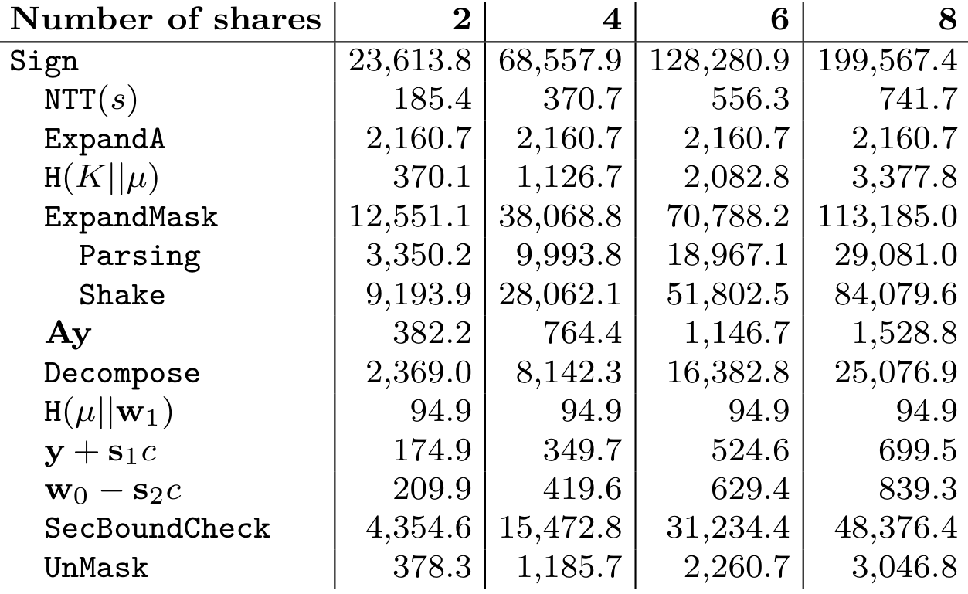
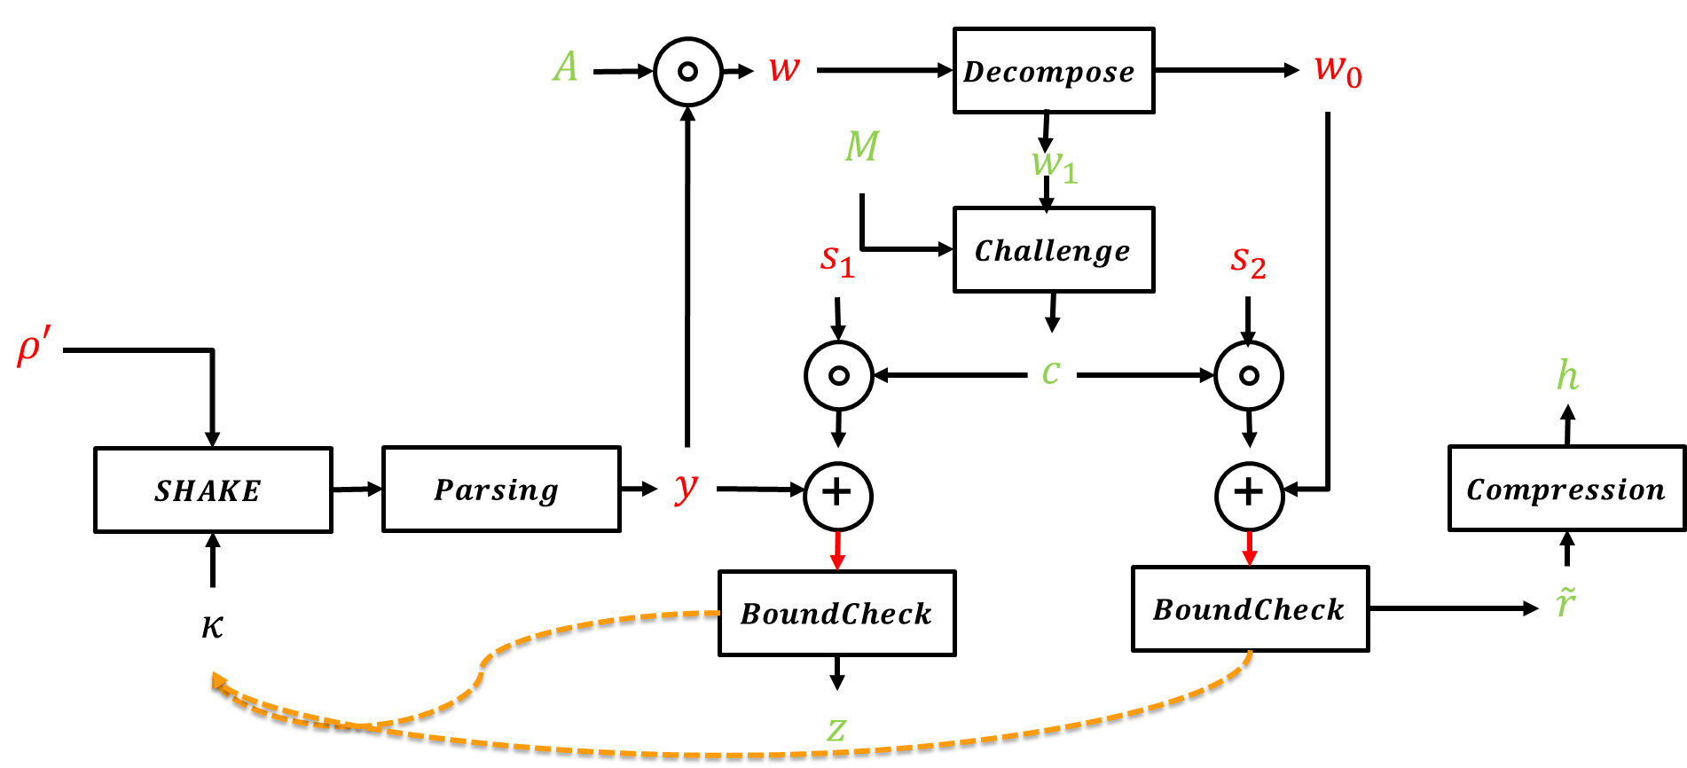
Performance overview
Min. runtime for determinitic Dilithium Level-3 Sign on Cortex-M4 (kCycles)

Slide 20
Comparing Dilithium Versions
Benchmark Masked Dilithium-3 (M4):
140M
120M
100M
Security
Order 2
Order 4
Order 6
80M
#Cycles
60M
40M
20M
0M
Draft Standard

Slide 21
Comparing Dilithium Versions
Benchmark Masked Dilithium-3 (M4):
140M
120M
100M
Security
Order 2
Order 4
Order 6
80M
#Cycles
60M
40M
20M
Shake
0M
Draft Standard
Observation 1:
Protected Keccak for sampling $y$ takes up 40% of runtime.

Slide 22
How could it be fixed?
Draft Standard:
$$TRNG$$
$$ρ′$$
$$SHAKE$$
$$Parsing$$
$$y$$
Protected Keccak
Flexible-Sampling:
Does not specify how $y$ is sampled.
Option: Generate shares of $y$ via TRNG.
$$TRNG$$
$$Parsing$$
$$y$$
Note: Requires proper TRNG or post-processing

Slide 23
What are the Bottlenecks?
Benchmark Masked Dilithium-3 (M4):
140M
120M
100M
Security
Order 2
Order 4
Order 6
80M
#Cycles
60M
40M
20M
Shake
0M
Draft Standard
Flex.
Observation 2:
Flexible-Sampling provides significant speed-up over randomized.

Slide 24
Lessons Learned
Hardening of Dilithium is not as mature as classical cryptography.
Randomized should be the default for embedded.
Flexible sampling would enable significant speed-up.

Slide 25
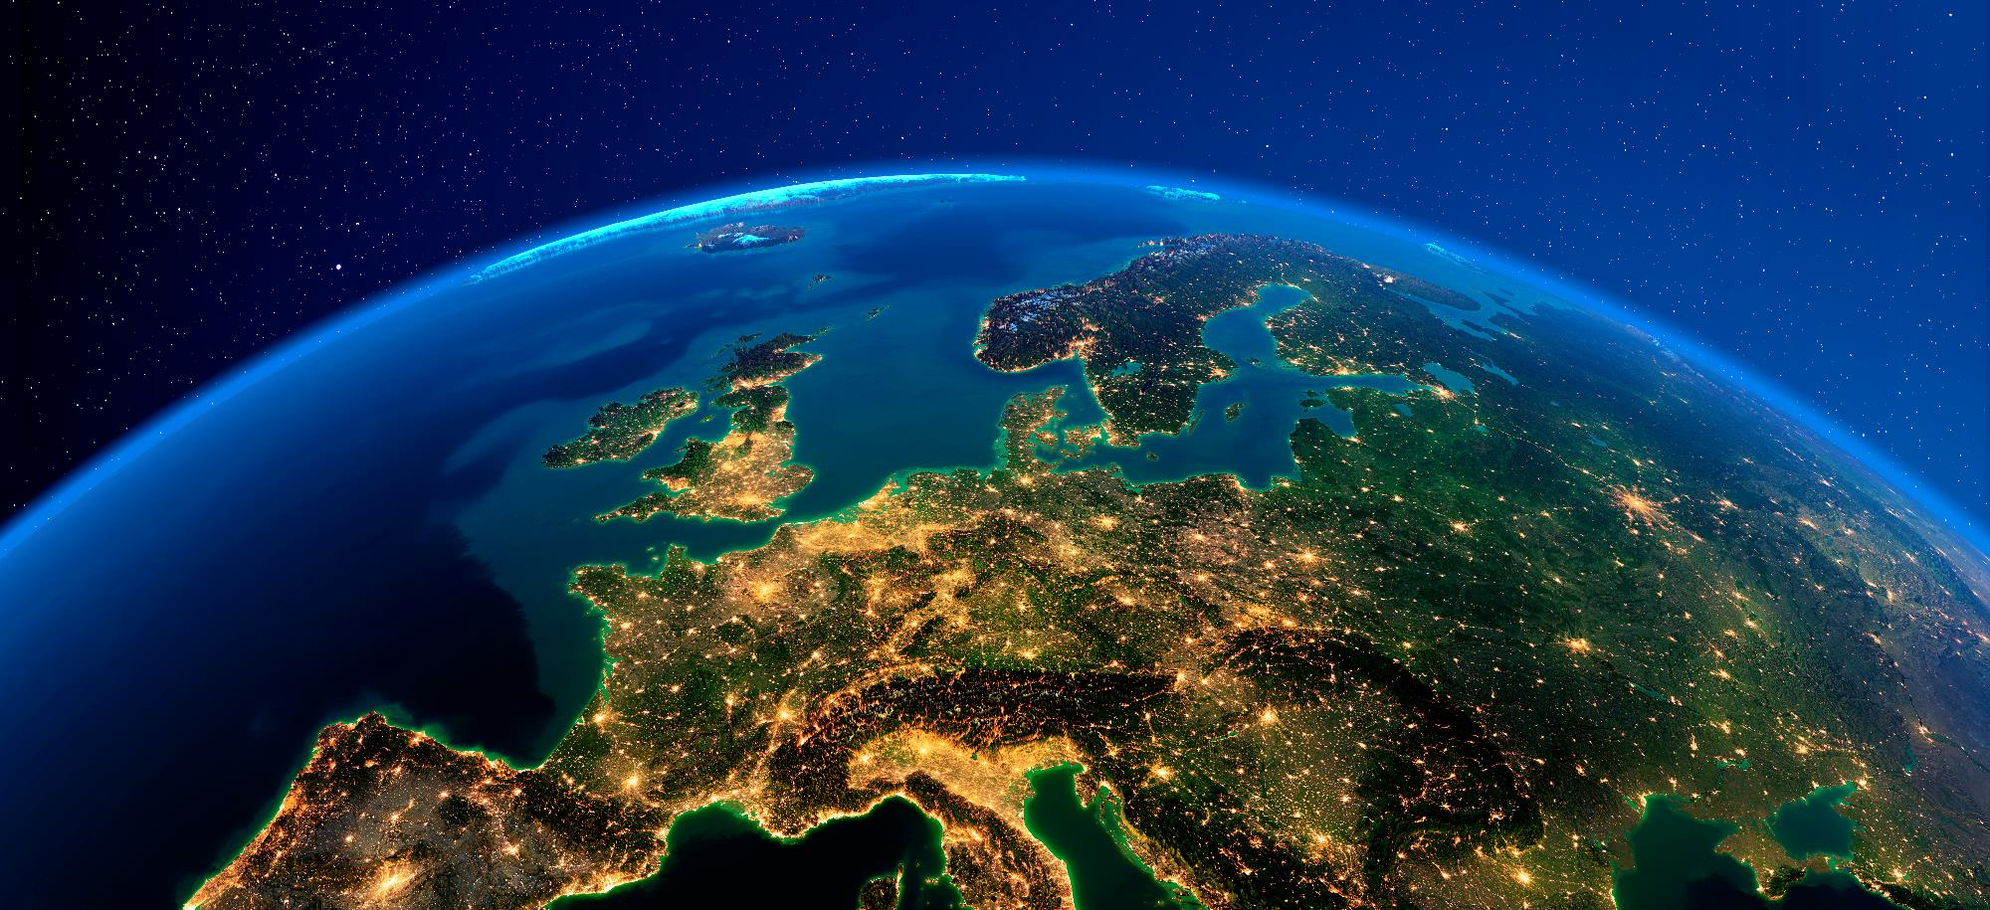
Thank you.
Questions?
Contact: pqc@nxp.com | NXP.com/PQC

