Slide 1
From MLWE to RLWE A Differential Fault Attack on Randomized & Deterministic Dilithium
Mohamed ElGhamrawy, Melissa Azouaoui, Olivier Bronchain, Joost Renes, Markus Schönauer, Tobias Schneider, Okan Seker, Christine van Vredendaal
CHES 2023

Slide 2
Overview of the new Fault Attack
MLWE:
Manipulated variables are polynomials.
Security depends on the module $(k,ℓ)$ and size of polynomials.
$\left[\begin{matrix}A[0,0] & ⋯ & A[0,ℓ−1] \\ ⋮ & ⋱ & ⋮ \\ A[k−1,0] & ⋯ & A[k−1,ℓ−1]\end{matrix}\right]$ $⋅$ $\left[\begin{aligned}s_{1}[0] \\ ⋮ \\ s_{1}\left[ℓ−1\right]\end{aligned}\right]+\left[\begin{aligned}s_{2}[0] \\ ⋮ \\ s_{2}\left[k−1\right]\end{aligned}\right]$ = $\left[\begin{aligned}t [0] \\ ⋮ \\ t\left[k−1\right]\end{aligned}\right]$
Public matrix $A$
Secret Keys
Public Key
Fault Injections:
Force the target to manipulate corrupted data.
Observe the resulting faulted signatures.
Use them to reduce the hardness of the problem.
Known by adversary
Target of the adversary
RLWE:
Security depends on the size of polynomials.
Key Recovery:
Dilithium polynomials size is chosen to be used in MLWE, not RLWE.
The hardness of the instance is decreased.
Lattice solving tools can practically recover the secret keys.
$a⋅$ $s_{1}\left[0\right]+s_{2}\left[0\right]= b$

Slide 3
Outline of the presentation
Overview of Dilithium signature generation.
High-level attack description:
Identify a potential fault location.
Reduction from MLWE to RLWE.
Impact of Fiat-Shamir with Aborts on the number of faults.
Extra content in the paper.
Notes for this presentation:
Omit the public key compression in Dilithium. Concept remains the same, but extra steps needed.
Equations are for illustration. See the paper for formalities.
The attack applies to all Dilithium variants (randomized / deterministic).

Slide 4
Attack Overview

Slide 5
Dilithium: Simplified Sign
$$M$$
$$A$$
$$Challenge$$
$$c$$
Dilithium is based on Fiat-Shamir with Aborts:
Generate $y$ from a seed and a counter.
Create a challenge $c.$
Compute the signature $z$.
If signature is too large: repeat !
$$ρ′$$
$$s_{1}$$
+
$$z$$
$$ExpandMask$$
$$y$$
Output:
$σ=(z,$c$)$
$$κ$$
Rejection? Increment $κ$
(We omit the Fiat-Shamir with Aborts for now, and will come to it later)

Slide 6
Attack Description: Impact on obtained signatures
$z\left[0\right]=ExpandMask\left(seed, ℓ.κ+0\right)+cs_{1}[0]$
$z\left[1\right]=$ $ExpandMask \left(seed, ℓ.κ+1\right)+cs_{1}[1]$
$$z\left[0\right]=y\left[0\right]+cs_{1}\left[0\right]$$
$$z\left[1\right]=y\left[1\right]+cs_{1}[1]$$
Correct Execution
$z\left[0\right]=$ $ExpandMask \left(seed, ℓ.κ+0\right)+cs_{1}[0]$
$z\left[1\right]=$ $ExpandMask \left(seed, ℓ.κ+0\right)+cs_{1}[1]$
$$z\left[0\right]=y\left[0\right]+cs_{1}\left[0\right]$$
$$z\left[1\right]=y\left[0\right]+cs_{1}[1]$$
Faulted Execution

Slide 7
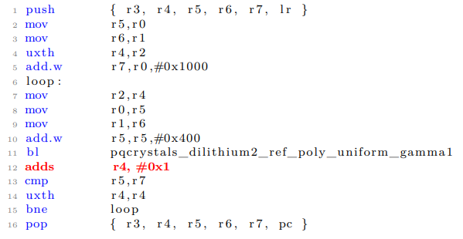
Attack Description: Fault location
Instruction skip
Notes:
Removed:
https://github.com/pq-crystals/dilithium compiled with arm-none-eabi-gcc v10.3.1 -mcpu=cortex-m4 … -O3

Slide 8
Attack Description: Recovering Differences
Adv obtains signature $(z,c)$
$$z\left[0\right]=y\left[0\right]+cs_{1}\left[0\right]$$
$$z\left[1\right]=y\left[0\right]+cs_{1}[1]$$
$$z\left[0\right]−z\left[1\right]=c{(s}_{1}\left[0\right]−s_{1}[1])$$
First Signature
$$z′\left[1\right]=y′\left[1\right]+c′s_{1}\left[1\right]$$
$$z′\left[2\right]=y′\left[1\right]+c{′s}_{1}[2]$$
$$z′\left[1\right]−z′\left[2\right]=c{′(s}_{1}\left[1\right]−s_{1}[2])$$
Second Signature
$$z′′\left[2\right]=y′′\left[2\right]+c′′s_{1}\left[2\right]$$
$$z′′\left[3\right]=y′′\left[2\right]+c{′′s}_{1}[3]$$
$$z′′\left[2\right]−z′′\left[3\right]=c′′{(s}_{1}\left[2\right]−s_{1}[3])$$
Third Signature
3 equations with 4 secret polynomials
Express all $s_{1}[i]$ as function of $s_{1}[0]$ and known data
Notes:
Ell – 1 signatures needed.

Slide 9
Attack Description: MLWE to RLWE
Eventually, we recover every polynomial of $s_{1}$as function $s_{1}[0]$. Example for $ℓ=4$:
$$s_{1}\left[1\right]=s_{1}\left[0\right]+λ_{0}$$
$$s_{1}\left[2\right]=s_{1}\left[0\right]+λ_{1}$$
$$s_{1}\left[3\right]=s_{1}\left[0\right]+λ_{2}$$
Substitution into public key equation $t=A⋅s_{1}+s_{2}$ reduces MLWE dimension from $(k, ℓ)$ to $\left(1, 1\right)$, i.e., RLWE.
$$t\left[0\right]−\sum_{j=1}^{ℓ−1}{A\left[0,j\right]⋅λ\left[j−1\right]}= \sum_{j=0}^{ℓ−1}{A\left[0,j\right]⋅s_{1}\left[0\right]}+s_{2}[0]$$
With $a, b, s_{1}\left[0\right], s_{2}\left[0\right]∈R_{q}.$
$b = a ⋅s_{1}\left[0\right] +s_{2}\left[0\right]$

Slide 10
Attack Description: Hardness of resulting rlwe
We use [DDGR20] to estimate and solve the resulting problem
Expected problem hardness.
Recovery of $ℓ−1$faulted signatures
Express the problem as RLWE
Resulting hardness estimates
Concrete Attack results
[DDGR20] D. Dachman-Soled, L. Ducas, H. Gong, M. Rossi. LWE with Side Information: Attacks and Concrete Security Estimation. CRYPTO 2020.
Notes:
voice over : Mention the own many cores are used on standard desktop

Slide 11
Attack improvements: RLWE with additional hints
Question:
Can we use the faulted signatures to ease the lattice reduction ?
Build Perfect Hints:
Express the system coefficientwise
$$\left\{\begin{aligned}s_{1}\left[1\right]=s_{1}\left[0\right]+λ_{0} \\ s_{1}\left[2\right]=s_{1}\left[0\right]+λ_{1} \\ s_{1}\left[3\right]=s_{1}\left[0\right]+λ_{2}\end{aligned}\right. ⇒ \left\{\begin{aligned}s_{1}\left[1,j\right]=s_{1}\left[0,j\right]+λ_{0}[j] \\ s_{1}\left[2,j\right]=s_{1}\left[0,j\right]+λ_{1}[j] \\ s_{1}\left[3,j\right]=s_{1}\left[0,j\right]+λ_{2}[j]\end{aligned}\right. ; ∀ 0≤j<n$$
Search for a unique solution for $s_{1}\left[0,j\right]$ by enumeration.
On average we fully recover 80/45/156 coefficients of $s_{1}\left[0\right]$ out of 256.
Use [DDGR20] to exploit that additional information.
[DDGR20] D. Dachman-Soled, L. Ducas, H. Gong, M. Rossi. LWE with Side Information: Attacks and Concrete Security Estimation. CRYPTO 2020.
Notes:
Mention DDGR20 DDGR20 is a lattice reduction / estimate tools ? Mention that this is because of these Hints that we actually use DDGR20.

Slide 12
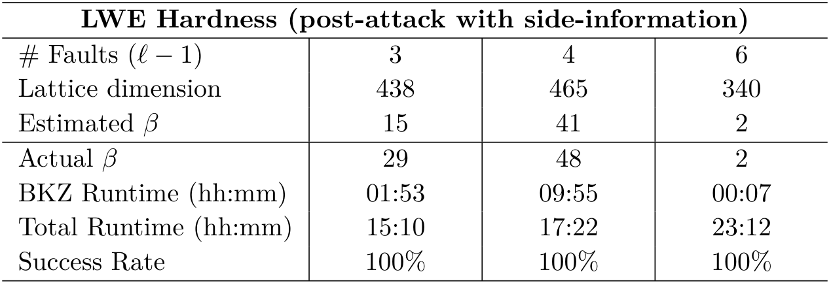
Attack improvements: RLWE with additional hints
Attacks without enumeration.
Recover hints with enumeration.
Use these hints in [DDGR20].
Resulting hardness estimates
Concrete Attack results
[DDGR20] D. Dachman-Soled, L. Ducas, H. Gong, M. Rossi. LWE with Side Information: Attacks and Concrete Security Estimation. CRYPTO 2020.
Notes:
At the cost of more faults level V is more vulnerable due to larger $ℓ$ → more equations/constraints in the system → more coefficients/hints recovered.
Lattice dimenson li

Slide 13
Impact of Fiat-Shamir with Aborts

Slide 14
Number of faults
Impact of Fiat-Shamir with aborts:
Signatures are rejected until a valid one is generated.
Does the Adv obtain the faulted signature or a valid one ?
Adv knows with high probability that she obtains a faulted signature thanks to its induced structured.
When to inject the fault ?
Randomized Dilithium: Always fault the first iteration.
Deterministic Dilithium: Always fault the final iteration in legit signatures
$$M$$
$$A$$
$$Challenge$$
$$c$$
$$ρ′$$
$$s_{1}$$
+
$$z$$
$$ExpandMask$$
$$y$$
Output:
$σ=(z,$c$)$
$$κ$$
Rejection? Increment $κ$

Slide 15
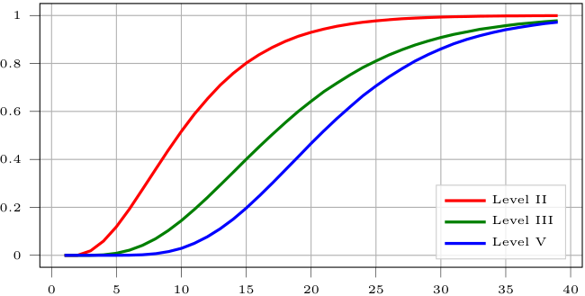
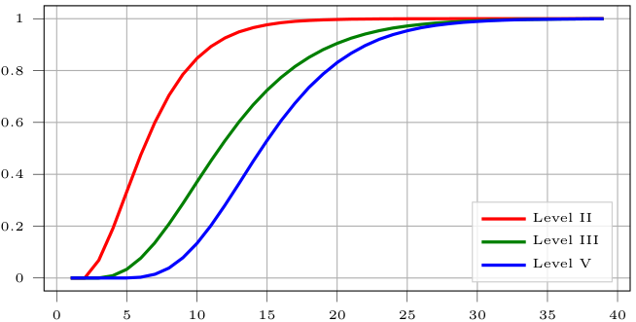
Number of faults
Questions:
How many faults need to be successfully injected ?
Requirements:
Key recovery requires $ℓ−1$ faulty signatures.
Results:
$ℓ−1$faults lead to possible attacks.
Randomized Level-II: With 15 faults, attack succeeds with probability 0.8.
Randomized: Successful attack needs in average 11.3/18.8/22.2 faults in average.
Deterministic: Successful attack needs in average 7.3/13/15.8 faults.
Randomized
Pr of key recovery
Number of injected Faults
Deterministic
Pr of key recovery
Number of injected Faults
Notes:
Randomized: on average 11.3, 18.8 and 22.2 signatures for levels II, III and V.
Deterministic: on average 7.3, 13 and 15.8 signatures for levels II, III and V

Slide 16
For interested readers
How can we prevent the attack:
Norm-based fault detection countermeasure:
Similarly, as the adversary deducing if she obvers a valid or faulted signature.
Recomputing only the final iteration.
Taking into account the public key compression:
Must be included as hints within the solver.
Estimated resulting $β$are larger (94/136/49).
We report successful attacks on Dilithium Level-V.

Slide 17
Summary and conclusion
A new DFA exploiting the MLWE structure:
Applies to deterministic and randomized Dilithium.
The attack reduces the MLWE problem of Dilithium to a much simpler RLWE one.
Resulting RLWE can be solved with lattice attacks:
Either directly or using hints on the secret key coefficients.
The attack requires only a few instruction skips (around 10) to succeed with good probability.
New countermeasures have been proposed.

Slide 18
Thank you.
Questions?
Contact: pqc@nxp.com | NXP.com/PQC

Slide 19
Back up / Appendix

Slide 20
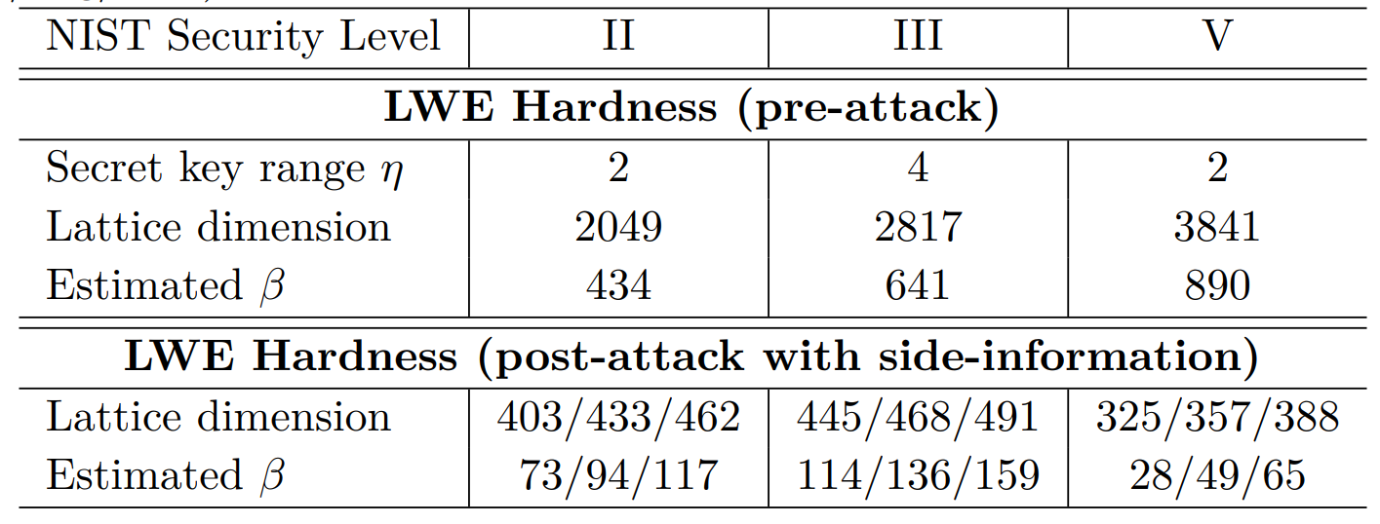
Attack estimations without knowledge of $t_{0}$
Lattice key recovery with hints results without knowledge of $t_{0}$.
[DDGR20] D. Dachman-Soled, L. Ducas, H. Gong, M. Rossi. LWE with Side Information: Attacks and Concrete Security Estimation. CRYPTO 2020.

