Slide 1
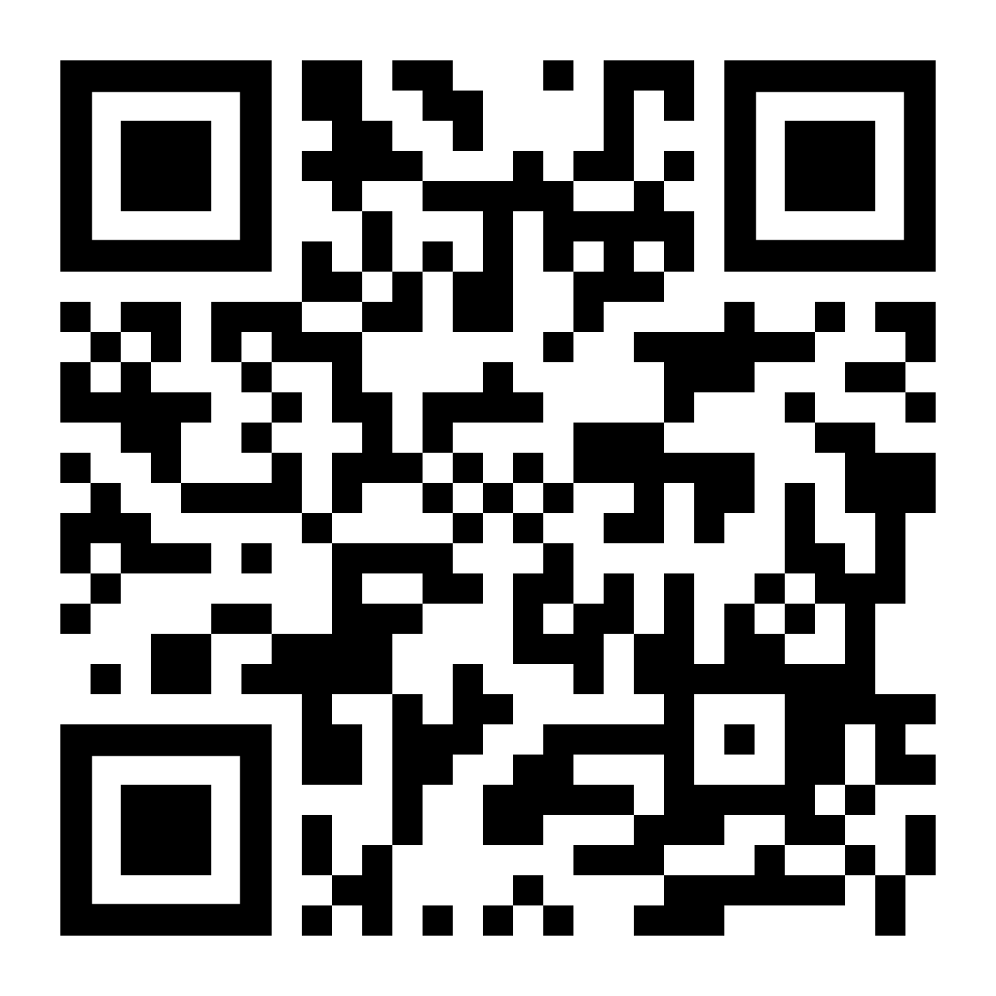
CPA-secure KEMs are also sufficient for Post-Quantum TLS 1.3
${Biming Zhou}^{1,2}$ ${Haodong Jiang}^{3}{ \text{Y}unlei Zhao}^{1,2}$
1
2
Fudan University
State Key Laboratory of Cryptology
3
Henan Key Laboratory of Network Cryptography Technology
Asiacrypt 2024
December 12, 2024
eprint:2024/1360

Slide 2
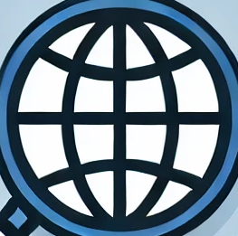



(Classical) TLS 1.3
TLS 1.3 is one of the most widely used cryptographic protocols in real-world applications, e.g., for browsing, email, instant messaging.
TLS 1.3 consists of two sub-protocols.
Handshake protocol: the client and server authenticate themselves, negotiate cryptographic parameters and establish shared secrets.
Record protocol: securely transmit the sensitive data.
We focus on the most common variant of the TLS 1.3 handshake: full 1-RTT handshake here.

Slide 3

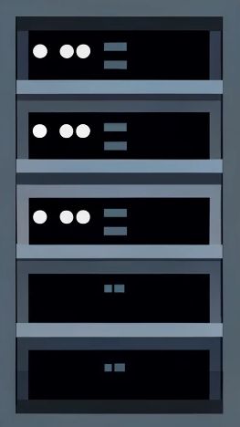









(Classical) TLS 1.3
TLS 1.3 handshake (full 1-RTT)
Client
Server
SYN
($sk_{s},pk_{s}$)
SYN-ACK
$$x∈_{U}Z_{q}$$
$$g^{x}$$
$$y∈_{U}Z_{q}$$
$g^{y},$cert[$pk_{s}$]||Sig($sk_{s},trans$)||${MAC}_{SF}$
$$K←KDF(g^{xy})$$
$$K←KDF(g^{xy})$$
$${MAC}_{CF}$$
$$data$$

Slide 4
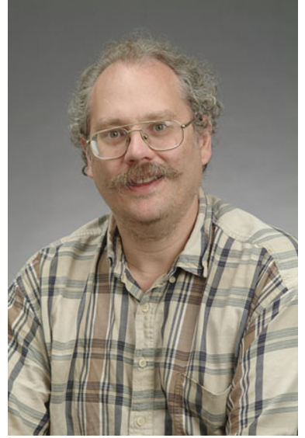
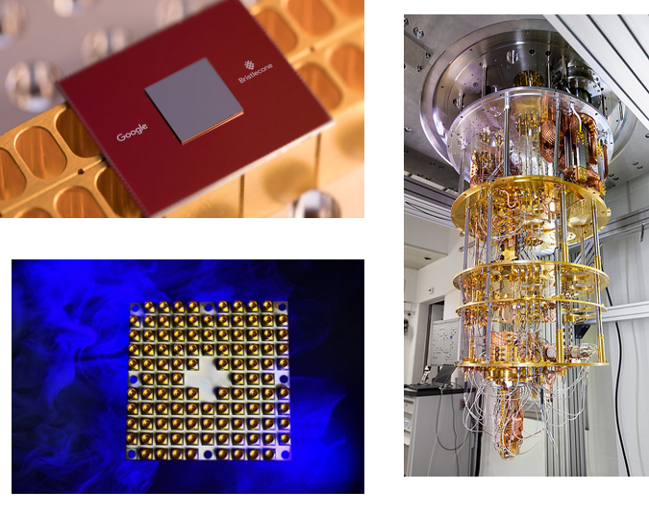








(Classical) TLS 1.3
TLS 1.3 handshake (full 1-RTT)
Client
Server
SYN
($sk_{s},pk_{s}$)
SYN-ACK
$$x∈_{U}Z_{q}$$
$$g^{x}$$
$$y∈_{U}Z_{q}$$
$g^{y},$cert[$pk_{s}$]||Sig($sk_{s},trans$)||${MAC}_{SF}$
$$K←KDF(g^{xy})$$
$$K←KDF(g^{xy})$$
$${MAC}_{CF}$$
$$data$$
Diffie-Hellman (DH) key exchange used in TLS 1.3 is vulnerable to quantum attacks.
Shor’s alogorithm
Rapid advance in quantum computing

Slide 5






PQC and NIST’s Standardization
Post-Quantum Cryptography (PQC) classical cryptosystems that remain secure in the presence of a quantum adversary
NIST’s PQC Standardization PKE, Digital signatures and KEM
August 13, 2024, NIST published the first KEM standard (Kyber) FIPS-203.
Kyber is a lattice-based KEM with IND-CCA security.
KEM = (Gen, Encaps, Decaps)
$$pk$$
$$c$$
$$Gen(1^{λ})→(pk,sk)$$
$$Encaps(pk)→(K,c)$$
$$Decaps(sk,c)→K$$

Slide 6

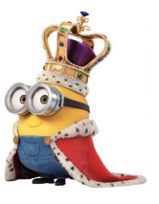

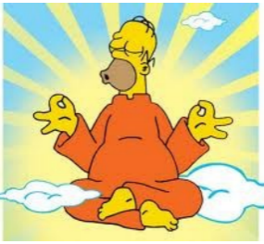










Security notion for KEM
Other Security notions:
Adversary
IND-CCA Security
Challenger
IND-1CCA Security : Adversary only can query Decaps Oracle once.
$$(pk,c^{∗},K_{b}^{∗})$$
IND-CPA Security: Adversary can’t query Decaps Oracle.
$$c≠c^{∗}$$
$$Decaps Oracle$$
Generic constructions:
$$Encaps(pk)→(K_{0}^{∗},c^{∗})$$
$$Decaps(sk,c)→K$$
FO-like generic constructions:
weakly-secure PKE
⇒ CCA-secure KEM
Guess b
$T {(T}_{H}[\text{HV}\text{22}] /T_{RH}[\text{JMZ}\text{23}])$ constructions:
weakly-secure PKE
⇒ 1CCA-secure KEM
Adversary
Challenger
OW-CPA Security
$$(pk,c^{∗})$$
Without ciphertext expansion
$$Gen(1^{λ})→(pk,sk)$$
Without re-encrypition
Output $K^{∗}$
$$Encaps(pk)→(K^{∗},c^{∗})$$
More efficient

Slide 7


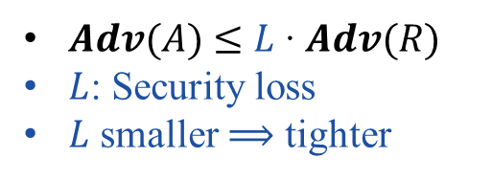

Tightness of Security Reduction
Hard problem/
Secure building blocks
design
Protocol Scheme $Π$
I will solve the problem if A succeed.
reduction
I break the security of $Π!$
Adversary R
Adversary A
Tightness of Reduction
Larger security loss$L$
$Adv(A)$ $≤$ $L$ ∙ $Adv(R)$
$L$: Security loss
$L$ smaller ⟹ tighter
inefficient deployment or insecure

Slide 8


Quantum Random Oracle Model
ROM
RO
H
$$x$$
$$H(x)$$
QROM
QRO

Slide 9

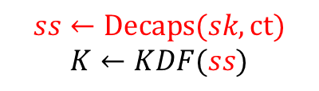
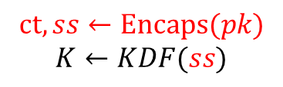






(Post-Quantum) TLS 1.3
Replace DH with KEM
Client
Server
$$PQ$$
SYN
($sk_{s},pk_{s}$)
SYN-ACK
$$\left(sk,pk\right)←KeyGen$$
$$pk$$
$$ct,ss←Encaps(pk)$$
$$K←KDF(ss)$$
$ct,$cert[$pk_{s}$]||Sig($sk_{s},trans$)||${MAC}_{SF}$
$$ss←Decaps(sk,ct)$$
$$K←KDF(ss)$$
$${MAC}_{CF}$$
$$data$$
Basic Question: What security requirement for this replaced KEM?

Slide 10




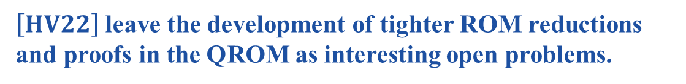



Existing Results of PQ TLS 1.3
Standard model
IND-CCA KEM
ROM
QROM
IND-1CCA KEM
[DFGS21]
$$O(t_{s}^{2})$$
$$O(q^{6})$$
$$[HV22]$$
$$O\left(t_{s}^{2}\right)$$
OW-CPA
IND-1CCA-MAC
PQ TLS 1.3 Security
$$[HV22]$$
$\left[HV22\right]$leave the development of tighter ROM reductions and proofs in the QROM as interesting open problems.
We resolve these open problems!

Slide 11
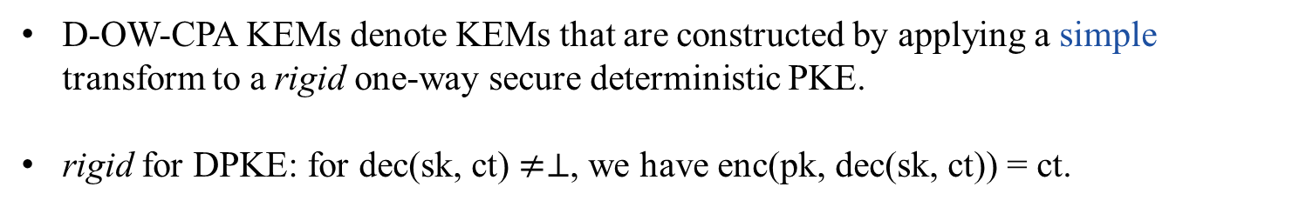





Our Contributions
Result 1:
Standard model
$$O(q^{2})$$
ROM
OW-CPA
QROM
$$O(q)$$
IND-CPA
IND-1CCA-MAC*
TLS 1.3 Security
$$O\left(t_{s}^{2}\right)$$
D-OW-CPA
$$O(1)$$
Result 2:
OW-CPA
IND-CPA
IND-1CCA-MAC *
TLS 1.3 Security
D-OW-CPA
$$O\left(t_{s}^{2}\right)$$
D-OW-CPA KEMs denote KEMs that are constructed by applying a simple transform to a rigid one-way secure deterministic PKE.
rigid for DPKE: for dec(sk, ct) $≠⊥$, we have enc(pk, dec(sk, ct)) = ct.
$$m←\$Μ, c = enc(pk, m); K=m$$

Slide 12
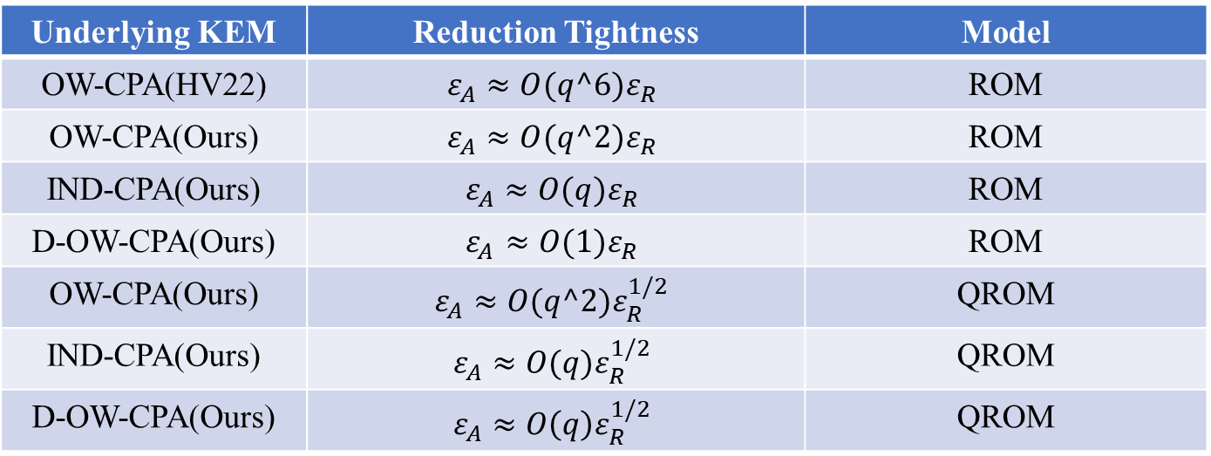

Our Contributions
Standard model
ROM
OW-CPA
QROM
Kyber.PKE
IND-CPA
IND-1CCA-MAC *
TLS 1.3 Security
NTRU.PKE
$$O\left(t_{s}^{2}\right)$$
D-OW-CPA
Classic McEliece.PKE
Table 1: Reduction tightness of the intermediate game IND-1CCA-MAC *.
Underlying KEM | Reduction Tightness | Model
OW-CPA(HV22) | $$ε_{A}≈O(q^6)ε_{R}$$ | ROM
OW-CPA(Ours) | $$ε_{A}≈O(q^2)ε_{R}$$ | ROM
IND-CPA(Ours) | $$ε_{A}≈O(q)ε_{R}$$ | ROM
D-OW-CPA(Ours) | $$ε_{A}≈O(1)ε_{R}$$ | ROM
OW-CPA(Ours) | $$ε_{A}≈O(q^2)ε_{R}^{1/2}$$ | QROM
IND-CPA(Ours) | $$ε_{A}≈O(q)ε_{R}^{1/2}$$ | QROM
D-OW-CPA(Ours) | $$ε_{A}≈O\left(q\right)ε_{R}^{1/2}$$ | QROM

Slide 13

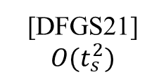


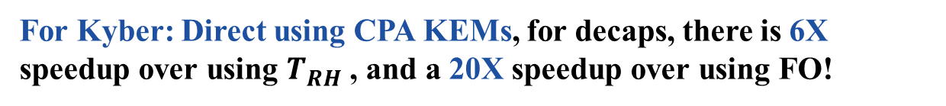

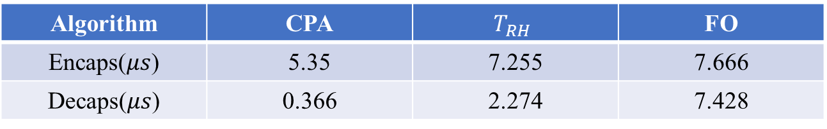
Tightness & Practical Efficiency Impact
IND-CCA KEM
Standard model
ROM
QROM
$$FO$$
IND-1CCA KEM
[DFGS21]
$$O(t_{s}^{2})$$
$${T_{H}/T}_{RH}:O\left(q^{k}ε^{μ}\right)[JMZ23]$$
$$O(q^{k}ε^{μ})$$
CPA PKEs
CPA KEMs
IND-1CCA-MAC*
TLS 1.3 Security
tight
Our work
$$O\left(t_{s}^{2}\right)$$
Note: [CWCHP24] obtain a tighter reduction for 1CCA KEM from rigid DPKE in the QROM.
Table 2: Benchmark of Encaps and Decaps for CRYSTALS-Kyber with different transforms using liboqs (AVX2 enabled, NIST security level I) on system specs: Intel(R) Core(TM) i9-10900X CPU @ 3.7 GHz, 32.0 GB RAM, 64-bit OS.
Algorithm | CPA | $$T_{RH}$$ | FO
Encaps($μs$) | 5.35 | 7.255 | 7.666
Decaps($μs$) | 0.366 | 2.274 | 7.428
For Kyber: Direct using CPA KEMs, for decaps, there is 6X speedup over using $T_{RH}$ , and a 20X speedup over using FO!

Slide 14
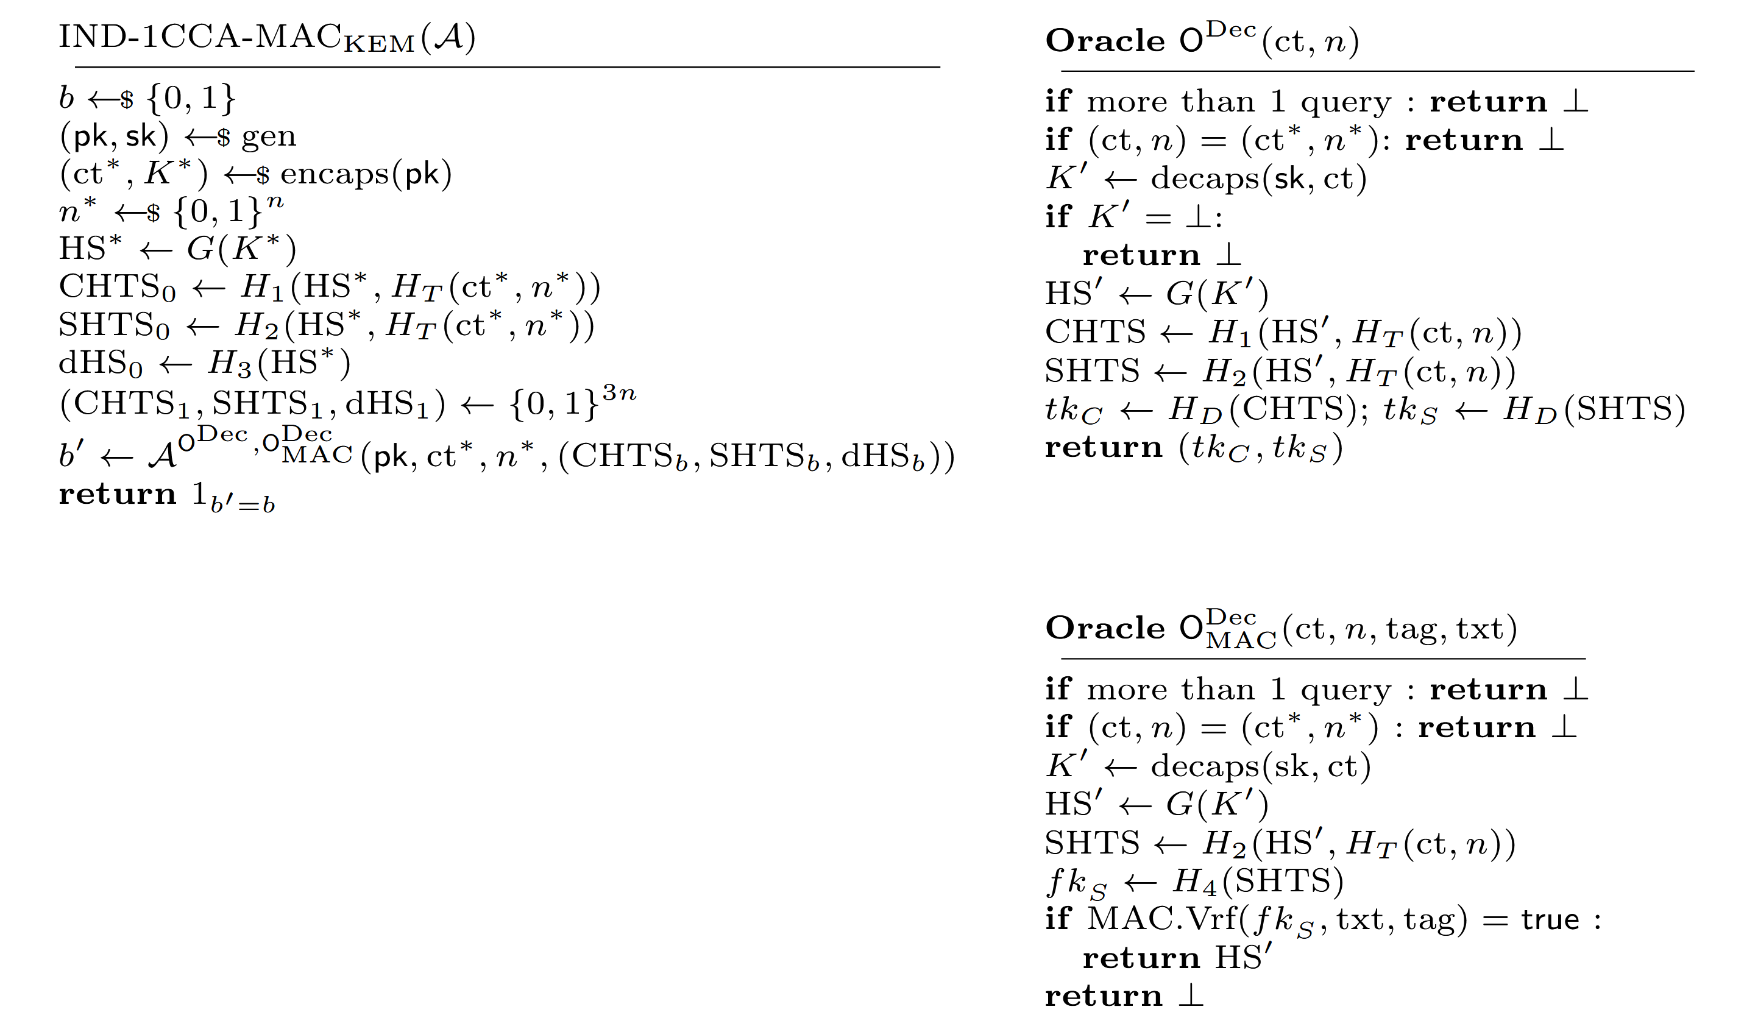






Approach by Huguenin-Dumittan and Vaudenay
Standard model
ROM
$$O(q^{6})$$
$$[HV22]$$
OW-CPA
IND-1CCA-MAC
TLS 1.3 Security
$$R(1^{λ},pk,ct)$$
$$H_{i}$$
$$O^{Dec}$$
$$O_{MAC}^{Dec}$$
$$A(1^{λ},pk,ct^{∗},n^{∗},(CHTS_{b},SHTS_{b},dHS_{b}))$$
Challenge

Slide 15
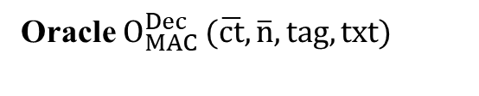


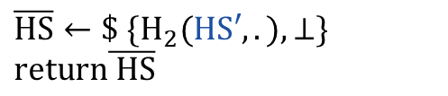


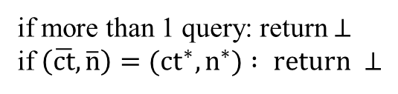

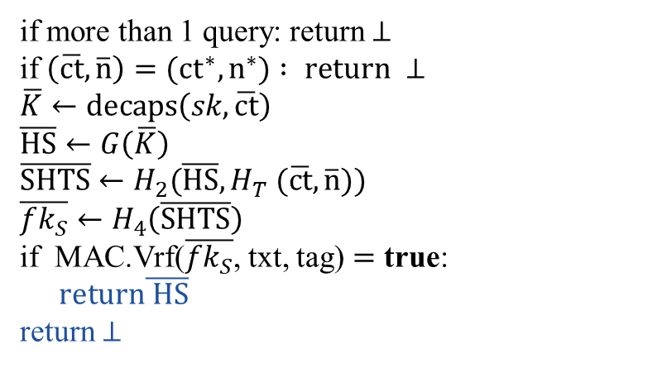
Approach by Huguenin-Dumittan and Vaudenay
Embed underlying OW-CPA experiment: randomly choose input in G-List
$$O(1/q_{G})$$
Simulating $O_{MAC}^{Dec}:$
Oracle $O_{MAC}^{Dec} (\overline{ct},\overline{n},tag,txt)$
Real
if more than 1 query: return $⊥$
if $\left(\overline{ct},\overline{n}\right)=(ct^{∗},n^{∗}) : return ⊥$
$$\overline{K}←decaps\left(sk,\overline{ct}\right)$$
$$\overline{HS}←G\left(\overline{K}\right)$$
$$\overline{SHTS}←H_{2}(\overline{HS}, H_{T} (\overline{ct},\overline{n}))$$
$$\overline{fk_{S}}←H_{4}\left(\overline{SHTS}\right)$$
if MAC.Vrf($\overline{fk_{S}}$, txt, tag) $=$ true:
$return\overline{ HS}$
return $⊥$
A must have queried $\left(\overline{HS}, H_{T} \left(\overline{ct},\overline{n}\right)\right) to H_{2}$(MAC security)
$A′query List H_{1}, H_{2}$(lazy sampling)
Oracle $O_{MAC}^{Dec} (\overline{ct},\overline{n},tag,txt)$
Sim
if more than 1 query: return $⊥$
if $\left(\overline{ct},\overline{n}\right)=(ct^{∗},n^{∗}) : return ⊥$
$\overline{HS}←\$$ ${\{H}_{2}(HS′,.),⊥\}$
$$return\overline{ HS}$$
$$O(1/(q_{H_{2}}+ 1)).$$

Slide 16
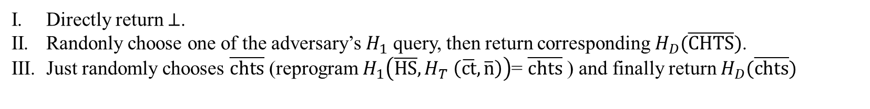


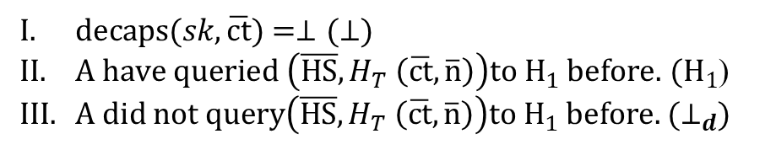

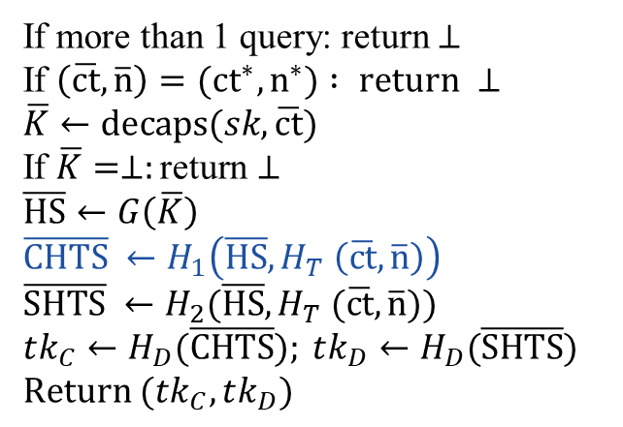



Approach by Huguenin-Dumittan and Vaudenay
Real
Simulating $O^{Dec}:$
Oracle $O^{Dec}(\overline{ct},\overline{n})$
If more than 1 query: return $⊥$
If $\left(\overline{ct},\overline{n}\right)=(ct^{∗},n^{∗}) : return ⊥$
$$\overline{K}←decaps(sk,\overline{ct})$$
If $\overline{K}=⊥:\text{return}⊥$
$$\overline{HS}←G\left(\overline{K}\right)$$
$$\overline{CHTS} ←H_{1}\left(\overline{HS},H_{T} \left(\overline{ct},\overline{n}\right)\right)$$
$$\overline{SHTS} ←H_{2}(\overline{HS},H_{T} (\overline{ct},\overline{n}))$$
$$tk_{C}←H_{D}(\overline{CHTS}); tk_{D}←H_{D}(\overline{SHTS})$$
$$Return (tk_{C},tk_{D})$$
$decaps(sk,\overline{ct})$ $=⊥(⊥)$
$A have queried \left(\overline{HS},H_{T} \left(\overline{ct},\overline{n}\right)\right)to H_{1} before.$ ${(H}_{1}$)
$A did not query\left(\overline{HS},H_{T} \left(\overline{ct},\overline{n}\right)\right)to H_{1} before.$ ${(⊥}_{d}$)
Sim:
$2+q_{H_{1}}$cases for $H_{1}$in total, reduction randomly guess one.
$$O(1/(q_{H_{1}}+2))$$
Directly return $⊥$.
Randonly choose one of the adversary’s $H_{1}$ query, then return corresponding $H_{D}(\overline{CHTS})$.
Just randomly chooses $\overline{chts}$ (reprogram $H_{1}\left(\overline{HS},H_{T} \left(\overline{ct},\overline{n}\right)\right)$= $\overline{chts}$ ) and finally return $H_{D}(\overline{chts})$
Ensure the consistency of $H_{1}$and $O^{Dec} :$ guessing when $H_{1}\left(HS, t\right) later$ query corresponds to the defined $\overline{chts}$in $O^{Dec}$, and reprogram at that time.
$$O(1/(q_{H_{1}}+1))$$
Thus the probability of reduction guessing correctly for $H_{1}$ is
$$O(1/(q_{H_{1}}+1)(q_{H_{1}}+2))$$
Similarity, the probability of reduction guessing correctly for $H_{2}$ is
$$O(1/(q_{H_{2}}+1)(q_{H_{2}}+2))$$
Thus, the total loss is $O(q^{6})$ in the ROM!

Slide 17
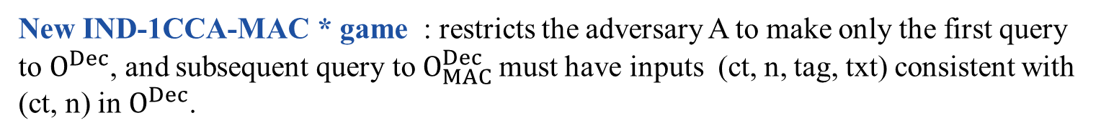
IND-1CCA-MAC*
[HV22]
IND-1CCA-MAC
TLS 1.3 Security (MultiStage security[DFGS21])
The reduction $actually query$ $O^{Dec}\left(ct,n\right) first$and $O_{MAC}^{Dec}\left(ct,n,tag,txt\right) with$ the same (ct,n) as in $O^{Dec}$ to simulate the multi-stage security game for TLS 1.3.
New IND-1CCA-MAC * game : restricts the adversary A to make only the first query to $O^{Dec}$, and subsequent query to $O_{MAC}^{Dec}$must have inputs (ct, n, tag, txt) consistent with (ct, n) in $O^{Dec}$.

Slide 18


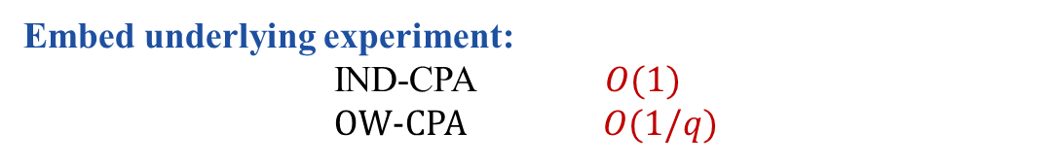
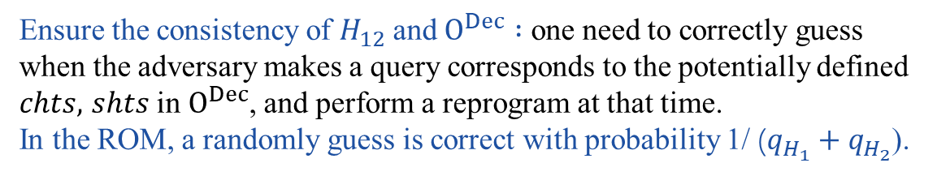


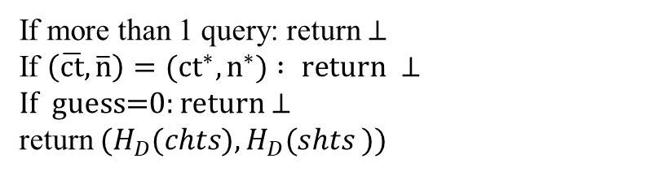

Our ROM proofs
OW-CPA
$$O(q)$$
IND-CPA
IND-1CCA-MAC *
TLS 1.3 Security
D-OW-CPA
Simulating $O^{Dec}:$
Define $H_{12}=\left(H_{1},H_{2}\right)$ to simulate $H_{1}$ and $H_{2}$ simultaneously.
Oracle $O^{Dec}(\overline{ct},\overline{n})$
reprogram $H_{12}(\overline{HS},H_{T}(\overline{ct},\overline{n}))$to a random $(chts,shts)$
Sim
If more than 1 query: return $⊥$
If $\left(\overline{ct},\overline{n}\right)=(ct^{∗},n^{∗}) : return ⊥$
If guess=0: return $⊥$
return $(H_{D}(chts), H_{D}(shts ))$
Ensure the consistency of $H_{12}$and $O^{Dec} :$ one need to correctly guess when the adversary makes a query corresponds to the potentially defined $chts,$ $shts$in $O^{Dec}$, and perform a reprogram at that time.
In the ROM, a randomly guess is correct with probability 1/ ($q_{H_{1}}+q_{H_{2}}$).
$$O(1/q).$$
Simulating $O_{MAC}^{Dec}:$
Directly using $the guess in O^{Dec} to simulate it .$
Embed underlying experiment:
IND-CPA $O(1)$
OW-CPA $O(1/q)$

Slide 19
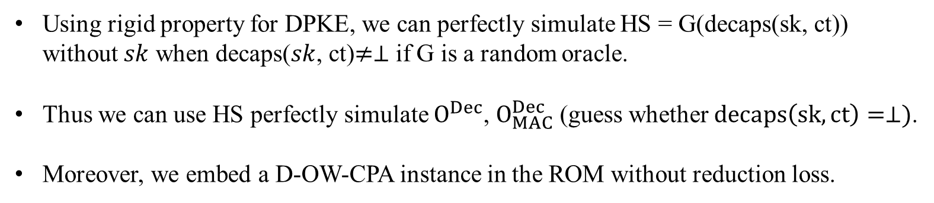




Our ROM proofs
OW-CPA
$$O(1)$$
IND-CPA
IND-1CCA-MAC *
TLS 1.3 Security
D-OW-CPA
$σ$-correctness
$$Enc(pk,m)=c$$
$$Dec(sk,c)=m≠⊥$$
rigid property
Using rigid property for DPKE, we can perfectly simulate HS = G(decaps(sk, ct)) without $sk$ when decaps($sk$, ct)$≠⊥$ if G is a random oracle.
Thus we can use HS perfectly simulate $O^{Dec}$, $O_{MAC}^{Dec}$ (guess whether $decaps\left(sk,ct\right)=⊥)$.
Moreover, we embed a D-OW-CPA instance in the ROM without reduction loss.

Slide 20



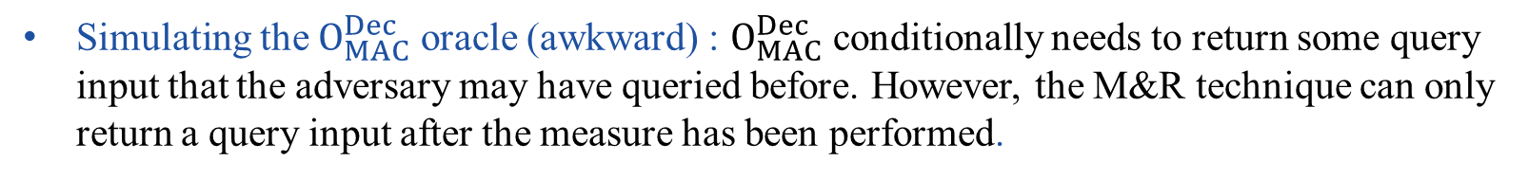

Lifting our ROM proofs into the QROM
OW-CPA
IND-CPA
IND-1CCA-MAC *
TLS 1.3 Security
D-OW-CPA
$$R(1^{λ},pk,ct)$$
$$H_{i}$$
$$O^{Dec}$$
$$O_{MAC}^{Dec}$$
$$A(1^{λ},pk,ct^{∗},n^{∗},(CHTS_{b},SHTS_{b},dHS_{b}))$$
Challenge
Challenge embedding: use the O2H and Double-sided O2H techniques to embed the instance of the underlying experiment.
Simulating the $O^{Dec}$ oracle: use the Measure-and-reprogram variant proposed by [JZM23].
Simulating the $O_{MAC}^{Dec}$ oracle (awkward) : $O_{MAC}^{Dec}$ conditionally needs to return some query input that the adversary may have queried before. However, the M&R technique can only return a query input after the measure has been performed.
We overcome this obstacle by successfully combining the MAC security and OW2H techniques.
If the $O_{MAC}^{Dec}$ oracle is queried before the measure: directly return $⊥.$

Slide 21

Summary
Result:
Standard model
ROM
OW-CPA
QROM
Kyber.PKE
IND-CPA
IND-1CCA-MAC*
TLS 1.3 Security
$$O\left(t_{s}^{2}\right)$$
NTRU.PKE
D-OW-CPA
Classic McEliece.PKE
According to our results, a CPA-secure KEM (which is more concise and efficient than the currently used CCA/1CCA-secure KEM) can be directly employed to construct a Post-Quantum TLS 1.3.
Thanks! Questions?
eprint:2024/1360

Slide 22
References
BDF+11 Boneh, D., Dagdelen, O., Fischlin, M., Lehmann, A., Schaffner, C., Zhandry, M.: Random oracles in a quantum world.
DFGS21 Dowling, B., Fischlin, M., Günther, F., Stebila, D.: A cryptographic analysis of the TLS 1.3 handshake protocol.
HV22 Huguenin-Dumittan, L., Vaudenay, S.: On IND-qCCA security in the ROM and its applications - CPA security is sufficient for TLS 1.3.
JMZ23 Jiang, H., Ma, Z., Zhang, Z.: Post-quantum security of key encapsulation mechanism against CCA attacks with a single decapsulation query.

Slide 23


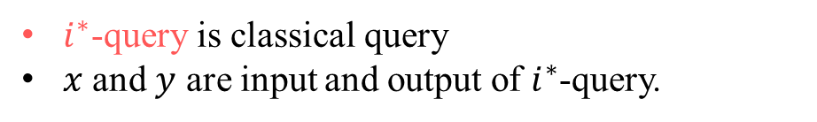





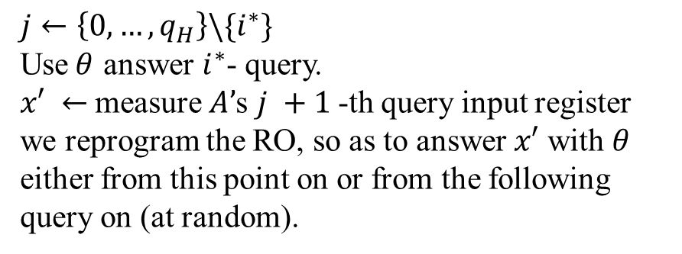




Refined Measure&Reprogram Technique [JZM23]
$$A$$
$$A$$
$$S$$
…
…
…
$i^{∗}$-query
$$\overline{x}$$
$$O^{H}$$
$$O^{H}$$
$$θ$$
…
…
…
S($θ$) simulate RO$H′$:
$$(x, z)$$
$$j←\left\{0,…,q_{H}\right\}\backslash \{i^{∗}\}$$
Use$θ$ answer $i^{∗}$- query.
$x′ ←$measure $A’$s $j +1$-th query input register
we reprogram the RO, so as to answer $x′$ with$θ$ either from this point on or from the following query on (at random).
$$(\overline{x},\overline{z})$$
$i^{∗}$-query is classical query
$x$ and $y$ are input and output of $i^{∗}$-query.
$Pr⁡[x=x_{0}⋀V(x,y,z)]≈O(q^{2})$ $Pr⁡[x=x_{0}⋀V(\overline{x}, θ,\overline{z})]$

Slide 24
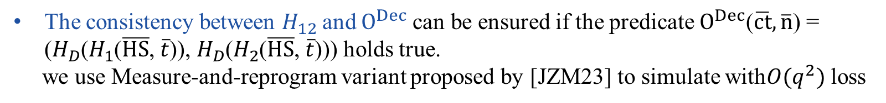

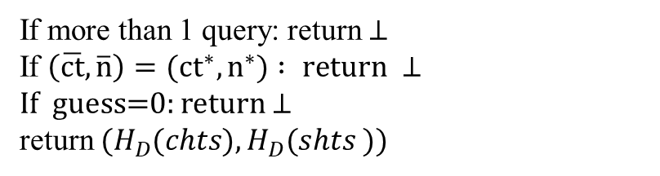
Simulating $O^{Dec}$ in the QROM
Define $H_{12}=\left(H_{1},H_{2}\right)$ to simulate $H_{1}$ and $H_{2}$ simultaneously.
Oracle $O^{Dec}(\overline{ct},\overline{n})$
reprogram $H_{12}(\overline{HS},H_{T}(\overline{ct},\overline{n}))$to a random $θ=$(chts,shts)
Sim
If more than 1 query: return $⊥$
If $\left(\overline{ct},\overline{n}\right)=(ct^{∗},n^{∗}) : return ⊥$
If guess=0: return $⊥$
return $(H_{D}(chts), H_{D}(shts ))$
The consistency between $H_{12}$and $O^{Dec}$can be ensured if the predicate $O^{Dec}$($\overline{ct},\overline{n}$) = ($H_{D}$($H_{1}$($\overline{HS}$, $\overline{t}$)), $H_{D}$($H_{2}$($\overline{HS}$, $\overline{t}$))) holds true.
we use Measure-and-reprogram variant proposed by [JZM23] to simulate with$O(q^{2})$ loss
24

Slide 25

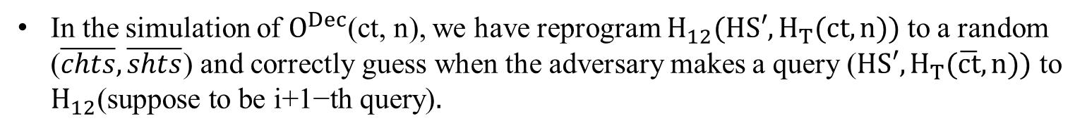
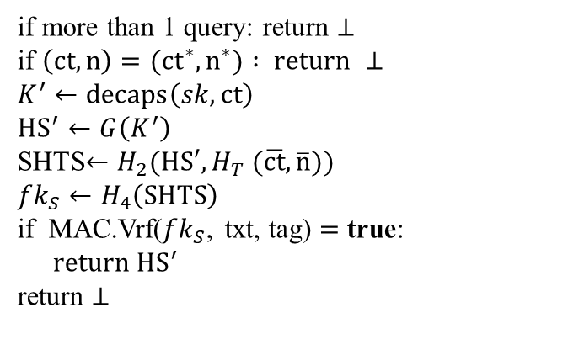

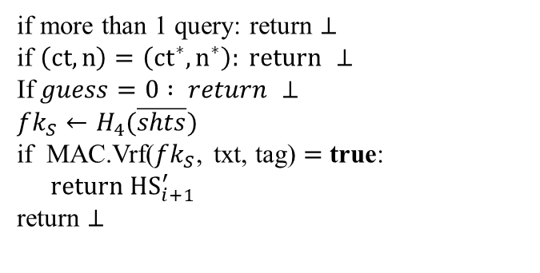
Simulating $O_{MAC}^{Dec}$
Oracle $O_{MAC}^{Dec} (ct,n,tag,txt)$
Sim
Oracle $O_{MAC}^{Dec} (ct,n,tag,txt)$
Real
if more than 1 query: return $⊥$
if $\left(ct,n\right)=\left(ct^{∗},n^{∗}\right): return ⊥$
If$guess=0 : return ⊥$
$$fk_{S}←H_{4}(\overline{shts})$$
if MAC.Vrf($fk_{S}$, txt, tag) $=$ true:
$return{ HS}_{i+1}^{′}$
return $⊥$
if more than 1 query: return $⊥$
if $\left(ct,n\right)=(ct^{∗},n^{∗}) : return ⊥$
$$K^{′}←decaps\left(sk,ct\right)$$
$${HS}^{′}←G\left(K^{′}\right)$$
SHTS$←H_{2}(HS′,H_{T} (\overline{ct},\overline{n}))$
$$fk_{S}←H_{4}\left(SHTS\right)$$
if MAC.Vrf($fk_{S}$, txt, tag) $=$ true:
$return{ HS}^{′}$
return $⊥$
ROM:
In the simulation of $O^{Dec}$(ct, n), we have reprogram $H_{12}(HS′,H_{T}(ct,n))$ to a random ($\overline{chts},\overline{shts}$) and correctly guess when the adversary makes a query ($HS′,H_{T}(\overline{ct},n))$ to $H_{12}\text{(}\text{suppose} \text{to} \text{be} \text{i}\text{+1−}\text{th} \text{query}\text{)}.$
if MAC.Vrf($fk_{S}$, txt, tag) $=$ true,where $fk_{S}=\overline{shts}$, then adversary must query $H_{2}(HS′,H_{T} (\overline{ct},\overline{n}))$before (MAC security). Directly return $HS_{i+1.}^{′}$

Slide 26
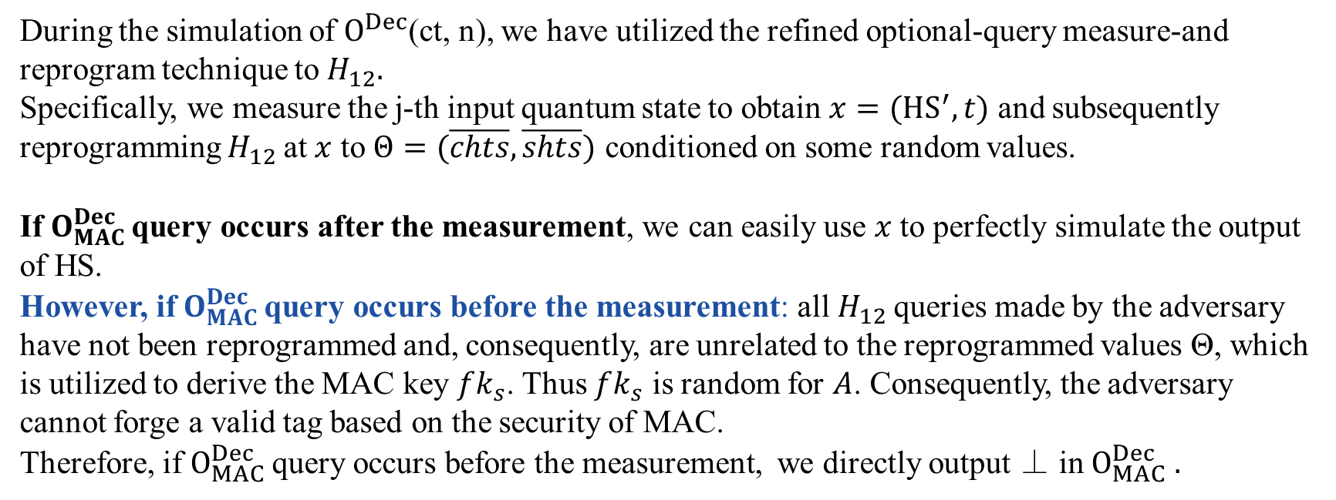
Simulating $O_{MAC}^{Dec}$ in the QROM
QROM:
During the simulation of $O^{Dec}$(ct, n), we have utilized the refined optional-query measure-and reprogram technique to $H_{12}.$
Specifically, we measure the j-th input quantum state to obtain $x=(HS^{′},t)$ and subsequently reprogramming $H_{12}$at $x$ to $Θ=(\overline{chts},\overline{shts})$ conditioned on some random values.
If $O_{MAC}^{Dec}$query occurs after the measurement, we can easily use $x$ to perfectly simulate the output of HS.
However, if $O_{MAC}^{Dec}$query occurs before the measurement: all $H_{12}$queries made by the adversary have not been reprogrammed and, consequently, are unrelated to the reprogrammed values Θ, which is utilized to derive the MAC key $fk_{s}$. Thus $fk_{s}$ is random for $A$. Consequently, the adversary cannot forge a valid tag based on the security of MAC.
Therefore, if $O_{MAC}^{Dec}$query occurs before the measurement, we directly output ⊥ in $O_{MAC}^{Dec} .$

