Slide 1


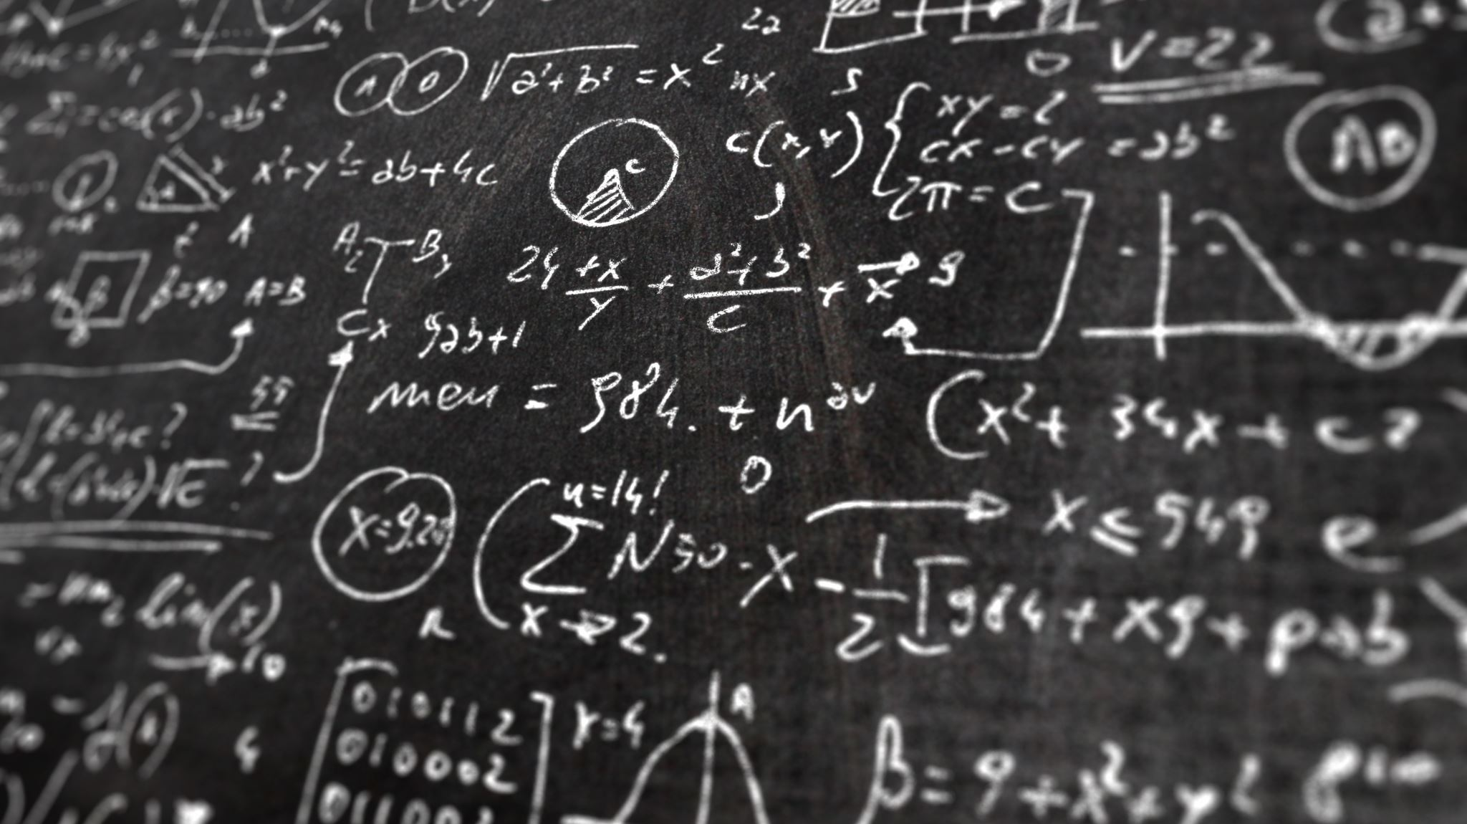
Proofs for Deep Thought:
Accumulation for Large Memories and Deterministic Computations
benedikt bünz, Jessica Chen
New York university

Slide 2
Machine computation
state_{i}
CPU
state_{i+1}
MEM

Slide 3
proving Machine computation
Proving the correctness of computations (record read/write)
+
Proving the correctness of all memory accesses
=> “Memory-proving”
state_{i}
CPU
state_{i+1}
MEM

Slide 4
Memory-proving: previous Approach
The best previous approach was Spice [SAGL18]
  1500 constraints per read/write
They used offline memory-checking [BEG+91]
  Can be built using multi-set hash functions
  Prover has small storage (a hash digest)
  hashing is expensive in circuit
    SHA256: 20k witness size
    Circuit-friendly hash like Poseidon: >200 witness size
Notes:
1500 constraints => witness for circuit is ~1500 elements

Slide 5
Memory-proving: previous Approach
The best previous approach was Spice [SAGL18]
  1500 constraints per read/write
They used offline memory checking [BEG+91]
  Can be built using multi-set hash functions
  Prover has small storage (a hash digest)
  hashing is expensive in circuit
  Can we perform memory-proving without proving hashes?
Notes:
1500 constraints => witness for circuit is ~1500 elements

Slide 6
Memory-proving: naïve approach
Unroll the entire machine into a circuit
  Circuits are used in most proof generation
Do not know a priori the bound on the total number of machine computation steps…
state_{i}
CPU
state_{i+1}
MEM

Slide 7
Memory-proving: Modern approach
Use folding/accumulation schemes
state_{i}
CPU
state_{i+1}
MEM

Slide 8
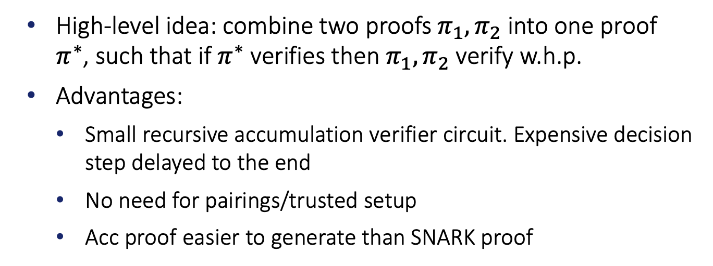
Accumulation scheme
  High-level idea: combine two proofs $π_{1},π_{2}$ into one proof $π^{∗}$, such that if $π^{∗}$ verifies then $π_{1},π_{2}$ verify w.h.p.
  Advantages:
    Small recursive accumulation verifier circuit. Expensive decision step delayed to the end
    No need for pairings/trusted setup
    Acc proof easier to generate than SNARK proof

Slide 9
Memory-proving: use accumulation
Generate one proof per state transition, then accumulate
Do not need to know a priori the bound on the number of computation steps
Can stop anytime to verify
state_{i}
CPU
state_{i+1}
MEM

Slide 10
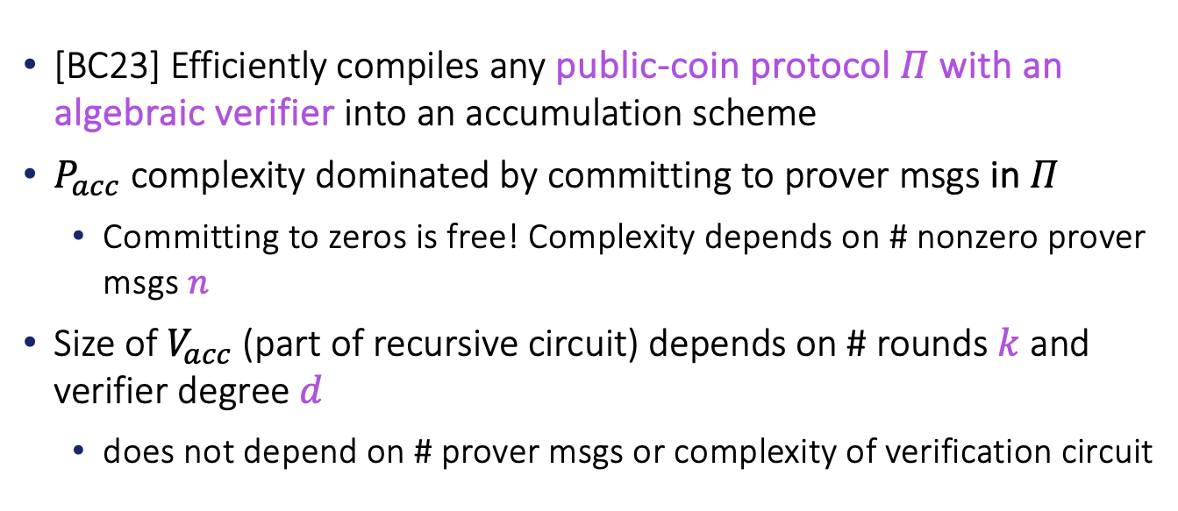
Building accumulation scheme: PROTOSTAR
[BC23] Efficiently compiles any public-coin protocol $Π$with an algebraic verifier into an accumulation scheme
$P_{acc}$ complexity dominated by committing to prover msgs in $Π$
  Committing to zeros is free! Complexity depends on # nonzero prover msgs $n$
Size of $V_{acc}$ (part of recursive circuit) depends on # rounds $k$ and verifier degree $d$
  does not depend on # prover msgs or complexity of verification circuit

Slide 11
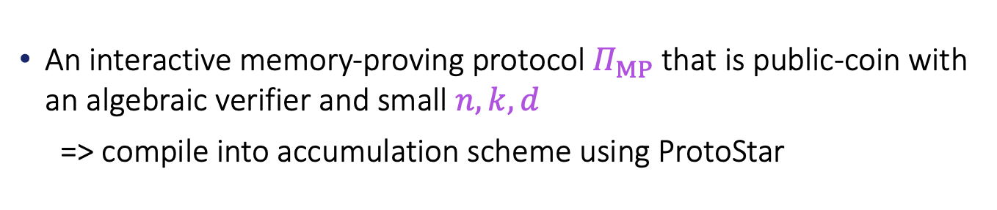
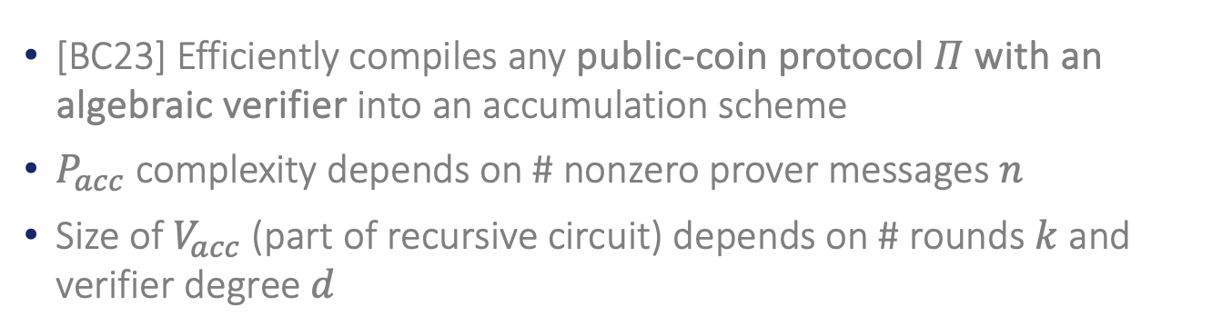
Our Goal: Accumulation for memory-proving
[BC23] Efficiently compiles any public-coin protocol $Π$with an algebraic verifier into an accumulation scheme
$P_{acc}$ complexity depends on # nonzero prover messages $n$
Size of $V_{acc}$ (part of recursive circuit) depends on # rounds $k$ and verifier degree $d$
An interactive memory-proving protocol $Π_{MP}$ that is public-coin with an algebraic verifier and small $n,k,d$
=> compile into accumulation scheme using ProtoStar

Slide 12

Research Question:
Efficient memory-proving for large memories
Can we do memory-proving without proving hashes
With the cost of $P_{acc}$ independent of memory size $T$?

Slide 13

Our Results
We designed an interactive memory-proving protocol $Π_{MP}$ that is public-coin with a low-degree algebraic verifier
The cost of the resulting $P_{acc}$ from compiling $Π_{MP}$ is independent of memory size $T$
  only commits to ~12 elements per read/write
More than 100X improvement on the previous best approach

Slide 14
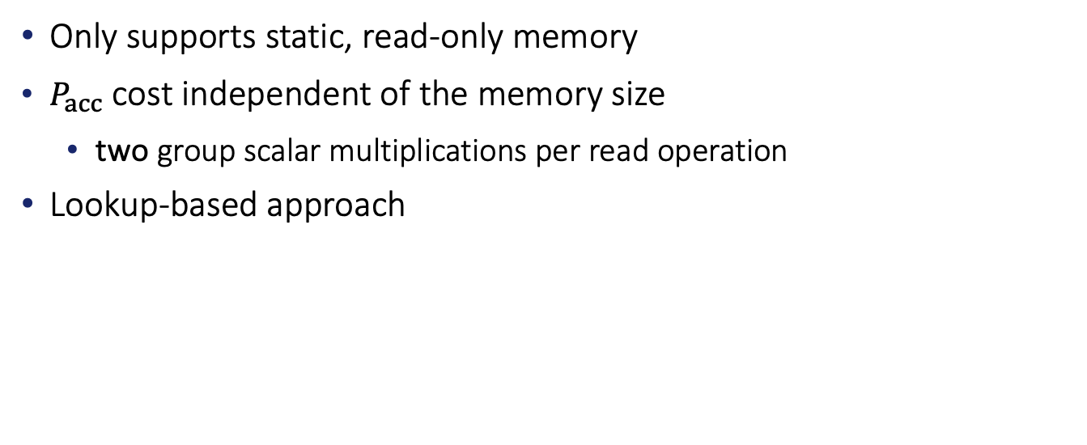
Starting Point: MEMory-proving in PROTOSTAR
Only supports static, read-only memory
$P_{acc}$ cost independent of the memory size
  two group scalar multiplications per read operation
Lookup-based approach
We extend the lookup argument to support dynamic memory

Slide 15
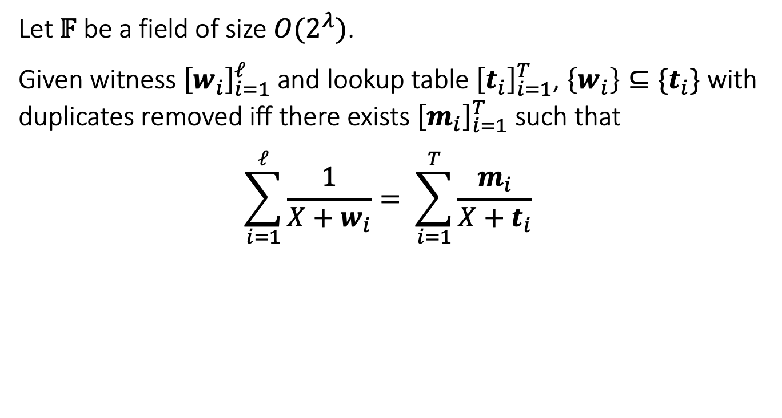
The Lookup Argument (LogUp) [Hab22]
Let $𝔽$ be a field of size $O(2^{λ})$.
Given witness ${\left[w_{i}\right]}_{i=1}^{ℓ}$and lookup table ${\left[t_{i}\right]}_{i=1}^{T}$, $\left\{w_{i}\right\}⊆\{t_{i}\}$ with duplicates removed iff there exists ${\left[m_{i}\right]}_{i=1}^{T}$ such that
$$\sum_{i=1}^{ℓ}{\frac{1}{X+w_{i}}}= \sum_{i=1}^{T}{\frac{m_{i}}{X+t_{i}}}$$

Slide 16


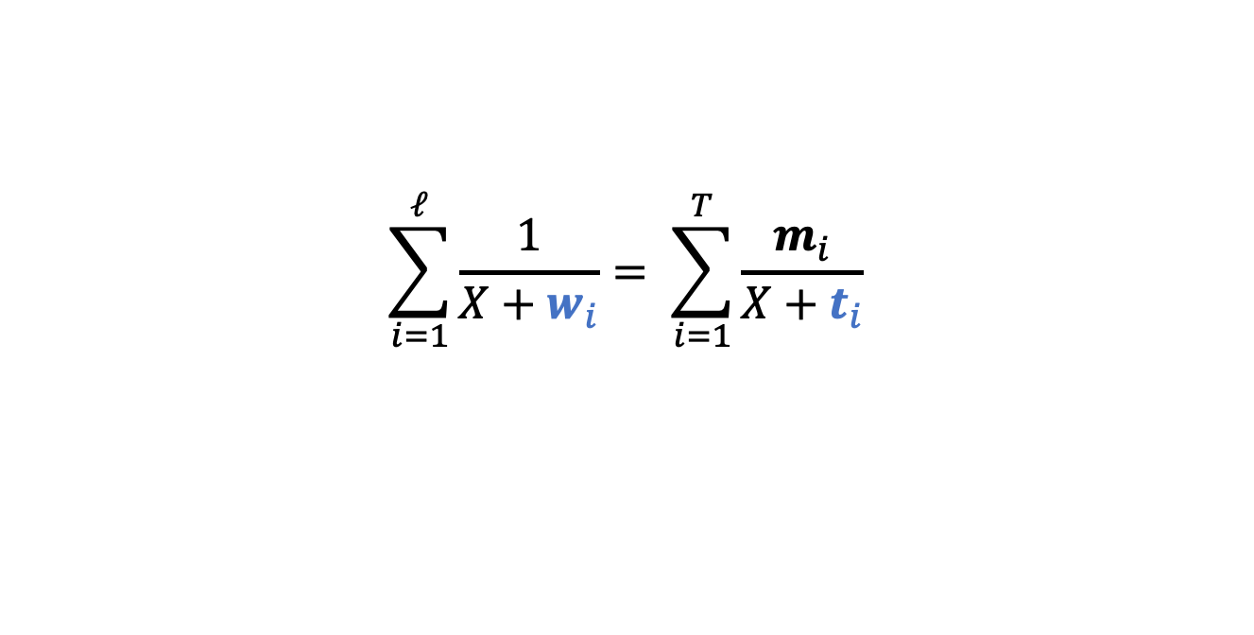

The Lookup Argument (LogUp) [Hab22]
$$\sum_{i=1}^{ℓ}{\frac{1}{X+w_{i}}}= \sum_{i=1}^{T}{\frac{m_{i}}{X+t_{i}}}$$
$$t$$
1
2
3
4
$$m$$
0
1
2
0
$$w$$
2
3
3
Sparseness!

Slide 17

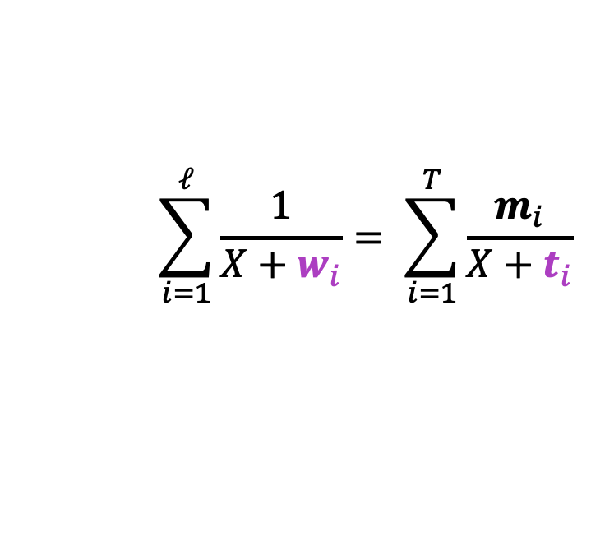


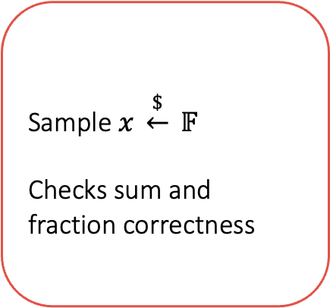

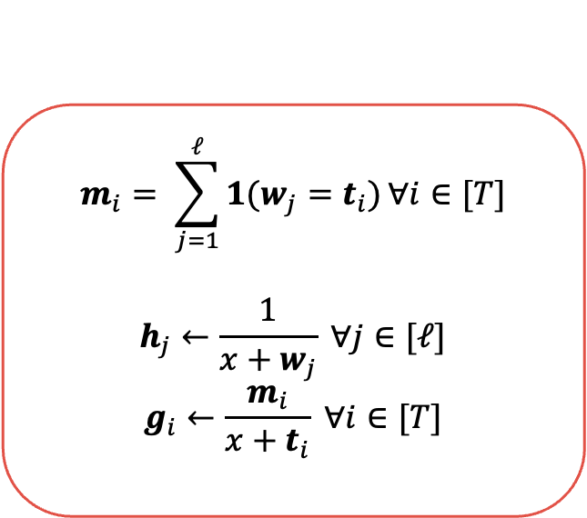

$$\sum_{i=1}^{ℓ}{\frac{1}{X+w_{i}}}= \sum_{i=1}^{T}{\frac{m_{i}}{X+t_{i}}}$$
The Lookup protocol
Vectors of witnesses
and numerators
$$P(t∈𝔽^{T}, w∈𝔽^{ℓ})$$
$$V(t∈𝔽^{T})$$
$$m_{i}= \sum_{j=1}^{ℓ}{1(w_{j}=t_{i})}∀i∈[T]$$
$$h_{j}←\frac{1}{x+w_{j}} ∀j∈[ℓ]$$
$$g_{i}←\frac{m_{i}}{x+t_{i}} ∀i∈[T]$$
Sample $x \underset{←}{\$} 𝔽$
Checks sum and fraction correctness
$$w,m$$
$$x$$
$$h,g$$
Vectors of fractions

Slide 18
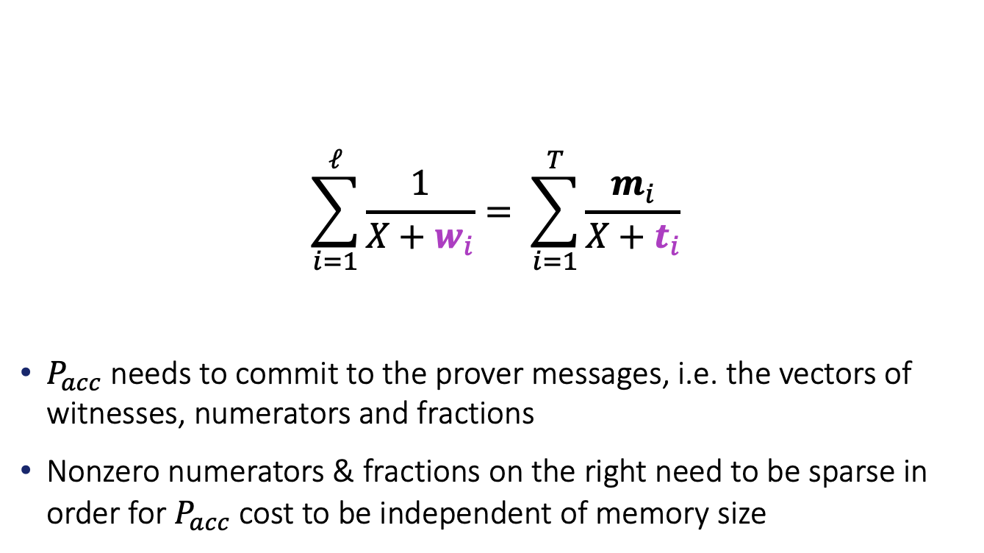
The Lookup Argument (LogUp) [Hab22]
$$\sum_{i=1}^{ℓ}{\frac{1}{X+w_{i}}}= \sum_{i=1}^{T}{\frac{m_{i}}{X+t_{i}}}$$
$P_{acc}$ needs to commit to the prover messages, i.e. the vectors of witnesses, numerators and fractions
Nonzero numerators & fractions on the right need to be sparse in order for $P_{acc}$ cost to be independent of memory size

Slide 19
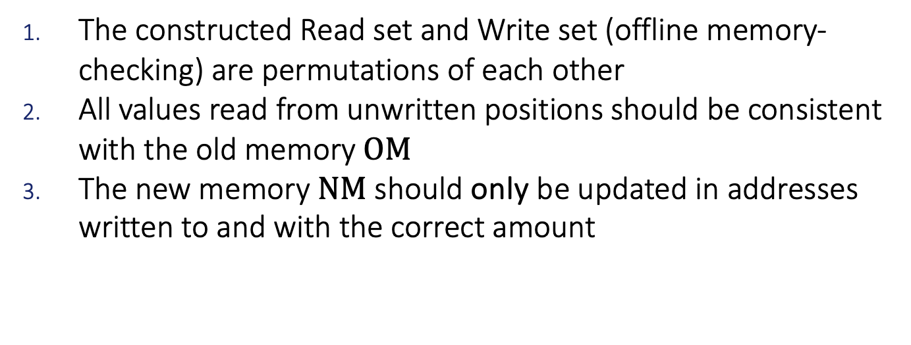
Proving dynamic memory
The constructed Read set and Write set (offline memory-checking) are permutations of each other
All values read from unwritten positions should be consistent with the old memory $OM$
The new memory $NM$ should only be updated in addresses written to and with the correct amount

Slide 20
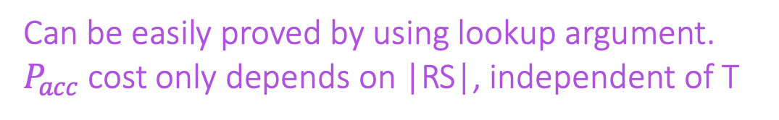
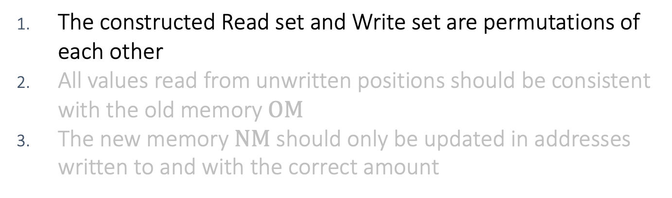
Proving dynamic memory
The constructed Read set and Write set are permutations of each other
All values read from unwritten positions should be consistent with the old memory $OM$
The new memory $NM$ should only be updated in addresses written to and with the correct amount
Can be easily proved by using lookup argument.
$P_{acc}$ cost only depends on |RS|, independent of T

Slide 21
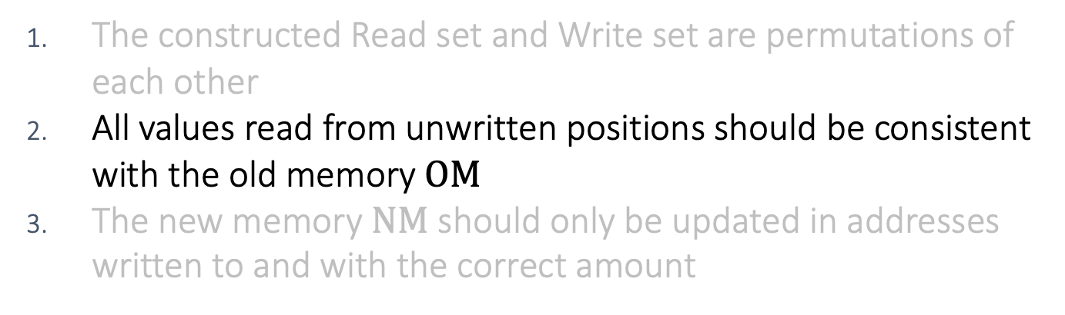
Proving dynamic memory
The constructed Read set and Write set are permutations of each other
All values read from unwritten positions should be consistent with the old memory $OM$
The new memory $NM$ should only be updated in addresses written to and with the correct amount
Extend the LogUp argument to indexed vector lookup

Slide 22
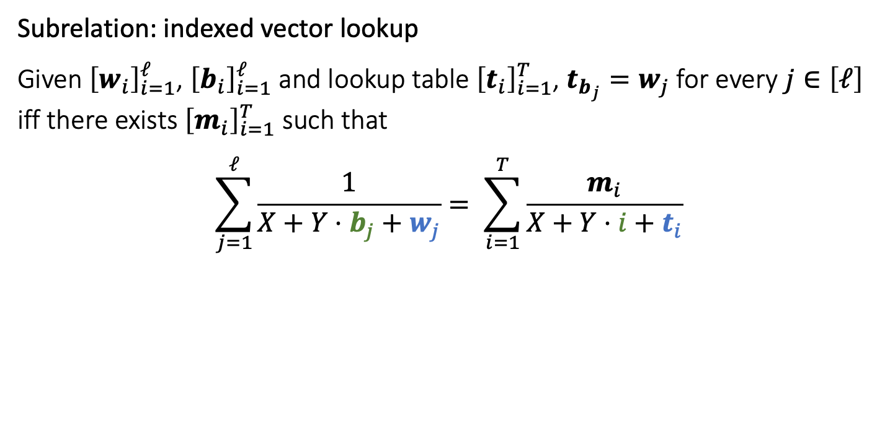
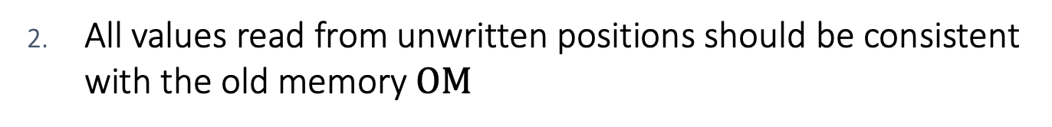
All values read from unwritten positions should be consistent with the old memory $OM$
Subrelation: indexed vector lookup
Given ${\left[w_{i}\right]}_{i=1}^{ℓ}$, ${\left[b_{i}\right]}_{i=1}^{ℓ}$and lookup table ${\left[t_{i}\right]}_{i=1}^{T}$, $t_{b_{j}}=w_{j}$ for every $j∈\left[ℓ\right]$ iff there exists ${\left[m_{i}\right]}_{i=1}^{T}$ such that
$$\sum_{j=1}^{ℓ}{\frac{1}{X+Y⋅b_{j}+w_{j}}}= \sum_{i=1}^{T}{\frac{m_{i}}{X+Y⋅i+t_{i}}}$$

Slide 23
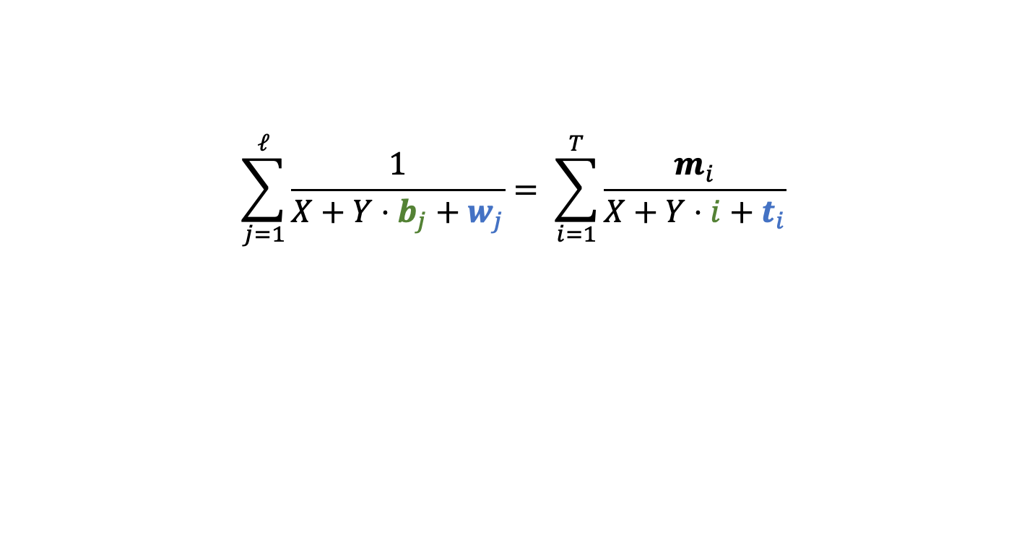

All values read from unwritten positions should be consistent with the old memory $OM$
$$\sum_{j=1}^{ℓ}{\frac{1}{X+Y⋅b_{j}+w_{j}}}= \sum_{i=1}^{T}{\frac{m_{i}}{X+Y⋅i+t_{i}}}$$

Slide 24
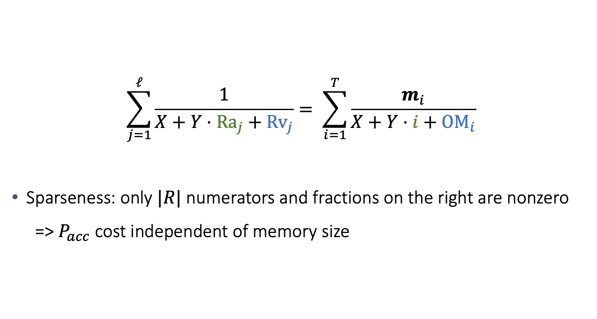
All values read from unwritten positions should be consistent with the old memory $OM$
$$\sum_{j=1}^{ℓ}{\frac{1}{X+Y⋅{Ra}_{j}+{Rv}_{j}}}= \sum_{i=1}^{T}{\frac{m_{i}}{X+Y⋅i+{OM}_{i}}}$$
Sparseness: only $|R|$ numerators and fractions on the right are nonzero
  => $P_{acc}$ cost independent of memory size

Slide 25

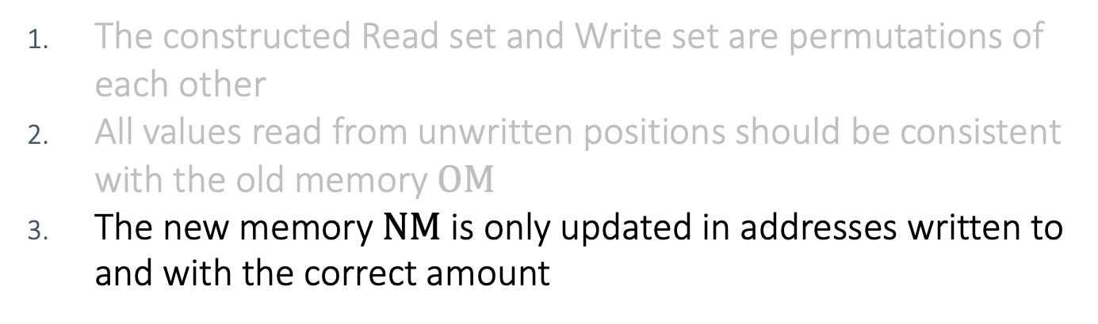
Proving dynamic memory
The constructed Read set and Write set are permutations of each other
All values read from unwritten positions should be consistent with the old memory $OM$
The new memory $NM$ is only updated in addresses written to and with the correct amount
Extend LogUp to memory update.
Use $Δ$ between final writes and initial reads.

Slide 26
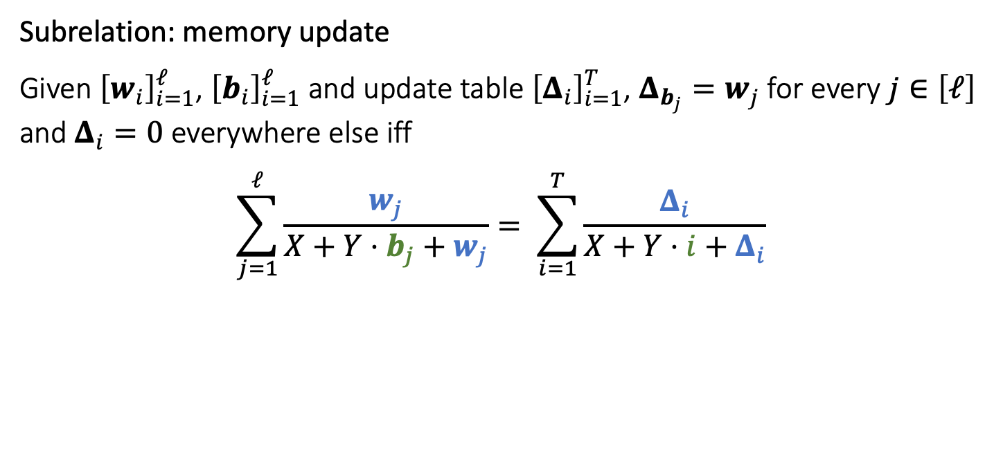

The new memory $NM$ is only updated in addresses written to and with the correct amount
Subrelation: memory update
Given ${\left[w_{i}\right]}_{i=1}^{ℓ}$, ${\left[b_{i}\right]}_{i=1}^{ℓ}$and update table ${\left[Δ_{i}\right]}_{i=1}^{T}$, $Δ_{b_{j}}=w_{j}$ for every $j∈\left[ℓ\right]$ and $Δ_{i}=0$ everywhere else iff
$$\sum_{j=1}^{ℓ}{\frac{w_{j}}{X+Y⋅b_{j}+w_{j}}}= \sum_{i=1}^{T}{\frac{Δ_{i}}{X+Y⋅i+Δ_{i}}}$$

Slide 27
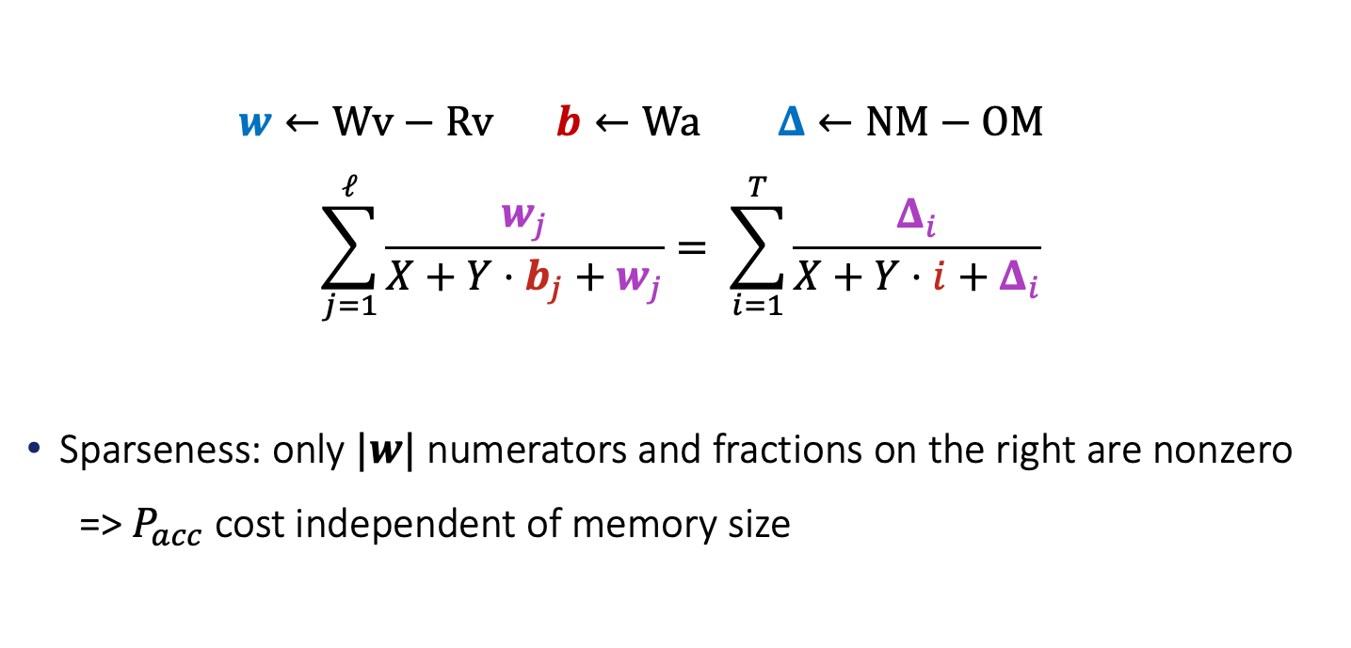

The new memory $NM$ is only updated in addresses written to and with the correct amount
$w←Wv−Rv$ $b←Wa$ $Δ←NM−OM$
$$\sum_{j=1}^{ℓ}{\frac{w_{j}}{X+Y⋅b_{j}+w_{j}}}= \sum_{i=1}^{T}{\frac{Δ_{i}}{X+Y⋅i+Δ_{i}}}$$
Sparseness: only $|w|$ numerators and fractions on the right are nonzero
  => $P_{acc}$ cost independent of memory size

Slide 28
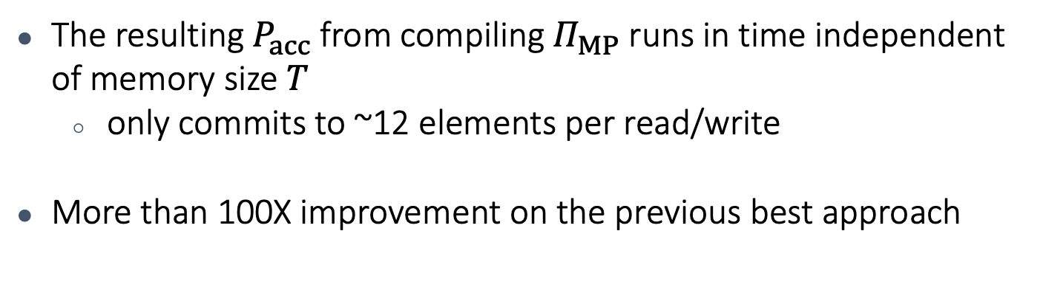
Results recap
The resulting $P_{acc}$ from compiling $Π_{MP}$ runs in time independent of memory size $T$
  only commits to ~12 elements per read/write
More than 100X improvement on the previous best approach

Slide 29
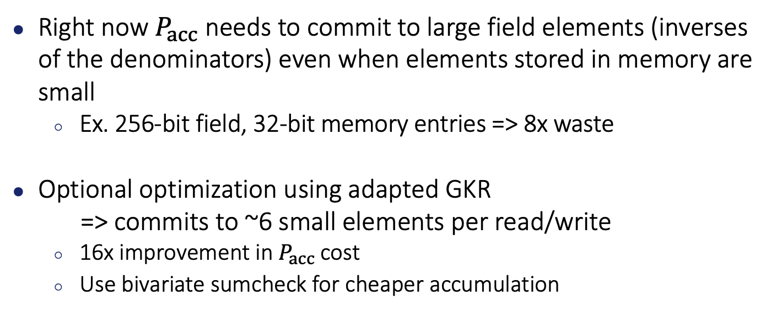
Further optimization
Right now $P_{acc}$needs to commit to large field elements (inverses of the denominators) even when elements stored in memory are small
  Ex. 256-bit field, 32-bit memory entries => 8x waste
Optional optimization using adapted GKR
=> commits to ~6 small elements per read/write
  16x improvement in $P_{acc}$cost
  Use bivariate sumcheck for cheaper accumulation

Slide 30
Other applications of GKR in accumulation
Any deterministic computation
  ideally uniform, algebraic and low depth
  Only requires committing to inputs/outputs

Slide 31

Thank you!
https://eprint.iacr.org/2024/325

