Slide 1
Generalized Hybrid Search with Applications to
Blockchain and Hash Functions Security
Alexandru Cojocaru Juan Garay Fang Song
University of Edinburgh
Texas A&M University
Portland State University
Asiacrypt 2024

Slide 2
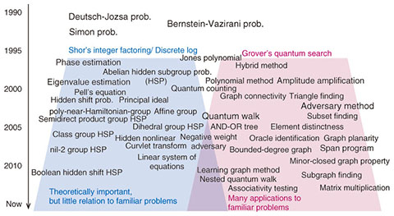
Quantum Query Algorithms
Quantum Algorithms
Numerous known algorithms are query algorithms;
Quantum and Post-Quantum Cryptography
Study query complexity of certain problems implies (post-)quantum security of cryptosystems
Allows lower bounds on # resources required solve problem
Find efficient query algorithm + circuit realize oracle $→$ efficient algorithm for explicit computational problem
Find efficient query algorithm + circuit realize oracle → efficient algorithm for explicit computational problem

Slide 3
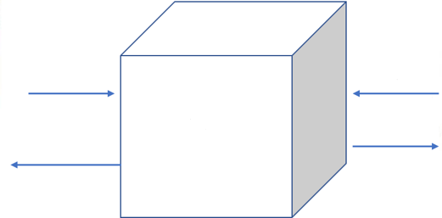
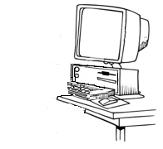
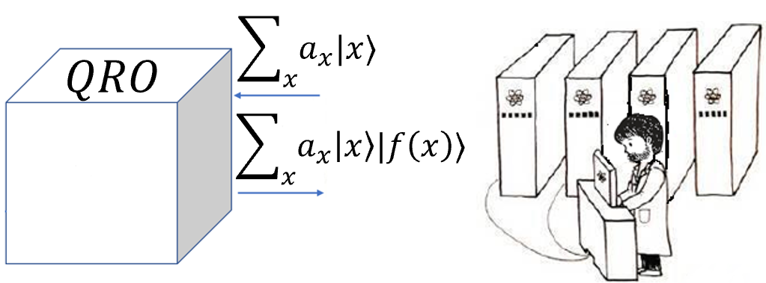
Query Model
Query Model - elegant abstraction adopted Cryptography & Complexity Theory
Random Oracle Model (ROM)
Numerous cryptosystems designed & analyzed in ROM
Cryptography & Complexity: query algorithm solves problem querying $f$
Complexity of Algorithm = # queries to $f$;
Landscape of Quantum Cryptography in query model divided in 2 categories:
(A) Study Post-Quantum Security protocols known secure in ROM:
analyze if protocol remains secure when Adv is equipped quantum superposition queries;
(B) Design New Quantum Cryptographic applications: all parties can quantumly query RO
$$RO$$
$$x$$
$$y$$
Random
black-box
function $f$
$$f(x)$$
$$f(y)$$
Quantum computing: new query model $→$ Quantum Random Oracle:
Superposition Queries to $f$ permitted
Equips quantum parties and quantum algorithms with new capabilities;
Random
black-box
function $f$

Slide 4
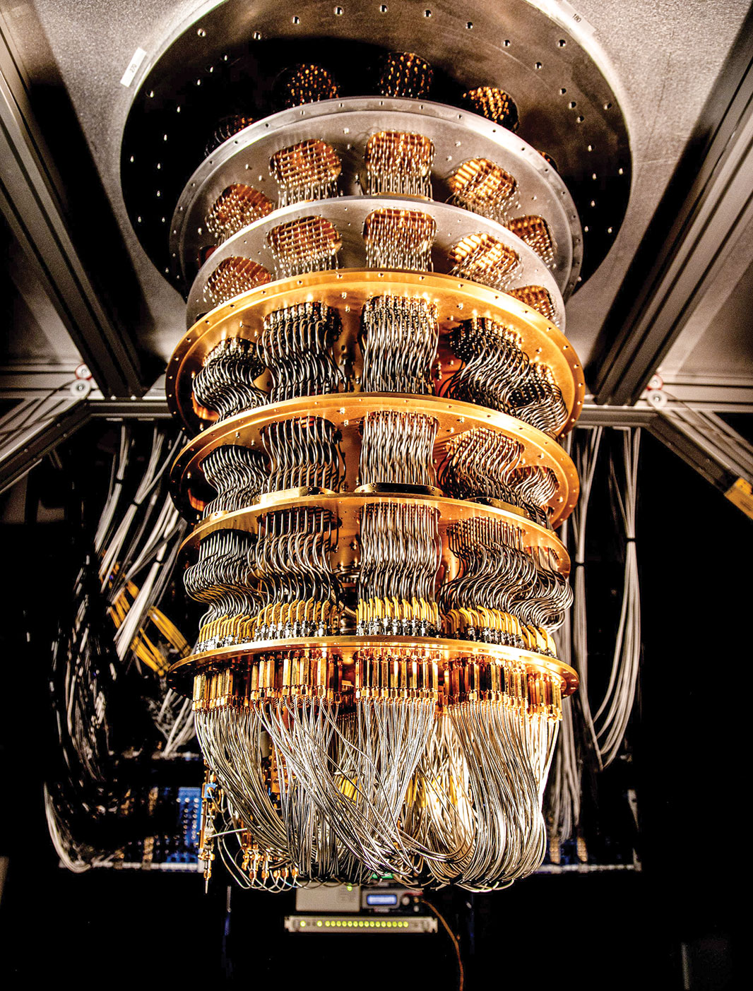
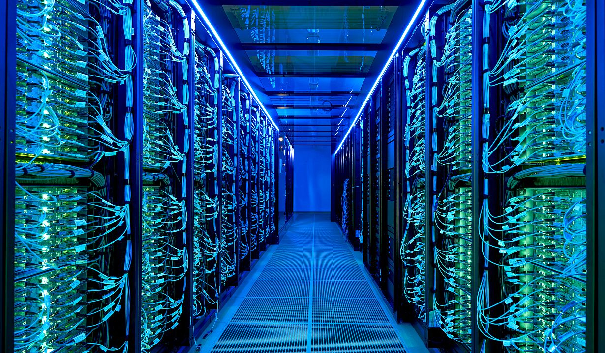
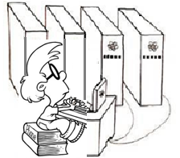
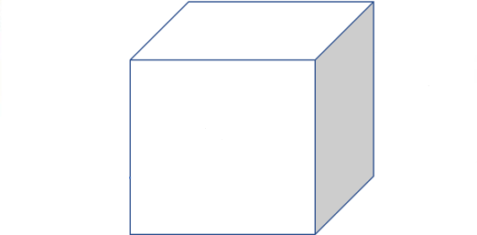
Hybrid Quantum-Classical Query Algorithms
Interest of party to supplement quantum with classical computational power.
Entities with quantum computers (e.g. big companies and government agencies) coincide with those employing high-performance computing e.g clusters and supercomputers.
Inspires hybrid query model: one is granted a quota of classical & quantum queries
model subsumes classical and quantum queries;
$c$ classical queries
$$f$$
$q$ classical queries
Notes:
Need a intro to this slide

Slide 5
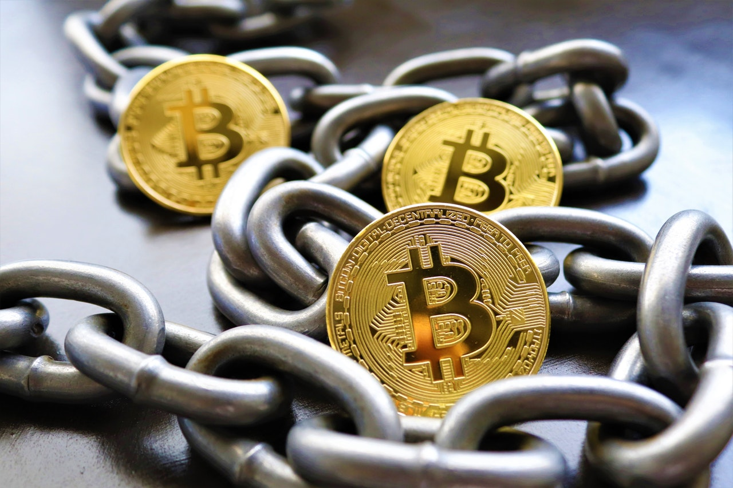
Post-Quantum Cryptography
One main implication of Query Complexity $→$ Post-Quantum Security cryptosystems
Post-Quantum Cryptography = Classical Protocols against Quantum Adversaries
Example Distributed Computing: Bitcoin
Bitcoin: first, most popular decentralized cryptocurrency.
Bitcoin backbone protocol (Garay et al) abstraction formally treat security in ROM;
Shown secure against classical adversaries;
Basis: Proof of Work (PoW) - parties prove they spent computational resources
Post-Quantum Security: Revisit security changes adversary Quantum Computers
Notes:
An important example of distributed computing protocol refers to Bitcoin…
notable

Slide 6
Hybrid Quantum-Classical Query Algorithms in Cryptography
Post-quantum security significant effort for quantum-query Adv
Maintain security need to pay efficiency overhead
e.g. more complex constructions or larger key sizes.
Threat of quantum adversaries is alarming, BUT:
Adversary needs run large-scale quantum computer coherently
Quantum devices available in near term are likely:
- Computationally restricted;
- Expensive;
Security hybrid adversary $→$ accurate security, optimized parameters depending on resources available to near-term quantum adversary.
Important study Post-Quantum Hybrid Security of Protocols
Notes:
On the other hand, ….

Slide 7
Our Goal: Hybrid Quantum-Classical Algorithms
$c$ classical queries
$$f$$
$q$ classical queries
Task: Examine hardness of various search problems by hybrid strategies
Focus: Search problems with multiple solutions where input is sampled according to a distribution $D$, establish their hybrid quantum-classical query complexities.
By choosing specific distribution for $D$ such as Bernoulli distribution useful in several cryptographic applications.
Our work extends the seminal work of Rosmanis ’22– hybrid search with unique solution and uniformly sampled; Concurrently, Hamoudi, Liu, Sinha ’22 proposed recording technique tailored to hybrid query model
– study hardness of collision finding;
Notes:
To show the post-quantum security of the bitcoin, in our work we proved that the query complexity of search problems of search problems implies.
Therefore, in order to derive the post-quantum hybrid security our next task would be to examine hardness of various
In the follow-up work we focused on search

Slide 8
Hybrid Algorithms: Cryptographic Applications
I) Generalized security of Bitcoin protocol:
from a setting where the adversary is fully quantum [CGKSW ‘23],
to setting where the adversary has both quantum and classical capabilities
Generally, security definitions often give a component of a cryptosystem as an oracle;
Long line of research focuses settling right definitions & constructions when adversaries quantum access to oracle;
Extending this to hybrid landscape offer fine-grained security assessments of post-quantum cryptosystems;
Hybrid Security: If hybrid honest majority condition is satisfied protocol is secure against $A$ with $c$ classical and $q$ quantum queries :
$$\sqrt{c}+2q≤\frac{1}{\sqrt{f\left(1 −f\right)p}}$$
$f$ = probability that one honest player generates a PoW in a single round
$p=$probability of generating a PoW using a single classical query
II) Re-examine generic security of hash f. against quantum-classical hybrid adversaries
Family of Hash functions: $$ℋ_{n}={\left\{H_{K} :X→{\left\{0,1\right\}}^{n}\right\}}_{K∈{\left\{0,1\right\}}^{k}}$$ | Classical Adversaries | Quantum Adversaries | Hybrid Adversaries
One-Wayness Second-Preimage Resistance | $$\frac{q+1}{2^{n}}$$ | $$O\left(\frac{{\left(q+1\right)}^{2}}{2^{n}}\right)$$ | $$O\left(\frac{{\left(\sqrt{c}+ q+1\right)}^{2} }{2^{n}}\right)$$
Extended-target Collision-Resistance | $$\frac{q+1}{2^{n}}+\frac{q}{2^{k}}$$ | $$O\left(\frac{{\left(q+1\right)}^{2}}{2^{n}}+\frac{q^{2}}{2^{k}}\right)$$ | $$O\left(\frac{{\left(\sqrt{c}+ q+1\right)}^{2} }{2^{n}}+\frac{{\left(\sqrt{c}+q\right)}^{2}}{2^{k}}\right)$$
Notes:
More concretely, in the follow-up work we first…

Slide 9
(I) Hardness of Distributional Search Problem
Task: Search a preimage of $1$ in an arbitrarily distributed black-box function
$ν_{D}$ - average over D fraction of preimages of 1
Notes:
Our first result is a hardness result, establishing what is the hybrid query complexity of solving the following search problem task

Slide 10
Hardness of Distributional Search Problem
Success Probability $≤ ν_{D} · {\left(2 \sqrt{τ_{c }} + 2τ_{q} + 1\right)}^{2}$, where $ν_{D}$ captures average fraction of preimages of 1 - solely det. by distribution $D$
All one need to do is analyze $ν_{D}$ - typically by simple combinatorial argument.
Example 1: Let $D$ be uniform distribution over functions with exactly 1 marked input.
$ν_{D} =\underset{f ←D}{Pr}{[f(x) = 1]} = 1/|X|$ for any $x$,
Example 2: By similar token, hardness of searching function with $w$ marked items:
$ν_{D}=\frac{w}{\left|X\right|} → \operatorname{Pr}\left[Success\right]≤\frac{w}{|X|} {\left(2\sqrt{τ_{c}} +2τ_{q}+1\right)}^{2}$
Example 3: Bernoulli distribution $D_{η}$ - each input is marked acc to Bernoulli trial: $∀x ∈ X$ set $f\left(x\right)= 1$ with probability $η$ independently.
$ν_{D}=η$ $→ \operatorname{Pr}\left[Success\right]≤η {\left(2\sqrt{τ_{c}} +2τ_{q}+1\right)}^{2}$
Notes:
Our first result is a hardness result, establishing what is the hybrid query complexity of solving the following search problem task

Slide 11
Hybrid Lower Bound Framework
To study hardness of hybrid algorithm consider instead adversary distinguishing between input function:
$f ← D$ OR
constant-$0$ function
Argue a query diverges states of algorithm in the two cases by small amount, called progress measure
In order to find marked input in $f$, final states need to differ significantly.
$→$ Sufficiently many queries necessary for cumulative progress to properly grow.
Issue: When classical queries mixed with quantum queries, quantum states collapse after each classical query - unclear how to measure progress
Notes:
Our first result is a hardness result, establishing what is the hybrid query complexity of solving the following search problem task
Transition is not great for this slide - from instantiation to hardness result

Slide 12
Hybrid Lower Bound Framework
$$|x⟩$$
$$|x⟩$$
$$|x⟩$$
$$|x⟩$$
$$|x⟩$$
$$|x⟩$$
Quantum
Pseudo-Classical
Classical
$$|b⟩$$
$$|b⊕f(x)⟩$$
$$|0⟩$$
$$|f(x)⟩$$
$$|0⟩$$
$$|f(x)⟩$$
Consider instead intermediate oracle pseudo-classical.
Let quantum query with output register initialized |0⟩: $\sum_{x}{a_{x}}|x⟩|0⟩ →\sum_{x}{a_{x}}|x⟩|f(x)⟩$
View classical query as result of measuring input register collapsing to $x$ and receiving $f(x)$
A pseudo-classical oracle measures output register resulting in one of two outcomes:
$\sum_{x:f\left(x\right)=0}{a_{x}}|x⟩|0⟩$ (0-outcome branch) OR
$\sum_{x:f\left(x\right)=1}{a_{x}}|x⟩|1⟩$ (the 1-outcome branch).
Track progress between:
$0$-outcome branch in case of $f ← D$ AND
state in case of constant-$0$ function (always stays in $0$-outcome branch).
Algorithm fails if its state stays in $0$-outcome branch and is close to state in constant-0 case.
Notes:
Our first result is a hardness result, establishing what is the hybrid query complexity of solving the following search problem task

Slide 13
(II) Hybrid Algorithm Design & Analysis
Construct Hybrid Search algorithm and analyze probability of success;
Algorithm Idea: First spends all classical queries, then runs “modified Grover”;
Analyze success probability for arbitrary $D$ and show optimality for special cases: e.g. uniform and Bernoulli distributions;
Show optimality of our hybrid algorithm ($c$ classical and $q$ quantum queries) for:
$D =$Uniform
$Pr⁡[Hybrid Success] =θ\left(\frac{1}{m}\left(c +q^{2}\right)\right)$
$D =$Bernoulli
$Pr⁡[Hybrid Success] =θ \left(η \left(c +q^{2}\right)\right)$
Notes:
Our second main result is a positive result, focusing on the design of a hybrid algorithm for this search task.

Slide 14
(II) Hybrid Algorithm Design & Analysis
Goal: Construct Hybrid Search algorithm and analyze probability of success;
Quantum search algorithm - tailored to prior knowledge on distribution $D$
Adaptation Grover’s algorithm
For any $x∈X$ let:
$ω(x) = \sum_{f}{D(f)}·f(x)$
Likelihood that $f(x)$ is assigned to $1$ under $D$
Average fraction of preimages $ν_{D} =\max_{x}{ω(x)}$
Main distinction from standard Grover: amplitudes in initial state are proportional to weights $ω(x)$ rather than uniform superposition.
Remark: Hybrid Algorithm needs to compute $ω(x)$ from description of $D$ and quantum alg implements unitary dependent on $ω(x)$ $→$ Algorithm needs not be time efficient.
Notes:
Our second main result is a positive result, focusing on the design of a hybrid algorithm for this search task.

Slide 15
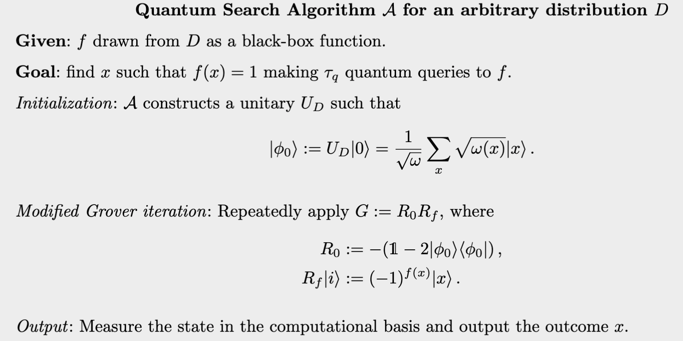
Quantum Algorithm Distributional Search
Likelihood that $f(x)$
is assigned to $1$ under $D$
Once $U_{D}$ is available $R_{0} = −U_{D} \left(1 − | 0\right\rangle ⟨0|)U_{D}^{†}$can be implemented
One application of $R_{f}$ can be realized by one query to $f$
11

Slide 16
Quantum Hybrid for Distributional Search
Idea: Given distribution $D$, let $S = \left\{x_{1}, …, x_{c} \right\}$ set of inputs with largest likelihoods
Algorithm first issues $c$ classical queries on $S$
If no solution found, run quantum alg, but on reduced search space $X − S$
Invoke previous quantum algorithm in modular way
$\operatorname{Pr}\left[Hybrid Success\right]≥\frac{1}{2} (\operatorname{Pr}\left[Classical Success\right]$ + $\operatorname{Pr}\left[Quantum Success\right])$
12

Slide 17
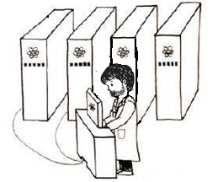
Future Directions
Show optimality of Classical Alg query inputs with highest likelihood and optimality of Hybrid Alg;
2. Find problems on which the Hybrid Success is not just Classical + Quantum;
3. Generally: Analyze post-quantum hybrid security of digital signatures, encryptions, commitments;
Thank You!

Slide 18
Hybrid Lower Bound: Query Operators
$$|x⟩$$
$$|x⟩$$
$$|x⟩$$
$$|x⟩$$
$$|x⟩$$
$$|x⟩$$
Quantum
Pseudo-Classical
Classical
$$|b⟩$$
$$|b⊕f(x)⟩$$
$$|0⟩$$
$$|f(x)⟩$$
$$|0⟩$$
$$|f(x)⟩$$
Pseudo-Classical Oracle: $P_{f, b}=\sum_{x :f\left(x\right)=b}{\left|x\right\rangle \left\langle x\right|⊗I⊗|b⟩}$
$P_{f, 0}$, $P_{f, 1}$correspond to the two possible measurement outcomes
Projectors $Π_{f} ≔\sum_{x :f\left(x\right)=1}{|x⟩⟨x|}$ on space spanned by preimages of $1$ and $Π_{f}^{⊥} ≔I −Π_{f}$
Average fraction of preimages of $1$ defined as:
$ν_{D} ≔{\sup_{φ :\left|\left|φ\right|\right|≤1 }{𝔼}}_{f←D}{\left|Π_{f} φ\right|}^{2}$
Recall Probability of Success: $\operatorname{Pr}\left[Success\right]≤ν_{D}⋅{\left(2 \sqrt{τ_{c}}+2 τ_{q}+1\right)}^{2}$
Failure probability after $t$ queries expressed as:
$δ_{f}≥{\left|Π_{f}^{⊥}ψ_{f}^{t}\right|}^{2}$ - $ψ_{f}^{t} =$ state of algorithm after $t$ queries
Goal: Lower bound ${\left|Π_{f}^{⊥}ψ_{f}^{t}\right|}^{2}$
Notes:
Our first result is a hardness result, establishing what is the hybrid query complexity of solving the following search problem task

Slide 19
Hybrid Lower Bound: State of Algorithm
When running hybrid algorithm on $f$ keep track of (sub-normalized) pure state $ψ_{f}^{t}$
$ψ_{f}^{t}$= state of algorithm on input $f$ after t queries in situation where every pseudo-classical query measures $0$ (0-branch)
Arbitrary Algorithm $τ$ queries ($τ_{q}$ quantum, $τ_{c}$ pseudo-classical) specified by unitaries: $(U^{0}, U^{1}, . . . , U^{τ})$.
Then $ψ_{f}^{t}$ is defined recursively by:
Consider running same algorithm but with null function: $f_{0}\left(x\right)=0 ∀ x$
Quantum query applies identity: $Q_{0}=I$
Pseudo-classical just appends $|0⟩$: $P_{0}=I⊗|0⟩$
State of the algorithm can be described by: $φ^{t}$
Progress Measures:
$A_{f}^{t} ≔{\left|\left\langle φ^{t}, ψ_{f}^{t}\right\rangle \right|}^{2}$ , $B_{f}^{t} ≔{{\left|ψ_{f}^{t}\right|}^{2}− \left|\left\langle φ^{t}, ψ_{f}^{t}\right\rangle \right|}^{2}$
$$ψ_{f}^{t}= \left\{\begin{aligned}U^{t} P_{f, 0} ψ_{f}^{t −1} , if t pseudo−classical \\ U^{t}Q_{f}ψ_{f}^{t −1}, if t quantum \end{aligned}\right.$$
$$φ^{t}= \left\{\begin{aligned}U^{t} P_{f_{0}, 0} φ^{t −1}, if t pseudo−classical \\ U^{t}φ^{t −1}, if t quantum \end{aligned}\right.$$
Notes:
Our first result is a hardness result, establishing what is the hybrid query complexity of solving the following search problem task

Slide 20
Hybrid Lower Bound: Putting Pieces Together
Proof Path
1. Show progress measures $A_{f}^{t}$ - $B_{f}^{t}$ lower bounds failure probability
$\operatorname{Pr}\left[Fail\right]≥A_{f}^{t }−{\left|Π_{f} ψ_{f}^{t}\right|}^{2} −2 \left|Π_{f} ψ_{f}^{t}\right|⋅\sqrt{B_{f}^{t}}$
As a result algorithm’s objective is to reduce $A_{f}^{t}$ and increase $B_{f}^{t}$
2. Limit how much progress measures $A$ and $B$ change after$τ$ queries
Analyzing effect of each quantum and pseudo-classical query
$A^{τ}≥1 −4 ν_{D}⋅{\left(\sqrt{τ_{c}}+τ_{q}\right)}^{2} and B^{τ}≤ ν_{D}⋅{\left(\sqrt{τ_{c}}+2τ_{q}\right)}^{2}$
3. Show that:
a) Quantum Query reduce $A$ by at most $4\sqrt{ν_{D}⋅B}$ and increase $B$ by same amount
b) Pseudo-classical query increase $B$ by at most $ν_{D}$, while part $z$ of it can be spent to decrease $A$ by $\sqrt{ν_{D}⋅z}$
If $t+1$ pseudo-classical $∃ z_{f}^{t}∈\left[0, B_{f}^{t}\right]$ :
$\left\{\begin{aligned}A_{f}^{t+1 }≥A_{f}^{t} −2 \sqrt{{ν_{D}⋅z}_{f}^{t}} \\ B_{f}^{t+1}≤B_{f}^{t}+ν_{D}\end{aligned}\right.$
If $t+1$ quantum :
$\left\{\begin{aligned}A_{f}^{t+1 }≥A_{f}^{t} −4 \sqrt{{ν_{D}⋅B}_{f}^{t}} \\ B_{f}^{t+1}≤B_{f}^{t}+4 \sqrt{{ν_{D}⋅B}_{f}^{t}}\end{aligned}\right.$
c) Intend to lower bound $A^{τ}$ and upper bound $B^{τ}$
Change the inequalities to equalities
Bound new sequences: reveals also intuition
on optimal hybrid algorithms
Notes:
Our first result is a hardness result, establishing what is the hybrid query complexity of solving the following search problem task

