Slide 1
One More Unforgeability for Multi- and Threshold Signatures
Sela Navot & Stefano Tessaro
University of Washington

Slide 2
Introduction
Often strongly unforgeable
Multi- and Threshold Signatures: protocols to generate digital signatures distributively.
Example: MuSig, MuSig2, FROST, and ROAST generate Schnorr signatures.
Does strong unforgeability carry over to the MS / TS schemes?
Strongly unforgeable
Not always.
Because of interactive signing.
Corrupted signers.

Slide 3
Motivation
NIST / IETF standardization efforts.
“[…] with EdDSA being SUF in the conventional setting, it is useful that a threshold scheme interchangeable w.r.t. EdDSA considers a threshold notion of SUF within the claimed corruption threshold.” [NIST, 2022]
Paraphrased: TS schemes that generate SUF signatures should be SUF.
Usage in Bitcoin and blockchain ecosystems.
History of attacks abusing non-SUF signature schemes.
Can multi-signatures introduce such vulnerabilities?

Slide 4
Our work: What is strong unforgeability for multi- and threshold signatures?

Slide 5
Talk Outline
Review: existential and strong unforgeability
Multi-Signatures
Case studies
Defining strong unforgeability
Results
Threshold Signatures

Slide 6
Existential Unforgeability of Plain Signatures
$$vk$$
Adversary $𝒜$ is given a target $vk$.
$𝒜$ queries a signing oracle for adaptively chosen messages.
$𝒜$ outputs a signature $σ$ for a message $m$.
$$m_{1}$$
$$σ_{1}$$
$$m_{k}$$
$$σ_{k}$$
$$(m,σ)$$
$𝒜$ wins if $σ$ is valid for $m$ under $vk$, and $m∉\{m_{1},…,m_{k}\}$.
Definition: EUF-CMA Security $⟺$ No efficient adversary wins with non-neg. probability.

Slide 7
Strong Unforgeability of Plain Signatures
$$vk$$
Adversary $𝒜$ is given a target $vk$.
$𝒜$ queries a signing oracle for adaptively chosen messages.
$𝒜$ outputs a signature $σ$ for a message $m$.
$$m_{1}$$
$$σ_{1}$$
$$m_{k}$$
$$σ_{k}$$
$$(m,σ)$$
$𝒜$ wins if $σ$ is valid for $m$ under $vk$, and $m∉\{m_{1},…,m_{k}\}$.
$(m,σ)∉\{{(m_{1},σ}_{1}),…,({m_{k}, σ}_{k})\}$.

Slide 8
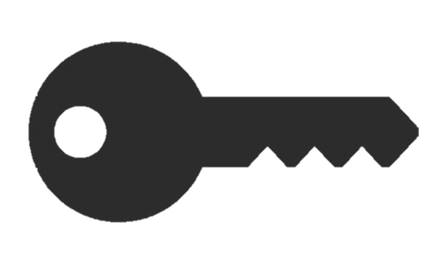
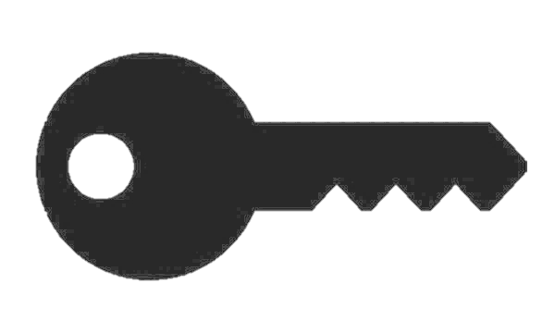
Now: Multi-Signatures
Setting: $n$ signers, each with their own secret and public key.
A multi-signature attests that each signer agreed to sign this message with this group of signers.

Slide 9
Multi-Signatures
Signers generate their own keys
Signing typically involves an interactive, multi-round protocol.
Verified w.r.t a (short) aggregate verification key.
Threat model: adversary with corrupt signers, controls communication
$\tilde{vk}←Agg($ , , $)$

Slide 10
Case Study: HBMS Multi-Signatures (Bellare & Dai, 2021)
Signing: an interactive 2-round protocol
HBMS multi-signatures:
A tuple $(T,s,z)$ satisfying
$g^{z}h^{s}=T⋅{\tilde{vk}}^{H\left(T, \tilde{vk}, m\right)}$,
where $h=H(m,pk_{1},…,pk_{n})$.
$$pk_{2}=g^{sk_{2}}$$
These are strongly unforgeable plain signatures!
$$pk_{3}=g^{sk_{3}}$$
$$pk_{1}=g^{sk_{1}}$$
$$\tilde{vk}←\prod_{i=1}^{n}{pk_{i}^{H(i, pk_{1}, …, pk_{n})}}$$
Existentially unforgeable as a MS scheme
(DL assumption in the ROM)

Slide 11
HBMS: Continued
(Using the “ROS attack” of Benhamouda et al., 2021; see our paper for attack details)
An adversary with 1 colluding signer can:
Start $ℓ≥log⁡(\left|𝔾\right|)$concurrent signing sessions for a message $m$.
Obtain $ℓ$ legitimate multi-signatures for $m$.
Forge another multi-signature for $m$.
Breaks the notion of strong unforgeability.

Slide 12
HBMS: Summary
Produces strongly unforgeable plain signatures.
Existentially unforgeable multi-signature scheme.
Not a strongly unforgeable multi-signature scheme.

Slide 13
In Contrast: MuSig & MuSig2 (Maxwell et al. 2019) & (Nick et al., 2021)
Resist the attack against HBMS.
Appear to satisfy a notion of strong unforgeability.
To prove that, we need to define SUF for multi-signatures.

Slide 14
Unforgeability of Multi-Signatures
Threat Model: $𝒜$ controls all but one signer.
Game Definition: $𝒜$ is given an honest signer’s $pk$, signing oracle access.
$$pk$$
Sign $m_{1}$ with $(pk_{1}^{1},…,pk_{n_{1}}^{1})$
Signature share
Sign $m_{k}$ with $(pk_{1}^{k},…,pk_{n_{k}}^{k})$
Signature share
Note: sessions can happen concurrently!
$$(m,σ,(pk_{1},…,pk_{n}))$$
Adversary’s Goal: Forge a multi-signature.

Slide 15
Unforgeability of Multi-Signatures
$$pk$$
$$(m,σ,(pk_{1},…,pk_{n}))$$
To win: $pk∈\left(pk_{1},…,pk_{n}\right)$ & $σ$ is non-trivial.
“Non-trivial” Definition:
For EUF: Signing oracle didn’t sign $m$ with this group of signers.
Idea for SUF: The signing oracle did not produce $σ$.
But the signing oracle outputs signature shares, not multi-signatures!
No well-defined mapping of signature shares to multi-signatures.

Slide 16
Strong Unforgeability for plain signatures: Alternative Notion
Previously: $𝒜$ can’t obtain a valid signature that is not a signing oracle response.
Alternatively: One-More Unforgeability
$𝒜$ can’t obtain $ℓ+1$ signatures for $m$ after $ℓ$ signing queries for $m$.
$$vk$$
$$m_{1}$$
$$σ_{1}$$
$$m_{k}$$
$$σ_{k}$$
$$(m,σ_{1}^{′},…,σ_{ℓ+1}^{′})$$
With some caveats, the notions are equivalent for plain signatures.
(For equivalence: $𝒜$ can’t obtain $ℓ+1$ signatures for $m$ after $ℓ$ distinct signing oracle responses on queries for $m$.)

Slide 17
SUF for Multi-Signatures via One more unforgeability
$$pk$$
Idea: after $ℓ$ signing sessions for $m$, $𝒜$ can obtain $≤ℓ$ multi-signatures for $m$.
Game:
$𝒜$ outputs:
$ℓ+1$ signatures
message $m$
a group of signers containing $pk$
Winning Condition:
All signatures are valid and distinct.
Signing oracle completed $≤ℓ$ sessions for $m$ with this group of signers.
$$(m,(σ_{1},…,σ_{ℓ+1}),(pk_{1},…,pk_{n}))$$

Slide 18
Multi-Signatures: Results
Scheme | OMUF? | Notes
HBMS (Bellare & Dai, 2021) | No
mBCJ (Drijvers et al., 2021) | No | Not OMUF in the model where it was proved existentially unforgeable. Not EUF in our model.
MuSig (Maxwell et al. 2019) | Yes
MuSig2 (Nick et al., 2021) | Yes
HBMS and mBCJ: OMUF is broken in poly-time using an ROS attack (Benhamouda et al. 2021).
MuSig and MuSig2: OMUF proof is nearly identical to existential unforgeability proof.

Slide 19
Now: Threshold-Signatures
Setting: A secret key is secret-shared among $n$ signers (using Distributed Key Generation protocol or a trusted dealer)
$$sk_{1}$$
$$sk_{2}$$
$$sk_{3}$$
$$m$$
Signing Protocol
Signature
Any subset $t$ or more signers can produce a signature via an interactive protocol.
Note: The verification key is independent on the signing subset.

Slide 20
Unforgeability of Threshold Signatures
Many existential unforgeability definitions, some complexities.
More than one honest signers
Static vs. adaptive security
DKG vs. idealized key generation
Strong Unforgeability?
Bellare et al. (2022) define SUF for a limited class of FROST-like schemes.
Can we define strong unforgeability in a more generic way?
One-More Unforgeability!

Slide 21
Threshold Signatures: Results
When restricted to schemes where the existing SUF definition applies:
SUF of Bellare et al. (Crypto 2022)
Implies
Our main OMUF definition
Not implies
Consequently, FROST (Komlo & Goldberg, 2020) satisfies one-more unforgeability.
ROAST (Ruffing et al., 2022) does not satisfy one-more unforgeability.

Slide 22
Summary
MS / TS schemes that generate strongly unforgeable plain signatures are not always strongly unforgeable.
One-More Unforgeability is a useful way to model strong unforgeability.
Thank You!
Full paper: https://eprint.iacr.org/2024/1947

