Slide 1

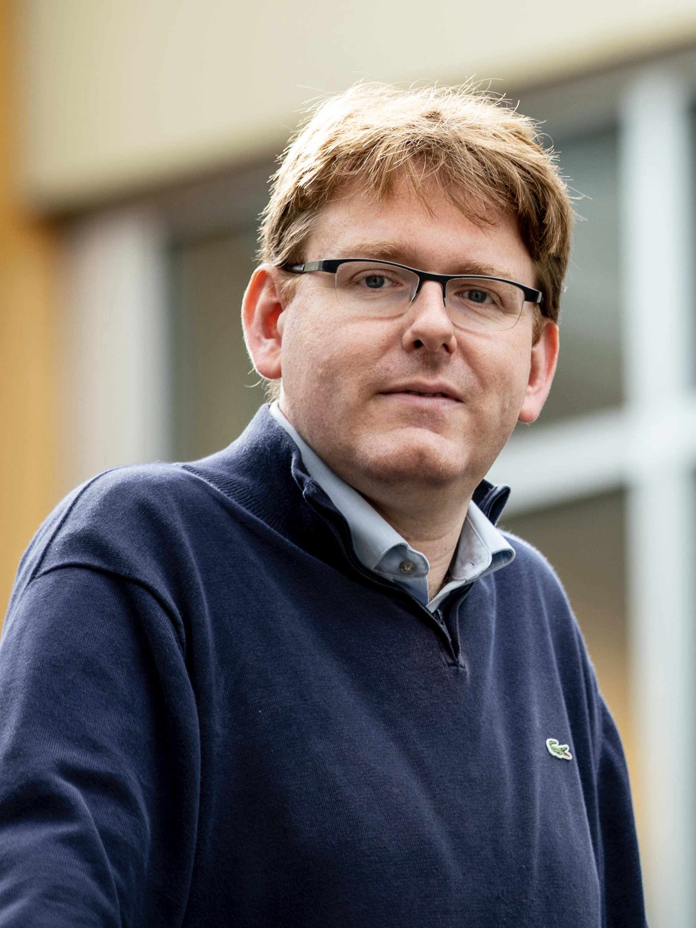

Partially Non-Interactive Two-Round Lattice-Based Threshold Signatures
Rutchathon (Champ)
Chairattana-Apirom
Stefano
Tessaro
Chenzhi
Zhu

Slide 2




















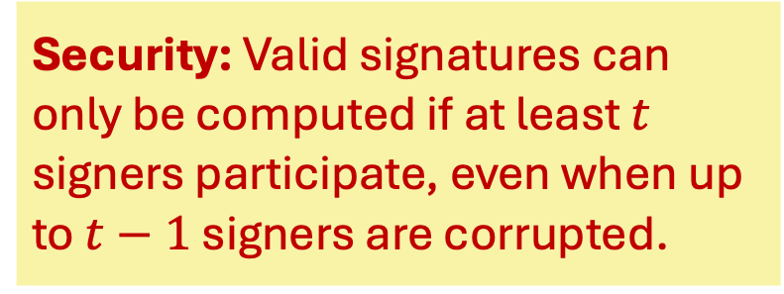
Threshold Signatures
Avoid single point failure
Multi-round protocol
NIST & IETF
Standardizations
Crypto Wallet
$$sk_{1}$$
$$m$$
$$pk, m$$
$KGen(1^{λ},t, n)$
$$σ$$
$$sk_{2}$$
$$Ver\left(pk,m,σ\right)=1$$
User
Security: Valid signatures can only be computed if at least $t$ signers participate, even when up to $t−1$ signers are corrupted.
$$⋮$$
$$⋮$$
$$pk$$
Subset of $≥t$signers
$$sk_{n}$$
This work: Static corruption
Notes:
Let’s start with threshold signatures. In this setting, we have a key generation algorithm which generates a public key and secret key shares for each of the n signers.
Then, a user can request a signature of its message by asking a subset of at least t signers to jointly participate in a signing protocol.
For security, we want to ensure that no malicious adversary who can corrupt up to t-1 signers can output a valid signature unless at least t signers (honest and corrupted combined) participate in the signing protocol.
Note that, in this work, we only care about adversaries who statically corrupt the signers.
The motivation for using threshold signatures is to avoid single point failure.
Moreover, there has been recent interest including standardization efforts by NIST and IETF and deployments in blockchains and cryptocurrency wallets.

Slide 3
What do we know about threshold signatures?
Well-studied from non-post-quantum assumptions
Post-quantum assumptions? Not so much
This talk: Lattice-based Threshold Signatures.
Notes:
Now, what do we know about threshold signatures?
From non-post-quantum assumptions, the primitive is very well-studied, and there are various efficient schemes with several properties.
From post-quantum assumptions, however, we don’t have many schemes proposed, and in this talk, we will discuss lattice-based schemes.

Slide 4
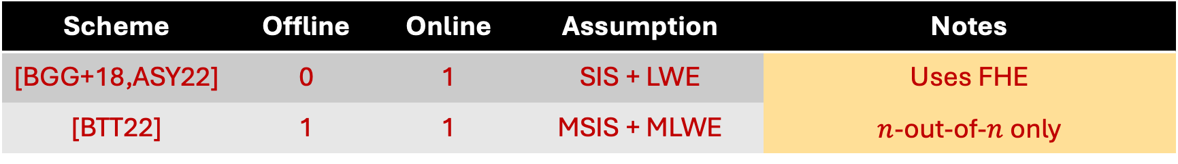
Prior Lattice-based Schemes
Scheme | Offline | Online | Assumption | Notes
[BGG+18,ASY22] | 0 | 1 | SIS + LWE | Uses FHE
[BTT22] | 1 | 1 | MSIS + MLWE | $n$-out-of-$n$ only
Partially non-interactive
Message Independent Round
Message Dependent Round
Can be preprocessed!!
Notes:
One of the first schemes gives solutions from threshold FHE. There is also a more efficient scheme that only support n-out-of-n threshold signing.
I note that this n-out-of-n scheme, although not round-optimal, is partially non-interactive, in that the signing protocol can be split into a message-independent and message-dependent round, where the former can be preprocessed. This is still better than having two online rounds.

Slide 5
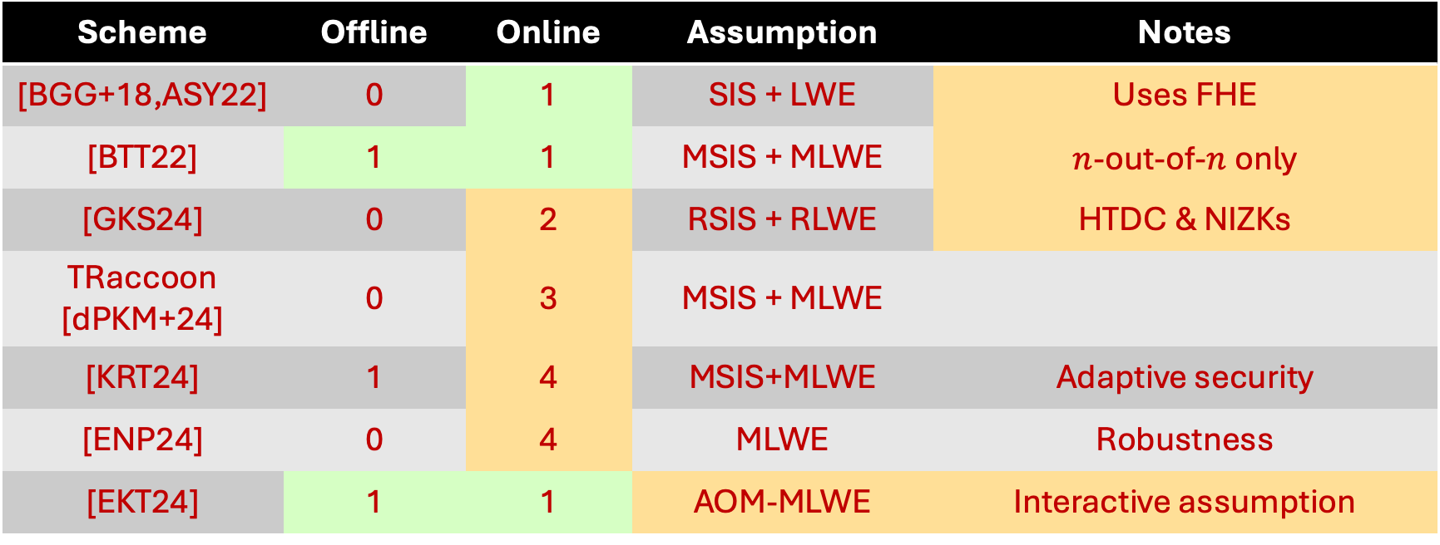
Prior Lattice-based Schemes
Scheme | Offline | Online | Assumption | Notes
[BGG+18,ASY22] | 0 | 1 | SIS + LWE | Uses FHE
[BTT22] | 1 | 1 | MSIS + MLWE | $n$-out-of-$n$ only
[GKS24] | 0 | 2 | RSIS + RLWE | HTDC & NIZKs
TRaccoon [dPKM+24] | 0 | 3 | MSIS + MLWE
[KRT24] | 1 | 4 | MSIS+MLWE | Adaptive security
[ENP24] | 0 | 4 | MLWE | Robustness
[EKT24] | 1 | 1 | AOM-MLWE | Interactive assumption
Our goal: Construct partially non-interactive threshold signatures from standard lattice assumptions and avoid heavy cryptographic primitives.
Notes:
Fast forwarding to this year, there has been a number of schemes proposed for any t-out-of-n threshold signing. Some of these schemes also have features such as robustness, security against adaptive corruptions, and/or being partially non-interactive.
Still, as we can see from the table that these schemes either have high round complexity, use FHE or trapdoor commitments, or rely on a non-standard assumption.
Hence, we naturally ask whether there is a partially non-interactive construction from standard lattice assumptions without relying on heavy cryptographic primitives?

Slide 6
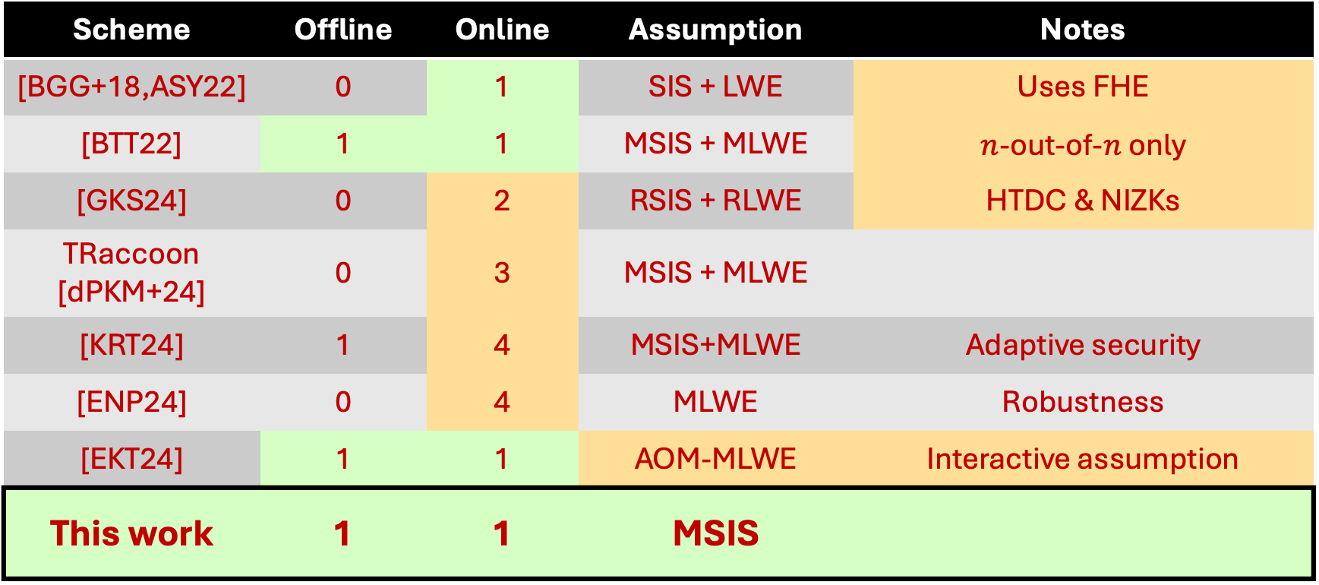
Our result
Scheme | Offline | Online | Assumption | Notes
[BGG+18,ASY22] | 0 | 1 | SIS + LWE | Uses FHE
[BTT22] | 1 | 1 | MSIS + MLWE | $n$-out-of-$n$ only
[GKS24] | 0 | 2 | RSIS + RLWE | HTDC & NIZKs
TRaccoon [dPKM+24] | 0 | 3 | MSIS + MLWE
[KRT24] | 1 | 4 | MSIS+MLWE | Adaptive security
[ENP24] | 0 | 4 | MLWE | Robustness
[EKT24] | 1 | 1 | AOM-MLWE | Interactive assumption
This work | 1 | 1 | MSIS
Notes:
We answer this question affirmatively by giving the first partially non-interactive threshold signature scheme from Module-SIS assumption, without relying on FHE or HTD.

Slide 7
Overview of our construction
Starting point
FROST-H: Variant of FROST from Linear Hash Function [Tessaro, Zhu ‘23]
* Partially non-interactive
* Secure from DL/RSA assumption
Instantiate with a lattice-based function + resolve several technical issues. Similar ideas have been applied in the context of blind signatures [HKLN’20].
Our Result: A partially non-interactive two-round threshold signature secure w.r.t. TS-UF-0 [BTZ22] under the MSIS assumption.
* Not quite efficient due to our choice of secret sharing scheme
Notes:
Now, let me give a brief outline of how we arrive at our solution.
Our starting point is a variant of threshold Schnorr signatures, FROST based on linear hash functions by Tessaro and Zhu, which is partially non-interactive, and secure from discrete log or RSA assumptions.
We then instantiate the linear hash function with a lattice-based linear function. I note that a similar idea has been done in the context of blind signatures before.
Finally, resolving technical issues gives us our partially non-interactive lattice-based construction based on MSIS assumption. We note that our solution needs a different secret sharing scheme that is not Shamir secret sharing making it not quite efficient. --- Remain at the high-level, notion is TS-UF-0 from Bellare et al. Mentions that this [Footnote might be unneeded]
For the rest of the talk, I will show how FROST-H is constructed and the main ideas of the proof. Then, I will discuss issues that arise from using lattice-based map and how we resolve them.

Slide 8





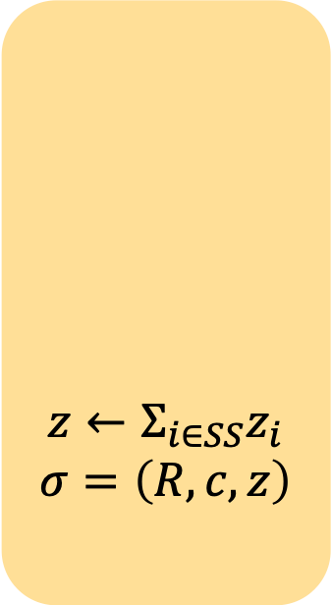

FROST [KG20,BCK+22]
Signer $i$ holds $(t,n)$-Shamir Secret Sharing $sk_{i}$ of $sk∈ℤ_{p}$
$$pk=g^{sk}, m$$
Prevent ROS attack [BLLOR20]
$$z←Σ_{i∈SS}z_{i}$$
$$σ=\left(R,c,z\right)$$
$$r_{i,0}, r_{i,1}\underset{←}{\$}ℤ_{p}$$
$$R_{i,0}←g^{r_{i,0}},R_{i,1}←g^{r_{i,1}}$$
$$b←H_{1}\left(pk,m,{\left(R_{i,0},R_{i,1}\right)}_{i∈SS}\right)∈ℤ_{p}$$
$$R←∏_{i∈SS}R_{i,0}⋅R_{i,1}^{b}$$
$$c←H_{2}(pk,m,R)$$
$$z_{i}←r_{i,0}+br_{i,1}+c λ_{i}^{SS}sk_{i}$$
$$\left(R_{i,0},R_{i,1}\right)$$
$$m,SS⊆[n], {\left\{\left(R_{i,0},R_{i,1}\right)\right\}}_{i∈SS}$$
Note: $SS =$ signer set, $\left|SS\right|≥t$
$$z_{i}$$
Schnorr Signature
FROST is secure based on OMDL assumption [BCK+22].
(Until recently) No natural lattice analogue
Easier to convert from a DL-based scheme
Notes:
Let me first introduce threshold Schnorr signatures, FROST.
In this scheme, the signer gets a Shamir secret sharing of the secret key, and the public key is a generator g raised to the secret key.
During the signing, the signer first computes two nonces nonce Ri0 Ri1 by sampling some random scalars ri0 ri1.
Next, the user picks its message, a subset of at least t signers and collects the nonces of the signers in this set. It then sends these to the signers
The signer computes a scalar b by hashing the signing request and use this b to aggregate the nonces. Note that this scalar is essential in preventing the ROS attack. Then, the signer computes the challenge c by hashing the public key, message, and the aggregated nonce, and computes the response which linearly combines the randomness and the secret key share * reconstruction coefficient * the challenge.
The response is sent to the user who aggregates them by summing up all the responses.
The final signature is the aggregated nonce, the challenge, and the aggregated response, and this is exactly Schnorr signatures.
Finally, FROST is secure based on one-more dlog assumption, which until recently has no lattice-based analogue. Also, it is easier to adapt dlog-based schemes to the lattice settings.

Slide 9
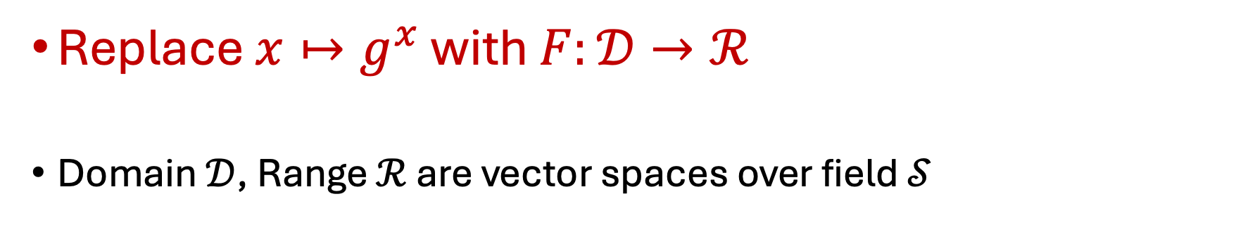
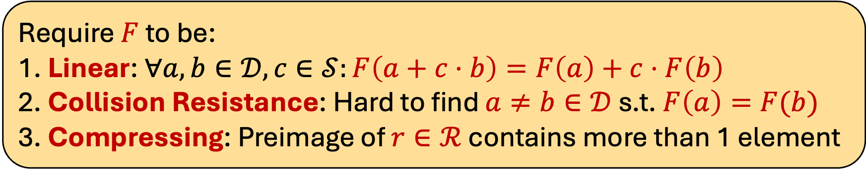
Generalization: Linear Hash Functions [TZ23]
These allow security to be based on non-interactive assumption.
Replace $x↦g^{x}$ with $F:𝒟→ℛ$
Domain $𝒟$, Range $ℛ$ are vector spaces over field $𝒮$
Require $F$ to be:
1. Linear: $∀a,b∈𝒟,c∈𝒮:F\left(a+c⋅b\right)=F\left(a\right)+c⋅F\left(b\right)$
2. Collision Resistance: Hard to find $a≠b∈𝒟$s.t. $F\left(a\right)=F(b)$
3. Compressing: Preimage of $r∈ℛ$ contains more than 1 element
Notes:
Hence, we consider the follow-up work by Tessaro and Zhu who generalize FROST using the notion of a linear hash function.
In particular, they replace the map of x to g to the x with a function F from some domain D to range R.
Note that these are vector spaces over some scalar field S.
They then require F to be:
linear as the name suggests.
Collision resistance
Finally, we also want it to be compressing, s.t., for any element r in Range, there is at least 2 preimages for this r.
The combination of these properties allow TZ23 to show security of FROST with linear hash function F to be secure from non-interactive assumption.

Slide 10

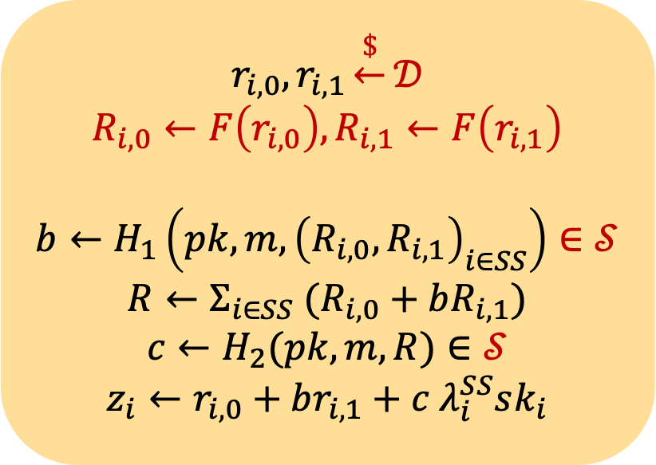


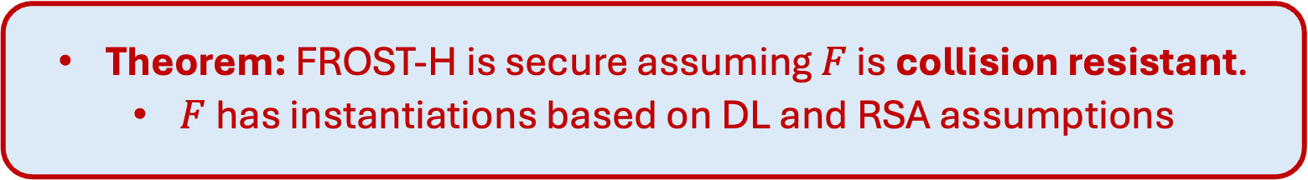
FROST-H [TZ23]
Signer $i$ holds $(t,n)$-Shamir Secret Sharing $sk_{i}$ of $sk∈𝒟$
$$pk=F\left(sk\right), m$$
$$z←Σ_{i∈SS}z_{i}$$
$$σ=\left(R,c,z\right)$$
$$r_{i,0}, r_{i,1}\underset{←}{\$}𝒟$$
$$R_{i,0}←F\left(r_{i,0}\right),R_{i,1}←F\left(r_{i,1}\right)$$
$$b←H_{1}\left(pk,m,{\left(R_{i,0},R_{i,1}\right)}_{i∈SS}\right)∈𝒮$$
$$R←Σ_{i∈SS} (R_{i,0}+bR_{i,1})$$
$$c←H_{2}(pk,m,R)∈𝒮$$
$$z_{i}←r_{i,0}+br_{i,1}+c λ_{i}^{SS}sk_{i}$$
$$\left(R_{i,0},R_{i,1}\right)$$
$$m,SS, {\left\{\left(R_{i,0},R_{i,1}\right)\right\}}_{i∈SS}$$
$$z_{i}$$
Theorem: FROST-H is secure assuming $F$ is collision resistant.
$F$ has instantiations based on DL and RSA assumptions
Notes:
And this is how they modify FROST to FROST-H, mostly by replacing the group notation with the linear map.
Note that the security of FROST-H is secure if F is collision resistant, and there are instantiations of F based on discrete log and RSA assumptions.

Slide 11
Rest of the talk
Lattice-based linear map
Proof Idea of [TZ23] and what goes wrong when using the lattice-based map
How we resolve the issues

Slide 12

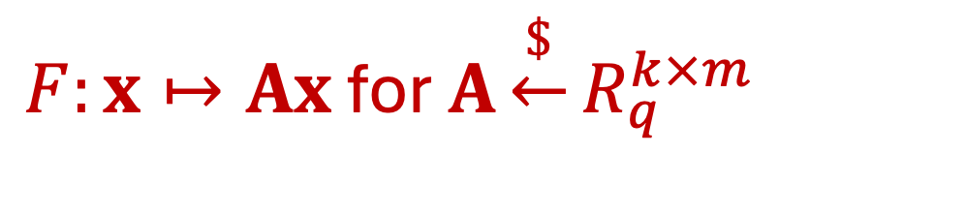
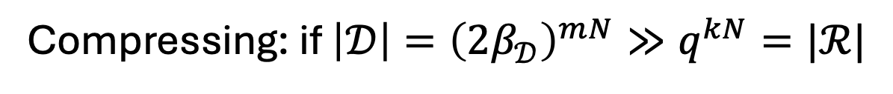
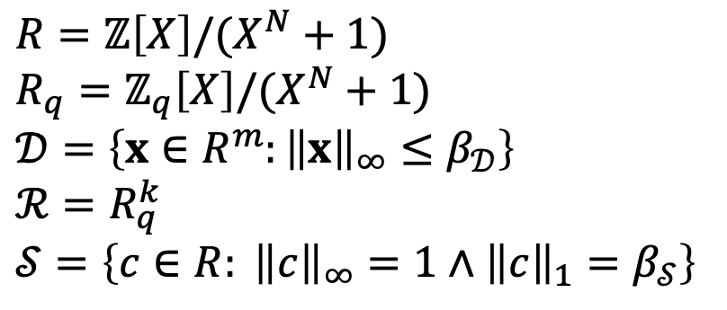
Lattice-based Linear Map
$R=ℤ\left[X\right]/(X^{N}+1)$
$$R_{q}=ℤ_{q}\left[X\right]/(X^{N}+1)$$
$$𝒟=\left\{x∈R^{m}:{\left\|x\right\|}_{∞}≤β_{𝒟}\right\}$$
$$ℛ=R_{q}^{k}$$
$$𝒮=\left\{c∈R: {\left\|c\right\|}_{∞}=1∧{\left\|c\right\|}_{1}=β_{𝒮}\right\}$$
$F:x↦Ax$ for $A\underset{←}{\$}R_{q}^{k×m}$
Linear
Compressing: if $\left|𝒟\right|={\left({2β}_{𝒟}\right)}^{mN}≫q^{kN}=|ℛ|$
Collision Resistant: Assuming Module-SIS
Notes:
Now, for our lattice-based linear map, we consider the cyclotomic ring R containing polynomials of degree less than N and R_q denotes R mod q.
Our domain as a set of vectors with entries in R such that their norm is bounded by some small value, the range is the set of vectors in R_q, and the scalars is the set of polynomials with {-1,0,1} coefficients and bounded ell-1 norm.
Our map is defined by a uniformly random matrix A with entries in R_q.
- It is easy to check that this is linear.
The map is also compressing if the size of D is much larger than the range
Finally, the map is collision resistant assuming MSIS assumption.

Slide 13
Rest of the talk
Lattice-based linear map
Proof Idea of [TZ23] and what goes wrong when using the lattice-based map
How we resolve the issues

Slide 14
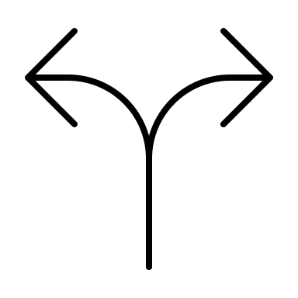
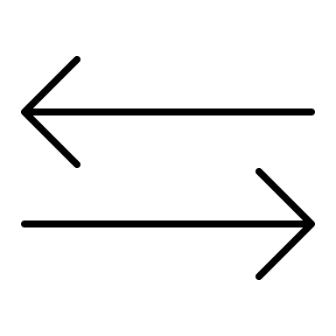

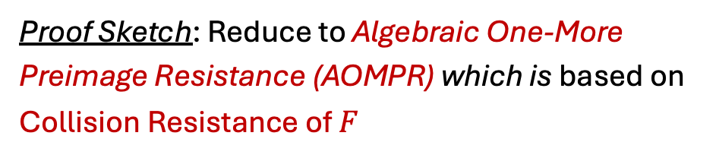

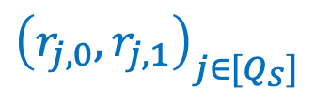




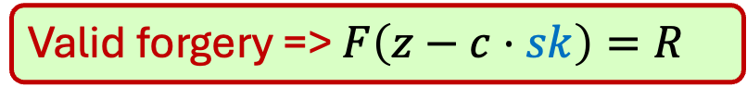

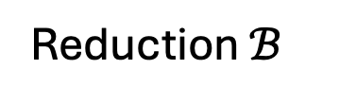
Recall [TZ23] proof
Proof Sketch: Reduce to Algebraic One-More Preimage Resistance (AOMPR) which is based on Collision Resistance of $F$
Reduction $ℬ$
samples…
$sk$
$${\left\{sk_{i}\right\}}_{i∈\left[n\right]}$$
$${\left(r_{j,0},r_{j,1}\right)}_{j∈[Q_{S}]}$$
Corrupted parties’ shares
Honest parties’ shares
Simulate signing sessions
$$pk=F\left(sk\right)$$
$$𝒜$$
Corrupt $S⊆\left[n\right], \left|S\right|<t$
$$pk=F\left(sk\right),{\left\{sk_{i}\right\}}_{i∈S}$$
…
$$\left(m, \left(R,c,z\right)\right)$$
Valid forgery => $F\left(z−c⋅sk\right)=R$
Notes:
To see our issues, we first recall the proof from TZ23.
As a rough sketch, their proof first reduce to Algebraic one-more preimage resistance assumption. Then, this assumption is shown to be supported by collision resistance of F. Here, we will skip the middle step and describe how one could reduce directly to CR of F.
We now consider a reduction B which runs the adversary A.
It first samples a secret key sk, secret key shares sk_i, and randomness to simulate the game to the adversary A.
A first corrupts a set of signers and gets the public key and the secret key shares of the corrupted parties.
Then, A can request signing sessions with B, and these are simulated using the honest parties’ secret key shares and the sampled randomness.
Finally, A outputs a forgery, containing message m, nonce R, challenge c, and a response z.
If this forgery is valid, B will learn a preimage of the nonce R, which is z – c times sk.

Slide 15
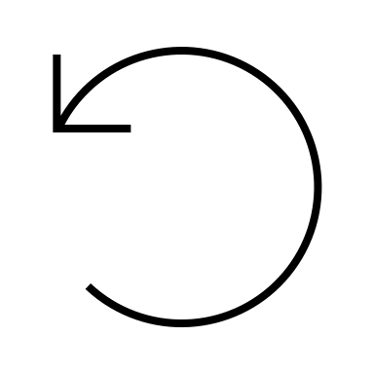
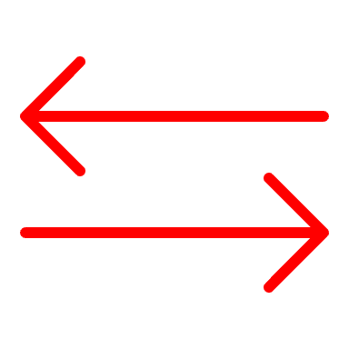
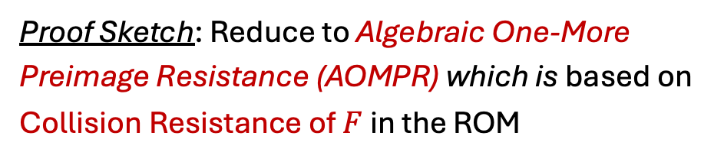
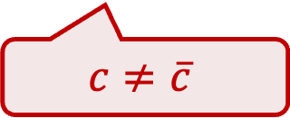




Recall [TZ23] proof
Proof Sketch: Reduce to Algebraic One-More Preimage Resistance (AOMPR) which is based on Collision Resistance of $F$ in the ROM
Reduction $ℬ$
samples…
$sk$
$${\left\{sk_{i}\right\}}_{i∈\left[n\right]}$$
$${\left(r_{j,0},r_{j,1}\right)}_{j∈[Q_{S}]}$$
Corrupted parties’ shares
Honest parties’ shares
Simulate signing sessions
$$pk=F\left(sk\right)$$
Rewind
$$𝒜$$
Previous run: $\left(m, \left(R, c,z\right)\right)$ s.t. $F\left(z−c⋅sk\right)=R$
…
If
$$\overline{z}−\overline{c}⋅sk≠z−c⋅sk$$
then $ℬ$ wins!
$$\left(m, \left(R,\overline{c},\overline{z}\right)\right)$$
But how do we show that this occurs with high probability?
s.t. $F\left(\overline{z}−\overline{c}⋅sk\right)=R$
$$c≠\overline{c}$$
Notes:
Then, the reduction will rewind the adversary A, and by the forking lemma it will get another forgery on the same message and nonce as the forgery from the previous run with high probability.
Note that the challenge in this forgery will be different from the previous run, and B will also learn another preimage of the nonce R.
If these preimages from the first and rewound runs are different, then B finds a collision on F! It is then left to show that this occurs with high prob.

Slide 16
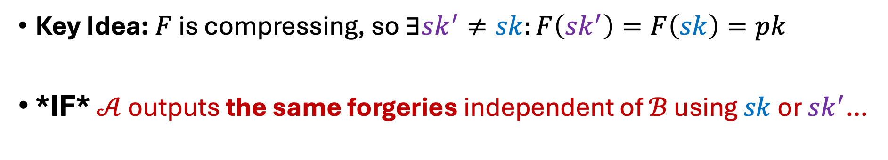
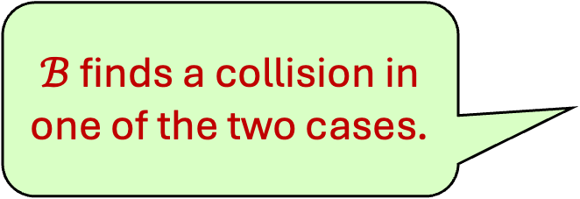
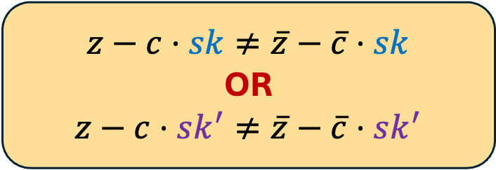
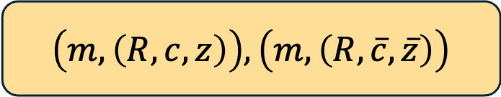
Arguing success probability
Key Idea: $F$ is compressing, so $∃sk^{′}≠sk:F\left(sk^{′}\right)=F\left(sk\right)=pk$
*IF* $𝒜$ outputs the same forgeries independent of $ℬ$ using $sk$ or $sk^{′}$…
$\left(m, \left(R,c,z\right)\right), \left(m,\left(R,\overline{c}, \overline{z}\right)\right)$
$ℬ$ finds a collision in one of the two cases.
$$z−c⋅sk≠\overline{z}−\overline{c}⋅sk$$
OR
$$z−c⋅sk^{′}≠\overline{z}−\overline{c}⋅sk^{′}$$
Notes:
The observation here is that with F compressing, there is a different secret key sk’ that maps to the same public key.
Then **IF** A outputs the same forgeries regardless of whether B uses sk or sk’ to simulate. We have that since sk and sk’ are different, either the extracted preimages with respect to sk’s or the extracted preimages with respect to sk’ are different. Hence, B will find a collision in one of the two cases.

Slide 17


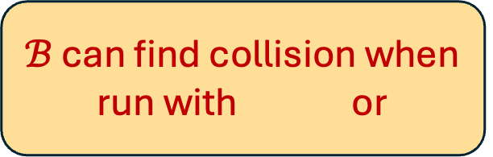


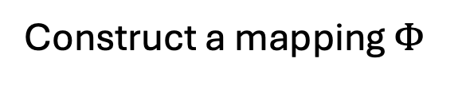
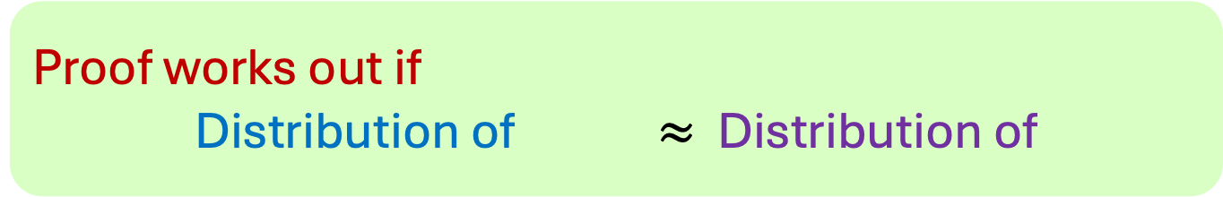
Arguing success probability (More detail)
Construct a mapping $Φ$
$$sk,{\left\{sk_{i}\right\}}_{i∈\left[n\right]}{,\left(r_{j,0},r_{j,1}\right)}_{j∈[Q_{S}]}$$
$$sk^{′},{\left\{sk_{i}^{′}\right\}}_{i∈\left[n\right]},{\left(r_{j,0}^{′},r_{j,1}^{′}\right)}_{j∈[Q_{S}]}$$
View of $𝒜$ is the same whether $ℬ$ uses or
Public key and corrupted parties’ shares
*Signing transcripts in original and rewound runs*
$ℬ$ can find collision when run with or
Proof works out if
Distribution of $≈$ Distribution of
Note: [TZ23] showed that these are identical
Notes:
To ensure that A outputs the same forgeries regardless of the secret key used in signing, they construct a mapping on the secret key, the secret shares, and the randomness. We then need this map to preserves the view of A which includes the shares of the corrupted parties and the signing transcript over the original and the rewound runs of A. With this, the outputs of A are the same regardless of whether B uses 1 or 2, and B wins in one of the cases.
It is then easy to see that the proof works out if the distribution of values before and after the mapping are close. Note that TZ23 showed that these distributions are identical.

Slide 18

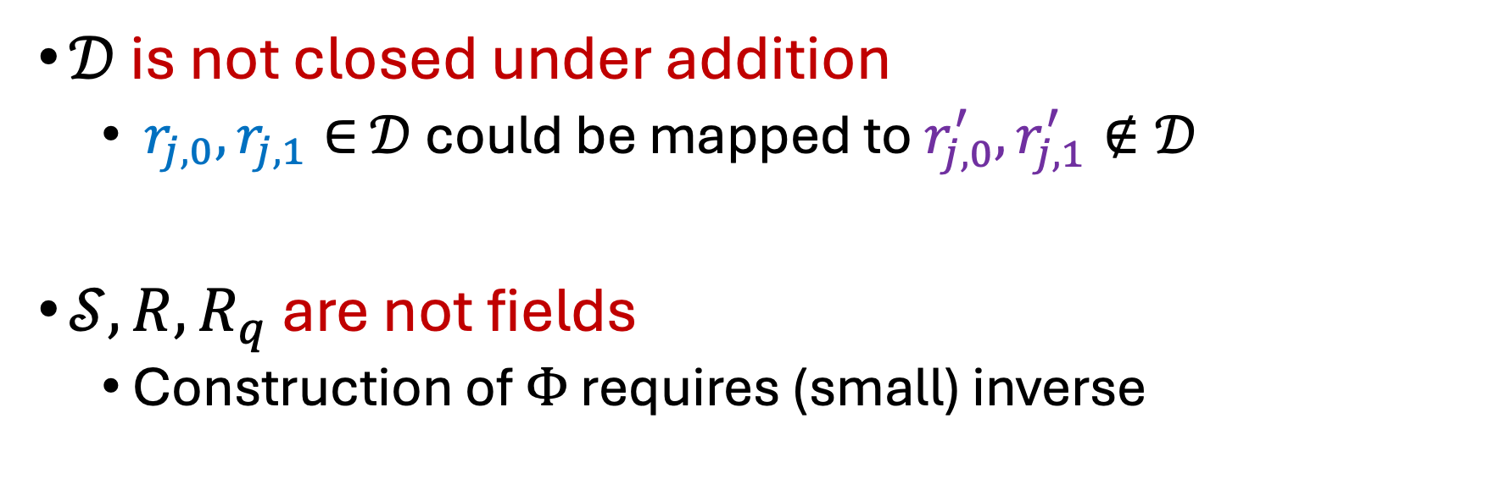


Issues with lattice-based function
Mapping $Φ$
$$sk,{\left\{sk_{i}\right\}}_{i∈\left[n\right]}{,\left(r_{j,0},r_{j,1}\right)}_{j∈[Q_{S}]}$$
$$sk^{′},{\left\{sk_{i}^{′}\right\}}_{i∈\left[n\right]},{\left(r_{j,0}^{′},r_{j,1}^{′}\right)}_{j∈[Q_{S}]}$$
$𝒟$ is not closed under addition
  $r_{j,0},r_{j,1}∈$ $𝒟$could be mapped to $r_{j,0}^{′},r_{j,1}^{′}∉𝒟$
$𝒮,R,R_{q}$ are not fields
  Construction of $Φ$ requires (small) inverse
Notes:
However, the same analysis does not quite apply with the lattice-based map instantiations.
Mainly, this is because the domain is not closed under addition, so the mapping \Phi in the analysis can map the randomness out of the domain.
Hence, to argue that the distributions are close, we need to make sure things remain small.
Also, the scalar set and the rings R and Rq are not fields, so values might not have inverses, or their inverses may not be small. And this is required for Phi to not map things out of the domain.

Slide 19
Rest of the talk
Lattice-based linear map
Proof Idea of [TZ23] and what goes wrong when using the lattice-based map
How we resolve the issues

Slide 20


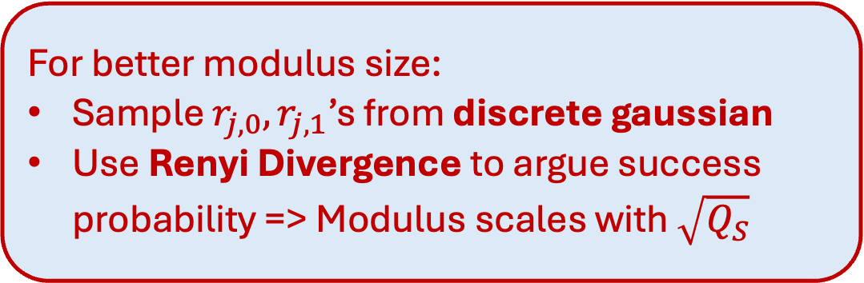
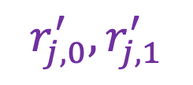
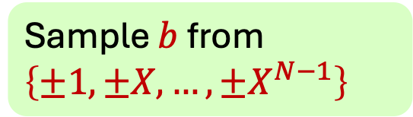
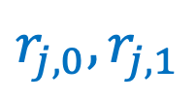
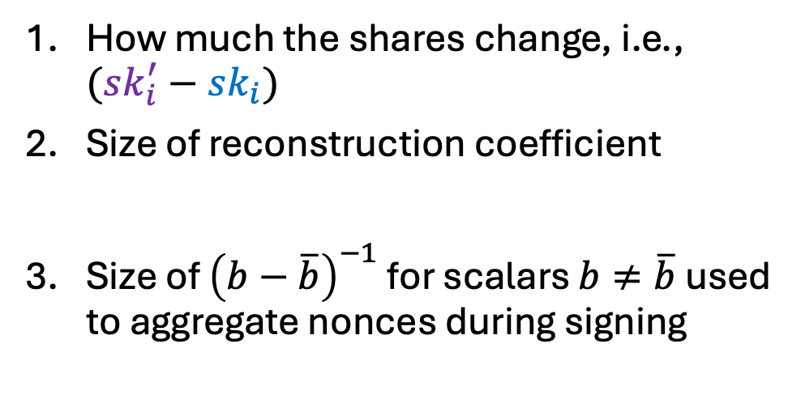
What we do
For better modulus size:
Sample $r_{j,0},r_{j,1}$’s from discrete gaussian
Use Renyi Divergence to argue success probability => Modulus scales with $\sqrt{Q_{S}}$
$$Φ$$
$$r_{j,0},r_{j,1}$$
$$r_{j,0}^{′},r_{j,1}^{′}$$
$$+Δ$$
Size depends on
# of signing sessions
Small-coefficient linear secret sharing: we use Benaloh-Leichter secret sharing [BL90]
How much the shares change, i.e., $(sk_{i}^{′}−sk_{i})$
Size of reconstruction coefficient
Size of ${\left(b−\overline{b}\right)}^{−1}$ for scalars $b≠\overline{b}$ used to aggregate nonces during signing
Sample $b$from $\left\{±1,±X,…,±X^{N−1}\right\}$
Notes:
To resolve this, we consider how \Phi maps one randomness to another randomness and we notice that how much the randomness changes depends on
1. How much the secret share changes
2. The size of reconstruction coefficient
3. The size of inverse of the b – b bar for some scalars b, b bar used to aggregate the nonces in the signing protocol.
To keep the first two small, we use small-coefficient secret sharing by Benaloh and Leichter.
For the inverse of the scalars, we pick this b from the set of signed monomials which lets us keep these values small.
Finally, to further improve efficiencies of our scheme, we sample the randomness from discrete gaussian and use Renyi Divergence to argue success probability of our reduction. This allows our modulus size to scale with sqrt of # of signing sessions.

Slide 21
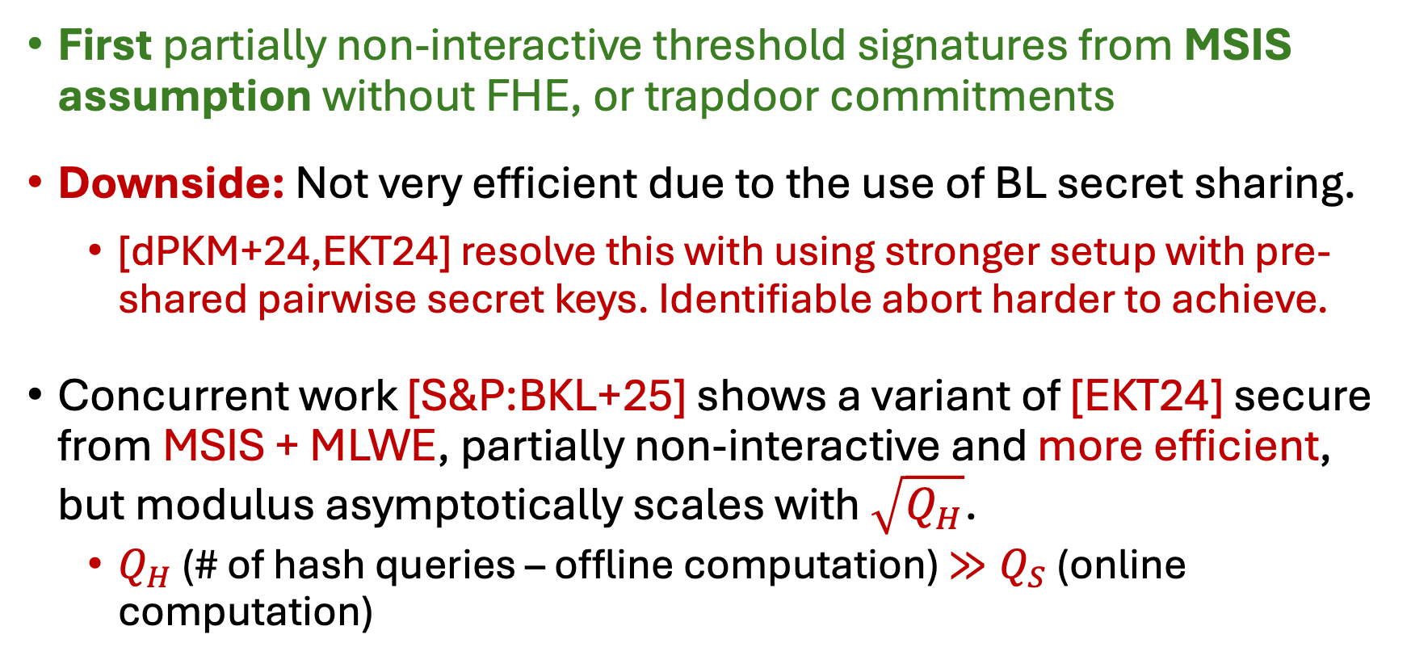
Summary and Comparison
First partially non-interactive threshold signatures from MSIS assumption without FHE, or trapdoor commitments
Downside: Not very efficient due to the use of BL secret sharing.
  [dPKM+24,EKT24] resolve this with using stronger setup with pre-shared pairwise secret keys. Identifiable abort harder to achieve.
Concurrent work [S&P:BKL+25] shows a variant of [EKT24] secure from MSIS + MLWE, partially non-interactive and more efficient, but modulus asymptotically scales with $\sqrt{Q_{H}}$.
  $Q_{H}$ (# of hash queries – offline computation) $≫Q_{S}$ (online computation)
Notes:
Finally, just to summarize:
We gave the first partially non-interactive threshold signatures from standard lattice assumption without heavy primitive
The big downside is that our efficiencies are not good due to the use of small coefficient secret sharing, and we do not scale well with large number of signers. Prior works does not have this issue due to using a stronger setup that pre-share pairwise PRF keys. Note that this makes it hard to identify misbehaving signers who could make the protocol abort.
Finally, I note a concurrent work which shows a variant of one of the prior schemes secure from standard assumption, which is more efficient, but their modulus size asymptotically scales with \sqrt of # of hash queries. In practice this is much larger than the number of signing sessions, since it is an offline computation.

Slide 22
Future directions
Best of both worlds: Efficient lattice-based scheme with identifiable abort
Alternative secret sharing for our construction?
Thank you!
Full Paper: https://ia.cr/2024/467
Notes:
For future direction,
It would be nice to have an efficient lattice-based scheme with identifiable abort.
Another question is can we give a better small coefficient secret sharing scheme to make our construction more efficient.
Thank you, and please check out our paper!

