Slide 1
A Tight Security Proof for SPHINCS⁺, Formally Verified
Manuel Barbosa (FCUP, INESC TEC & MPI-SP)
François Dupressoir (University of Bristol)
Andreas Hülsing (TU/e & SandboxAQ)
Matthias Meijers (TU/e & SandboxAQ)
Pierre-Yves Strub (PQShield)

Slide 2
Context

Slide 3
SPHINCS⁺
Stateless hash-based digital signature scheme
Post-quantum
Standardized as SLH-DSA (by NIST in FIPS 205)
Mistake in security proof
Discovery: ~3 years after publication
Fix (on paper): ~2 years after discovery

Slide 4
Computer-Aided Cryptography
Cryptography is (increasingly) complex
Broken designs, proofs, and implementations
Alleviate through computers
Reduce complexity
Enforce rigor
Shift “trust”
EasyCrypt

Slide 5
Purpose and Contribution
Increase confidence in security of SPHINCS⁺
Modularize and granularize security proof
Reuse existing artifacts
Formally verify reconstructed security proof
Generic relation between hash function properties (Bernstein and Hülsing, 2019)
Facilitate future formal verification
Libraries: binary/Merkle trees and hash functions
Other: novel proof technique (with reusable results)

Slide 6
Process

Slide 7
Objectives
Formally verify security proof for SPHINCS⁺
EUF-CMA
Hash function properties

Slide 8
Approach
Construct Proof
Formalize Context and Proof Steps
Formally Verify Proof
= Without Tool
= With Tool

Slide 9
Construct Proof – Scheme Overview
SPHINCS⁺: XMSS^{MT} (one) + FORS (many) + message compression
Fixed-length variant of XMSS^{MT}
XMSS^{MT}: Tree of XMSS instances
“Hypertree” structure (size/time trade-off)
Used to sign public keys of FORS instances
FORS: “Forest” (sequence) of Merkle trees
One instance per leaf of XMSS^{MT}
Used to sign messages

Slide 10
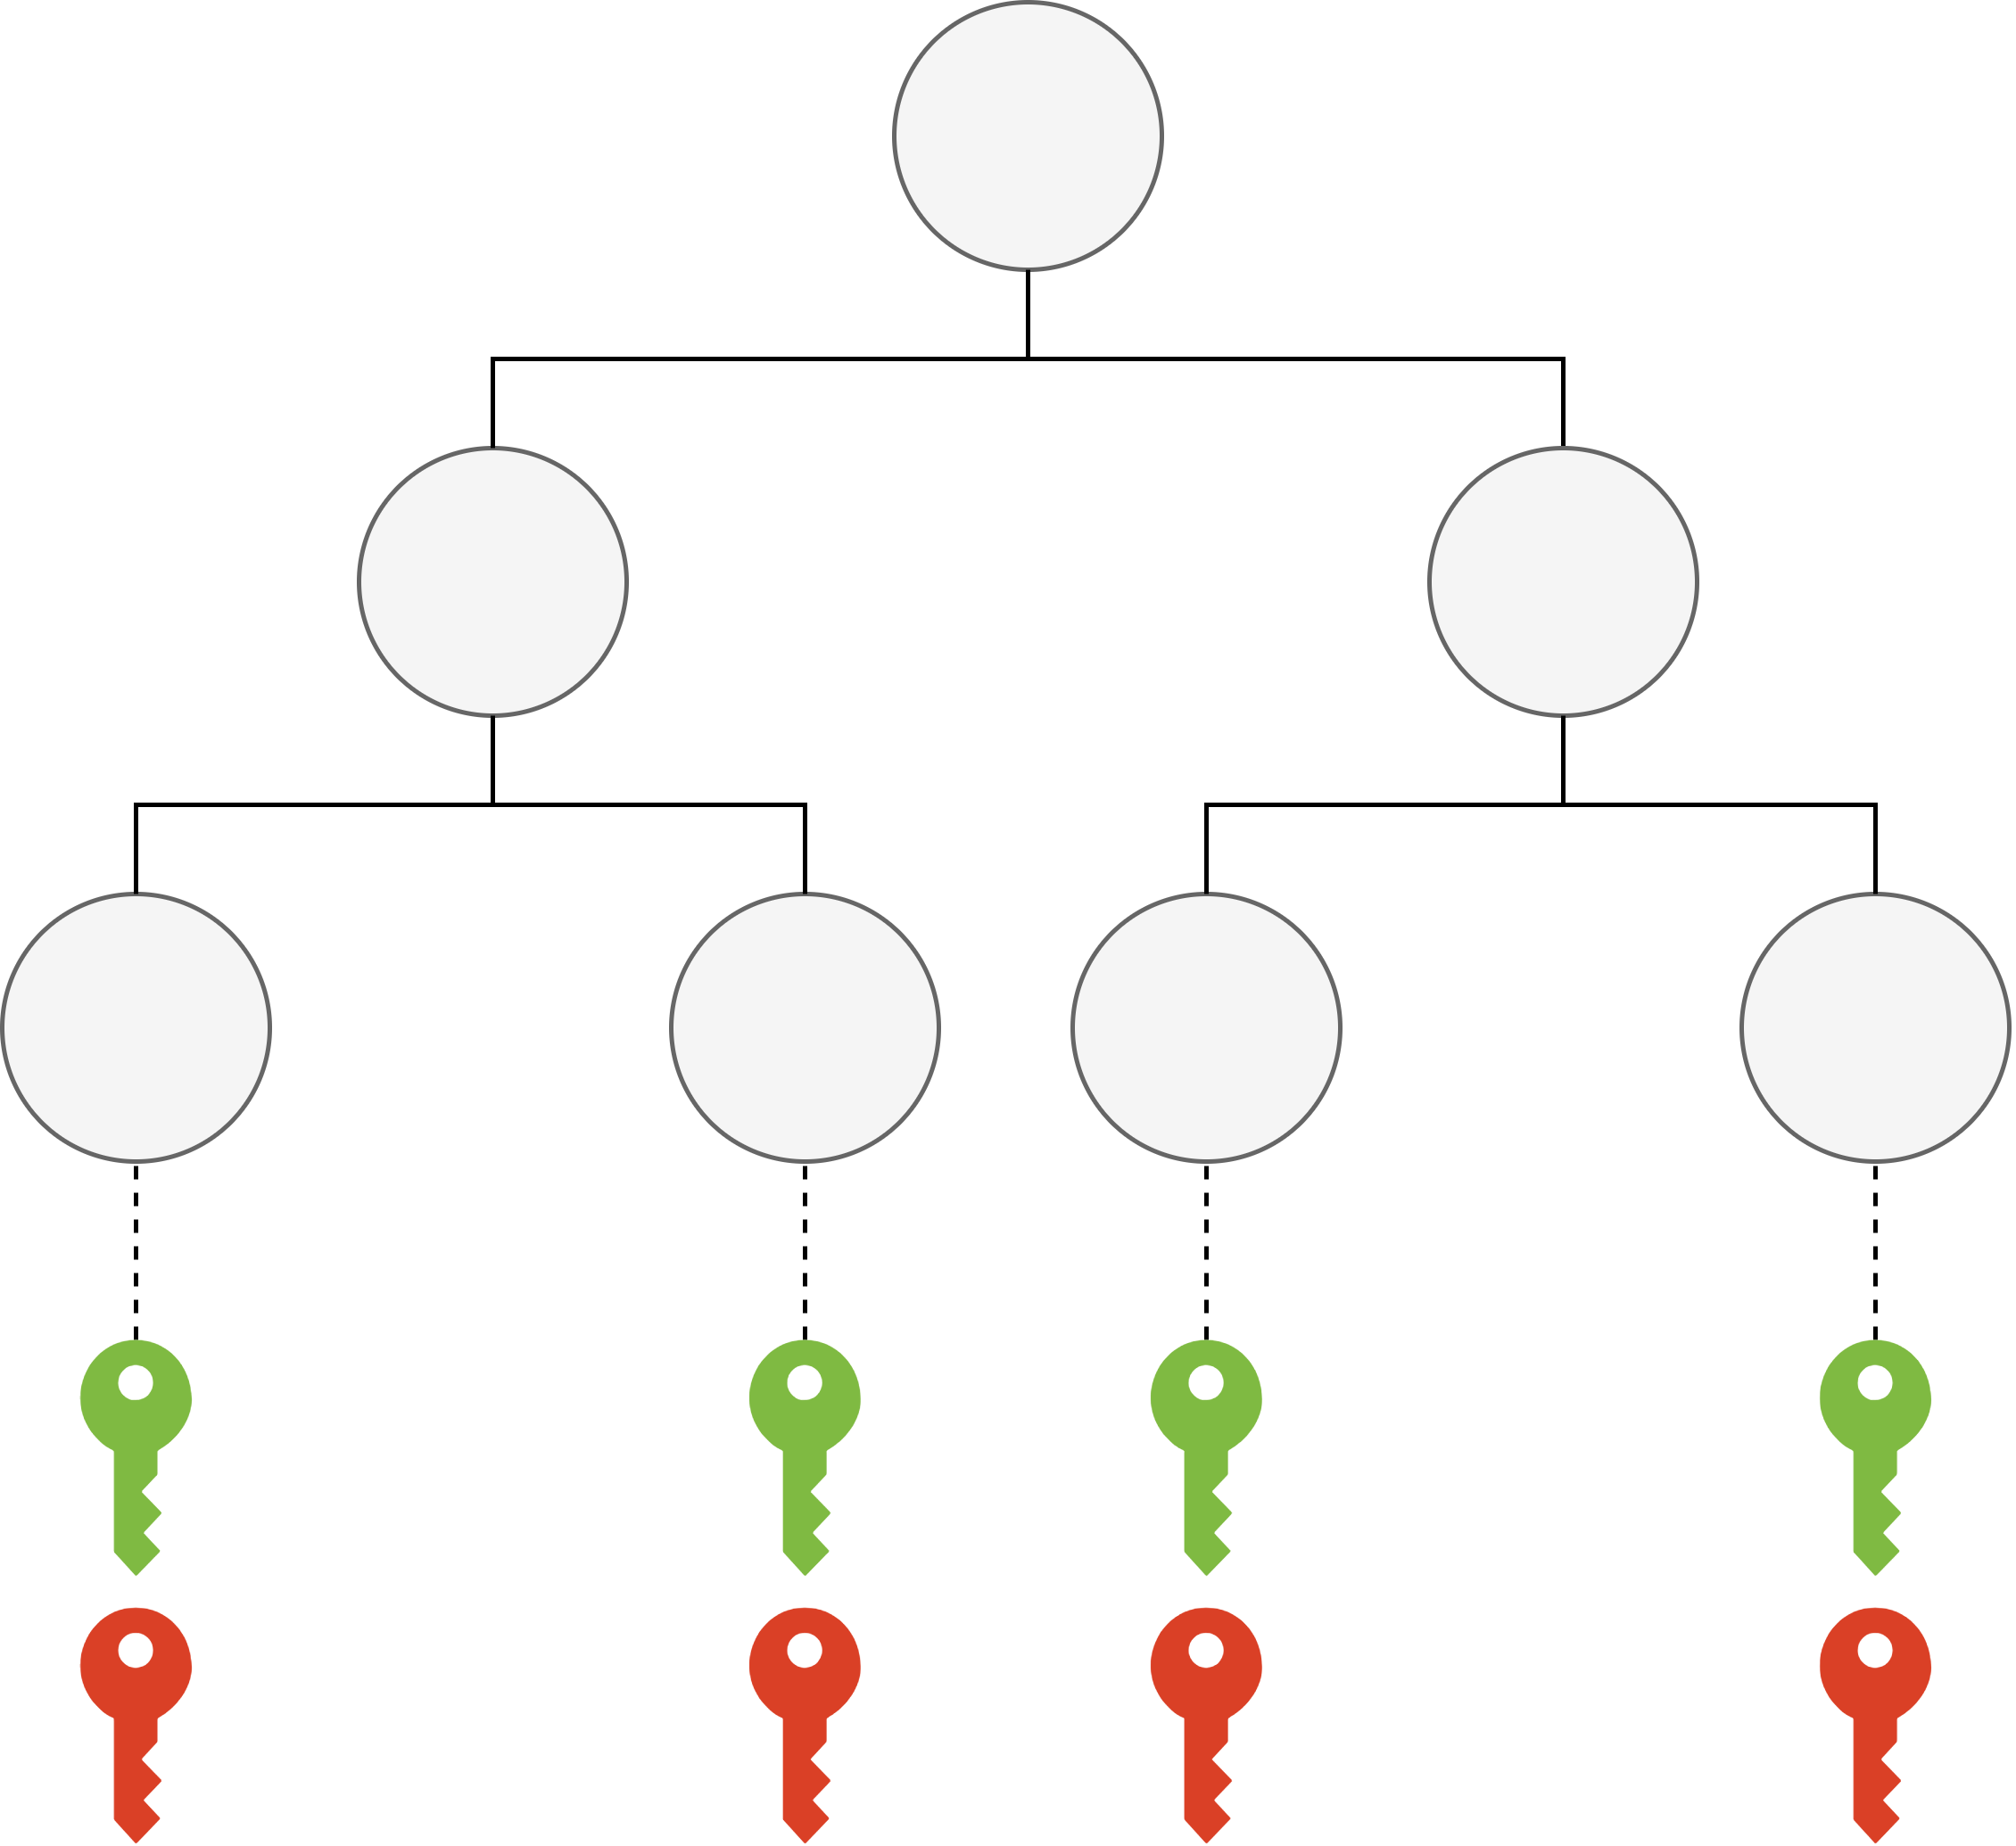
Construct Proof – Scheme Overview (XMSS)
Merkle tree + OTS (Winternitz)
Signature
(W)OTS signature
Authentication path
Combine and Hash
Key Compression
(W)OTS Public Key
(W)OTS Secret Key

Slide 11
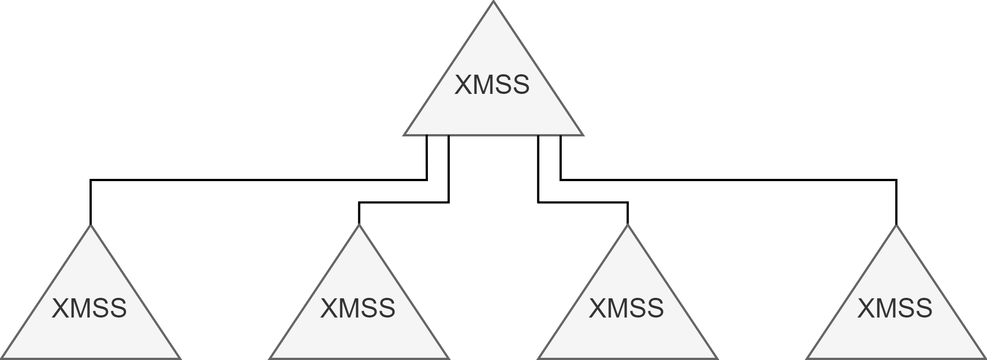
Construct Proof – Scheme Overview (XMSS^{MT})
Tree of XMSS instances
Bottom instances sign “messages” (SPHINCS⁺: FORS public keys)
Intermediate instances sign roots of instances below
Signature
XMSS signatures from instances on path from signing instance to root instance

Slide 12
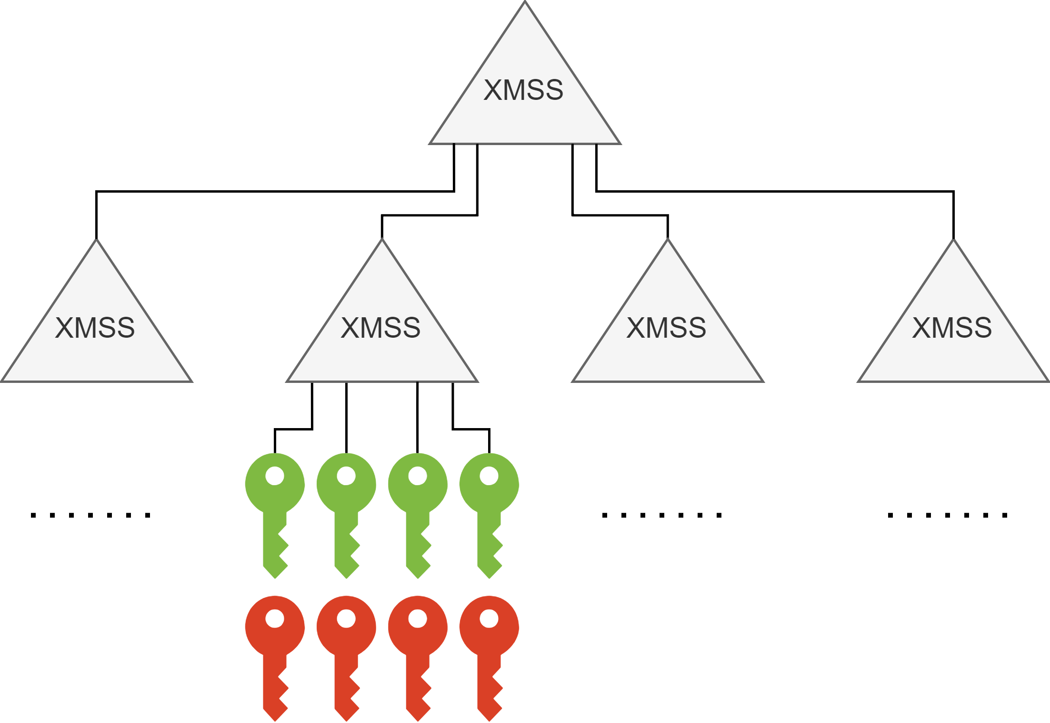
Construct Proof – Scheme Overview (SPHINCS⁺)
XMSS^{MT} + FORS (+ message compression)
Message compression determines FORS instance
FORS instance signs message
XMSS^{MT} signs FORS public key
Signature
FORS signature (on message)
XMSS^{MT} signature (on FORS public key)
Sign Root
Sign Public Key
FORS Public Key
FORS Secret Key

Slide 13
Construct Proof – Modularization
Multi-instance FORS (M-FORS)
Includes message compression
Manages all FORS instances
SPHINCS⁺: XMSS^{MT} + M-FORS
XMSS^{MT}
M-FORS

Slide 14
Construct Proof – Proof Structure
SPHINCS⁺ EUF-CMA
Nonce Generation PRF
Fixed-Length XMSS^{MT} EUF-NAGCMA
Message Compression ITSR
Leaf Hash OpenPRE
Tree Hash TCR
Root Compression TCR
WOTS M-EUF-GCMA
Key Compression TCR
Tree Hash TCR
Chain Hash UD
Chain Hash PRE
Chain Hash TCR
Leaf Hash DSPR
Leaf Hash TCR
M-FORS EUF-CMA
Secret Key Generation PRF
Previous
Work
Generic Relation

Slide 15
Formalize Context and Proof Steps
Context
Parameters
Types, functions, and distributions (binary/Merkle trees)
Schemes
Proof Steps
Security notions and hardness assumptions (hash functions)
Adversary classes and reduction adversaries
Games
Probability statements

Slide 16
Formally Verify Proof
Leaf Hash OpenPRE
Leaf hash
Granular, multi-dimensional analysis
Complex conditional probability
(Fixed-length) XMSS^{MT} and M-FORS
Node-by-node construction of entire structure (through oracle calls)
Authentication path collisions
Leaf Hash DSPR
Leaf Hash TCR
Fixed-Length XMSS^{MT} EUF-NAGCMA
M-FORS EUF-CMA

Slide 17
Future Work and Summary

Slide 18
Future Work
Hash function instantiations/properties
Formally verified implementations
EasyCrypt (Formosa Crypto project*)
*For more information, see formosa-crypto.org

Slide 19
Summary and Statistics
Formally verified security proof for SPHINCS⁺
New/Improved EasyCrypt libraries and novel proof technique
Effort
1 main and 4 support/guiding, part-time for about 7 months (excluding reused artifacts)
Output
~17000 lines of EasyCrypt code (excluding reused artifacts)

Slide 20
Questions?

