Slide 1
Password-Protected Threshold Signatures
¹ University of Warsaw, Poland
² IDEAS NCBR, Poland
³ University of California Irvine, USA
⁴ Amazon Web Services, USA
⁵ Privacy + Scaling Explorations, Vietnam
⁶ Oregon State University, USA
Stefan Dziembowski¹², Stanisław Jarecki³, Paweł Kędzior¹, Hugo Krawczyk⁴, Chan Nam Ngo⁵, Jiayu Xu⁶

Slide 2
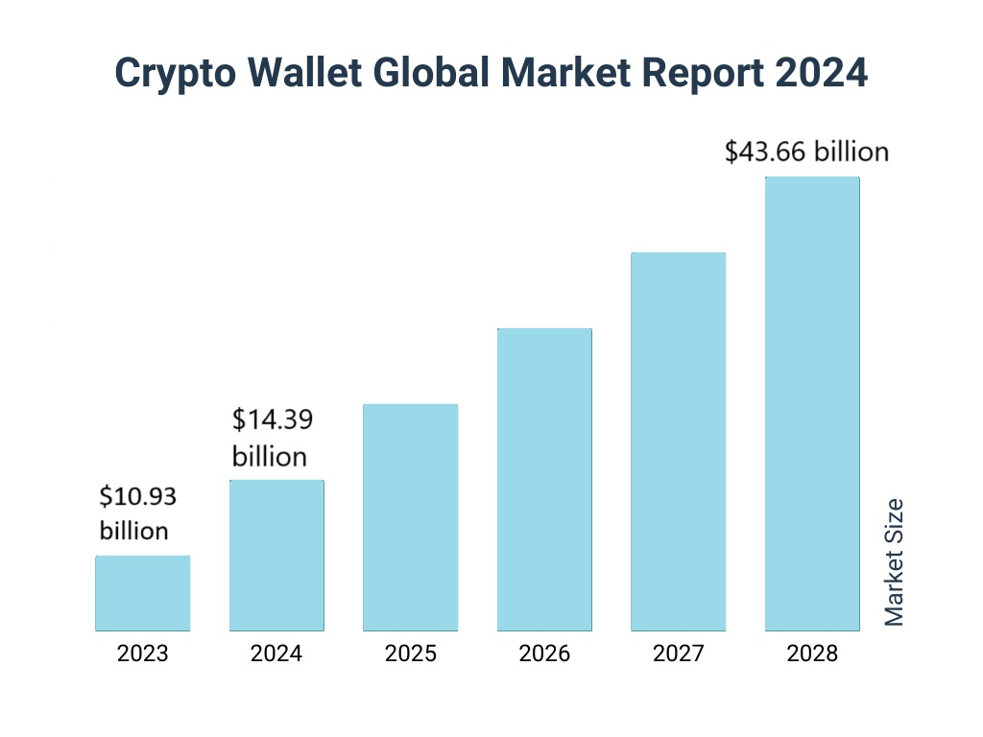
As of recent estimates, there are roughly 400 million blockchain wallet users worldwide.
Some also use custodial wallets...(How to trust that they are secure)
Custodial wallets may be distributed among many servers for security reasons.
https://www.thebusinessresearchcompany.com/report/crypto-wallet-global-market-report
Notes:
As of recent estimates, there are roughly 400 million blockchain wallet users worldwide.
Crypto wallet market size increased year to year by 30 % reaching over 14 billion dollars in 2024.
People access their blockchain wallets primarily through private keys or seed phrases, which are unique cryptographic codes that unlock the wallet and authorize transactions. Users often manage these keys through wallet apps, either as software wallets (like mobile apps or browser extensions) or hardware wallets (physical devices offering secure offline storage).
There is a chicken-and-egg problem. Yet, this setting raises the question of how a user can authorize the servers to sign on her behalf. An attacker who impersonates the user in this authorization process can request signatures on messages of its choice. On the other hand, if this authentication requires a user-held cryptographic key then we have a chicken-and-egg problem: we outsourced one user’s key but we still require the user to hold another
Users may include like passwords (something that only the user knows), has to be short

Slide 3
Case 1: n servers – n passwords
Case 2: n servers – one password
pw₁
password
pw₂
password
password_file: (pw₁,pw₂,pw₃)
password
pw₃
password
Too much to memorize!
User outputs signature σ
Strawman solution creates n points of failure
Notes:
(((Strawman solution - secret-share signing key among servers)))

Slide 4
We define 4 properties of a good Password-Protected Threshold Signature scheme:
1. One protocol execution = one online password guess.
password
password*
Correct password guess: password* = password

Slide 5
We define 4 properties of a good Password-Protected Threshold Signature scheme:
1. One protocol execution = one online password guess.
2. Compromising ≤ t servers = no security loss.
password

Slide 6
We define 4 properties of a good Password-Protected Threshold Signature scheme:
1. One protocol execution = one online password guess.
2. Compromising ≤ t servers = no security loss.
3. Compromising > t servers (even all n) without successful ODA = no security loss.
password
Offline dictionary attack: password* = password (recover password using brute force)
password*

Slide 7
We define 4 properties of a good Password-Protected Threshold Signature scheme:
1. One protocol execution = one online password guess.
2. Compromising ≤ t servers = no security loss.
3. Compromising > t servers (even all n) without successful ODA = no security loss.
password
4. An attacker who knows the password, can sign only one message per each interaction with t + 1 servers.
No signature can be created!
Signature is created!

Slide 8
We define 4 properties of a good Password-Protected Threshold Signature scheme:
1. One protocol execution = one online password guess.
Password Authenticated Key Exchange (tPAKE) + threshold signature scheme (tSIG).
2. Compromising ≤ t servers = no security loss.
3. Compromising > t servers (even all n) without successful ODA = no security loss.
Property 4. adds security mechanisms:
rate-limiting
4. An attacker who knows the password, can sign only one message per each interaction with t + 1 servers.
multi-factor authentication
application policy
protects the user in case of a break into the client machine
Notes:
Properties 1 and 2 can be achieved by a composition of threshold Password Authenticated Key Exchange (tPAKE) and threshold signature scheme (tSIG). However, property 3 is not implied by such composition, and indeed does not seem easy to achieve using any tPAKE and tSIG schemes alone.
protects the user in case of a break into the client machine: Such break might leak the password, but it cannot leak the signing key.

Slide 9
augmented password-protected threshold SIGnature (aptSIG)
aptSIG
1. One protocol execution = one online password guess.
aPPSS
2. Compromising ≤ t servers = no security loss.
3. Compromising > t servers (even all n) without successful ODA = no security loss.
OPRF
4. An attacker who knows the password, can sign only one message per each interaction with t + 1 servers.
tSIG
Proven secure in Universally Composable (UC) framework.

Slide 10
​​augmented password-protected threshold SIGnature (aptSIG)
Run between a User and n Servers.
The only input of the User is her password.
Two phases:
1. Initialization
2. Signing
password
At the end of Signing the User outputs (m,σ).
At the beginning of both phases parties run aPPSS protocol [BJSL11].
Bagherzandi, Jarecki, Saxena, Lu; CCS11

Slide 11
aPPSS Initialization phase
We extend security proof of [JKK14] to the augmented setting (protocol remains unchanged)
Protocol begins with a computation of oblivious PRF (OPRF) [JKKX16] between the User and each server.
password
Jarecki, Kiayias, Krawczyk; Asiacrypt14
Jarecki, Kiayias, Krawczyk, Xu; EuroS&P16
Notes:
We did only cosmetic changes to UC OPRF functionality from [Jarecki, S., Krawczyk, H., Xu, J]

Slide 12
aPPSS Initialization phase
password
Notes:
Run only between user and one server

Slide 13
aPPSS Initialization phase
Oblivious PRF (OPRF)
password
Notes:
Run only between user and one server

Slide 14
Adaptive Oblivious Pseudorandom Function (OPRF)
2HashDH
USER
SERVER
Input: pw
Input: k
Choose random α
a = H(pw)^{α}
a
Compute b = a^{k}
b
Compute c=H'(pw,b^{1/α})
Output c
Notes:
For reference we include in Figure 10 the UC OPRF functionality modeled on [33]. However, we make two cosmetic changes: (1) we adapt the functionality to the multi-session model, whereas the original presentation of this functionality in [33] was done in a single-session model, and (2) each party can output a transcript of the protocol interaction to the environment. The functionality additionally enforces that transcript equality implies that two parties are passively connected, so if U and S outputs the same transcripts then U evaluates the OPRF on the key of S.

Slide 15
aPPSS Initialization phase
Can be replaced by tOPRF [GJKNX] to achieve security against proactive adversary!
SERVER 1
SERVER 2
password
SERVER 3
Gu, Jarecki, Kedzior, Nazarian, Xu; Asiacrypt24
Notes:
Let us get back to aPPSS Initialization phase, where the OPRF computation is performed once with each server.
Can be replaced by tOPRF [Gu et al.] to achieve security against proactive adversary!

Slide 16
Run OPRF
aPPSS Initialization Phase
User chooses random s​
,ω
Generates SS (s₁,…,s_{n}) of s
e_{i} = s_{i} XOR ρ_{i​}
key₁
Parses e = (e₁,…,e_{n})
(C || sk):=H(pw,e,s), ω:=(e,C)​
,ω
password
key₂
Sends ω to each server
Server saves ω
key₃
,ω

Slide 17
If C' = C output sk, else output error message
aPPSS Reconstruction Phase
Run OPRF get ω_{i} from each server
,ω
Parse ω= (C,e)​
key₁
​s_{i} = e_{i} XOR ρ_{i}
Recover s
Parse H(pw,e,s) as (C' || sk)​
,ω
password
key₂
key₃
,ω
Notes:
Recover s using SS rec

Slide 18
aptSIG Initialization Phase
Run aPPSS
Run tBLS Key Generation
key₁
password
key₂
sk
key₃
Notes:
– wymiana wiadomosci pomiedzy U oraz S
– jedna wiadomosc U - S

Slide 19
Threshold BLS Signature (tBLS)
Threshold BLS scheme for the “1+t” access structure
Introduced by Boldyreva in 2003
Key generation
Input : (P₀, P₁, …,P_{n})
Output: (i,sig_key_{i},V,V)
Signing
Server: On m computes σ_{i} := H(m)^{si} and sends (i, σ_{i}) to all other parties
P₀ computes full signature σ using Lagrange interpolation
Boldyreva; PKC03
Notes:
assumes a group G of prime order p with a bilinear map e : G×G→GT , and defines σ as a signature on m under public key V = g s if e(g, σ) = e(V, H(m)), where g generates G and H is a hash onto G. BLS signature is CMA-unforgeable in ROM under the Gap DH assumption, i.e. if the computational Diffie-Hellman is hard in G even on access to a DDH oracle [8].

Slide 20
aptSIG Initialization Phase
Run aPPSS Initialization between the user and all servers – get sk
key₁, V₁
aec_{U}
Run tBLS Key generation
Encrypt user's partial signing key with sk : aec_{U}= Enc_{sk}(s₀)
password
key₂, V₁
sk
aec_{U}
Send aec_{U} to each server
key₃, V₁
aec_{U}

Slide 21
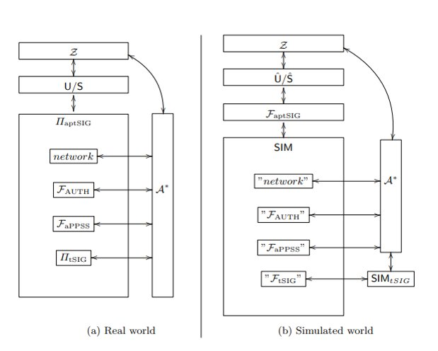
aptSIG Signing Phase
Run aPPSS Reconstruction
key₁, V₁
Run tBLS Signing on message m
aec_{U}
Efficiency – minimal overhead
password
key₂, V₁
UC secure against an adaptive adversary
sk
aec_{U}
(m, σ)
Applications to blockchain wallets
Extensions to Password-Protected MPC
MPC for Obfuscated Point Function
key₃, V₁
aec_{U}
Notes:
tSIG to an aptSIG is the cost of the aPPSS scheme, which can be instantiated efficiently: our UC aPPSS scheme, which is essentially identical to the PPSS of [30], is a generic construction from any UC Oblivious PRF (OPRF), and using the 2HashDH OPRF of [30] it requires only two communication flows and its computational cost is 1 exponentiation for each server and t + 2 for the user
Extensions to Password-Protected MPC. While this paper develops definitions and mechanisms specific to the case of aptSIG, our approach and techniques can be generalized to provide “password-protection” of other cryptographic functions. For example, in the case of encryption, a user may want to decrypt encrypted data only in collaboration with a threshold of servers conditioned on knowledge of a password, and with additional assurances similar to those in our aptSIG treatment (e.g., enforcing a decryption policy by the servers, allowing for rate limits, etc.). In another example, one can consider a variant of aptSIG where the keyed function is a blind signature scheme, to keep messages signed hidden from the servers. In general, one can use this approach to password-protect multi-party computation of arbitrary functions, with security guarantees as in items 1–4 above, but with signatures replaced by an arbitrary keyed function. We leave such extensions and generalizations as subjects for future work.

Slide 22
Our contributions
Future Work
We introduce a new notion of augmented password-protected threshold signature (aptSIG)
password-protected (arbitrary) keyed function e.g. threshold encryption or blind signatures
aPPSS – a new variant of PPSS, with better security
Concrete instantiations for ECDSA (t = n-1) and BLS signature schemes
Security proven in UC framework

Slide 23
Thank you for your attention!
eprint.iacr.org/2024/1469

